Slide 1
DNS Privacy
Geoff Huston AM
APNIC Labs

Slide 2
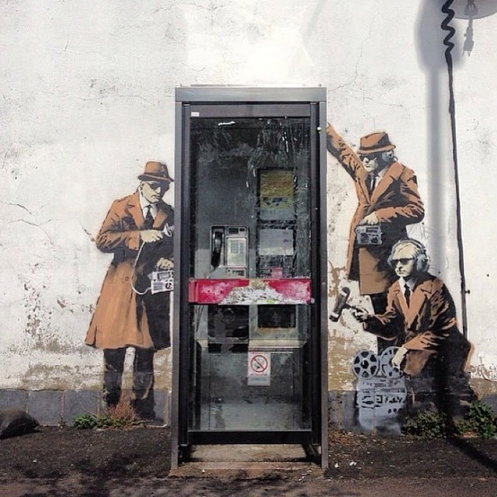

Slide 3
DNS Surveillance
The DNS is used by many actors as a means of looking at what we do online and censoring what services we can access online
Can we stop DNS surveillance completely?
Probably not!
Can we make it harder for others to collect individual profiles of activity?
Well, yes, we can!
And that’s what I want to talk about today

Slide 4
How we might think the DNS works
Client
stub
DNS Resolver
DNS Server

Slide 5
What we suspect the DNS is like
Client
Stub
DNS Resolver
DNS Server
DNS Resolver
DNS Resolver
DNS Resolver
DNS Resolver
DNS Resolver
DNS Resolver
DNS Resolver
DNS Resolver
DNS Resolver
DNS Resolver
DNS Resolver
DNS Resolver

Slide 6
What we suspect the DNS is like
Client
Stub
DNS Resolver
DNS Server
Servers that leak queries
DNS Resolver
DNS Resolver
Corrupted host platforms
DNS Resolver
Wireline and middleware
Inspection and interception
DNS Resolver
DNS Resolver
DNS Resolver
DNS Resolver
Resolvers that leak queries
DNS Resolver
DNS Resolver
DNS Resolver
DNS Resolver
DNS Resolver

Slide 7
Why pick on the DNS?
The DNS is very easy to tap
Its open and unencrypted
DNS traffic is easy to tamper with
Its payload is not secured and tampering cannot be detected
Its predictable and false answers can be readily inserted
The DNS is hard to trace
Noone knows exactly where their queries go
Noone can know precisely where their answers come from

Slide 8
Second-hand DNS queries are a business opportunity these days

Slide 9
How can we improve DNS Privacy?
Lets look at a few behaviours of the DNS and see what we are doing to try and improve its privacy properties

Slide 10
I. The DNS is overly chatty
The DNS uses the full query name to discover the identity of the name servers for the query name
Hi root server, I want to resolve www.example.com
Not me – try asking the servers for .com

Slide 11
The DNS is overly chatty
The DNS uses the full query name to discover the identity of the name servers for the query name
Hi root server, I want to resolve www.example.com
Not me – try asking the servers for .com
Hi .com server, I want to resolve www.example.com
Not me – try asking the servers for example.com

Slide 12
The DNS is overly chatty
The DNS uses the full query name to discover the identity of the name servers for the query name
Hi root server, I want to resolve www.example.com
Not me – try asking the servers for .com
Hi .com server, I want to resolve www.example.com
Not me – try asking the servers for example.com
Hi example.com server, I want to resolve www.example.com
Sure – its 93.184.216.34

Slide 13
The DNS is overly chatty
The DNS uses the full query name to discover the identity of the name servers for the query name
Why are we telling root servers all our DNS secrets?
In our example case, both a root server and a .com server now
know that I am attempting to resolve the name
www.example.com
Maybe I don’t want them to know this

Slide 14
The DNS is overly chatty
Is there an alternative approach to name server discovery that strips the query name in iterative search for a zone’s servers?
Yes – the extra information was inserted into the query to make the protocol simpler and slightly more efficient in some cases
But we can alter query behaviour to only expose as much as is necessary to the folk who need to know in order to answer the query

Slide 15
QNAME Minimisation
A resolver technique intended to improve DNS privacy where a DNS resolver no longer sends the entire original query name to the upstream name server
Described in RFC 7816

Slide 16
Example of QNAME Minimisation
Ask the authoritative server for a zone for the NS records of the next zone:
Hi Root server, I want to know the nameservers for com
Sure, here are the servers for .com

Slide 17
Example of QNAME Minimisation
Ask the authoritative server for a zone for the NS records of the next zone:
Hi Root server, I want to know the nameservers for com
Sure, here are the servers for .com
Hi .com server, I want to know the nameservers for example.com
Sure, here are the servers for example.com

Slide 18
Example of QNAME Minimisation
Ask the authoritative server for a zone for the NS records of the next zone:
Hi Root server, I want to know the nameservers for com
Sure, here are the servers for .com
Hi .com server, I want to know the nameservers for example.com
Sure, here are the servers for example.com
Hi example.com server, I want to resolve www.example.com
Sure – its 93.184.216.34

Slide 19
DNS Privacy
Client
stub
DNS Resolver
DNS Server
Qname Minimisation

Slide 20
II. Interception and Rewriting
The DNS is an easy target for the imposition of control over access
Try asking for www.thepiratebay.org in Australia
Try asking for www.facebook.com in China
And on and on and on…
These days interception systems typically offer an incorrect response
How can you tell is the answer that the DNS gives you is the genuine answer or not?

Slide 21
DNSSEC
DNSSEC adds additional information into the DNS
a digital signature record is added to all RRsets in a zone, signed by the zone controller
Any third party who tries to alter a signed zone is unable to generate an authentic signature (as they do not know the zone key value)
DNSSEC validation of the signed DNS response can tell you if the response is genuine or if it is out of date or has been altered
DNSSEC can’t tell you what the “good” answer is, just that the answer you got was not it!
DNSSEC will also tell if is an NXDOMAIN response is authentic

Slide 22
DNSSEC and Recursive Resolvers
A DNS response that has been modified will fail to validate.
When:
a client asks a security-aware resolver to resolve a name, and
sets the EDNS(0) DNSSEC OK bit, and
the zone is DNSSEC-signed
then the recursive resolver will only return a RRset for the query if it can validate the response using the attached digital signature

Slide 23
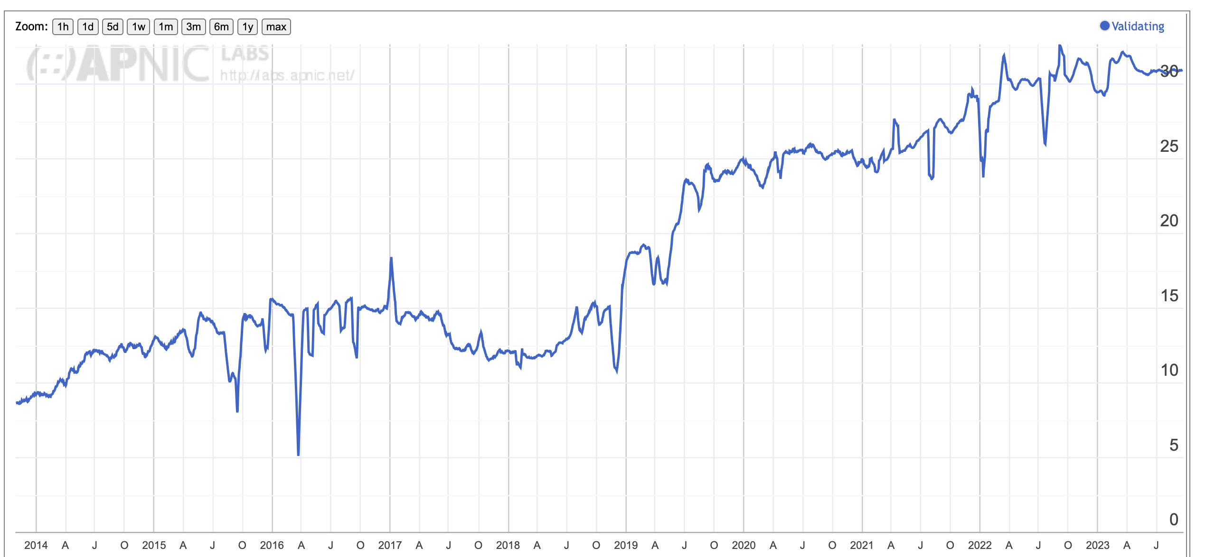
DNSSEC Validation Use
30%

Slide 24
DNS Privacy
Client
stub
DNS Resolver
DNS Server
Qname Minimisation
DNSSEC Validation

Slide 25
III. Wire Tapping and Inspection
The DNS is an open (unencrypted) protocol
If we want to stop third party inspection we need to encrypt the transport used by DNS queries and responses
Today the standard tool is TLS, which uses dynamically generated session keys to encrypt all traffic between two parties
We could use TLS between the end client and the client’s recursive resolver

Slide 26
DNS over DTLS
DTLS is a UDP variant of TLS that is intended to work over UDP rather than TCP (RFC 8094)
However:
DTLS is intolerant of fragmentation
It appears to have similar overheads to TLS
I’m not sure if there are any robust implementations of DNS over DTLS

Slide 27
DNS over TLS (DoT)
TLS is a TCP ‘overlay’ that adds server authentication and session encryption to TCP
TLS uses an initial handshake to allow a client to:
Validate the identity of the server
Negotiate a session key to be used in all subsequent packets in the TCP session
Best used between the stub resolver and its recursive resolver in persistent session mode

Slide 28
DNS over TLS (DoT)
The queries and the responses are hidden from intermediaries – preventing wiretapping from revealing DNS queries and responses
The client can validates the recursive resolver’s identity – preventing third parties from intercepting DNS queries and generating fake responses

Slide 29
DNS over TLS (DoT)
Will generate a higher recursive resolver load as stub client may have a held state with the recursive resolver
The TCP session state is on port 853
DNS over TLS can be readily blocked by middleware
The privacy is relative, as the recursive resolver still knows all your DNS queries

Slide 30
DNS over QUIC (DoQ)
DOT
DOQ
DNS
DNS
TLS
QUIC
TCP
UDP
IP
IP
QUIC is a transport protocol originally developed by Google and passed over to the IETF for standardised profile development
QUIC uses a thin UDP shim and an encrypted payload
The payload is divided into a TCP-like transport header and a payload
The essential difference between DOT and DOQ is the deliberate hiding of the transport protocol from network middleware with the use of QUIC

Slide 31
DNS over QUIC DoQ
Has much the same benefits as DNS over TLS, but adds the ability to have multiple outstanding queries between the stub and the recursive

Slide 32
DNS over HTTPS/2 (DoH)
Uses an HTTPS session with a resolver
Similar to DNS over TLS, but with HTTP object semantics
Uses TCP port 443, so can be masked within other HTTPS traffic
Can use DNS wireformat or JSON format DNS payload

Slide 33
DNS over HTTPS/3 (DoH)
Uses an HTTPS session with a resolver
Similar to DNS over QUIC, but with HTTP object semantics
Uses UDP port 443, so can be masked within other HTTPS/3 traffic
Can use DNS wireformat or JSON format DNS payload

Slide 34
DNS Privacy
Client
stub
DNS Resolver
DNS Server
DoT, DoQ, DoH
Qname Minimisation
DNSSEC Validation

Slide 35
DNS within the Browser
Firefox’s “Trusted Recursive Resolver”
Avoids using the local DNS resolver library and local DNS infrastructure
Has the browser sending its DNS queries directly to a trusted resolver over HTTPS
Servers available from Cloudflare, Google, Cleanbrowsing

Slide 36
Choose your resolver carefully
The careful choice of an open recursive resolver and an encrypted DNS session will go a long way along the path of DNS privacy
But the compromise is that you are sharing your activity profile with the recursive resolver operator
But this need not be the case

Slide 37
DoH and Push DNS
HTTPS allows server push objects as well as pull/get methods
This can allow a web page to push a DNS result to the client without the client performing any DNS query at all
When used with DNSSEC and Chained Validation responses the client can ensure that the DNS data is valid and current
Its fast and very private

Slide 38
Obfusified DNS
Use two separate agents in place of a single recursive resolver
Use double encryption wrapping
The first agent “knows” the IP identity of the client, but not the DNS query that the client has generated
The second agent “knows” the query, but not the IP identity of the client

Slide 39
Obfusified DNS
This approach can extremely effective in preserving end user privacy in the DNS
This approach has been used in Apple’s Private Data Relay service as a way of protecting the user from third party observervation

Slide 40
DNS Privacy
DNS Obfusication
Client
stub
DNS Agent
DNS Resolver
DNS Server
DoQ
DoQ
Qname Minimisation
DNSSEC Validation

Slide 41
EDNS Client Subnet
There is a tension between CDN operators that rely on customized DNS responses to perform content steering, and the use of large scale open resolvers that do not necessarily preserve locality
The CDN wants to use the assumed location of the DNS resolver to infer the location of the client and direct them to a nearby service instance
The result is that the CDN operators want the stub client’s IP subnet embedded in the query to ensure that the CDN could provide enhanced content steering for the client by geolocating this subnet

Slide 42
EDNS Client Subnet
This has raised a number of concerns about DNS privacy
There is a forming consensus that Client Subnet has been a step too far in terms of potential privacy leakage into the DNS

Slide 43
Privacy Tensions in the DNS
Exposing the end user’s IP location to the DNS leads to better outcomes for content server steering, but compromises user privacy
Hiding the end user completely (DoH Push, Obfusified DNS) can lead to pretty comprehensive levels of privacy, and faster DNS operations, but can disrupt content server steering
Given that many CDN’s are now reliant on DNS-based geolocation, there is current work to use an obscured subnet token value that geo-locates to a similar location, but is unrelated to the end client’s IP address / subnet
Presumably, we could replace this subnet with a standard geolocator reference, were one defined as an industry standard

Slide 44
Thanks!

