Slide 1
The Post-IPocalypse Internet
Geoff Huston AM
Chief Scientist, APNIC

Slide 2
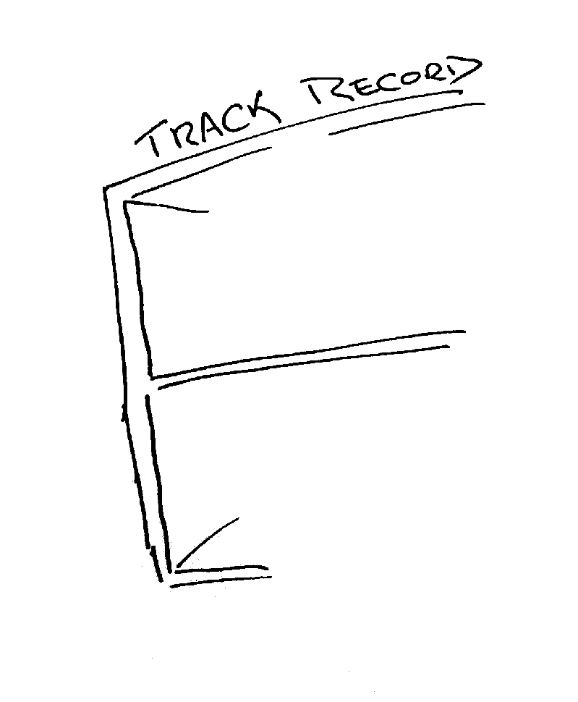
The mainstream telecommunications industry has a rich history

Slide 3
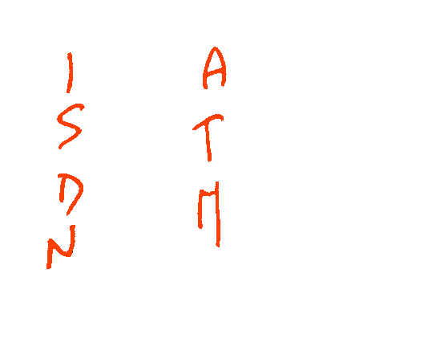

The mainstream telecommunications industry had a rich history
…of making very poor
technology guesses

Slide 4


The mainstream telecommunications industry had a rich history
…of making very poor
technology guesses
and regularly being
taken by
surprise!

Slide 5
The Internet...
Has been a runaway success that has transformed not just the telecommunications sector, but entire social structures are being altered by the Internet!
And then we used up the Internet’s 32bit address pool

Slide 6
The Internet...
Has been a runaway success that has transformed not just the telecommunications sector, but entire social structures are being altered by the Internet!
And then we used up the Internet’s 32bit address pool
This was not news – we knew that this IPocalypse was coming thirty years ago!

Slide 7
IETF Meeting – August 1990

Slide 8
IETF Meeting – August 1990
oops!

Slide 9
What did we do back in 1992?
We bought some time by removing the CLASS A, B, C address structure from IP addresses

Slide 10
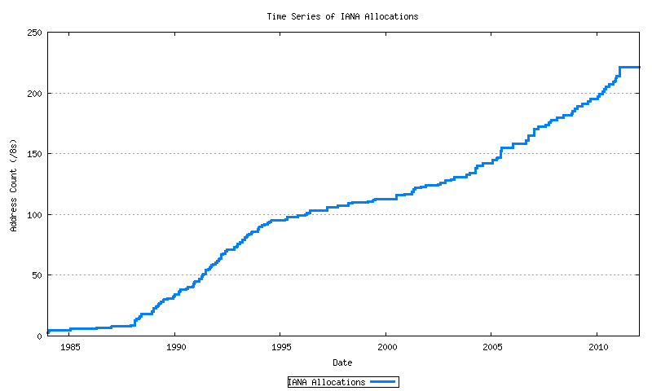
The CIDR Fix
Class-full
A&R networks
CIDR
NSFNET

Slide 11
What else did we do back in 1992?
And we started working on a new Internet Protocol – to become IPv6 - to replace IPv4
We left the task of transition until after we had figured out what this new protocol would look like

Slide 12
zzzzzz
For a while this did not look to be an urgent problem...

Slide 13
CIDR worked!
Class-full
CIDR
A&R networks
NSFNET

Slide 14
Meanwhile, we continued to build (IPv4) networks
Mobiles
Broadband
Boom & Bust
CIDR
A&R networks
NSFNET

Slide 15
The rude awakening
Until all of a sudden, the IPv4 address piggy bank was looking extremely empty...

Slide 16
IPv4 Address Allocations
Exhaustion!
Mobiles
Broadband
Boom & Bust
CIDR
A&R networks
NSFNET

Slide 17
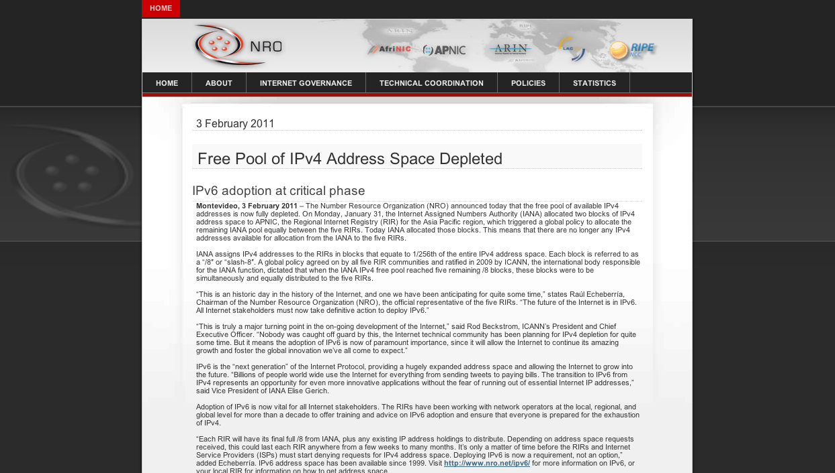
Ooops!

Slide 18
The rude awakening
Until all of a sudden the IPv4 address piggy bank was looking extremely empty...
And transition to IPv6 suddenly became a very important topic!

Slide 19
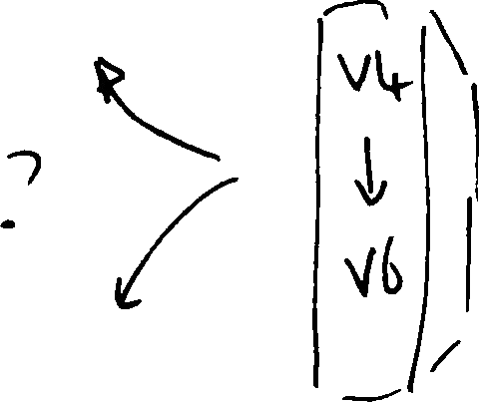
So, how are we going with the IPv4 to IPv6 transition?

Slide 20
Do we really need to worry about this?

Slide 21
Do we really need to worry about this?
Surely IPv6 will just happen – its just a matter
of waiting for the pressure of Ipv4 address
exhaustion to get to sufficient levels of intensity.

Slide 22
Do we really need to worry about this?
Surely IPv6 will just happen – its just a matter
of waiting for the pressure of Ipv4 address
exhaustion to get to sufficient levels of intensity.
Or maybe not – let’s look a bit closer at the situation ...

Slide 23
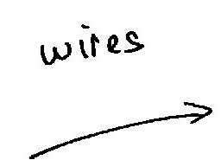
The “inevitability” of technological evolution

Slide 24
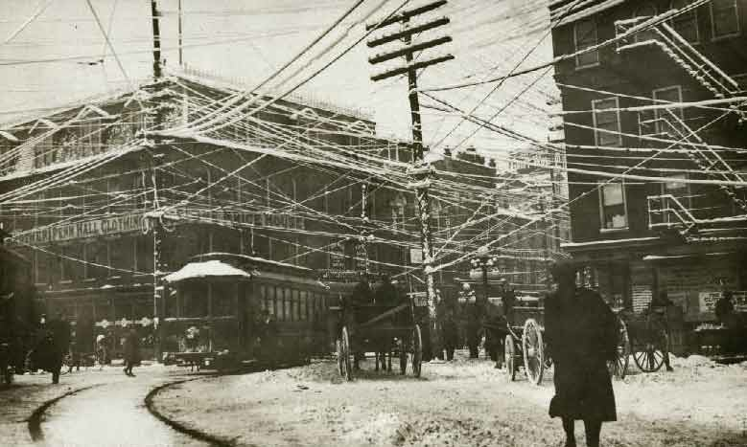

Slide 25
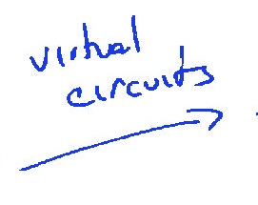
The “inevitability” of technological evolution

Slide 26
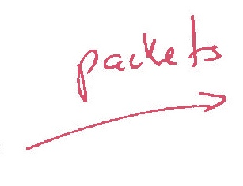
The “inevitability” of technological evolution

Slide 27
The “inevitability” of technological evolution
Each time we shifted the technology base of the network, the cost efficiencies of the “new” technology in effect motivated the shift from the older technology to the new

Slide 28
The “inevitability” of technological evolution
Now let’s look at something a little more topical to today!

Slide 29

The “inevitability” of technological evolution?

Slide 30
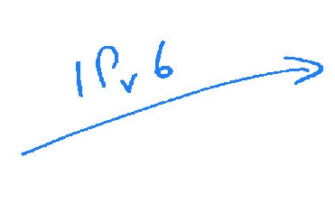
The “inevitability” of technological evolution?

Slide 31


The challenge often lies in managing the transition from one technology to another

Slide 32
Option 1: Flag Day!
We all agree to turn off IPv4 and turn on IPv6 EVERYWHERE
All at the same time! All over the Internet!

Slide 33
Option 1: Flag Day!
We’re just too big!
We all agree to turn off IPv4 and turn on IPv6 EVERYWHERE
All at the same time! All over the Internet!

Slide 34
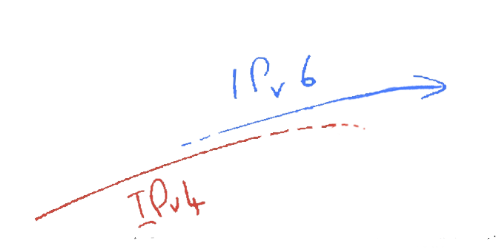
Option 2: Parallel Transition!
We start to slide in IPv6 in parallel with Ipv4
Then we gradually phase out IPv4

Slide 35
Option 2: Parallel Transition!
Size of the Internet
IPv6 Deployment
IPv6 Transition – Dual Stack
IPv4 Pool Size
Time
For this to work we have to start early and finish BEFORE IPv4 address pool exhaustion

Slide 36
Option 2: Parallel Transition!
We’re just too late!
We start to slide in IPv6 in parallel with Ipv4
Then we gradually phase out IPv6
The small print: It’s incredibly difficult for markets to plan without clear price signals, and we never managed to price future scarcity into the Internet model. Our chosen address distribution model was one that deliberately avoided any form of price-based market signaling. We sort of hoped that operators would price future risk. We were very wrong!

Slide 37
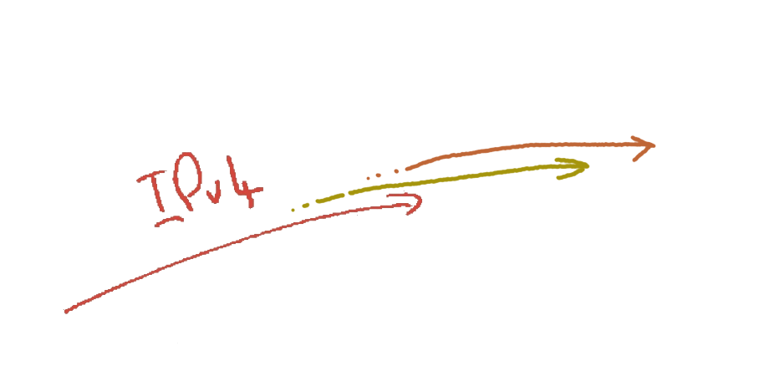
Hybrid IPv4
+ALGs
+CGNs
IPv4
The increasing scarcity of Ipv4 will force carriage providers to add address sharing mechanisms into the IPv4 network

Slide 38
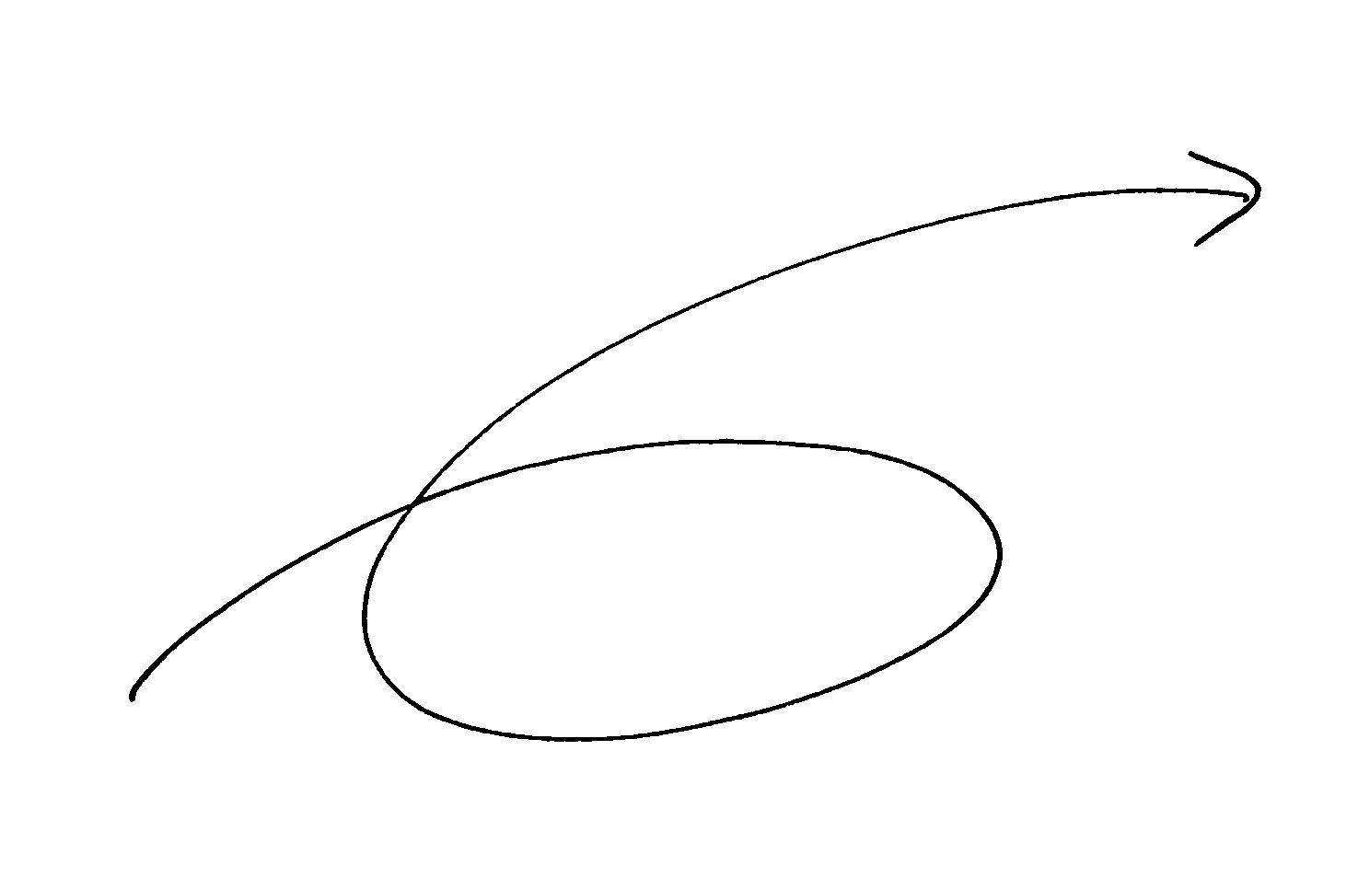
Option 3: Hybrid Transition
To get from “here” to “there” requires an excursion through an environment of CGNs, CDNs, ALGs and similar middleware ‘solutions’ to IPv4 address exhaustion
IPv6
CGNs
IPv4
ALGs
CDNs

Slide 39
But will this be merely a temporary phase of transition?
IPv6
CGNs
IPv4
ALGs
CDNs
Transition requires the network owner to undertake capital investment in network service infrastructure to support IPv4 address sharing/rationing.

Slide 40
But will this be merely a temporary phase of transition?
IPv6
CGNs
IPv4
ALGs
CDNs
Transition requires the network owner to undertake capital investment in network service infrastructure to support IPv4 address sharing/rationing.
What lengths will the network owner then go to to protect the value of this additional investment by locking itself into this “transitional” service model for an extended/indefinite period?

Slide 41
The problem is...
We are now supporting an ever-expanding Internet:
  without any feed of more IPv4 addresses
and
  without sufficient IPv6 deployment to cut over

Slide 42
The problem is...
We are now supporting an ever-expanding Internet:
  without any feed of more IPv4 addresses
and
  without sufficient IPv6 deployment to cut over
And, surprisingly, its working!!!

Slide 43
The problem is...
We are now supporting an ever-expanding Internet:
  without any feed of more IPv4 addresses
and
  without sufficient IPv6 deployment to cut over
And, surprisingly, its working!!!
So far

Slide 44

The challenge often lies in managing the transition from one technology to another
IPv6
CGNs
IPv4
ALGs
CDNs
The risk in this transition phase is that the Internet carriage provider heads off in a completely different direction!

Slide 45
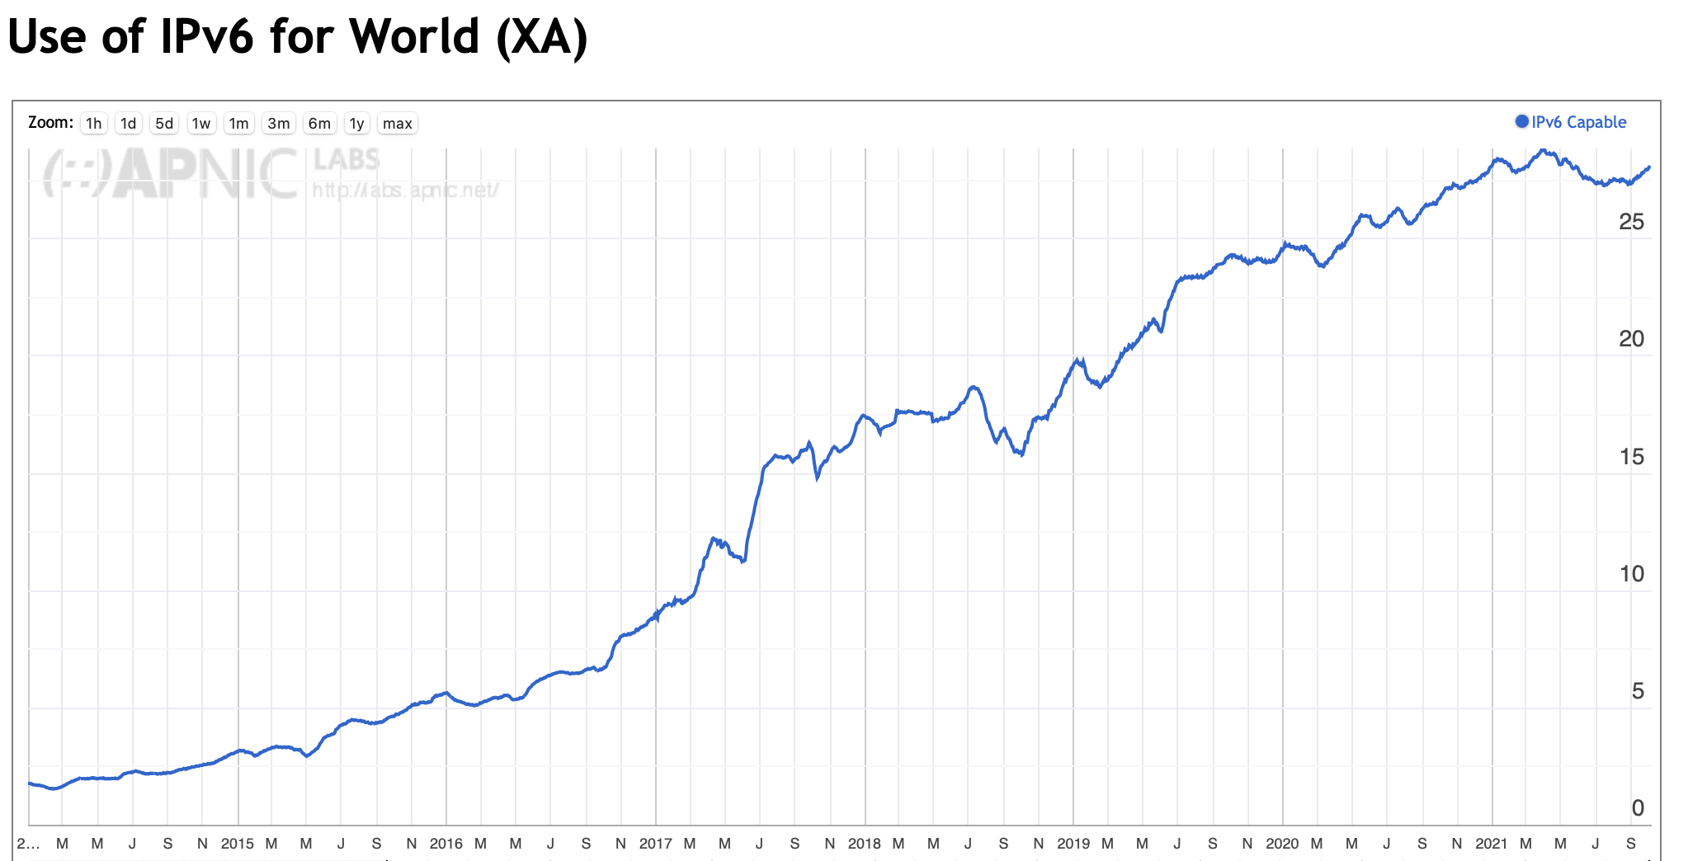
Just how are we going?
2015
2017
2019
2021

Slide 46
Just how are we going?
28%
Clearly there is no sense of urgency in this transition!
2015
2017
2019
2021

Slide 47
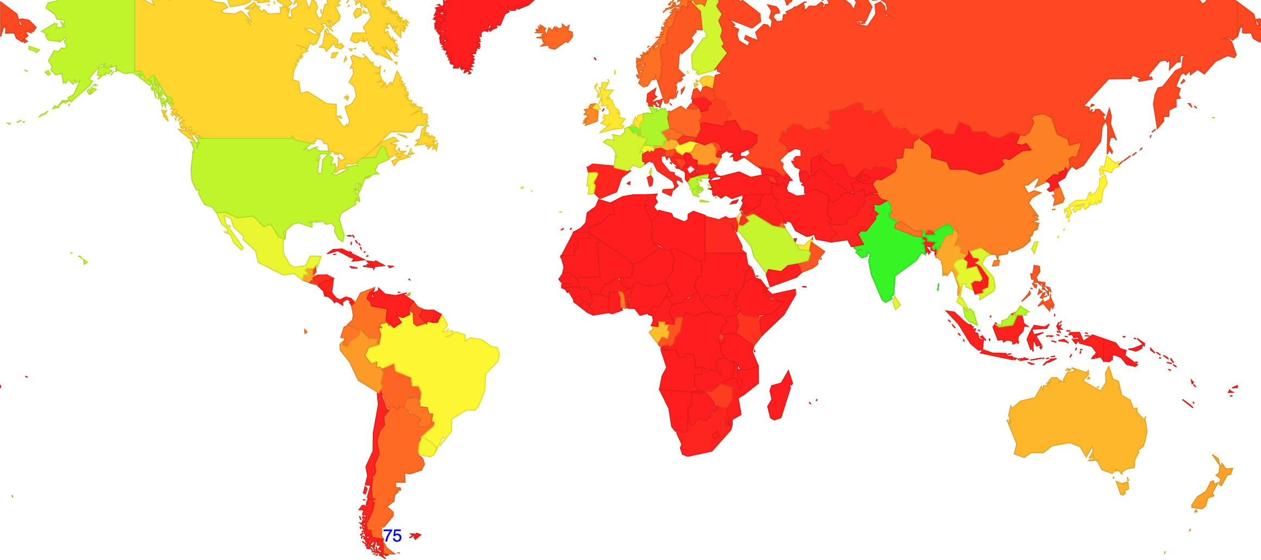
Where is it?

Slide 48
Where is it?
Lets take the 20 countries with the largest national user populations.
Its pretty clear that many countries see differing pressures to adopt IPv6 at present

Slide 49
What’s the Problem?
Is there IPv6 in Android, iOS, Mac OS, Windows and Linux? Do platforms support IPv6?
Does every access ISP support IPv6?
Does every service support IPv6?
Clearly, YES!
Well, NO!!
Well, NO!!

Slide 50
Why?
Dual Stack networks are more complex to operate and support
Some server platforms perceive Dual Stack as slower and less reliable than IPv4 only
We seem to be comfortable with extensive use of NATs
Most importantly, we don’t seem to care any more!

Slide 51
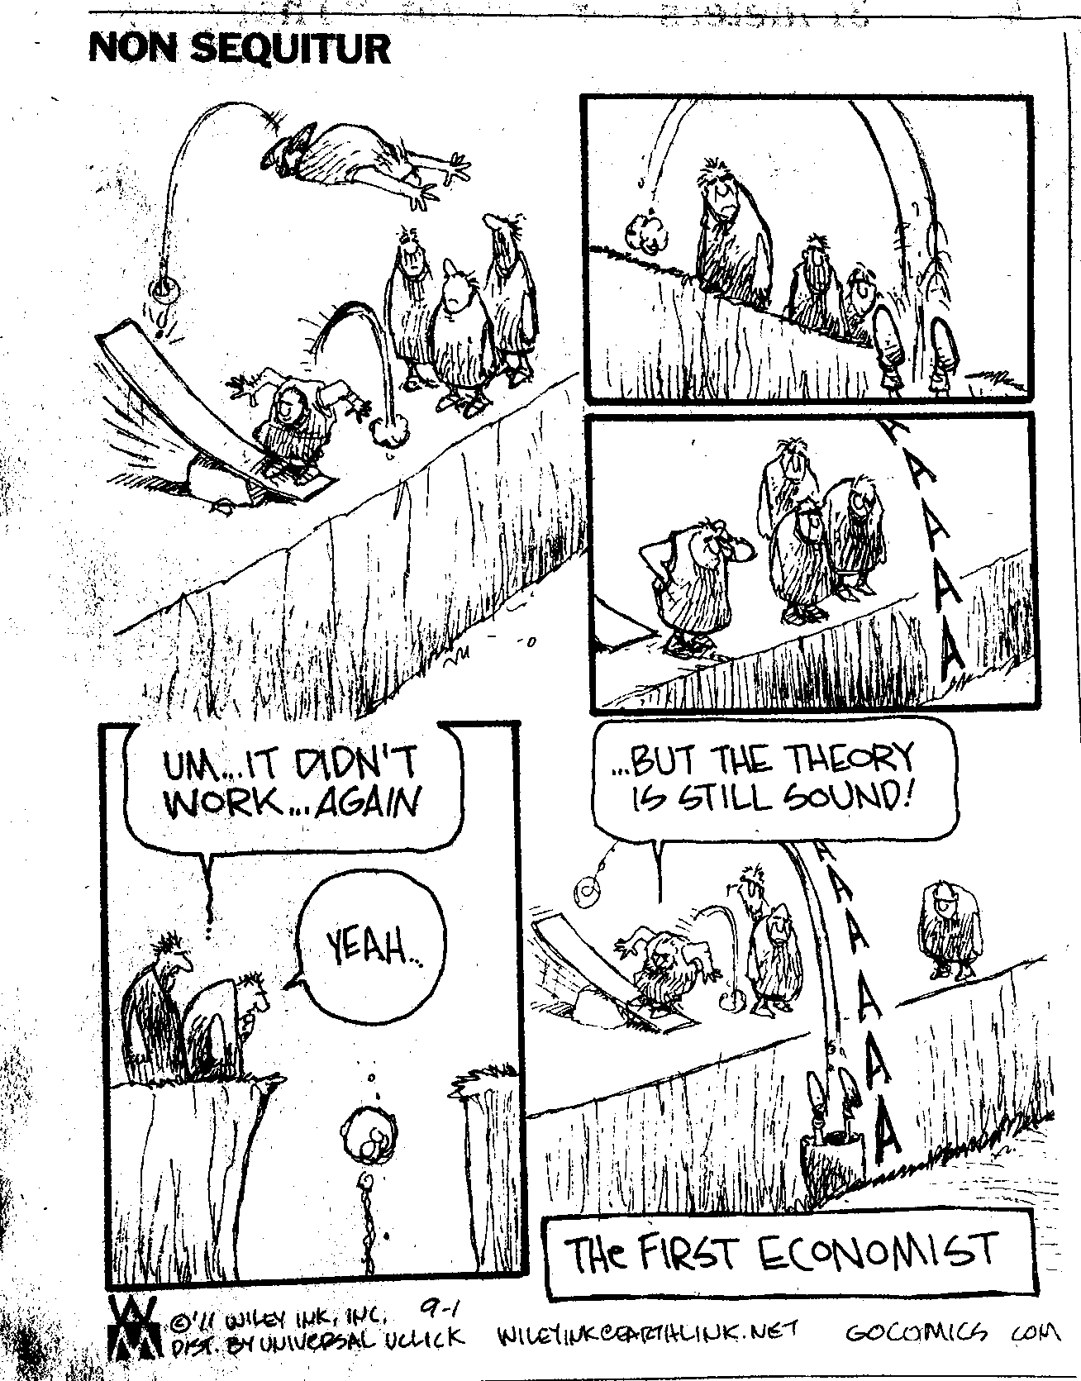
Economics!

Slide 52
Economics!
The Internet’s last mile access is mired in commodity utility economics. Relentless competition has resulted in a sector where margins are thin. A move to IPv6 represents expenditure without immediate revenue gain. This is classic case of economic dislocation in an unbundled industry, where expenditure in one sector only yields benefits in another

Slide 53
This situation represents a period of considerable uncertainty for our industry

Slide 54
This situation represents a period of considerable uncertainty for our industry
If I wait will equipment get cheaper or will the user experience get worse?
Is Ipv6 really ready for prime time yet?
Will turning on
IPv6 increase my helpdesk call rate?
How big should these CGNs be?
Should all users be shunted through a CGN?
How much is all this
going to cost?
How long will this transition take?
What is going to break?
If we deploy CGNs to keep
IPv4 running, then how long should we plan to keep them in service?
Can I afford it? Will my revenue base sustain this additional cost?

Slide 55
Where is this heading?

Slide 56
Where is this heading?
It’s possible that within the next 10 years or so we will complete this dual stack ”transition” and folk will feel sufficiently confident to deploy IPv6-only services in which case IPv4 will rapidly decay

Slide 57
Where is this heading?
Its possible that within the next 10 years or so we will complete this dual stack ”transition” and folk will feel sufficiently confident to deploy IPv6-only services in which case IPv4 will rapidly decay
It’s equally possible this won’t happen, because we’ve changed the Internet so much that the choice of which IP address space to use simply won’t matter any more!

Slide 58
And its not yet clear which of these paths the Internet will take!

Slide 59
And its not yet clear which path the Internet will take!
market forces

Slide 60
You see, there us an
Alternate View of where we are today
The Internet, as we knew it, is over.

Slide 61
An Alternate View
We don’t use the network to reach far-away content and services any more.
Content and services have some to our front door through the intense levels of investment in Content Data Networks
If you look at the dominant traffic volumes “The Internet” is no more than a collection of discrete access networks that use a common technology
The Internet, as we knew it, is over.

Slide 62
What would that mean?
We need to think about how to build a post-Internet world where content, computation, storage and communications are sustainable, abundant and openly available commodities.

Slide 63
What do we need?
And its not clear that we need a single massive address space any more!
Maybe all we need now is a common name space

Slide 64
What do we need?
And its not clear that we need a single massive address space any more!
Maybe all we need now is a common name space
Yes, we didn’t realise it at the time, but it IS all about the DNS after all!

Slide 65
What do we want?
Why were we so keen about IPv6 anyway?

Slide 66
  IPv6 represented an open and accessible platform for further network growth and innovation
  Our common public interest lies in a continuing open and accessible network
  And that needs to be expressed within the dynamics of market pressures.
  Today’s question is:
  How can we do this?

Slide 67
How can we “manage” this period of transition?
To ensure that the industry maintains a collective focus on continued innovation and openness as the ultimate objective of this exercise!

Slide 68
How can we “manage” this period of transition?
To ensure that the industry maintains a collective focus on continued innovation and openness as the ultimate objective of this exercise!
And ensure that we do not get trapped in a new round of entrenched monopolies that will resist all forms of further innovation!

Slide 69
How can we “manage” this period of transition?
To ensure that the industry maintains a collective focus on continued innovation and openness as the ultimate objective of this exercise!
Or at least, how can we avoid making it any worse than it is now?
And ensure that we do not get trapped in a new round of entrenched monopolies that will resist all forms of further innovation!

Slide 70
How can we “manage” this period of transition?

Slide 72
Yes, that was intentionally left blank!
I really don’t know what will work.
And as far as I can see, nor does anyone else!

Slide 73
But even though I don’t have an answer here, I have some thoughts to offer about this issue of pulling the Internet though this transition

Slide 74

Three thoughts...
!
!
!

Slide 75
Firstly
If we want one working Internet at the end of all this, then keep an eye on the larger picture
  Think about what is our common interest here
  and try to find ways for local interests to converge with our common interest in a single coherent digital environment that remains open, neutral, and accessible

Slide 76
Secondly
Stop trying to make yesterday perfect!
  We are moving on in trying to make the Internet bigger, faster, cheaper and better
  And the effort has changed focus to concentrate on applications and services
  If application-centric networking and CDNs make bigger, faster, cheaper and better services then that’s what we should be doing!

Slide 77
Finally...
Bring it on!
  Resisting further innovation will simply entrench today’s incumbents and will recreate the old stifling vertically bundled carriage monopolies of the telephone era!
  And at that point we’ve lost everything!

Slide 78

Thanks!

