Slide 1
DNS Centrality
Geoff Huston AM
APNIC

Slide 2
This Presentation
What’s the problem with centrality anyway?
What does centrality in the DNS mean?
How to measure DNS centrality
What we measured
What I think it means
All in 20 minutes!

Slide 3
Why pick on the DNS?
The DNS is used by everyone and everything
  Because pretty much everything you do on the net starts with a call to the DNS
  If a single entity “controlled” the entire DNS then to all practical purposes that entity would control not just the DNS, but the entire Internet!

Slide 4

Centrality is today’s Internet
Many aspects of the Internet’s infrastructure are operated by fewer and fewer entities over time
  Shift from entrepreneurial ventures to established business practices have largely driven these broad changes that have resulted in amalgamation and market concentration in many aspects of the Internet’s service provision
Competition has been replaced by Oligarchies

Slide 5

What’s the problem?
Economics A01 (or Adam Smith’s Invisible Hand)
  Competition rewards efficient producers
  Innovation that increases production efficiency is rewarded
  Consumers benefit from increased production efficiency and innovation
Consolidation in the market
  Distorts the functions of an open competitive market
  Decreases competition pressure
  Creates barriers to entry in the market
  Reduces pressure for increased production efficiency and innovation
  Consumers end up paying a premium

Slide 6
Consolidation in the DNS
It’s not a new topic:
  For many years BIND was a defacto monopoly provider for DNS software. At the time almost every DNS recursive resolver and authoritative server ran BIND software
  Due to a deliberate effort to broaden the DNS resolver space from a monoculture to a richer space, this picture has broadened out to a number of DNS software platforms and is less of a concern these days
But there are many other places where the DNS is aggregating
  Name Registration services
  Name Hosting service providers
  Name Resolution providers

Slide 7
Let’s Focus!
Here we are going to concentrate on just one of these areas
We will look at the recursive resolver market and try to understand the extent to which we are seeing consolidation of the recursive name resolution function
And then assess to what extent this represents a source of concern in the DNS

Slide 8
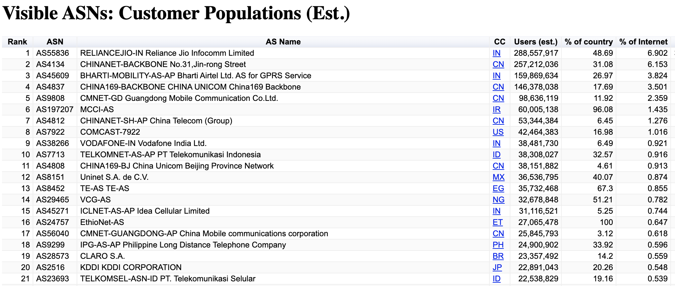
Recursive Resolvers
This function is generally bundled with an ISP’s access service for public network services
  Which means that there is already some level of consolidation in this space as the concentration of these DNS services follows the concentration of ISPs in the retail market
https://stats.labs.apnic.net/aspop

Slide 9
Aside: Concentration in the retail ISP market
The ISP retail access market is already heavily concentrated/centralised:
10 ISPs serve some 30% of the Internet’s user base
90% of users are served by 1,000 ISPs

Slide 10
DNS Recursive Resolvers
This function is generally bundled with an ISP’s access service for public network services
  So we would expect to see a level of concentration in recursive resolvers in line with the concentration in the ISP access market
The question is: Is there consolidation in the DNS recursive resolution function over and above the existing access market consolidation?
Where might we see such consolidation?

Slide 11
Open DNS Resolvers
There are some 6M open DNS resolvers in operation today*
Most of these appear to be inadvertently open due to errant CPE equipment
  Where the resolver implementation does not correctly distinguish between “inside” and “outside” and provides a resolution service on all interfaces
That may sound like a large number, but it has got a whole lot better over time!
  33M open resolvers were seen in 2013 **
* https://scan.shadowserver.org/dns/
** https://indico.dns-oarc.net/event/0/contributions/1/attachments/19/125/201305-dnsoarc-mauch-openresolver.pdf

Slide 12
Open DNS Resolvers as a Service
Others are explicitly configured to offer DNS resolution services as a open service
  Hard to say where all this started, but an early example was the the 4.2.2.2 open resolver project offered by BBN Planet in the mid-90’s, though there were many others even then
    At that time many ISPs used recursive resolvers as a service and some operated these platforms as a open service as a least cost / lowest admin overhead option
  The use of anycast in the DNS made it possible to operate a single service with a distributed footprint
  OpenDNS was one of the early offerings of a dedicated recursive resolution service with a scaled up infrastructure
  Google Public DNS entered the picture with a service that took scaling to the next level
* https://scan.shadowserver.org/dns/

Slide 13
What’s the Centrality Question here?
One way to measure centrality is by “market share”
So the market share question here would be: What proportion of users of the Internet use <X> as their DNS resolver?
  We won’t distinguish between end users explicitly adding their own DNS configuration into their platform and ISPs using forwarding structures to pass all DNS queries to an open resolver. Through the lens of “centrality” both paths to using open DNS resolvers look the same!

Slide 14
How we* Measure DNS Centrality
We use Google Ads as the main element of this measurement
  The measurement script is an embedded block of HTML5 code in an Ad
  The Ad runs in campaigns that generate some 10M impressions per day
  We get to “see” the DNS in operation from the inside of most mid-to-large ISPs and service providers across the entire Internet
Ads provide very little functionality in the embedded scripts – it’s basically limited to fetching URLs
  But that’s enough here, as a URL fetch involves the resolution of a domain name
  So we use unique DNS names in every ad, so the DNS queries will be passed though to our authoritative servers
* by “we” I mean APNIC Labs!

Slide 15
How we Measure DNS Centrality
User–to–recursive resolver
mapping
Ad delivery
DNS Stuff!
Resolver Engine
Authoritative Server
Stub-to-recursive
DNS Query
Recursive-to-Authoritative
DNS Query

Slide 16
Recursive Resolver Behaviours
The task is to match the source of a query of a domain name to both a resolver and an end user
We need to
  map query IP source addresses to resolvers
  understand how the DNS “manages” queries
  how the resolver lists in /etc/resolv.conf are used

Slide 17
Mapping Resolver Addresses
We use periodic sweeps with RIPE Atlas to reveal the engine addresses used by popular Open DNS resolvers, and load this into an identification database

Slide 18
Understanding Resolver Behaviour
Resolver Engine
Service Address
Resolver Engine
Query Distributor
From Client
Resolver Engine
Resolver Engine
Engine Address
To Server

Slide 19
Resolution Metrics
Average query count per unique name: 3.4
  (Dual stack hosts may be a factor here)
  Max observed query count in 30 seconds is 1,761 queries!
30%
20%
10%

Slide 20
Resolution Metrics
Average number of resolvers (IP addresses) per unique name: 2.1
30 second maximum resolvers seen: 94
50%
40%
30%
20%
10%

Slide 21
First Resolver vs Full Resolver Set
What happens if the authoritative server always reports SERVFAIL to all queries?
We use a server that always returns a SERVFAIL error code to prompt the client to run through its full set of recursive resolvers

Slide 22
SERVFAIL Resolution Metrics
Average query count per unique name: 36.5
  Max observed query count in 30 seconds is 292,942 queries!
(yes, really!)
4%
3%
2%
1%

Slide 23
SERVFAIL Resolution Metrics
Average number of resolvers (IP addresses) per unique name: 8.9
30 second maximum resolvers seen: 1,368
16%
12%
8%
4%

Slide 24
Recursive Resolver Stats
Of the 140,000 visible recursive resolvers, just 150 resolvers account for 20% of all users and 1,500 resolvers account for 50% of all users.
10,000 resolvers account for 90% of all users
However we are looking here at resolver IP addresses, and that’s probably misleading.
Lets try and group resolver IP addresses into resolver services*
* Use techniques of common origin AS, direct probing with RIPE Atlas and (occasionally) operator provided lists

Slide 25
Recursive Resolver Stats
Of the 14,600 visible recursive resolvers services, just 15 resolver services serve 50% of users
250 resolver services serve 90% of users
Is this what we mean by “centralisation”?

Slide 26
Details
Lets break this data down into:
  Using a “known” open DNS resolver
  Using a resolver in the same AS as the user
  Using a resolver in the same country as the user
  Others

Slide 27
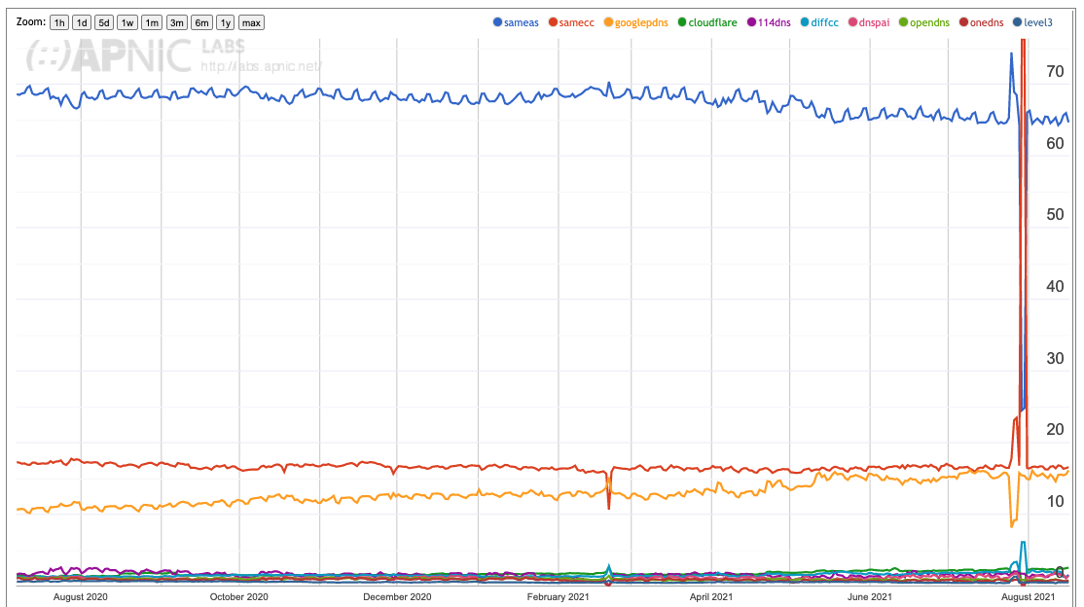
”First” Resolver Use
65% of users use a resolver located in the same AS as the user (ISP resolver)
17% of users use a resolver located in the same CC as the user (ISP resolver?)
17% of users use the Google open resolver (8.8.8.8)

Slide 28
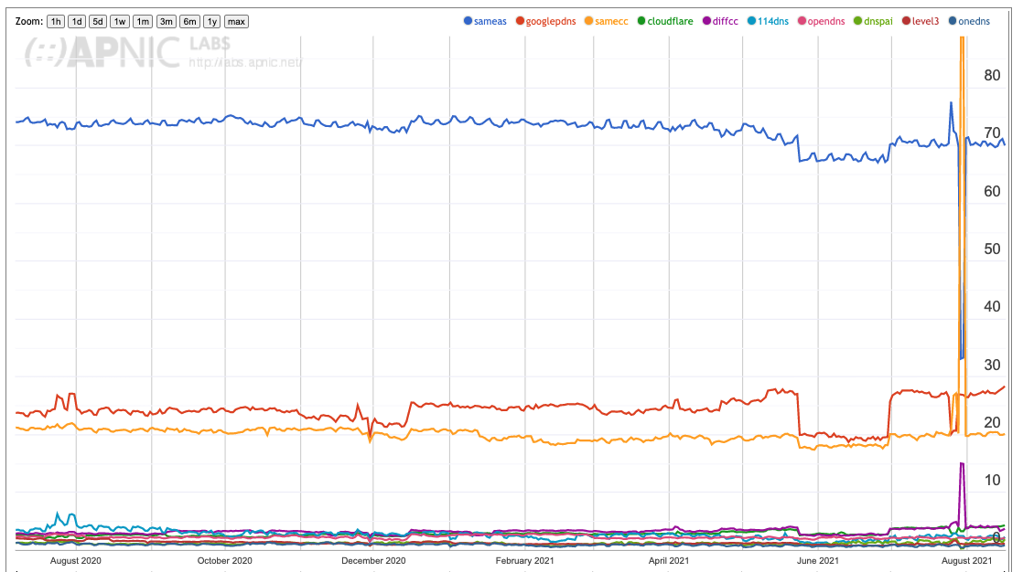
All Resolver Use (SERVFAIL)
65% -> 69% for same ISP
Experiment Failure
15% -> 29% for Google use
(yes, the plotting software performed a colour change – sorry!)

Slide 29
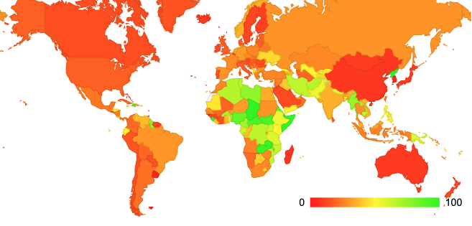
Google DNS
Use of Google Service per CC
Within each country how many users (%)
in that country use Google’s resolver service?

Slide 30
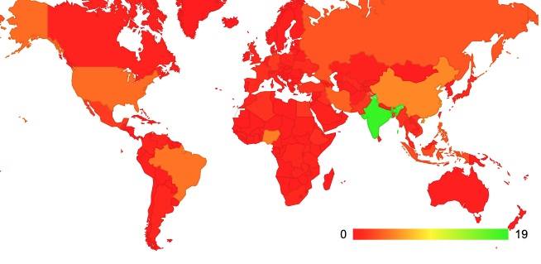
Google DNS
Use of Google Service by User Count
Looking at the total population of users using Google’s service, where are they located?

Slide 31
Google DNS
Google DNS use appears to be equally split between first use (15% of users) and backup resolvers (a further 14% of users)
Within each economy Google DNS is heavily used in some African economies, and central and southern Asian economies
The largest pool of Google DNS users are located in India (19% of Google DNS users)
Significant pools Google users are also seen in the US, China, Nigeria, Brazil and Iran (each CC has some 4% - 6% of Google’s DNS users)

Slide 32
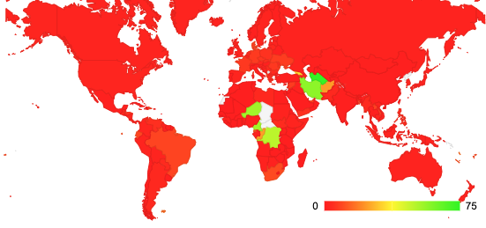
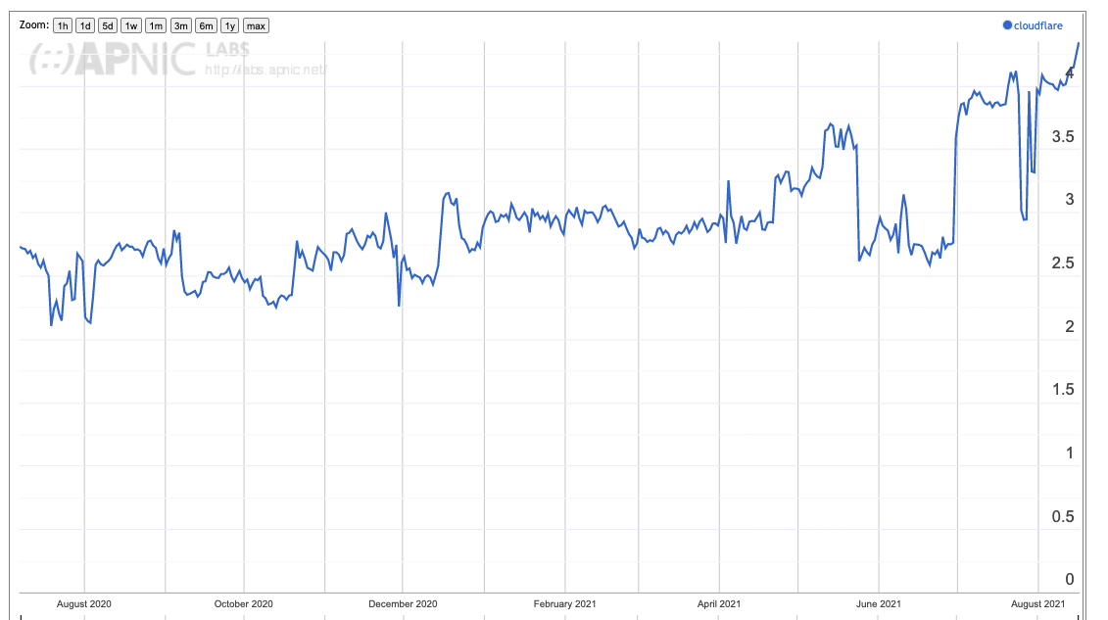
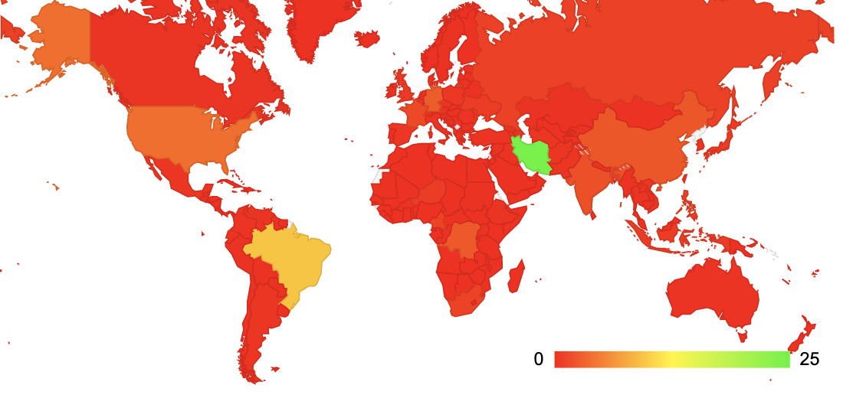
Cloudflare’s 1.1.1.1 service
Where is Cloudflare used?
Cloudflare market share
Cloudflare is extensively used in Turkmenistan (80%), Iran (57%), Niger (54%) Cameroon (54%) and the Congo (49%)
Cloudflare User breakdown?

Slide 33
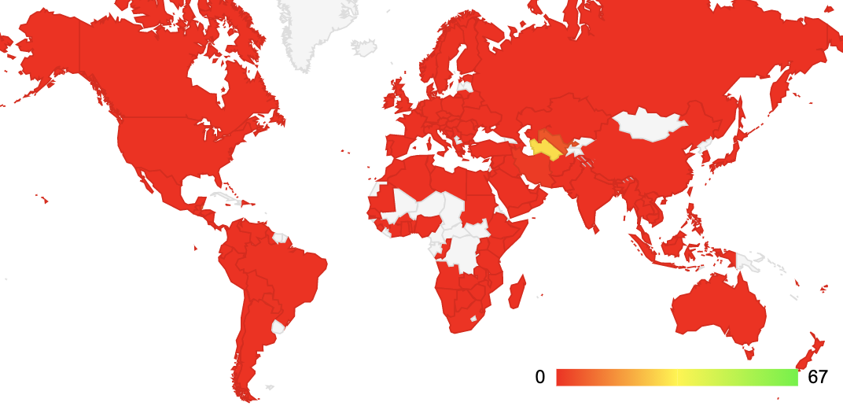
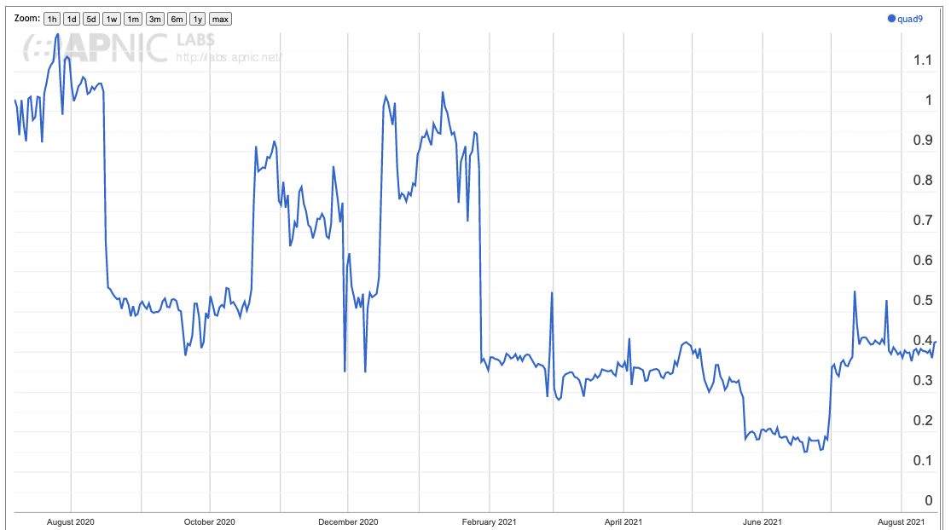
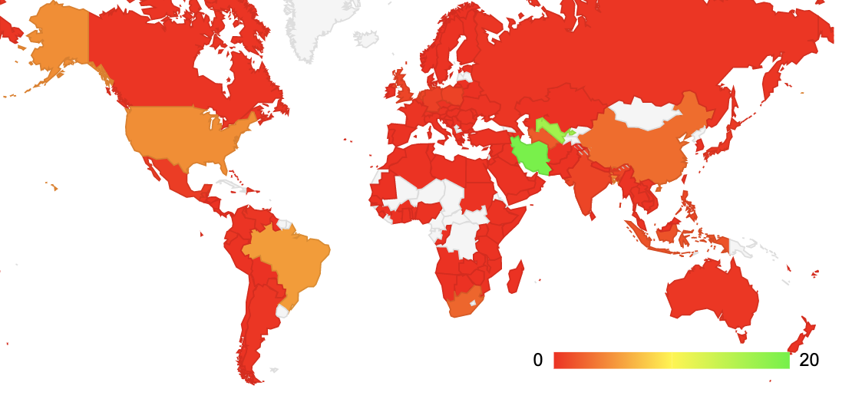
Quad9 service
Where is Quad9 used?
Quad9 market share
Quad9 User breakdown?

Slide 34
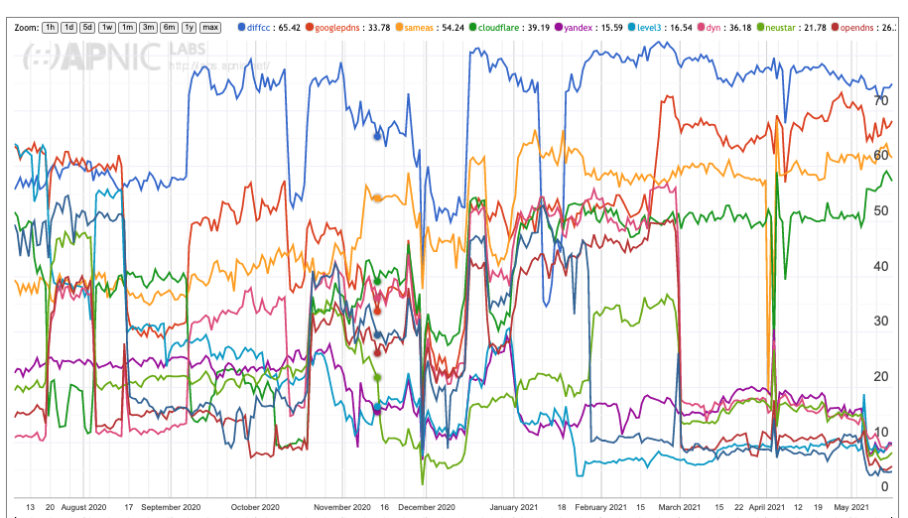
Iran
A major ISP in IRAN, MCCI, distributes its queries across Google, Cloudflare, Yandex, Neustar, OpenDNS, Quad9 and others – all at once!

Slide 35
Who makes the choice?
Is this the ISP‘s resolver performing forwarding of the query to an open resolver, or the users themselves opting out of the ISP service?
  The numbers vary, but it is quite common to see 60% - 80% of users in an AS having their queries sent to an open resolver when open resolvers are used

Slide 36
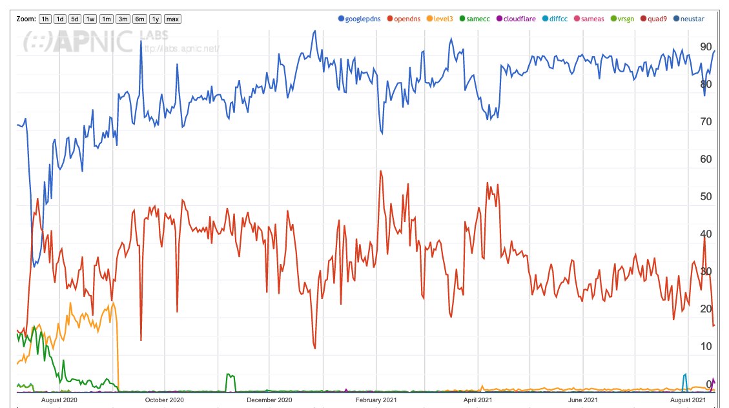
Who makes the choice?
Is this the ISP‘s resolver performing forwarding of the query to an open resolver, or the users themselves opting out of the ISP service?
  The numbers vary, but it is quite common to see 60% - 80% of users in an AS having their queries sent to an open resolver when open resolvers are used
Resolver Use – AS131429, Mobifone, Vietnam
Google DNS at 90%
OpenDNS at 20%

Slide 37
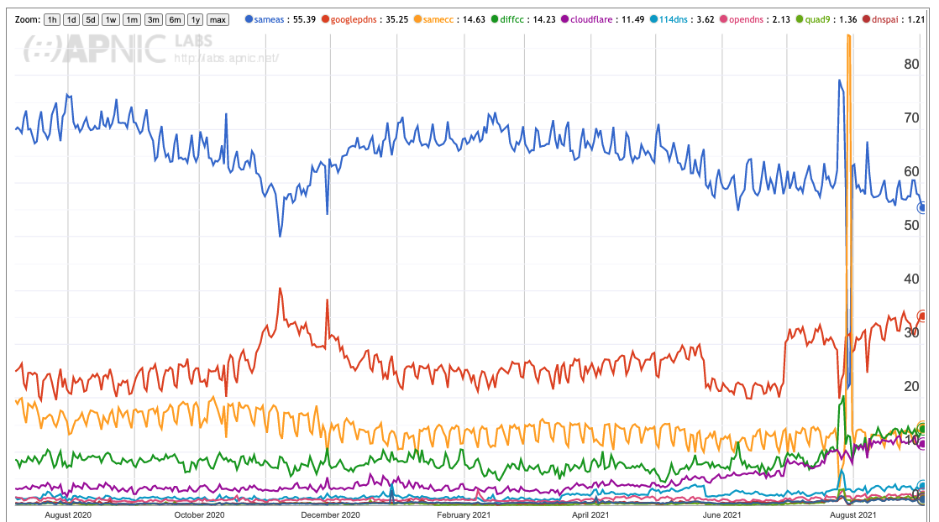
DNS Use in Hong Kong
ISP Resolver
Google
Other HK
Other Country
Cloudflare

Slide 38
Resolver Centrality?
Its not a “small number” of open resolvers
  It’s actually just 1 – Google’s Public DNS
Its not end users reconfiguring their devices
  It’s the ISP
  And where its not the ISP it’s mainly enterprise customers of ISPs
Is this changing?
  Yes, but quite slowly

Slide 39
Commentary and Opinions
What follows are my opinions!

Slide 40
Is this a centrality “problem”?
Is this an emerging distortion of the market that puts excessive market control in the hands of a small set of providers?
  A lot of users have the DNS queries passed on to authoritative servers via Google’s open resolver service
  But does this present us with issues?
    8.8.8.8 is fast, supports DNSSEC validation and does not filter or alter DNS responses (as far as I am aware)
    Its cheap, its fast, its well managed, and it works reliably
    So what’s the issue here?

Slide 41
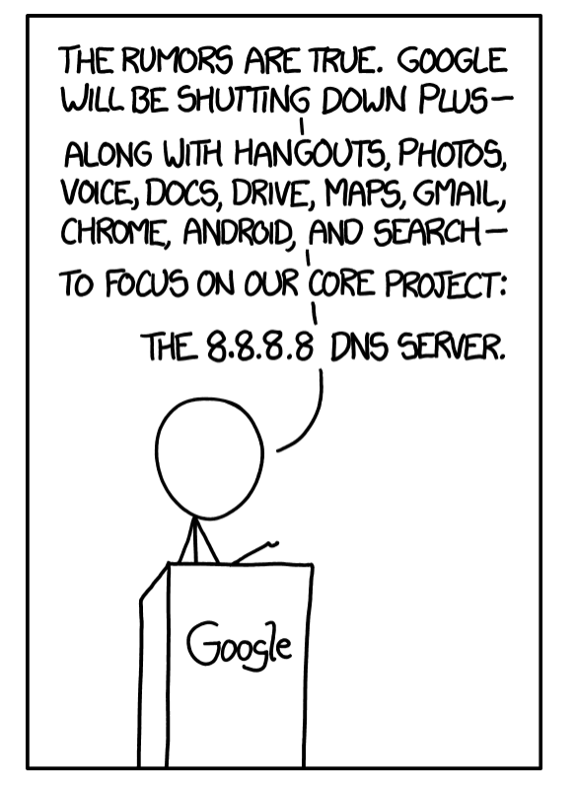

https://xkcd.com/1361/

Slide 42
What’s the problem here?
It’s a sensitive issue these days
There are many privacy undertakings in our space, but the undeniable fact is that many “free” services are indirectly funded through advertising revenue, and advertising is based on individual tracking and profiling
Open DNS providers typically provide undertakings that they do not use their query traffic for profiling - and I have no evidence that these undertakings are not being adhered to
  But I still have some questions as a consumer of their services:
  How are these undertakings audited and/or enforced? By whom?
  Are there penalties for breaches of these undertakings?
  Considering the size of these actors are any of these penalties even meaningful?

Slide 43
Barriers to Entry
Why is there only 1 very large open DNS provider in today’s Internet?
Is it because the incumbent is raising the barriers of entry to all potential competitors?
  Unlikely, as there is no evidence that this is the case
Or are there “natural” barriers to entry?
  Possibly – lets look

Slide 44
“Natural” Barriers to DNS Entry
The DNS economy is such a financial wasteland that very few have a natural incentive to enter this market
  No one pays for queries!
  Selling query logs can very damaging in terms of reputation and liability – particularly when you cannot get the users’ informed consent to do so
  Selling NXDOMAIN substitution is also very damaging in terms of reputation
It can be argued* that only someone with a massive presence is search has a commercial case for deploying a DNS resolver that is “honest” about the DNS (including NXDOMAIN)
* And some have from time to time

Slide 45
But…

Slide 46
Is all this a distraction?
It’s more likely that the shift of DNS functions into application realms using DoH services as an application function is a far greater threat to the current model of the DNS as a common single infrastructure
Maybe the convergence of:
    increased autonomy of applications in today’s Internet
    the dominant position of Android
    the dominant position of Chrome
  poses a greater potential threat to the integrity of the name infrastructure of the Internet than the issue of recursive resolver use

Slide 47
Is this a problem?
If applications develop their own application-centric name universes then what is the issue here?
While we’ve used a single name space for the past 40 years or so, that does not mean that we have to keep on doing so
And just because many others use a single name space as a means of surveillance and imposed control does not mean that we have to keep on using this single name space
  Particularly when applications can be far more effective in cloaking the user’s interactions in the application space than we’ve been able to do in a single DNS so far

Slide 48
Maybe this is a Good Thing
Again, it could be argued that this deliberate fragmentation of a single cohesive name space for the Internet into a set of application-specific spaces is a shift that lies in protecting the interests of privacy and service integrity for users
Its early days, and right now we just don’t know!

Slide 49

Watch This Space
The Internet remains one where the stasis of incumbent services has to compete against the pressure of continued innovation
While the pressures of aggregation and centralisation are evident in the space of common infrastructure services such as bandwidth, the DNS and CDN services, innovation in the Internet is moving up into the application space
We are inexorably moving to application-centric networking where both the network and the platforms are stripped back and the functionality and value is loaded into application-environments

Slide 50

Thanks!
Report on Resolver Use: https://stats.labs.apnic.net/rvrs

