Slide 1
Is “Big” Necessarily “Bad”?
Geoff Huston
APNIC
June 2021

Slide 2

This is not a new question…
High Museum of Art, Atlanta

Slide 3
Foundations: the US in the 1870’s
The dislocation of a previously agrarian workforce by the civil war created the opportunity for expansion of the industrial workforce through urbanisation and immigration
The massive expansion of the national railway system allowed efficient distribution of goods throughout the year
Liberalised capital markets with offshore investment encouraged entrepreneurial ventures
The telegraph (and subsequently the telephone) network allowed the projection of power and influence, allowing corporate entities to expand their effective scope beyond a single locale
Industrialisation transformed small scale cottage industries into large scale industrial production

Slide 4
The Gilded Age
A term applied to America in the 1870 – 1890’s about the building of new industrial and commercial corporate giants on platforms that were a mix of industrial innovation and enterprise with elements of greed, corruption and labor exploitation
Andrew Carnegie - US Steel
John Rockfeller - Standard Oil
Theodore Vail - AT&T
George Westinghouse – Rail Brakes
Thomas Edison – General Electric
J P Morgan - Banking

Slide 5
The Gilded Age
During this period in the United States the dominant position within industry and commerce was occupied by a very small number of players who were moving far faster than the regulatory measures of the day.
The resulting monopolies took the US decades to dismember, and even today many of these gilded age companies remain dominant in their field

Slide 6
The Sherman Act
An attempt to curtail the excessive aggregation of power that interferes with trade and competition
The act was intended to protect the public from the perils of failure of a market to sustain competition within the market
It prohibits anti-competitive arrangements and conduct that creates market monopolisation that results in the restraint of trade and competition within a market
Applied in 1911 to Standard Oil, American Tobacco and General Electric
Applied in 1982 to AT&T

Slide 7
What happened between 1911 and 1982?
What happened after 1982?
Why wasn’t the Sherman Act bought to bear on other industrial enterprises through most of the 20th century?
  Unintended side-effects of application the Sherman Act may be a factor - the break up of Standard Oil and American Tobacco caused the economic panic of 1910-1911
  Dominant enterprises turned to political lobbying to forestall political action in the form of anti-trust actions
  The US assumed a dominant position in international markets
    In 1913 the US auto industry was already manufacturing 485,000 units out of a world total of 606,000, and by 1929 Ford, GM and Chrysler had 80% of global market share
  The US domestic economy was a major beneficiary of large scale US enterprises dominating the global market, making them politically untouchable in the domestic marketplace

Slide 8
Louis Brandeis – “Big is Bad” by definition
US Supreme Court – 1916 – 1939
He argued that big business was too big to be managed effectively in all cases.
The growth of these very large enterprises that were at the extreme end of the excesses of monopolies, and their behaviours harmed competition, harmed customers and harmed further innovation
The quality of their products tended to decline, and the prices of their products tended to rise once they had achieved market dominance
When large companies can shape their regulatory environment, take advantage of lax regulatory oversight to take on more risk than they can manage, and transfer downside losses onto the taxpayer, then we should be very concerned

Slide 9
Theodore Roosevelt
US President 1901 – 1909
There are legitimate economies of scale where large enterprises could achieve higher efficiencies and lower prices to consumers in the production of goods and services by virtue of the volume of production
Large enterprises gain access to volumes of capital and resources that are otherwise inaccessible
The auto industry and the electricity industry are examples of a prohibitively expensive luxury good that turned into a generally accessible product through the application of massive scale in production of the good

Slide 10
Regulation?
Brandeis: no methods of regulation ever have been or can be devised to remove the menace inherent in private monopoly and overwhelming commercial power
John Ralston Saul: you should never expect the private sector to safeguard the public interest
If we regulate, then are we attempting to forestall the condition, or applying regulatory sanctions on the consequent behaviour?
What happens during periods of rapid change in the enterprise landscape? How does regulation remain relevant? How can we prevent regulation from embedding enterprises in the past?

Slide 11
The Internet’s Gilded Age
At some point in the past decade or so the dominant position across the entire Internet has been occupied by a very small number of players who are moving far faster than the regulatory measures that were intended to curb the worst excesses of market dominance by a small clique of actors.

Slide 12
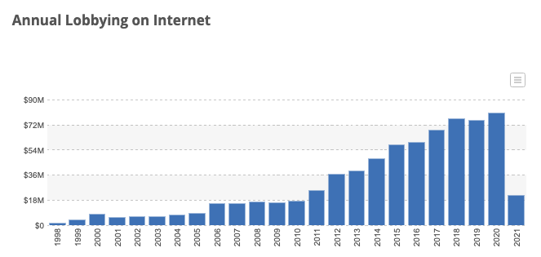
The Internet’s Gilded Age
At some point in the past decade or so the dominant position across the entire Internet has been occupied by a very small number of players who are moving far faster than the regulatory measures that were intended to curb the worst excesses of market dominance by a small clique of actors.
Source: Open Secrets

Slide 13
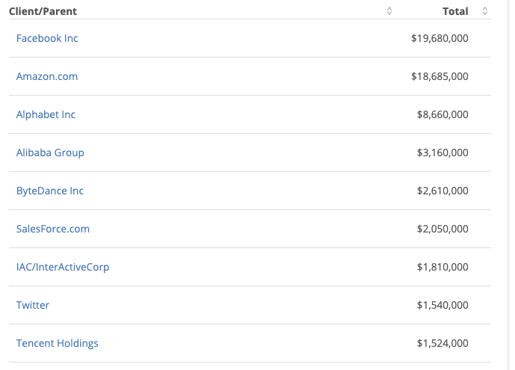
The Internet’s Gilded Age
2020 Lobbying Sources - US
At some point in the past decade or so the dominant position across the entire Internet has been occupied by a very small number of players who are moving far faster than the regulatory measures that were intended to curb the worst excesses of market dominance by a small clique of actors.
Source: Open Secrets

Slide 14
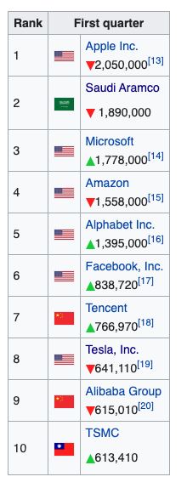
Market Sentiment
9 of the 10 largest publicly traded companies are now technology companies
And one fossil fuel company!
In this top 10 list there are no
- financial services
- chemicals
- industrials
- retails
Based on national GDP Apple’s market cap is now more valuable than all but 8 of the world’s economies!
https://en.wikipedia.org/wiki/List_of_public_corporations_by_market_capitalization

Slide 15
The Internet’s Gilded Age
These actors have enough market influence to set their own rules of engagement with:
  Users,
  Each other,
  Third party suppliers,
  Regulators and Governments
By taking a leading position with these emergent technologies, these players can amass vast fortunes, with little in the way of accountability to a broader common public good

Slide 16
What’s the problem?
Is it that these enterprises are:
  so big?
  exploitative of their workers?
  distorting markets?
  extracting monopoly rentals from consumers?
  not providing consumers what they want?

Slide 17
What we want?
It seems that these enterprises have focussed very sharply on giving users precisely what they want
The ability to customise a solution to a market of 1 and still bring economies of scale to that market underlies their success
Their ability lies in achieving a critical mass in size that allows them sufficient bulk to capitalise an asset that individually is worthless
So we all use these services – because they are obtained through the capitalisation of something that individually we are incapable of capitalising

Slide 18
There are side-effects
In order to understand what each consumer wants, the service provider needs to understand the consumer
Which brings us to…

Slide 19

Surveillance Capitalism
Much of the wealth and impact of these activities is built upon a foundation of aggregation of individual user behaviour and construction of personal profiles
It also has benefitted from a cavalier attitude towards data security and privacy concerns and the absence of regulatory imposts that attempt to safeguard some basic common aspects of personal privacy

Slide 20
What we might want
If this situation calls for some public sector response then perhaps the thrust of any such response should focus on the user rather than the dynamics of the market
But the public sector efforts to do so remain largely ineffectual despite the magnitude of the public concern over private sector seizure of the space of public discourse

Slide 21
Where are we?
We are now communicating with a computer-mediated environment rather than with each other
The network itself is largely incidental to this evolving story, and this is not really about the Internet any more
It’s about a set of revolutionary social changes on a par with the industrial revolution that have been triggered by abundant computing, storage and comms

Slide 22
Maybe its more than this
In a world of abundant content what do we choose to view?
What do we choose to believe?
Search becomes the arbiter of content selection and assumes a level of ultimate importance in this world
What’s the outcome of search being dominated by a single entity?

Slide 23
Is it about what we buy or is this more about what we think?
Bing – 5%
Google – 89%
Share of search in US market - 2021
https://gs.statcounter.com/search-engine-market-share/all/united-states-of-america

Slide 24
Where does all this head?
For our society this market-driven digitisation of our world has the potential to be incredibly empowering or incredibly threatening
Or both at the same time!

