Slide 1
DNS Privacy (an update)
Geoff Huston
APNIC Labs

Slide 2
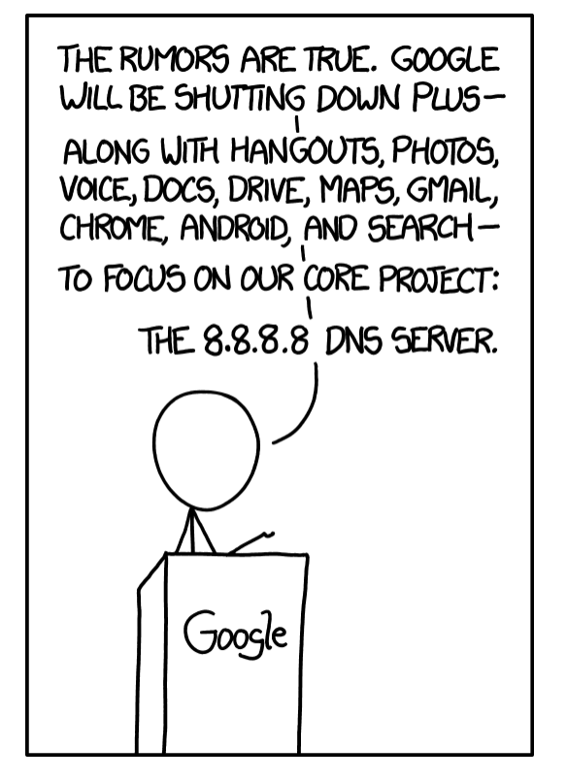
https://xkcd.com/1361/

Slide 3
Why pick on the DNS?
The DNS is used by everyone and everything
Because pretty much everything you do on the net starts with a call to the DNS
If we could see your stream of DNS queries in real time we could easily assemble a detailed profile of you and your interests and activities as it happens!

Slide 4
Why pick on the DNS?
The DNS is very easy to tap and tamper
DNS queries are open and unencrypted
DNS payloads are not secured and tampering cannot be detected
DNS responses are predictable and false answers can be readily inserted

Slide 5
Why pick on the DNS?
The DNS is hard for users to trace
Noone knows exactly where their queries go
Noone can know precisely where their answers come from

Slide 6
DNS Surveillance
Can we stop DNS surveillance completely?
Probably not!
Can we make it harder to collect individual profiles of activity?
Well, yes
And that’s what I want to talk about today

Slide 7
What’s the problem here?
Is the DNS label being queried a secret?
Well, not normally *
Although there are DNS versions of steganography that can conceal data in the query string

Slide 8
What’s the problem here?
Is the DNS label being queried a secret?
Well, not normally
Is the DNS response to a query a secret?
Again, not normally *
Although there are DNS versions of steganography that can conceal data in the response value

Slide 9
What’s the problem here?
Is the DNS label being queried a secret?
Well, not normally
Is the DNS response to a query a secret?
Again, not normally
So what is the issue here?
It’s the combination of query and the meta-data around a query that creates a problem:
The end user identity, from the IP packet header
The DNS label (or sequence of labels) being queried, from the payload
The date and time

Slide 10
How we might think the DNS works
Client
DNS Resolver
DNS Server

Slide 11
What we suspect the DNS is like
DNS Resolver
DNS Resolver
DNS Resolver
DNS Resolver
DNS Resolver
Client
DNS Resolver
DNS Server
DNS Resolver
DNS Resolver
DNS Resolver
DNS Resolver
DNS Resolver
DNS Resolver
DNS Resolver
DNS Resolver
DNS Resolver
DNS Resolver
DNS Resolver
DNS Resolver
DNS Resolver

Slide 12
What we suspect the DNS is like
Client
DNS Resolver
DNS Server
Servers that leak queries
DNS Resolver
DNS Resolver
Corrupted host platforms
DNS Resolver
Wireline and middleware
Inspection and interception
DNS Resolver
DNS Resolver
DNS Resolver
DNS Resolver
Resolvers that leak queries
DNS Resolver
DNS Resolver
DNS Resolver
DNS Resolver
DNS Resolver

Slide 13
Second-hand DNS queries are a business opportunity these days

Slide 14
How can we improve DNS Privacy?
Let’s look at a few behaviours of the DNS and see what we are doing to try and improve its privacy properties

Slide 15
1. The DNS is overly chatty
The DNS uses the full query name to discover the identity of the name servers for the query name
Hi root server, I want to resolve the A record for www.example.com
Not me – try asking the servers for .com
Hi .com server, I want to resolve the A record for www.example.com
Not me – try asking the servers for example.com
Hi example.com server, I want to resolve the A record for www.example.com
Sure – its 93.184.216.34

Slide 16
The DNS is chatty
The DNS uses the full query name to discover the identity of the name servers for the query name
Why are we telling root servers all our DNS secrets?
In our example case, both a root server and a .com server now know that I am attempting to resolve the name www.example.com
Maybe I don’t want them to know this

Slide 17
QNAME Minimisation
A resolver technique intended to improve DNS privacy where a DNS resolver no longer sends the entire original query name to the upstream name server
Described in RFC 7816

Slide 18
Yes, but…
It’s a technique to minimise the information leak between a recursive resolver and authoritative servers, as stub resolvers pass the full query label to the recursive resolver
A number of commonly used recursive resolvers only perform qname minimisation on the first three labels
(Why do they limit Qname minimisation to just the upper level domains)?

Slide 19
2. Interception and Rewriting
The DNS is an easy target for the imposition of control over access
Try asking for www.thepiratebay.org in Australia
Try asking for www.facebook.com in China
Etc, etc
These days interception systems typically offer an incorrect response
How can you tell if the answer that the DNS gives you is the genuine answer or not?
This sounds like a question for DNSSEC!

Slide 20
DNSSEC and Recursive Resolvers
A DNS response that has been modified will fail to validate under DNSSEC when:
a client asks a security-aware resolver to resolve a name, and
sets the EDNS(0) DNSSEC OK bit, and
the zone is DNSSEC-signed
A DNSSEC-validating recursive resolver will only return a RRset for the query if it can validate the response using the associated digital signature, and It will set the AD bit in the resolver response to indicate validation success
Otherwise it will return SERVFAIL
But SERVFAIL is not the same as “I smell tampering”
Its ”nope, I failed. Try another resolver”

Slide 21
Yes, but…
The zone (and all its parent zones) must be DNSSEC-signed
If the recursive resolver performs DNSSEC validation (using the recursive resolver to validate is the most prevalent deployment model) then the all-important stub-to-recursive link is still vulnerable to interception and re-writing
And if your recursive resolver is performing the re-writing of the response then the stub is none the wiser if the stub does not perform DNSSEC validation
Stub resolvers don’t generally perform DNSSEC validation
It’s too slow!

Slide 22
3. Middleware and WireTapping
If we want to make DNS surveillance harder we should look at encrypting the transport used by DNS queries and responses between stub and recursive resolvers
Today’s standard tool is TLS, which uses dynamically generated session keys to encrypt all traffic between two parties

Slide 23
DoT - DNS over TLS
TLS is a TCP ‘overlay’ that adds server authentication and session encryption to TCP
DoT uses a persistent stub-to-recursive relationship to amortize the setup costs of TCP and TLS over many subsequent queries
Which works efficiently in a stub-to-recursive scenario, but not even a little bit for recursive-to-authoritatives!
If the initial server name certificate is validated by the client then
The client can be assured (to some extent) of who it is talking to by name
No third parties can intrude or observe the DoT session or its contents

Slide 24
Yes, but…
The TCP session state is on port 853
DNS over TLS can be readily blocked by CPE and middleware
Will generate a higher recursive resolver memory load as each client may have a held state with one or more recursive resolvers
The privacy is relative, as the recursive resolver still knows all about you and your DNS queries
And until ECH* in TLS 1.3 is widely supported, the identity of the TLS server is still in the clear, which also facilitates blocking even if the DoT session jumps over to use TCP port 443
* Encrypting the Server Name in the Client Hello message of TLS setup

Slide 25
DoH - DNS over HTTPS
DNS over HTTPS
Uses an HTTPS session for the stub-to-recursive link
Similar to DNS over TLS, but with HTTP object semantics interposed between the DNS and TLS
Uses TCP port 443, so can be masked within other HTTPS traffic
Uses DNS wire format

Slide 26
Why use DoH over DoT?
Bypass middleware blocking of TCP port 853 (DoT)
DoH allows the stub resolver function to be merged into the application at the client end and DNS resolver to be multiplexed at the server side (browsers and web servers)
HTTP object semantics allow for HTTP object caching in the client
This enables server-side HTTP push of DNS responses
Resolver-less DNS!
Can speed up transactions through pre-provisioning of DNS responses

Slide 27
Yes, but…
Aside from changing the TCP port to 443 there is little difference between DoH and DoT from a conventional DNS perspective
Most of the issues with DoH are about the use of resolver-less DNS and content-based DoH-server switching using the HTTP framing shim, which are still largely speculative matters these days
Application-level DoH can be readily hidden from the platform and from the local network – this can be seen as a good or bad thing!

Slide 28
DNS over QUIC
QUIC is a transport protocol originally developed by Google and passed over to the IETF for standardised profile development
QUIC uses a thin UDP shim and an encrypted payload
The payload is divided into a TCP-like transport header and a payload
QUIC allows for multiple DNS queries without TCP HOL blocking
DOT
DOQ
DNS
DNS
TLS
QUIC
TCP
UDP
IP
IP

Slide 29
Yes, but…
QUIC on UDP port 443 has issues with port blocking in middleware
There is little difference between DoQ, DoH and DoT from a conventional DNS perspective
The remote end recursive resolver still is privy to all your DNS queries and your identity

Slide 30
DoH again!
DNS over HTTPS/3
From the perspective of the DNS its still DNS binary objects encased in an HTTP wrapper, using POST for the query and a HTTP Data Frame for the response
From the perspective of the network, HTTP/3 can negotiate the use of QUIC as its transport network
DoH is morphing into DNS-over-HTTPS-over-QUIC-over-UDP at about the same speed as HTTP/2 is morphing into HTTP/3 that incorporates TLS 1.3 into QUIC

Slide 31
4. DNS Profiling
Your identity and the sequences of your DNS queries represent a rich vein of profiling information
Can we deconstruct the DNS in such a way that no single party has both pieces of information?

Slide 32
Oblivious DNS
Uses the QUERY name to disassociate stub identity from query
Stub resolver encrypts the DNS query label into a new query label
Encryption uses the public key of a known oDNS server, and appends the name of the oDNS server
Stub resolver queries a ‘normal’ recursive resolver with this encrypted query name
Recursive resolver queries an oDNS server with this encrypted query name
oDNS server strips out its own name and decrypts the query name, and resolves this name and encrypts the DNS RR to send back to the stub via the recursive resolver

Slide 33
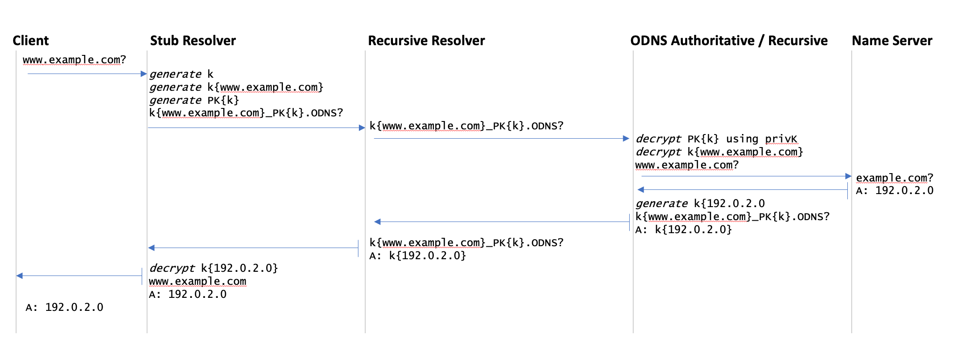
Oblivious DNS

Slide 34
Yes, but…
The DNS is still DNS over UDP port 53
But nothing prevents a oDNS stub using Do[THQ] to a recursive resolver. The recursive resolver has no knowledge of oDNS and process the DNS query like any other
The encryption is limited due to limited size and alphabet of the query name field

Slide 35
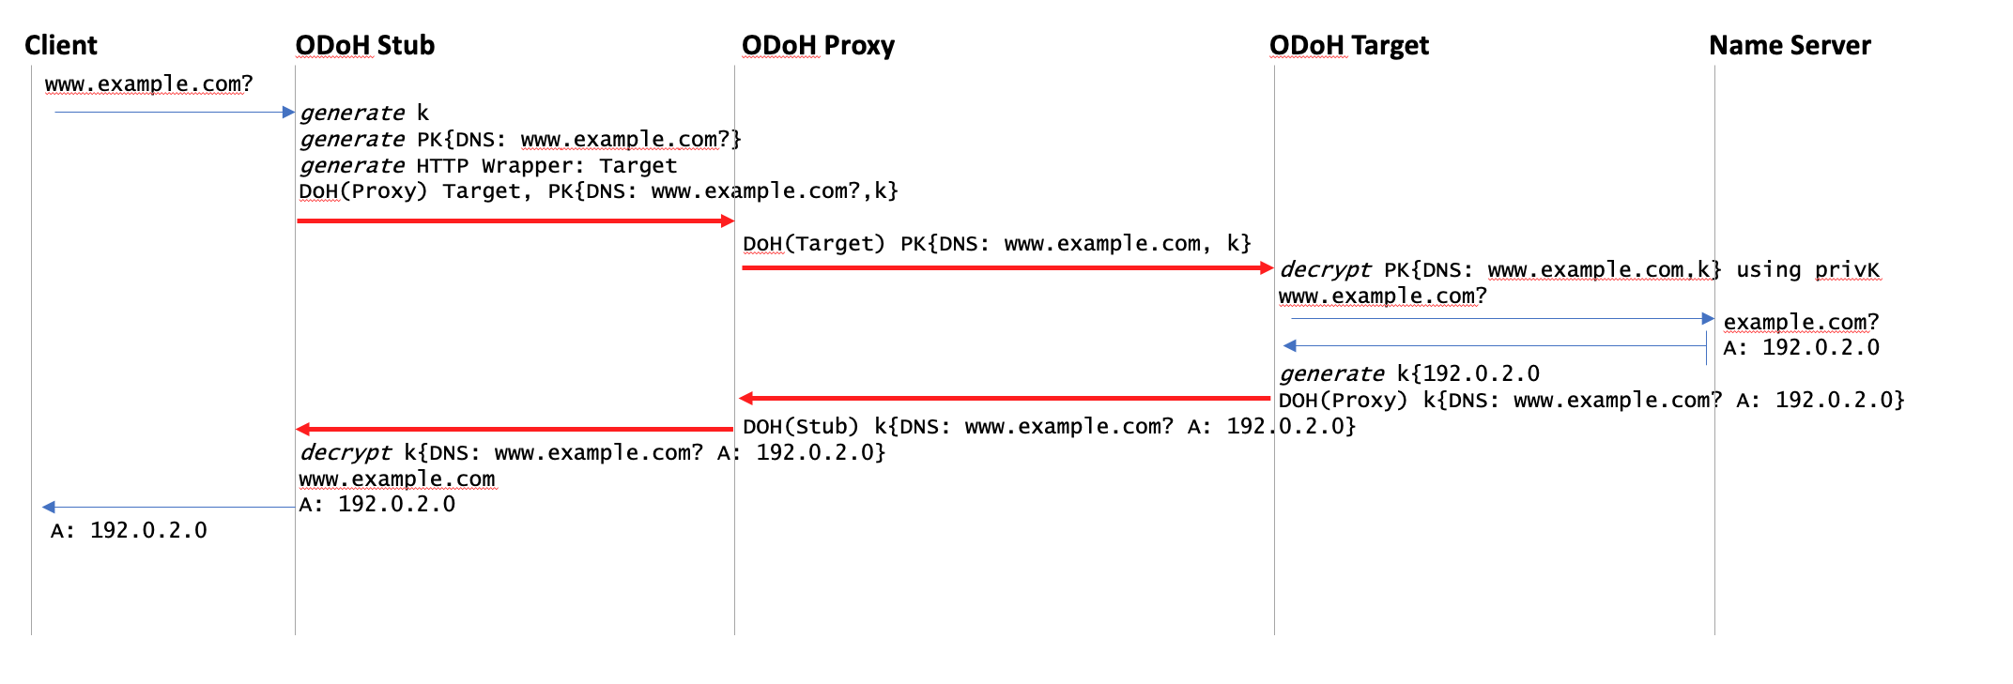
Oblivious DoH
Use double TLS wrapper on a DoH transport to dissociate query name from stub identity

Slide 36
Oblivious DoH
An outer TLS wrapper is used for the stub-to-oDoH Proxy hop and a different TLS wrapper is used for the oDoH Proxy-to-oDoH Target hop
The inner TLS wrapper is used to encrypt the DNS query, encrypted using the public key of the target
The response is encrypted using a session key generated by the client

Slide 37
Yes, but…
This requires a modified DNS stub resolver that can send and receive oDoH messages, an ODoH Proxy and an ODoH Target
Oh, and the ODoH proxy and the ODoH Target should not collude!
But we can’t ensure that no collusion happens!

Slide 38
Obscured DNS
Borrowed from the approach used by IDNS
Apply a hash the zone file by passing the zone labels through a hash to get a base32hex encoded version of the labels, keyed with a passphrase
The encrypted zone is published through conventional DNS
Qnames need to be encrypted before passing them to the DNS
Only holders of the common passphrase can decrypt the responses – no DNS intermediary can determine the original query label

Slide 39
Yes, but…
“shared secrets” are often an oxymoron!

Slide 40
Hiding in the Crowd
What if you use an encrypted session to a very busy open resolver?
No third party can see you queries to the open resolver
Noone else can see the responses from the open resolver
The open resolver asks the authoritative servers which makes it challenging to map the query back to the end user
So if you you are prepared to trust Google, Open DNS, Cloudflare, Quad9, etc with your DNS, and you use DoH or DoT on the stub-to-recursive hop then its far harder for any third party to associate your identity with your queries
But that is a very large amount of trust you are investing here in folk whom you are not paying to provide this service!

Slide 41
Hiding in the Crowds
What if you round-robin your queries to a number of open resolvers?
No single open resolver provider can see your complete DNS query set
Which makes profiling at the open resolver more challenging
Even though many open DNS providers assert that they do not retain queries nor profile users in any case

Slide 42
Where is this heading?
Will any of these privacy approaches becomes mainstream in the public Internet?

Slide 43
The DNS Economy
In the Public Internet end clients don’t normally pay directly for DNS recursive resolution services
Which implies that outside of the local ISP, DNS resolvers are essentially unfunded by their clients
And efforts to monetise the DNS (such as NXDOMAIN substitution) are generally viewed with disfavour
Open Resolver efforts run the risk of success-disaster
They more they are used the greater the funding problem
The default option is that the ISP funds and operate the recursive DNS service, funded by the ISP’s client base

Slide 44
My Opinion
ISP-based provisioning of DNS servers without channel encryption will continue to be the mainstream of the public DNS infrastructure
Most users don’t change from the defaults and CPE based service provisioning in the wired networks and direct provisioning in mobile networks will persist for the moment
Some applications will shift to DoH support, but on the whole will continue to use the default ISP-based resolvers (assuming that they include DoH support)

Slide 45
If HTTPS worked, why not DoH?
Any change to the DNS that requires user configuration, or a change of CPE behaviour will not be easy to gather deployment momentum
There is no untapped financial return in DNS resolution, so this is not an activity that has strong commercial impetus
Many public environments use DNS oversight and alteration as a means of content moderation. There is little appetite to make that harder
Browser vendors have far more limited leverage in the DNS, as compared to content delivery over HTTP

Slide 46
“Split” DNS
Is appears likely that browsers will hive off to use DoH to the ISP default recursive resolver, while the platform itself will continue to use libraries that will default to DNS over UDP
Which will produce some awesome corner cases when failure modes are encountered!

Slide 47
Choose your resolver carefully!
The careful choice of an open recursive resolver and an encrypted DNS session will go a long way along the path of DNS privacy
But the compromise is that you are sharing your activity profile with the recursive resolver operator
Or you could just take the default option, do nothing and pass your queries, along with your traffic, to your ISP!

Slide 48
Thanks!

