Slide 1
Technology Adoption Data
Adoption Rates for IPv6, DNSSEC and RPKI
Geoff Huston
Joao Damas
APNIC Labs
EURODiG
WS-11
11 June 2020

Slide 2
IPv6 adoption - 2012 to Today
25% of the Internet’s user base have IPv6 today

Slide 3
Europe is (slightly) lagging…
20% of the Europe’s user base have IPv6 today

Slide 4
And is very diverse
IPv6 is deployed in Central
Europe and Greece, but not in
the North, South or East

Slide 5
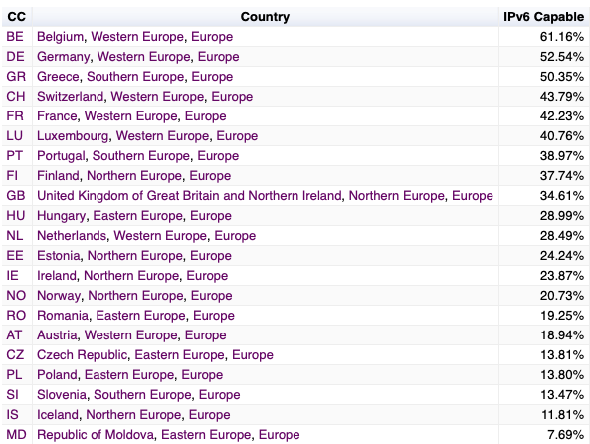
And is very diverse

Slide 6
DNSSEC adoption

Slide 7
Europe is (slightly) ahead

Slide 8
Same (but different) diversity
DNSSEC is deployed in Northern Europe,
but not as much in Central, Southern or
Eastern Europe

Slide 9
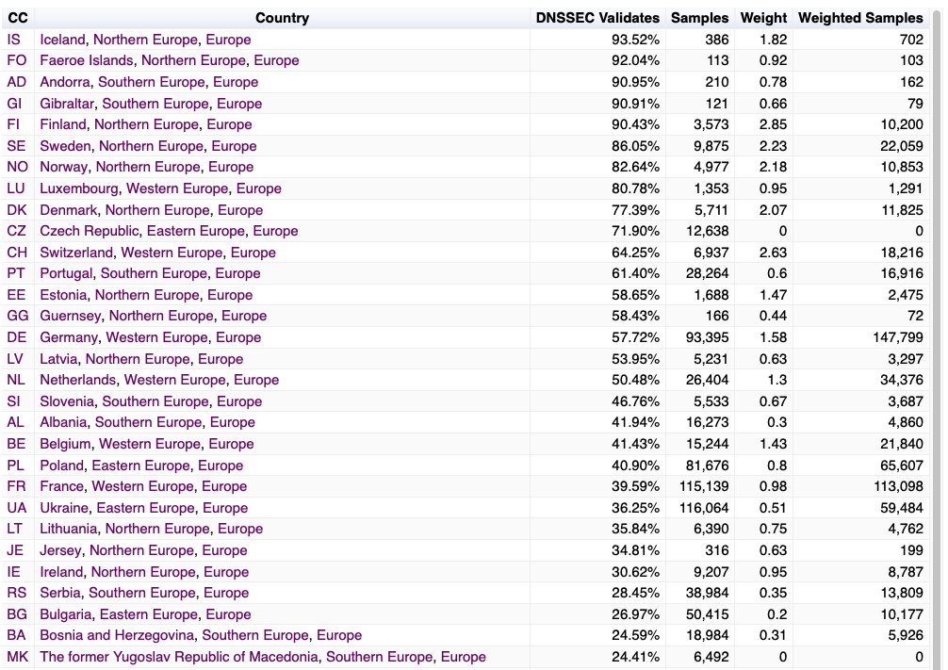
Same (but different) diversity

Slide 10
RPKI ROV Adoption
All End Users behind ROV-aware filters: 5.3%
European users: 1.7%

Slide 11
RPKI ROV Adoption in Europe
Rate of RoV Filtering

Slide 12
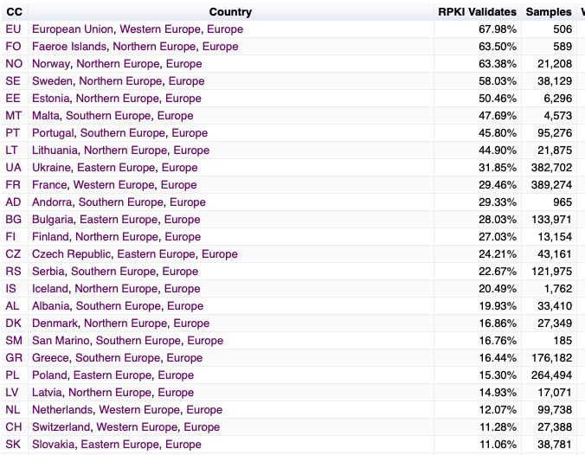
RPKI ROV Adoption in Europe
Rate of RoV Filtering

Slide 13
Why is there such Diversity in Deployment?

Slide 14
Challenges for adoption:
This is a deregulated and highly
competitive environment
There are many different players
Each with their own perspective
?
And all potential approaches will be explored!

Slide 15
Challenges for adoption:
2. The myth of long-term planning
?
“IPv6 Transition will take many years...
5 years, maybe 10 years, maybe longer”
Are we still firmly committed to the plans we had 5 years ago? How about our 10-year-old plans?
The longer the period of transition, the higher the risk of completely losing the plot and heading into other directions!

Slide 16
Today’s Internet Architecture
Challenges:
The Internet keeps changing

Slide 17
Some providers see advantage in adoption
Competitive positioning in a diverse market
Early adoption of future mainstream technologies (first user advantage)
Perception of enhanced utility, security and safety in these more recent technologies

Slide 18
Other providers see reasons to wait …
IPv6 is a 1990’s technology solution to a 1980’s networking architectural challenge – CDN feeder networks do not need globally unique address plans across every device all of the time
DNSSEC is only partially-implemented. If we pushed DNSSEC validation to the edges of the network we’re scared that the DNS will slow down to unacceptable levels. DANE is a good example of this
RPKI Route Origin Validation makes DNS route hijacking only slightly harder. More moving parts can introduce fragility, and not necessarily enhance operating stability

