Slide 1
Buffers and Protocols
Geoff Huston
Chief Scientist, APNIC Labs

Slide 2
Networking is all about moving data
The way in which data movement is controlled is a key characteristic of the network architecture
The Internet Protocol architecture passed all controls to the end systems, and treated the network as a passive switching environment
All this is changing again as we see a what could well be a new generation of flow control algorithms being adopted in the Internet

Slide 3
Let’s talk about speed
How fast can we push a single session to move data through the network?
Session speed is the result of a combination of:
    available transmission speed
    transmission bit error rate
    packet sizes
    switching capacity
    end-to-end latency
    host buffer size
    network buffer size
    protocol efficiency
  All of these factors are critical

Slide 4
The Evolution of Speed
1980’s
  TCP rates of Kilobits per second
1990’s
  TCP rates of Megabits per second
2000’s
  TCP rates of Gigabits per second
2010’s
  TCP rates of Gigabits per second
G
M
K
80’s
90’s
00’s
10’s

Slide 5
The Evolution of Speed
1980’s
  TCP rates of Kilobits per second
1990’s
  TCP rates of Megabits per second
2000’s
  TCP rates of Gigabits per second
2010’s
  TCP rates of Gigabits per second
G
M
?
K
80’s
90’s
00’s
10’s

Slide 6
Today
Optical transmission speeds are now in Terrabit capacity
But peak TCP session speeds are not keeping up
Its likely that network buffers play a role here
How?
optical transport
T
TCP speed
G
M
K
80’s
90’s
00’s
10’s

Slide 7
TCP
The Transmission Control Protocol is an end-to-end protocol that creates a reliable stream protocol from the underlying IP datagram device
TCP operates as an adaptive rate control protocol that attempts to operate fairly and efficiently

Slide 8
TCP Design Objectives
To maintain an average flow which is Efficient and Fair
Efficient:
  Minimise packet loss
  Minimise packet re-ordering
  Do not leave unused path bandwidth on the table!
Fair:
  Do not crowd out other TCP sessions
  Over time, take an average 1/N of the path capacity when there are N other TCP sessions sharing the same path

Slide 9
It’s a Flow Control process
Think of this as a multi-flow fluid dynamics problem
Each flow has to gently exert pressure on the other flows to signal them to provide a fair share of the network, and be responsive to the pressure from all other flows

Slide 10
TCP Control
Ideally TCP would send packets at a fair share of available network capacity. But the TCP sender has no idea what “available network capacity” means.
So TCP uses ‘rate adaptation’ to probe into network, increasing the sending rate until it is ‘too fast’
Packet drop is the conventional signal of ‘too fast”

Slide 11
TCP Control
TCP is an ACK Pacing protocol
Data sending rate is matched to the ACK arrival rate

Slide 12
TCP Control
ACK pacing protocols relate to a past network state, not necessarily the current network state
  The ACK signal shows the rate of data that left the network at the receiver that occurred at ½ RTT back in time
  So if there is data loss in the forward path, the ACK signal of that loss is already at least ½ RTT old!
    So TCP should react quickly to ‘bad’ news
  If there is no data loss, that is also old news
    So TCP should react conservatively to ‘good’ news

Slide 13
“Classic TCP” – TCP Reno
Additive Increase Multiplicative Decrease (AIMD)
  While there is no packet loss, increase the sending rate by one segment (MSS) each RTT interval
  If there is packet loss decrease the sending rate by 50% over the next RTT Interval, and halve the sender’s window
Start Up
  Each RTT interval, double the sending rate
  We call this “slow start” – probably because its anything but slow!!!

Slide 14
Idealised TCP Reno
Notification of Packet Loss via Duplicate ACKs causes RENO to halve its sending rate
Slow Start
Rate Doubles
each RTT
Interval
Congestion Avoidance
Rate increases by 1 MSS per RTT
Rate halves on Packet Loss
Time

Slide 15
TCP RENO and Idealized Queue Behaviour
Total Queue Capacity
(Onset of Packet Loss)
Network Buffers Fill
Link Capacity Capacity
(Onset of Queuing)
Network Buffers Drain

Slide 16
TCP and Buffers – the Theory
When a sender receives a low signal it repairs the loss and halves its sending window
This will cause the sender to pause for the amount of time to drain halve the outstanding data in the network
Ideally this exactly matches the amount of time taken for the queue to drain
At the time the queue is drained the sender resumes its sending (at half the rate) and the buffer has fully drained
For this to work, the queue size should equal the delay bandwidth product of the link it drives
All this works with an assumption of a single queue and a single flow

Slide 17
TCP and Buffers – the Theory
Queue formation
Queue drain

Slide 18
TCP and Buffers
The rule of thumb for buffer size is
Size = (BW ∙ RTT)
“High Performance TCP in ANSNET”
Villamizar & Song, 1994

Slide 19
TCP and Buffers
Larger: The queue never drains, so the buffer adds delay to the connection
Smaller: The queue drains and the sender operates below bottlenck speed – so the link is under-used

Slide 20
From 1 to N – Scaling Switching
This finding of buffer size relates to a single flow through a single bottleneck resource
What happens with more flows and faster transmission system?
It appears that scaling has non-linear properties

Slide 21
Scaling Switching

Slide 22
Scaling Switching
If we can’t up the clock speed of a switching chip we need to use parallel architectures
Double the switching speed requires 6x the overall switch capacity and >4x the memory
This non–linear scaling represents a considerable challenge in high speed systems
Is it really necessary to use delay-bandwidth sized high speed memory interfaces?

Slide 23
Smaller buffers?
If 2 flows use a single buffer and they resonate precisely then the buffer still needs to be delay-bandwidth size
If they are precisely out of phase the common buffer requirement is halved

Slide 24
Smaller buffers?
If 2 flows use a single buffer and they resonate precisely then the buffer still needs to be delay-bandwidth size
If they are precisely out of phase the common buffer requirement is halved
What about the case of N de-synchronised flows?
Stanford 2004 study (“Sizing Router Buffers”, Appenzeller, McKeown, Keslassy, SIGCOM’04)
  Size = (BW ∙ RTT) / √N
  Assuming that the component flows manage to achieve a fair outcome of obtaining 1/N of the resource in a non-synchronised manner, then the peak buffer resource is inversely proportionate to the square root of N

Slide 25
Switching Chip Design TradeOffs
On Chip memory is fast, but limited to between ~16M to ~64M
A chip design can include an interface to external memory banks but the memory interface/controller also takes up chip space and the external memory is slower
Between 20% to 60% of switch chip real estate is devoted to memory / memory control
Small memory buffers in switch design allows for larger switch fabric implementations on the chip

Slide 26
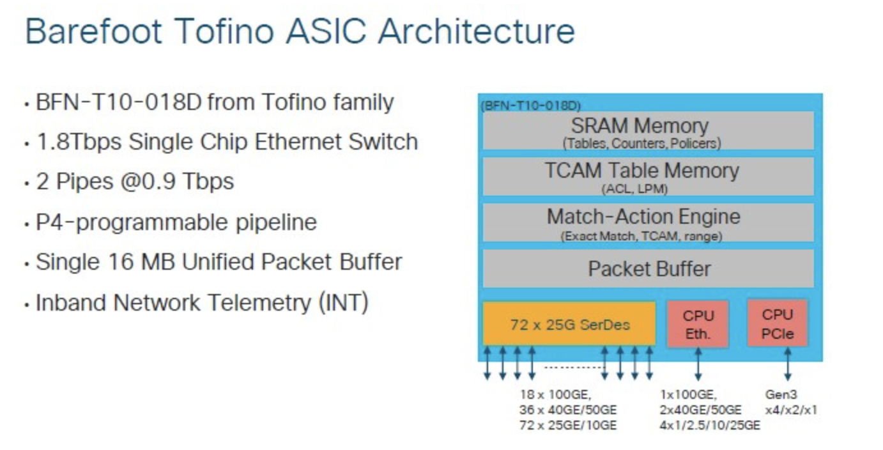
Switch Design

Slide 27
The Network Design Dilemma
What are the acceptable tradeoffs here?
  Larger buffers tend to create more efficient outcomes for aggregate throughput
  Smaller buffers limit the achievable performance of some protocols

Slide 28
Buffer Sizing
Transmission BER
Flow Protocol
Transmission Capacity
Number of Flows
Transmission Jitter
Flow Bandwidth x Delay
Flow Pacing

Slide 29
Buffer Sizing
Transmission BER
Flow Protocol
Transmission Capacity
Number of Flows
Transmission Jitter
Flow Bandwidth x Delay
Flow Pacing
We can change these (possibly)

Slide 30
Protocols and Buffers
It seems that Reno strongly influenced the design assumption that BDP buffers are necessary in the Internet
But are there other protocols that lead to different assumptions about buffer sizes?

Slide 31
Refinements to RENO
There have been many efforts to alter RENO’s flow control algorithm
In a loss-based AIMD control system the essential parameters are the manner of rate increase and the manner of loss-based decrease
  For example:
    MulTCP behaves as it it were N simultaneous TCP sessions: i.e. increase by N segments each RTT and rate drop by 1/N upon packet loss
What about varying the manner of rate increase away from AI?

Slide 32
Enter CUBIC
CUBIC is designed to be useful for high speed sessions while still being ‘fair’ to other sessions and also efficient even at lower speeds
Rather than probe in a linear manner for the sending rate that triggers packet loss, CUBIC uses a non-linear (cubic) search algorithm

Slide 33
CUBIC and Queue formation
Total Queue Capacity
(Onset of Packet Loss)
Network Buffers Fill
Link Capacity Capacity
(Onset of Queuing)
Network Buffers Drain

Slide 34
CUBIC assessment
Can react quickly to available capacity in the network
Tends to sit for extended periods in the phase of queue formation
Can react efficiently to long fat pipes and rapidly scale up the sending rate
Operates in a manner that tends to exacerbate ‘buffer bloat’ conditions, but also operates efficiently in small buffer environments

Slide 35
Can we do even better?
Lets look at the model of the network once more, and observe that there are three ‘states’ of flow management in this network:
  Under-Utilised – where the flow rate is below the link capacity and no queues form
  Over-Utilised – where the flow rate is greater that the link capacity and queues form
  Saturated – where the queue is filled and packet loss occurs
Loss-based control systems probe upward to the Saturated point, and back off quickly to what they guess is the Under-Utilised state in order to the let the queues drain
But the optimal operational point for any flow is at the point of state change from Under to Over-utilised, not at the Saturated point

Slide 36
RTT and Delivery Rate with Queuing
Under-Utilised
Over-Utilised
Saturated

Slide 37
How to detect the onset of queuing?
By carefully measuring the Round Trip Time!

Slide 38
BBR Design Principles
Probe the path capacity only intermittently
Probe the path capacity by increasing the sending rate for a short interval and then drop the rate to drain the queue:
  If the RTT of the probe equals the RTT of the previous state then there is available path bandwidth that could be utilised
  If the RTT of the probe rises then the path is likely to be at the onset of queuing and no further path bandwidth is available
Do not alter the path bandwidth estimate in response to packet loss
Pace the sending packets to avoid the need for network buffer rate adaptation

Slide 39
Idealised BBR profile
sending rate
network queues

Slide 40
BBR Politeness?
BBR will probably not constantly pull back when simultaneous loss-based protocols exert pressure on the path’s queues
BBR tries to make minimal demands on the queue size, and does not rely on a large dynamic range of queue occupancy during a flow

Slide 41
From Theory to Practice
Lets use BBR in the wild
I’m using iperf3 on Linux platforms (Linode)
  The platforms are dedicated to these tests
It’s the Internet
  The networks paths vary between tests
  The cross traffic is highly variable
  No measurement is repeatable to a fine level of detail

Slide 42
Cubic vs BBR over a 12ms RTT 10G circuit

Slide 43
Wow!
That was BRUTAL!
As soon as BBR started up it collided with CUBIC, and BBR startup placed pressure on CUBIC such that CUBIC’s congestion window was reduced close to zero
At this stage CUBIC’s efforts to restart its congestion window appear to collide with BBR’s congestion control model, so CUBIC remains suppressed
  The inference is that BBR appears to be operating in steady state with an ability to crowd out CUBIC

Slide 44
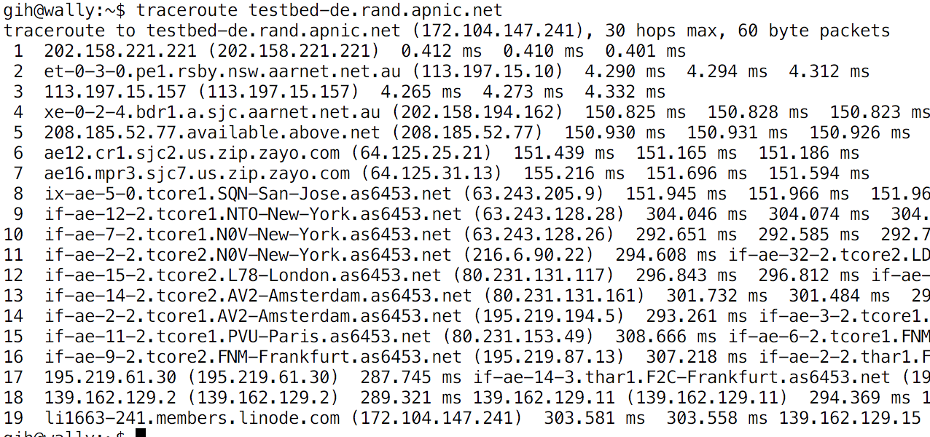
BBR vs Cubic – second attempt
Same two endpoints, same network path across the public Internet
Using a long delay path AU to Germany via the US

Slide 45
BBR vs Cubic
The Internet is capable of offering a 400Mbps capacity path on demand!
In this case BBR is apparently operating with filled queues, and this crowds out CUBIC
BBR does not compete well with itself, and the two sessions oscillate in getting the majority share of available path capacity
BBR (1) starts
Cubic starts
BBR (2) starts
Cubic ends
BBR(2) ends

Slide 46
BBR and Loss Recovery
Packet loss causes retransmission that appears to occur in addition to the stable link capacity model used by BBR.
Once loss is reduced, BBR maintains a more consistent sending model

Slide 47
Parallel
BBR
Streams
We used 50 parallel BBR streams between the same two endpoints (200ms RTT)
In this larger setup the majority of sessions managed to equilibrate between each other and evenly share the path bandwidth

Slide 48
So what can we say about BBR?
It’s “interesting” in so many ways:
  It’s a move away from the more common loss-based flow control protocols
  It looks like it will operate very efficiently in a high-speed small-buffer world
    High speed small buffer switching chips are far cheaper, but loss-based TCP reacts really badly to small buffers by capping its flow rate
  It will operate efficiently over ECMP paths, as it is relatively impervious to packet re-ordering
  It also looks as if it will operate efficiently in rate policed environments
  Unlike AIMD systems, it will scale from Kbps to Gbps over long delay paths very efficiently
  It resists the conventional network-based traffic control mechanisms

Slide 49
Why use BBR?
Because it achieves
Its incredibly efficient
It makes minimal demands on network buffer capacity
It’s fast!

Slide 50
Why not use BBR?
Because it over achieves!
The classic question for many Internet technologies is scaling – “what if everyone does it?”
  BBR is not a scalable approach in competition with loss-based flows
  It works so well while it is used by just a few users, some of the time
  But when it is active, BBR has the ability to slaughter concurrent loss-based flows
  Which sends all the wrong signals to the TCP ecosystem
    The loss-based flows convert to BBR to compete on equal terms
    The network is then a BBR vs BBR environment, which is unstable

Slide 51
Is this BBR experiment a failure?
Is it just too ‘greedy’ and too ‘insensitive’ to other flows to be allowed out on the Internet to play?
  Many networks have been provisioned as a response to the aggregate behaviours of loss-based TCP congestion control
  BBR changes all those assumptions, and could potentially push many networks into sustained instability
  We cannot use the conventional network control mechanisms to regulate BBR flows
    Selective packet drop just won’t create back pressure on the flow

Slide 52
Is BBR an outstanding success?
We can’t achieve speed if we need also large high speed buffers in network routers
  Loss-based flow-control systems have a sloppy control loop that is always ½ RTT late
We can use small buffers in switches if we use sender pacing coupled with flow control systems that are sensitive to the onset of queue formation (rather than being sensitive to packet loss resulting from a full queue)
BBR points to an approach that does not require large buffer pools in switches

Slide 53
Where now with BBR?
BBR 2.0
  Alter BBR’s ‘sensitivity’ to loss rates, so that it does not persist with an internal bandwidth delay product (BDP) that exceeds the uncongested BDP
    This measure would moderate BBR 1.0’s ability to operate for extended periods with very high loss levels
  Improve the dynamic sharing fairness by moderating the Bandwidth Delay Product by using an estimated ‘fair’ proportion of the path BDP
  Accommodate the signal distortion caused by ACK stretching middleware
  Place an upper bound on the volume of in-flight data
  Alter the +/- 25% probe factors dynamically (i.e. allow this to be less than 25% overload)

Slide 54
The new Network Architecture
We are seeing a shift in end systems to assert edge-centric control and hide from network-level active middleware in the Internet
QUIC and BBR are instances of a recent push back from the network-level QoS bandwidth control mechanisms, and result in greater levels of autonomous control being passed back to the end hosts
For better or worse!

Slide 55
What is all this telling us?
The Internet still contains a large set of important unsolved problems
And some of our cherished assumptions about network design may be mistaken
Moving large data sets over high speed networks requires a different approach to what we are doing today
BBR seems to be a step in an interesting direction, particularly for very high speed networking
But it still calls for more research and more testing at scale

Slide 56
Tiny Buffers
Buffers in a network serve two major purposes:
  smooth sender burstiness
  Multiplexing
What if all senders ‘paced’ their sending to avoid bursting, and were sensitive to the formation of standing queues?
Then we would likely have a residual multiplexing requirement for buffers where:
  B >= O(log W)
  where W is the average flow window size
  This would allow Tbps switches to operate with on-chip memory (10’s Mb) and still allow highly efficient network utilisation

Slide 57
That’s it!
Questions?

