Slide 1
What part of “NO” is so hard to understand?
Geoff Huston
APNIC Labs

Slide 2
We were looking elsewhere…
We were setting up a measurement experiment that was looking at the extent of support for aggressive NSEC caching (RFC8198) in the DNS
The experiment setup involved presenting to the user a DNS name that did not exist from a signed zone, so that we would pass an NSEC record to a DNSSEC-aware resolver
But was was intriguing was that we were seeing many more queries for the non-existent name than we had expected

Slide 3
What we saw:
We used an online ad to get users to query for a unique non-existent DNS name
And then counted the number of queries we saw for these names
uuid.example.com?
NXDOMAIN
uuid.example.com?
NXDOMAIN
uuid.example.com?
NXDOMAIN
Authoritative Server

Slide 4
What we saw:
We used an online ad to get users to query for a unique non-existent DNS name
And then counted the number of queries we saw for these names
That’s an average of 2.37 queries per non-existent name!
Why so many queries?
Queried Names: 60,210,983
DNS Queries: 142,631,272

Slide 5
Expectations
If “NO means NO” then naïvely we would expect to see 1 query per name, not 2.37 queries per name
But maybe that’s just too naïve these days…
After all - the DNS is now SO clever that this just couldn’t be due to random DNS insanity – could it?

Slide 6
Happy Eyeballs and the DNS
A ‘happy eyeballs” dual stack client will launch 2 DNS queries back-to-back (roughly), for A and AAAA records of the name
  23% of clients asked both A and AAAA records
  3% asked only AAAA records (*)
  74% asked only for A records
AAAA?
A?
Client stub resolver
* If the client asks for an AAAA record and waits for a response before asking for the A record then the NXDOMAIN response will stop the connection process and any subsequent A query will not be performed

Slide 7
Factoring Happy Eyeballs
If we split out the A and AAAA queries the experiment launched 73,537,852 DNS resolution ‘events’
We saw 142,631,272 DNS queries, or an average of 1.93 queries per name
That’s better, but still
unexpectedly high

Slide 8
Single vs Multiple Queries
36,059,484 resolution ‘events’ were completed with just 1 query to the authoritative server (49% of all resolution events)
If there were multiple queries for a name (>= 2 queries), then the average of the multiple queries was 2.84 queries

Slide 9
Distribution of Queries
Are averages misleading here?
Is this a generic issue of re-queries across a large set of queries?
Or a small number of queries that are the subject of a total frenzy of re-queries?

Slide 10
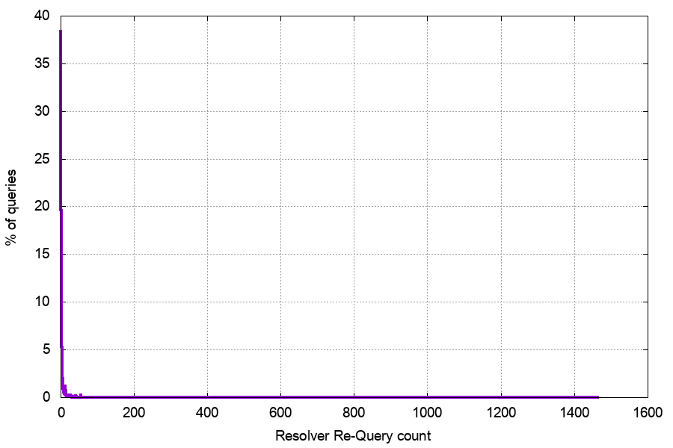
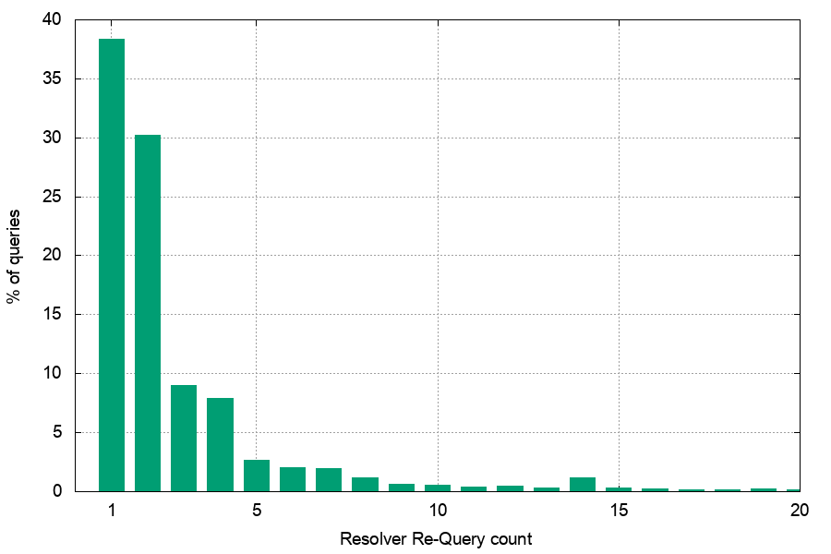
Re-query Distribution
!! Seriously????
32% of queries were parts of query sequences of 3 or more

Slide 11
Does UDP suck THAT much?
Why is the total re-query rate at 51% of tests?
Surely DNS over UDP is not THAT bad
  The servers are responding to every query
  The signed response is 603 bytes in size
  We are using a distributed setup of servers to localize DNS transactions
  So why are the servers seeing 51% of tests generate 2 or more queries?

Slide 12
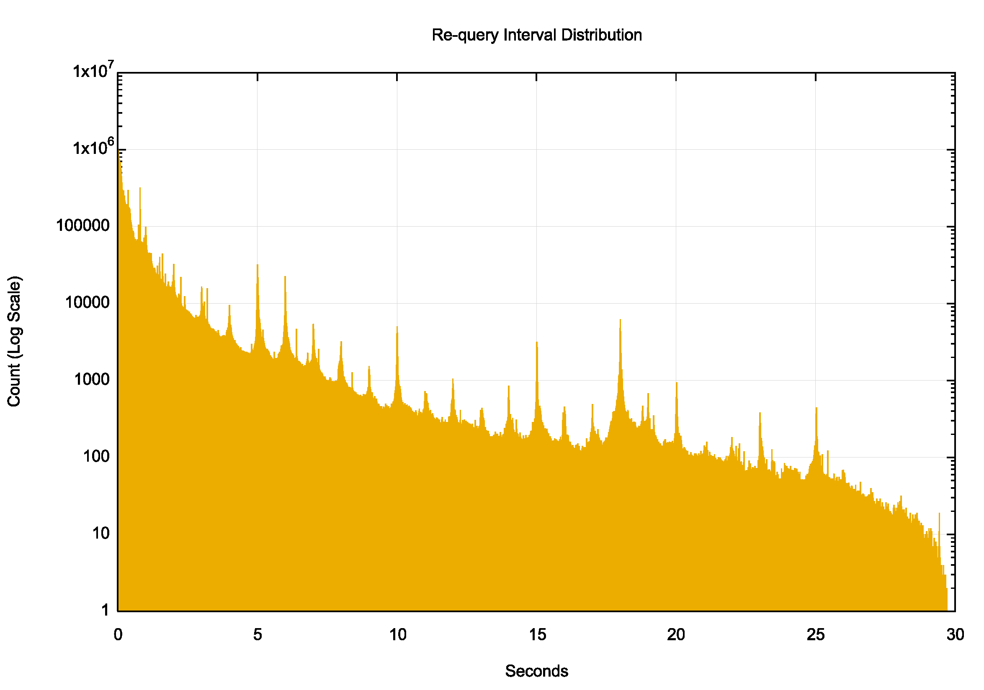
Re-Query Time Intervals
There are strong local peaks at regular 1 second intervals – this would appear to be an end host / stub resolver re-query behaviour

Slide 13
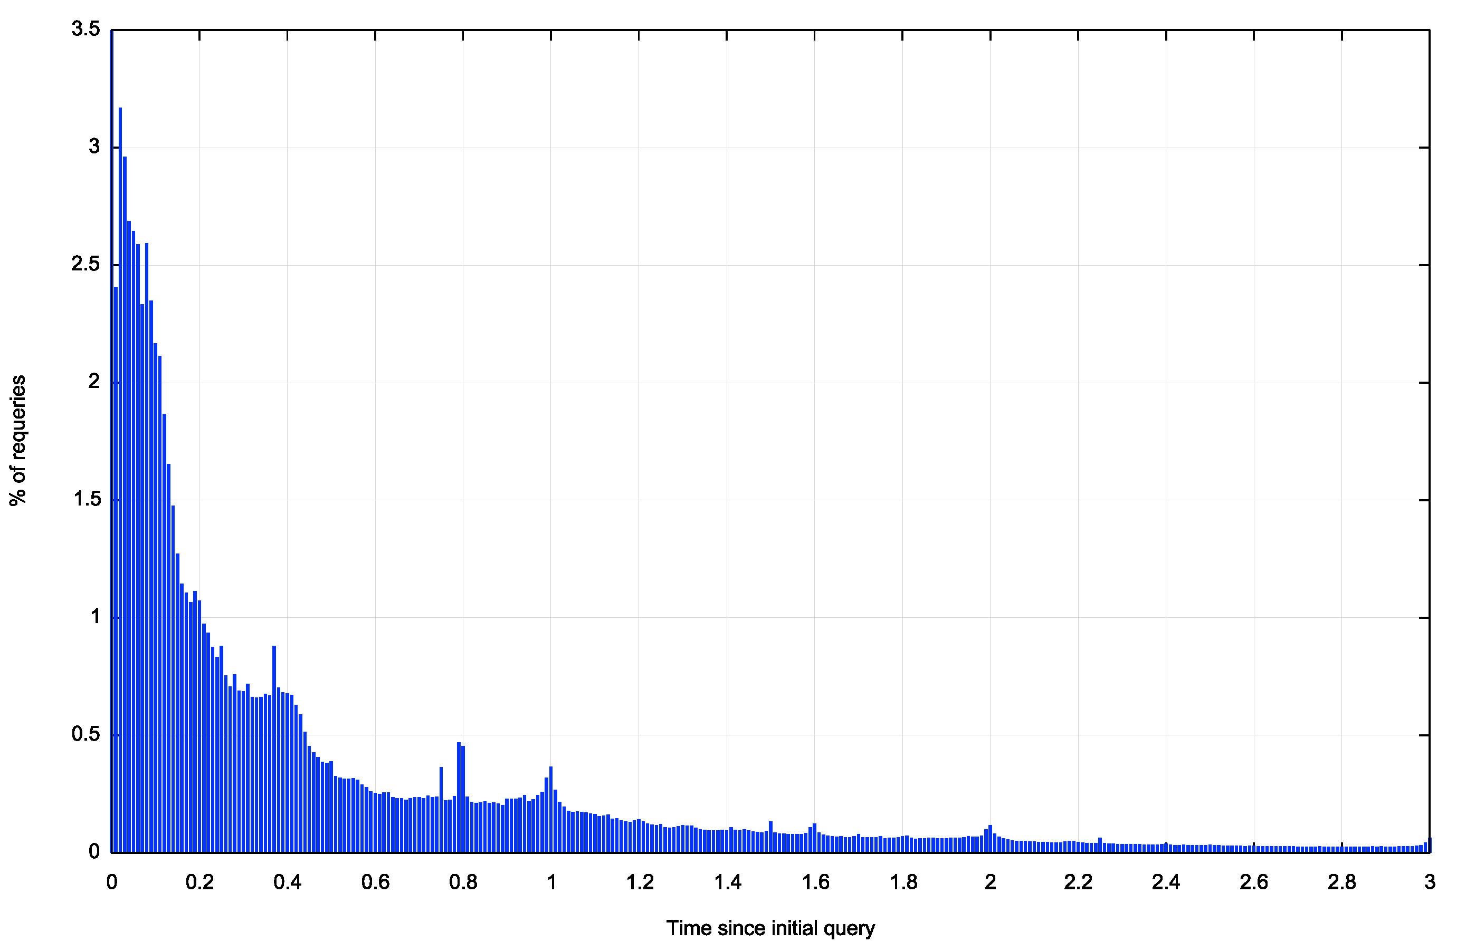
Re-Query Time Intervals
There are local re-query peaks here at 370 ms, 800ms, 1 sec and 1.5sec
It is likely that these time intervals represent stub and/or recursive resolver re-query timers
370ms
800ms
1s
1.5s

Slide 14
DNSSEC?
This is a DNSSEC-signed non-existent name
  i.e. the NXDOMAIN also has an NSEC record if DO is set in the query
Is DNSSEC a factor in the excessive re-query volume?
  i.e. is the additional time to validate causing requery timers to trigger?
We added an unsigned non-existent name to the test set

Slide 15
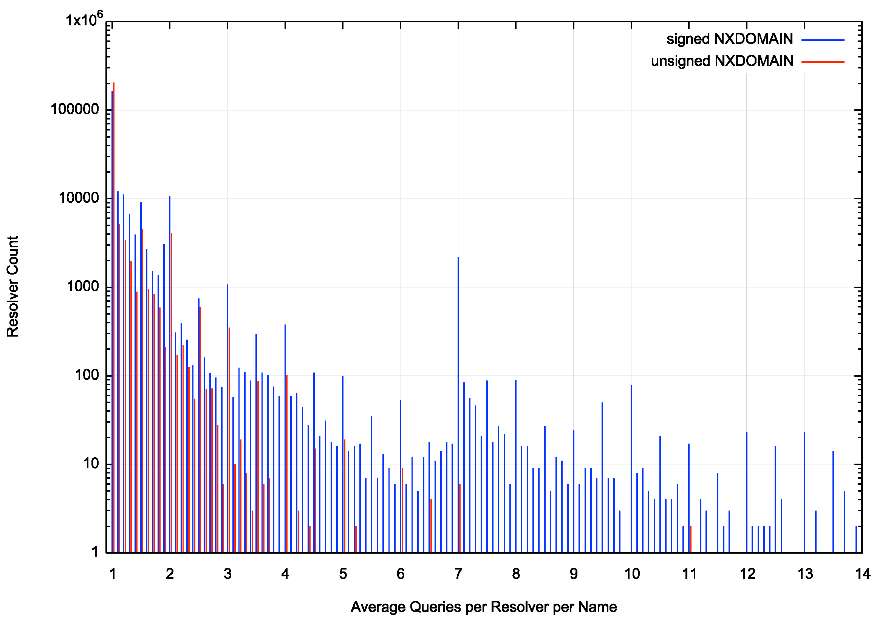
Re-Queries per resolver IP addresss
The log scale exaggerates the effect, but we observe that a DNSSEC-signed NXDOMAIN response generates a higher repeat query profile from the same resolver IP address

Slide 16
Signed vs Unsigned
Signed Unsigned
Experiments 65,686,452 69,251,349
A/AAAA 81,057,694 84,979,990
Queries 153,697,947 122,665,888
Single Query Exps 47,694,930 60,061,746
Ratio 59% 71%
Multi-Query Exps 33,092,764 24,918,244
Re-Query Rate 3.19 2.51
Split out the ‘happy eyeballs’ factor
DNSSEC validation adds delay, and in around 12% of cases this additional delay causes the resolver system to re-query the name

Slide 17
DNSSEC!
About 12% of cases of re-query for non-existent names appear to be related to recursive resolver’s DNSSEC validation of NSEC records

Slide 18
Resolver “farms”
stupid
We also see query patterns of the form:
Resolver Query Time
7x.xxx.0.178 0.752
6z.zzz.161.146 0.865
7x.xxx.0.230 0.980
6z.zzz.161.220 1.094
7x.xxx.0.188 1.201
6z.zzz.161.182 1.319
7x.xxx.0.180 1.430
6z.zzz.161.144 1.542
7x.xxx.0.226 1.650
7x.xxx.0.138 1.654
6z.zzz.161.134 1.762
6z.zzz.161.222 1.775
It appears that some resolver farms operate by farming
the query across all members of the farm. This pattern seen here shows two such cases where different IP addresses in the same subnet repeat the initial query at approximately 100ms intervals
How common is this form of subnet-based query repetition?

Slide 19
Re-query Profile
Re-queries 59,782,873
Same IP Address 17,848,729
Same Subnet 41,111,416
Wow!
Some 70% of the re-queries are from resolvers that share the same subnet prefix!!!
This points to some outstanding issues with resolver farm management

Slide 20
It may sound odd but…
Is NO worse than YES?
Is NXDOMAIN part of the issue here?
Is the re-query rate lower if the name exists in the DNS?

Slide 21
NXDOMAIN vs A/AAAA re-queries
NXDOMAIN Signed:
41% of experiments generate multiple queries
39% of queries are re-queries (avg of 3.19 queries per experiment)
A/AAAA Signed:
18% of experiments generate multiple queries
13% of queries are re-queries (avg of 5.81 queries per experiment)
NXDOMAIN Unsigned:
39% of experiments generate multiple queries
29% of queries are re-queries (avg of 2.51 queries per experiment)
A/AAAA Unsigned
38% of experiments generate multiple queries
36% of queries are re-queries (avg of 3.03 queries per experiment)
Fewer re-query events but each event has more queries!

Slide 22
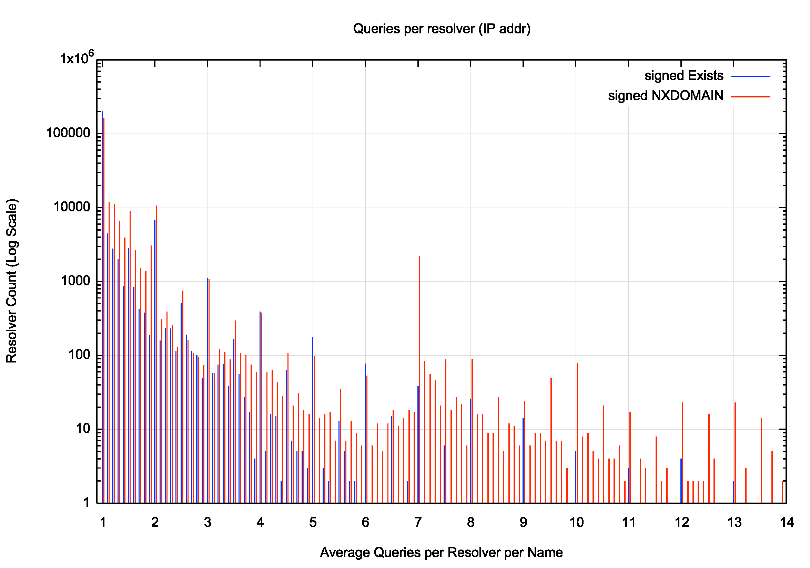
WTF?
A DNSSEC-signed NXDOMAIN response generates many more re-queries than a DNSSEC-signed A / AAAA response

Slide 23
Pulling it back together
Why are there so many DNS repeat queries?

Slide 24
Pulling it back together
Why are there so many DNS repeat queries?
  Happy Eyeballs

Slide 25
Pulling it back together
Why are there so many DNS repeat queries?
  Happy Eyeballs
  DNSSEC

Slide 26
Pulling it back together
Why are there so many DNS repeat queries?
  Happy Eyeballs
  DNSSEC
  NXDOMAIN

Slide 27
Pulling it back together
Why are there so many DNS repeat queries?
  Happy Eyeballs
  DNSSEC
  NXDOMAIN
  stupidity down on the farm

Slide 28
Pulling it back together
Why are there so many DNS repeat queries?
  Happy Eyeballs
  DNSSEC
  NXDOMAIN
  Stupidity down on the farm
  <reasons>

Slide 29
Thanks!

