Slide 1
DNS Privacy
(or not!)
Geoff Huston
APNIC

Slide 2
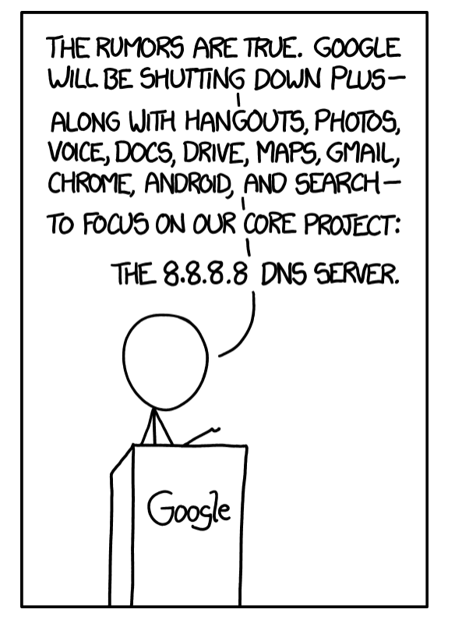
https://xkcd.com/1361/

Slide 3
Why?
Because everything you do on the net starts with a call to the DNS
If we could see your stream of queries in real time we could assemble a detailed profile of you and interests and activities
Do we have any evidence of DNS data mining?
  Data miners don’t disclose their sources as a rule
How about something related:
  Do we have any evidence of DNS stalking?

Slide 4
What if…
I gave you an absolutely unique name to resolve:
  The name never existed before now
  The name will never be used again
  The name includes the time when the name was created
If I am the authoritative server for the name’s zone then I should see your efforts to resolve the name
Then I should never see the name as a resolution query ever again
  Unless you have attracted a digital stalker who performs re-queries of your DNS names!

Slide 5
What if DNS queries contained usable information?
06s-0640-uedb11641-c13-s1565985257-i0a000001-0.ap.dotnxdomain.net
The querier is at 10.0.0.1
The DNS label creation time is 1565985257
Querier is geolocated to Australia
Then we could distinguish between the initial query and various re-query events!

Slide 6
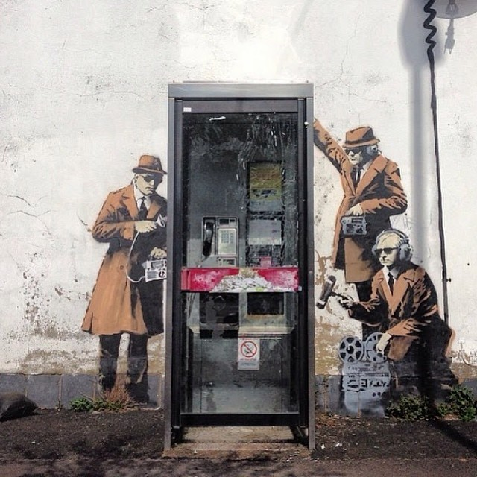

Slide 7
DNS Re-query Rate
Over the past 30 days, some 5% of users have some kind of DNS stalker that is asking the same query more than 30 seconds after the initial query
Only some of these could be explained by incredibly slow DNS resolver systems
Daily Counts
Daily Ratios

Slide 8
DNS Stalking
There are two kinds of DNS stalkers
  Rapid tracking stalkers that appear to track users in real time
  Bulk replay stalkers that replay DNS queries at a very high rate in bursts

Slide 9
DNS Stalking by Query Age
DNS Stalking uses both really recent data and more than year-old data!
Real time stalking
Log replay stalking

Slide 10
DNS Surveillance
The DNS appears to be used by many actors as a means of looking at what we do online and censoring what services we can access online

Slide 11
Top Stalker Subnets
Rank IP Net Count AVG Delay AS Description
1 119.147.146.0 339,855 122.6 4134 CHINANET-BACKBONE No.31,Jin-rong Street,CN
2 101.226.33.0 53,181 1,502.2 4812 CHINANET-SH-AP China Telecom (Group),CN
3 180.153.206.0 51,592 1,528.0 4812 CHINANET-SH-AP China Telecom (Group),CN
4 112.64.235.0 33,067 1,470.8 17621 CNCGROUP-SH China Unicom Shanghai network,CN
5 180.153.214.0 32,954 1,468.4 4812 CHINANET-SH-AP China Telecom (Group),CN
6 101.226.66.0 30,863 1,499.3 4812 CHINANET-SH-AP China Telecom (Group),CN
7 180.153.163.0 23,941 1,515.0 4812 CHINANET-SH-AP China Telecom (Group),CN
8 180.153.201.0 22,673 1,562.2 4812 CHINANET-SH-AP China Telecom (Group),CN
9 101.226.89.0 19,337 1,426.4 4812 CHINANET-SH-AP China Telecom (Group),CN
10 221.176.4.0 14,019 855.7 9808 CMNET-GD Guangdong Mobile Communication Co.Ltd.,CN
11 101.226.65.0 13,604 1,519.9 4812 CHINANET-SH-AP China Telecom (Group),CN
12 101.226.51.0 10,226 1,490.8 4812 CHINANET-SH-AP China Telecom (Group),CN
13 112.65.193.0 8,619 1,555.5 17621 CNCGROUP-SH China Unicom Shanghai network,CN
14 66.249.93.0 8,306 31,355.1 15169 GOOGLE - Google Inc.,US
15 180.153.205.0 6,816 1,557.0 4812 CHINANET-SH-AP China Telecom (Group),CN
16 180.153.114.0 6,796 1,550.6 4812 CHINANET-SH-AP China Telecom (Group),CN
17 69.41.14.0 5,724 810.0 47018 CE-BGPAC - Covenant Eyes, Inc.,US
18 66.249.81.0 5,218 38,095.9 15169 GOOGLE - Google Inc.,US
19 66.249.88.0 4,817 31,119.7 15169 GOOGLE - Google Inc.,US
20 66.249.80.0 4,685 24,641.1 15169 GOOGLE - Google Inc.,US
21 222.73.77.0 4,471 1,398.5 4812 CHINANET-SH-AP China Telecom (Group),CN
22 180.153.161.0 4,352 1,470.3 4812 CHINANET-SH-AP China Telecom (Group),CN
23 180.153.211.0 4,271 1,520.9 4812 CHINANET-SH-AP China Telecom (Group),CN
24 66.249.85.0 3,774 23,607.7 15169 GOOGLE - Google Inc.,US
25 93.186.23.0 3,707 37.3 18705 RIMBLACKBERRY - Research In Motion Limited,CA

Slide 12

Street Art: Banksy

Slide 13
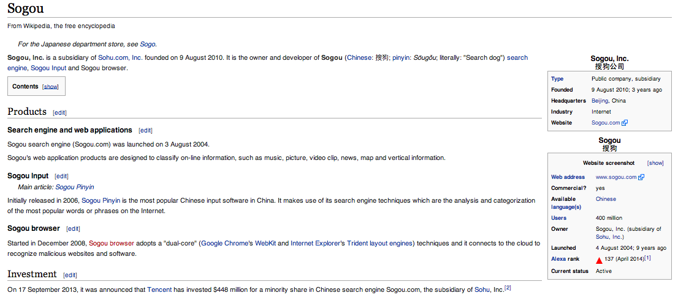
Top 25 User Agent Strings of the stalked systems
6,068 Mozilla/5.0 (Windows NT 5.1) AppleWebKit/537.36 (KHTML, like Gecko) Chrome/28.0.1500.95 Safari/537.36 SE 2.X MetaSr 1.0
5,458 Mozilla/5.0 (Windows NT 6.1; WOW64) AppleWebKit/537.36 (KHTML, like Gecko) Chrome/28.0.1500.95 Safari/537.36 SE 2.X MetaSr 1.0
5,389 Mozilla/5.0 (Windows NT 6.1; WOW64) AppleWebKit/537.36 (KHTML, like Gecko) Chrome/33.0.1750.154 Safari/537.36
5,029 Mozilla/5.0 (Windows NT 6.1; WOW64) AppleWebKit/537.36 (KHTML, like Gecko) Chrome/32.0.1700.107 Safari/537.36
4,669 Mozilla/5.0 (Windows NT 6.1) AppleWebKit/537.36 (KHTML, like Gecko) Chrome/28.0.1500.95 Safari/537.36 SE 2.X MetaSr 1.0
Sogou Explorer 2.X
“It connects to the cloud to recognize malicious websites and software”

Slide 14
This data set is just a tiny glimpse into the overall pattern of web activity

Slide 15
DNS Surveillance
Can we stop DNS surveillance completely?
  Probably not!
Can we make it harder to collect individual profiles of activity?
  Well, yes
  And that’s what I want to talk about today

Slide 16
The DNS Privacy Issue
Lots of actors get to see what I do in the DNS
  My platform
  My ISP’s recursive resolver
  Their forwarding resolver, if they have one
  Authoritative Name servers
  Snoopers on the wire
Can we make it harder for these “others” to snoop on me?

Slide 17
How we might think the DNS works
Client
DNS Resolver
DNS Server

Slide 18
What we suspect the DNS is like
DNS Resolver
DNS Resolver
DNS Resolver
DNS Resolver
DNS Resolver
Client
DNS Resolver
DNS Server
DNS Resolver
DNS Resolver
DNS Resolver
DNS Resolver
DNS Resolver
DNS Resolver
DNS Resolver
DNS Resolver
DNS Resolver
DNS Resolver
DNS Resolver
DNS Resolver
DNS Resolver

Slide 19

What we suspect the DNS is like
Client
DNS Resolver
DNS Server
Servers that leak queries
DNS Resolver
DNS Resolver
Corrupted host platforms
DNS Resolver
Wireline and middleware
Inspection and interception
DNS Resolver
DNS Resolver
DNS Resolver
DNS Resolver
Resolvers that leak queries
DNS Resolver
DNS Resolver
DNS Resolver
DNS Resolver
DNS Resolver

Slide 20
Why pick on the DNS?
The DNS is very easy to tap
  Its open and unencrypted
DNS traffic is easy to tamper with
  Its payload is not secured and tampering cannot be detected
  Its predictable and false answers can be readily inserted
The DNS is hard for users to trace
  Noone knows exactly where their queries go
  Noone can know precisely where their answers come from
The DNS is used by everyone

Slide 21
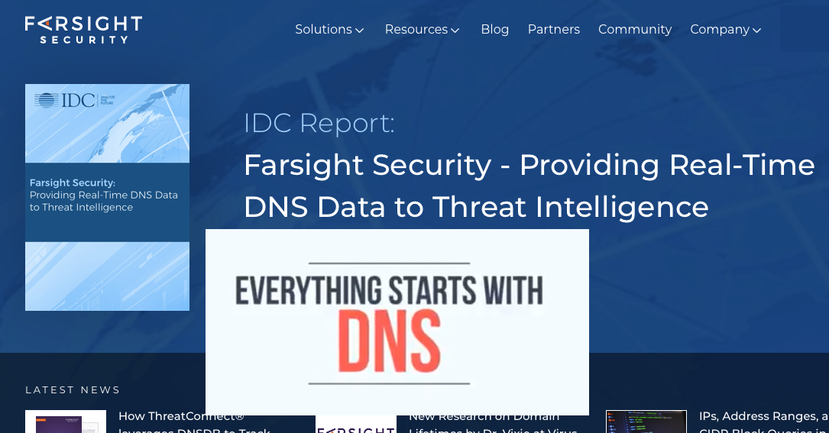
Second-hand DNS queries are a business opportunity these days

Slide 22
How can we improve DNS Privacy?
Lets look at a few behaviours of the DNS and see what we are doing to try and improve its privacy properties

Slide 23
1. The DNS is overly chatty
The DNS uses the full query name to discover the identity of the name servers for the query name
  Hi root server, I want to resolve the A record for www.example.com
  Not me – try asking the servers for .com
  Hi .com server, I want to resolve the A record for www.example.com
  Not me – try asking the servers for example.com
  Hi example.com server, I want to resolve the A record for www.example.com
  Sure – its 93.184.216.34

Slide 24
The DNS is overly chatty
The DNS uses the full query name to discover the identity of the name servers for the query name
  Why are we telling root servers all our DNS secrets?
  In our example case, both a root server and a .com server now know that I am attempting to resolve the name www.example.com
  Maybe I don’t want them to know this

Slide 25
The DNS is overly chatty
Is there an alternative approach to name server discovery that strips the query name in iterative search for a zone’s servers?
  Yes – the extra information was inserted into the query to make the protocol simpler and slightly more efficient in some cases
  But we can alter query behaviour to only expose as much as is necessary to the folk who need to know in order to answer the query

Slide 26
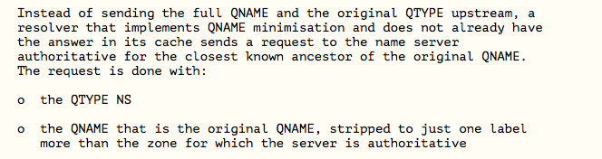
QNAME Minimisation
A resolver technique intended to improve DNS privacy where a DNS resolver no longer sends the entire original query name to the upstream name server
Described in RFC 7816

Slide 27
Example of QNAME Minimisation
Ask the authoritative server for a zone for the NS records of the next zone:
  Hi Root server, I want to know the nameservers for com
  That’s a delegated zone, so here are the servers for .com
  Hi .com server, I want to know the nameservers for example.com
  That’s a delegated zone, so here are the servers for example.com
  Hi example.com server, I want to resolve the A record for www.example.com
  Sure – its 93.184.216.34

Slide 28
Example of QNAME Minimisation
Ask the authoritative server for a zone for the NS records of the next zone:
  Hi Root server, I want to know the nameservers for com
  That’s a delegated zone, so here are the servers for .com
  Hi .com server, I want to know the nameservers for example.com
  That’s a delegated zone, so here are the servers for example.com
  Hi example.com server, I want to resolve the A record for www.example.com
  Sure – its 93.184.216.34
It’s a good idea, but only some 3% of users have their queries protected in this way today

Slide 29
2. Interception and Rewriting
The DNS is an easy target for the imposition of control over access
  Try asking for www.thepiratebay.org in Australia
  Try asking for www.facebook.com in China
  Etc, etc
These days interception systems typically offer an incorrect response
How can you tell if the answer that the DNS gives you is the genuine answer or not?

Slide 30
DNSSEC
DNSSEC is defined in RFCs 4033, 4034 & 4035
  Adds a number of new RRtypes that allow a digital signature to be attached to RRsets in a zone and to define how keys that are used to generate signatures are also stored in the zone
DNSSEC validation of the DNS response can tell you if the response is genuine or if it is out of date or has been altered
DNSSEC can’t tell you what the “good” answer is, just that the answer you got was not it!
DNSSEC will also tell if is an NXDOMAIN response is authentic

Slide 31
DNSSEC and Recursive Resolvers
A DNS response that has been modified will fail to validate.
  When:
    a client asks a security-aware resolver to resolve a name, and
    sets the EDNS(0) DNSSEC OK bit, and
    the zone is DNSSEC-signed
  then the recursive resolver will only return a RRset for the query if it can validate the response using the attached digital signature
  It will set the AD bit in the resolver response to indicate validation success
  Otherwise it will return SERVFAIL
But SERVFAIL is not the same as “I smell tampering”
Its ”nope, I failed. Try another resolver”

Slide 32
DNSSEC and Recursive Resolvers
If you are going to use a DNSSEC-validating recursive resolver
  Such as 1.1.1.1, 8.8.8.8, 9.9.9.9 or any other validating open resolver
Then make sure that all your resolvers perform DNSSEC validation if you don’t want to be mislead
  Because SERVFAIL from a validating resolver means “try the next resolver in your resolver list”

Slide 33
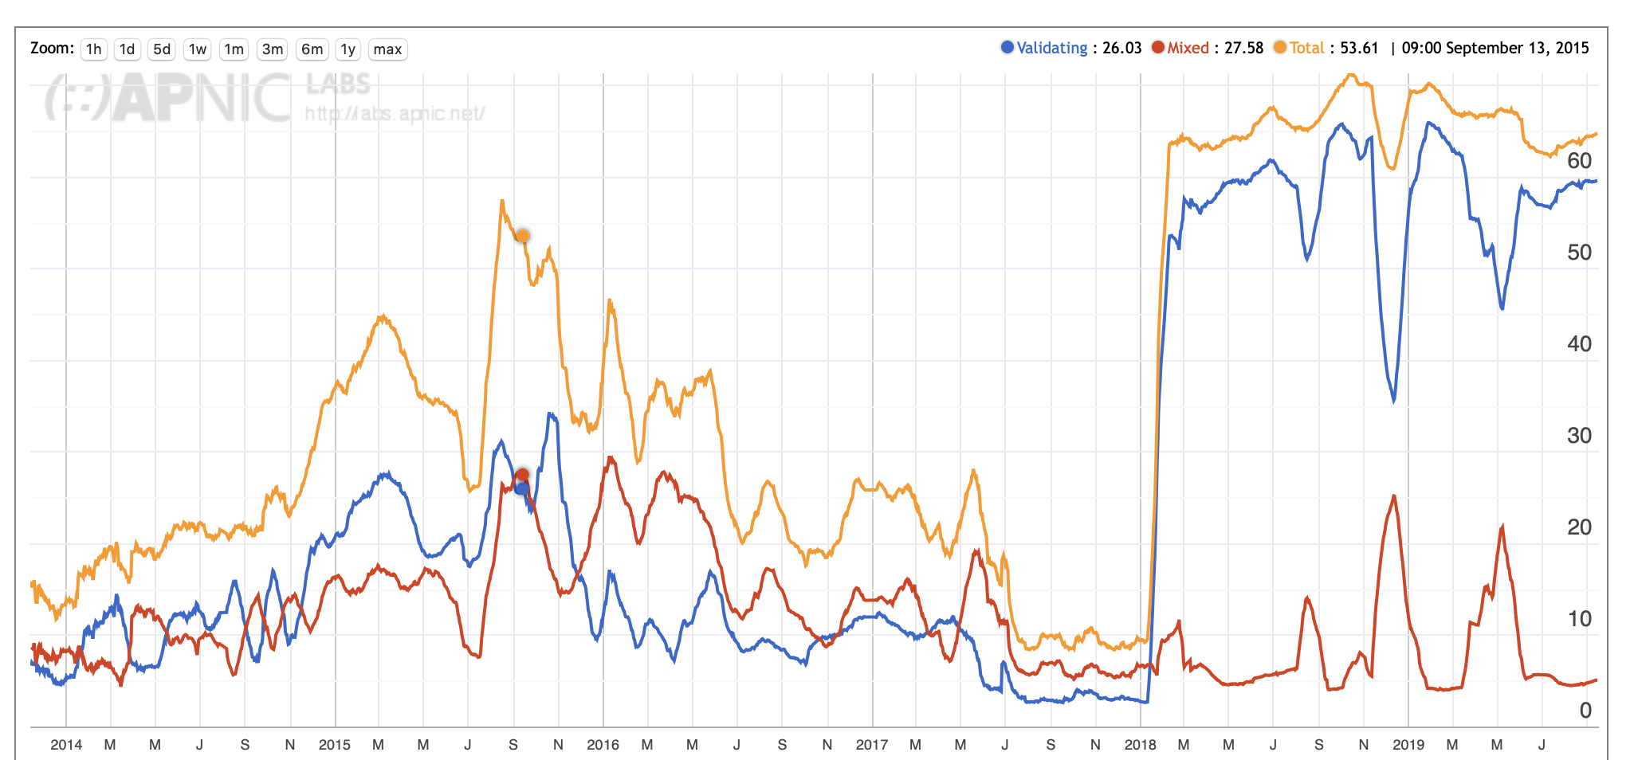
DNSSEC in Mongolia

Slide 34
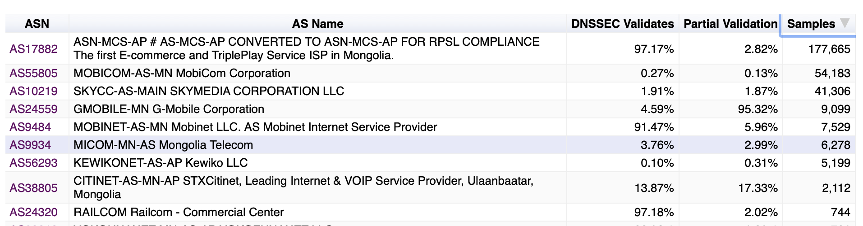
DNSSEC in Mongolia

Slide 35
3. Middleware and WireTapping
Protecting the content of DNS responses is part of what we need to make the DNS more robust
If we want to prevent DNS inspection we also should look at encrypting the transport used by DNS queries and responses
Today the standard tool is TLS, which uses dynamically generated session keys to encrypt all traffic between two parties
We could use TLS between the end client and the client’s recursive resolver
  It’s more challenging to use encryption between recursive resolvers and authoritative servers

Slide 36
DNS over TLS
TLS is a TCP ‘overlay’ that adds server authentication and session encryption to TCP
TLS uses an initial handshake to allow a client to:
  Validate the identity of the server
  Negotiate a session key to be used in all subsequent packets in the TCP session
RFC 7858, RFC 8310
TLS 1.2 handshake

Slide 37
DNS over TLS
Similar to DNS over TCP:
  Open a TLS session with a recursive resolver
  Pass the DNS query using DNS wireline format
  Wait for the response
Can use held DNS sessions to allow the TLS session to be used for multiple DNS queries
The queries and the responses are hidden from intermediaries
The client validates the recursive resolver’s identity

Slide 38
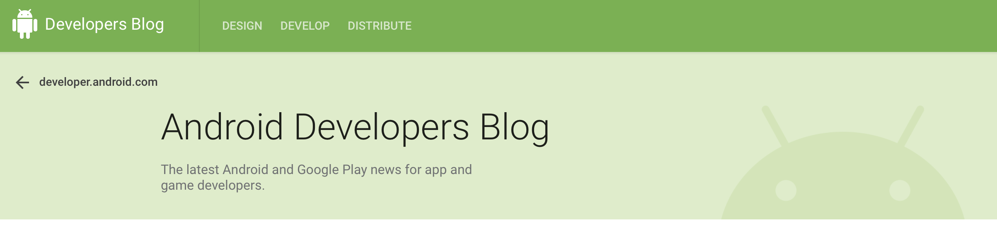
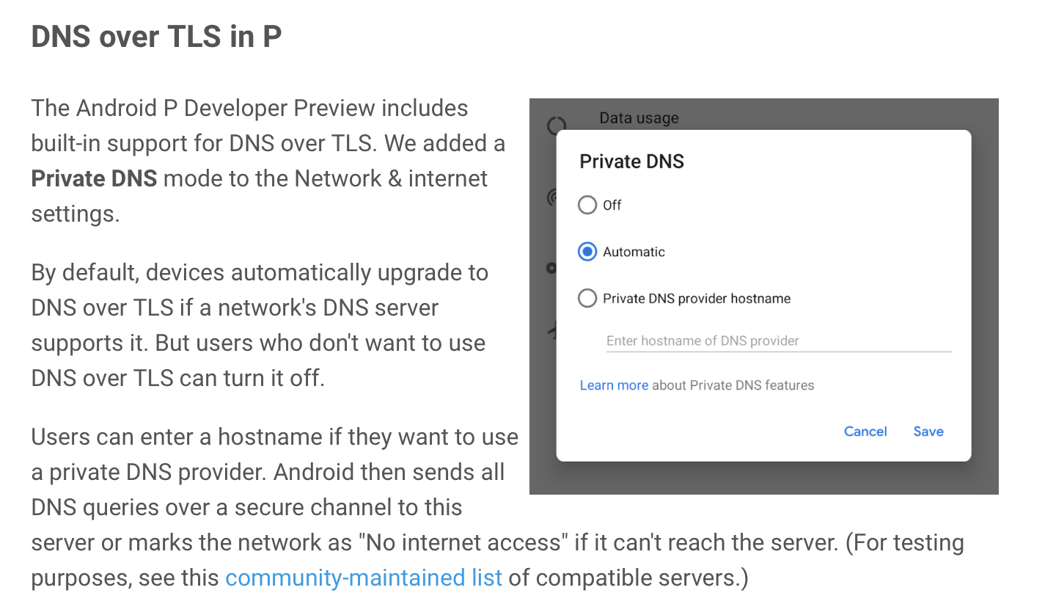
DNS over TLS and Android
https://android-developers.googleblog.com/2018/04/dns-over-tls-support-in-android-p.html

Slide 39
DNS over TLS
Will generate a higher recursive resolver memory load as each client may have a held state with one or more recursive resolvers
The TCP session state is on port 853
  DNS over TLS can be readily blocked by middleware
The privacy is relative, as the recursive resolver still knows all your DNS queries
Supported by Bind (stunnel), Unbound, DNSDist

Slide 40
DNS over QUIC
QUIC is a transport protocol originally developed by Google and passed over to the IETF for standardised profile development
QUIC uses a thin UDP shim and an encrypted payload
  The payload is divided into a TCP-like transport header and a payload
The essential difference between DOT and DOQ is the deliberate hiding of the transport protocol from network middleware with the use of QUIC
No known implementations of DNS over QUIC exist, though IETF work continues
draft-huitema-quic-dns-quic-06
DOT
DOQ
DNS
DNS
TLS
QUIC
TCP
UDP
IP
IP

Slide 41
DoH - DNS over HTTPS
DNS over HTTPS
Uses an HTTPS session with a resolver
Similar to DNS over TLS, but with HTTP object semantics
Uses TCP port 443, so can be masked within other HTTPS traffic
Can use DNS wire format or JSON format DNS payload

Slide 42
DoH - DNS within the Browser
Firefox’s “Trusted Recursive Resolver”
Avoids using the local DNS resolver library and local DNS infrastructure
Has the browser sending its DNS queries directly to a trusted resolver over HTTPS
Servers available from Cloudflare, Google, CleanBrowsing

Slide 43
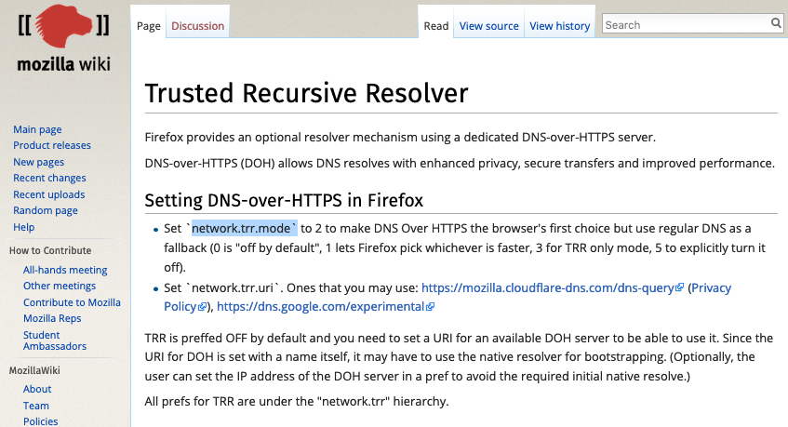
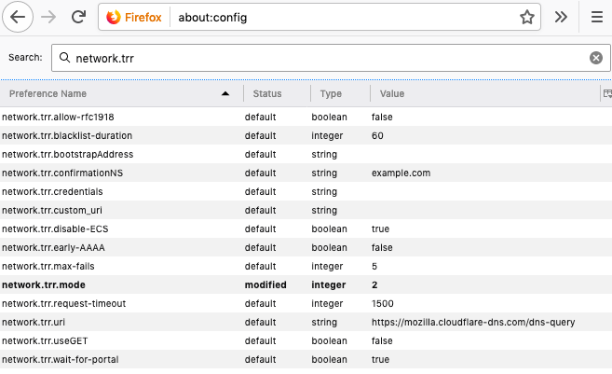
DoH - DNS within the Browser

Slide 44
5. EDNS(0) Client Subnet
There is a current debate between CDN operators that rely on customized DNS responses to perform content steering, and the use of large scale open resolvers that so not necessarily preserve locality
The result is that the CDN operators wanted the client’s subnet embedded in the query to ensure that the CDN could provide enhanced content steering for the client
This has raised a number of concerns about DNS privacy
There is a forming consensus that Client Subnet has been a step too far in terms of potential privacy leakage into the DNS

Slide 45
Hiding in the Crowd
What if you use an encrypted session to a very busy open resolver?
  No third party can see you queries to the open resolver
  Noone else can see the responses from the open resolver
  The open resolver asks the authoritative servers which makes it challenging to map the query back to the end user
  So if you you are prepared to trust Goolge, Open DNS, Cloudflare, Quad9 with your DNS then its far harder for anyone else to see you
    But that is a very large amount of trust you are investing here!

Slide 46
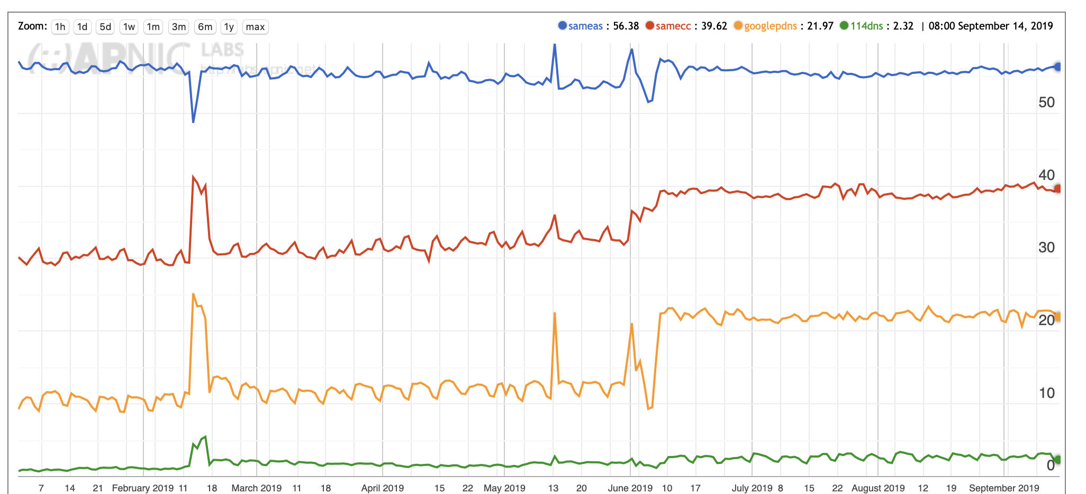
Hiding in the crowd
Internet Measurements
Only 55% of the world’s users use their local ISP’s DNS service
39% of users use in-country DNS resolvers
20% of the world’s users use Google’s public DNS

Slide 47
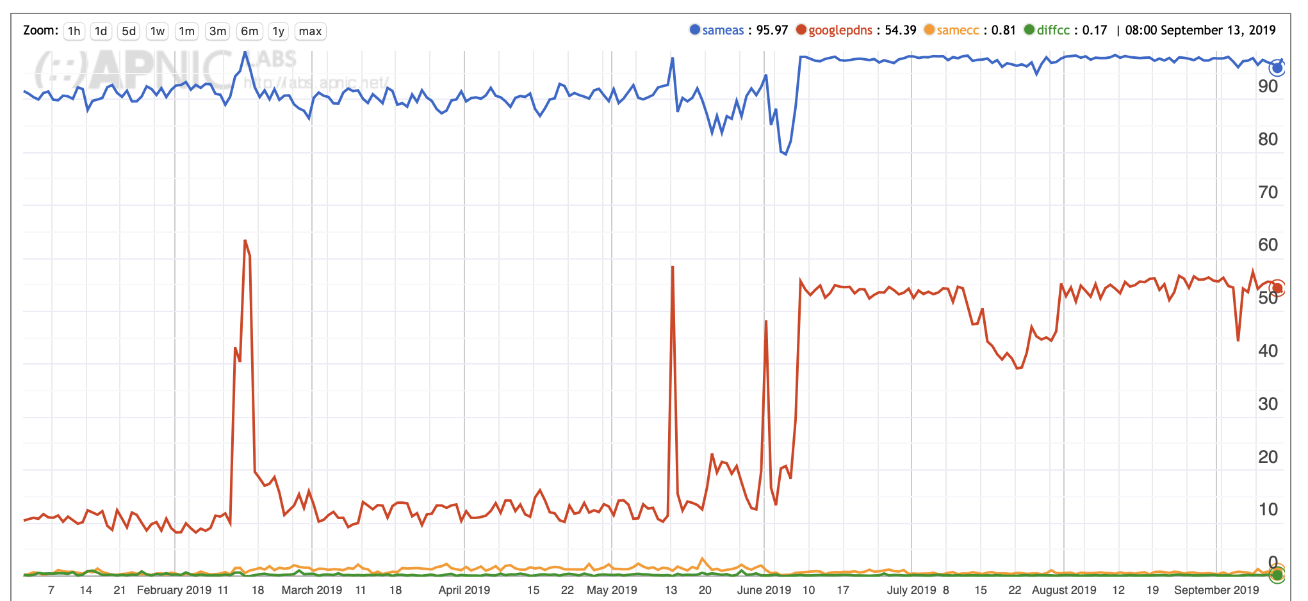
Hiding in the crowd
Mongolian Measurements
97% of the Mongolian users use their local ISP’s DNS service
51% of Mongolians list Google’s public DNS
as a backup resolver

Slide 48
Choose your resolver carefully
The careful choice of an open recursive resolver and an encrypted DNS session will go a long way along the path of DNS privacy
But the compromise is that you are sharing your activity profile with the recursive resolver operator

Slide 49
My (current) DNS Config
I use DNS over HTTPS
  I have configured Cloudflare’s Cloudflared * to listen of localhost:53
  I have set up my local /etc/resolv.conf to contain 127.0.0.1
  All my DNS queries leave my laptop in an HTTPS port 443 stream towards 1.1.1.1
* https://developers.cloudflare.com/1.1.1.1/dns-over-https/cloudflared-proxy/

Slide 50
Thanks!

