Slide 1
D*
(DNS, and DNSSEC and DDOS)
Geoff Huston
APNIC

Slide 2

How to be bad

Slide 3
How to be bad
Host and application-based exploits abound
  And are not going away anytime soon!
And there are attacks on the Internet infrastructure itself
  These attacks don’t compromise a service, but are intended to totally overwhelm the service or the local network such that nothing works!

Slide 4
How to be bad
SYN
TCP-based DDOS attacks:
  TCP SYN flooding attacks
    Try and exhaust the server’s resources by saturating the server with TCP SYN packets
    Can be circumvented at the server with the use of SYN cookies
This attack was effective when servers allocated memory for a TCP process control block upon receipt of the first TCP SYN packet.
SYN cookies change the server behaviour to pass the initial server state to connecting client within the initial TCP sequence number, and no state is retained on the server.

Slide 5
How to be badder
SYN
SYN+ACK
TCP-based DDOS attacks:
  TCP SYN/ACK reflection attacks
    Use a spoofed source address in the initial SYN packet
    The server’s SYN/ACK response will be directed to the victim’s address
    This has limited attack leverage because the SYN and SYN/ACK packets are the same length
    SYN/ACK packets do not reserve state at the victim– they normally just generate a RST, if anything at all
    Widespread use of BCP38 filters would limit the extent to which course address spoofing is possible
Reflection attacks without amplification are of limited use!

Slide 6
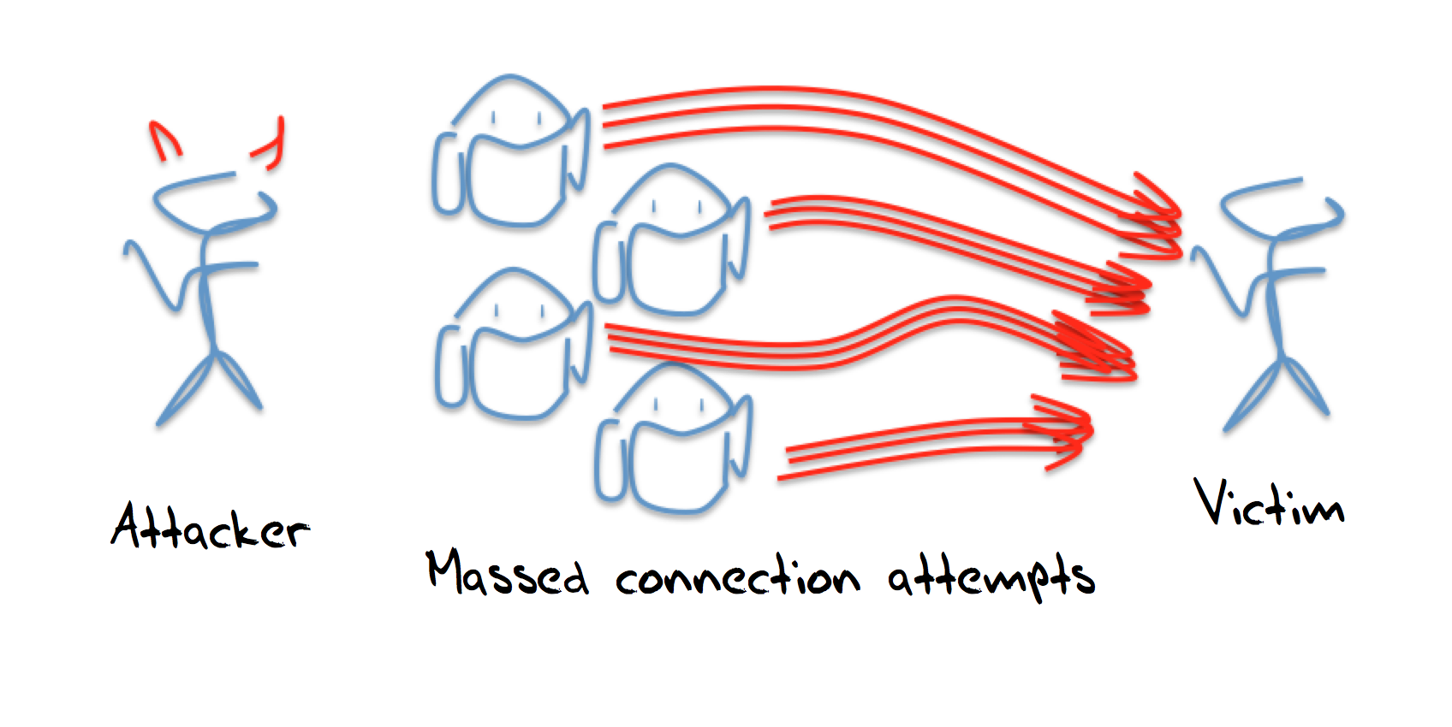
How to be more bad
UDP-based DDOS attacks:
  UDP is far easier to use for a DDOS attack
  Use a bot army to send UDP packets directly to a UDP-based server
  Or use spoofed sources to generate a reflection / amplification attack
  There are a number of cases in UDP applications where the response can be far larger than the query:
    SNMP, NTP, chargen, finger, DNS
  Reflection/Amplification attacks can transform a small query UDP stream into a massive response stream
This has far more potential than TCP-based attacks!

Slide 7
How to be most bad
UDP-based DDOS attacks:
  If you are going to use UDP then the DNS is the obvious weapon of choice:
    Highly suitable for amplification attacks
    Universally supported, and often permitted through firewalls
    Promiscuous servers that will attempt to respond to every query
    Individual responses are readily discarded by the victim, so the attack is useful only effective in very high volume – the attack is a form of resource starvation of the network in the region around the victim
In this case the victim is usually a DNS name server

Slide 8
Don’t overthink it!
Attacks don’t need to extent any more effort than necessary
Simple attack forms are more effective than complex ones
  Code injection is complex – so even source address spoofing is harder to install on enlisted bots than simple scripted commands
  Attacks will stick to simple scripted commands where possible – it’s a whole lot easier than pulling in an extended hack library for a bunch of potential platforms
Do what ‘normal’ traffic does
  That way there is no clear signal of an attack traffic profile

Slide 9
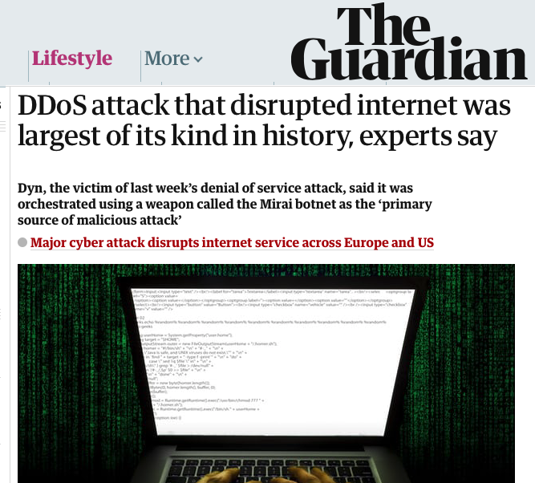
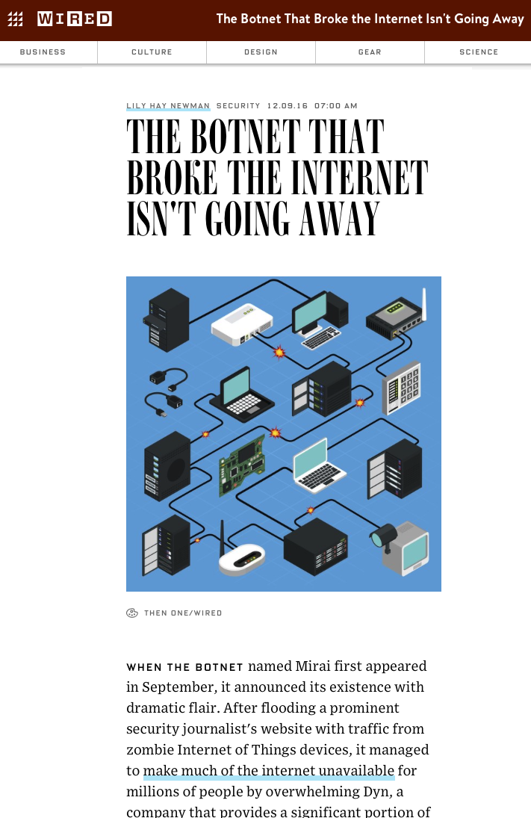
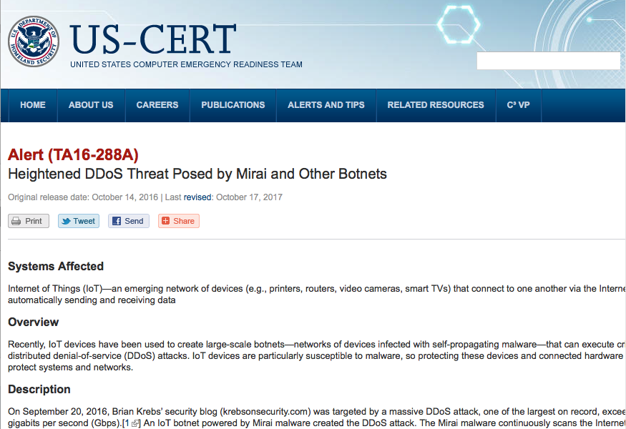
Simple Works!

Slide 10
The DNS
If you want to cause maximal impact then attacking the DNS is a logical choice
Every application uses the DNS
It is want to disrupt users and the apps that they run then you need to turn to the DNS and try and disrupt the DNS
If you want to be maximally ambitious, then attack the root itself
Why would one attack the root of the DNS?

Slide 11
Resolving a DNS Name
Your resolver needs need to ask a DNS server for the zone that contains the terminal label for the associated information (resource record) associated with the DNS name
But…
  Where exactly is the zone cut?
  Who are the servers?
Resolvers discover this information by performing a top-down iterative search…

Slide 12
How to be bad
Every DNS resolution procedure starts with a query to the root!
If an attacker could prevent the root servers from answering DNS queries then the entire Internet will suffer!

Slide 13
It’s no surprise that the DNS Root Servers are a highly visible attack target

Slide 14
It’s no surprise that the DNS Root Servers are a highly visible attack target
If you can prevent resolvers from getting answers from the root then the resolvers will stop answering all queries as their local cache expires

Slide 15
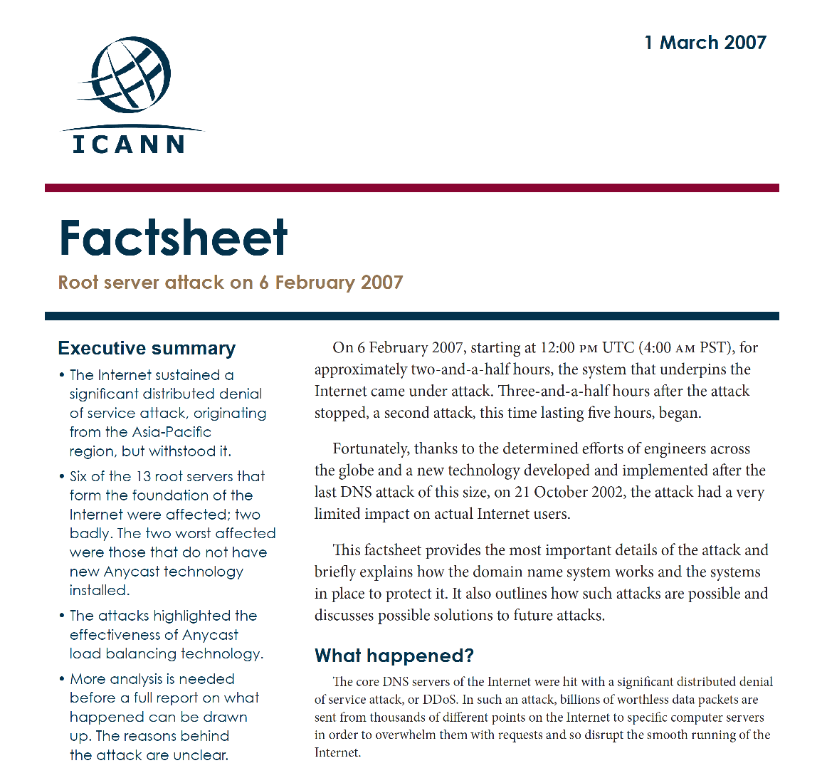
It’s no surprise that the DNS Root Servers are a highly visible attack target
If you can prevent resolvers from getting answers from the root then the resolvers will stop answering all queries as their local cache expires

Slide 16
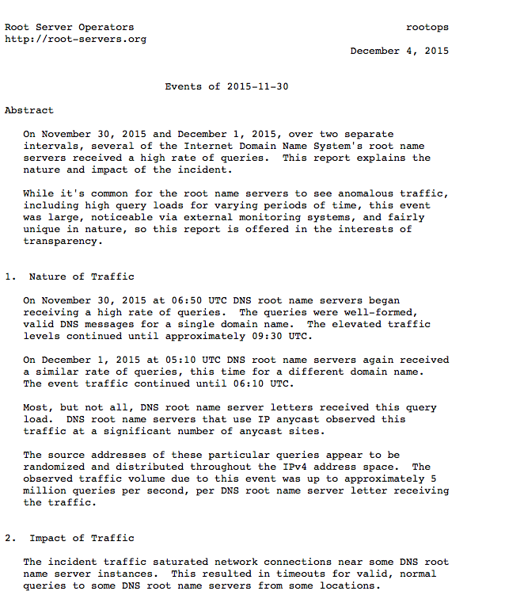
It’s no surprise that the DNS Root Servers are a highly visible attack target
If you can prevent resolvers from getting answers from the root then the resolvers will stop answering all queries as their local cache expires

Slide 17
Caching in the DNS
The main role of the DNS server system is to answer queries that are not cached in local name caches
If it wasn’t for caching the DNS would not be here today!

Slide 18
How to be bad
To attack a name’s servers you need to get past DNS resolvers’ caches.
This means you need to have every query in the DNS attack flow ask for a different non-existent name
So how can we defend ourselves from attack?

Slide 19
How should we defend the DNS?
Larger Server platforms?
More Authoritative Servers?
More Anycast Instances?
Change Server response behaviours?
Or…

Slide 20
How should we defend the DNS?
Can’t scale *
Larger Server platforms?
More Authoritative Servers?
More Anycast Instances?
Change Server response behaviours?
Or…
* Distributed parallel attacks can scale up in intensity more effectively than a single point of service can scale its defence mechanisms

Slide 21
How should we defend the DNS?
Can’t scale *
Larger Server platforms?
More Authoritative Servers?
More Anycast Instances?
Change Server response behaviours?
Or…
Err, umm – well no *
Longer lists of servers for a name make name resolution slower, not faster. So its probably a bad idea

Slide 22
How should we defend the DNS?
Can’t scale *
Larger Server platforms?
More Authoritative Servers?
More Anycast Instances?
Change Server response behaviours?
Or…
Err, umm – well no *
Today’s practice for many hosted
DNS servers

Slide 23
How do we defend the DNS today?
As the traffic levels to DNS servers increases both as steady state query levels and instances of attacks, we keep on adding more instances to the existing anycast clouds and spend more money on deploying larger and more distributed servers

Slide 24

The attacks get bigger

Slide 25


Our defence is to build bigger walls!

Slide 26

But the attackers are our own recursive resolvers!
We are scaling the DNS root server infrastructure in order to be resilient against floods of queries about non-existent random names coming from the existing DNS resolvers, who are scaling their own capabilities to survive the very same query attacks that are being directed against them!

Slide 27
How do we defend the DNS today?
As the traffic levels to DNS servers increases both as steady state query levels and instances of attacks, we keep on adding more instances to the existing anycast clouds and spend more money on deploying larger and more distributed servers
What we are in effect doing is building ever bigger and larger trash processors to handle ever larger amounts of garbage queries to cope with ever larger attacks via the DNS!

Slide 28
How do we defend the DNS today?
Can we jump out of this vicious cycle?
Can we change the behaviour of the DNS system to improve both its service and its resilience?

Slide 29
DNSSEC changes Everything
Before DNSSEC we relied on the assumption that if we asked an IP address of a root server, then the response was genuine
With DNSSEC we can ask anyone, and then use DNSSEC validation to assure ourselves that the answer is genuine
How can we use this?

Slide 30
Caching NXDOMAIN
If we could answer NXDOMAIN queries from recursive resolvers we could reduce the load on the DNS servers
For the root zone we’ve measured this to be close to 70%
NXDOMAIN would be a very significant win:
  reducing root query traffic
  providing faster response to these queries
  reduces the local cache load on recursive resolvers

Slide 31
NSEC caching – RFC 8198
A DNSSEC-signed NXDOMAIN response actually describes a range of labels that do not exist, and it’s the range that is signed, not the actual query name
If resolvers cached this range and the signed response, then they can use the same signed response to locally answer a query for any name that falls within the same label range

Slide 32
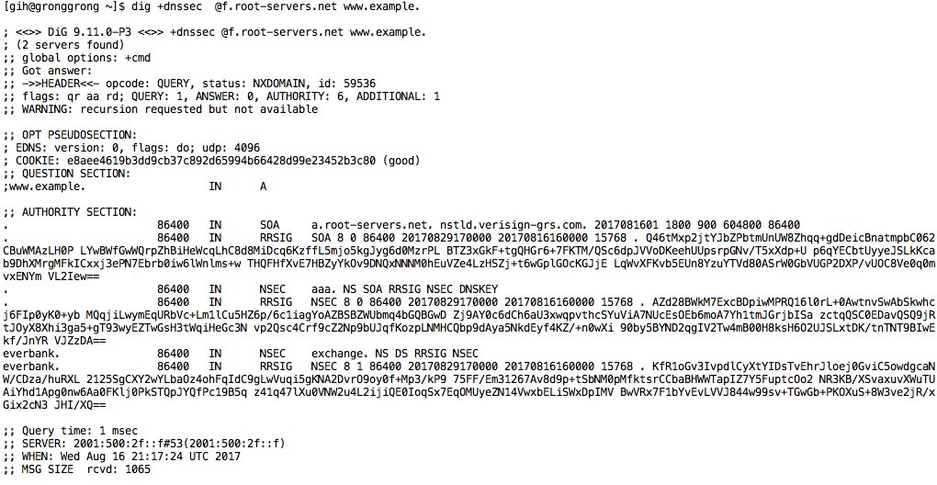
NSEC caching
For example, if you were to query the root server for the non-existant name www.example. the returned response from the root says that there are NO TLDS between everbank. and exchange.
The same response can be used to respond to queries for every TLD between these labels.
So we can cache this range response and use it to respond to subsequent queries that fall into the same range

Slide 33
Architecturally speaking…
Rather than have recursive resolvers act as “amplifiers” for DNS queries for non-existent names, NSEC caching enlists these recursive resolvers to act on behalf of the zone’s authoritative servers, and provide the answers for them.
This approach uses existing DNS functionality and existing queries – there is nothing new in this.
The change here is to take advantage of the use of the NSEC response to define a range of names, allowing what is in effect semi-wildcard cache entries that can be used to respond to a range of query labels

Slide 34
Impacts…
Rather than trying to expand the capabilities of the root zone servers, we can leverage the massive number of already deployed recursive resolvers to extend their cache to cover both defined and non-existant root labels
We anticipate that this will have a major effect on the DNS by absorbing most of the current root query load at the edge, rather than passing these queries into the root system

Slide 35
Impacts…
Its not just the Root Zone – its all signed zones
This is a general approach that also provides the same level of projection to other servers in the DNS from the same form of random name query attack

Slide 36
Impacts…
NSEC caching can also help recursive resolvers:
Instead of caching non-existent individual names they can cache the NSEC-described range, and refresh the cached NSEC record instead of any individual name
This will shrink the demands placed on the local cache, which can improve local cache performance in the recursive resolver

Slide 37
There is no silver bullet for DNS DDOS
But we can take incremental steps to decrease the effectiveness of some of these DNS DDOS attacks
  BCP38 source address filtering reduces the ability to mount DNS reflection / amplification attacks that leverage open DNS resolvers
  Shutting down open DNS resolvers would be good too!
  DNSSEC zone signing, coupled with resolver DNSSEC validation and resolver use of NSEC caching reduces the effectiveness of various forms of random name DNS query attacks

Slide 38
There is no silver bullet for DNS DDOS
But we can take incremental steps to decrease the effectiveness of some of these DNS DDOS attacks
  BCP38 source address filtering reduces the ability to mount DNS reflection / amplification attacks that leverage open DNS resolvers
  Shutting down open DNS resolvers would be good too!
  DNSSEC zone signing, coupled with resolver DNSSEC validation and resolver use of NSEC caching reduces the effectiveness of various forms of random name DNS query attacks
APNIC has sponsored the inclusion of this NSEC caching code in the forthcoming Bind 9.12 release. This function will be enabled by default in this release

Slide 39
So, we can improve this situation!
But to do that, we all need to take some steps here

Slide 40
So, we can improve this situation!
But to do that, we all need to take some steps here
How well is New Zealand DNS infrastructure doing with this?

Slide 41
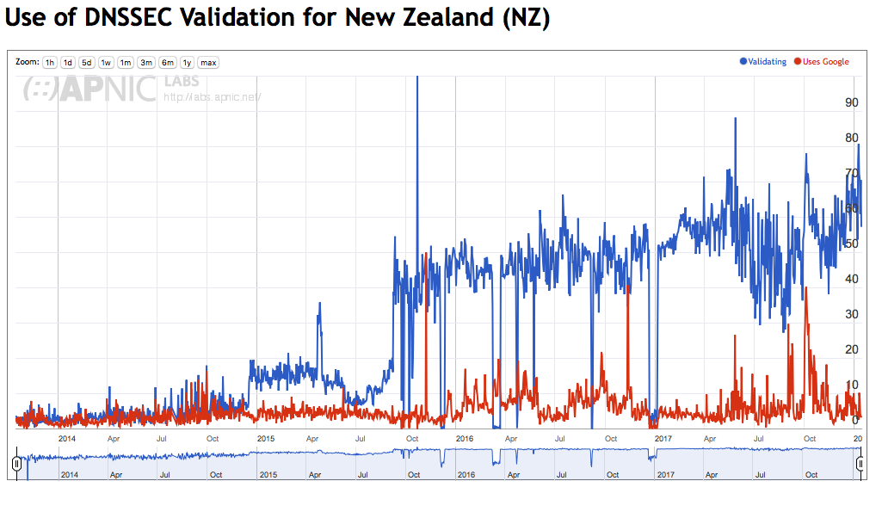
DNSSEC in New Zealand
That’s impressive!

Slide 42
DNSSEC in New Zealand
Count of DNSSEC signed zones in .NZ
Data Source: idp.nz

Slide 43
DNSSEC in New Zealand
Relative Count of DNSSEC signed zones in .NZ
Yes, just 0.17% of names in .nz are DNSSEC-signed
That’s totally NOT
impressive!
Data Source: idp.nz

Slide 44
Thanks!

