Slide 1
In Defence of NATs
Geoff Huston,
Chief Scientist APNIC

Slide 2
The Architecture of the 1990’s Internet
“Dumb Network, Smart Hosts”
IP Network
TCP/IP Engine
TCP/IP Engine

Slide 3
The Architecture of the 1990’s Internet
“Dumb Network, Smart Hosts”
  Remove all the functionality from the network apart from forwarding and buffering
  Place all the responsibility for data flow integrity and control into the end host protocol stacks

Slide 4
The Architecture of the 1990’s Internet
Each IP header carries sufficient information to enable a network of stateless forwarders to pass a packet to its intended destination
Version
IHL
Type of Service
Total Length
Identification
Flags
Fragment Offset
Time To Live
Protocol
Header Checksum
Source Address
Destination Address
Options
Padding

Slide 5
Data Flow
Application
Application
Process to Process
Transport
Host to Host
Transport
Internet
Internet
Internet
Internet
Internet
Link
Link
Link
Link
Link
The intention was that only the IP header is used by the network, and the entire remainder of the packet, including the transport headers, is an opaque payload
Each packet can be forwarded (optionally fragmented) or discarded

Slide 6
IP’s Strengths
There is no “setup” and “tear down” of network state
There is no requirement for symmetry between forward and reverse packet flows
While it is preferred that the network maintain the order of packets, it’s not a strict requirement
End-to-End Transport and Hop-by-Hop Forwarding are decoupled: the end-to-end transport protocol is a host choice, not a network choice

Slide 7
Consequences
IP addresses are globally significant unique identifiers – they are not local virtual circuit identifiers
All IP routers need to be aware of the relative location of all active IP addresses
The total capacity of the network is limited by the number of IP addresses and the ability to represent the relative location of all these addresses within every router

Slide 8
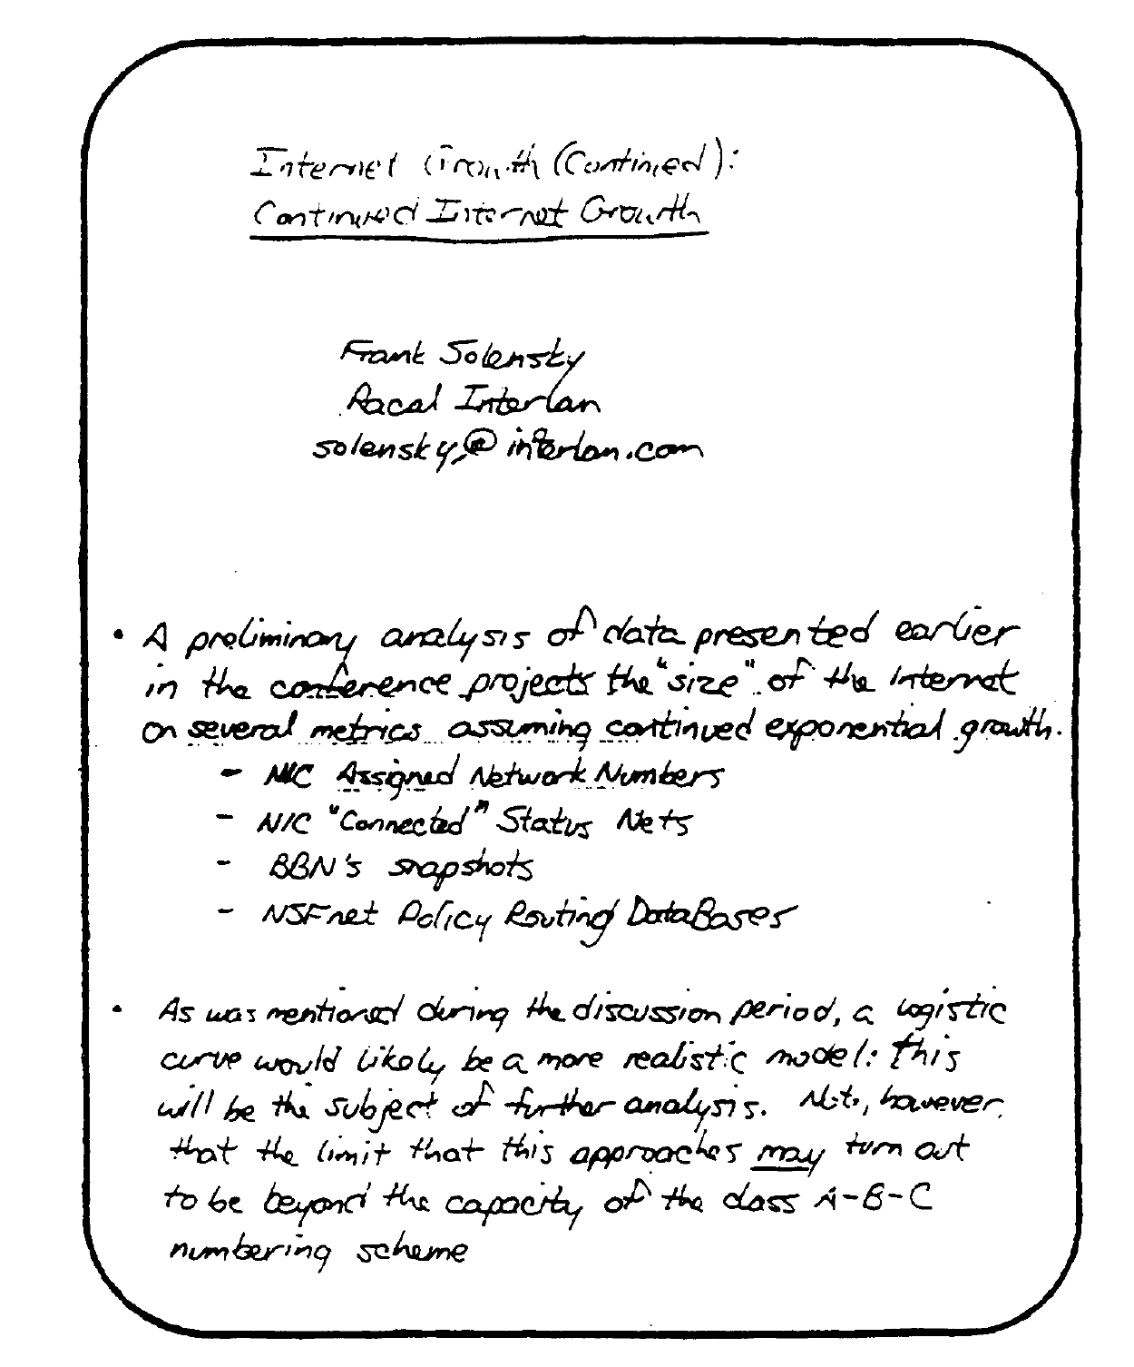
Proceedings of the 18th IETF Meeting
August 1990
“Internet Growth”
Frank Solensky,
Proc. IETF, Aug 1990

Slide 9
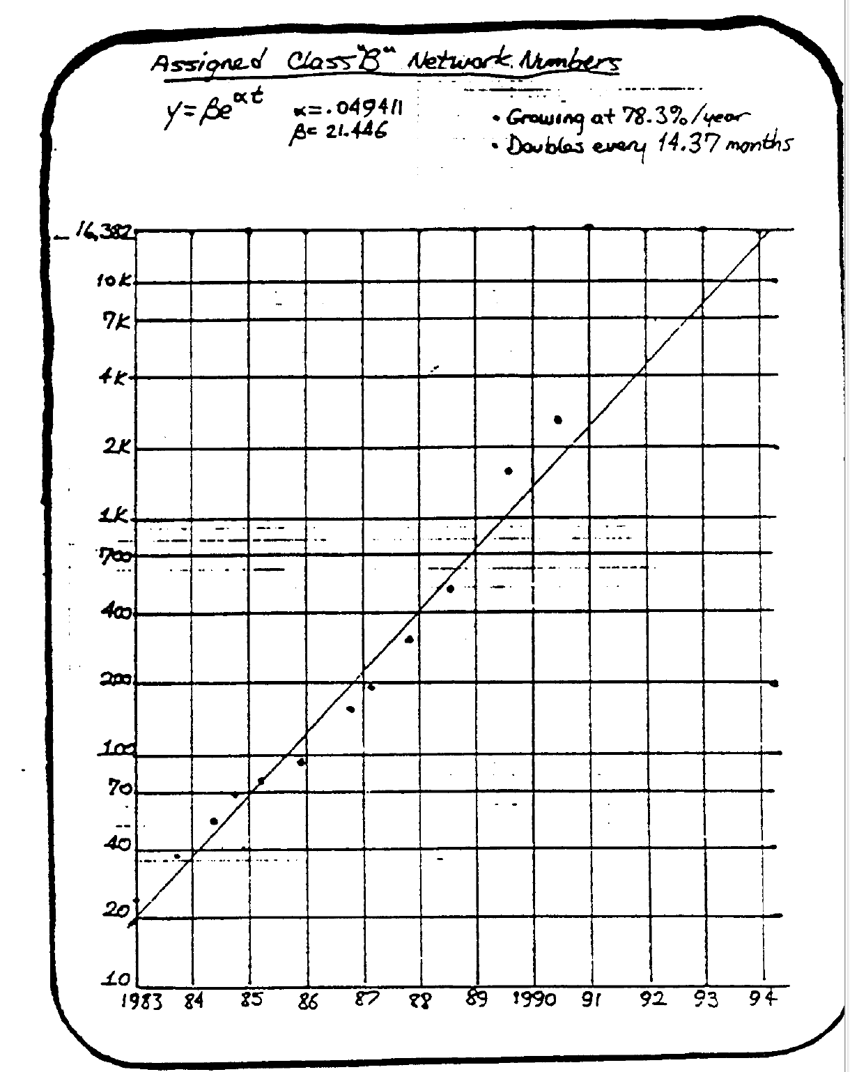
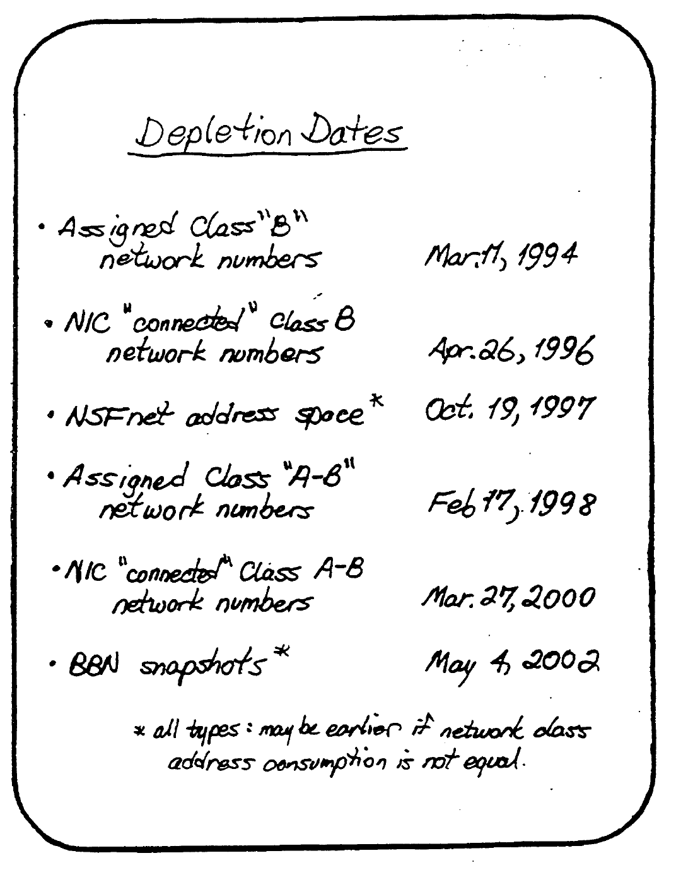
Proceedings of the 18th IETF Meeting
“Internet Growth” Frank Solensky, Proc. IETF, Aug 1990

Slide 10
Removing IP Classes
The problem was not that we were running out of addresses
The problem was that we were running out of Class B addresses
The adopted solution was to keep the implicit routing aggregation of the network / host division of addresses, but carry the network/host division point with the address prefix
  E.g. 192.0.2.0/24
Length of network prefix in bits

Slide 11
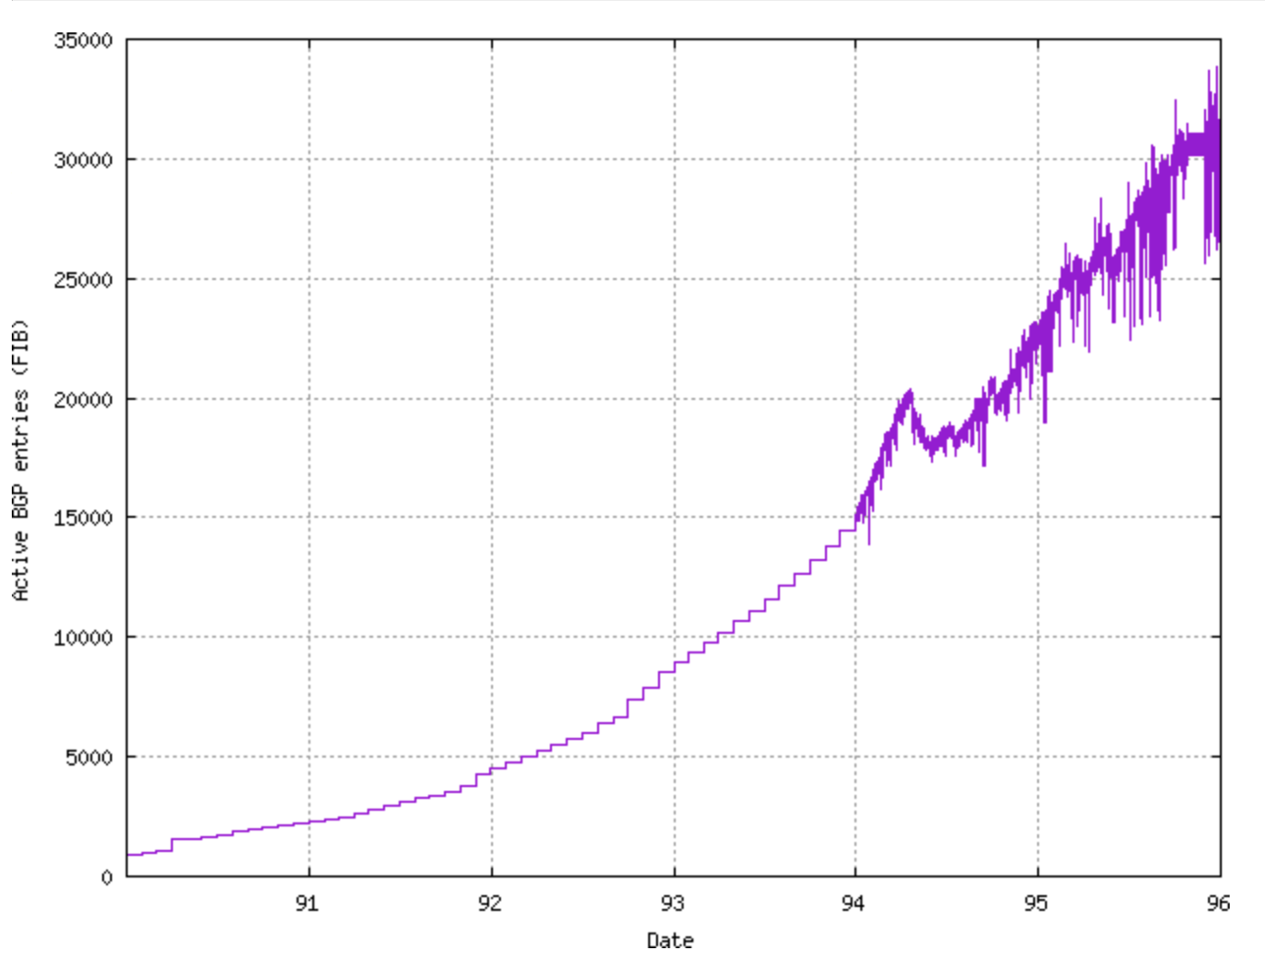
CIDR Worked!
Pre-CIDR Routing Table Growth
Post-CIDR Routing Table Growth
March 1994 – deployment of CIDR in BGP

Slide 12
“Buying Time” was just a stopgap measure
The underlying issue was the personal computer, which dramatically increased the numbers of connected devices and indirectly fueled the first wave of commercialization of the Internet
And this was not going to stop – laptops, mobile devices, and embedded ‘things’ have all added to the numbers of connected devices
The thinking at the time was to change as little as possible, so we thought that enlarging the address fields of the IP header would be sufficient to meet this challenge to scaling
The “answer” that was adopted by the IETF was IPv6

Slide 13
The origins of IPv6
IPv6 represented a minimal change to IPv4
Some aspects of IP were changed:
  Expanded address fields
  Altered fragmentation controls
  Re-formatted options and control fields
Much was unaltered:
  UDP and TCP transport protocol behaviour
  Hop-by-hop destination-based datagram forwarding
And some was unspecified:
  IPv6 Address Plan

Slide 14
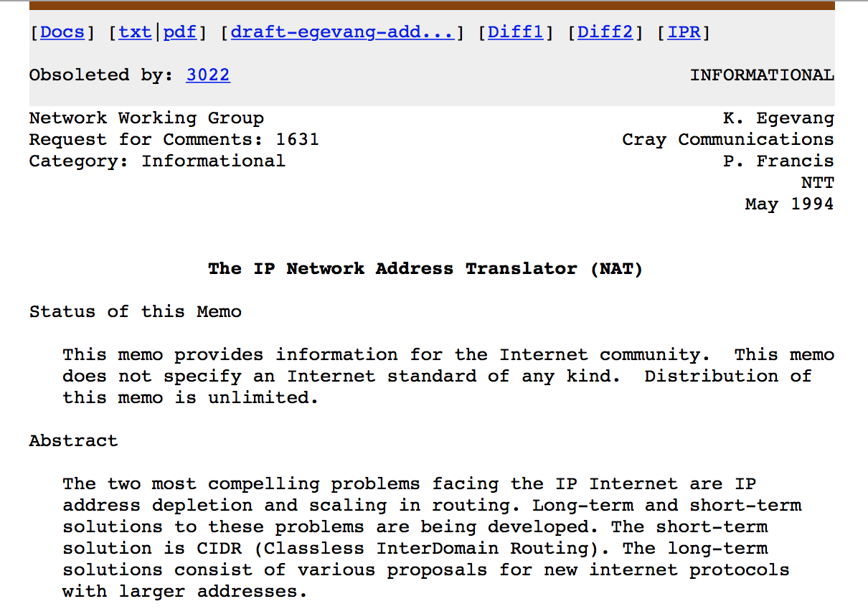
There were many other ideas that were aired at the time
And one of them was a mechanism for address ”sharing”

Slide 15
Address Sharing
NAT
Private Address
Realm
PublicAddress
Realm

Slide 16
Port-Translating NATs
Version
IHL
Type of Service
Total Length
Identification
Flags
Fragment Offset
IP Header
Time To Live
Protocol = 6
Header Checksum
Source Address
Destination Address
Options
Padding
Source Port
Destination Port
TCP
Sequence Number
Acknowledgment Number
Data
offset
S
Y
N
U
R
G
F
I
N
A
C
K
P
S
H
R
S
T
Window
Checksum
Urgent Pointer
TCP Options
Padding
TCP Data
These NATs allow address sharing by using the transport protocol’s port fields as part of the address ‘distinguisher’

Slide 17
NAT
Binding table
Source Address/Port + Dest Address/Port
Source Address/Port + Dest Address/Port
”Inside”
”Outside”
NATs take the 96-bit 4-tuple of Addresses+Ports and replaces the packet’s fields
that match one side of the binding table with the fields on the other side
Outbound packets that do not match any binding table generate a new table entry
Inbound packets that are not matched in the binding table are discarded

Slide 18
NATs:
Enforce symmetric network paths
Require session state within the network
Enforce Client / Server architecture
Create fragility in the network
Violate layer integrity
Motivate the use of proxies and gateways
Prevent innovation in transport services
Handle UDP bindings inconsistently

Slide 19
NATs are Evil!
These considerations led to a long-held mantra in the IETF that “NATS are Evil”
  The IETF refused to work on standardizing NAT behaviour for many years
The consequence was that NATs were developed with idiosyncratic behaviours, particularly in relation to UDP-based binding
Which led to all kinds of convoluted application level behaviours to discover and adapt to the NATs in the path (STUN, TURN, ICE, TEREDO,…)

Slide 20
And yet…

Slide 21
NATs run today’s Internet
2.8B advertised IPv4 Addresses
25B connected devices *
The average address sharing ratio appears to be 10:1
NATs are everywhere!
* https://www.statista.com/statistics/471264/iot-number-of-connected-devices-worldwide/

Slide 22
Why are NATs so pervasive?
They are backward compatible with the existing network
They allow for uncoordinated piecemeal deployment
They impair open peer to peer connectivity and enforce client behaviours behind the NATs
They use the port space to enlarge the effective address space
They isolate the edge networks from the carriage network

Slide 23
Why are NATs so pervasive?
This is an extremely important aspects of NATs. It allowed unconstrained innovation in devices (and services) offered in edge networks without meeting any limitation imposed by the carriage operators
They are backward compatible with the existing network
They allow for uncoordinated piecemeal deployment
They impair open peer to peer connectivity and enforce client behaviours behind the NATs
They use the port space to enlarge the effective address space
They isolate the edge networks from the carriage network

Slide 24
How far can we push NATs?
I have 7,000 DSL broadband customers behind it. Peak time throughput is hitting up at 4 gbps... I see a little over 100,000 service flows
(translations) at peak time
I think each MX104 MS-MIC-16G can able about ~7 million translations and about 7 gbps of cgnat throughput... so I'm good.
I have a /25 for each MX104 outside public address pool (so /24 total for both MX104's)... pretty sweet how I use /24 for ~7,000 customers :)
Aaron Gould, NANOG, https://mailman.nanog.org/pipermail/nanog/2017-April/090809.html

Slide 25
How far can we push NATs?
The NAT binding space is a 96 bits wide 4-tuple
Source Address/Port + Dest Address/Port
96 bits
Address Compression
Ratio
10:1
100:1
1,000:1
>>10,000:1
NAT type:
CGN with per user port blocks
CGN with per user port blocks + pooled overflow
CGN with pooled ports
CGN with 4-tuple binding maps

Slide 26
So, in comparison, what does IPv6 offer?
Is IPv6 Backward Compatibility with IPv4?
  Nope!
Does IPv6 have more usable address bits?
  Yes, but
  The current IPv6 address plans typically use a 48 bit end site prefix
  CGNats potentially push the virtual IPv4 address space to between 42 and 45 bits
Does IPv6 have more flexibility?
  It is unclear if there is a clear need to shift back to the overloaded location / identifier semantics of addresses as the client / server model is closely aligned to today’s Internet
Does IPv6 represent lower cost?
  Well no – for as long as IPv4 remains the dominant protocol then the Internet needs to support IPv4, which implies the use of NATs. It is IPv6 that is the discretionary expenditure item for many service providers

Slide 27
What is going on?
Our industry is running to a different script than what we had planned:
  We had envisaged a transition from IPv4 through Dual Stack to IPv6
  We are seeing a somewhat different transition from IPv4 to NAT44 to Dual Stack-plus-NATs to eventually end up with IPv6
  The NAT phase has removed the urgency from the transition by papering over the crunch time of IPv4 supply exhaustion

Slide 28
But its not just transition
NATs have bought the Internet around 5 years of additional time in the transition by extending IPv4 addresses
But they do more than address extension – they also alter the relative roles of names and addresses in the network’s architecture

Slide 29
NATs make addresses temporary
For some time now we have been contemplating what it means to have a name-based data network, where instead of using a fixed relationship between names and IP addresses, we eschew this mapping and perform network transactions by specifying the name of the desired service or resource to the network
NATs are an interesting step in this direction, where IP addresses have lost their static association with particular endpoints, and are used more as ephemeral session tokens than endpoint locators

Slide 30
Name-based Networks
This certainly appears to be an important step in the direction of named data networking where addresses lose any permanent association with endpoint identity, and retain only the fixed semantics of a network locator used in routing
The service name becomes the endpoint identifier
Addresses are not used to identify service endpoints, but instead are used to distinguish and direct session traffic within the network

Slide 31
In Defence of NATs
It’s NATs, and only NATs, that have kept the Internet running for the past decade
In that time the network has grown from around 2B connected devices to ten times that number
The IPv4 network and its application suite is now built on the assumption of pervasive use of NATs
These same application and service design parameters are used in the context of IPv6

Slide 32
IPv6 Addresses
Do we use “fixed” end addresses in IPv6 anyway?
  Well, no, not all the time!
  Clients typically use “privacy” addresses that use a random 64 bit interface identifier
  So the IPv6 IP end address is now ephemeral for clients
Services are increasingly using name based hosting
  There are more levers and control points in the DNS as distinct from IP anycast
So even IPv6 has eschewed “fixed” end addressing!

Slide 33
NATs in IPv6
For some this is heresy!
However:
  IPv6 has already dissociated itself from fixed end addresses
  we have already marked off ULAs as private use IPv6 address prefixes (fc00::/7 – RFC4193)
  Persistent private addresses and NATs avoid forced site renumbering
  NATs allow site multi-homing without route de-aggregation
  NATs obscure internal site network details and enforce client obscurity
As IPv6 gathers momentum it may be the case that network admins will use ULA prefixes plus NATs to re-create the IPv4 NAT architecture in IPv6

Slide 34
What’s the Message Here?

Slide 35
NATs are Good!
Maintaining a network infrastructure that uniquely names and numbers every attached device has proved to be economically infeasible in the Internet
NATs segment the device population into clients and servers - Clients are not uniquely named, nor uniquely addressed
We may not have planned it this way, but undeniably what keeps today’s Internet running as a single cost effective network is NATs.

Slide 36
NATs as part of the Architecture
NATs have pushed the network into a mode where IP addresses are ephemeral conversation tokens without lasting significance as an endpoint identifier
For clients, address uniqueness is a locally scoped property, rather than a globally scoped attribute
Some services still use unique addresses
Other services use generic “aggregate” addresses and relay on the application to perform service identification

Slide 37
Today’s Internet Architecture
Is this the model of disambiguation of location and service identity that we’ve been searching for for the past couple of decades?
Are we over a model of networking where “addresses” uniquely denote points of attachment to a common network?
Are addresses locally scoped elements that provides disambiguation only to the extent that they are necessary?

Slide 38
Questions?

