Slide 1
The State of IP Addresses
Geoff Huston
APNIC

Slide 2
IPv6

Slide 3
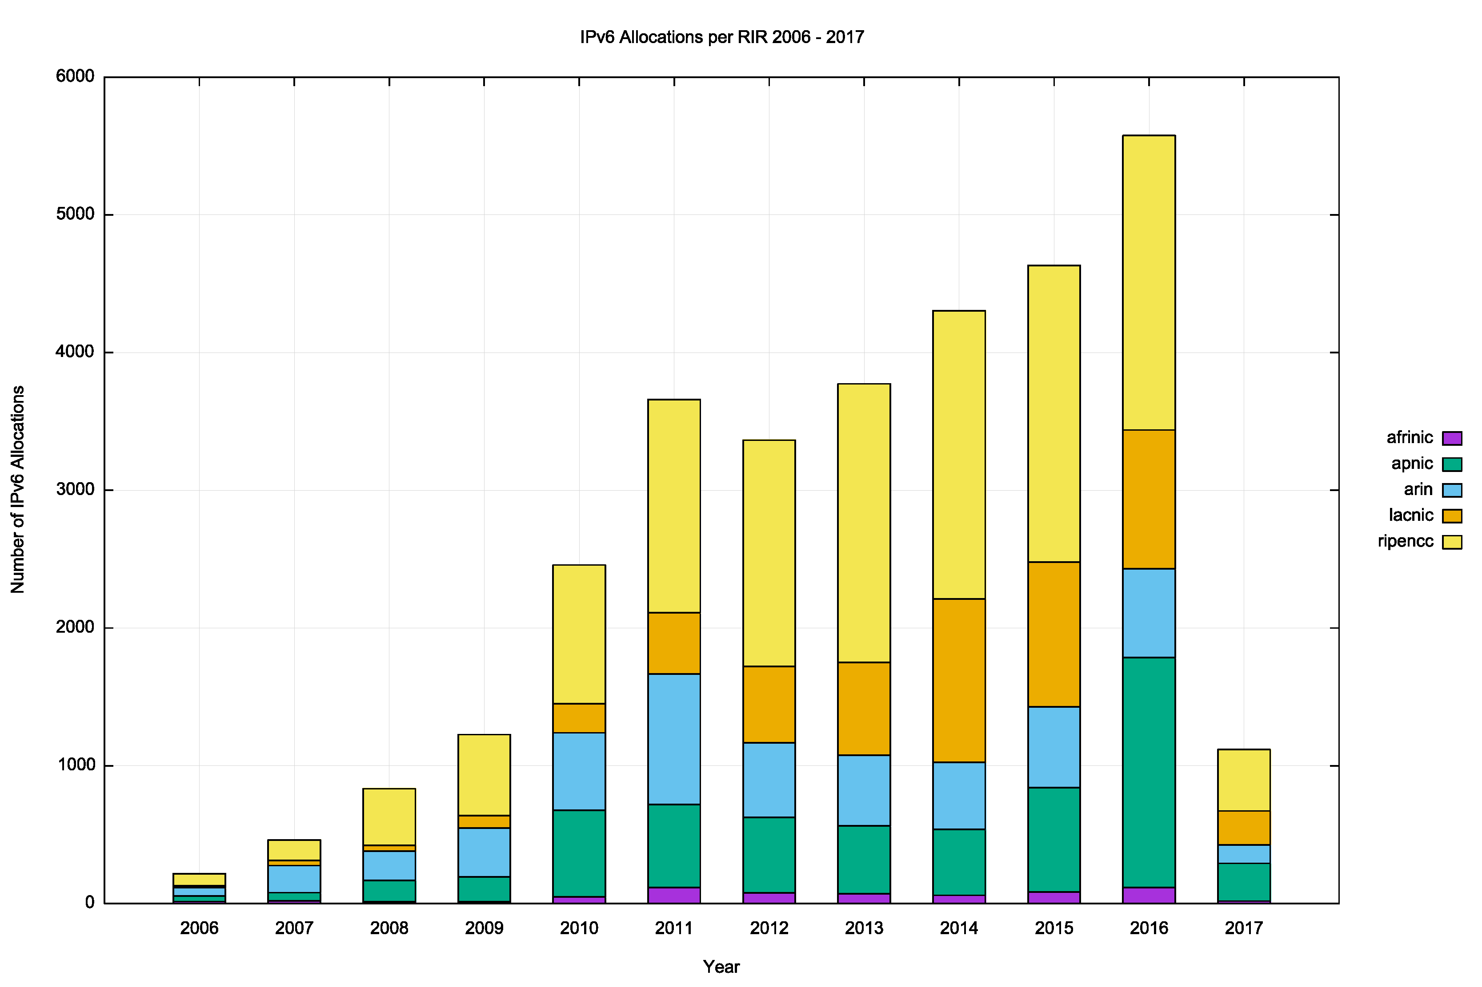
IPv6 Allocations by RIRs
Number of individual IPv6
address allocations per year

Slide 4
IPv6 Allocations by RIRs
Year-by-year
up and to the right
Number of individual IPv6
address allocations per year

Slide 5
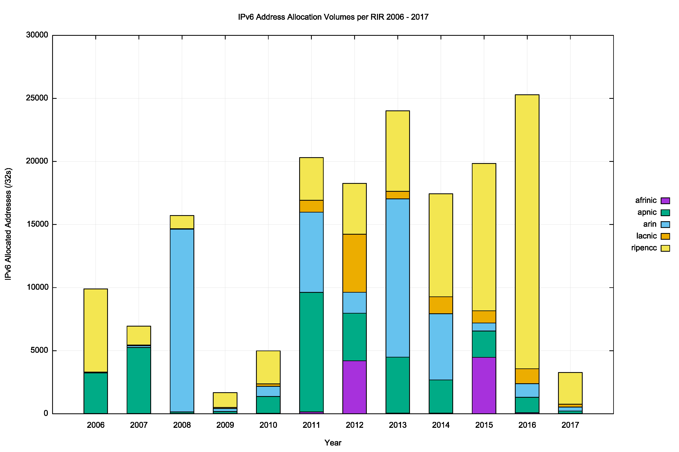
IPv6 Allocated Addresses
Year-by-year steady
(+/- 20%)
Volume of Allocated IPv6 Addresses (using units of /32s) per year

Slide 6
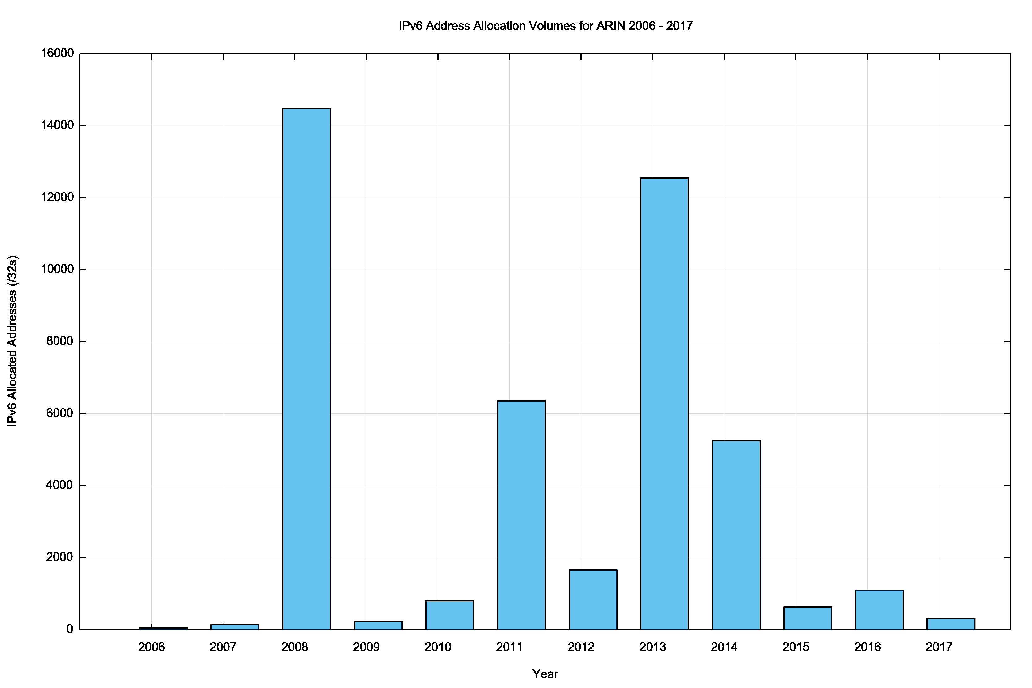
ARIN: IPv6 Allocated Addresses
Volume of Allocated IPv6 Addresses (using units of /32s) per year

Slide 7
Where did these IPv6 addresses go?
Volume of Allocated IPv6 Addresses (using units of /32s) per country, per year

Slide 8
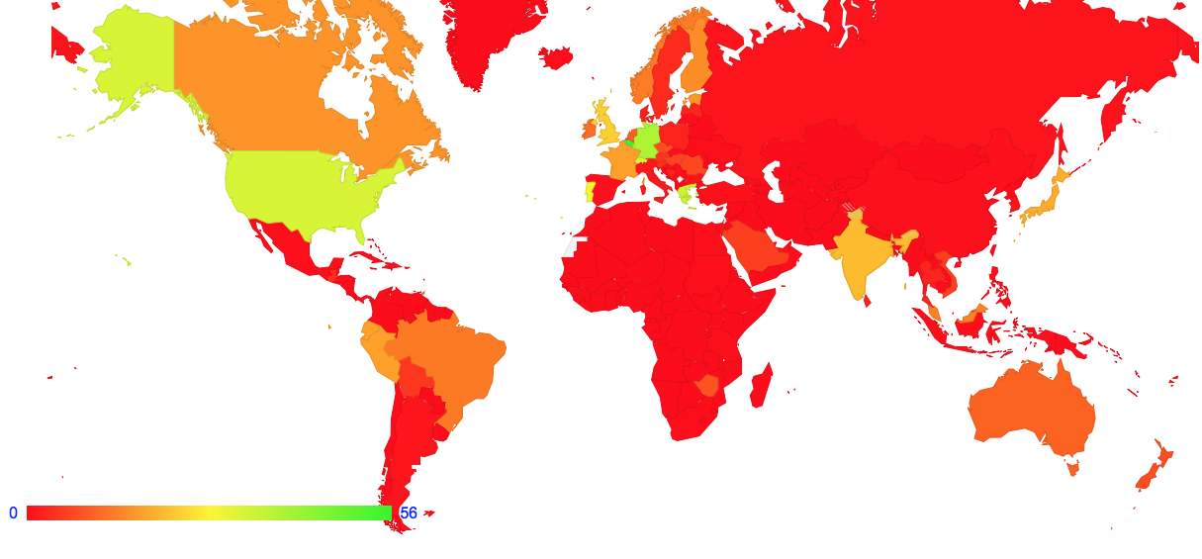
Where did these IPv6 addresses go?
0.1%
10%
1.5%
1%
0.5%
IPv6 Adoption rate per country (%)
5 of the 10 largest IPv6 allocations have been made into countries with little in the way of visible current deployment in the public Internet

Slide 9
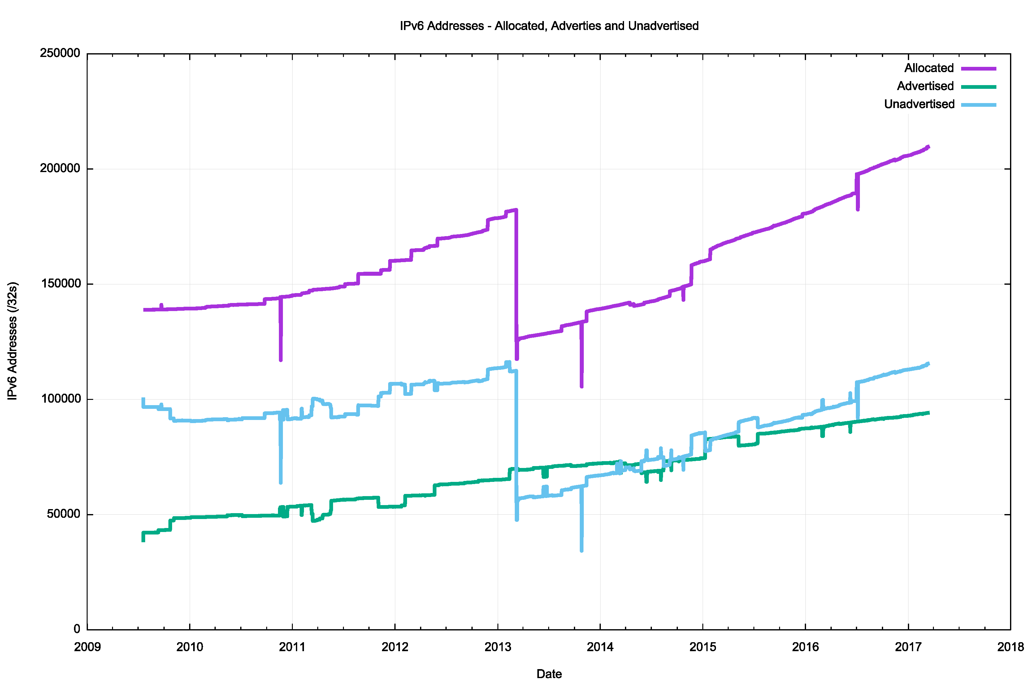
Advertised vs Unadvertised
Re-registration of the /18 BR IPv6 block in March 2013 in LACNIC

Slide 10
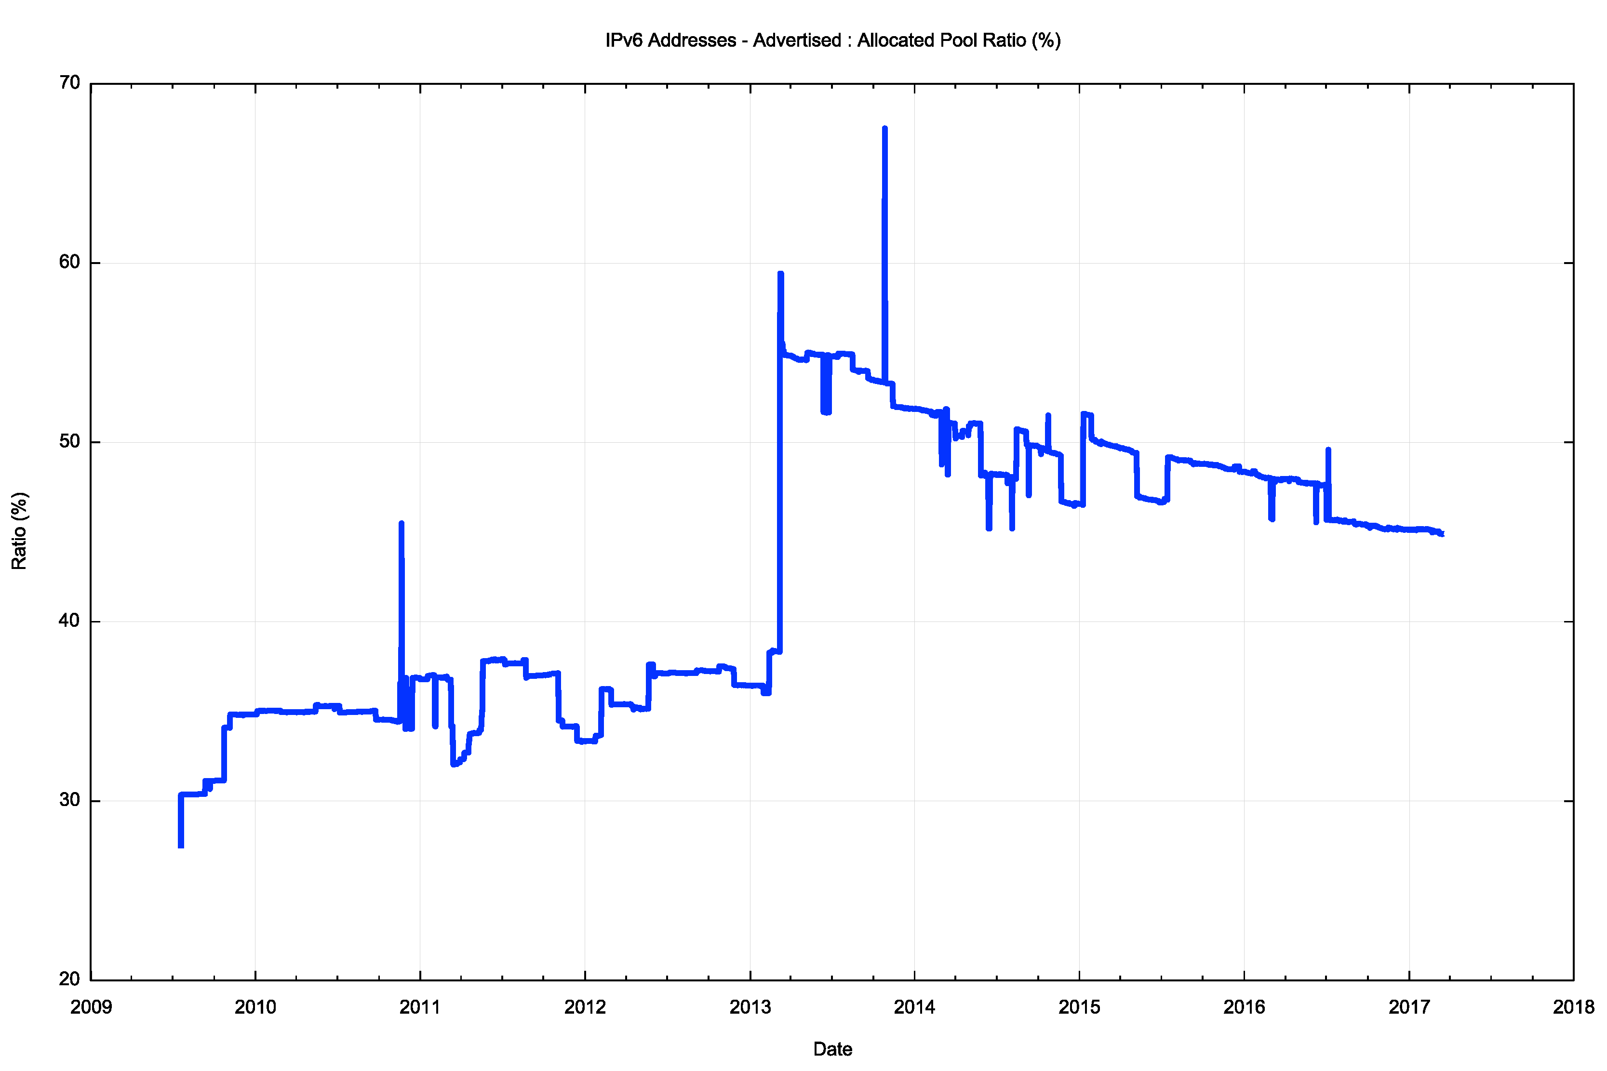
Advertised : Allocated (%)
Some 45% of allocated IPv6 address space is visible as a BGP advertisement

Slide 11
Total IPv6 Holdings by Country

Slide 12
IPv6 Allocations
Many IPv6 address holders appear to want to avoid being “caught short” with IPv6, and have received IPv6 address allocations that are far larger than their current needs for public IPv6 addresses
This is consistent with an overall address management framework that is not primarily driven by address conservation objectives
This, in turn, is consistent with the IPv6 design choice to use a very large address field, so that such liberal address allocation practices can be sustained for many decades

Slide 13
IPv4

Slide 14
Addressing V4 Exhaustion
APNIC
RIPE NCC

Slide 15
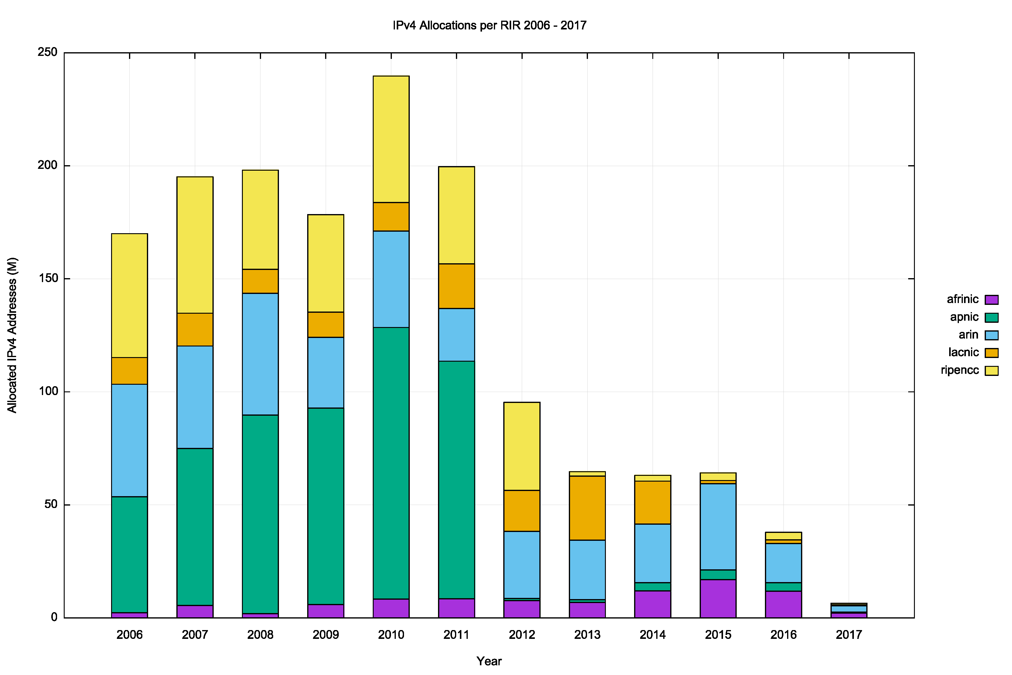
A Decade of IPv4 Allocations

Slide 16
A Decade of IPv4 Allocations
Pre Exhaustion
Global Financial
Crisis
Exhaustion
Profile

Slide 17
Where did the Addresses Go?
Volume of Allocated IPv4 Addresses (using units of millions of /32s) per year
APNIC ran out in 2011
RIPE NCC ran out in 2012
LACNIC ran out in 2014
ARIN ran out
In 2015

Slide 18
What’s Left? (20 March 2017)
Available /32s Reserved /32s Current Run Out
APNIC 6,840,832 4,071,680 Last /8: early 2020
RIPE NCC 12,497,304 1,050,176 Last /8: early 2021
ARIN 0 6,163,968
LACNIC 16,128 4,930,560
AFRINIC 18,076,672 1,840,384 Pool: May2018
37,412,936 18,056,768

Slide 19
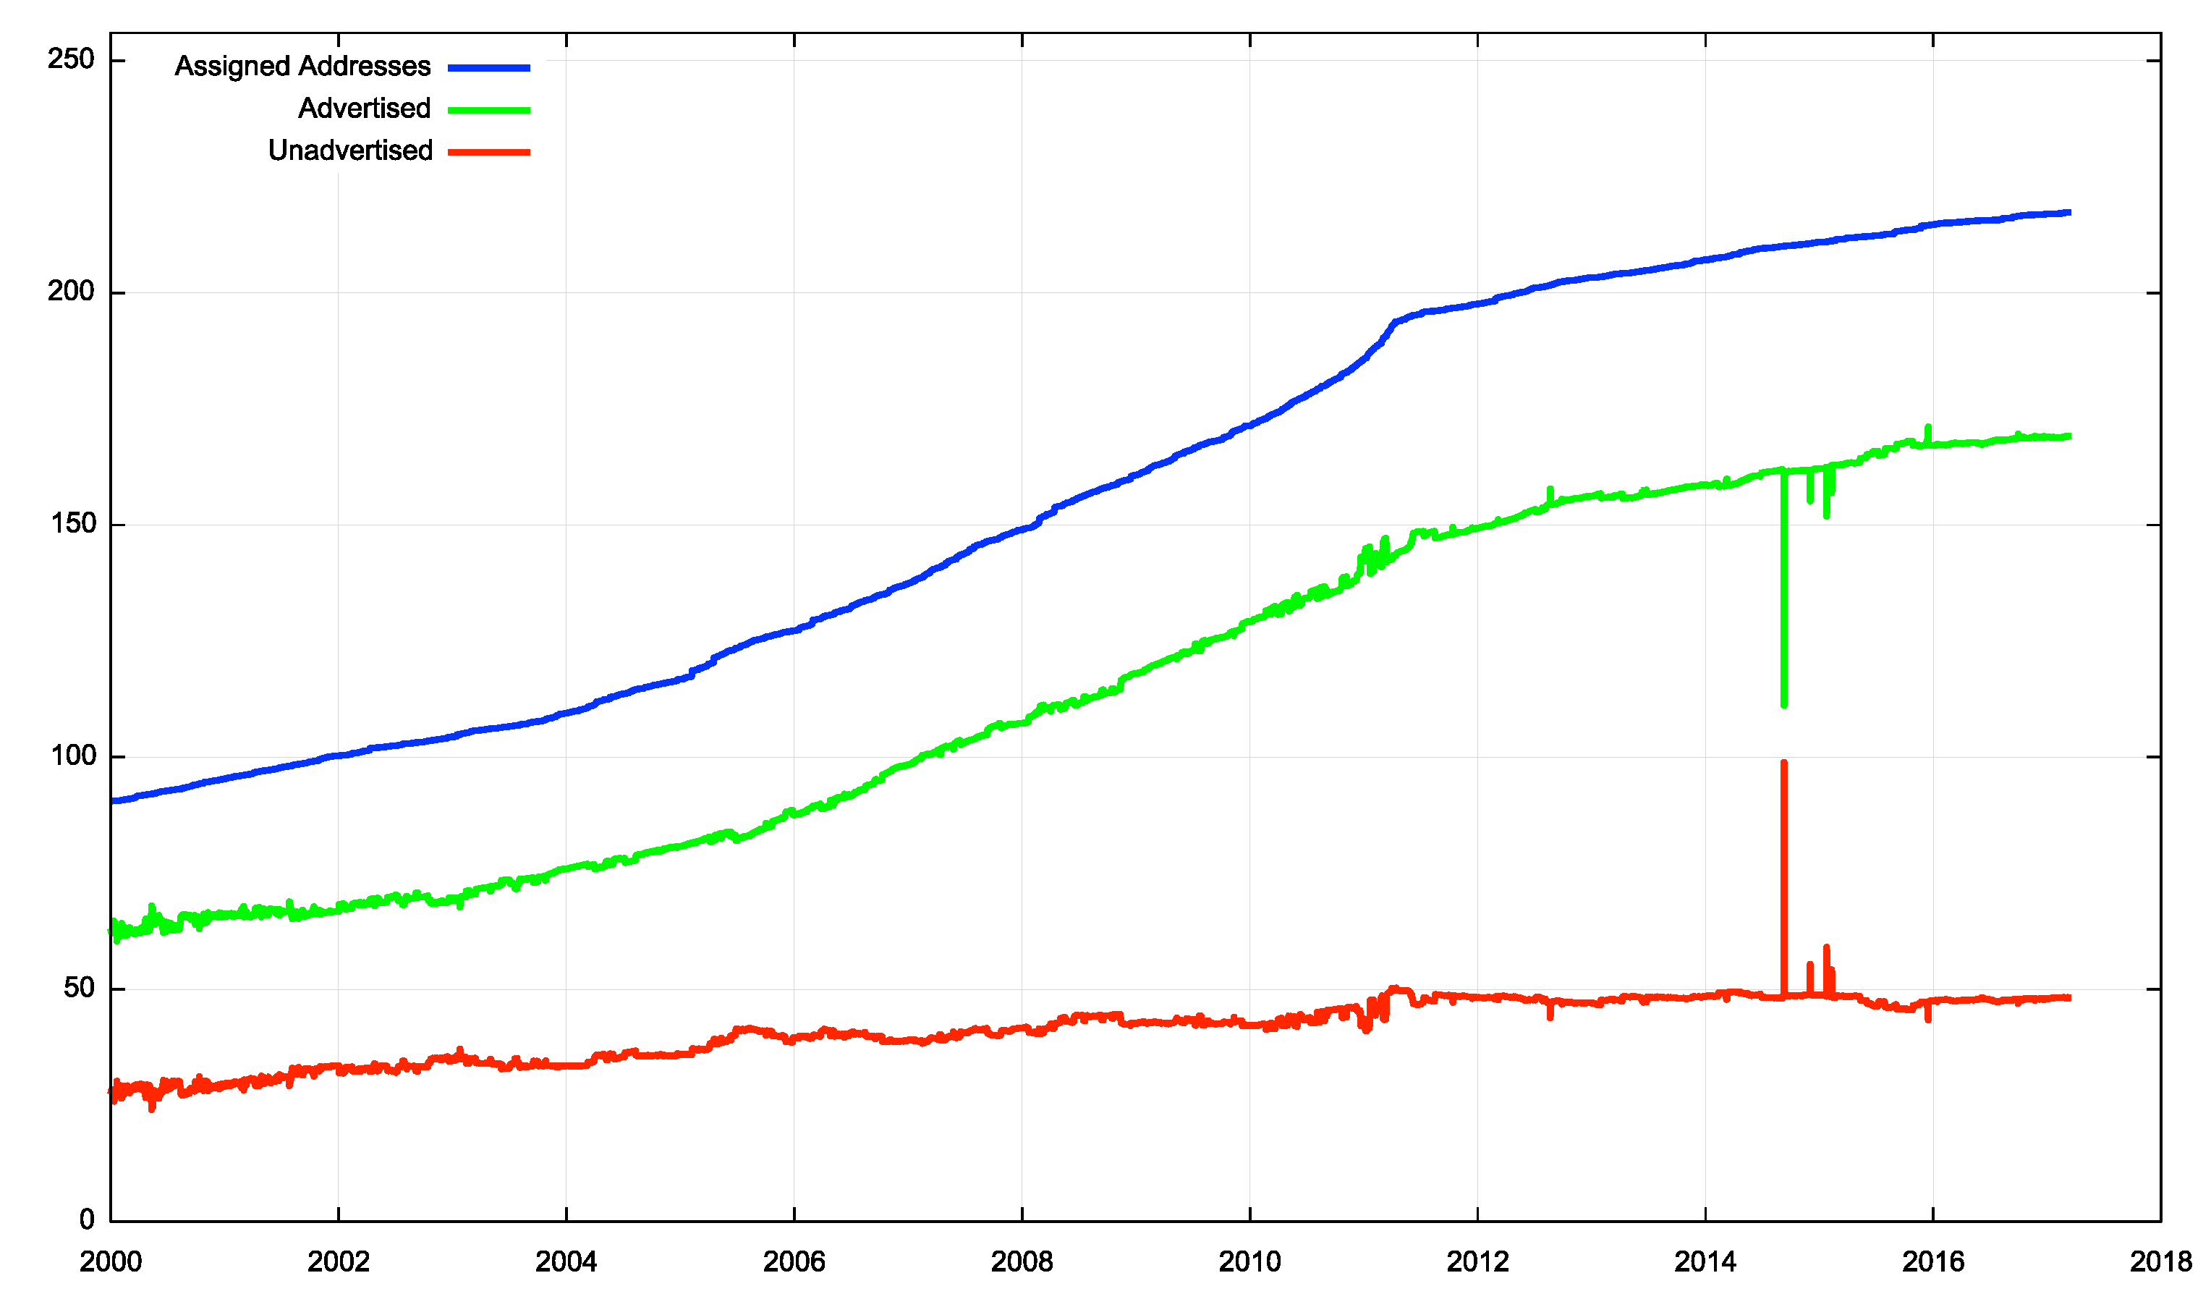
IPv4: Advertised vs Unadvertised

Slide 20
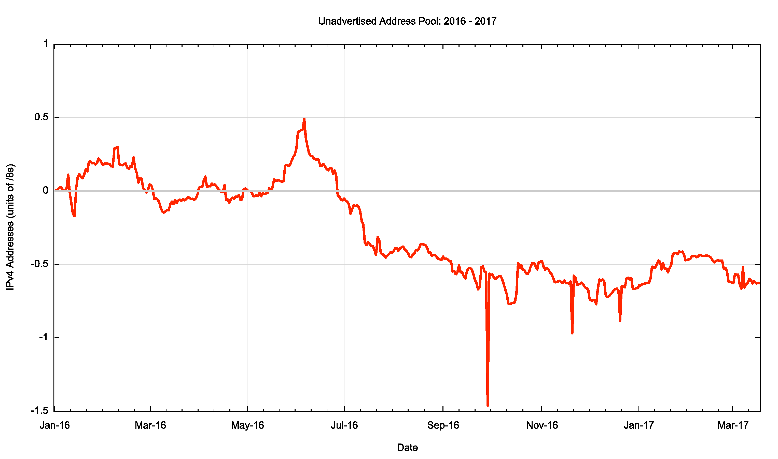
IPv4 Unadvertised Address Pool: 2016 - 2017

Slide 21
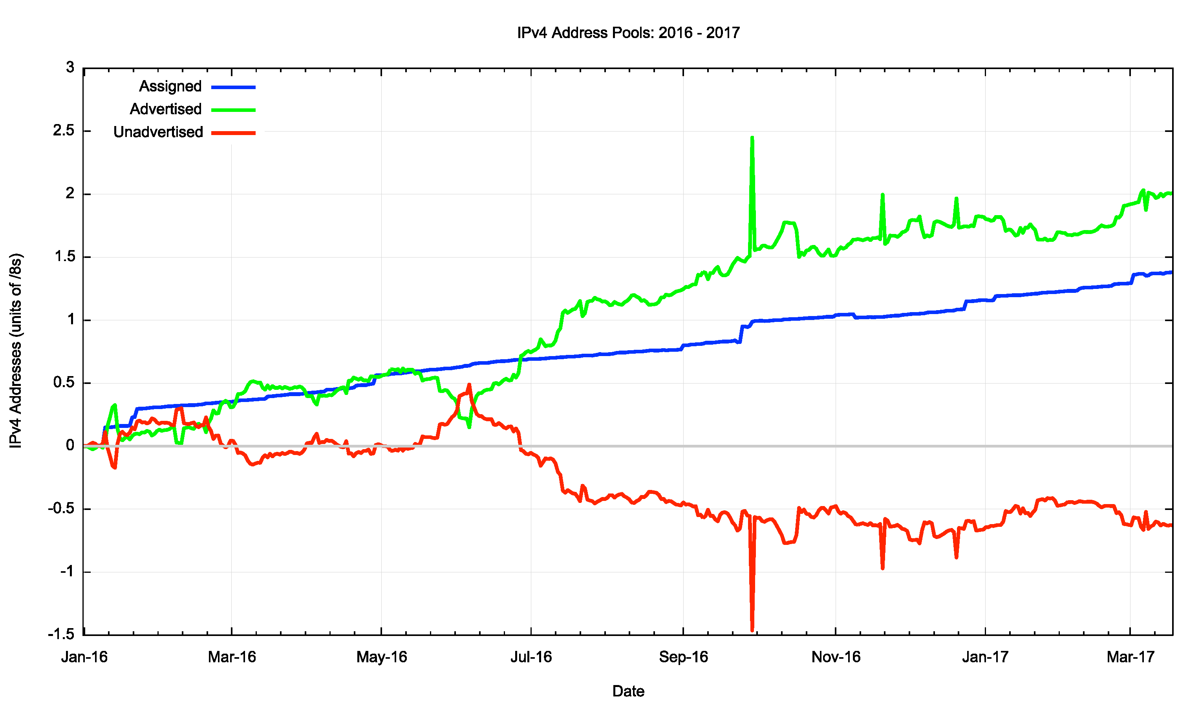
IPv4:Allocated vs Recovered in 2016
Growth in Advertised Addresses
RIR Allocations
1.4 /8s
0.6 /8s
Change in the Unadvertised Address Pool

Slide 22
The IPv4 After-Market:
Address Transfers
There is a considerable residual demand for IPv4 addresses following exhaustion
  IPv6 is not a direct substitute for the lack of IPv4
Some of this demand is pushed into using middleware that imposes address sharing (Carrier Grade NATS, Virtual Hosting, etc)
Where there is no substitute then we turn to the aftermarket
Some address transfers are “sale” transactions, and they are entered into the address registries
Some transfers take the form of “leases” where the lease holder’s details are not necessarily entered into the address registry

Slide 23
Registered Address Transfers
Number of registered
Address transfers per year
Volume of addresses transferred
per year (/32s)

Slide 24
Where From and Where To?

Slide 25
US & Canada: Exports and Imports

Slide 26
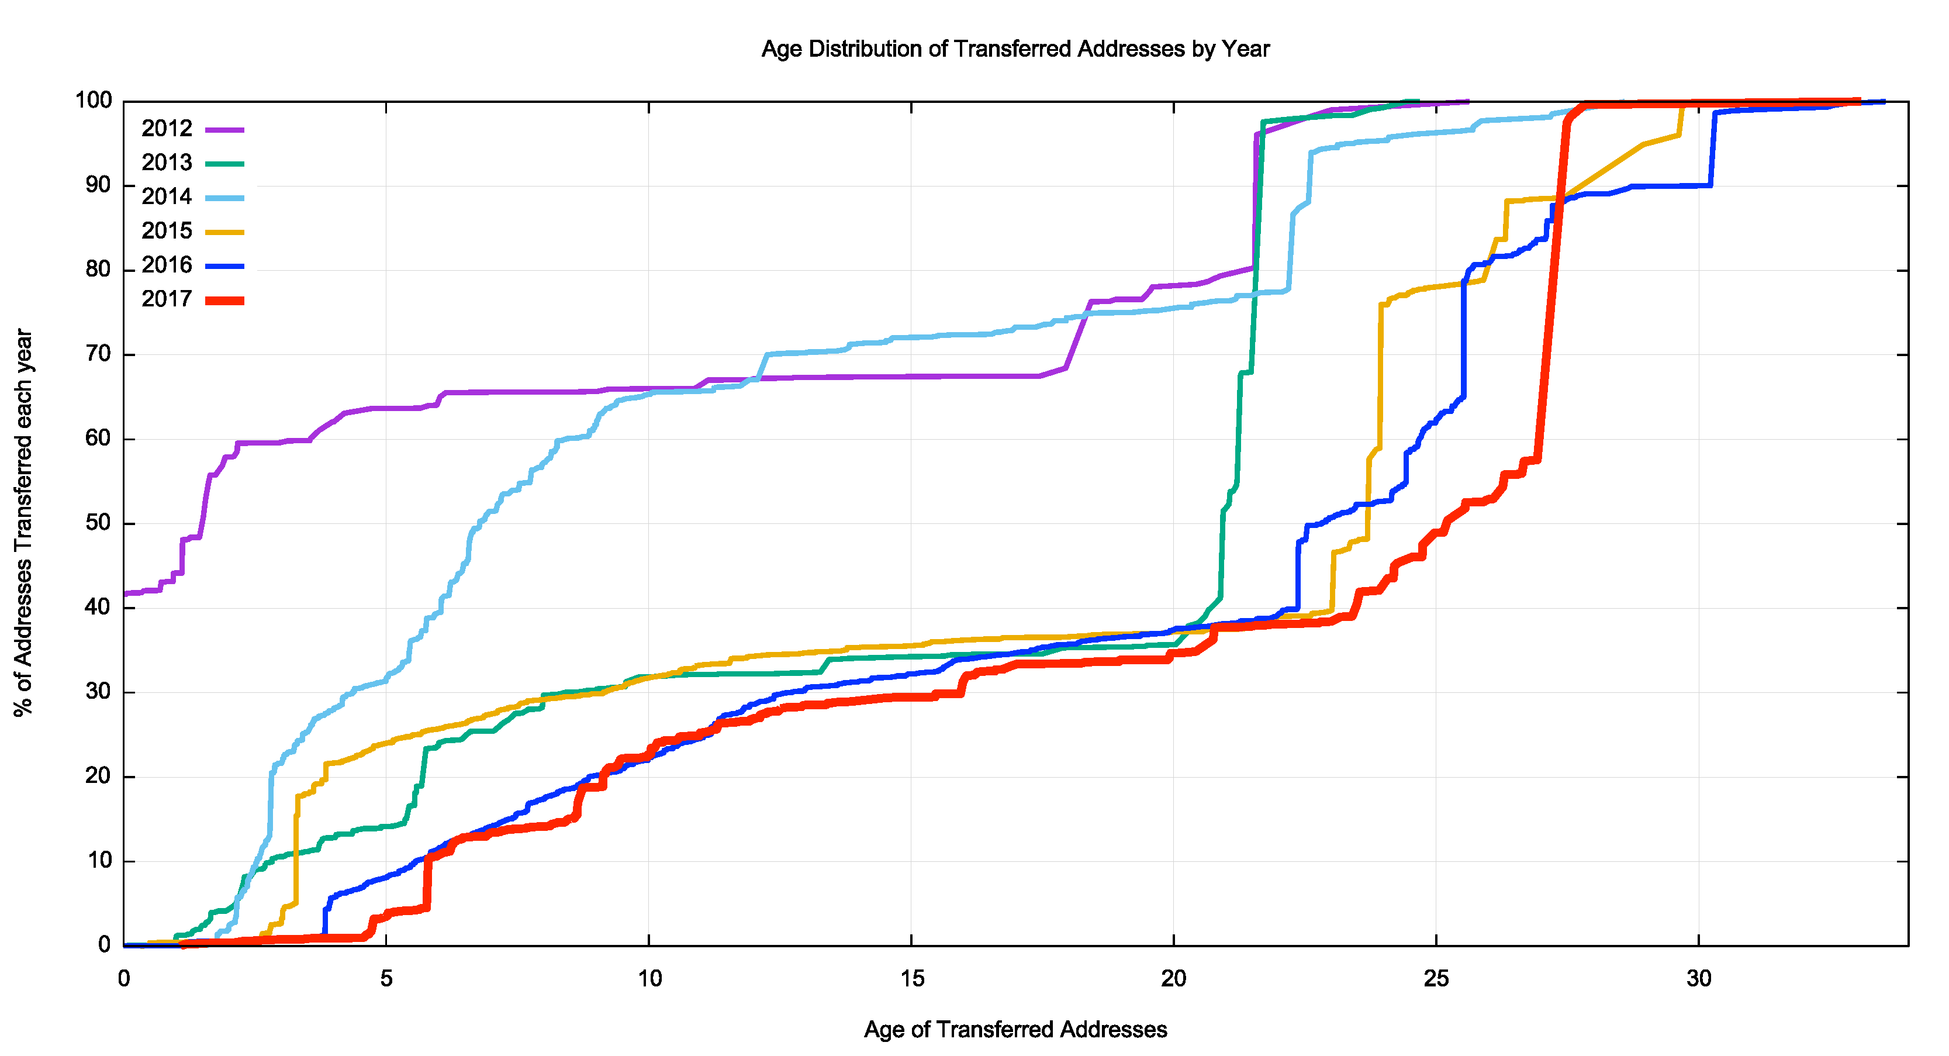
How old are transferred addresses?
65% of transferred addresses are >20 years old in 2017

Slide 27
But
The RIR Transfer Logs are not the entire story:
  For example, the RIPE NCC’s address transfer logs appear not to contain records of transfers of legacy space
  Address leases and similar “off market” address transactions are not necessarily recorded in the RIRs’ transfer logs
Can BGP tell us anything about this missing data?

Slide 28
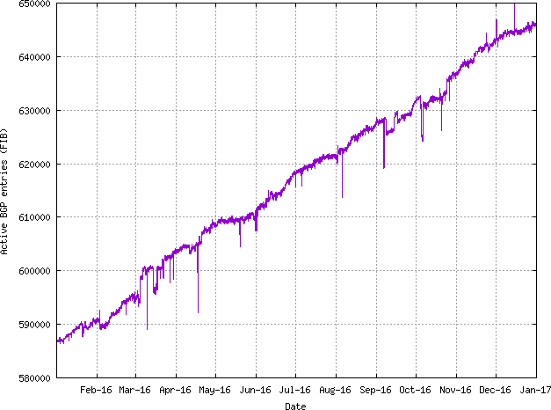
A BGP View of Addresses
Lets compare a snapshot of the routing table at the start of 2016 with a snapshot taken at the end of the year.

Slide 29
BGP Changes Across 2016
What is the level of correlation between these addresses and the address ranges recorded in the transfer logs?

Slide 30
BGP Changes Across 2016
8,663 announcements are listed in the transfer logs
117,982 announcements are NOT listed in the transfer logs

Slide 31
BGP Changes Across 2016
Listed as Transferred
UnListed
Rehomed
All 1,539 15,389 9%
Root Prefixes 1,184 9,551 11%
Removed
All 3,287 64,287 5%
Root Prefixes 1,877 20,203 9%
Added
All 8,663 117,982 7%
Root Prefixes 4,617 41,621 10%

Slide 32
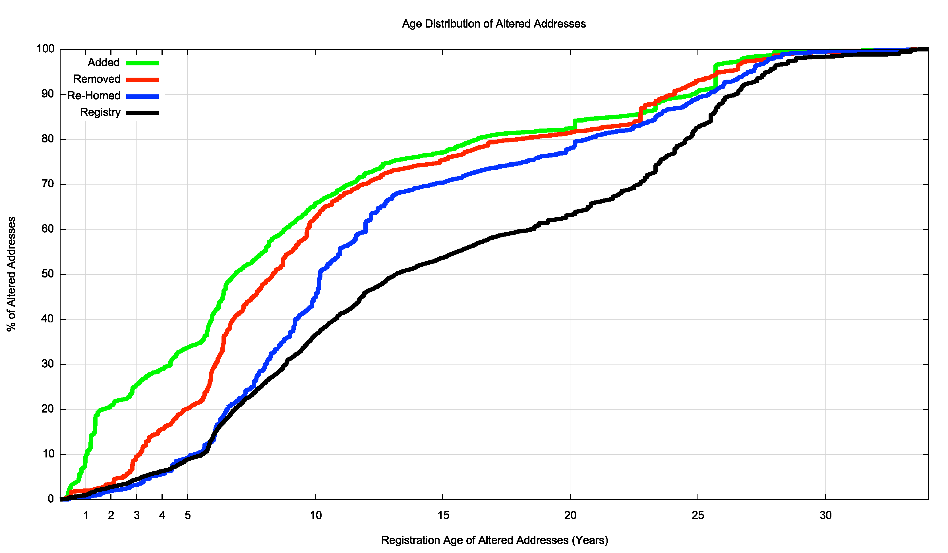
“Age” of Shifted Addresses
20% of all removed addresses are more than 20 years “old”
50% of all re-homed addresses are more than 10 years “old”
20% of all added addresses are under 18 months “old”

Slide 33
“Age” of Shifted Addresses
Some 20% of addresses that changed their routing state in 2016 are “legacy” allocated addresses that are more than 20 years “old”
Addresses older than 20 years look to be more stable than the registry “norm”
Addresses allocated in the past 18 months are more likely to have been announced (naturally!)
Addresses that are 5 – 10 years old are more likely to have been removed from the routing system in 2016

Slide 34
BGP Data and Transfer Logs
Some 5-10 % of address changes seen across 2016 (announced, withdrawn and re-homed) are listed in the RIR transfer logs
That does NOT imply that the remaining 90-95% of address transfers are all unrecorded transfers
  But it does point to a larger body of addresses that have changed their advertisement status in one way or another, some of which may have involved leasing or other forms of address movement, that are not recorded in the transfer logs

Slide 35
Address Movement and the Registries
It is not clear from this analysis what has happened in the case of the other addresses. This could include:
  ”normal” movement of edge networks between upstream providers (customer ‘churn’)
  Occluded multi-homing
  Address movement within a distributed edge network
  Address leasing
  Address transfers not recorded in the transfer registries
More analysis is required to understand what is happening here

Slide 36
Thank You!

