Slide 1
RSA and ECDSA
Geoff Huston
APNIC

Slide 2
It’s all about Cryptography

Slide 3
Why use Cryptography?
Public key cryptography can be used in a number of ways:
protecting a session from third party eavesdroppers
Encryption using a session key that is known only to the parties to the conversation
protecting a session from interference
Injection (or removal) of part of a session can only be undertaken by the parties to the session
authentication and non-repudiation
What is received is exactly what the other party sent, and cannot be repudiated

Slide 4
Symmetric Crypto
A symmetric crypto algorithm uses the same key to
Convert a plaintext message to a crypted message
Convert a crypted message to its plaintext message
They are generally fast and simple
BUT they use a shared key
This key distribution problem can be a critical weakness in the crypto framework

Slide 5
Asymmetric Crypto
This is a class of asymmetric transforms applied to a message such that:
Messages encrypted using Key A and algorithm X can only be translated back to the original message using Key B and algorithm X
This also holds in reverse
This can address the shared key problem:
If I publish Key A and keep Key B a secret then you can send me a secret by encrypting it using my public key A

Slide 6
The Asymmetric Crypto Challenge
Devise an algorithm (encoding) and keys such that:
Messages encoded with one key can only be decoded with the other key
Knowledge of the value of one key does not infer the value of the other key
http://bit.ly/2iQ0oi7

Slide 7
RSA
Select two large (> 256 bit) prime numbers, p and q, then:
n = p.q
⏀(n) = (p-1).(q-1) (the number of numbers that are relatively prime to n)
Pick an e that is relatively prime to ⏀(n)
The PUBLIC KEY is <e,n>
Pick a value for d such that d.e = 1 mod ⏀(n)
The PRIVATE KEY is <d,n>
For any x, x^{de} ≡ x (mod n)

Slide 8
Why does RSA work?
Encryption using the public key consists of taking a message x and raising it to the power e
Crypt = x^{e}
Decryption consists of taking an encrypted message and raising it to the power d, mod n
Decrypt = Crypt^{d} mod n = (x^{e})^{d} mod n = x^{ed} mod n = x
Similarly, one can encrypt a message with the private key (x^{d} ) and decrypt with the public key ((x^{d} ) ^{e} mod n = x)

Slide 9
Why does RSA work?
If you know e and n (the public key) then how can you calculate d (the private key)?
Now d.e = 1 mod ⏀(n)
If you know ⏀(n) you can calculate d
But ⏀(n) = (p-1).(q-1), where p.q = n
i.e. you need to find the prime factors of n, a large composite number that is the product of two primes

Slide 10
The ‘core’ of RSA
(x^{e})^{d} ≡ x mod n
As long as d and n are relatively large, and n is the product of two large prime numbers, then finding the value of d when you already know the values of e and n is computationally expensive

Slide 11
The ‘core’ of RSA
(x^{e})^{d} ≡ x mod n
As long as d and n are relatively large, and n is the product of two large prime numbers, then finding the value of d when you already know the values of e and n is computationally expensive
But computers get larger and faster - what was infeasible yesterday may be possible tomorrow

Slide 12
The ‘core’ of RSA
(x^{e})^{d} ≡ x mod n
As long as d and n are relatively large, and n is the
product of two large prime numbers, then finding the value of d when you already know the values of e and n is computationally expensive
But computers get larger and faster - what was infeasible yesterday may be possible tomorrow
The way to stay ahead is to make the value of n larger and larger

Slide 13
Why is this important?
Because much of the foundation of Internet Security rests upon this relationship

Slide 14
How big can RSA go?
In theory we can push this to very large sizes of n to generate RSA private keys
The algorithm is not itself arbitrarily limited in terms of key size
But as the numbers get larger there is higher computation overhead to generate and manipulate these keys
So we want it large enough not to be ‘broken’ by most forms of brute force, but small enough to be computed by our everyday processors

Slide 15
How big should RSA go?
You need to consider time as well
How long do you want or need your secret to remain a secret?
Because if the attacker has enough time a brute force attack may work
Also time is on the attacker’s side: keys that are considered robust today may not be as robust tomorrow, assuming that feasible compute capabilities rise over time
So you want to pick a key size that is resistant to attempts to brute force the key both today and tomorrow

Slide 16
Bigger and bigger?
Well, no – the larger the key sizes compared to compute capabilities means:
Longer times to generate keys
Longer times to encrypt (and decrypt) messages
More space to represent the key values
So you need to use big keys, but no bigger then necessary!

Slide 17
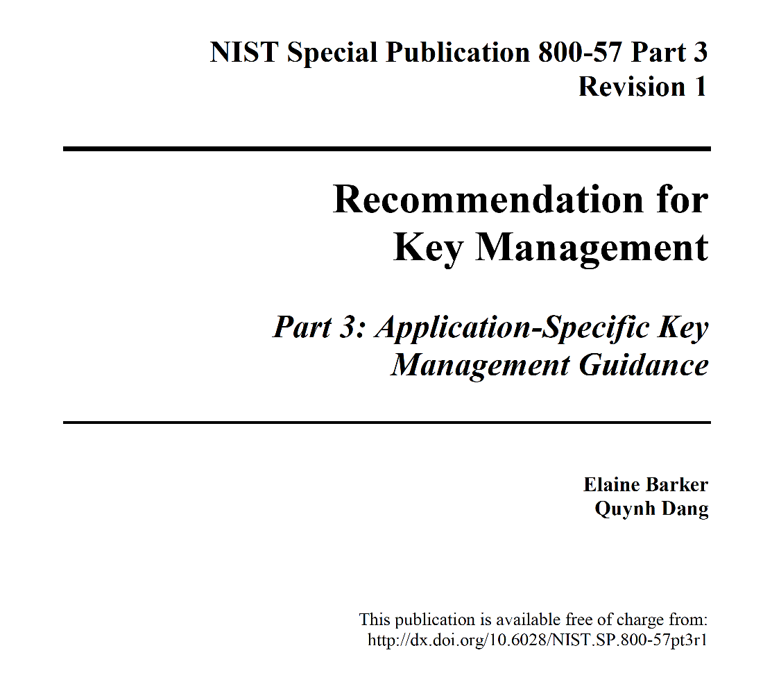
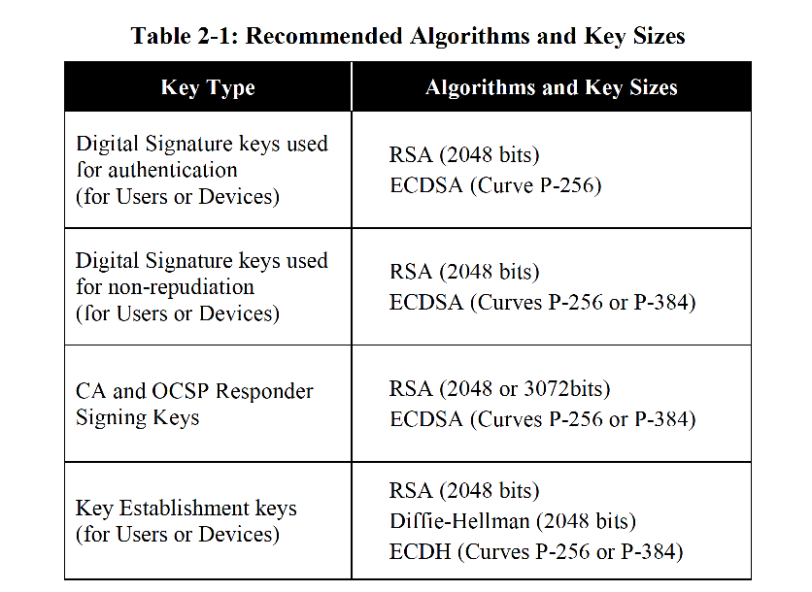
Be Specific!
Time to consult the experts!
http://nvlpubs.nist.gov/nistpubs/SpecialPublications/NIST.SP.800-57Pt3r1.pdf

Slide 18
RSA is everywhere…

Slide 19
My Bank…(I hope!)

Slide 20
TLS: Protecting the session
https://rhsecurity.wordpress.com/tag/tls/

Slide 21
The Key to My Bank
Yes, the fine print says my bank is using a 2048-bit RSA Public key to as the foundation of the session key used to secure access to my bank

Slide 22
I trust its my bank because …
The server has demonstrated knowledge of a private key that is associated with a public key that I have been provided
The public key has been associated with a particular domain name by a Certificate Authority
My browser trusts that this Certificate Authority never lies about such associations
So if the server can demonstrate that it has the private key then my browser will believe that its my bank!

Slide 23
DNSSEC and the DNS
Another major application for crypto in the Internet is securing the DNS
You want to be assured that the response you get to from DNS query is:
Authentic
Complete
Current

Slide 24
DNSSEC Interlocking Signatures
. (root)
. Key-Signing Key – signs over
. Zone-Signing Key – signs over
DS for .com (Key-Signing Key)
.com
.com Key-Signing Key – signs over
.com Zone-Signing Key – signs over
DS for example .com (Key-Signing Key)
.example.com
example.com Key-Signing Key – signs over
example.com Zone-Signing Key – signs over
www.example.com
www.example.com

Slide 25
DNSSEC Interlocking Signatures
. (root)
. Key-Signing Key – signs over
. Zone-Signing Key – signs over
DS for .com (Key-Signing Key)
.com
.com Key-Signing Key – signs over
.com Zone-Signing Key – signs over
DS for example .com (Key-Signing Key)
.example.com
example.com Key-Signing Key – signs over
example.com Zone-Signing Key – signs over
www.example.com
www.example.com IN A 192.0.1

Slide 26
DNSSEC Interlocking Signatures
Is the KSK for . valid?
. (root)
. Key-Signing Key – signs over
Is the ZSK for . valid?
. Zone-Signing Key – signs over
Is this DS equal to the hash of the KSK?
Is the signature for this record valid?
DS for .com (Key-Signing Key)
.com
Is the KSK for .com valid?
.com Key-Signing Key – signs over
.com Zone-Signing Key – signs over
Is the ZSK for .com valid?
DS for example .com (Key-Signing Key)
Is this DS equal to the hash of the KSK?
Is the signature for this record valid?
.example.com
example.com Key-Signing Key – signs over
Is the KSK for example.com valid?
example.com Zone-Signing Key – signs over
Is the ZSK for example.com valid?
www.example.com
Is the signature for this record valid?
www.example.com IN A 192.0.1

Slide 27
DNSSEC Interlocking Signatures
Is the KSK for . valid?
. (root)
As long as you have a valid local trust anchor for the root zone then you can validate a signed DNS response by constructing this backward path to the local root trust anchor
Is the ZSK for . valid?
. Key-Signing Key – signs over
. Zone-Signing Key – signs over
Is this DS equal to the hash of the KSK?
Is the signature for this record valid?
DS for .com (Key-Signing Key)
.com
Is the KSK for .com valid?
.com Key-Signing Key – signs over
.com Zone-Signing Key – signs over
Is the ZSK for .com valid?
DS for example .com (Key-Signing Key)
Is this DS equal to the hash of the KSK?
Is the signature for this record valid?
.example.com
example.com Key-Signing Key – signs over
Is the KSK for example.com valid?
example.com Zone-Signing Key – signs over
Is the ZSK for example.com valid?
www.example.com
Is the signature for this record valid?
www.example.com IN A 192.0.1

Slide 28
A DNSSEC response using RSA
$ dig +dnssec u5221730329.s1425859199.i5075.vcf100.5a593.z.dotnxdomain.net
; <<>> DiG 9.9.6-P1 <<>> +dnssec u5221730329.s1425859199.i5075.vcf100.5a593.z.dotnxdomain.net
;; global options: +cmd
;; Got answer:
;; ->>HEADER<<- opcode: QUERY, status: NOERROR, id: 25461
;; flags: qr rd ra ad; QUERY: 1, ANSWER: 2, AUTHORITY: 4, ADDITIONAL: 1
;; OPT PSEUDOSECTION:
; EDNS: version: 0, flags: do; udp: 4096
;; QUESTION SECTION:
;u5221730329.s1425859199.i5075.vcf100.5a593.z.dotnxdomain.net. IN A
;; ANSWER SECTION:
u5221730329.s1425859199.i5075.vcf100.5a593.z.dotnxdomain.net. 1 IN A 199.102.79.186
u5221730329.s1425859199.i5075.vcf100.5a593.z.dotnxdomain.net. 1 IN RRSIG A 5 4 3600 20200724235900 20130729104013 1968 5a593.z.dotnxdomain.net. ghHPoQd71aZtsdH823eWP16g07q80UJAcIcaPrLl9t3lljqecmjbJzfT prxiRetxvfJSoOelTVKNTiT7vUI0Qk8jB40gwYYnZ9GnFKb9RQOVZJWT ddIs8BhePQDbKqSqh5tElH41UhFzSigEK0VIVXzjIruqlGehn3s++ptL TWs=
;; AUTHORITY SECTION:
33d23a33.3b7acf35.9bd5b553.3ad4aa35.09207c36.a095a7ae.1dc33700.103ad556.3a564678.16395067.a12ec545.6183d935.c68cebfb.41a4008e.4f291b87.479c6f9e.5ea48f86.7d1187f1.7572d59a.9d7d4ac3.06b70413.1706f018.0754fa29.9d24b07c.5a593.z.dotnxdomain.net. 1 IN NSEC z1.5a593.z.dotnxdomain.net. A RRSIG NSEC
33d23a33.3b7acf35.9bd5b553.3ad4aa35.09207c36.a095a7ae.1dc33700.103ad556.3a564678.16395067.a12ec545.6183d935.c68cebfb.41a4008e.4f291b87.479c6f9e.5ea48f86.7d1187f1.7572d59a.9d7d4ac3.06b70413.1706f018.0754fa29.9d24b07c.5a593.z.dotnxdomain.net. 1 IN RRSIG NSEC 5 28 1 20200724235900 20130729104013 1968 5a593.z.dotnxdomain.net. OQhZFbIXs5TMETv3zQLk/obD0nQ7IYeaeLTo3XYYh+vKqP1xcvIeNWKk 908SeoMbtdeeY3EZFN7TCLQO6R8qULuvF/u++zbK5pJ1F3nTOdx9gJAH O4iF/YCz/8DUxzMEunGYuUipWctLTaOEqlUKYpbPKDHWhJLhT02ON77g sXI=
5a593.z.dotnxdomain.net. 3599 IN NS nsz1.z.dotnxdomain.net.
5a593.z.dotnxdomain.net. 3600 IN RRSIG NS 5 4 3600 20200724235900 20130729104013 1968 5a593.z.dotnxdomain.net. ntxWo5UwL1vQjOHY0z5DCVNDDScnd3Tglgd0PsBRRhk3B9iJOGH2orxl FRpOeefg7LmpWNtayJOH6nim58ggQU8U/+KZcoNwv0M5TUAo7IRFG+87 ARvw0lcHU9XMGUAr1wDxaicl2fhgg37gDXi5o8Wgdk/2kNsfmrJg8ZMm UPk=
;; Query time: 1052 msec
;; SERVER: 127.0.0.1#53(127.0.0.1)
;; WHEN: Thu Mar 12 03:59:57 UTC 2015
;; MSG SIZE rcvd: 937
RSA signed response – 937 octets

Slide 29
Another DNSSEC response using RSA
$ dig +dnssec DNSKEY org
; <<>> DiG 9.11.0-P1 <<>> +dnssec DNSKEY org
;; global options: +cmd
;; Got answer:
;; ->>HEADER<<- opcode: QUERY, status: NOERROR, id: 53713
;; flags: qr rd ra; QUERY: 1, ANSWER: 7, AUTHORITY: 0, ADDITIONAL: 1
;; OPT PSEUDOSECTION:
; EDNS: version: 0, flags: do; udp: 4096
;; QUESTION SECTION:
;org. IN DNSKEY
;; ANSWER SECTION:
org. 900 IN DNSKEY 256 3 7 AwEAAXxsMmN/JgpEE9Y4uFNRJm7Q9GBwmEYUCsCxuKlgBU9WrQEFRrvA eMamUBeX4SE8s3V/TEk/TgGmPPp0pMkKD7mseluK6Ard2HZ6O3nPAzL4 i8py/UDRUmYNSCxwfdfjUWRmcB9H+NKWMsJoDhAkLFqg5HS7f0j4Vb99 Wac24Fk7
org. 900 IN DNSKEY 256 3 7 AwEAAayiVbuM+ehlsKsuAL1CI3mA+5JM7ti3VeY8ysmogElVMuSLNsX7 HFyq9O6qhZVJz54Teuzf2EGjO8cbK/fUbyzFW+4i4BRk+pVx673NRgQq DiB2oJDmQRK918Rmoxi/Sf8S7k9FB1Xzxspli9AJmn5tz4ACVsD2xTc1 wZtAKVjr
org. 900 IN DNSKEY 257 3 7 AwEAAcMnWBKLuvG/LwnPVykcmpvnntwxfshHlHRhlY0F3oz8AMcuF8gw 9McCw+BoC2YxWaiTpNPuxjSNhUlBtcJmcdkz3/r7PIn0oDf14ept1Y9p dPh8SbIBIWx50ZPfVRlj8oQXv2Y6yKiQik7bi3MT37zMRU2kw2oy3cgr sGAzGN4s/C6SFYon5N1Q2O4hGDbeOq538kATOy0GFELjuauV9guX/431 msYu4Rgb5lLuQ3Mx5FSIxXpI/RaAn2mhM4nEZ/5IeRPKZVGydcuLBS8G ZlxW4qbb8MgRZ8bwMg0pqWRHmhirGmJIt3UuzvN1pSFBfX7ysI9PPhSn wXCNDXk0kk0=
org. 900 IN DNSKEY 257 3 7 AwEAAZTjbIO5kIpxWUtyXc8avsKyHIIZ+LjC2Dv8naO+Tz6X2fqzDC1b dq7HlZwtkaqTkMVVJ+8gE9FIreGJ4c8G1GdbjQgbP1OyYIG7OHTc4hv5 T2NlyWr6k6QFz98Q4zwFIGTFVvwBhmrMDYsOTtXakK6QwHovA1+83BsU ACxlidpwB0hQacbD6x+I2RCDzYuTzj64Jv0/9XsX6AYV3ebcgn4hL1jI R2eJYyXlrAoWxdzxcW//5yeL5RVWuhRxejmnSVnCuxkfS4AQ485KH2tp dbWcCopLJZs6tw8q3jWcpTGzdh/v3xdYfNpQNcPImFlxAun3BtORPA2r 8ti6MNoJEHU=
org. 900 IN RRSIG DNSKEY 7 1 900 20170207153219 20170117143219 3947 org. S6+vpFWz6hfPmvI7zxRa4NPLjre4Vow9mlAxmn1zS+bd0NuXFZQW9Bb/ oXKvHqv5MgMrNSFigogakX9AhQpHKd1LTLmd+hndAooCs+MA6+KsZ96i L+17wFoDbBT3nEgpBC8V2rOu3Z0NNIeLhApSrqz1O9sbak5/bcOHNZwS 8e0=
org. 900 IN RRSIG DNSKEY 7 1 900 20170207153219 20170117143219 9795 org. iEyiroy02ljtH5hf5RIdf4aRSpbItnqdxlKbvGt6vLVjws3ZNPzMoGxN P9cxzsblIPEY07pCXOgCw1D8cdCcAzbtYGxCJuh/K3MWQprQBJuvDZHG wUY5e8A51txvzSBXZLanxhlfmfoRtp1WT9/wJoGfxqtcHCn7MkjNU94m 3N42rSBGZ7zE3ZD9WdUii1shcxLks+i42BJtXYlK2QvpU2Z6Xl3G3VlN eMihmFPieOe2xiYGZ8iaxULPhkQ7JxOkGJmQSrNk1OW5Wa1qrQHac/81 7xVllJHmg+wvGVectr8wUmjI1KJDtptKtsWRb43gzfCOEZjH9tDW6vMk kvJZrA==
org. 900 IN RRSIG DNSKEY 7 1 900 20170207153219 20170117143219 17883 org. A2hLUswcas+W4h8gZYpAtUIjzcXYPfhFwXEiVMM6ELEHzCrDB4IN5k4y EE8ETabPeNH3fl/o7i5R7oJfPTVPSl/VJcjZwa1o/SqGoQSeZpI/lRJW DKKMoz+g1cyOskD41hG+GMMff7e+4x66L7uMD3tFKh6TKHQy21sA7XpU AvjvsOfbMRV76Xz0kYABcaCg74Q4YRVvJSkX+51ivrALum4r4LvtcFRT dsv6d7cR/F6UhBVAjkcWlA/4rcZbI8UFokefUkniSBVjw3grz2US0DUW NriO0QA2+MaNe7brnxSsVTUoY2K6xEmXy1uXj9QjNZjGDva0BFfiaszC pVvV3A==
;; Query time: 475 msec
;; SERVER: 203.133.248.1#53(203.133.248.1)
;; WHEN: Thu Jan 19 23:37:38 UTC 2017
;; MSG SIZE rcvd: 1625
RSA signed response – 1,625 octets

Slide 30
Not every application can tolerate large keys…
The DNS and DNSSEC is a problem here:
including the digital signature increases the response size
Large responses generate packet fragmentation
Fragments are commonly filtered by firewalls
IPv6 Fragments required IPv6 Extension Headers, and packets with Extension Headers are commonly filtered
DNS over TCP imposes server load
DNS over TCP is commonly filtered
If you can avoid large responses in the DNS, you should!

Slide 31
The search for small keys
Large keys and the DNS don’t mix very well:
We try and make UDP fragmentation work reliably (for once!)
Or we switch the DNS to use TCP
Or we look for smaller keys

Slide 32
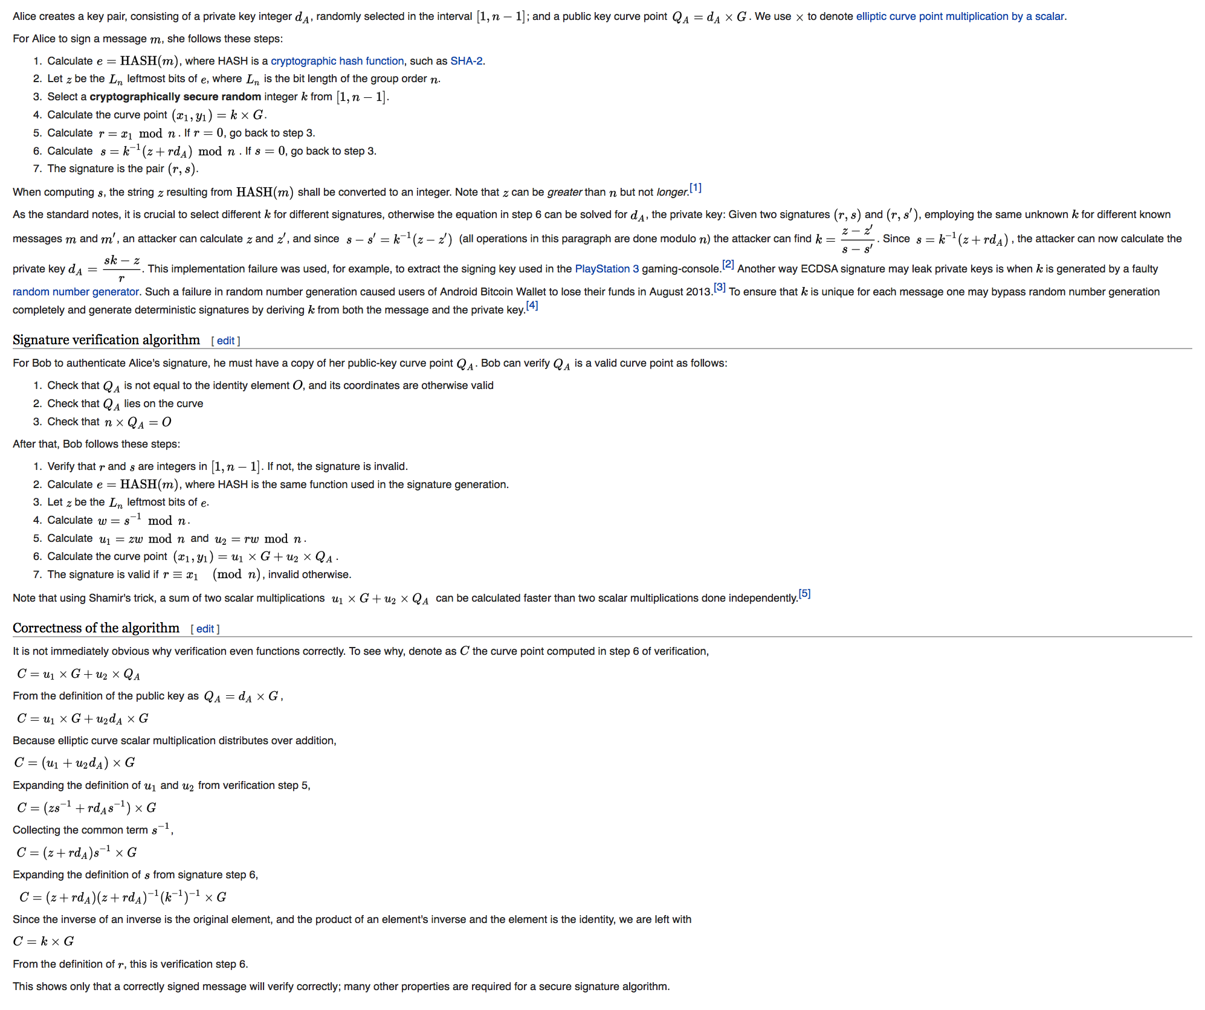
Enter Elliptic Curves
y² = x³ + ax + b

Slide 33
Enter Elliptic Curves
y² = x³ + ax + b
“It is not immediately obvious why verification even functions correctly.” !!

Slide 34
ECDSA P-256
Elliptic Curve Cryptography allows for the construction of “strong” public/private key pairs with key lengths that are far shorter than equivalent strength keys using RSA
A 256-bit ECC key should provide comparable security to a 3072-bit RSA key

Slide 35
ECDSA vs RSS
$ dig +dnssec u5221730329.s1425859199.i5075.vcf100.5a593.z.dotnxdomain.net
; <<>> DiG 9.9.6-P1 <<>> +dnssec u5221730329.s1425859199.i5075.vcf100.5a593.z.dotnxdomain.net
;; global options: +cmd
;; Got answer:
;; ->>HEADER<<- opcode: QUERY, status: NOERROR, id: 25461
;; flags: qr rd ra ad; QUERY: 1, ANSWER: 2, AUTHORITY: 4, ADDITIONAL: 1
;; OPT PSEUDOSECTION:
; EDNS: version: 0, flags: do; udp: 4096
;; QUESTION SECTION:
;u5221730329.s1425859199.i5075.vcf100.5a593.z.dotnxdomain.net. IN A
;; ANSWER SECTION:
u5221730329.s1425859199.i5075.vcf100.5a593.z.dotnxdomain.net. 1 IN A 199.102.79.186
u5221730329.s1425859199.i5075.vcf100.5a593.z.dotnxdomain.net. 1 IN RRSIG A 5 4 3600 20200724235900 20130729104013 1968 5a593.z.dotnxdomain.net. ghHPoQd71aZtsdH823eWP16g07q80UJAcIcaPrLl9t3lljqecmjbJzfT prxiRetxvfJSoOelTVKNTiT7vUI0Qk8jB40gwYYnZ9GnFKb9RQOVZJWT ddIs8BhePQDbKqSqh5tElH41UhFzSigEK0VIVXzjIruqlGehn3s++ptL TWs=
;; AUTHORITY SECTION:
33d23a33.3b7acf35.9bd5b553.3ad4aa35.09207c36.a095a7ae.1dc33700.103ad556.3a564678.16395067.a12ec545.6183d935.c68cebfb.41a4008e.4f291b87.479c6f9e.5ea48f86.7d1187f1.7572d59a.9d7d4ac3.06b70413.1706f018.0754fa29.9d24b07c.5a593.z.dotnxdomain.net. 1 IN NSEC z1.5a593.z.dotnxdomain.net. A RRSIG NSEC
33d23a33.3b7acf35.9bd5b553.3ad4aa35.09207c36.a095a7ae.1dc33700.103ad556.3a564678.16395067.a12ec545.6183d935.c68cebfb.41a4008e.4f291b87.479c6f9e.5ea48f86.7d1187f1.7572d59a.9d7d4ac3.06b70413.1706f018.0754fa29.9d24b07c.5a593.z.dotnxdomain.net. 1 IN RRSIG NSEC 5 28 1 20200724235900 20130729104013 1968 5a593.z.dotnxdomain.net. OQhZFbIXs5TMETv3zQLk/obD0nQ7IYeaeLTo3XYYh+vKqP1xcvIeNWKk 908SeoMbtdeeY3EZFN7TCLQO6R8qULuvF/u++zbK5pJ1F3nTOdx9gJAH O4iF/YCz/8DUxzMEunGYuUipWctLTaOEqlUKYpbPKDHWhJLhT02ON77g sXI=
5a593.z.dotnxdomain.net. 3599 IN NS nsz1.z.dotnxdomain.net.
5a593.z.dotnxdomain.net. 3600 IN RRSIG NS 5 4 3600 20200724235900 20130729104013 1968 5a593.z.dotnxdomain.net. ntxWo5UwL1vQjOHY0z5DCVNDDScnd3Tglgd0PsBRRhk3B9iJOGH2orxl FRpOeefg7LmpWNtayJOH6nim58ggQU8U/+KZcoNwv0M5TUAo7IRFG+87 ARvw0lcHU9XMGUAr1wDxaicl2fhgg37gDXi5o8Wgdk/2kNsfmrJg8ZMm UPk=
;; Query time: 1052 msec
;; SERVER: 127.0.0.1#53(127.0.0.1)
;; WHEN: Thu Mar 12 03:59:57 UTC 2015
;; MSG SIZE rcvd: 937
$ dig +dnssec u5221730329.s1425859199.i5075.vcf100.5a593.y.dotnxdomain.net
; <<>> DiG 9.9.6-P1 <<>> +dnssec u5221730329.s1425859199.i5075.vcf100.5a593.y.dotnxdomain.net
;; global options: +cmd
;; Got answer:
;; ->>HEADER<<- opcode: QUERY, status: NOERROR, id: 61126
;; flags: qr rd ra ad; QUERY: 1, ANSWER: 2, AUTHORITY: 4, ADDITIONAL: 1
;; OPT PSEUDOSECTION:
; EDNS: version: 0, flags: do; udp: 4096
;; QUESTION SECTION:
;u5221730329.s1425859199.i5075.vcf100.5a593.y.dotnxdomain.net. IN A
;; ANSWER SECTION:
u5221730329.s1425859199.i5075.vcf100.5a593.y.dotnxdomain.net. 1 IN A 144.76.167.10
u5221730329.s1425859199.i5075.vcf100.5a593.y.dotnxdomain.net. 1 IN RRSIG A 13 4 3600 20200724235900 20150301105936 35456 5a593.y.dotnxdomain.net. IMXSIJ/uKixSAt8GXsh6Lm8CvEOmK5n/5bPgsMmqXl7wQTy29P3OiSrB gtNtX5NkxMzt/3ojq3NbUgXa4aAe5A==
;; AUTHORITY SECTION:
ns1.5a593.y.dotnxdomain.net. 1 IN NSEC x.5a593.y.dotnxdomain.net. A RRSIG NSEC
ns1.5a593.y.dotnxdomain.net. 1 IN RRSIG NSEC 13 5 1 20200724235900 20150301105936 35456 5a593.y.dotnxdomain.net. vM+5YEkAc8B9iYHV3ZO3r9v+RvICn3qfWRfneytLP+nHCOku66X31pzB TjHZWCeZzqOKCRHryJe8gqo6G8y/oA==
5a593.y.dotnxdomain.net. 3598 IN NS ns1.5a593.y.dotnxdomain.net.
5a593.y.dotnxdomain.net. 3600 IN RRSIG NS 13 4 3600 20200724235900 20150301105936 35456 5a593.y.dotnxdomain.net. dzFik3O4HhiEg8TXcn3dCFdCfXCzLj7V0y5qIkCNYXYQ5EfoiWMhUh1s Lb9I0CQkOX9Ki/hPtgXRgn2MyTfxbw==
;; Query time: 1880 msec
;; SERVER: 127.0.0.1#53(127.0.0.1)
;; WHEN: Thu Mar 12 03:59:42 UTC 2015
;; MSG SIZE rcvd: 527
ECDSA signed response – 527 octets
RSA signed response – 937 octets

Slide 36
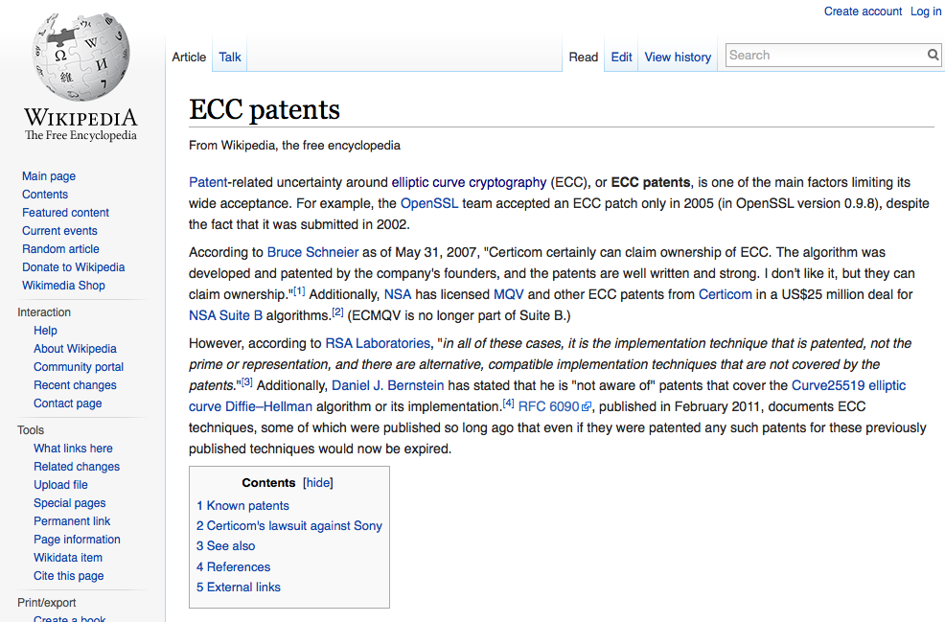
ECDSA has a history…

Slide 37
ECDSA and OpenSSL
OpenSSL added ECDSA support as from 0.9.8 (2005)
Other bundles and specific builds added ECDSA support later
But deployed systems often lag behind the latest bundles, and therefore still do not include ECC support in their running configuration

Slide 38
Is ECDSA viable?
What does NIST say?
http://nvlpubs.nist.gov/nistpubs/SpecialPublications/NIST.SP.800-57Pt3r1.pdf

Slide 39
Do folk use ECDSA for public keys?
$ dig +dnssec www.cloudflare-dnssec-auth.com
; <<>> DiG 9.9.6-P1 <<>> +dnssec www.cloudflare-dnssec-auth.com
;; global options: +cmd
;; Got answer:
;; ->>HEADER<<- opcode: QUERY, status: NOERROR, id: 7049
;; flags: qr rd ra ad; QUERY: 1, ANSWER: 6, AUTHORITY: 0, ADDITIONAL: 1
;; OPT PSEUDOSECTION:
; EDNS: version: 0, flags: do; udp: 4096
;; QUESTION SECTION:
;www.cloudflare-dnssec-auth.com. IN A
;; ANSWER SECTION:
www.cloudflare-dnssec-auth.com. 300 IN A 104.20.23.140
www.cloudflare-dnssec-auth.com. 300 IN A 104.20.21.140
www.cloudflare-dnssec-auth.com. 300 IN A 104.20.19.140
www.cloudflare-dnssec-auth.com. 300 IN A 104.20.22.140
www.cloudflare-dnssec-auth.com. 300 IN A 104.20.20.140
www.cloudflare-dnssec-auth.com. 300 IN RRSIG A 13 3 300 20150317021923 20150315001923 35273 cloudflare-dnssec-auth.com. pgBvfQkU4Il8ted2hGL9o8NspvKksDT8/jvQ+4o4h4tGmAX0fDBEoorb tLiW7mcdOWYLoOnjovzYh3Q0Odu0Xw==
;; Query time: 237 msec
;; SERVER: 127.0.0.1#53(127.0.0.1)
;; WHEN: Mon Mar 16 01:19:24 UTC 2015
;; MSG SIZE rcvd: 261
Algorithm 13 is ECDSA P-256
Signed response is 261 octets long!

Slide 40
So lets use ECDSA for DNSSEC
Or maybe we should look before we leap...
Is ECDSA a “well supported” crypto protocol? *
If you signed using ECDSA would resolvers validate the signature?
It’s not that crypto libraries deliberately exclude ECDSA support these days. The more likely issue appears to be the operational practic es of some ISPs who use crufty old software sets to support DNS resolvers which are now running old libraries that predate the incorporation of ECDSA into Open SSL
*

Slide 41
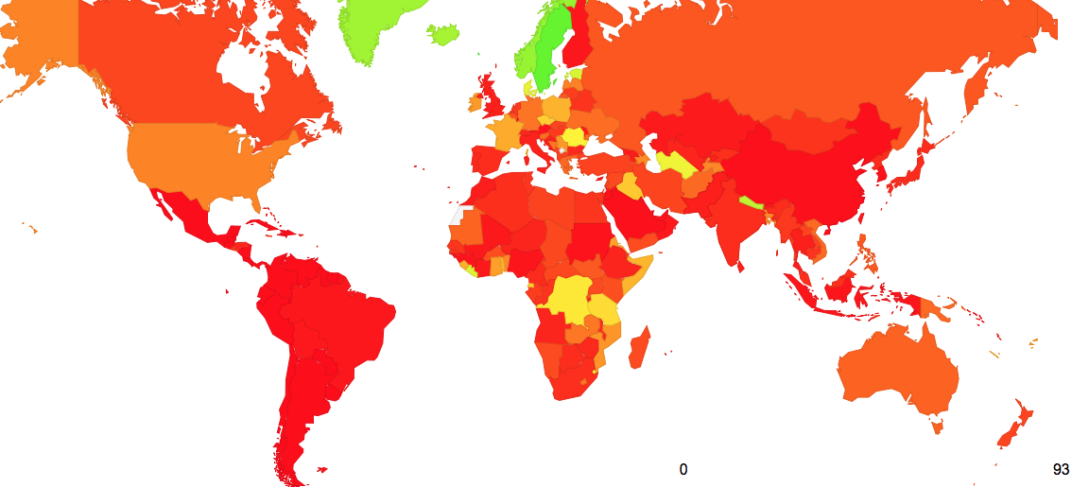
Where are the users who can validate ECDSA-signed DNSSEC records?
https://stats.labs.apnic.net/ecdsa

Slide 42
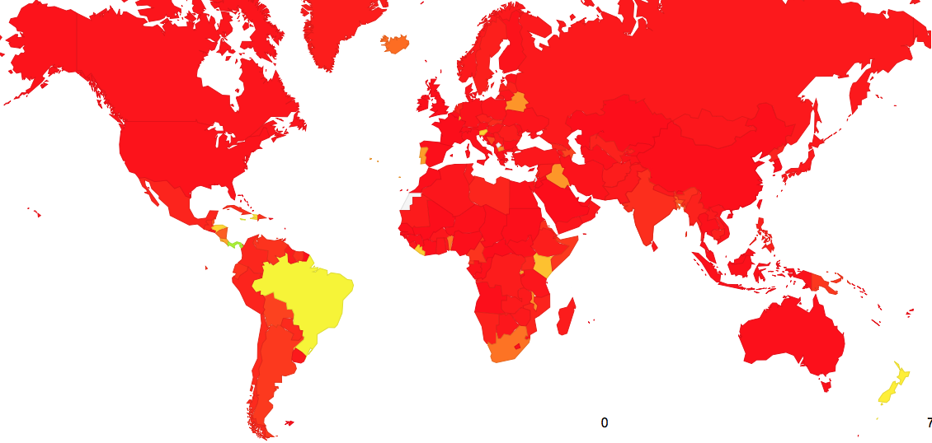
And where ECDSA support is missing
https://stats.labs.apnic.net/ecdsa

Slide 43
Today we’re in Vietnam…

Slide 44
Today we’re in Vietnam…

Slide 45
The Top 5 Vietnam ISPs
And the extent to which their uses perform DNSSEC validation with ECDSA and RSA

Slide 46
And it if wasn’t for Google…
There would probably be no DNSSEC at all!
And no ECDSA!

Slide 47
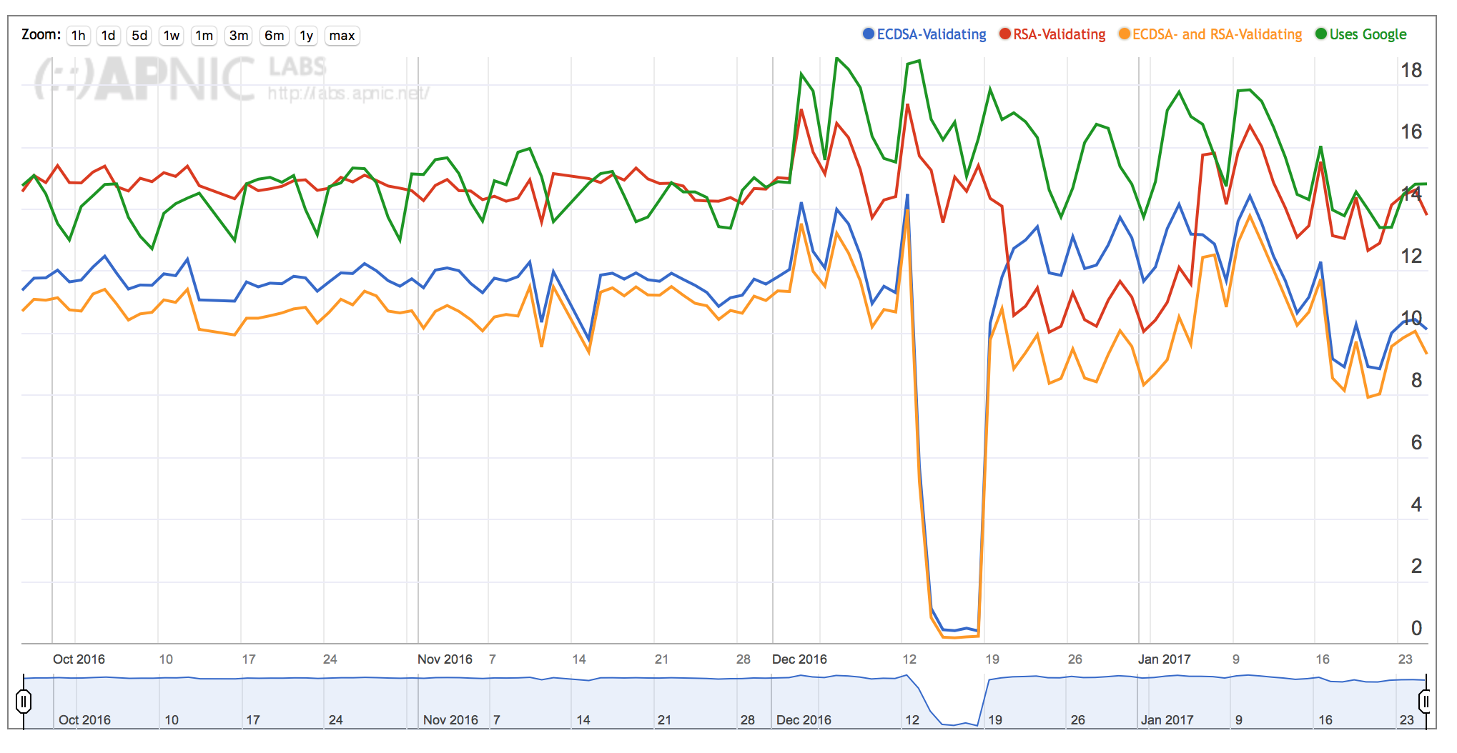
APNIC Labs Report on ECDSA use
https://stats.labs.apnic.net/ecdsa

Slide 48
Thanks!
Me: gih@apnic.net

