Slide 1
Desperately Seeking Default
Geoff Huston
APNIC

Slide 2
In the Telephone Network
All telephones were equally reachable
Anyone could dial anyone else

Slide 3
In the Telephone Network
Internet
Are all connected endpoints equally reachable?
Can anyone can reach anyone else?

Slide 4
In the Telephone Network
Internet
No!
Are all connected endpoints are equally reachable?
Can anyone can reach anyone else?
NATs and Firewall Filters changed all that – so our current expectations are that if you stand up a public service on port 80 (or 443 for that matter) then maybe everyone can reach you, but otherwise, no.

Slide 5
In the Telephone Network
Internet
All connected endpoints are equally reachable
Can anyone can reach anyone else?

Slide 6
In the Telephone Network
Internet
All connected endpoints are equally reachable
Anyone can reach anyone else
We might THINK this, but is it true ALL the time?

Slide 7
What do we see?
On the Internet is everyone really connected to everyone else?

Slide 8
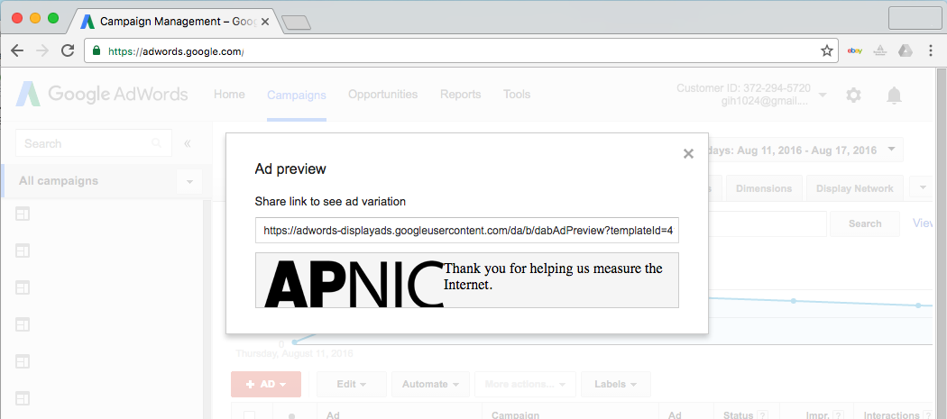
How We See
We use an online ad to present a sequence of small fetches to the user’s browser

Slide 9
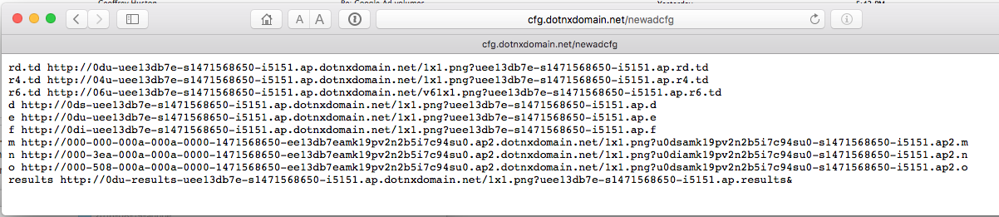
How We See
The sequence of tests is used to test a number of types of actions including fetches of IPv4,
IPv6 and Dual stack

Slide 10
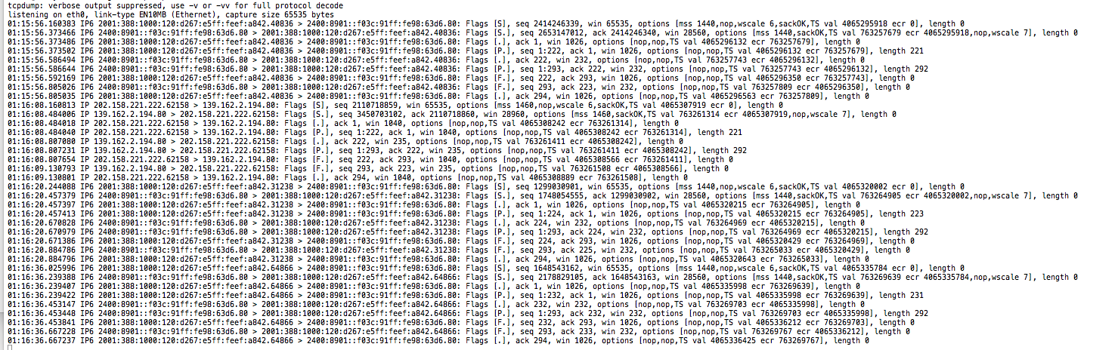
How We See
We use tcpdump to record all packet activity at the experiment’s servers

Slide 11
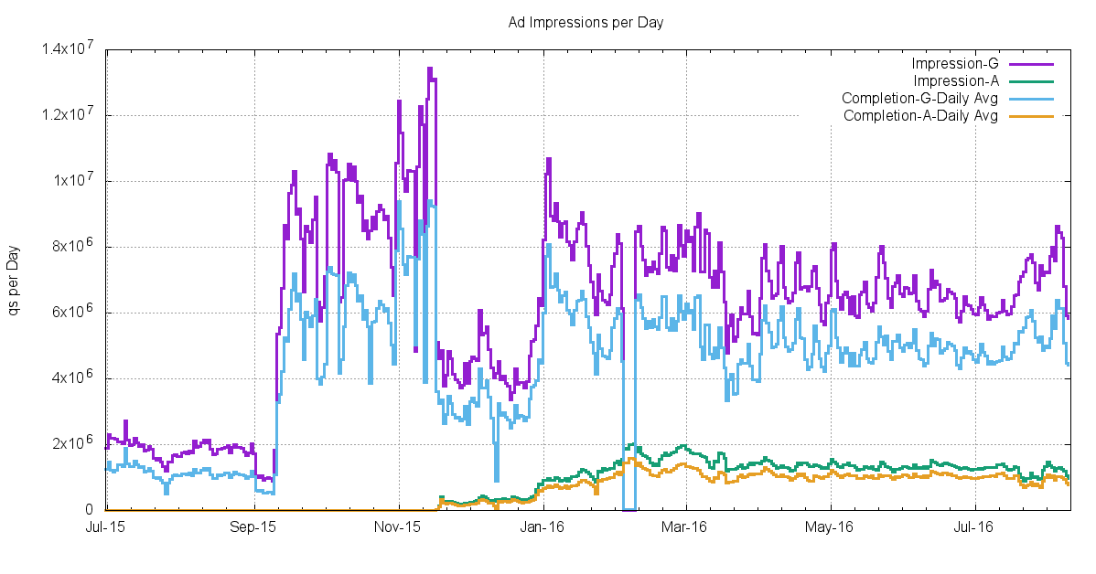
How Much do We See?

Slide 12
What we see: Connection Failure
Outbound SYN
client
server
Busted SYN ACK
Return path
What the server sees is an incoming SYN, but no matching incoming ACK

Slide 13
Daily IPv6 Failures
RIP
Flash!
HTML5 + TLS +
Mobile Devices

Slide 14
Daily IPv6 Failures

Slide 15
Daily IPv6 Failures

Slide 16
IPv6 Failures
1.5% failure for unicast V6 is unacceptable!
Why is this happening
  Auto-tunnelling?
  Lousy CPE firmware?
  Strange firewall filters?
But is all of this due to local configuration / equipment? What is the comparable view in IPv4?

Slide 17
IPv4 Connection Failure
Missing PCAP data

Slide 18
IPv4 Failures
IPv4 failures are around 1 in 500
And we are pretty sure its NOT:
  Auto-tunnelling
  Lousy CPE firmware
  Strange firewall filters
So what is the reason for this residual asymmetric failure rate?
Is it asymmetric routing connectivity?

Slide 19
Route Views Routing Table

Slide 20
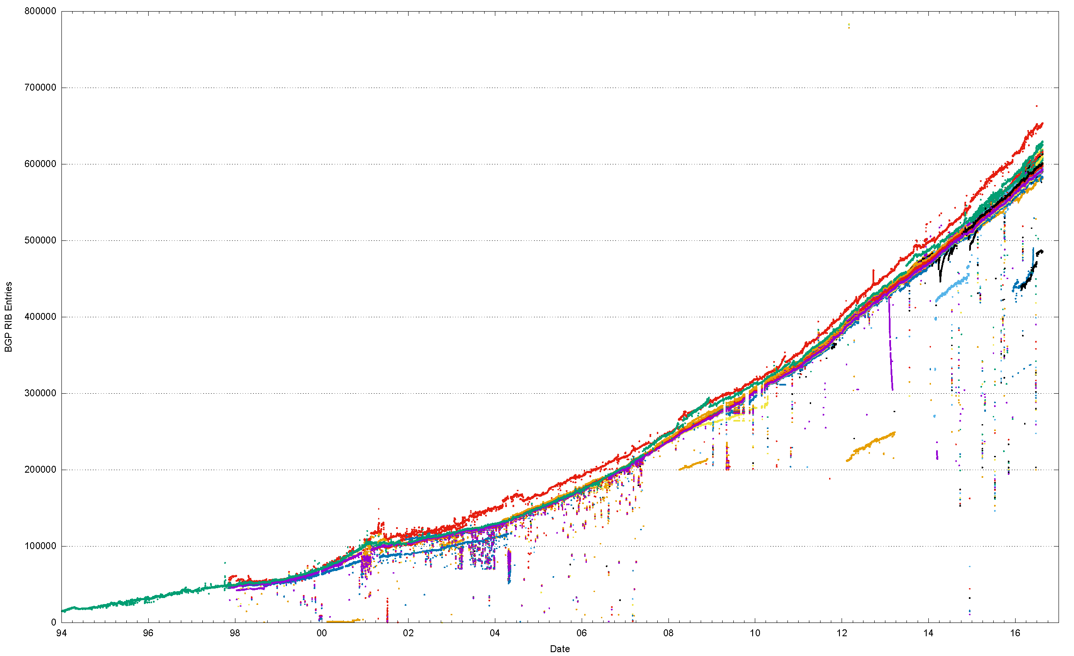
25 Years of Routing the Internet
This is a view pulled together from each of the routing peers of Route Views

Slide 21
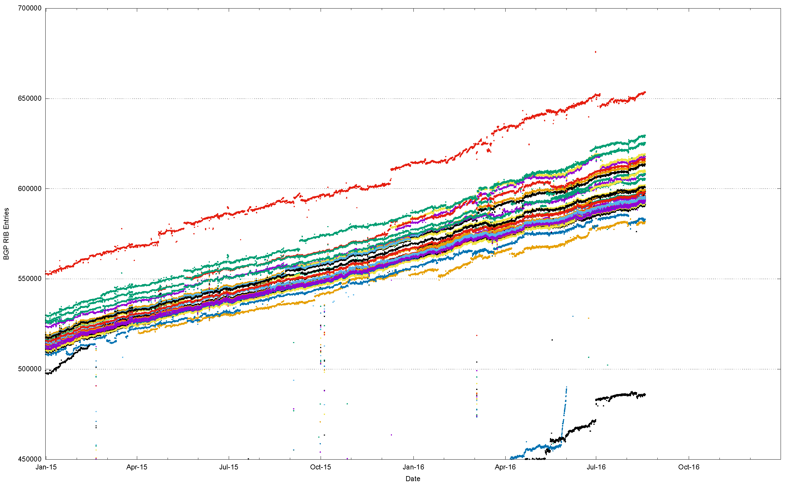
2015/16, Route Views + RIS
This is a view pulled together from each of the routing peers of Route Views and RIS
That’s a
range of 75,000
routes!

Slide 22
Different peers see a slightly different Internet
But is this just traffic engineering more specifics?
Or do different peers see a different set of reachable addresses in the routing table?

Slide 23
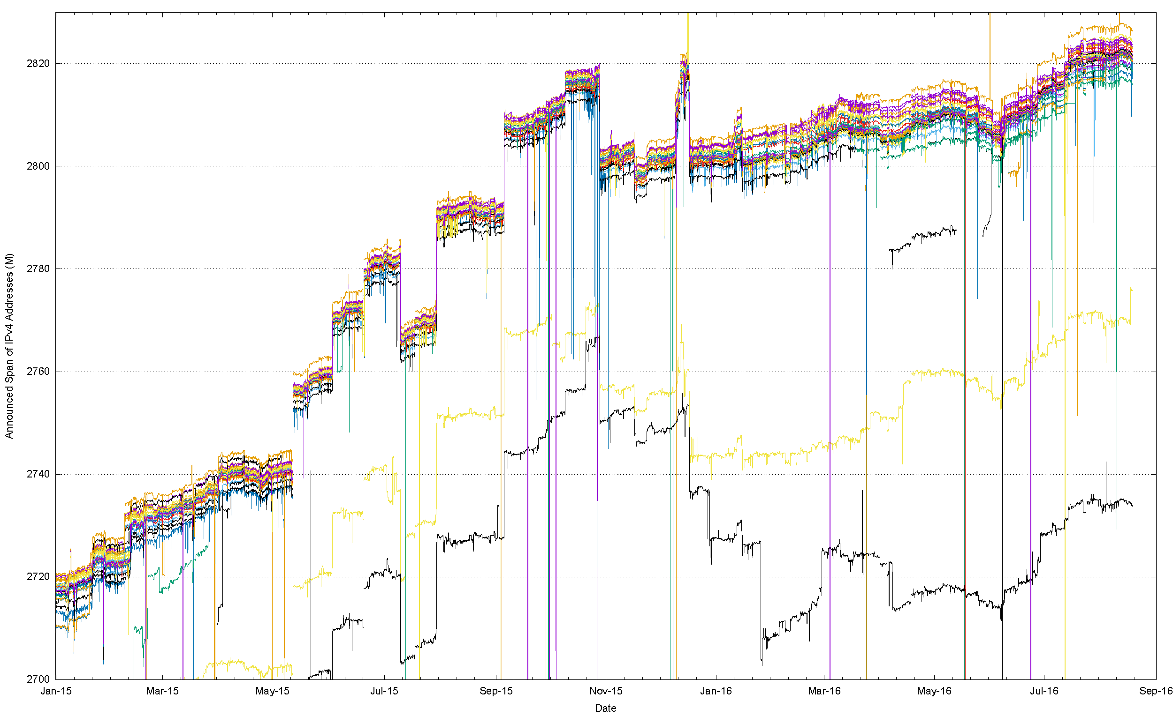
Address Span
(Route Views + RIS data sets)

Slide 24
Address Span
(Route Views + RIS data sets)
15 M Addresses

Slide 25
What does this mean?
Each peer of RouteViews and RIS announces a span of addresses that appears to be a unique span.
In total, these spans agree with other to within ~20M addresses, but this means that there are potentially some 20M uniquely addressed endpoints that cannot be reached from all other endpoints.
This variation is stable over time for each peer, so its not transient routing that is generating this – the reasons for this difference in reachability are structural

Slide 26
What about IPv6?

Slide 27
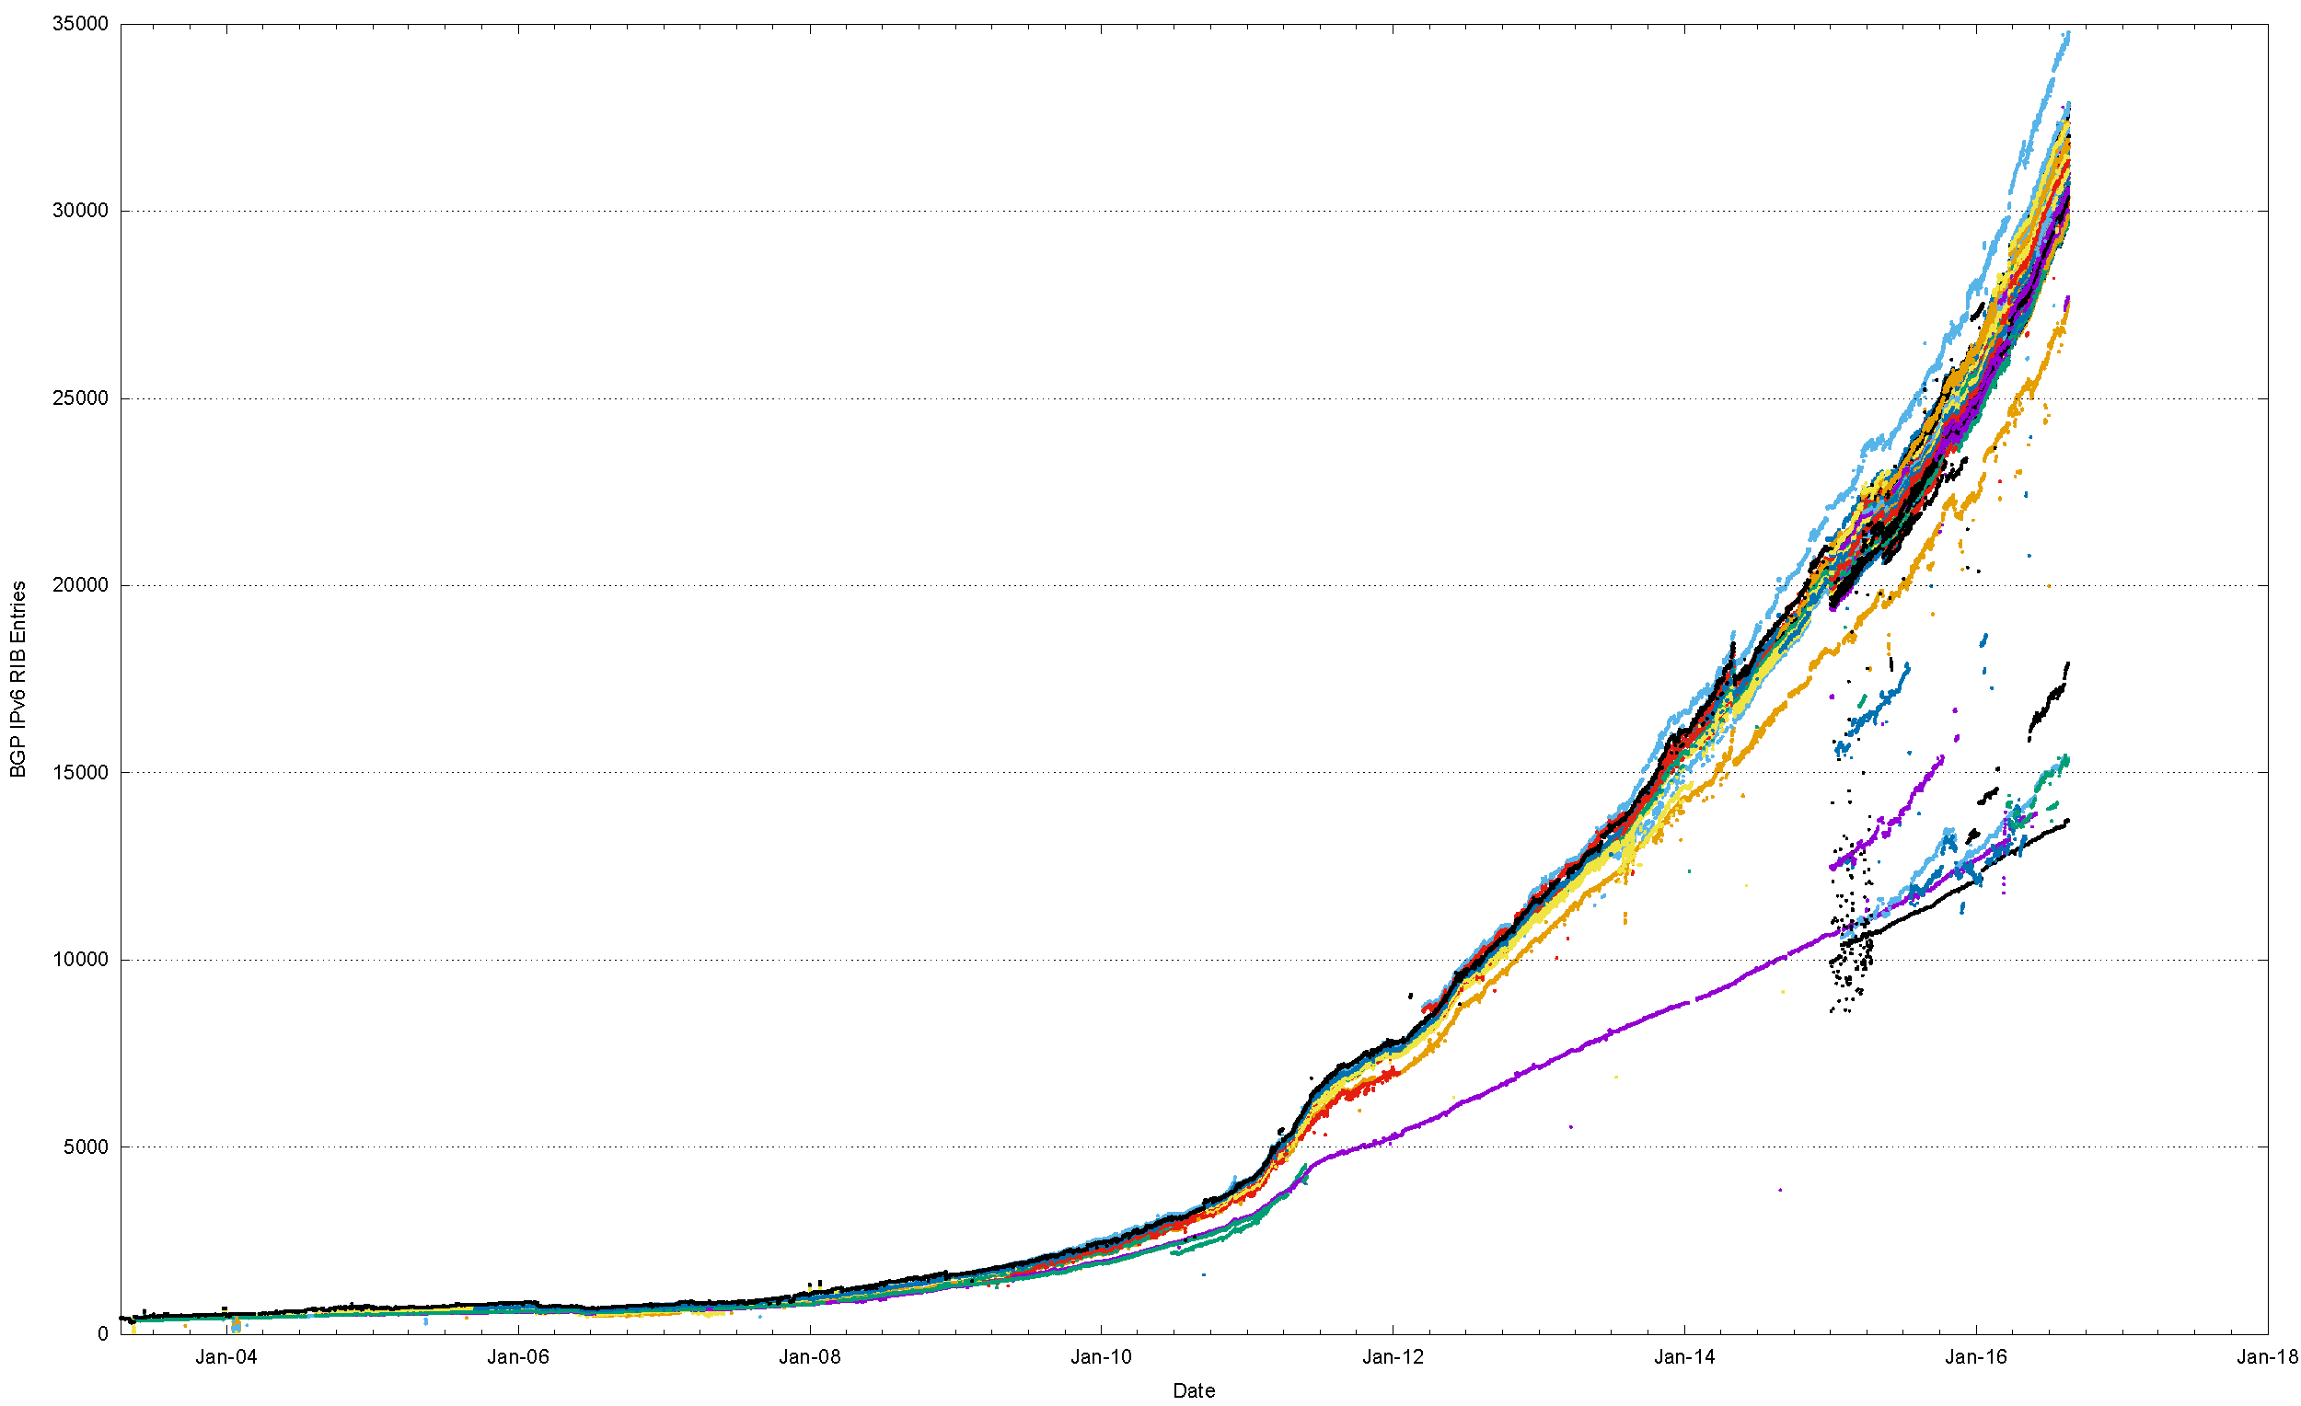
The Route Views view of IPv6
World IPv6 Day
IANA IPv4 Exhaustion

Slide 28
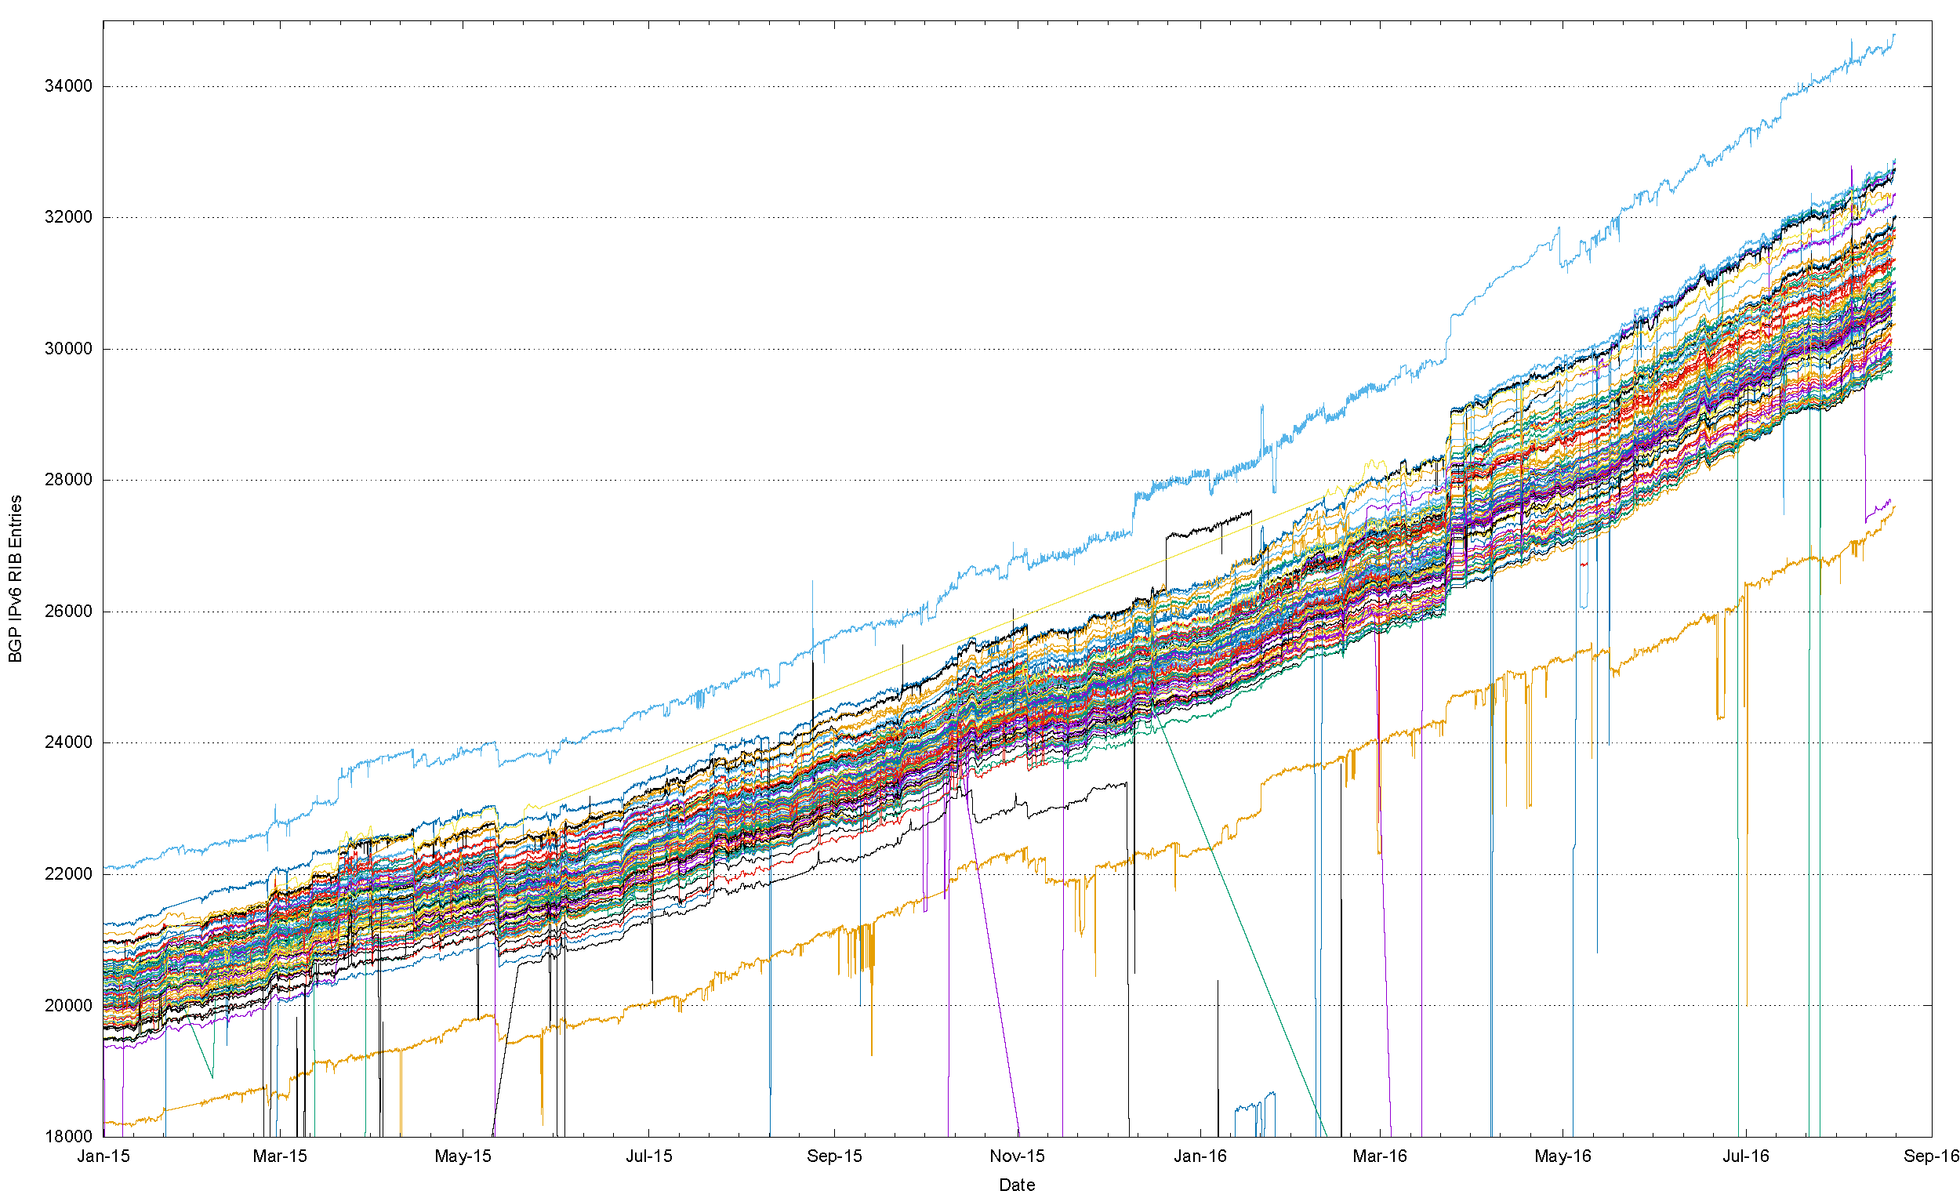
Number of IPv6 Routes in 2015/16
That’s a
range of 2,300
routes!

Slide 29
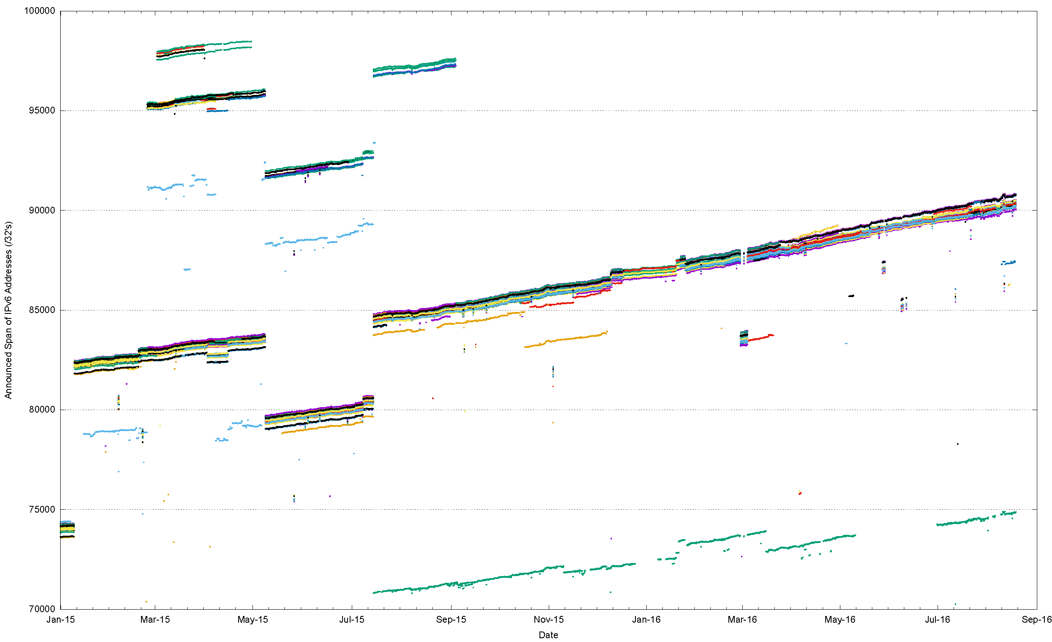
IPv6 Announced Address Span Variation (RV + RIS)

Slide 30
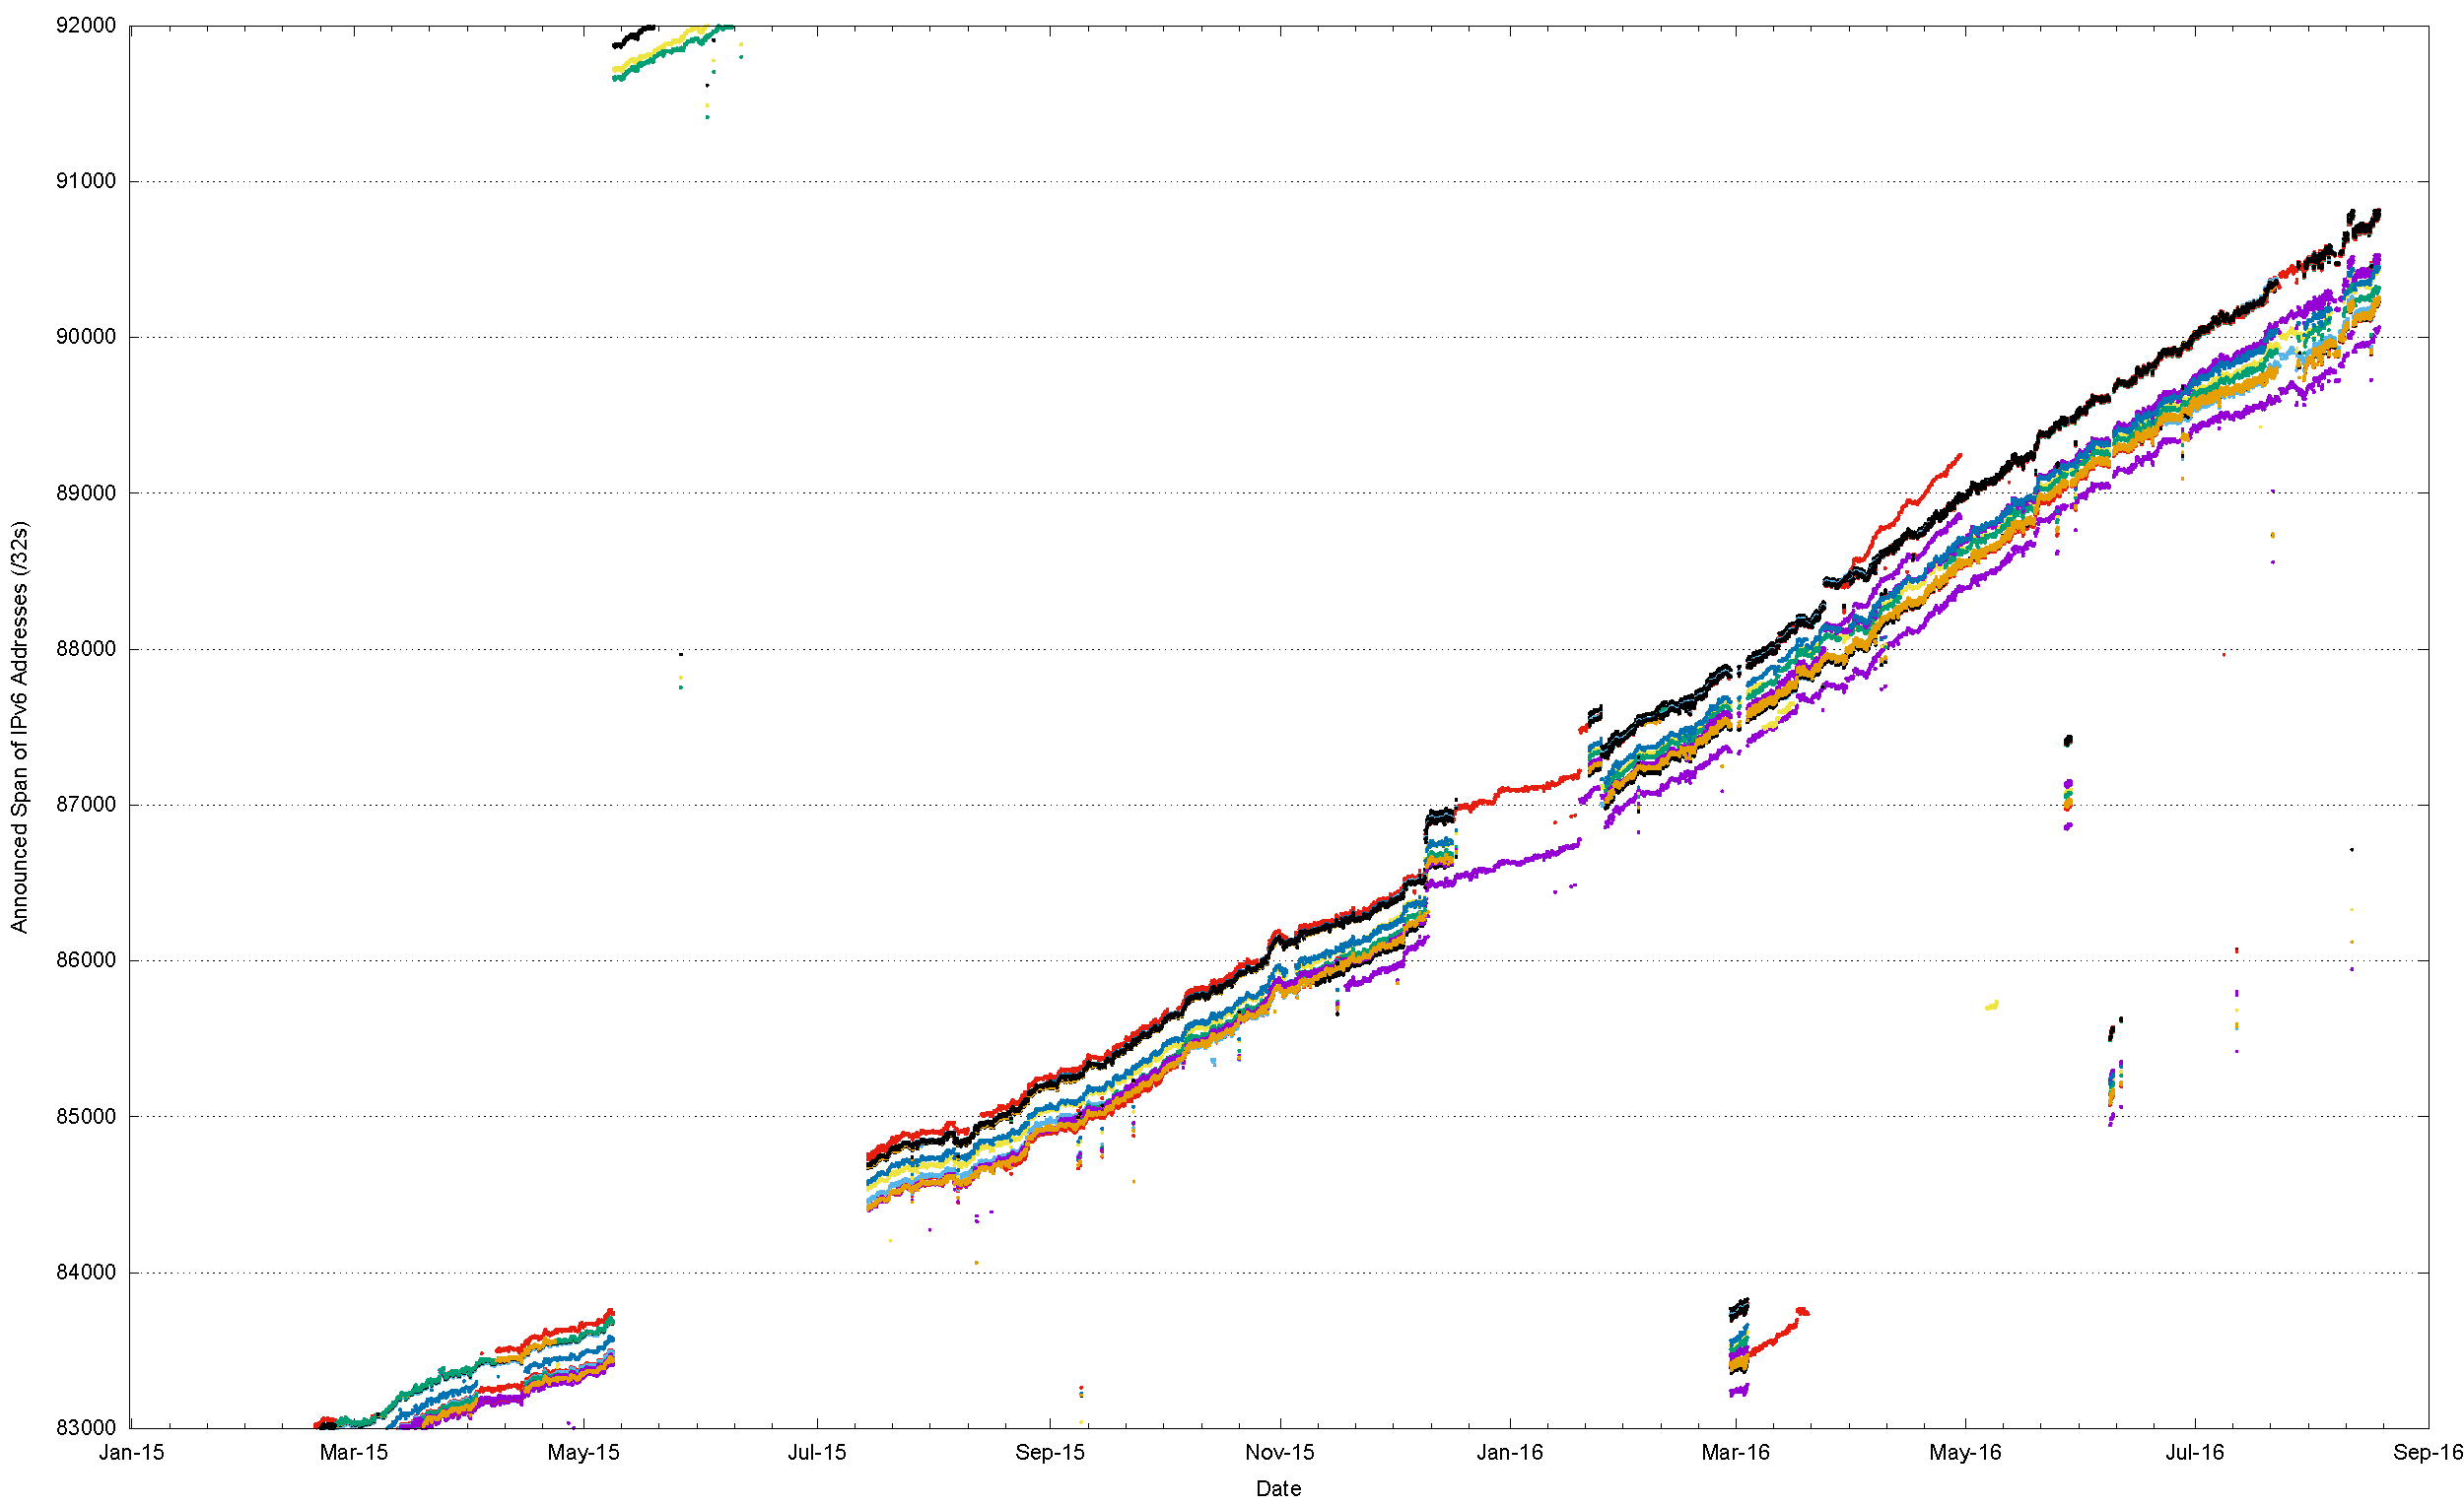
IPv6 Announced Address Span Variation (RV + RIS)

Slide 31
What is “default”?
There is no “default” route set that we can all agree on

Slide 32
What is “default”?
At best “default” is an informal quorum
  So lets define this quorum by arbitrarily setting the quorum threshold at 2/3
  i.e. if 2/3 of the peers of a route collector advertise a route then it is part of the default quorum.
Individual peer networks will contain route sets that differ from this quorum by having both additional prefixes and holes.
  Lets look at the variance from the quorum

Slide 33
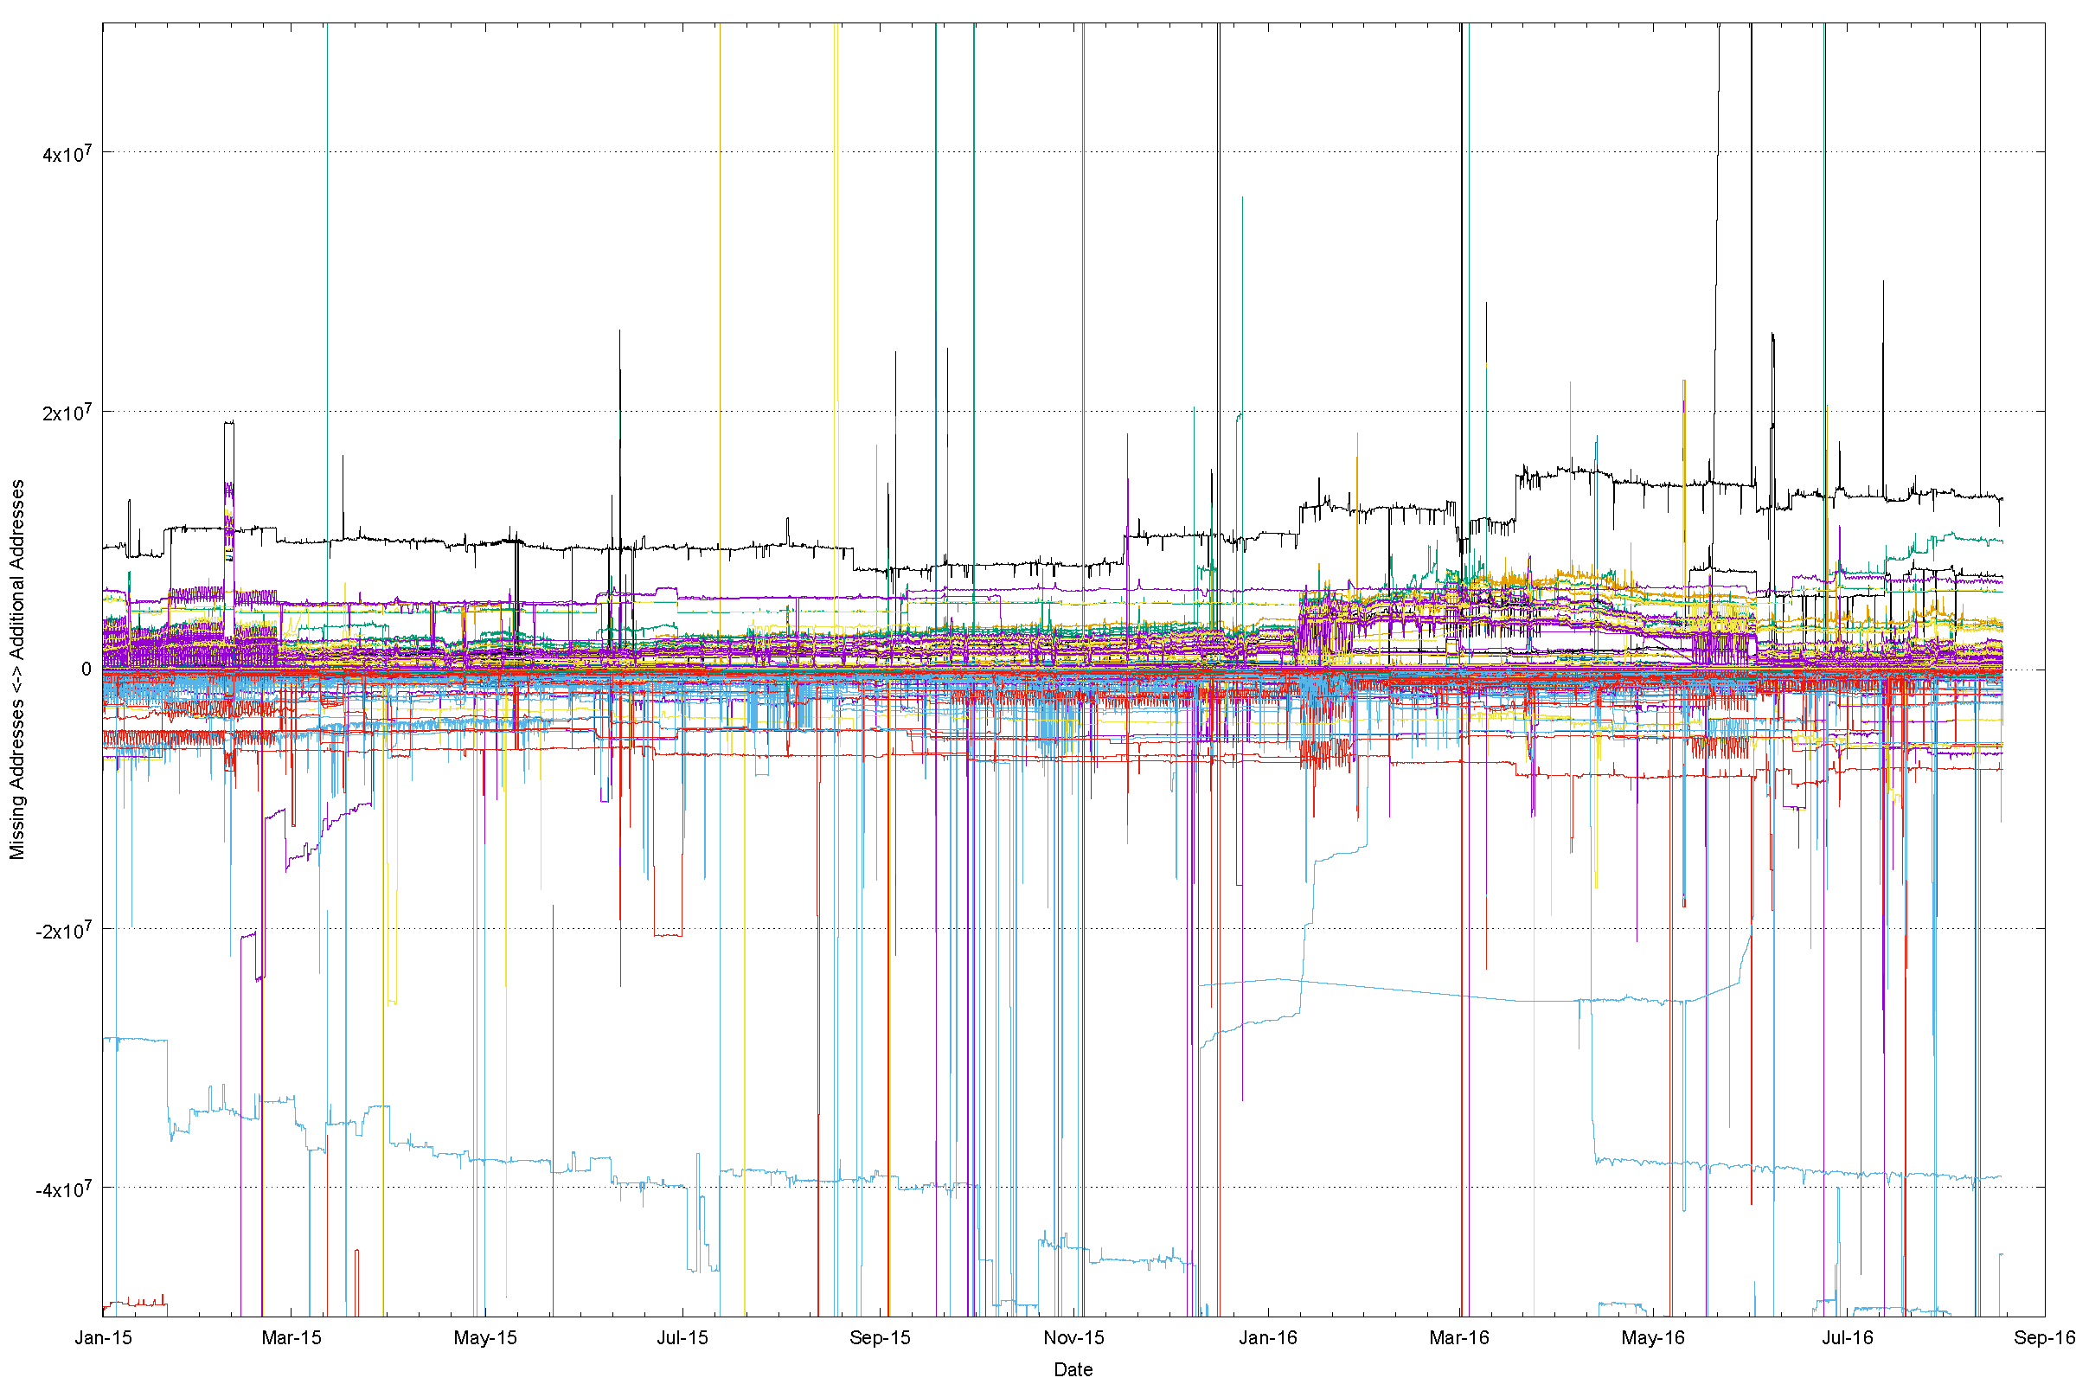
A “Quorum” deviation view of IPv4

Slide 34
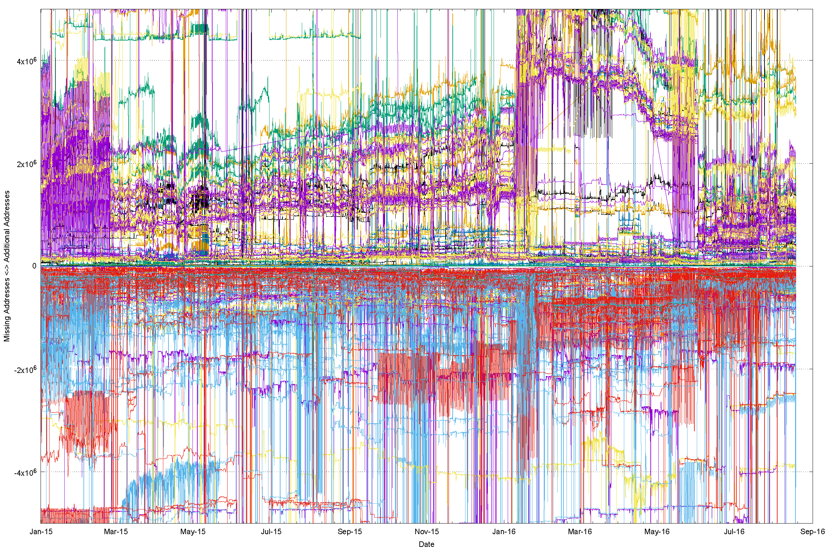
A magnified view

Slide 35
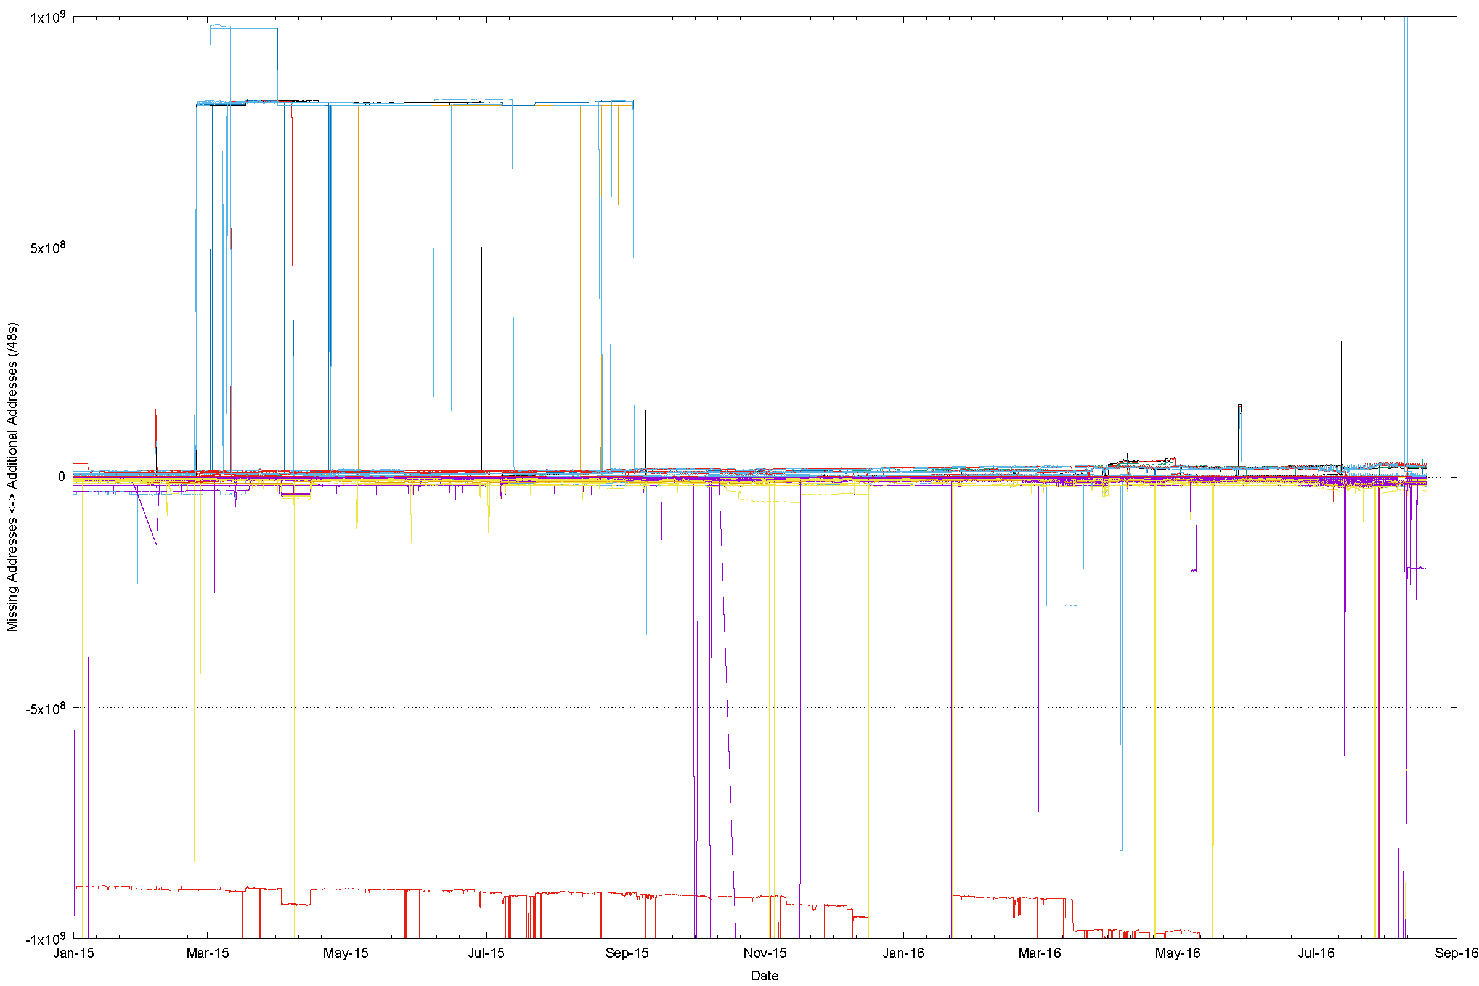
IPv6 “Quorum” Deviation

Slide 36
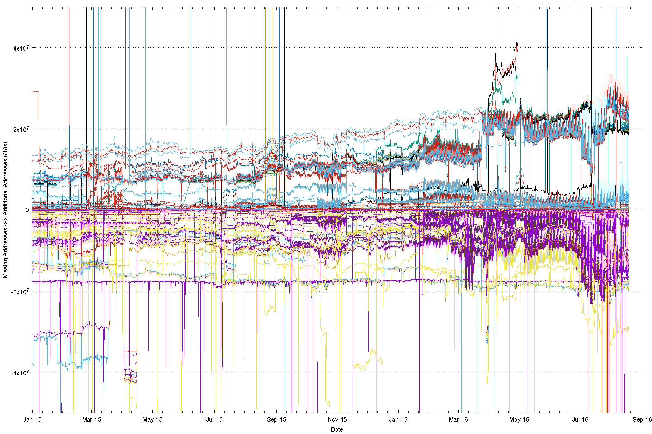
Zooming In

Slide 37
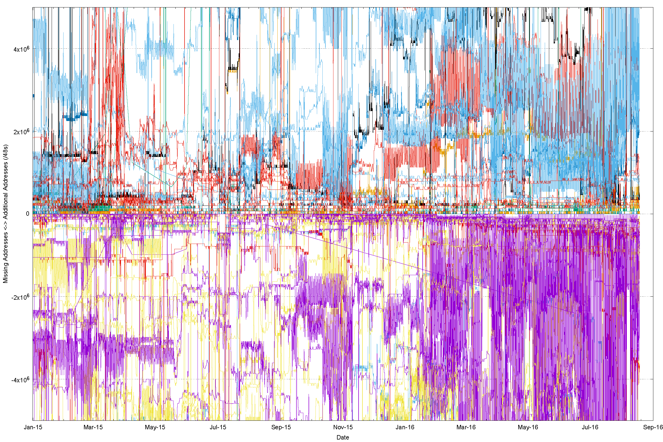
And Again

Slide 38
And Again!

Slide 39
Quorum Deviation for RVA IPv4 Peers (18th August 2016)

Slide 40
Quorum Deviation for RIS IPv4 Peers 18th August 2016)

Slide 41
Quorum Deviation: IPv6, RVA

Slide 42
Quorum Deviation: IPv6, RIS

Slide 43
It’s structural, not temporal
There is a visible stability to this deviation from the quorum route set
  The variation from the quorum is long–term stable, and does not rapidly self-correct – its not a transient routing state
We appear to assume that all Tier 1 providers, and their Tier 2, 3, … resellers offer the same reachability set as each other – i.e. ”default” is consistent everywhere
But this is not necessarily the case all the time for every address in the routing system
“Default” appears to vary by provider and by location
  E.g.: 25 April, 1600 UTC:
    AS2914: RouteViews 2,808,560,896 addresses
    RIS: 2,807,358,208

Slide 44
So What?
Surely all this is patched up by the widespread use of default in addition to specific routes? (*)
* Internet Optometry: Assessing the Broken Glasses in Internet Reachability”,
R. Bush, O. Maennel, M. Roughan, S Uhlig, ACM SIGCOMM IMC, 2009

Slide 45
So What?
Surely all this is patched up by the widespread use of default in addition to specific routes?
  Well, not really
  Default points along upstream transits
  It does not patch downstreams
Route to B not propagated on this connection
Packet from B to A follows explicit route
A
Packet from B to A follows default and then
dropped
B

Slide 46
To Recap: What is causing this?

Slide 47
To Recap: What is causing this?
Could part of this be due to connectivity failure?

Slide 48
Connection Failure
Outbound SYN
client
server

Slide 49
Connection Failure
Outbound SYN
client
server
SYN ACK
Return path

Slide 50
Connection Failure
Outbound SYN
client
router
server
Busted SYN ACK
Return path

Slide 51
Connection Failure
Outbound SYN
client
router
server
Busted SYN ACK
Return path
ICMP Dest Unreachable

Slide 52
Connection Failure
Outbound SYN
client
router
server
Busted SYN ACK
Return path
ICMP Dest Unreachable
What the server sees is an incoming SYN, and then an ICMP destination unreachable

Slide 53
And we see this … here’s an example
14:16:05.999497 IP (tos 0x0, ttl 55, id 31005, offset 0, flags [none], proto ICMP (1), length 80)
84.41.108.74 > 139.162.146.97: ICMP host 46.163.63.47 unreachable, length 60
Outer packet is an ICMP Packet with a “destination unreachable” code sent to the server from the router at address 84.41.108.74
IP (tos 0x0, ttl 57, id 0, offset 0, flags [DF], proto TCP (6), length 52)
139.162.146.97.443 > 46.163.63.xx.52087: Flags [S.], cksum 0x5130 (correct), seq 3917125220, ack 685287936, win 29200, options [mss 1460,nop,nop,sackOK,nop,wscale 7], length 0
Payload packet is a SYN+ACK packet

Slide 54
Connection Failure
Outbound SYN
client
router
server
Busted SYN ACK
Return path
ICMP Dest Unreachable
What the server sees is an incoming SYN, and then an ICMP destination unreachable
But this is not a reliable signal – routers do not always generate an ICMP Dest Unreachable, and firewalls often filter them. But they are still visible some of the time.

Slide 55
Of course it’s not the only reason why connections fail in IPv4
NATs are also erratic:
14:16:37.959604 IP (tos 0x38, ttl 55, id 40091, offset 0, flags [none], proto ICMP (1), length 80)
197.114.50.xx > 139.162.146.97: ICMP host 197.114.50.20 unreachable, length 60
IP (tos 0x20, ttl 49, id 0, offset 0, flags [DF], proto TCP (6), length 52)
139.162.146.97.443 > 197.114.50.xx.55648: Flags [S.], cksum 0xeb1e (correct), seq 3454637726, ack 3599361621, win 29200, options [mss 1400,nop,nop,sackOK,nop,wscale 7], length 0
Why is the destination telling us that it is unreachable?

Slide 56
Of course it’s not the only reason why connections fail in IPv4
NATs are also erratic:
14:16:37.959604 IP (tos 0x38, ttl 55, id 40091, offset 0, flags [none], proto ICMP (1), length 80)
197.114.50.xx > 139.162.146.97: ICMP host 197.114.50.20 unreachable, length 60
IP (tos 0x20, ttl 49, id 0, offset 0, flags [DF], proto TCP (6), length 52)
139.162.146.97.443 > 197.114.50.xx.55648: Flags [S.], cksum 0xeb1e (correct), seq 3454637726, ack 3599361621, win 29200, options [mss 1400,nop,nop,sackOK,nop,wscale 7], length 0
Why is the destination telling us that it is unreachable?
It’s probably a CGN that has lost its binding state while the TCP session was being established!

Slide 57
Connectivity appears to have a 1 in 500 failure rate in IPv4
Some of it is based on asymmetric views of connectivity from the routing system
Some of it is based on anomalous NAT behaviours
And some of it … we just can’t tell!

Slide 58
In the Telephone Network
Internet
All connected endpoints are equally reachable
Anyone can reach anyone else
Almost
almost
most of the time!

Slide 59
In the Telephone Network
Internet
All connected endpoints are equally reachable
Anyone can reach anyone else
Almost
almost
most of the time!
As long as all the feeder access networks can connect to Facebook, Google, Netflix, Ebay, Amazon,… then nobody seems to care enough any more to be motivated to fix it
What we now have in 2016 is a tier 1 feeder system, as it’s no longer a true uniquitous fully connected peer network
And that makes me sad!

Slide 60
Thanks!

Slide 61


