Slide 1
IPv6 Performance
Geoff Huston
APNIC Labs
November 2015

Slide 2
What are we looking at:
How “reliable” are IPv6 connections?
How “fast” are IPv6 connections?

Slide 3
What are we looking at:
How “reliable” are IPv6 connections?
How “fast” are IPv6 connections?
Do all TCP connection attempts succeed?
Is V6 slower than V4?

Slide 4
The Measurement Technique
Embed a script in an online ad
Have the script generate a set of URLs to fetch
Examine the packets seen at the server to determine reliability and RTT

Slide 5
Measurement Count

Slide 6
Measurement Count
Yes, that’s 10 M measurements per day!

Slide 7
Measurement Count
Log

Slide 8
What are we looking at:
How “reliable” are IPv6 connections?
How “fast” are IPv6 connections?
Do all TCP connection attempts succeed?
Is V6 slower than V4?

Slide 9
Connection Failure
Outbound SYN
client
server
Busted SYN ACK
Return path
What the server sees is an incoming SYN, but no matching incoming ACK

Slide 10
Compare two data sets
The first data set has been collected across 2011
  Teredo and 6to4 were still active as IPv6 mechanisms
  Little in the way of other IPv6 services
The second data set has been collected across 2015
  Missing comparative IPv4 data for the period September – October ☹

Slide 11
2011 - Measuring Failure

Slide 12
2011 - Relative Connection Failure Rates
Why is this failure rate for V6
so incredibly high?

Slide 13
2011 - Relative Connection Failure Rates
What is this spike?
And why is the V4 relative failure rate dropping over time?

Slide 14
What is going on with IPv4?

Slide 15
What is going on with IPv4?
The failure rate for V4 decreases as the volume of experiments increases – which implies that the number of “naked SYNs” being sent to the servers is not related to the number of tests being performed.
Aside from residual IPv4 failures in the image fetch due to device resets, connection dropouts, etc, the bulk of the recorded failures here is probably attributable to researchers bots doing all-of-address scanning on port 80

Slide 16
What is going on with IPv4?
Syn attacks?
bot scanning on port 80?

Slide 17
What about IPv6?
Local Miredo Relay Failures
Why is the base failure rate
of all IPv6 connections sitting
at 40%? This is amazingly bad!

Slide 18
V6 Failure Rate by Address Type
Teredo
All V6 Average
6 to 4
Unicast

Slide 19
6to4 Failure is Local Failure
6to4 failure appears to be related to two factors:
  The client’s site has a protocol 41 firewall filter rule for incoming traffic (this is possibly more prevalent in AsiaPac than in Europe)
  Load / delay / reliability issues in the server’s chosen outbound 6to4 relay (noted in the data gathered at the US server)
Even so, the 10% to 20% connection failure rate for 6to4 is unacceptably high!

Slide 20
V6 Unicast Failures
January – March 2012:
  110,761 successful V6 connecting endpoints
  6,227 failures
  That’s a failure rate of 5.3%!
  7 clients used fe80:: link local addresses
  7 clients used fc00:/7 ULA source addresses
  2 clients used fec0::/16 deprecated site local addresses
  16 clients used 1f02:d9fc::/16
  Nobody used 3ffe::/16 prefixes!

Slide 21
Data Set 2:
Connection Failure in 2015
January– November 2015
24,212,563 IPv6 endpoints
352,919 Failure rate (4.1%)

Slide 22
Daily IPv6 Failures

Slide 23
Daily IPv6 Failures
RIP
Flash!
HTML5 + TLS +
Mobile Devices

Slide 24
6to4
6,634,660 6to4 endpoints
  27% of all IPv6 used 6to4
  9% failure rate within the set of 6to4 connections
This is still very high!

Slide 25
Daily IPv6 Failures

Slide 26
Daily IPv6 Failures
6to4 failure rate has improved from 15%-20% in 2011 to 9% in 2015
Teredo has all but disappeared
Unicast failure rate is between 1.5% and 4% in 2015
  Current unicast failure rate is 2%

Slide 27
Origin AS’s with High IPv6 Failure Rates
AS Failure Samples AS Name
Rate
AS13679 99.69% 318 Centros Culturales de Mexico, A.C., MX
AS201986 94.74% 133 ARPINET Arpinet LLC, AM
AS5511 90.68% 161 OPENTRANSIT Orange S.A., FR
AS20880 72.56% 962 TELECOLUMBUS Tele Columbus AG, DE
AS17660 57.06% 1,041 DRUKNET-AS DrukNet ISP, BT
AS21107 46.64% 7,564 BLICNET-AS Blicnet d.o.o., BA
AS4755 40.82% 316 TATACOMM-AS TATA Communications formerly VSNL is Leading ISP, IN
AS37992 40.25% 159 THAMMASAT-BORDER-AS Thammasat University in thailand, TH
AS28580 39.64% 1,158 CILNET Comunicacaoe Informatica LTDA., BR
AS17412 35.58% 163 WOOSHWIRELESSNZ Woosh Wireless, NZ
AS52207 33.62% 931 TULA-AS JSC "ER-Telecom Holding", RU
AS4796 32.61% 414 BANDUNG-NET-AS-AP Institute of Technology Bandung, ID
AS30036 30.59% 17,001 MEDIACOM-ENTERPRISE-BUSINESS - Mediacom Communications Corp, US
AS9329 29.35% 184 SLTINT-AS-AP Sri Lanka Telecom Internet, LK
AS7477 28.10% 153 TEREDONN-AS-AP SkyMesh Pty Ltd, AU
AS52888 25.79% 190 UNIVERSIDADE FEDERAL DE SAO CARLOS, BR
AS28343 24.52% 681 TPA TELECOMUNICACOES LTDA, BR
AS210 22.27% 247 WEST-NET-WEST - Utah Education Network, US
AS29632 19.25% 239 NASSIST-AS NetAssist LLC, UA
AS20857 18.10% 105 TRANSIP-AS TransIP B.V., NL

Slide 28
Origin AS’s with Zero Failure Rates
AS3223 0.00% 3,138 VOXILITY Voxility S.R.L., RO
AS16265 0.00% 2,761 LEASEWEB-NETWORK LeaseWeb Network B.V., NL
AS24961 0.00% 2,644 MYLOC-AS myLoc managed IT AG, DE
AS39832 0.00% 1,945 NO-OPERA Opera Software ASA, NO
AS2686 0.00% 1,824 ATGS-MMD-AS - AT&T Global Network Services, LLC, US
AS33070 0.00% 1,633 RMH-14 - Rackspace Hosting, US
AS55536 0.00% 1,351 PSWITCH-HK PACSWITCH GLOBAL IP NETWORK, HK
AS21191 0.00% 1,210 ASN-SEVERTTK Closed Joint Stock Company TransTeleCom, RU
AS22584 0.00% 1,165 NTELOS-PCS - Ntelos Inc., US
AS32780 0.00% 1,119 HOSTINGSERVICES-INC - Hosting Services, Inc., US
AS29854 0.00% 1,039 WESTHOST - WestHost, Inc., US
AS18144 0.00% 974 AS-ENECOM Energia Communications,Inc., JP
AS12510 0.00% 762 SAP_AG_WDF SAP SE, DE
AS21837 0.00% 757 OPERASOFTWARE - Opera Software Americas LLC, US
AS13213 0.00% 741 UK2NET-AS UK2 - Ltd, GB
AS9619 0.00% 672 SSD Sony Global Solutions Inc., JP
AS19994 0.00% 660 RACKSPACE - Rackspace Hosting, US
AS32934 0.00% 654 FACEBOOK - Facebook, Inc., US
AS25513 0.00% 639 ASN-MGTS-USPD OJS Moscow city telephone network, RU
AS2614 0.00% 608 ROEDUNET Agentia de Admin a Retelei Nationale de Informatica Educatie si Cercetare, RO
Ranked by IPv6 measurement count

Slide 29
Origin AS’s with Zero Failure Rates
AS3223 0.00% 3,138 VOXILITY Voxility S.R.L., RO
AS16265 0.00% 2,761 LEASEWEB-NETWORK LeaseWeb Network B.V., NL
AS24961 0.00% 2,644 MYLOC-AS myLoc managed IT AG, DE
AS39832 0.00% 1,945 NO-OPERA Opera Software ASA, NO
AS2686 0.00% 1,824 ATGS-MMD-AS - AT&T Global Network Services, LLC, US
AS33070 0.00% 1,633 RMH-14 - Rackspace Hosting, US
AS55536 0.00% 1,351 PSWITCH-HK PACSWITCH GLOBAL IP NETWORK, HK
AS21191 0.00% 1,210 ASN-SEVERTTK Closed Joint Stock Company TransTeleCom, RU
AS22584 0.00% 1,165 NTELOS-PCS - Ntelos Inc., US
AS32780 0.00% 1,119 HOSTINGSERVICES-INC - Hosting Services, Inc., US
AS29854 0.00% 1,039 WESTHOST - WestHost, Inc., US
AS18144 0.00% 974 AS-ENECOM Energia Communications,Inc., JP
AS12510 0.00% 762 SAP_AG_WDF SAP SE, DE
AS21837 0.00% 757 OPERASOFTWARE - Opera Software Americas LLC, US
AS13213 0.00% 741 UK2NET-AS UK2 - Ltd, GB
AS9619 0.00% 672 SSD Sony Global Solutions Inc., JP
AS19994 0.00% 660 RACKSPACE - Rackspace Hosting, US
AS32934 0.00% 654 FACEBOOK - Facebook, Inc., US
AS25513 0.00% 639 ASN-MGTS-USPD OJS Moscow city telephone network, RU
AS2614 0.00% 608 ROEDUNET Agentia de Admin a Retelei Nationale de Informatica Educatie si Cercetare, RO
Ranked by IPv6 measurement count

Slide 30
IPv6 Failures – Q3 2015
279,116 failing IPv6 addresses
143,357 6to4 addresses
118 teredo addresses
92 fe80:: local scope addresses
709 unallocated addresses
1,358 unannounced addresses
133,482 addresses from unicast allocated routed space
102,826 unique /64s

Slide 31
What about IPv4 Connection Failures?
2011: failure rate 0.2%

Slide 32
What about IPv4 Connection Failures?
2011: failure rate 0.2%
2015:
334,957,192 IPv4 endpoints
1,197,903 Connection Failures (0.3%)

Slide 33
IPv4 Connection Failure
Missing PCAP data

Slide 34
Comparison

Slide 35
Comparison: Unicast

Slide 36
Comparison: Unicast
9x

Slide 37
It’s still not good!
IPv6 Unicast Failure rate: 1.8% (steady)
IPv4 Failure rate: 0.2% (and falling!)

Slide 38
What are we looking at:
How “reliable” are IPv6 connections?
How “fast” are IPv6 connections?
Do all TCP connection attempts succeed?
Is V6 slower than V4?

Slide 39
Let’s dive into SYNs!

Slide 40
Why SYNs?
Every TCP session starts with a SYN handshake
Its typically a kernel level operation, which means that there is little in the way of application level interaction with the SYN exchange
On the downside there is only a single sample point per measurement

Slide 41
Generating a comparative RTT profile
For each successful connection couplet (IPv4 and IPv4) from the same endpoint, gather the pair of RTT measurements from the SYN-ACK exchanges
  Use the server’s web logs to associate a couplet of IPv4 and IPv6 addresses
  Use the packet dumps to collect RTT information from the SYN-ACK Exchange
  Plot the difference in RTT in buckets

Slide 42
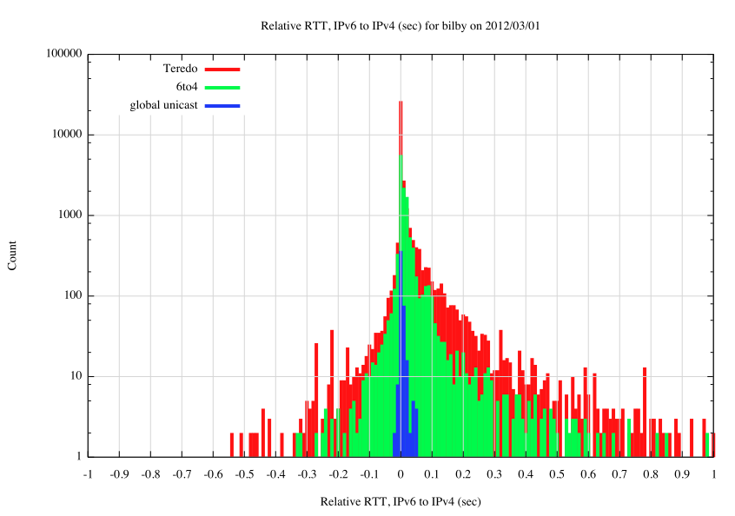
2012 Data

Slide 43
2012 Data
IPv6 is faster
IPv6 is slower
Number of samples (log scale)
6 to 4
Teredo
Unicast
RTT Difference (in fractions of a second)

Slide 44
2015 Data – November 2015
IPv6 is faster
IPv6 is slower
Number of samples (log scale)
Unicast
RTT Difference (in fractions of a second)

Slide 45
2015 Data – November 2015
IPv6 is faster
IPv6 is slower
Number of samples (log scale)
6 to 4
RTT Difference (in fractions of a second)

Slide 46
2015 Data – November 2015
IPv6 is faster
IPv6 is slower
Number of samples (log scale)
6 to 4
Unicast
RTT Difference (in fractions of a second)

Slide 47
2015 Data CDF (using 10ms resolution)
IPv6 is faster
IPv6 is slower
Proportion of samples
6 to 4
Unicast
RTT Difference (in fractions of a second)

Slide 48
2015 Data CDF (using 10ms resolution)
IPv6 is faster
IPv6 is slower
24% of samples unicast IPv6 is more than 1/100 sec slower than IPv4
Proportion of samples
6 to 4
Unicast
18% of samples unicast IPv6 is more than 1/100 sec faster than IPv4
RTT Difference (in fractions of a second)

Slide 49
2015 Data CDF (using 0.1 ms resolution)
IPv6 is slower
IPv6 is faster
Proportion of samples
6 to 4
Unicast
RTT Difference (in fractions of a second)

Slide 50
Is IPv6 as “good” as IPv4?

Slide 51
Is IPv6 as “good” as IPv4?
Is IPv6 as fast as IPv4?
  Basically, yes
  IPv6 is faster about half of the time
  For 70% of unicast cases, IPv6 is within 10ms RTT of IPv4
  So they perform at much the same rate
  But that’s just for unicast IPv6
  The use of 6to4 makes this a whole lot worse!

Slide 52
Is IPv6 as “good” as IPv4?
Is IPv6 as robust as IPv4?
  IPv4 connection reliability currently sits at 0.2%
  The base failure rate of Unicast V6 connection attempts at 1.8% of the total V6 unicast connections is not brilliant.
  6to4 is still terrible!
  It could be better.
  It could be a whole lot better!

Slide 53
Is IPv6 as “good” as IPv4?
If you can establish a connection, then IPv4 and IPv6 appear to have comparable RTT measurements across most of the Internet
But the odds of establishing that connection are still weighted in favour of IPv4!

Slide 54
That’s it!
Questions?

