Slide 1
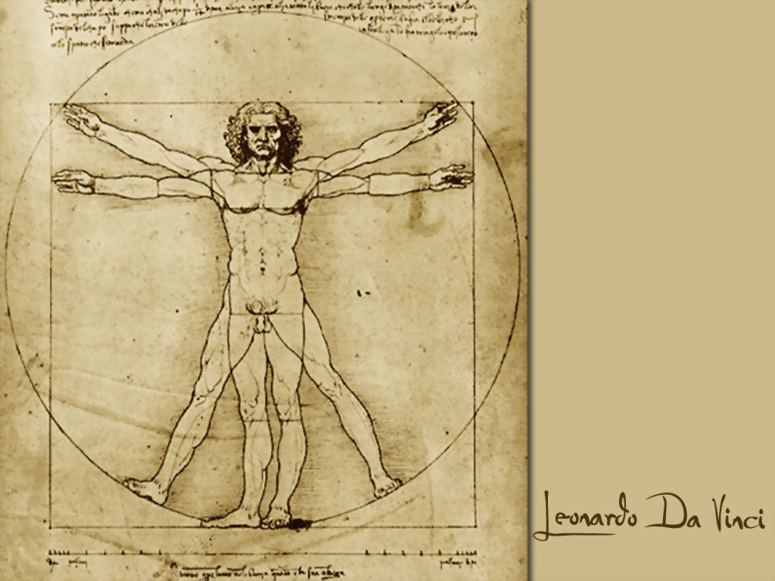
Measuring the End User
Geoff Huston
APNIC Labs

Slide 2
Measurement Bias
When we first looked at measuring in the Internet, it was all about the network, and the distinction between network management and network measurement was not very clear
We ended up measuring what’s easy to measure and often missed measuring what’s useful to understand

Slide 3
“Measurable” Questions?
How many routes are IPv6 routes?
How many service providers offer IPv6?
How many domain names have AAAA RRs?
How many domains are DNSSEC signed?
How many DNS queries are made over IPv6?
How much traffic uses IPv6?
How many connections use IPv6?
…

Slide 4
Users vs Infrastructure
None of these specific measurement questions really embrace the larger questions about the end user experience
They are all aimed at measuring an aspect of of behaviour within particular parameters of the network infrastructure, but they don’t encompass how the end user assembles a coherent view of the network

Slide 5
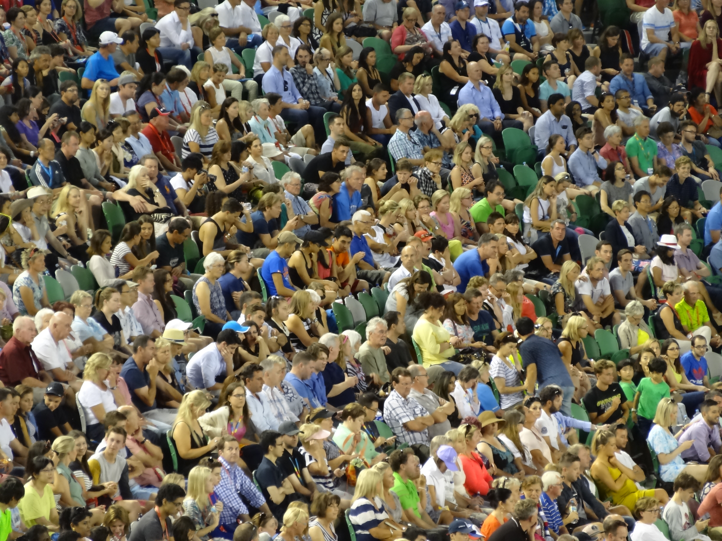
The Internet is all about US!

Slide 6
What’s the question?
How many users do <x>?
    How many users can are running IPv6?
    How many users are using DNSSEC validation?
    How many users support ECDSA in digital signatures in DNSSEC?
    How many users can resolve a DNS name?
    etc

Slide 7
Private vs Public
Very few measurements on the Internet are public
Most “all of Internet” metrics are wild-eyed guesses
  How many people use the Internet?
  How many devices use the Internet
  How much traffic is passed across the Internet?
And the bits that aren’t guesses are often folded into proprietary data

Slide 8
The Challenge:
How can we undertake meaningful public measurements that quantify aspects of users’ experiences drawn from across the entire Internet that does not rely on access to private data?

Slide 9
For example… IPv6
It would be good to know how we are going with the transition to IPv6
And it would be good everyone to know how everyone else is going with the transition to IPv6
What can we measure?
  IPv6 in the DNS – AAAA records in the Alexa top N
  IPv6 in routing – IPv6 routing table
  IPv6 traffic exchanges – traffic graphs
What should we measure?
  How many connected devices on today’s Internet are capable of making IPv6 connections?

Slide 10
How to measure millions of end devices for their IPv6 capability?

Slide 11

How to measure millions of end devices for their IPv6 capability?
a) Be

Slide 12
How to measure millions of end devices for their IPv6 capability?
Be Google
OR
b) Have your measurement code run on a million end devices

Slide 13

Ads are ubiquitous

Slide 14
Ads are ubiquitous

Slide 15
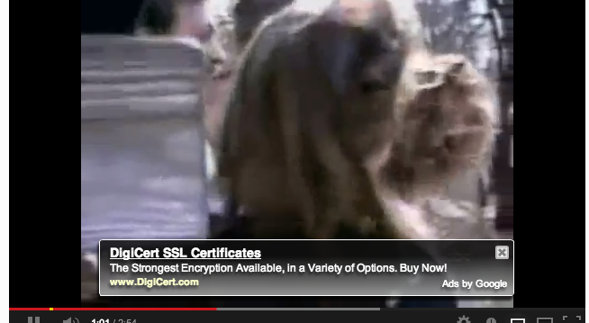
Ads are ubiquitous

Slide 16


Ads use active scripts
Advertising channels use active scripting to make ads interactive
  This is not just an ‘animated gif’ – it uses a script to sense mouse hover to change the displayed image

Slide 17
Adobe Flash and the network
Flash includes primitives in ‘actionscript’ to fetch ‘network assets’
  Typically used to load alternate images, sequences
  Not a generalized network stack, subject to constraints over what connections can be made
Flash has asynchronous ‘threads’ model for event driven, sprite animation

Slide 18
Adobe Flash and the network
Flash includes primitives in ‘actionscript’ to fetch ‘network assets’
  Typically used to load alternate images, sequences
  Not a generalized network stack, subject to constraints over what connections can be made
Flash has asynchronous ‘threads’ model for event driven, sprite animation
Flash is disappearing in today’s devices, so these days we use HTML5 as the vehicle for the measurement script

Slide 19
APNIC’s measurement technique
Craft a script which fetches URLs to measure.
URLs are reduced to a notional ‘1x1’ image which is not added to the browser’s display manager and is not displayed
URLs trigger DNS resolution via whatever name resolution mechanism is used by the local browser and host
We encode data transfer from the client to the server in the name of fetched URLs
  Could use the DNS as the information conduit:
    Result is returned by DNS name
  Could use HTTP as the information conduit
    Result is returned via parameters attached to an HTTP GET command
  We use a combination of http requests and server logs

Slide 20
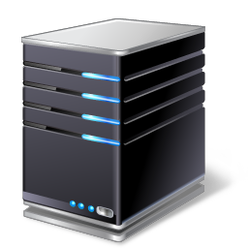

The Ad Measurement Technique
Ad Server
Authoritative Name Server
End user
Web Server

Slide 21
The Ad Measurement Technique
1. Ad Impression
Ad Server
Authoritative Name Server
End user
Web Server

Slide 22
The Ad Measurement Technique
Ad Server
2. DNS resolution
DNS Resolvers
Authoritative Name Server
End user
Web Server

Slide 23
The Ad Measurement Technique
Ad Server
Authoritative Name Server
End user
Web Server
3. Web Fetch

Slide 24
The Ad Measurement Technique
Ad Server
Authoritative Name Server
End user
Web Server
4. Result Web Fetch

Slide 25
Advertising placement logic
Fresh Eyeballs == Unique IPs
  We have good evidence the advertising channel is able to sustain a constant supply of unique IP addresses
Pay by impression
  If you select a preference for impressions, then the channel tries hard to present your ad to as many unique IPs as possible
Time/Location/Context tuned
  Can select for time of day, physical location or keyword contexts (for search-related ads)
  But if you don’t select, then placement is generalized
Aim to fill budget
  If you request $100 of placement a day, then inside the ad placement machinery an algorithm tries hard to achieve even placement loads, but in the end, will ‘soak’ place your ad to achieve enough views to bill you that target of $100

Slide 26
Ad Placement Training – Day 1

Slide 27
Ad Placement Training – Day 2

Slide 28
Ad Placement Training – Day 3

Slide 29
Ad Placement Training – Day 4

Slide 30
Ad Placement Training – Days 5, 6 & 7

Slide 31
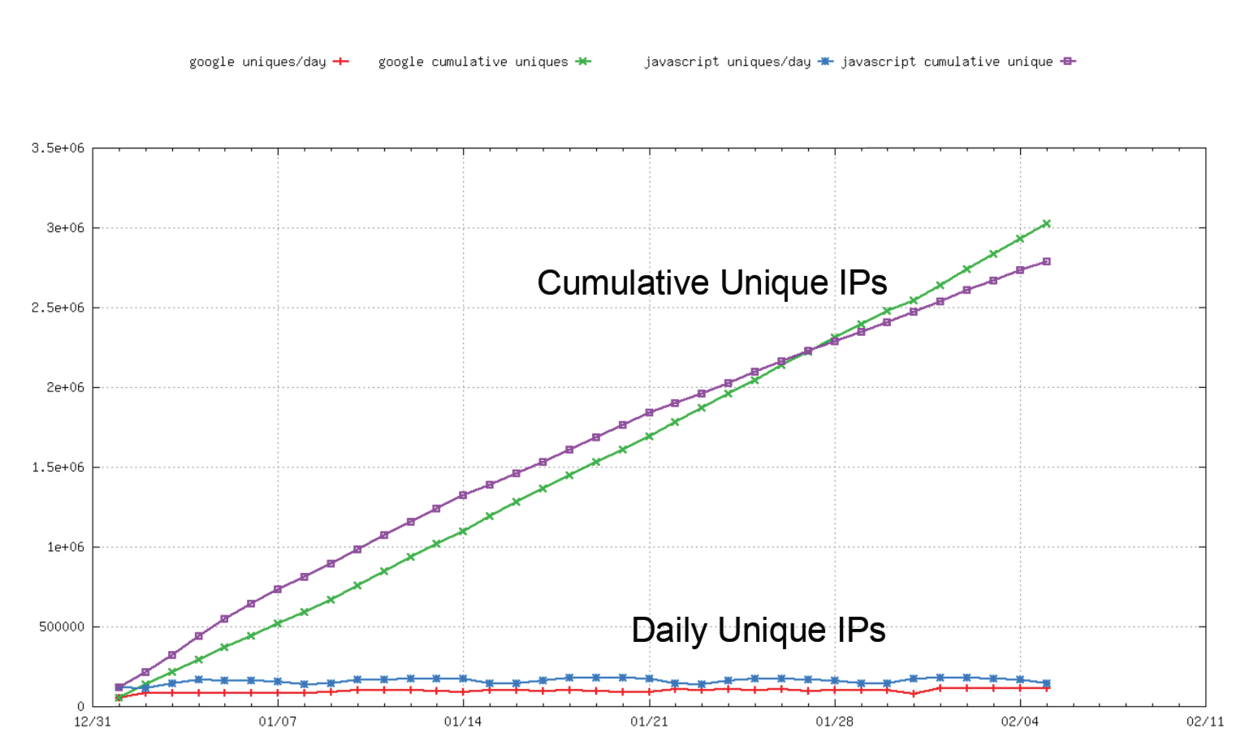
Fresh Eyeballs
Ads
Web Page

Slide 32
Success!
2.5M – 3M samples per day – mostly new!
Large sample space across much of the known Internet
Assemble a rich data set of end user addresses and DNS resolvers

Slide 33
Success … of a sort!
What we are after is a random sample of the entire Internet
And we are close
But what we have is a data set biased towards “cheap” eyeballs in fixed networks

Slide 34
“Raw” AD counts per day
155,430 VN Vietnam
103,517 CN China
92,107 MX Mexico
79,092 TH Thailand
73,702 IN India
65,402 PK Pakistan
64,121 BR Brazil
54,637 TR Turkey
52,532 US United States of America
52,240 AR Argentina
48,315 CO Colombia
45,216 ID Indonesia
39,839 PE Peru
36,962 RU Russian Federation
34,529 PH Philippines
33,899 EG Egypt
22,983 TW Taiwan
22,712 RO Romania
22,490 UA Ukraine
22,403 ES Spain
IP address to country code mapping for
experiments placed on the 24th May 2015

Slide 35
ITU-T’s Internet User Census
155,430 VN Vietnam
103,517 CN China
92,107 MX Mexico
79,092 TH Thailand
73,702 IN India
65,402 PK Pakistan
64,121 BR Brazil
54,637 TR Turkey
52,532 US United States of America
52,240 AR Argentina
48,315 CO Colombia
45,216 ID Indonesia
39,839 PE Peru
36,962 RU Russian Federation
34,529 PH Philippines
33,899 EG Egypt
22,983 TW Taiwan
22,712 RO Romania
22,490 UA Ukraine
22,403 ES Spain
668,493,485 China
282,384872 United States of America
252,482905 India
110,345878 Brazil
109,390190 Japan
87,305661 Russian Federation
72,663301 Nigeria
71,823404 Indonesia
71,174958 Germany
61,579582 Mexico
57,306333 United Kingdom of Great Britain and Northern Ireland
54,114094 France
45,416941 Iran (Islamic Republic of)
45,019465 Egypt
42,187842 Republic of Korea
41,780667 Philippines
40,980368 Vietnam
39,256999 Bangladesh
35,793673 Italy
35,503461 Turkey
ITU’s estimates of number of Internet users per country

Slide 36
“Weighting” sample data to correct AD Placement bias
We “weight” the raw data by:
  Geolocating the IP address to a particular country
  Multiplying the sample by the relative weight of the country

Slide 37
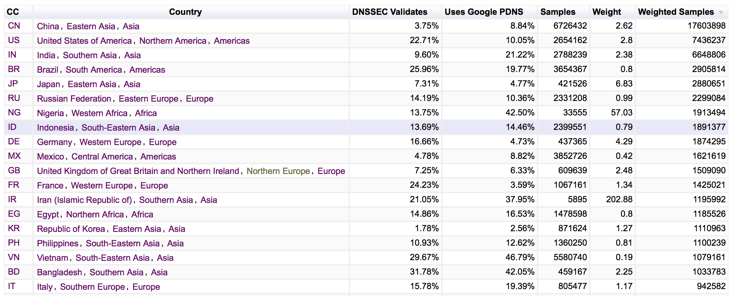
Weighting the Results

Slide 38
Measuring ALL of the Internet
It’s not perfect by any means, but it is a reasonable first pass to correct for the implicit ad placement bias in the raw data
So now we have a method to measure a sample of Internet users and a process that can relate that measurement back to the Internet as a whole.
How can we use this?

Slide 39
What does this allow?
In providing an end user with a set of URLs to retrieve we can examine:
  Protocol behaviour
    e.g.: V4 vs V6, protocol performance, connection failure rate
  DNS behaviours
    e.g.: DNSSEC use, DNS resolution performance, DNS response size, crypto protocol performance,…

Slide 40
1. Measuring IPv6

Slide 41
Measuring IPv6
  Client is given 4 unique URLs to load:
    Dual Stack object
    V4-only object
    V6-only object
    Result reporting URL (10 second timer)
  We want to compare the number of end devices that can retrieve the V6-only object to the number of devices that can retrieve the V4-only object (V6 Capable)
  We can also look at the number of end devices that use IPv6 to retrieve the Dual Stack Object (V6 Preferred)

Slide 42
What we see (Web Log)
temora.rand.apnic.net 124.13.125.185 [04/Aug/2015:00:01:29 +0000] "GET /newadcfg/ad.py?A=2121&N&R&F HTTP/1.1" 200 799 "https://tpc.googlesyndication.com/sadbundle/7103675352697911246/basic/index.html" "Mozilla/5.0 (Macintosh; Intel Mac OS X 10_9_5) AppleWebKit/537.36 (KHTML, like Gecko) Chrome/44.0.2403.125 Safari/537.36" 0.000 u281fd425-s1438646489 1438646489.894 cfg.dotnxdomain.net
temora.rand.apnic.net 2001:e68:5431:519e:f002:854e:2741:278 [04/Aug/2015:00:01:30 +0000] "GET /1x1.png?u281fd425-s1438646489-i5097.ap.rd.td HTTP/1.1" 200 68 "https://tpc.googlesyndication.com/sadbundle/7103675352697911246/basic/index.html" "Mozilla/5.0 (Macintosh; Intel Mac OS X 10_9_5) AppleWebKit/537.36 (KHTML, like Gecko) Chrome/44.0.2403.125 Safari/537.36" 0.000 https 1438646490.290 0du-u281fd425-s1438646489-i5097.ap.dotnxdomain.net
temora.rand.apnic.net 2001:e68:5431:519e:f002:854e:2741:278 [04/Aug/2015:00:01:30 +0000] "GET /1x1.png?u281fd425-s1438646489-i5097.ap.e HTTP/1.1" 200 68 "https://tpc.googlesyndication.com/sadbundle/7103675352697911246/basic/index.html" "Mozilla/5.0 (Macintosh; Intel Mac OS X 10_9_5) AppleWebKit/537.36 (KHTML, like Gecko) Chrome/44.0.2403.125 Safari/537.36" 0.000 https 1438646490.290 0du-u281fd425-s1438646489-i5097.ap.dotnxdomain.net
temora.rand.apnic.net 2001:e68:5431:519e:f002:854e:2741:278 [04/Aug/2015:00:01:30 +0000] "GET /1x1.png?u281fd425-s1438646489-i5097.ap.r6.td HTTP/1.1" 200 68 "https://tpc.googlesyndication.com/sadbundle/7103675352697911246/basic/index.html" "Mozilla/5.0 (Macintosh; Intel Mac OS X 10_9_5) AppleWebKit/537.36 (KHTML, like Gecko) Chrome/44.0.2403.125 Safari/537.36" 0.000 https 1438646490.578 06u-u281fd425-s1438646489-i5097.ap.dotnxdomain.net
temora.rand.apnic.net 2001:e68:5431:519e:f002:854e:2741:278 [04/Aug/2015:00:01:30 +0000] "GET /1x1.png?u281fd425-s1438646489-i5097.ap.f HTTP/1.1" 200 68 "https://tpc.googlesyndication.com/sadbundle/7103675352697911246/basic/index.html" "Mozilla/5.0 (Macintosh; Intel Mac OS X 10_9_5) AppleWebKit/537.36 (KHTML, like Gecko) Chrome/44.0.2403.125 Safari/537.36" 0.000 https 1438646490.871 0di-u281fd425-s1438646489-i5097.ap.dotnxdomain.net
temora.rand.apnic.net 2001:e68:5431:519e:f002:854e:2741:278 [04/Aug/2015:00:01:31 +0000] "GET /1x1.png?u281fd425-s1438646489-i5097.ap.d HTTP/1.1" 200 68 "https://tpc.googlesyndication.com/sadbundle/7103675352697911246/basic/index.html" "Mozilla/5.0 (Macintosh; Intel Mac OS X 10_9_5) AppleWebKit/537.36 (KHTML, like Gecko) Chrome/44.0.2403.125 Safari/537.36" 0.000 https 1438646491.159 0ds-u281fd425-s1438646489-i5097.ap.dotnxdomain.net
temora.rand.apnic.net 124.13.125.185 [04/Aug/2015:00:01:31 +0000] "GET /1x1.png?u281fd425-s1438646489-i5097.ap.r4.td HTTP/1.1" 200 68 "https://tpc.googlesyndication.com/sadbundle/7103675352697911246/basic/index.html" "Mozilla/5.0 (Macintosh; Intel Mac OS X 10_9_5) AppleWebKit/537.36 (KHTML, like Gecko) Chrome/44.0.2403.125 Safari/537.36" 0.000 https 1438646491.448 04u-u281fd425-s1438646489-i5097.ap.dotnxdomain.net
temora.rand.apnic.net 2001:e68:5431:519e:f002:854e:2741:278 [04/Aug/2015:00:01:31 +0000] "GET /1x1.png?u281fd425-s1438646489-i5097.ap.results&zrdtd-390.zr4td-1548.zr6td-678.zd-1258.ze-390.zf-971. HTTP/1.1" 200 68 "https://tpc.googlesyndication.com/sadbundle/7103675352697911246/basic/index.html" "Mozilla/5.0 (Macintosh; Intel Mac OS X 10_9_5) AppleWebKit/537.36 (KHTML, like Gecko) Chrome/44.0.2403.125 Safari/537.36" 0.000 https 1438646491.815 0du-results-u281fd425-x-i5097.ap.dotnxdomain.net

Slide 43
What we see (Web Log)
temora.rand.apnic.net 124.13.125.185 [04/Aug/2015:00:01:29 +0000] "GET /newadcfg/ad.py?A=2121&N&R&F HTTP/1.1" 200 799 "https://tpc.googlesyndication.com/sadbundle/7103675352697911246/basic/index.html" "Mozilla/5.0 (Macintosh; Intel Mac OS X 10_9_5) AppleWebKit/537.36 (KHTML, like Gecko) Chrome/44.0.2403.125 Safari/537.36" 0.000 u281fd425-s1438646489 1438646489.894 cfg.dotnxdomain.net
temora.rand.apnic.net 2001:e68:5431:519e:f002:854e:2741:278 [04/Aug/2015:00:01:30 +0000] "GET /1x1.png?u281fd425-s1438646489-i5097.ap.rd.td HTTP/1.1" 200 68 "https://tpc.googlesyndication.com/sadbundle/7103675352697911246/basic/index.html" "Mozilla/5.0 (Macintosh; Intel Mac OS X 10_9_5) AppleWebKit/537.36 (KHTML, like Gecko) Chrome/44.0.2403.125 Safari/537.36" 0.000 https 1438646490.290 0du-u281fd425-s1438646489-i5097.ap.dotnxdomain.net
temora.rand.apnic.net 2001:e68:5431:519e:f002:854e:2741:278 [04/Aug/2015:00:01:30 +0000] "GET /1x1.png?u281fd425-s1438646489-i5097.ap.e HTTP/1.1" 200 68 "https://tpc.googlesyndication.com/sadbundle/7103675352697911246/basic/index.html" "Mozilla/5.0 (Macintosh; Intel Mac OS X 10_9_5) AppleWebKit/537.36 (KHTML, like Gecko) Chrome/44.0.2403.125 Safari/537.36" 0.000 https 1438646490.290 0du-u281fd425-s1438646489-i5097.ap.dotnxdomain.net
temora.rand.apnic.net 2001:e68:5431:519e:f002:854e:2741:278 [04/Aug/2015:00:01:30 +0000] "GET /1x1.png?u281fd425-s1438646489-i5097.ap.r6.td HTTP/1.1" 200 68 "https://tpc.googlesyndication.com/sadbundle/7103675352697911246/basic/index.html" "Mozilla/5.0 (Macintosh; Intel Mac OS X 10_9_5) AppleWebKit/537.36 (KHTML, like Gecko) Chrome/44.0.2403.125 Safari/537.36" 0.000 https 1438646490.578 06u-u281fd425-s1438646489-i5097.ap.dotnxdomain.net
temora.rand.apnic.net 2001:e68:5431:519e:f002:854e:2741:278 [04/Aug/2015:00:01:30 +0000] "GET /1x1.png?u281fd425-s1438646489-i5097.ap.f HTTP/1.1" 200 68 "https://tpc.googlesyndication.com/sadbundle/7103675352697911246/basic/index.html" "Mozilla/5.0 (Macintosh; Intel Mac OS X 10_9_5) AppleWebKit/537.36 (KHTML, like Gecko) Chrome/44.0.2403.125 Safari/537.36" 0.000 https 1438646490.871 0di-u281fd425-s1438646489-i5097.ap.dotnxdomain.net
temora.rand.apnic.net 2001:e68:5431:519e:f002:854e:2741:278 [04/Aug/2015:00:01:31 +0000] "GET /1x1.png?u281fd425-s1438646489-i5097.ap.d HTTP/1.1" 200 68 "https://tpc.googlesyndication.com/sadbundle/7103675352697911246/basic/index.html" "Mozilla/5.0 (Macintosh; Intel Mac OS X 10_9_5) AppleWebKit/537.36 (KHTML, like Gecko) Chrome/44.0.2403.125 Safari/537.36" 0.000 https 1438646491.159 0ds-u281fd425-s1438646489-i5097.ap.dotnxdomain.net
temora.rand.apnic.net 124.13.125.185 [04/Aug/2015:00:01:31 +0000] "GET /1x1.png?u281fd425-s1438646489-i5097.ap.r4.td HTTP/1.1" 200 68 "https://tpc.googlesyndication.com/sadbundle/7103675352697911246/basic/index.html" "Mozilla/5.0 (Macintosh; Intel Mac OS X 10_9_5) AppleWebKit/537.36 (KHTML, like Gecko) Chrome/44.0.2403.125 Safari/537.36" 0.000 https 1438646491.448 04u-u281fd425-s1438646489-i5097.ap.dotnxdomain.net
temora.rand.apnic.net 2001:e68:5431:519e:f002:854e:2741:278 [04/Aug/2015:00:01:31 +0000] "GET /1x1.png?u281fd425-s1438646489-i5097.ap.results&zrdtd-390.zr4td-1548.zr6td-678.zd-1258.ze-390.zf-971. HTTP/1.1" 200 68 "https://tpc.googlesyndication.com/sadbundle/7103675352697911246/basic/index.html" "Mozilla/5.0 (Macintosh; Intel Mac OS X 10_9_5) AppleWebKit/537.36 (KHTML, like Gecko) Chrome/44.0.2403.125 Safari/537.36" 0.000 https 1438646491.815 0du-results-u281fd425-s1438646489-i5097.ap.dotnxdomain.net
This is a Mac OSX system, using OS X 10.9.5, with Chrome 44.0.2403.125

Slide 44
What we see (Web Log)
temora.rand.apnic.net 124.13.125.185 [04/Aug/2015:00:01:29 +0000] "GET /newadcfg/ad.py?A=2121&N&R&F HTTP/1.1" 200 799 "https://tpc.googlesyndication.com/sadbundle/7103675352697911246/basic/index.html" "Mozilla/5.0 (Macintosh; Intel Mac OS X 10_9_5) AppleWebKit/537.36 (KHTML, like Gecko) Chrome/44.0.2403.125 Safari/537.36" 0.000 u281fd425-s1438646489 1438646489.894 cfg.dotnxdomain.net
temora.rand.apnic.net 2001:e68:5431:519e:f002:854e:2741:278 [04/Aug/2015:00:01:30 +0000] "GET /1x1.png?u281fd425-s1438646489-i5097.ap.rd.td HTTP/1.1" 200 68 "https://tpc.googlesyndication.com/sadbundle/7103675352697911246/basic/index.html" "Mozilla/5.0 (Macintosh; Intel Mac OS X 10_9_5) AppleWebKit/537.36 (KHTML, like Gecko) Chrome/44.0.2403.125 Safari/537.36" 0.000 https 1438646490.290 0du-u281fd425-s1438646489-i5097.ap.dotnxdomain.net
temora.rand.apnic.net 2001:e68:5431:519e:f002:854e:2741:278 [04/Aug/2015:00:01:30 +0000] "GET /1x1.png?u281fd425-s1438646489-i5097.ap.e HTTP/1.1" 200 68 "https://tpc.googlesyndication.com/sadbundle/7103675352697911246/basic/index.html" "Mozilla/5.0 (Macintosh; Intel Mac OS X 10_9_5) AppleWebKit/537.36 (KHTML, like Gecko) Chrome/44.0.2403.125 Safari/537.36" 0.000 https 1438646490.290 0du-u281fd425-s1438646489-i5097.ap.dotnxdomain.net
temora.rand.apnic.net 2001:e68:5431:519e:f002:854e:2741:278 [04/Aug/2015:00:01:30 +0000] "GET /1x1.png?u281fd425-s1438646489-i5097.ap.r6.td HTTP/1.1" 200 68 "https://tpc.googlesyndication.com/sadbundle/7103675352697911246/basic/index.html" "Mozilla/5.0 (Macintosh; Intel Mac OS X 10_9_5) AppleWebKit/537.36 (KHTML, like Gecko) Chrome/44.0.2403.125 Safari/537.36" 0.000 https 1438646490.578 06u-u281fd425-s1438646489-i5097.ap.dotnxdomain.net
temora.rand.apnic.net 2001:e68:5431:519e:f002:854e:2741:278 [04/Aug/2015:00:01:30 +0000] "GET /1x1.png?u281fd425-s1438646489-i5097.ap.f HTTP/1.1" 200 68 "https://tpc.googlesyndication.com/sadbundle/7103675352697911246/basic/index.html" "Mozilla/5.0 (Macintosh; Intel Mac OS X 10_9_5) AppleWebKit/537.36 (KHTML, like Gecko) Chrome/44.0.2403.125 Safari/537.36" 0.000 https 1438646490.871 0di-u281fd425-s1438646489-i5097.ap.dotnxdomain.net
temora.rand.apnic.net 2001:e68:5431:519e:f002:854e:2741:278 [04/Aug/2015:00:01:31 +0000] "GET /1x1.png?u281fd425-s1438646489-i5097.ap.d HTTP/1.1" 200 68 "https://tpc.googlesyndication.com/sadbundle/7103675352697911246/basic/index.html" "Mozilla/5.0 (Macintosh; Intel Mac OS X 10_9_5) AppleWebKit/537.36 (KHTML, like Gecko) Chrome/44.0.2403.125 Safari/537.36" 0.000 https 1438646491.159 0ds-u281fd425-s1438646489-i5097.ap.dotnxdomain.net
temora.rand.apnic.net 124.13.125.185 [04/Aug/2015:00:01:31 +0000] "GET /1x1.png?u281fd425-s1438646489-i5097.ap.r4.td HTTP/1.1" 200 68 "https://tpc.googlesyndication.com/sadbundle/7103675352697911246/basic/index.html" "Mozilla/5.0 (Macintosh; Intel Mac OS X 10_9_5) AppleWebKit/537.36 (KHTML, like Gecko) Chrome/44.0.2403.125 Safari/537.36" 0.000 https 1438646491.448 04u-u281fd425-s1438646489-i5097.ap.dotnxdomain.net
temora.rand.apnic.net 2001:e68:5431:519e:f002:854e:2741:278 [04/Aug/2015:00:01:31 +0000] "GET /1x1.png?u281fd425-s1438646489-i5097.ap.results&zrdtd-390.zr4td-1548.zr6td-678.zd-1258.ze-390.zf-971. HTTP/1.1" 200 68 "https://tpc.googlesyndication.com/sadbundle/7103675352697911246/basic/index.html" "Mozilla/5.0 (Macintosh; Intel Mac OS X 10_9_5) AppleWebKit/537.36 (KHTML, like Gecko) Chrome/44.0.2403.125 Safari/537.36" 0.000 https 1438646491.815 0du-results-u281fd425-s1438646489-i5097.ap.dotnxdomain.net
This system can do IPv6, and prefers to use IPv6 in dual stack contexts

Slide 45
What we see (Web Log)
temora.rand.apnic.net 124.13.125.185 [04/Aug/2015:00:01:29 +0000] "GET /newadcfg/ad.py?A=2121&N&R&F HTTP/1.1" 200 799 "https://tpc.googlesyndication.com/sadbundle/7103675352697911246/basic/index.html" "Mozilla/5.0 (Macintosh; Intel Mac OS X 10_9_5) AppleWebKit/537.36 (KHTML, like Gecko) Chrome/44.0.2403.125 Safari/537.36" 0.000 u281fd425-s1438646489 1438646489.894 cfg.dotnxdomain.net
temora.rand.apnic.net 2001:e68:5431:519e:f002:854e:2741:278 [04/Aug/2015:00:01:30 +0000] "GET /1x1.png?u281fd425-s1438646489-i5097.ap.rd.td HTTP/1.1" 200 68 "https://tpc.googlesyndication.com/sadbundle/7103675352697911246/basic/index.html" "Mozilla/5.0 (Macintosh; Intel Mac OS X 10_9_5) AppleWebKit/537.36 (KHTML, like Gecko) Chrome/44.0.2403.125 Safari/537.36" 0.000 https 1438646490.290 0du-u281fd425-s1438646489-i5097.ap.dotnxdomain.net
temora.rand.apnic.net 2001:e68:5431:519e:f002:854e:2741:278 [04/Aug/2015:00:01:30 +0000] "GET /1x1.png?u281fd425-s1438646489-i5097.ap.e HTTP/1.1" 200 68 "https://tpc.googlesyndication.com/sadbundle/7103675352697911246/basic/index.html" "Mozilla/5.0 (Macintosh; Intel Mac OS X 10_9_5) AppleWebKit/537.36 (KHTML, like Gecko) Chrome/44.0.2403.125 Safari/537.36" 0.000 https 1438646490.290 0du-u281fd425-s1438646489-i5097.ap.dotnxdomain.net
temora.rand.apnic.net 2001:e68:5431:519e:f002:854e:2741:278 [04/Aug/2015:00:01:30 +0000] "GET /1x1.png?u281fd425-s1438646489-i5097.ap.r6.td HTTP/1.1" 200 68 "https://tpc.googlesyndication.com/sadbundle/7103675352697911246/basic/index.html" "Mozilla/5.0 (Macintosh; Intel Mac OS X 10_9_5) AppleWebKit/537.36 (KHTML, like Gecko) Chrome/44.0.2403.125 Safari/537.36" 0.000 https 1438646490.578 06u-u281fd425-s1438646489-i5097.ap.dotnxdomain.net
temora.rand.apnic.net 2001:e68:5431:519e:f002:854e:2741:278 [04/Aug/2015:00:01:30 +0000] "GET /1x1.png?u281fd425-s1438646489-i5097.ap.f HTTP/1.1" 200 68 "https://tpc.googlesyndication.com/sadbundle/7103675352697911246/basic/index.html" "Mozilla/5.0 (Macintosh; Intel Mac OS X 10_9_5) AppleWebKit/537.36 (KHTML, like Gecko) Chrome/44.0.2403.125 Safari/537.36" 0.000 https 1438646490.871 0di-u281fd425-s1438646489-i5097.ap.dotnxdomain.net
temora.rand.apnic.net 2001:e68:5431:519e:f002:854e:2741:278 [04/Aug/2015:00:01:31 +0000] "GET /1x1.png?u281fd425-s1438646489-i5097.ap.d HTTP/1.1" 200 68 "https://tpc.googlesyndication.com/sadbundle/7103675352697911246/basic/index.html" "Mozilla/5.0 (Macintosh; Intel Mac OS X 10_9_5) AppleWebKit/537.36 (KHTML, like Gecko) Chrome/44.0.2403.125 Safari/537.36" 0.000 https 1438646491.159 0ds-u281fd425-s1438646489-i5097.ap.dotnxdomain.net
temora.rand.apnic.net 124.13.125.185 [04/Aug/2015:00:01:31 +0000] "GET /1x1.png?u281fd425-s1438646489-i5097.ap.r4.td HTTP/1.1" 200 68 "https://tpc.googlesyndication.com/sadbundle/7103675352697911246/basic/index.html" "Mozilla/5.0 (Macintosh; Intel Mac OS X 10_9_5) AppleWebKit/537.36 (KHTML, like Gecko) Chrome/44.0.2403.125 Safari/537.36" 0.000 https 1438646491.448 04u-u281fd425-s1438646489-i5097.ap.dotnxdomain.net
temora.rand.apnic.net 2001:e68:5431:519e:f002:854e:2741:278 [04/Aug/2015:00:01:31 +0000] "GET /1x1.png?u281fd425-s1438646489-i5097.ap.results&zrdtd-390.zr4td-1548.zr6td-678.zd-1258.ze-390.zf-971. HTTP/1.1" 200 68 "https://tpc.googlesyndication.com/sadbundle/7103675352697911246/basic/index.html" "Mozilla/5.0 (Macintosh; Intel Mac OS X 10_9_5) AppleWebKit/537.36 (KHTML, like Gecko) Chrome/44.0.2403.125 Safari/537.36" 0.000 https 1438646491.815 0du-results-u281fd425-s1438646489-i5097.ap.dotnxdomain.net
This experiment ran through to conmpletion

Slide 46
What we see (Web Log)
temora.rand.apnic.net 124.13.125.185 [04/Aug/2015:00:01:29 +0000] "GET /newadcfg/ad.py?A=2121&N&R&F HTTP/1.1" 200 799 "https://tpc.googlesyndication.com/sadbundle/7103675352697911246/basic/index.html" "Mozilla/5.0 (Macintosh; Intel Mac OS X 10_9_5) AppleWebKit/537.36 (KHTML, like Gecko) Chrome/44.0.2403.125 Safari/537.36" 0.000 u281fd425-s1438646489 1438646489.894 cfg.dotnxdomain.net
temora.rand.apnic.net 2001:e68:5431:519e:f002:854e:2741:278 [04/Aug/2015:00:01:30 +0000] "GET /1x1.png?u281fd425-s1438646489-i5097.ap.rd.td HTTP/1.1" 200 68 "https://tpc.googlesyndication.com/sadbundle/7103675352697911246/basic/index.html" "Mozilla/5.0 (Macintosh; Intel Mac OS X 10_9_5) AppleWebKit/537.36 (KHTML, like Gecko) Chrome/44.0.2403.125 Safari/537.36" 0.000 https 1438646490.290 0du-u281fd425-s1438646489-i5097.ap.dotnxdomain.net
temora.rand.apnic.net 2001:e68:5431:519e:f002:854e:2741:278 [04/Aug/2015:00:01:30 +0000] "GET /1x1.png?u281fd425-s1438646489-i5097.ap.e HTTP/1.1" 200 68 "https://tpc.googlesyndication.com/sadbundle/7103675352697911246/basic/index.html" "Mozilla/5.0 (Macintosh; Intel Mac OS X 10_9_5) AppleWebKit/537.36 (KHTML, like Gecko) Chrome/44.0.2403.125 Safari/537.36" 0.000 https 1438646490.290 0du-u281fd425-s1438646489-i5097.ap.dotnxdomain.net
temora.rand.apnic.net 2001:e68:5431:519e:f002:854e:2741:278 [04/Aug/2015:00:01:30 +0000] "GET /1x1.png?u281fd425-s1438646489-i5097.ap.r6.td HTTP/1.1" 200 68 "https://tpc.googlesyndication.com/sadbundle/7103675352697911246/basic/index.html" "Mozilla/5.0 (Macintosh; Intel Mac OS X 10_9_5) AppleWebKit/537.36 (KHTML, like Gecko) Chrome/44.0.2403.125 Safari/537.36" 0.000 https 1438646490.578 06u-u281fd425-s1438646489-i5097.ap.dotnxdomain.net
temora.rand.apnic.net 2001:e68:5431:519e:f002:854e:2741:278 [04/Aug/2015:00:01:30 +0000] "GET /1x1.png?u281fd425-s1438646489-i5097.ap.f HTTP/1.1" 200 68 "https://tpc.googlesyndication.com/sadbundle/7103675352697911246/basic/index.html" "Mozilla/5.0 (Macintosh; Intel Mac OS X 10_9_5) AppleWebKit/537.36 (KHTML, like Gecko) Chrome/44.0.2403.125 Safari/537.36" 0.000 https 1438646490.871 0di-u281fd425-s1438646489-i5097.ap.dotnxdomain.net
temora.rand.apnic.net 2001:e68:5431:519e:f002:854e:2741:278 [04/Aug/2015:00:01:31 +0000] "GET /1x1.png?u281fd425-s1438646489-i5097.ap.d HTTP/1.1" 200 68 "https://tpc.googlesyndication.com/sadbundle/7103675352697911246/basic/index.html" "Mozilla/5.0 (Macintosh; Intel Mac OS X 10_9_5) AppleWebKit/537.36 (KHTML, like Gecko) Chrome/44.0.2403.125 Safari/537.36" 0.000 https 1438646491.159 0ds-u281fd425-s1438646489-i5097.ap.dotnxdomain.net
temora.rand.apnic.net 124.13.125.185 [04/Aug/2015:00:01:31 +0000] "GET /1x1.png?u281fd425-s1438646489-i5097.ap.r4.td HTTP/1.1" 200 68 "https://tpc.googlesyndication.com/sadbundle/7103675352697911246/basic/index.html" "Mozilla/5.0 (Macintosh; Intel Mac OS X 10_9_5) AppleWebKit/537.36 (KHTML, like Gecko) Chrome/44.0.2403.125 Safari/537.36" 0.000 https 1438646491.448 04u-u281fd425-s1438646489-i5097.ap.dotnxdomain.net
temora.rand.apnic.net 2001:e68:5431:519e:f002:854e:2741:278 [04/Aug/2015:00:01:31 +0000] "GET /1x1.png?u281fd425-s1438646489-i5097.ap.results&zrdtd-390.zr4td-1548.zr6td-678.zd-1258.ze-390.zf-971. HTTP/1.1" 200 68 "https://tpc.googlesyndication.com/sadbundle/7103675352697911246/basic/index.html" "Mozilla/5.0 (Macintosh; Intel Mac OS X 10_9_5) AppleWebKit/537.36 (KHTML, like Gecko) Chrome/44.0.2403.125 Safari/537.36" 0.000 https 1438646491.815 0du-results-u281fd425-s1438646489-i5097.ap.dotnxdomain.net
This user is a customer of TMNET in Malaysia, AS4788

Slide 47
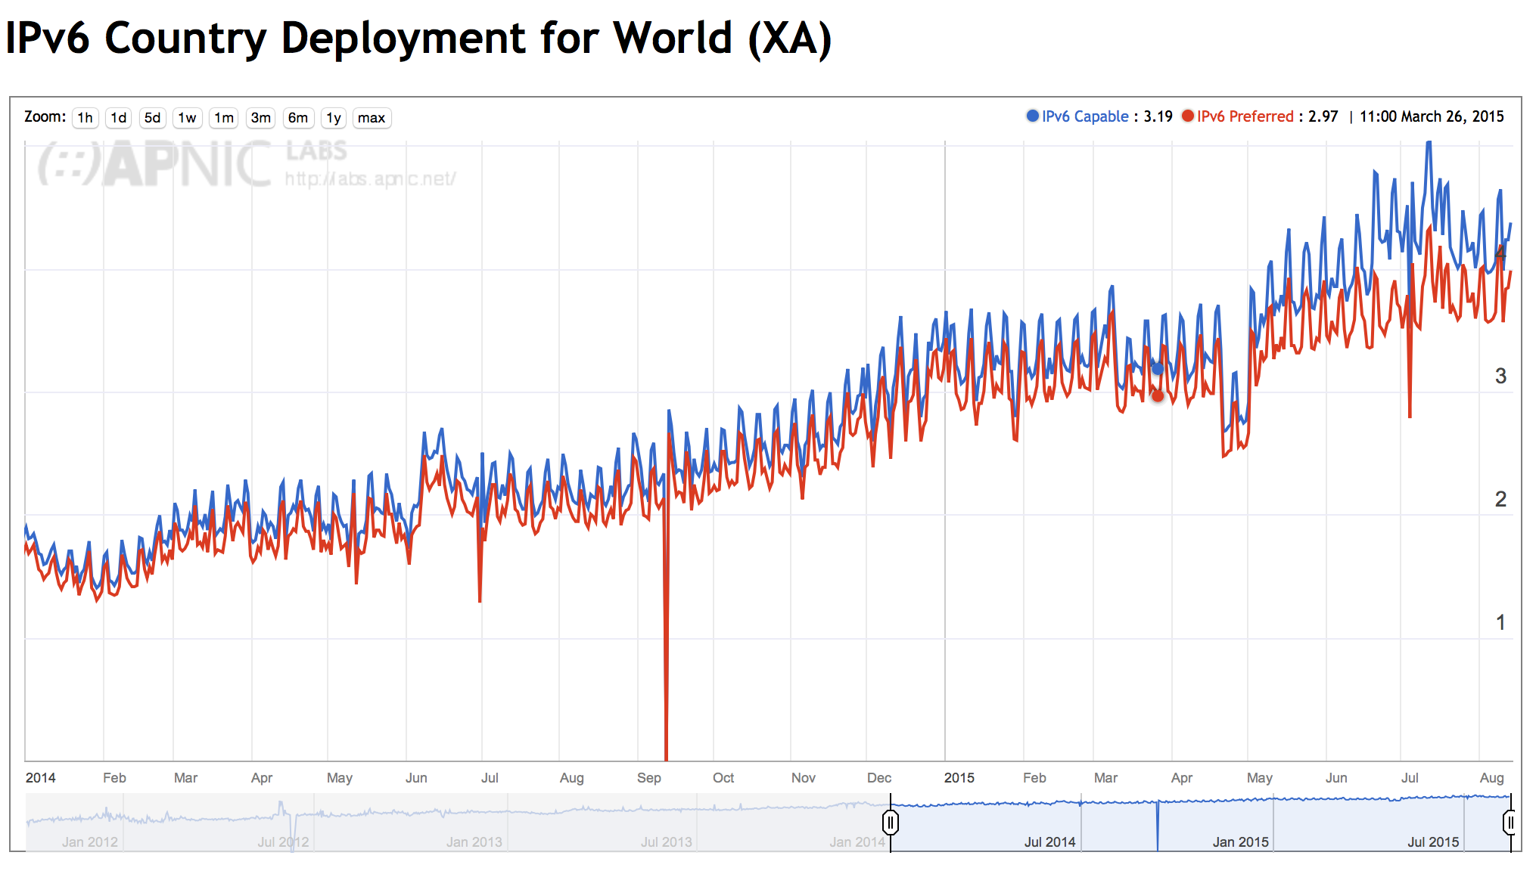
IPv6 Deployment

Slide 48
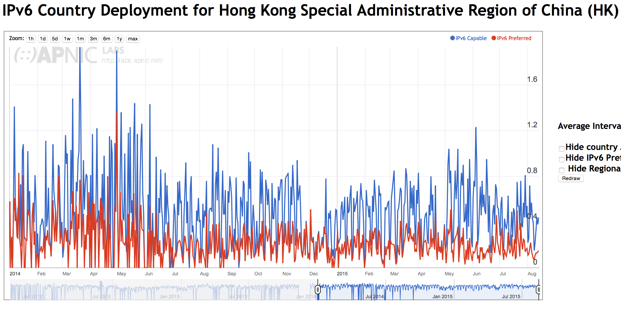
IPv6 Deployment in Hong Kong

Slide 49
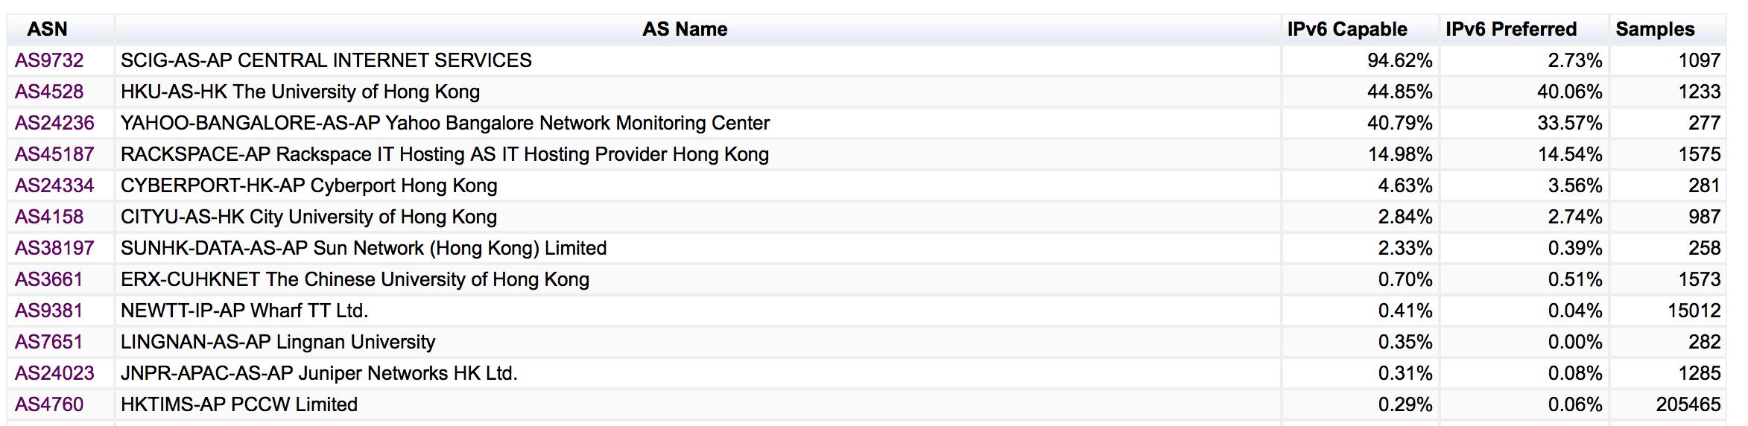
IPv6 Deployment in Hong Kong

Slide 50
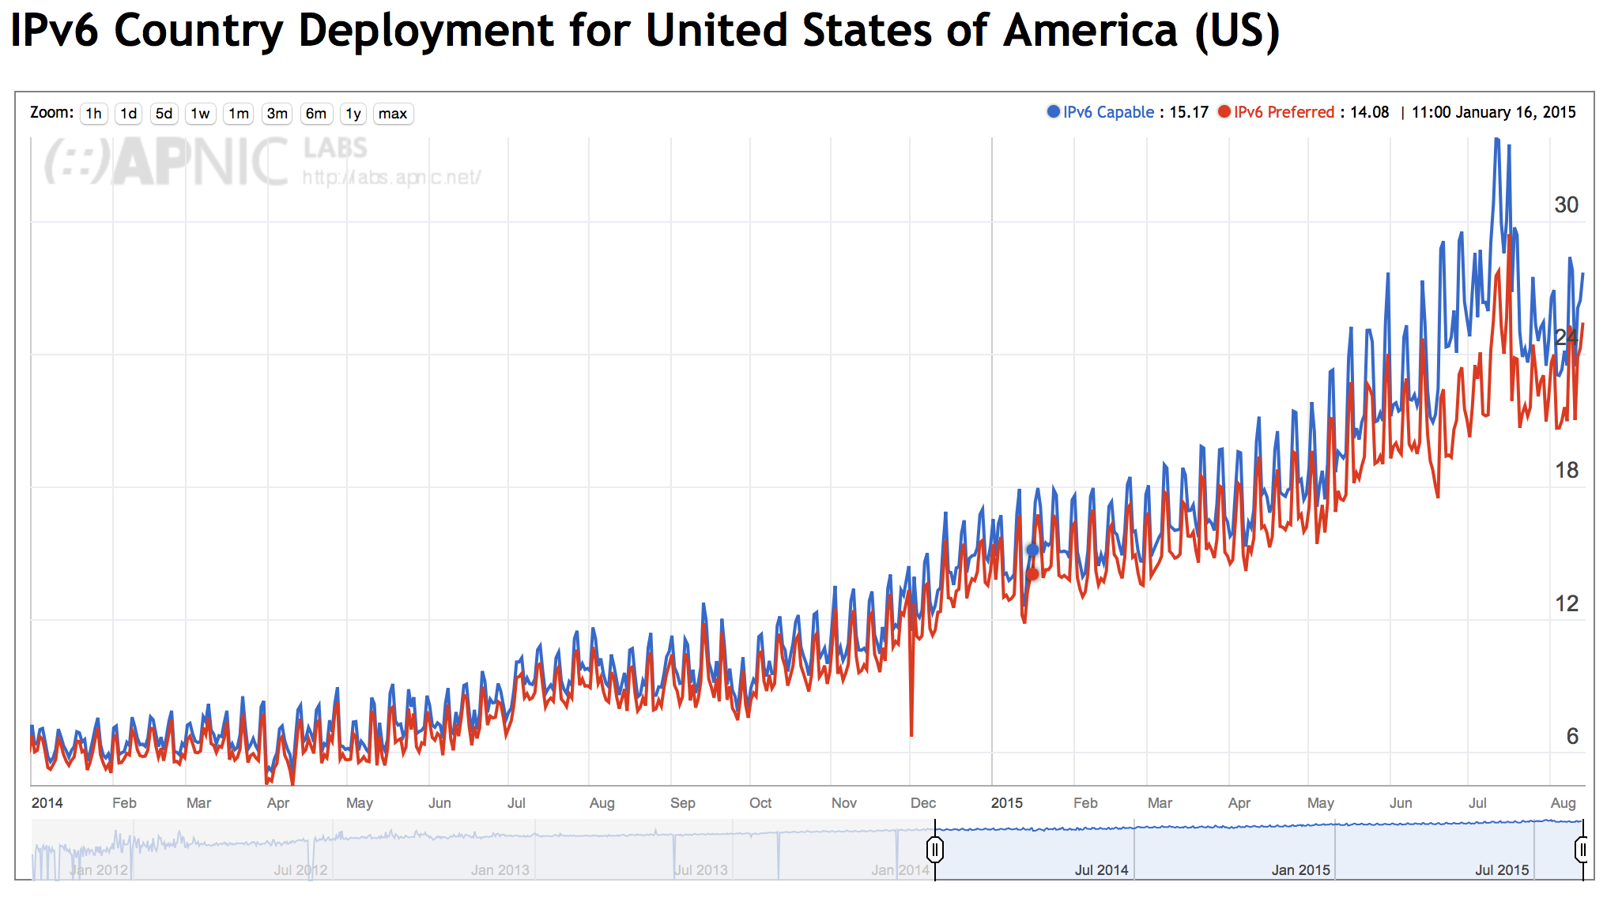
IPv6 Deployment in the US

Slide 51
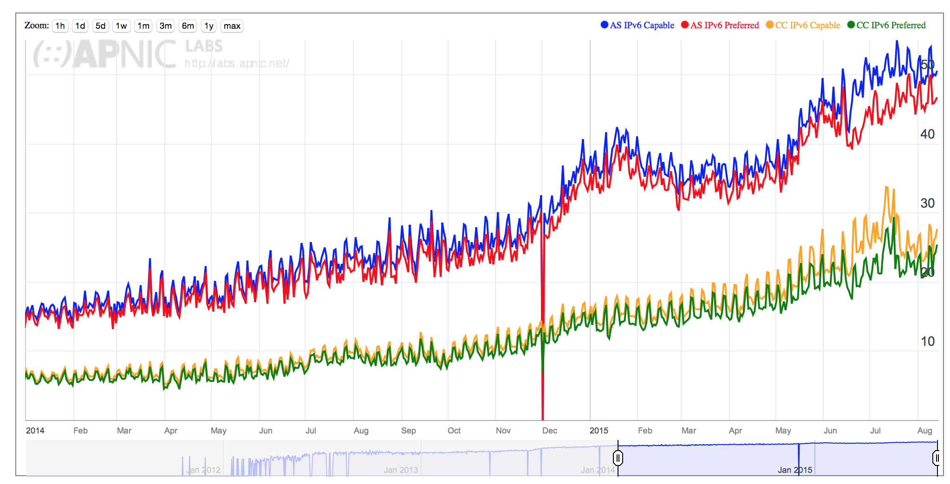
IPv6 Deployment in Comcast

Slide 52
Measuring Platforms

Slide 53
Measuring Browsers

Slide 54
2. Measuring DNS Behaviours

Slide 55
Measuring DNSSEC
  Client is given 4 unique URLs to load:
    DNSSEC-validly signed DNS name
    DNSSEC-invalidly signed DNS name
    Unsigned DNS name (control)
    Result reporting URL (10 second timer)
    All DNS is IPv4

Slide 56
What We See (DNS Log)
1438646489.920 [ap] 04-Aug-2015 00:01:29.920 queries: client 202.188.0.254#14118: (0du-u281fd425-s1438646489-i5097.ap.dotnxdomain.net): query: 0du-u281fd425-s1438646489-i5097.ap.dotnxdomain.net. IN AAAA -ED () 0 157
1438646489.920 [ap] 04-Aug-2015 00:01:29.920 queries: client 202.188.0.254#2911: (04u-u281fd425-s1438646489-i5097.ap.dotnxdomain.net): query: 04u-u281fd425-s1438646489-i5097.ap.dotnxdomain.net. IN A -ED () 0 145
1438646489.921 [ap] 04-Aug-2015 00:01:29.921 queries: client 202.188.0.254#40461: (0du-u281fd425-s1438646489-i5097.ap.dotnxdomain.net): query: 0du-u281fd425-s1438646489-i5097.ap.dotnxdomain.net. IN A -ED () 0 145
1438646489.922 [ap] 04-Aug-2015 00:01:29.922 queries: client 202.188.0.254#48755: (06u-u281fd425-s1438646489-i5097.ap.dotnxdomain.net): query: 06u-u281fd425-s1438646489-i5097.ap.dotnxdomain.net. IN AAAA -ED () 0 157
1438646489.923 [ap] 04-Aug-2015 00:01:29.923 queries: client 202.188.0.254#12230: (06u-u281fd425-s1438646489-i5097.ap.dotnxdomain.net): query: 06u-u281fd425-s1438646489-i5097.ap.dotnxdomain.net. IN A -ED () 0 203
1438646489.937 [ap] 04-Aug-2015 00:01:29.937 queries: client 202.188.0.254#11044: (0ds-u281fd425-s1438646489-i5097.ap.dotnxdomain.net): query: 0ds-u281fd425-s1438646489-i5097.ap.dotnxdomain.net. IN A -ED () 0 405
1438646489.938 [ap] 04-Aug-2015 00:01:29.938 queries: client 202.188.0.254#58615: (0ds-u281fd425-s1438646489-i5097.ap.dotnxdomain.net): query: 0ds-u281fd425-s1438646489-i5097.ap.dotnxdomain.net. IN AAAA -ED () 0 417
1438646489.939 [ap] 04-Aug-2015 00:01:29.939 queries: client 202.188.0.254#47094: (0di-u281fd425-s1438646489-i5097.ap.dotnxdomain.net): query: 0di-u281fd425-s1438646489-i5097.ap.dotnxdomain.net. IN A -ED () 0 405
1438646489.941 [ap] 04-Aug-2015 00:01:29.941 queries: client 202.188.0.254#64994: (0di-u281fd425-s1438646489-i5097.ap.dotnxdomain.net): query: 0di-u281fd425-s1438646489-i5097.ap.dotnxdomain.net. IN AAAA -ED () 0 417
1438646490.730 [ap] 04-Aug-2015 00:01:30.730 queries: client 202.188.0.254#42282: (04u-u281fd425-s1438646489-i5097.ap.dotnxdomain.net): query: 04u-u281fd425-s1438646489-i5097.ap.dotnxdomain.net. IN AAAA -ED () 0 203
1438646491.466 [ap] 04-Aug-2015 00:01:31.466 queries: client 202.188.0.254#36631: (0du-results-u281fd425-s1438646489-i5097.ap.dotnxdomain.net): query: 0du-results-u281fd425-s1438646489-i5097.ap.dotnxdomain.net. IN A -ED () 0 161
1438646491.466 [ap] 04-Aug-2015 00:01:31.466 queries: client 202.188.0.254#52006: (0du-results-u281fd425-s1438646489-i5097.ap.dotnxdomain.net): query: 0du-results-u281fd425-s1438646489-i5097.ap.dotnxdomain.net. IN AAAA -ED () 0 173

Slide 57
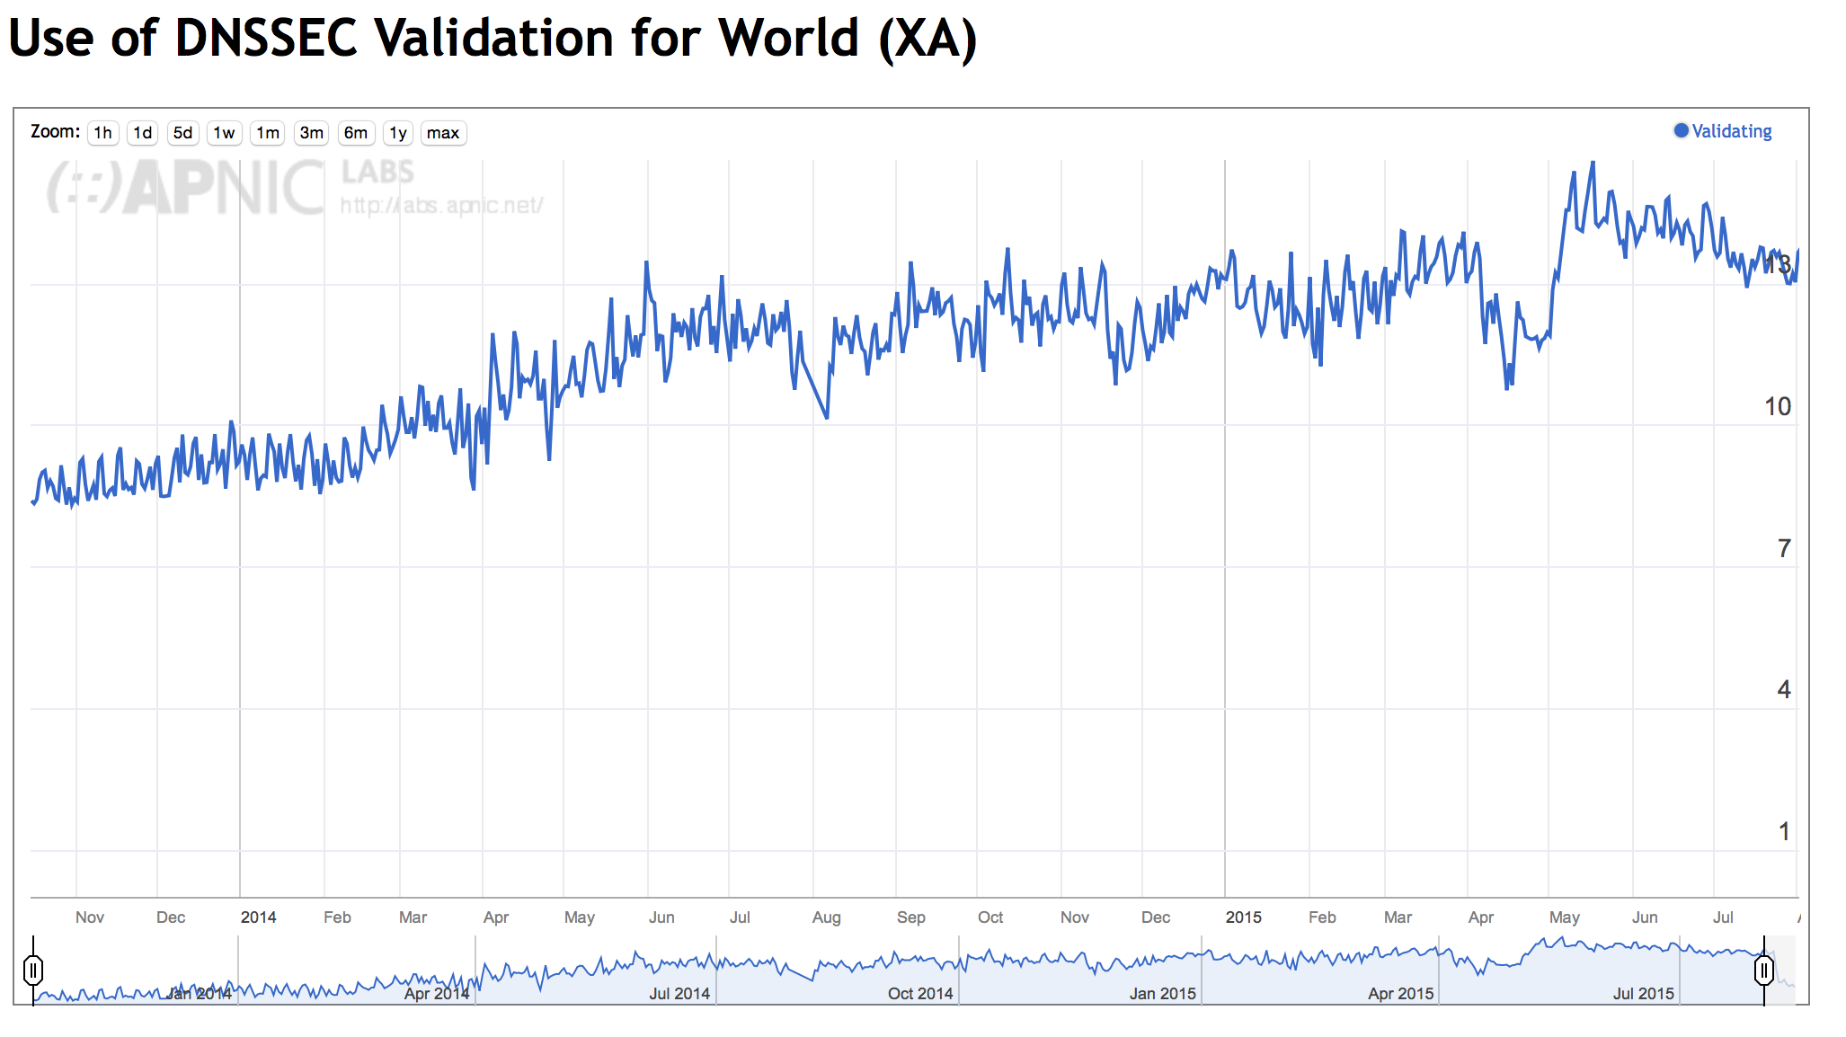
DNSSEC Validation

Slide 58
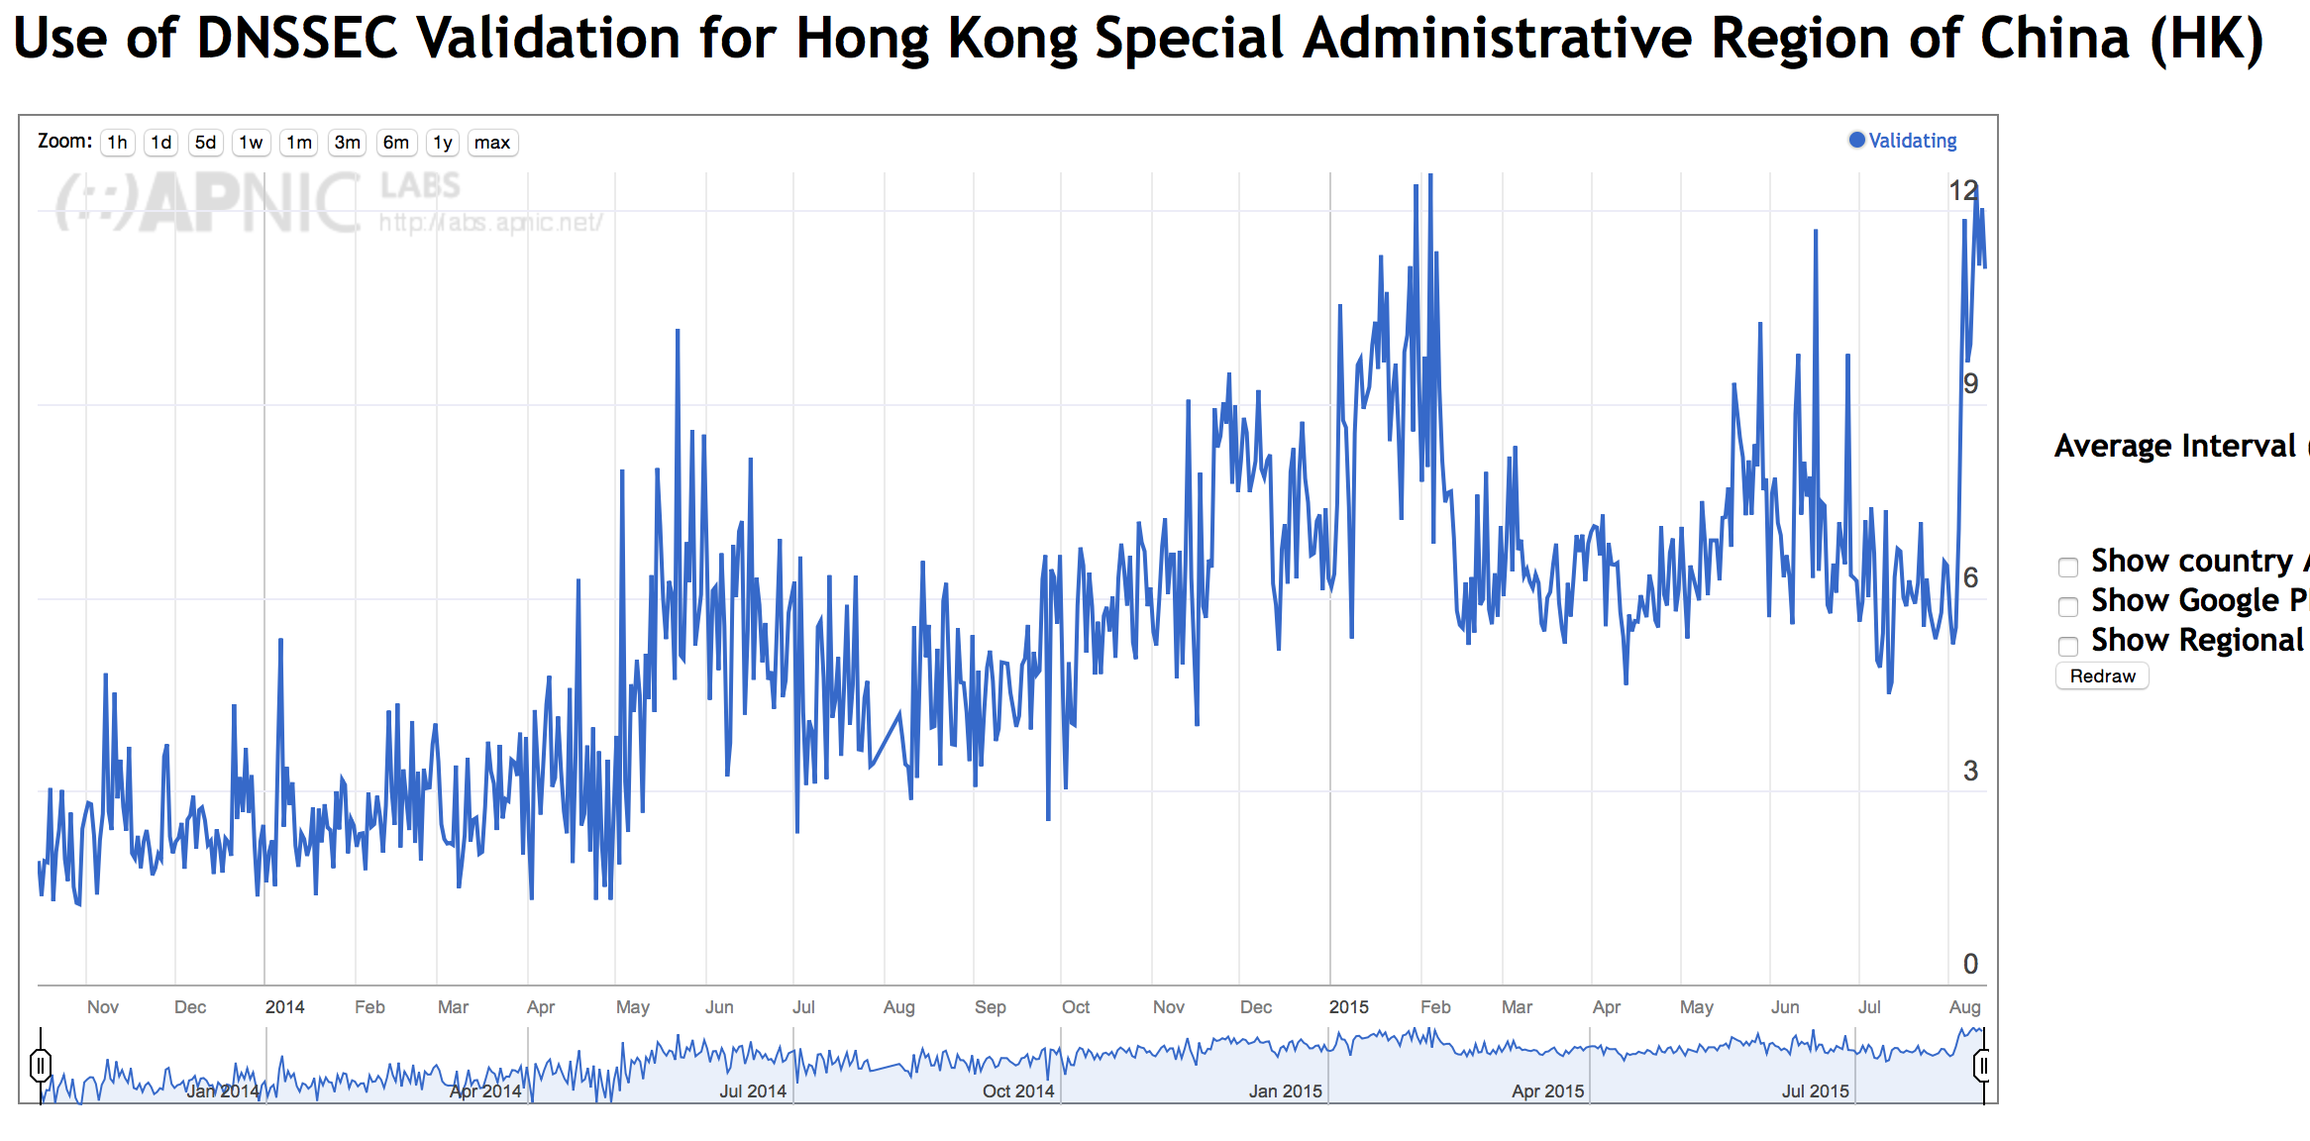
DNSSEC Validation in Hong Kong

Slide 59
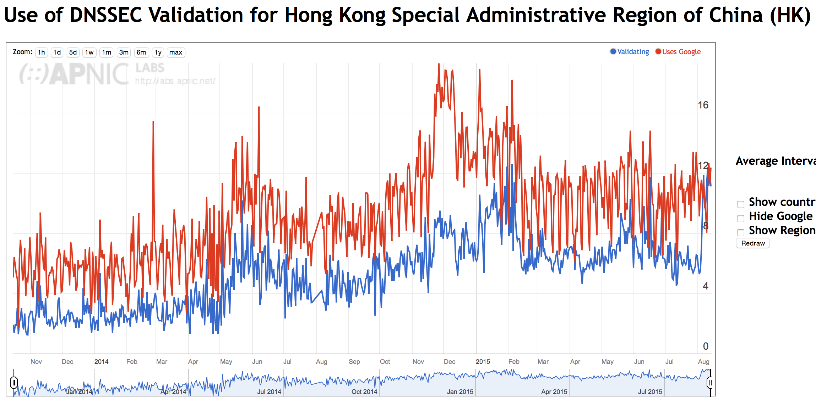
DNSSEC Validation in Hong Kong

Slide 60
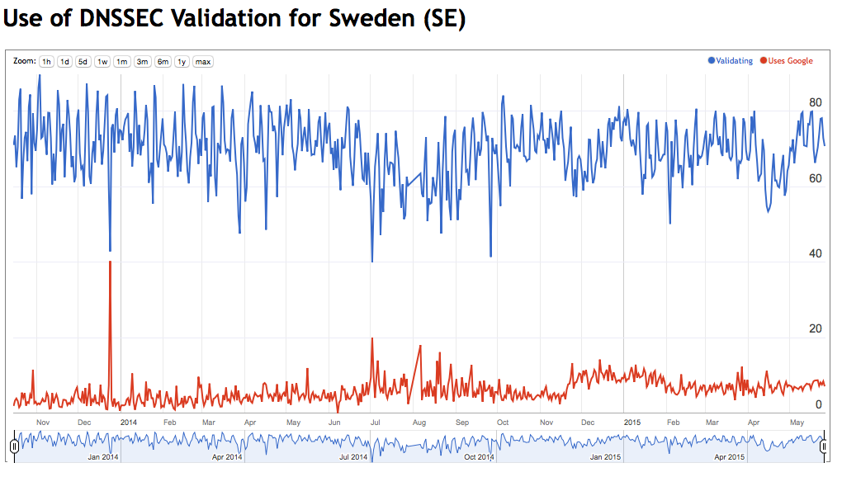
DNSSEC Validation in Sweden

Slide 61
What Else?
DNSSEC Crypto Support:
  How many users who use DNSSEC validating resolvers correctly validate when the signatures use ECDSA (as distinct from RSA)

Slide 62
Answering the ECC question – DNS + WEB
Data collection: 2/3/15 – 19/3/15
1,830,668 clients who appear to be exclusively using RSA DNSSEC-Validating resolvers
ECC Results:
Success: 79.9% 1,461,772 Saw fetches of the ECC DNSSEC RRs and the well-
signed named URL, but not the badly signed named URL
Failure (fetched both URLs):
Mixed Resolvers 5.1% 93,746 Used both ECDSA-Validating and non-validating resolvers
NO ECC 13.3% 243,794 Saw A, DS, no DNSKEY, fetched both URLs
Mixed 1.3% 24,420 Saw some DNSSEC queries, fetched both URLs
No Validation 0.4% 6,836 Did not fetch any DNSSEC RRs
Apparent Fail: 20.1% 368,796
1 in 5 clients that use resolvers that perform DNSSEC validation with RSA fail to validate with ECDSA

Slide 63
ECC Results
These results show that 80% of clients who appeared to use RSA DNSSEC-Validating resolvers were also seen to perform validation using ECDSA
Two thirds of the the remaining clients fetched both objects (13% of the total), but did not fetch any DNSKEY RRs.
Of the remainder (5%), most were using a validating resolver (which returned SERVFAIL for the badly signed object), and then the client failed over to a non-validating resolver *
* This is curious, because these clients did not failover to a non-validating resolver on a badly signed RSA structure

Slide 64
What Else?
The “market” for DNS resolution: how many users send their queries through Google’s Public DNS servers?
How many users use resolvers located in a foreign country?
Which countries?

Slide 65
Foreign (CC) Resolution: Top Resolvers by AS
Rank AS Use AS Name
1 15169 42.69% GOOGLE - Google Inc.,US
2 3356 7.47% LEVEL3 - Level 3 Communications, Inc.,US
3 36692 7.05% OPENDNS - OpenDNS, LLC,US
4 19994 2.56% RACKSPACE - Rackspace Hosting,US
5 174 1.87% COGENT-174 - Cogent Communications,US
6 16880 1.70% AS2-TRENDMICRO-COM - TREND MICRO INCORPORATED,US
7 2914 1.09% NTT-COMMUNICATIONS-2914 - NTT America, Inc.,US
8 4134 0.91% CHINANET-BACKBONE No.31,Jin-rong Street,CN
9 29791 0.70% VOXEL-DOT-NET - Voxel Dot Net, Inc.,US
10 3462 0.67% HINET Data Communication Business Group,TW
11 9121 0.64% TTNET Turk Telekomunikasyon Anonim Sirketi,TR
12 3303 0.64% SWISSCOM Swisscom (Switzerland) Ltd,CH
13 6939 0.63% HURRICANE - Hurricane Electric, Inc.,US
14 6147 0.50% Telefonica del Peru S.A.A.,PE
15 6713 0.48% IAM-AS,MA
16 8048 0.47% CANTV Servicios, Venezuela,VE
17 3257 0.47% TINET-BACKBONE Tinet SpA,DE
18 13238 0.43% YANDEX Yandex LLC,RU
19 45595 0.41% PKTELECOM-AS-PK Pakistan Telecom Company Limited,PK
20 9299 0.40% IPG-AS-AP Philippine Long Distance Telephone Company,PH
21 7643 0.39% VNPT-AS-VN Vietnam Posts and Telecommunications (VNPT),VN
22 45758 0.39% TRIPLETNET-AS-AP TripleT Internet Internet service provider Bangkok,TH
23 8151 0.38% Uninet S.A. de C.V.,MX
24 7470 0.35% TRUEINTERNET-AS-AP TRUE INTERNET Co.,Ltd.,TH
4837 0.35% CHINA169-BACKBONE CNCGROUP China169 Backbone,CN
Total: 21,770,772 (28% of total) end user query sets

Slide 66
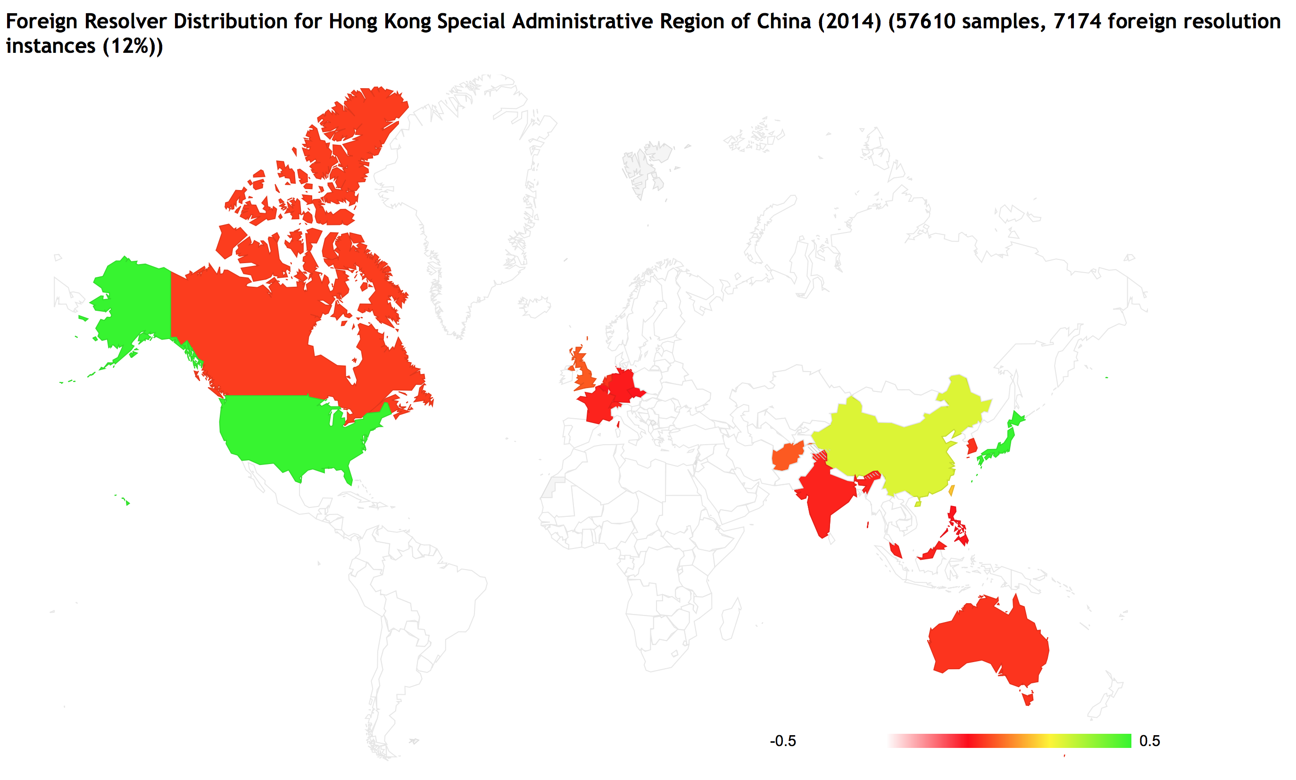
Offshore DNS from HK Users

Slide 67
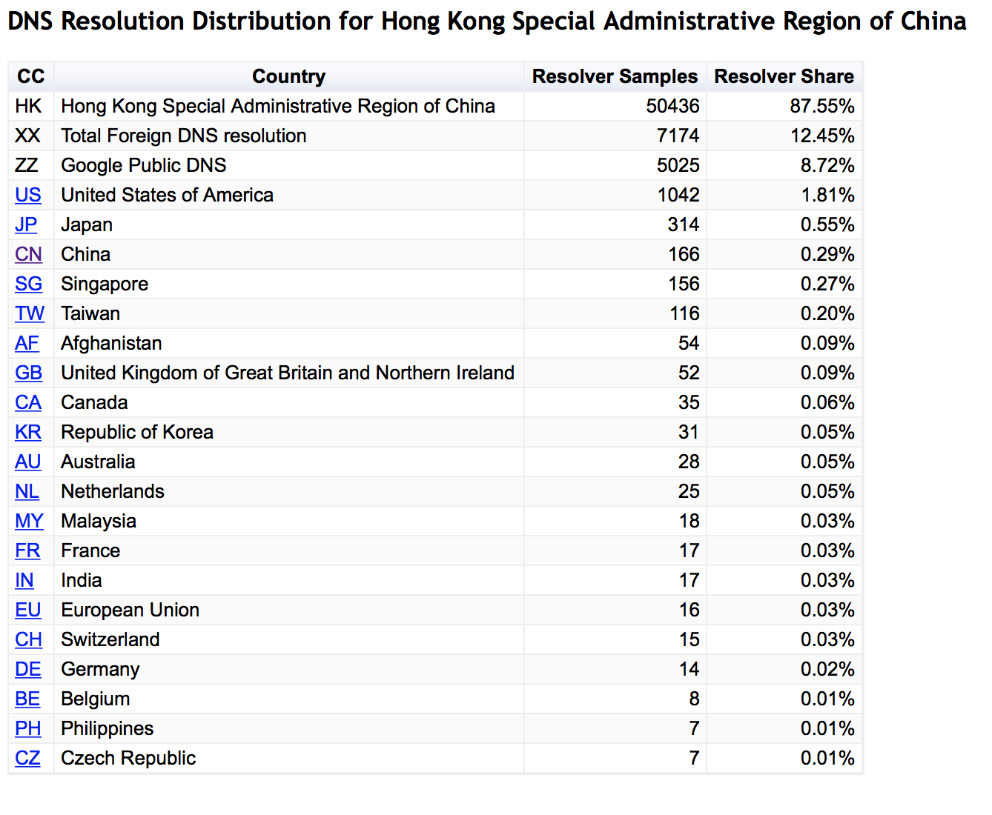
Offshore DNS from HK Users

Slide 68
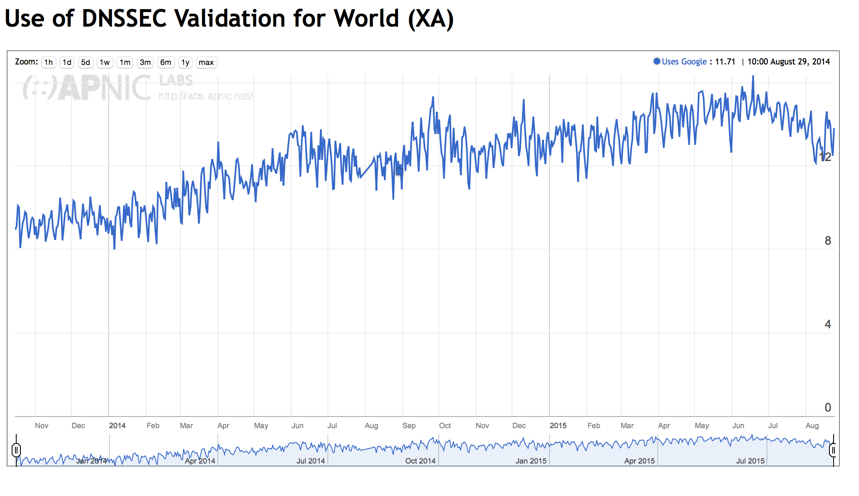
Market Penetration of Google’s Public DNS

Slide 69
Why is this happening?
It’s Google: Google’s Public DNS (all instances are mapped to the US in this per-AS analysis)
Users’ efforts to circumvent DNS-based geo-loc content access controls (think Netflix!)
3rd party DNS query monitoring/stalking (yes, there is some of this going on, but that’s a talk for another time!)
Virus contamination of the host (yes, captured systems often show a redirected DNS config)
<insert your favourite theory here>

Slide 70
3. Digital Stalking

Slide 71
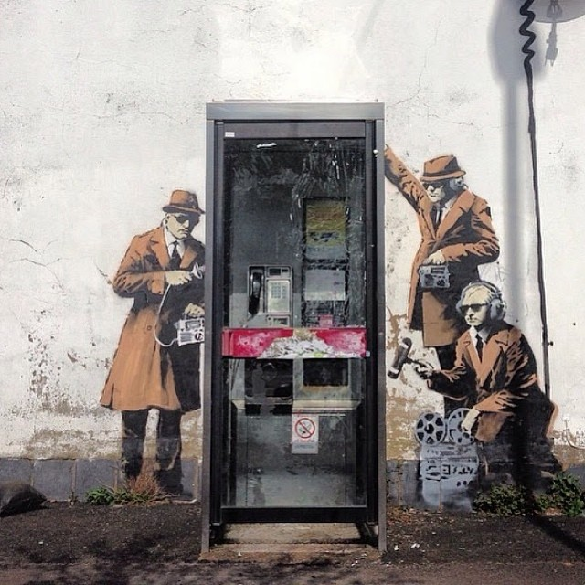
7
Who’s Watching?
Geoff Huston, APNIC
Street Art: Banksy

Slide 72
Some Stalker Numbers
In the first 248 days of 2014 we saw:
  123,110,633 unique end-user IP addresses presented to our servers from these test scripts
  317,309 of these end-user IP addresses presented HTTP GET strings to us that were subsequently presented to us from a different client IP address!
That’s some 1 in 400* users that seem to have attracted some kind of digital stalker!
* Or maybe a bit more, due to NATs hiding multiple end users behind a single public IP address

Slide 73
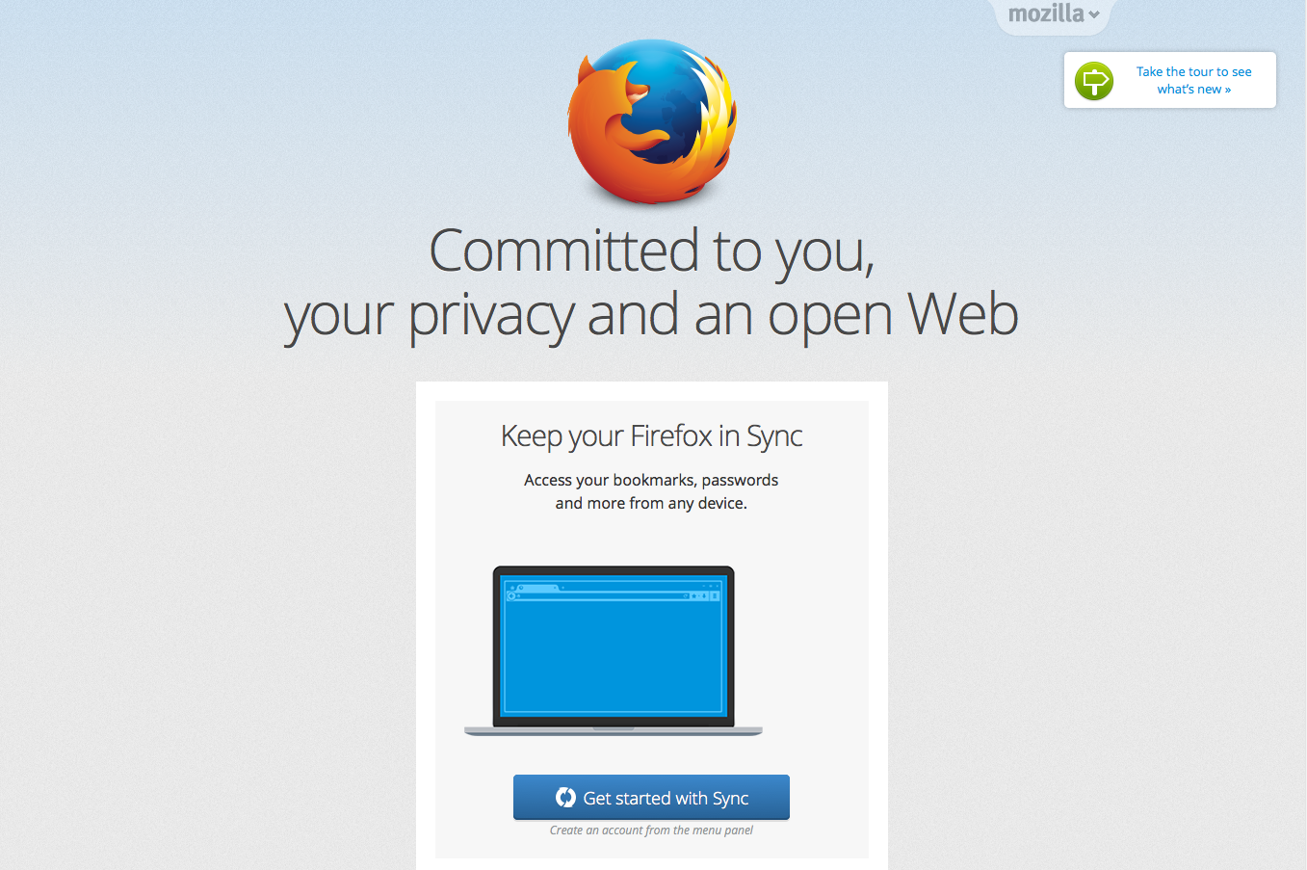

Slide 74
Online Privacy? Really?
It’s hard to believe that today’s Internet respects personal privacy when it seems that around 1 in 400 users have attracted some kind of digital stalker that tracks the URLs they visit.

Slide 75
Stalking Rates by Country
CC Samples Stalked Rate/1,000,000 Country
IR 674 111 164,688 Iran (Islamic Republic of)
LA 28,506 2,875 100,855 Lao People's Democratic Republic
MO 38,761 2,954 76,210 Macao Special Administrative Region of China
SG 240,188 17,406 72,468 Singapore
HK 486,101 22,136 45,537 Hong Kong Special Administrative Region of China
CN 10,419,638 435,040 41,751 China
GB 872,124 28,845 33,074 United Kingdom of Great Britain and Northern Ireland
TW 1,769,367 36,823 20,811 Taiwan
JP 1,500,779 23,971 15,972 Japan
AU 293,193 4,620 15,757 Australia
US 4,491,711 53,370 11,881 United States of America
MY 1,035,434 10,214 9,864 Malaysia
AL 437,399 4,043 9,243 Albania
CA 947,922 6,244 6,587 Canada
KH 143,886 897 6,234 Cambodia
MM 16,411 97 5,910 Myanmar
MK 458,820 2,214 4,825 The former Yugoslav Republic of Macedonia
BZ 8,139 35 4,300 Belize
MN 57,622 233 4,043 Mongolia
NZ 344,951 1,385 4,015 New Zealand
CV 3,742 14 3,741 Cape Verde
ME 223,005 775 3,475 Montenegro
FJ 14,892 47 3,156 Fiji
SR 44,116 136 3,082 Suriname
AW 11,123 34 3,056 Aruba
The top 25 countries in terms
of observed URL stalking rates

Slide 76
Stalking Delay
The 15, 30 and 60 minute local peaks are likely to be local web proxy refresh cycles
This local peak matches a result timer in the test script

Slide 77
Top 25 International Stalkers
Rank IP Net # AVG Delay AS Description
1 119.147.146.0 205,033 130.7 4134 CHINANET-BACKBONE No.31,Jin-rong Street,CN
2 101.226.33.0 6,198 1,576.1 4812 CHINANET-SH-AP China Telecom (Group),CN
3 180.153.206.0 6,120 1,608.3 4812 CHINANET-SH-AP China Telecom (Group),CN
4 180.153.214.0 3,827 1,561.0 4812 CHINANET-SH-AP China Telecom (Group),CN
5 112.64.235.0 3,819 1,544.9 17621 CNCGROUP-SH China Unicom Shanghai network,CN
6 101.226.66.0 3,603 1,577.3 4812 CHINANET-SH-AP China Telecom (Group),CN
7 180.153.163.0 2,742 1,540.1 4812 CHINANET-SH-AP China Telecom (Group),CN
8 223.27.200.0 2,740 1.8 45796 BBCONNECT-TH-AS-AP BB Connect Co., Ltd.,TH
9 101.226.89.0 2,658 2,230.2 4812 CHINANET-SH-AP China Telecom (Group),CN
10 180.153.201.0 2,628 1,549.4 4812 CHINANET-SH-AP China Telecom (Group),CN
11 101.226.65.0 1,528 1,573.3 4812 CHINANET-SH-AP China Telecom (Group),CN
12 69.41.14.0 1,243 1,127.4 47018 CE-BGPAC - Covenant Eyes, Inc.,US
13 101.226.51.0 1,195 1,627.6 4812 CHINANET-SH-AP China Telecom (Group),CN
14 112.65.193.0 1,038 1,623.9 17621 CNCGROUP-SH China Unicom Shanghai network,CN
15 64.124.98.0 906 1,288.9 6461 ABOVENET - Abovenet Communications, Inc,US
16 180.153.114.0 819 1,632.6 4812 CHINANET-SH-AP China Telecom (Group),CN
17 180.153.205.0 765 1,497.7 4812 CHINANET-SH-AP China Telecom (Group),CN
18 208.184.77.0 649 1,419.5 6461 ABOVENET - Abovenet Communications, Inc,US
19 222.73.77.0 535 1,373.8 4812 CHINANET-SH-AP China Telecom (Group),CN
20 180.153.211.0 517 1,450.6 4812 CHINANET-SH-AP China Telecom (Group),CN
21 180.153.161.0 504 1,675.7 4812 CHINANET-SH-AP China Telecom (Group),CN
22 183.60.153.0 262 451.3 4134 CHINANET-BACKBONE No.31,Jin-rong Street,CN
23 222.73.76.0 255 1,512.7 4812 CHINANET-SH-AP China Telecom (Group),CN
24 101.226.102.0 235 2,012.7 4812 CHINANET-SH-AP China Telecom (Group),CN
25 208.80.194.0 227 10,731.5 13448 WEBSENSE - Websense, Inc,US

Slide 78
The Leakiest Browser!
Wow! “Public Security Equipment 110 No 0000000025!”

Slide 79
4. Access ISP Market Share
  http://stats.labs.apnic.net/aspop

Slide 80
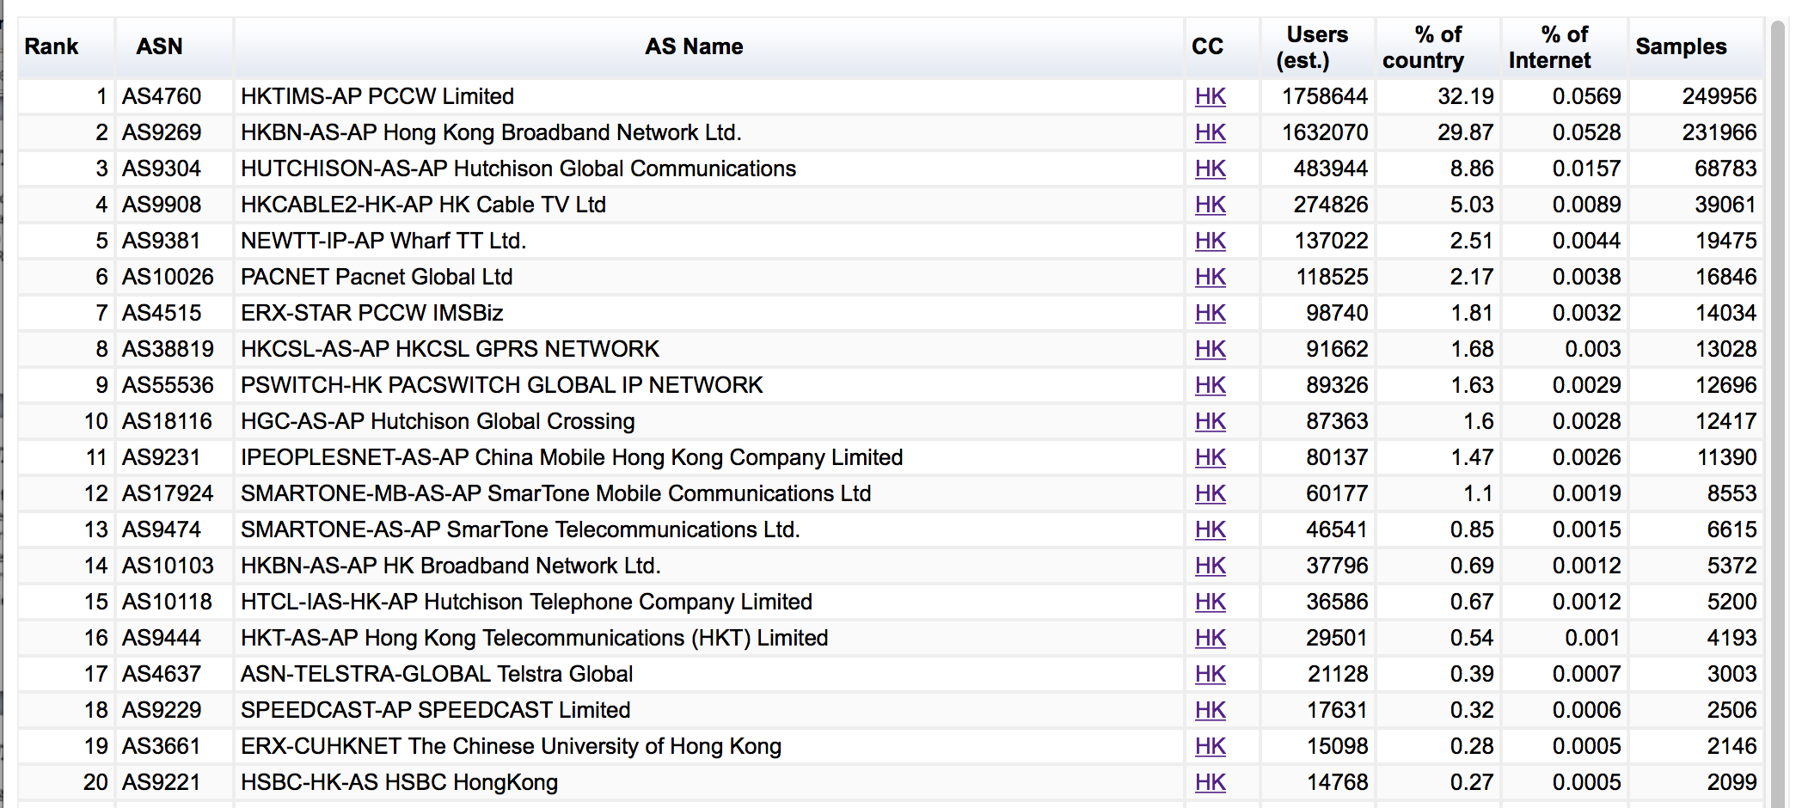
Market Share in HK

Slide 81
What Else?
Analysis of failure patterns to detect evidence of structured interception of DNS and Web retrieval

Slide 82
Content Blocking in Iran?
.sexy appears to use Web
Response blocking
.il appears to use DNS
Response blocking

Slide 83
Hong Kong
That looks like a high (3%) DNS loss rate – why?

Slide 84
What Else?
This approach allows us to analyze user behaviour when presented with particular tests
  DNS: response size, TCP behaviour, resolver distribution, matching resolvers to users, resolver timers, EDNS0 use, EDNS0 client subnet use and accuracy, dual stack behaviour, response size,…
  Web: Protocol preference, dual stack behaviour, response size, fragmentation behaviour, …

Slide 85
But…
It’s not a general purpose compute platform, so it can’t do many things
  Ping, traceroute, etc
  Send data to any destination
  Pull data from any destination
  Use different protocols
This is a “many-to-one” styled setup where the server instrumentation provides insight on the inferred behaviour of the edges

Slide 86
In Summary…
Measuring what happens at the user level by measuring some artifact or behaviour in the infrastructure and inferring some form of user behaviour is always going to be a guess of some form
If you really want to measure user behaviour then its useful to trigger the user to behave in the way you want to study or measure
The technique of embedding simple test code behind ads is one way of achieving this objective
  for certain kinds of behaviours relating to the DNS and to URL fetching

Slide 87
Thanks to the folk at Google Research for their generous support of our work!
APNIC Labs:
Geoff Huston
George Michaelson
research@apnic.net

Slide 88
Questions?

