Slide 1
The Status of APNIC’s IPv4 Resources:
Exhaustion & Transfers
Geoff Huston
APNIC Labs

Slide 2
IPv4 Exhaustion

Slide 3
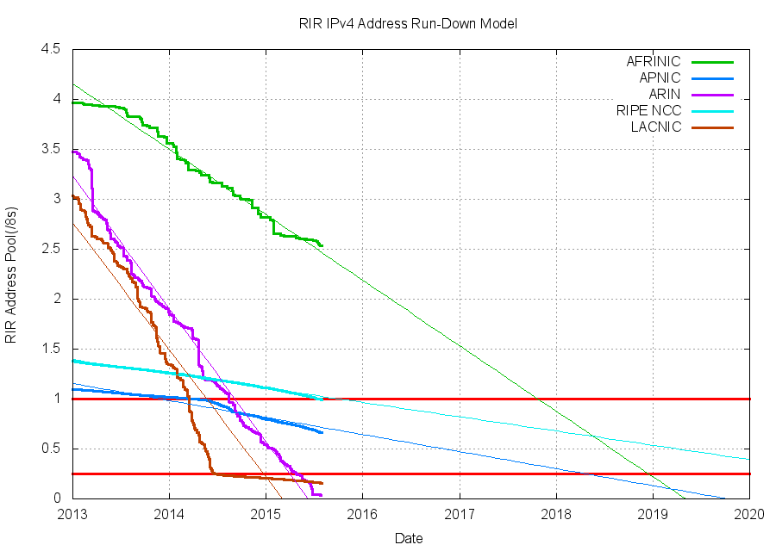
What’s Left in IPv4

Slide 4
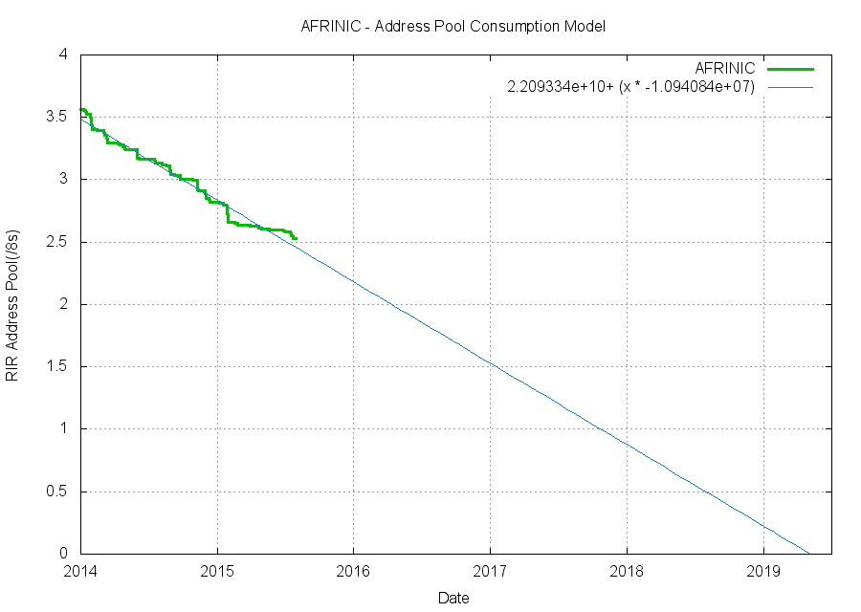
Exhaustion: AFRINIC

Slide 5
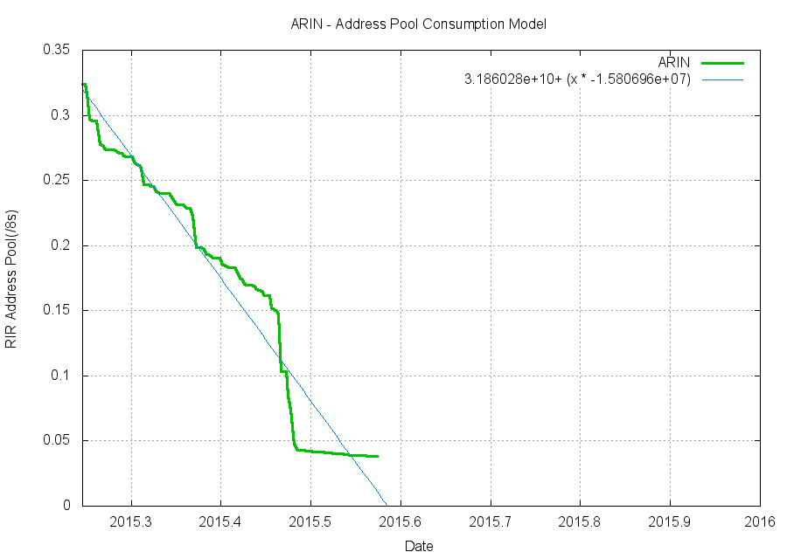
Exhaustion: ARIN

Slide 6
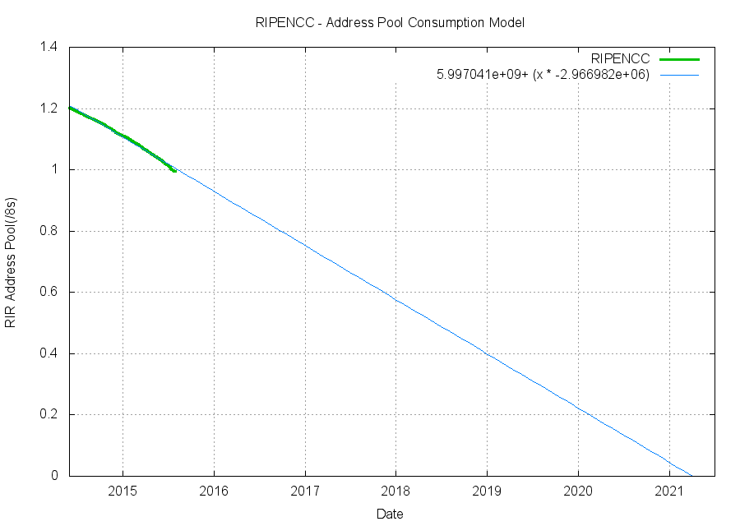
Exhaustion, Pt 2: RIPE NCC’s final /8

Slide 7
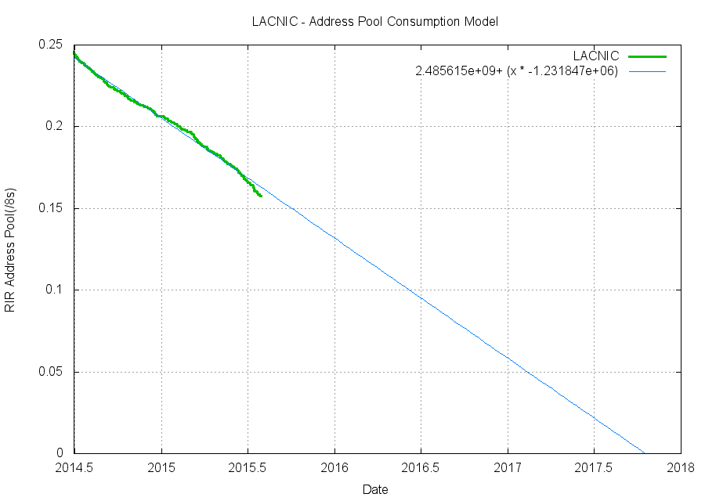
Exhaustion, Pt 2: LACNIC’s 2 final /11’s

Slide 8
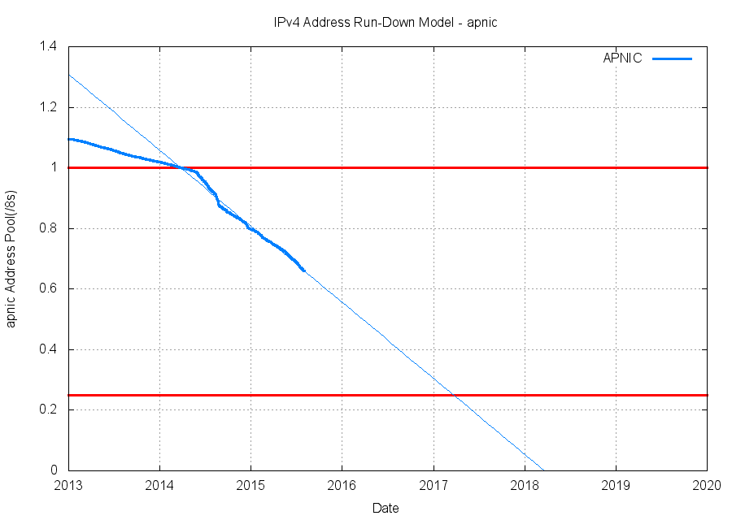
Exhaustion, Pt 2: APNIC’s final /8

Slide 9
Where Are We?
LACNIC running a split pool of two /11 blocks
  1 ½ - 2 years to go
APNIC running out of their last /8 plus IANA Return Pool (max allocation is a /22 from each pool)
  2 - 2 ½ years to go
AFRINIC still have a pool of 2.5 /8s to go
  4 years to go
RIPE NCC running out of their last /8 plus IANA Return Pool (max allocation is a /22)
  4 ½ - 5 ½ years to go
ARIN reserved a /10 for V6 transition, running the remaining pool to complete exhaustion
  Inadequate data

Slide 10
Where Are We?
LACNIC running a split pool of two /11 blocks
  1 ½ - 2 years to go
APNIC running out of their last /8 plus IANA Return Pool (max allocation is a /22 from each pool)
  2 - 2 ½ years to go
AFRINIC still have a pool of 2.5 /8s to go
  4 years to go
RIPE NCC running out of their last /8 plus IANA Return Pool (max allocation is a /22)
  4 ½ - 5 ½ years to go
ARIN reserved a /10 for V6 transition, running the remaining pool to complete exhaustion
  Inadequate data
Really?
Lets take a more detailed look at
APNIC’s situation

Slide 11
APNIC’s Last /8

Slide 12
APNIC’s Address Pools

Slide 13
APNIC’s Address Pools

Slide 14
APNIC Allocation from the last /8
“This means that Members can still get IPv4 address space; however, each Member is entitled to a total maximum of a /22 (or 1,024 addresses) from each pool.”

Slide 15
Status of 103/8
Assigned: 6,101,760
Available: 10,379,264
Reserved: 296,192
As of mid August 2015

Slide 16
APNIC’s Last /8
1
4
5
3
2

Slide 17
Allocation Sizes - APNIC

Slide 18
Larger Holdings in 103/8?
There are 100 instances where the same end entity is listed as holding more than 1,024 addresses assigned from 103/8
These are probably the result of post allocations mergers, acquisitions and transfers
1 x 1,280
4 x 1,536
70 x 2,048
2 x 2,560
15 x 3,072
3 x 4,096
3 x 5,120
1 x 7,168
1 x 14,336
For a full list of the grouped allocations to a single holding
entity of more than 1,024 addresses from the last /8 see
http://labs.apnic.net/103-multi-allocations.txt

Slide 19
Allocations from 103/8

Slide 20
Advertised vs Assigned in 103/8
Assigned Addresses: 6,101,760
Advertised Addresses: 4,582,784
Unadvertised Addresses: 1,518,976

Slide 21
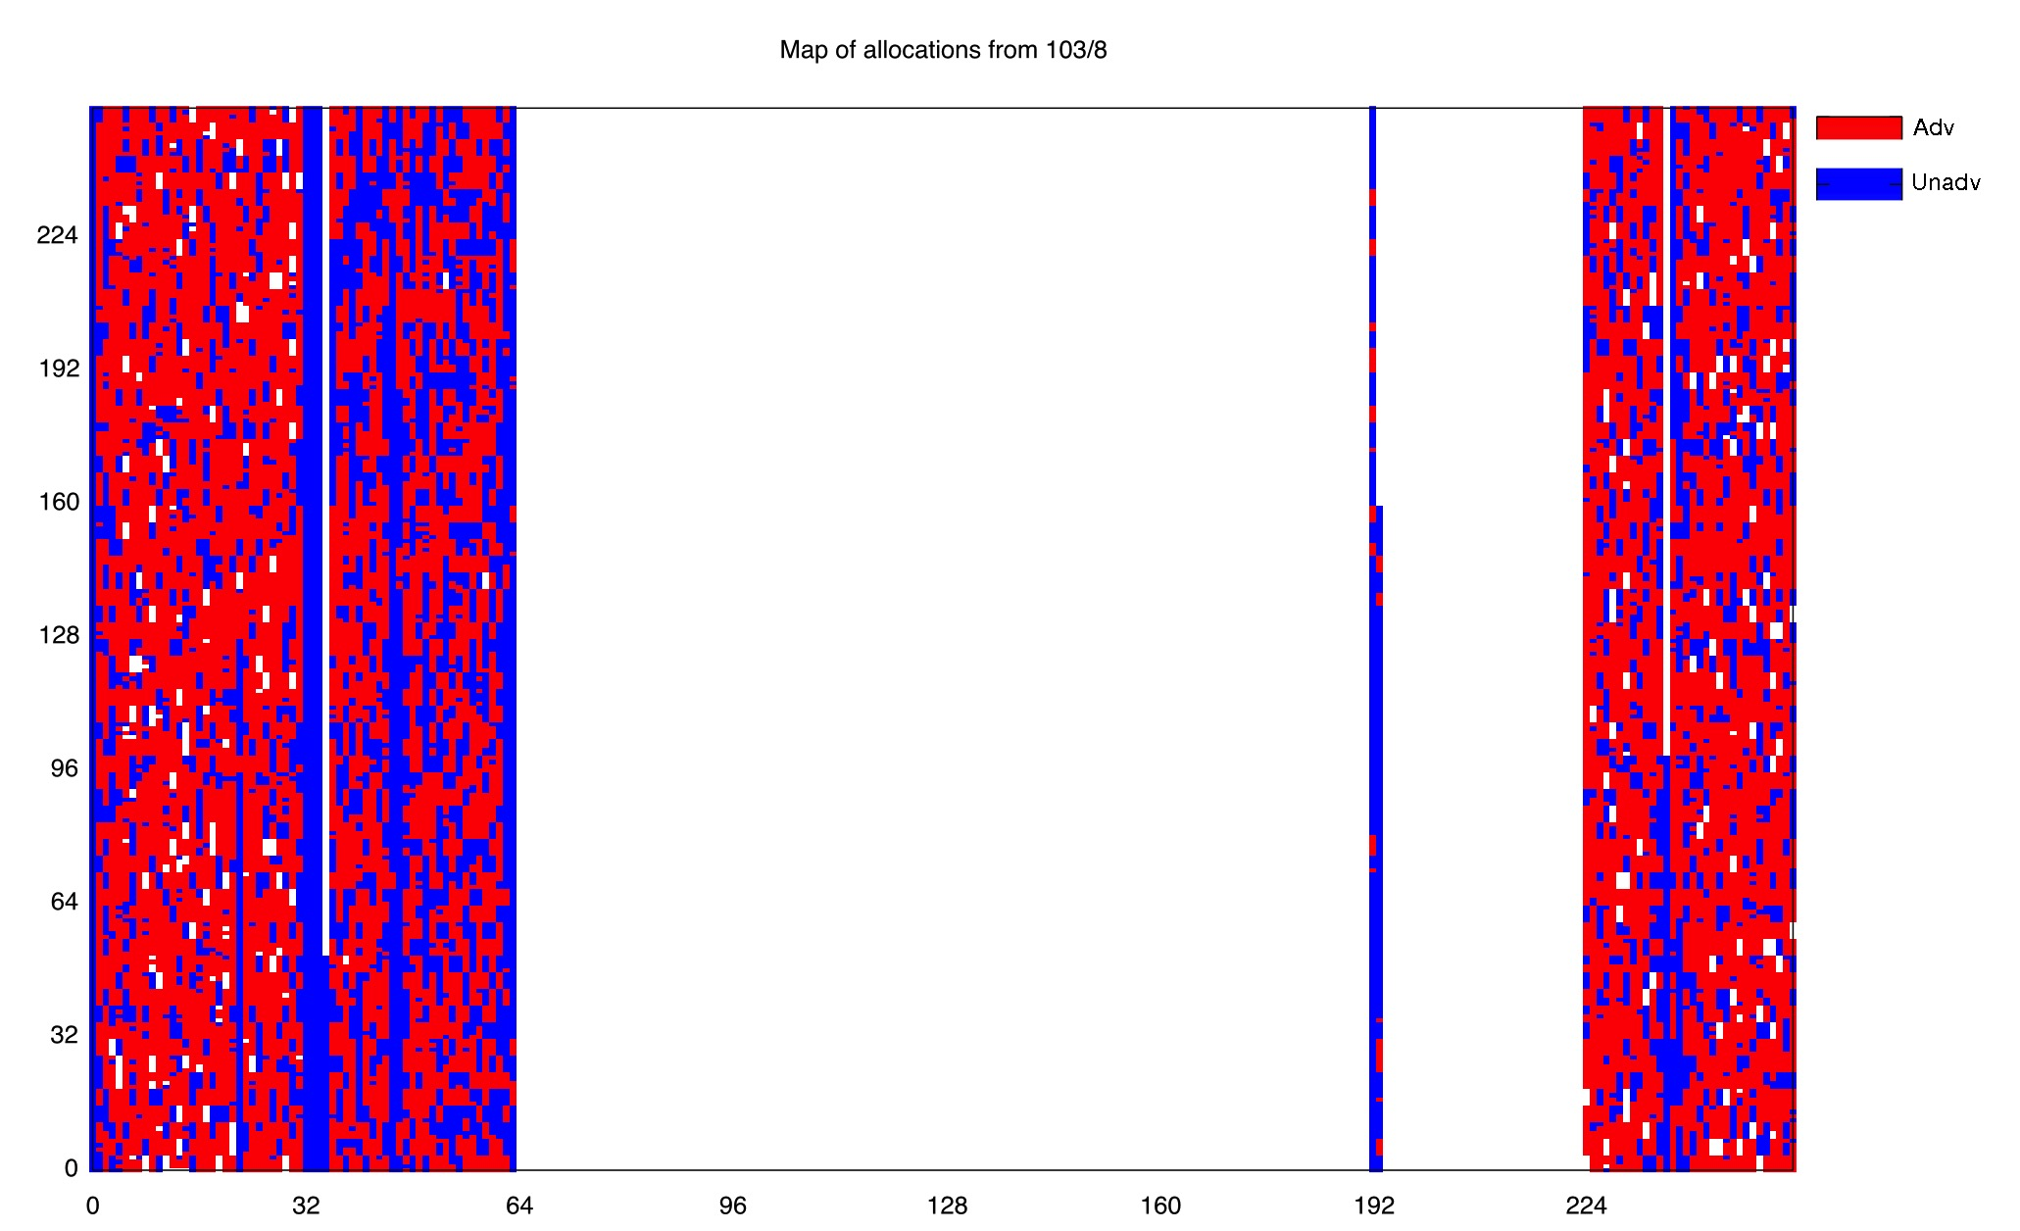
Advertised/Unadvertised Map of 103/8

Slide 22
Consumption

Slide 23
Projection for the last /8
We have 4 – 5 years left!

Slide 24
IANA Recovered Space:
Returns to APNIC

Slide 25
APNIC’s Address Pools

Slide 26
APNIC’s IANA Return Pool

Slide 27
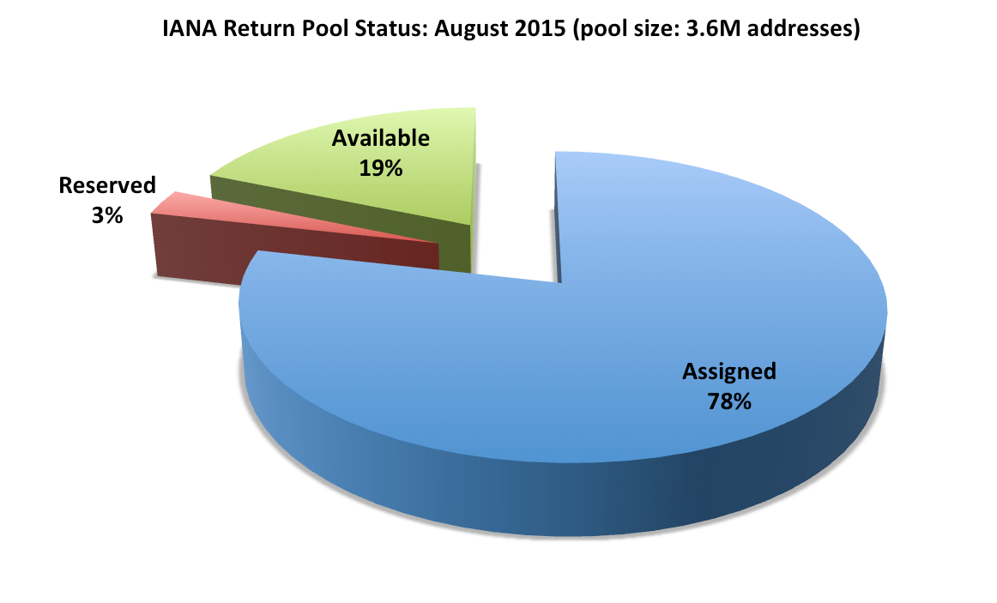
Pool Status
As of mid August 2015

Slide 28
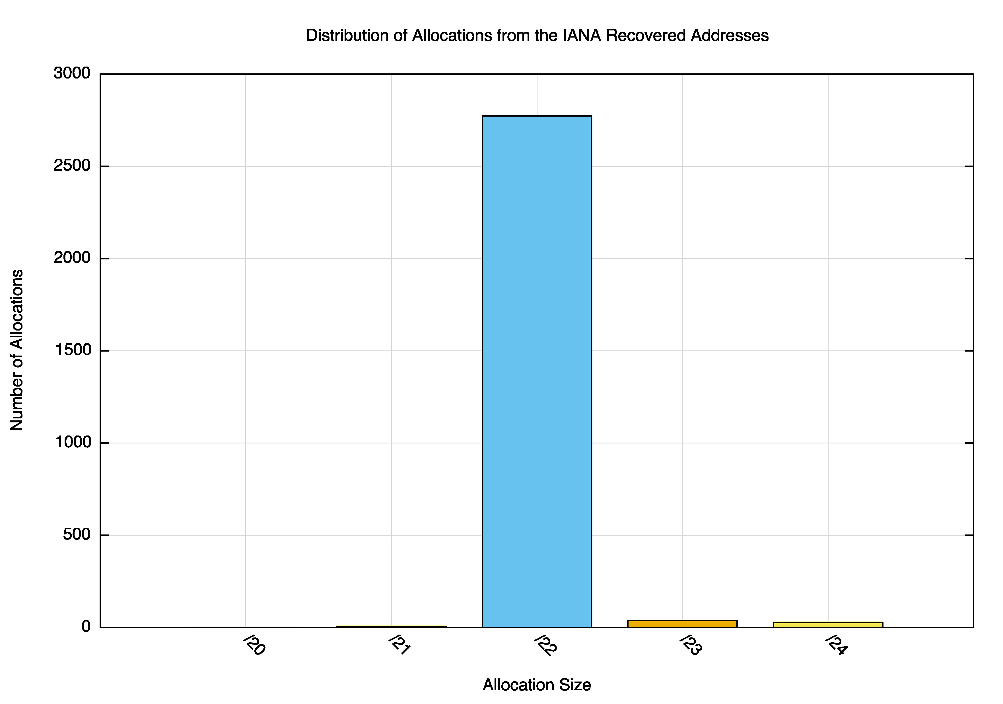
Allocation Size Distribution

Slide 29
Economy Distribution

Slide 30
Advertised vs Unadvertised
Last /8 IANA Returned
Advertised 4,037,376 1,334,528
UnAdvertised 2,015,232 1,549,056
Total 6,052,608 2,883,584
66% advertised
46% advertised

Slide 31
Who Has What
Pre-Exhaustion Last /8 IANA Return Count
✔ 4,803
✔ 3,051
✔ ✔ 671
✔ 14
✔ ✔ 4
✔ ✔ 2,276
✔ ✔ ✔ 509
5,987 6,507 2,803 11,328

Slide 32
Consumption

Slide 33
Projection for the Returned Pool
We have ~7 months left

Slide 34
Transfers

Slide 35
IPv4 Address Transfers
Total Transfers Registered with APNIC: 1,086
Internal (APNIC -> APNIC): 914
Inter-RIR (ARIN->APNIC): 172
Total Address Volume Transferred: 14,210,816
Internal (APNIC -> APNIC): 9,674,496
Inter-RIR (ARIN->APNIC): 4,536,320

Slide 36
Transfers started in APNIC in late 2010
The average number of transfers per month has risen from 2 – 3 per month to 30 – 80 per month in 2015
The volume of addresses transferred has risen from some 10 x /24s per to a total monthly volume of of 1,000 – 6,000 /24s in 2015. This is double the 2014 volumes

Slide 37
Original Allocation (Registration) date of the Transferred Addresses
There are two visible peaks here: one is the so-called “legacy” space which was originally allocated pre 1994
The other is the address blocks allocated in 2009 – 2011, immediately prior to APNIC address exhaustion.
These relative peaks are visible when looking at the volumes of transferred addresses,

Slide 38
Age (since allocation) of the Transferred Addresses
There are again two visible peaks here: one is the so-called “legacy” space which is transferred some 20 years after the initial allocation and the second is a peak of transferred addresses that were transferred within 5 years of the initial allocation. This is visible both in the number of transfers, and the amount of addresses transferred that share a common age

Slide 39
Original Allocation (Registration) date of the Transferred Addresses for addresses in 103/8
This shows the same data (relative age of transferred addresses) but looks in particular at transfers of addresses from APNIC’s final /8 (103/8).
It appears that 1 and 12 months of tenure of an allocation from 103/8 are the most common for allocations from 103/8

Slide 40
An Economy View of Transfers
The next few slides look at transfers from a national perspective.
An “Import” is where the receiver of the transferred address is registered within the country
An “Export” is where the disposer of the transferred address is registered within the country
A “Domestic” transfer is where the dfisposer and receiver are both in the same country

Slide 41
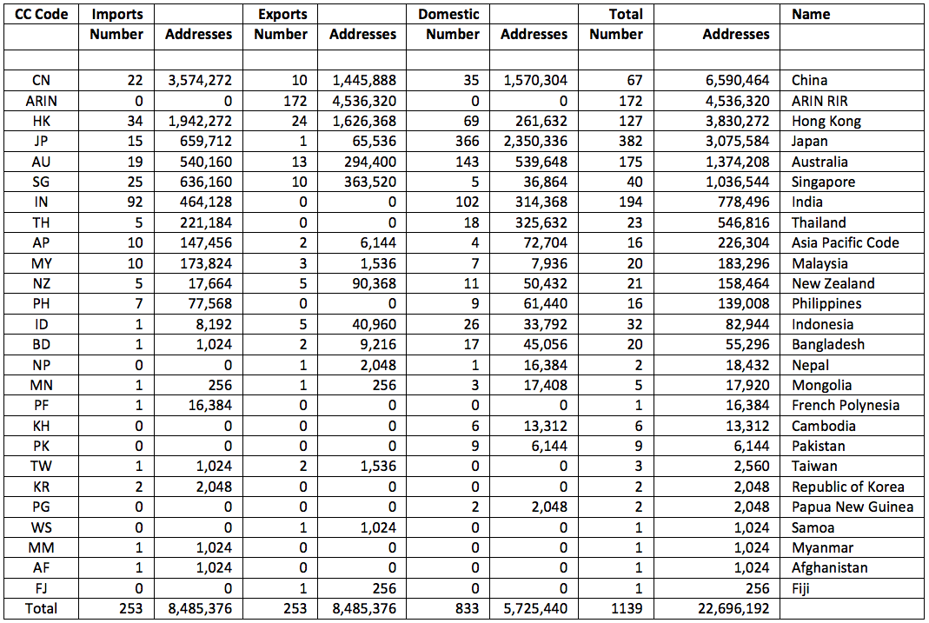
Imports and Exports

Slide 42
Imports and Exports
The Asia Pacific region is a net importer of IPv4 addresses (4.5M addresses have been imported from ARIN via transfers)
Most address transfers happen within a single economy. Japan is the largest domestic market for IPv4 addresses
China is the largest regional net importer of addresses (2M), and New Zealand is the largest regional net exporter (72K)
ARIN is the largest source of transferred addresses

Slide 43
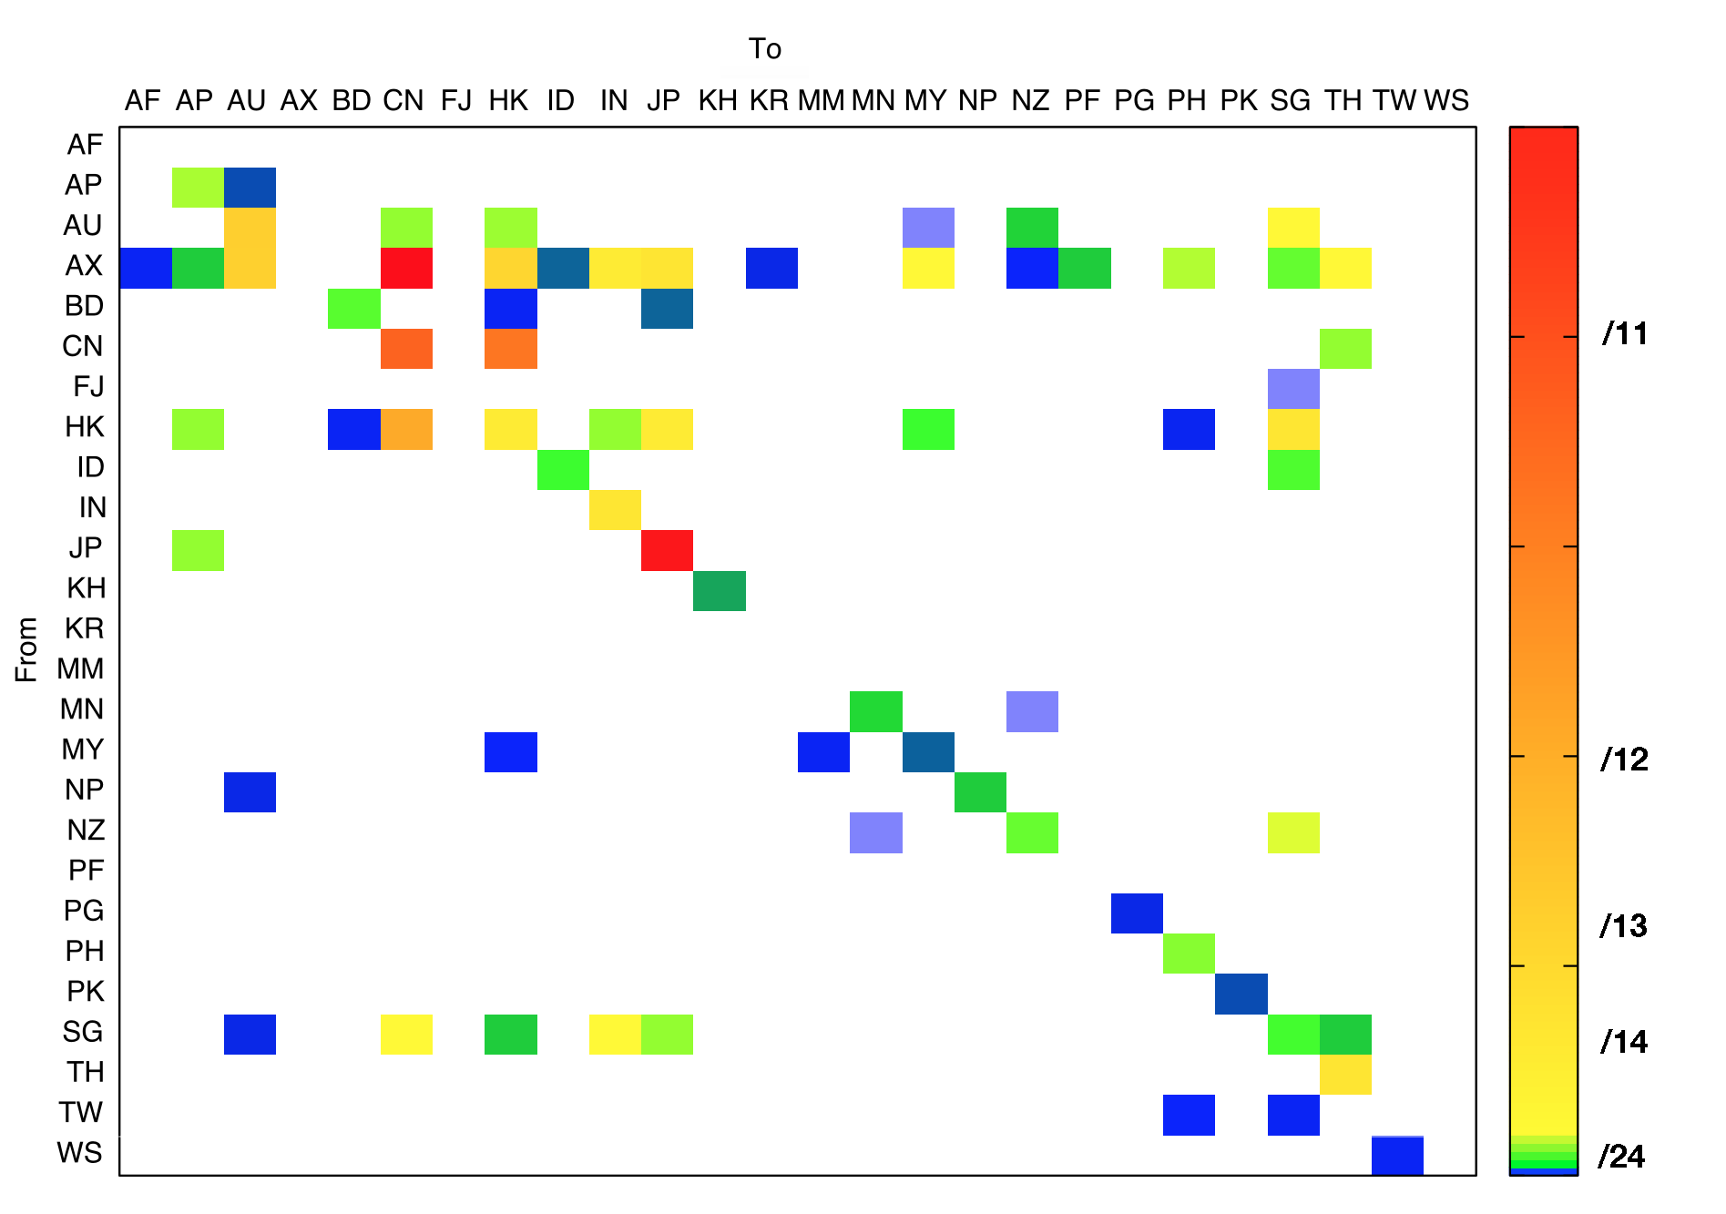
ARIN
ARIN
/11
/12
/13
/14
/24

Slide 44
Largest Sellers into Asia Pacific
Seller Address Count
Nortel, US (ARIN) 2,359,296
CNISP-Union Technology (Beijing) Co., Ltd, CN 1,409,024
Cloud-Sense Technology Corporation Ltd, HK 1,179,648
GuangXi Seehu Technology Co., Ltd, CN 827,832
DOMIRU, JP 587,776
AOL, US (ARIN) 524,288
JPNIC (no details) 421,888
Beyond Excellent Technology Ltd,HK 262,144
Northern Telecom Canada, CA (ARIN) 262,144
Outstanding Telecommunication Pte Ltd, SG 262,144
Renjiao International Technology Ltd, HK 245,760
Bank of America, US (ARIN) 197,632
Oak Point Partners, US (ARIN) 196,608
ShenZhen TC telecom Network Corp, CN 183,296
SPACENET, US (ARIN) 147,456

Slide 45
Largest Buyers in the Asia Pacific
Buyer Address Count
ALISOFT, Aliyun Computing Co, CN 3,801,088
Cloud-Sense Technology Corporation Ltd, HK 1,179,648
SAKURA Internet, JP 541,696
Foxtel Management Pty Ltd, AU 524,288
True Internet Co., Ltd, TH 327,680
Beyond Excellent Technology Ltd, HK 262,144
Abitcool BroadBand Inc, CN 262,144
Vodafone Spacetel Limited, IN 229,376
NTT DoCoMo, JP 212,992
DIX Co, JP 199,936
Bank of America, N.A. HK 197,632
Telewings Communications Services Ltd, IN 196,608
IIJ, JP 196,608
FreeBit Co, JP 192,512
SingTel Optus Pty Ltd, AU 180,224

Slide 46
Multi-Transfers
A number of addresses have been transferred multiple times – For example:
39.96.0.0/12|CNISP-Union Technology|CN|APNIC|20110405|Cloud-Sense|HK|APNIC|20111028
39.110.0.0/15|Cloud-Sense|HK|APNIC|20110405|JPNIC/So-net|JP|APNIC|20140901
39.109.0.0/17|Cloud-Sense|HK|APNIC|20110405|Huayun Data Holdings|HK|APNIC|20141120
39.109.128.0/17|Cloud-Sense|HK|APNIC|20110405|Starhub Internet Pte Ltd|SG|APNIC|20141223
39.104.0.0/14|Cloud-Sense|HK|APNIC|20110405|CNNIC/ALISOFT|CN|APNIC|20150210
39.108.0.0/17|Cloud-Sense|HK|APNIC|20110405|CNNIC/ALISOFT|CN|APNIC|20150210
39.108.128.0/17|Cloud-Sense |HK|APNIC|20110405|CNNIC/ALISOFT|CN|APNIC|20150210
39.96.0.0/13|Cloud-Sense |HK|APNIC|20110405|CNNIC/ALISOFT|CN|APNIC|20150210
1,074,432 addresses have been transferred multiple times in APNIC

Slide 47
How Many are Buying and Selling?
319 different sellers
320 different buyers
596 participants

Slide 48
Transfer Size
The transfer log records a transfer in terms of individual CIDR blocks
We can group these together by using a common key of source entity, destination entity and date.
Using this we see that the transfer log contains distinct 480 transactions

Slide 49
Transfer Size Distribution

Slide 50
Transfers
This is still a relatively small scale activity in this region.
Out of the 875,936,768 addresses in the APNIC registry, transfers account for the movement of 12,371,712 addresses (1.4%), involving 596 entities out of a total of 11,319 unique holders of IP addresses (5.2%)
The rise of IPv6 adoption in the past 12 months calls into question precisely how much longer we will need to keep IPv4 in circulation

Slide 51
Questions?

