Slide 1
An Update on Mobility in Today’s Internet
Geoff Huston,
APNIC Labs

Slide 2
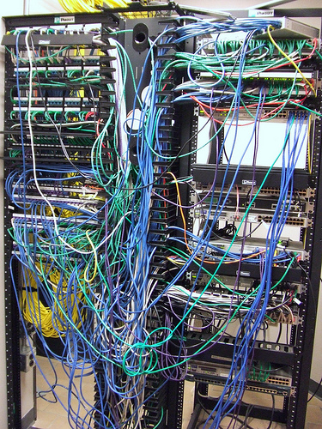
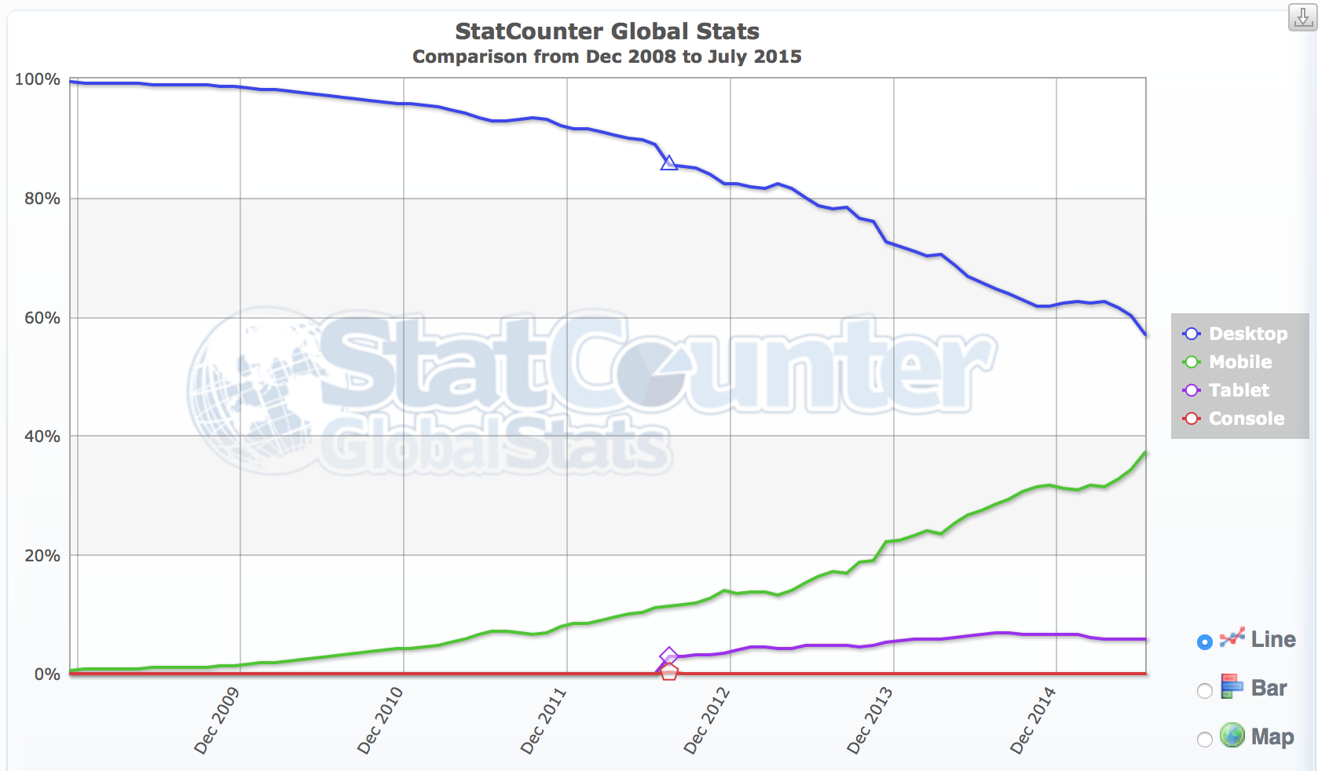
Counting Platforms
Mobiles are now
40% of all visible devices
8.5%
4.3%
http://statcounter.com/

Slide 3
Counting the Money
Mobiles are now
40% of all visible devices
Mobile access services represent
75% of all Access Provider revenue
8.5%
4.3%
http://statcounter.com/

Slide 4
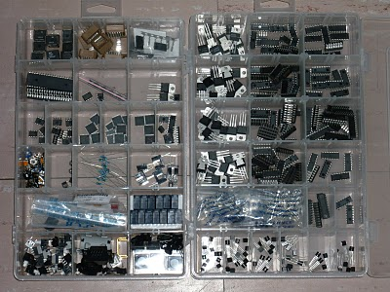
Mobile Production Numbers
2014: 1.5 billion units shipped
Factors:
Production volumes are bringing down component unit cost
Android is bringing down software unit cost
No need for new content - leverage off the the existing web universe of content
Shift away from the desktop and the laptop by the production industry seeking new markets for their production capability

Slide 5
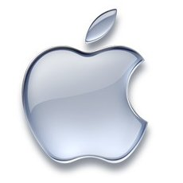
Who’s playing
Android
84% of all smartphone shipments in 2014
Multi-vendor adoption
Android also extending into tablets and large screens
Apple iPhone / iPad
12% of all smartphone shipments in 2014
Revenues for Apple: $182B in 2014
Windows
3% market share
Mostly Lumia models with Nokia

Slide 6
We used to think…
That the mobile market was the market “driver” for the Internet
Mobiles represent the highest revenue sector, and show the highest growth numbers
And this is still true today
That the true driver for IPv6 adoption in the Internet was in the mobile sector
If mobile platforms went to IPv6 then everyone else would be forced to follow
But maybe this is not so true today.

Slide 7
One Mobile Technology?
GSM revolutionised the mobile industry by offering a single technology standard and a single business model across a large part of the mobile market
Roaming just worked in the GSM world
Has the mobile industry managed to stay in lock step as it moves into the 4G world?

Slide 8
One Mobile Technology? Not!
The mobile industry is now very heterogeneous
Various spectrum allocations and regulatory constraints
Various service objectives
Various operator business objectives (incumbent vs challenger)
Radically different objectives from handset suppliers vs network carriage operators
3G is the LCD for roaming – 4G is more random!

Slide 9
The Mobile IPv6 Story
The result is that the approach to IPv6 transition is highly fragmented across the operators and across handsets
The result is the deployment of various permutations of transitional IPv4 and IPv6 support in the mobile environment:
Native mode dual stack over LTE: e.g. Verizon
IPv4 layered over native IPv6, 464 XLAT: e.g. T-Mobile
IPv4 synthesized over native IPv6 with NAT64 support
IPv6 tunnelled over IPv4

Slide 10
The Mobile IPv6 Story
The result is that the approach to IPv6 transition is highly fragmented across the operators and across handsets
The result is the deployment of various permutations of transitional IPv4 and IPv6 support in the mobile environment:
Native mode dual stack over LTE: e.g. Verizon
IPv4 layered over native IPv6, 464 XLAT: e.g. T-Mobile
IPv4 synthesized over native IPv6 with NAT64 support
IPv6 tunnelled over IPv4
This diversity implies that many operators have unique requirements for network and device capabilities
Which implies the imposition of cost and complexity for the service operators through customization of technologies
Which all adds to the cost of service to consumers
Nobody wins from this fragmented transition scenario!

Slide 11
Dual Stack vs Mono Stack
IPv6 only access network
Single NAT64 at the network edge to map external IPv4 services to local IPv6 addresses
or
4-to-6 mapping in the handset and 6-to-4 mapping at the network edge to provide a NAT+XLATE based IPv4 service
Dual Stack access
Pass IPv6 and IPv4 all the way through to the handset

Slide 12
Mobile Devices and IPv6
iOS
No OS preference for IPv6 – uses a mechanism that should result in an approximate 50/50 split between IPv6 and IPv4 for dual stack
Browsers may add their own IPv6 selection bias
We saw in August 2015 1,216,594 iOS devices
64,740 responded in IPv6 (5%)
46,784 preferred to use IPv6 (72%)
iOS 9 beta changes this behaviour to prefer IPv6 in dual stack contexts
No currently planned support for 464XLAT – proposes a NAT64 solution to single protocol access networks

Slide 13
Mobile Devices and IPv6
Android
No preference for IPv6 – uses a mechanism that should result in an approximate 50/50 split between IPv6 and IPv4 for dual stack
Browsers may add their own IPv6 selection bias
We saw in August 2015 3,353,463 iOS devices
175,922 responded in IPv6 (5%)
151,754 preferred to use IPv6 (86%)
No current plans to add any bias to use IPv6
Has support for 464XLAT
Does not support DHCPv6 (prefers RA and PD framework)

Slide 14
It’s not just Transitional Complexities
It’s also the issue of Wifi Handoff and/or multi-path support
The traditional mobile providers operate with exclusive access to spectrum within defined locales (with associated license costs)
Alternate access competitors can operate in unlicensed spectrum with WiFi network services
Handsets are also entering the space with platform services that support connection agility across diverse access networks
Mobile incumbents are being forced to chase this alternate access market or risk losing market share
And here there are visible cracks in the protocol stack!

Slide 15
The Mobile Stack Model
Application
OS Platform Library
Access Network Services

Slide 16
Cracks in the Stack
Application
The Google Fi Approach:
OS-Controlled Seamless
Handoff Agility
OS Platform Library
Virtual Connection Client
Access Network Services
Access Network Services
Access Network Services
Access Network Services
Virtual Connection Server

Slide 17
Cracks in the Stack
Application
MP-TCP
OS Platform Library
The MP-TCP Approach:
Apple’s Siri
Application-Controlled
Handoff Agility
Access Network Services
Access Network Services
Access Network Services
Access Network Services
Internet
MP-TCP Server

Slide 18
Cracks in the Stack
Application
Application Library
OS Platform Library
The Application Approach: Facebook
Fold the entire transport
session control into the
application
Raw IP
Access Network Services
Access Network Services
Access Network Services
Access Network Services

Slide 19
Cracks in the Stack
Application
Application Library
Virtual Connection Client
The VPN Application Approach:
Hide the application traffic from both the local platform as well as the local network
Raw IP
Access Network Services
Access Network Services
Access Network Services
Access Network Services
Virtual Connection Server

Slide 20
Where now for Mobiles?
Mobile Carriage Operators are being pushed into undistinguished utility roles
No more voice premiums
Erosive pressure on data service margins
OS and App providers splitting away from carrier constraints
Mobile Device manufacturers are being squeezed (except Apple)
Google and Apple now control the platform space
So apps are now turning on their over versions of paranoia!

Slide 21
Where now for Mobiles?
Consumers want more for less
The rise of the Streamers
(much) higher download speeds
(much) larger data caps
Lower premiums
Competitive pressure on providers to response to this consumer pressure

Slide 22
Where now for Mobiles?
Exclusive Use radio spectrum is too expensive
Are they pricing themselves out of the consumer market?
WiFi access and application handover approaches are placing pressure on the traditional mobile operator’s margins
If the cellular providers want cheaper carriage then they need to look at augmenting their offering with WiFi base station handoff infrastructure

Slide 23
Where now for Mobiles?
The underlying observation here is that the mobile network operator has lost control of the mobile access device and the services offerred across the mobile network
And after losing that control there is no way back!
The device vendor and its applications are charting a course that is in direct conflict with the mobile network operator’s desires, and managing to monetize this far more efficiently than the mobile network operator
Which means that there is increasing pressure to increased shared unregulated spectrum and increasing discontent with the behaviour of the exclusive spectrum holders
Mobile operators are trying to seize the initiative with WiFi handoff, while OS platforms and Apps are trying to place themselves in control and constrain the mobile providers into limited cellular data role

Slide 24
Thank You!
Questions?

