Slide 1
Rolling the Keys of the DNS Root Zone
Geoff Huston
APNIC Labs

Slide 2
DNSSEC in AU
1 in 6 Australian users use DNS resolvers that validate responses with DNSSEC
stats.labs.apnic.net/dnssec/AU

Slide 3
DNSSEC in AU

Slide 4
Why is this relevant?

Slide 5
Why is this relevant?
Because the root zone managers are preparing to roll the DNS Root Zone Trust Anchor Key
(and in the worst case that may break your DNS service!)

Slide 6
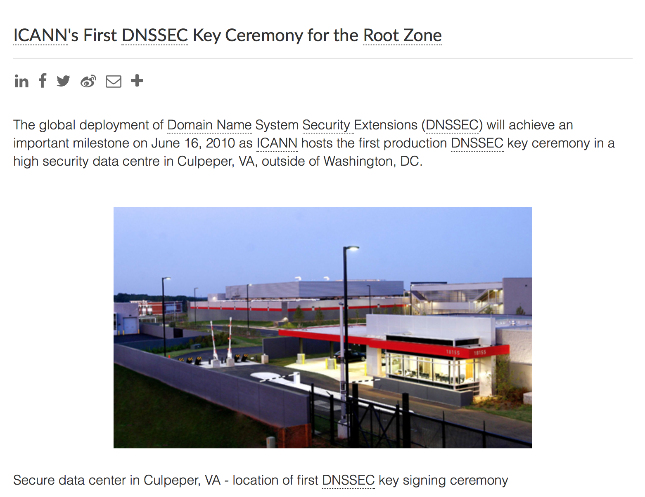
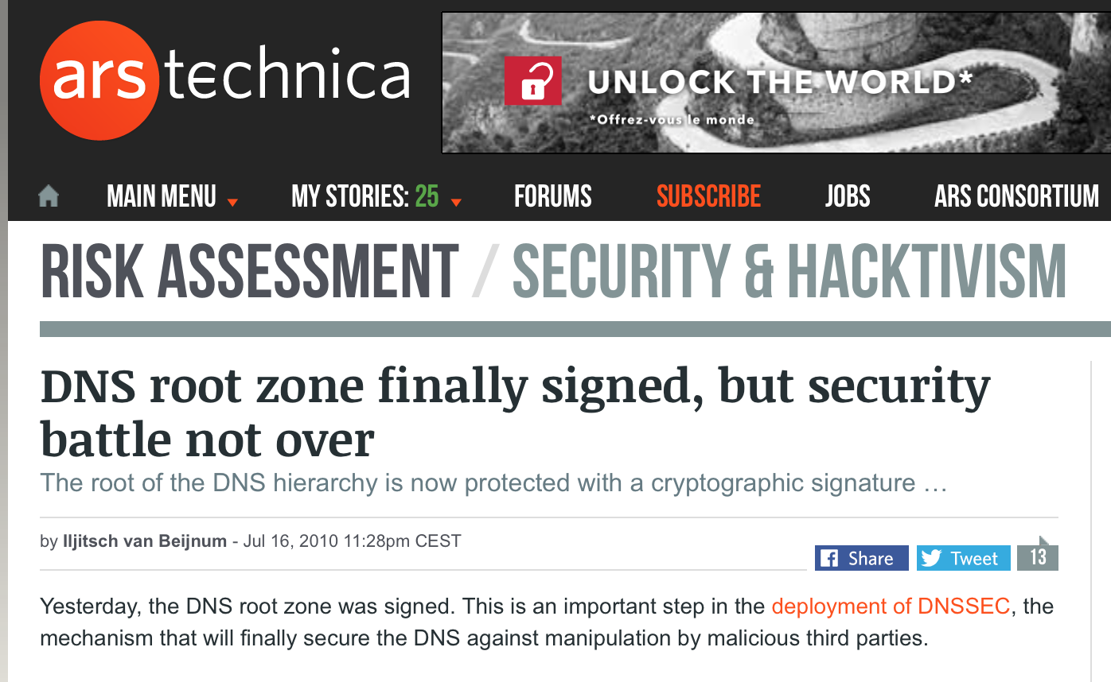
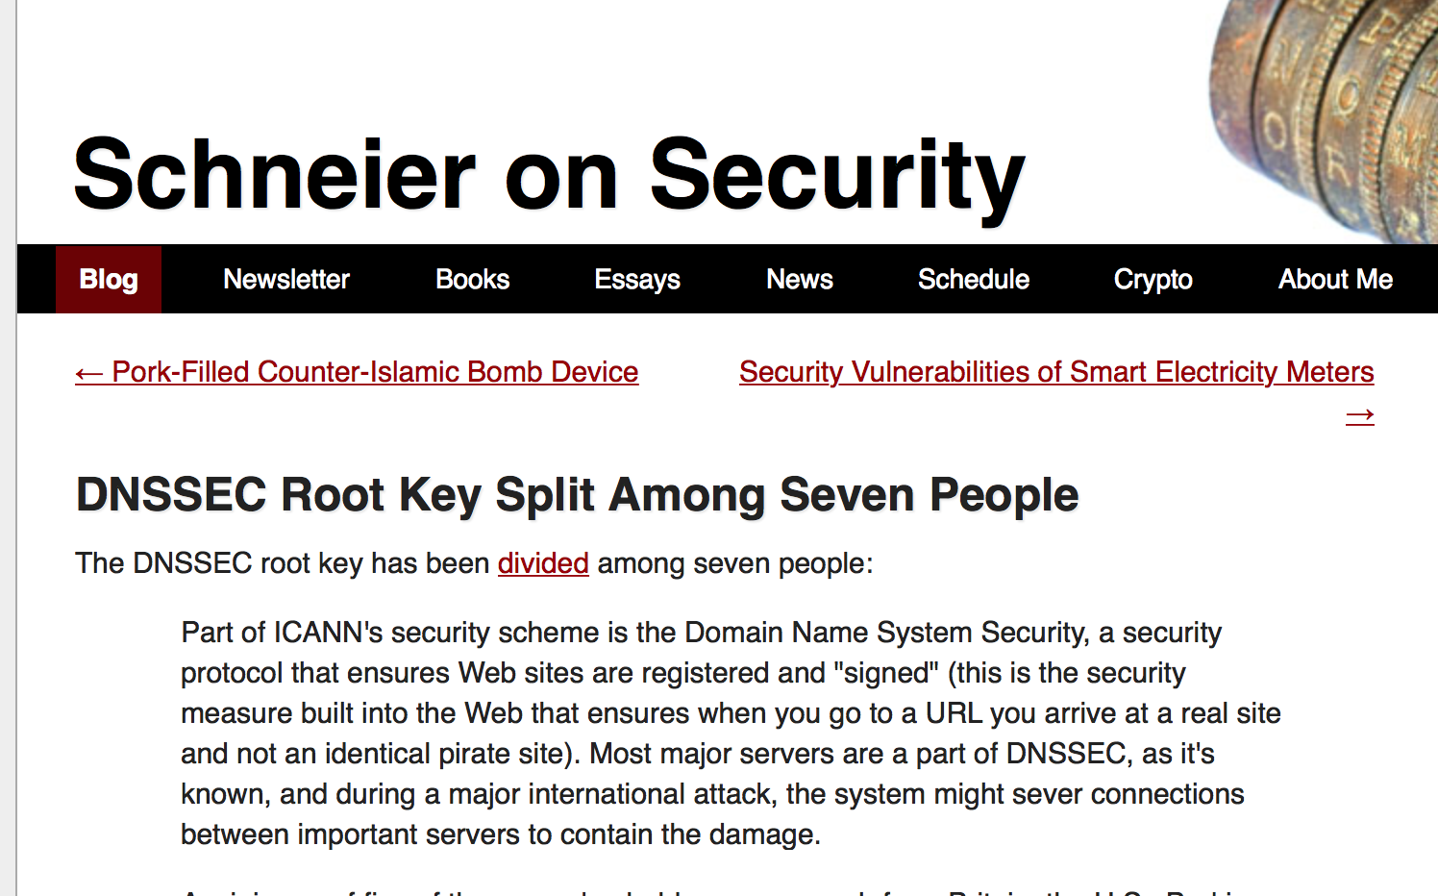
Five Years Ago

Slide 7
The Eastern KSK Repository

Slide 8
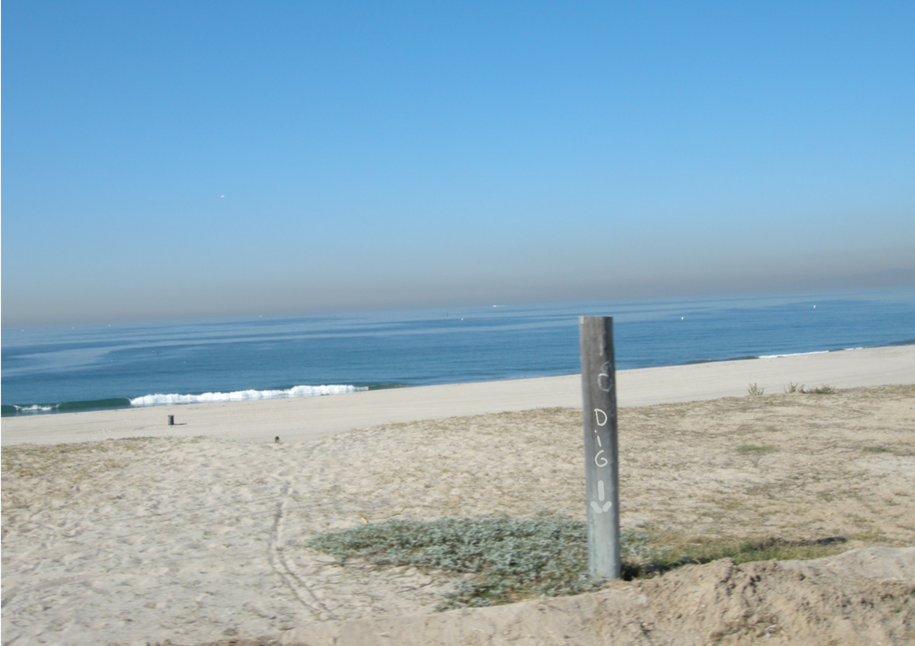
The Western KSK Repository
El Segundo, California *
* No – that’s not really a picture of the the El Segundo KSK repository facilities!

Slide 9
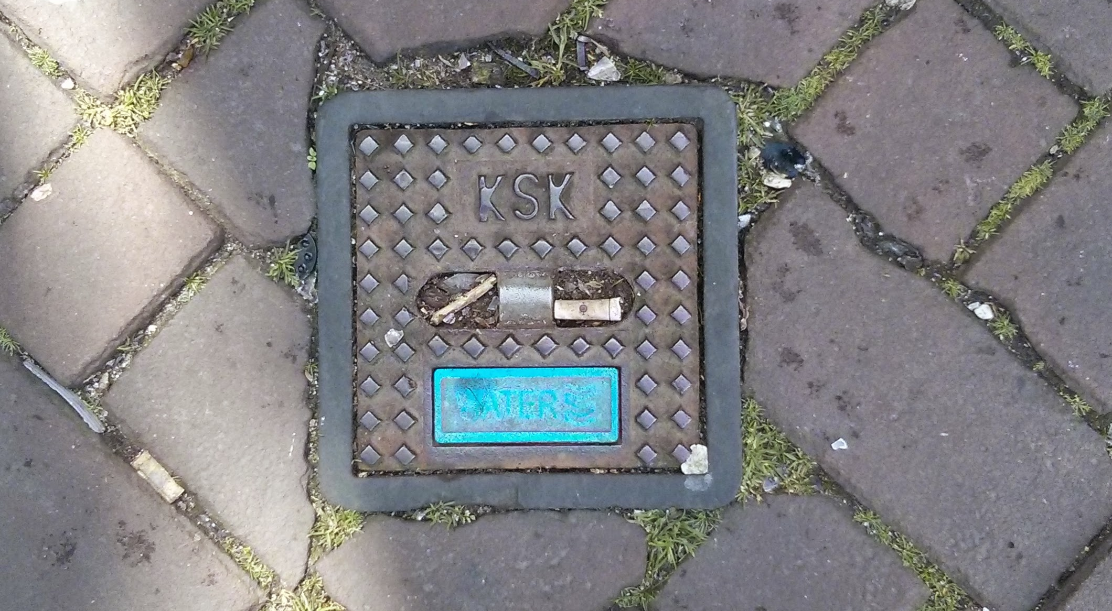
The Ultra Secret Third KSK Repository in Amsterdam

Slide 10
KSK?
The Root Zone Key Signing Key signs the DNSKEY RR set of the root zone
The Zone Signing Key (ZSK) signs the individual root zone entries
The KSK Public Key is used as the DNSSEC Validation trust anchor
It is copied everywhere as “configuration data”

Slide 11
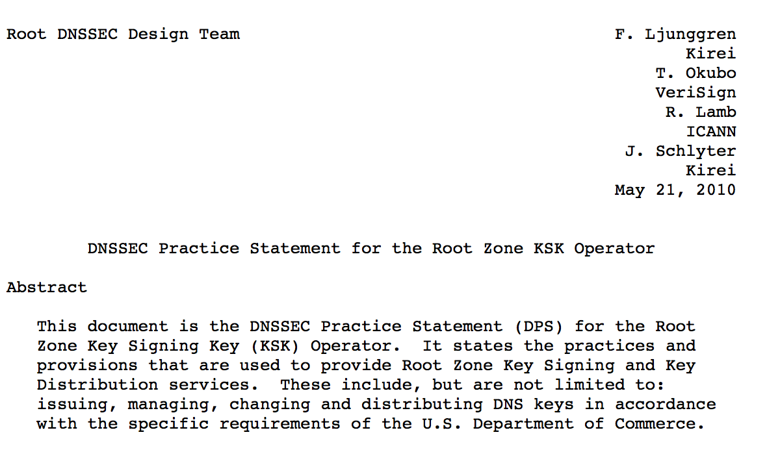
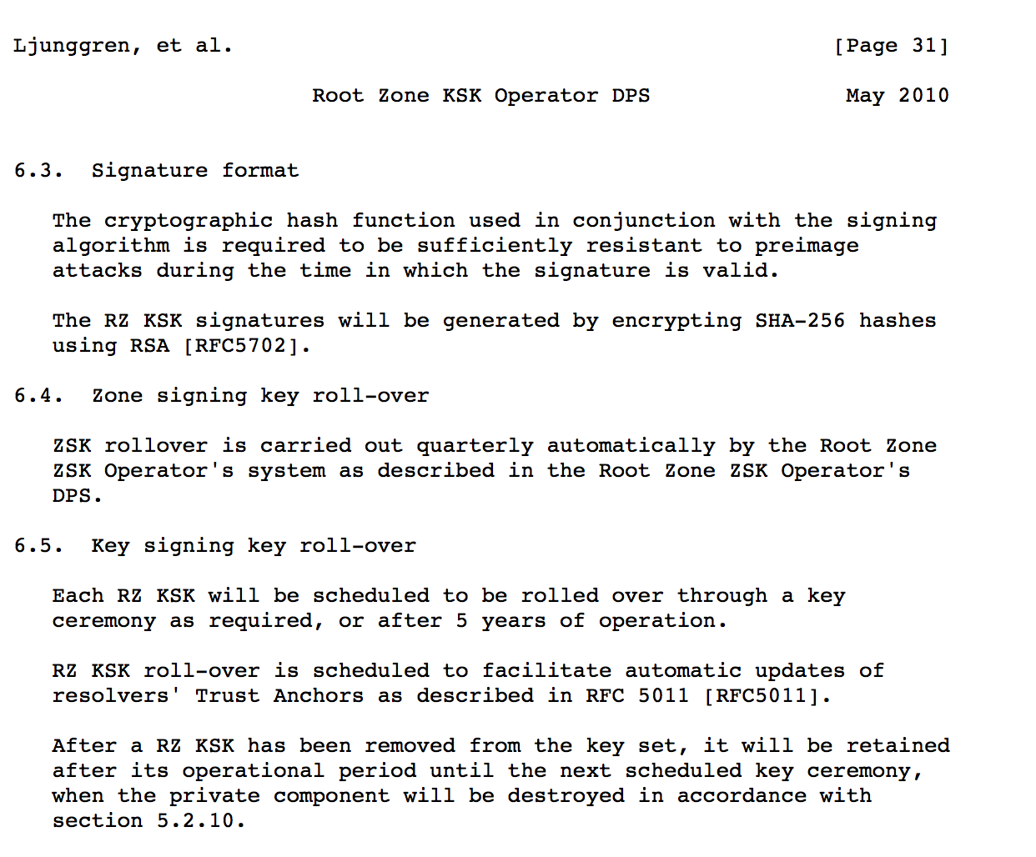
Five Years Ago…

Slide 12
Five Years Ago…

Slide 13
The Cast of Actors
Root Zone Management Partners:
Internet Corporation for Assigned Names and Numbers (ICANN)
National Telecommunications and Information Administration, US Department of Commerce (NTIA)
Verisign
External Design Team for KSK Roll

Slide 14
Approach
ICANN Public Consultation – 2012
Detailed Engineering Study - 2013
SSAC Study (SAC-063) - 2013
KSK Roll Design Team - 2015

Slide 15
2015 Design Team Milestones
January – June:
Study, discuss, measure, ponder, discuss some more
August
Present a draft report for ICANN Public Comment
https://www.icann.org/public-comments/root-ksk-2015-08-06-en
(comment close 15th September 2015)
September
Prepare final report
Pass to the Root Zone Management Partners who then will develop an operational plan and execute

Slide 16
Rolling the KSK?
All DNS resolvers that perform validation of DNS responses use a local copy of the KSK
They will need to load a new KSK public key and replace the existing trust anchor with this new value at the appropriate time
This key roll could have a public impact, particularly if DNSSEC-validating resolvers do not load the new KSK

Slide 17
Easy, Right?
Publish a new KSK and include it in DNSKEY responses, signed by the old KSK
Use the new KSK to sign the ZSK, as well as the old KSK signature
Resolvers use old-signs-over-new to pick up the new KSK, validate it using the old KSK, and replace the local trust anchor material with the new KSK
Withdraw the old signature signed via the old KSK
Revoke the old KSK

Slide 18
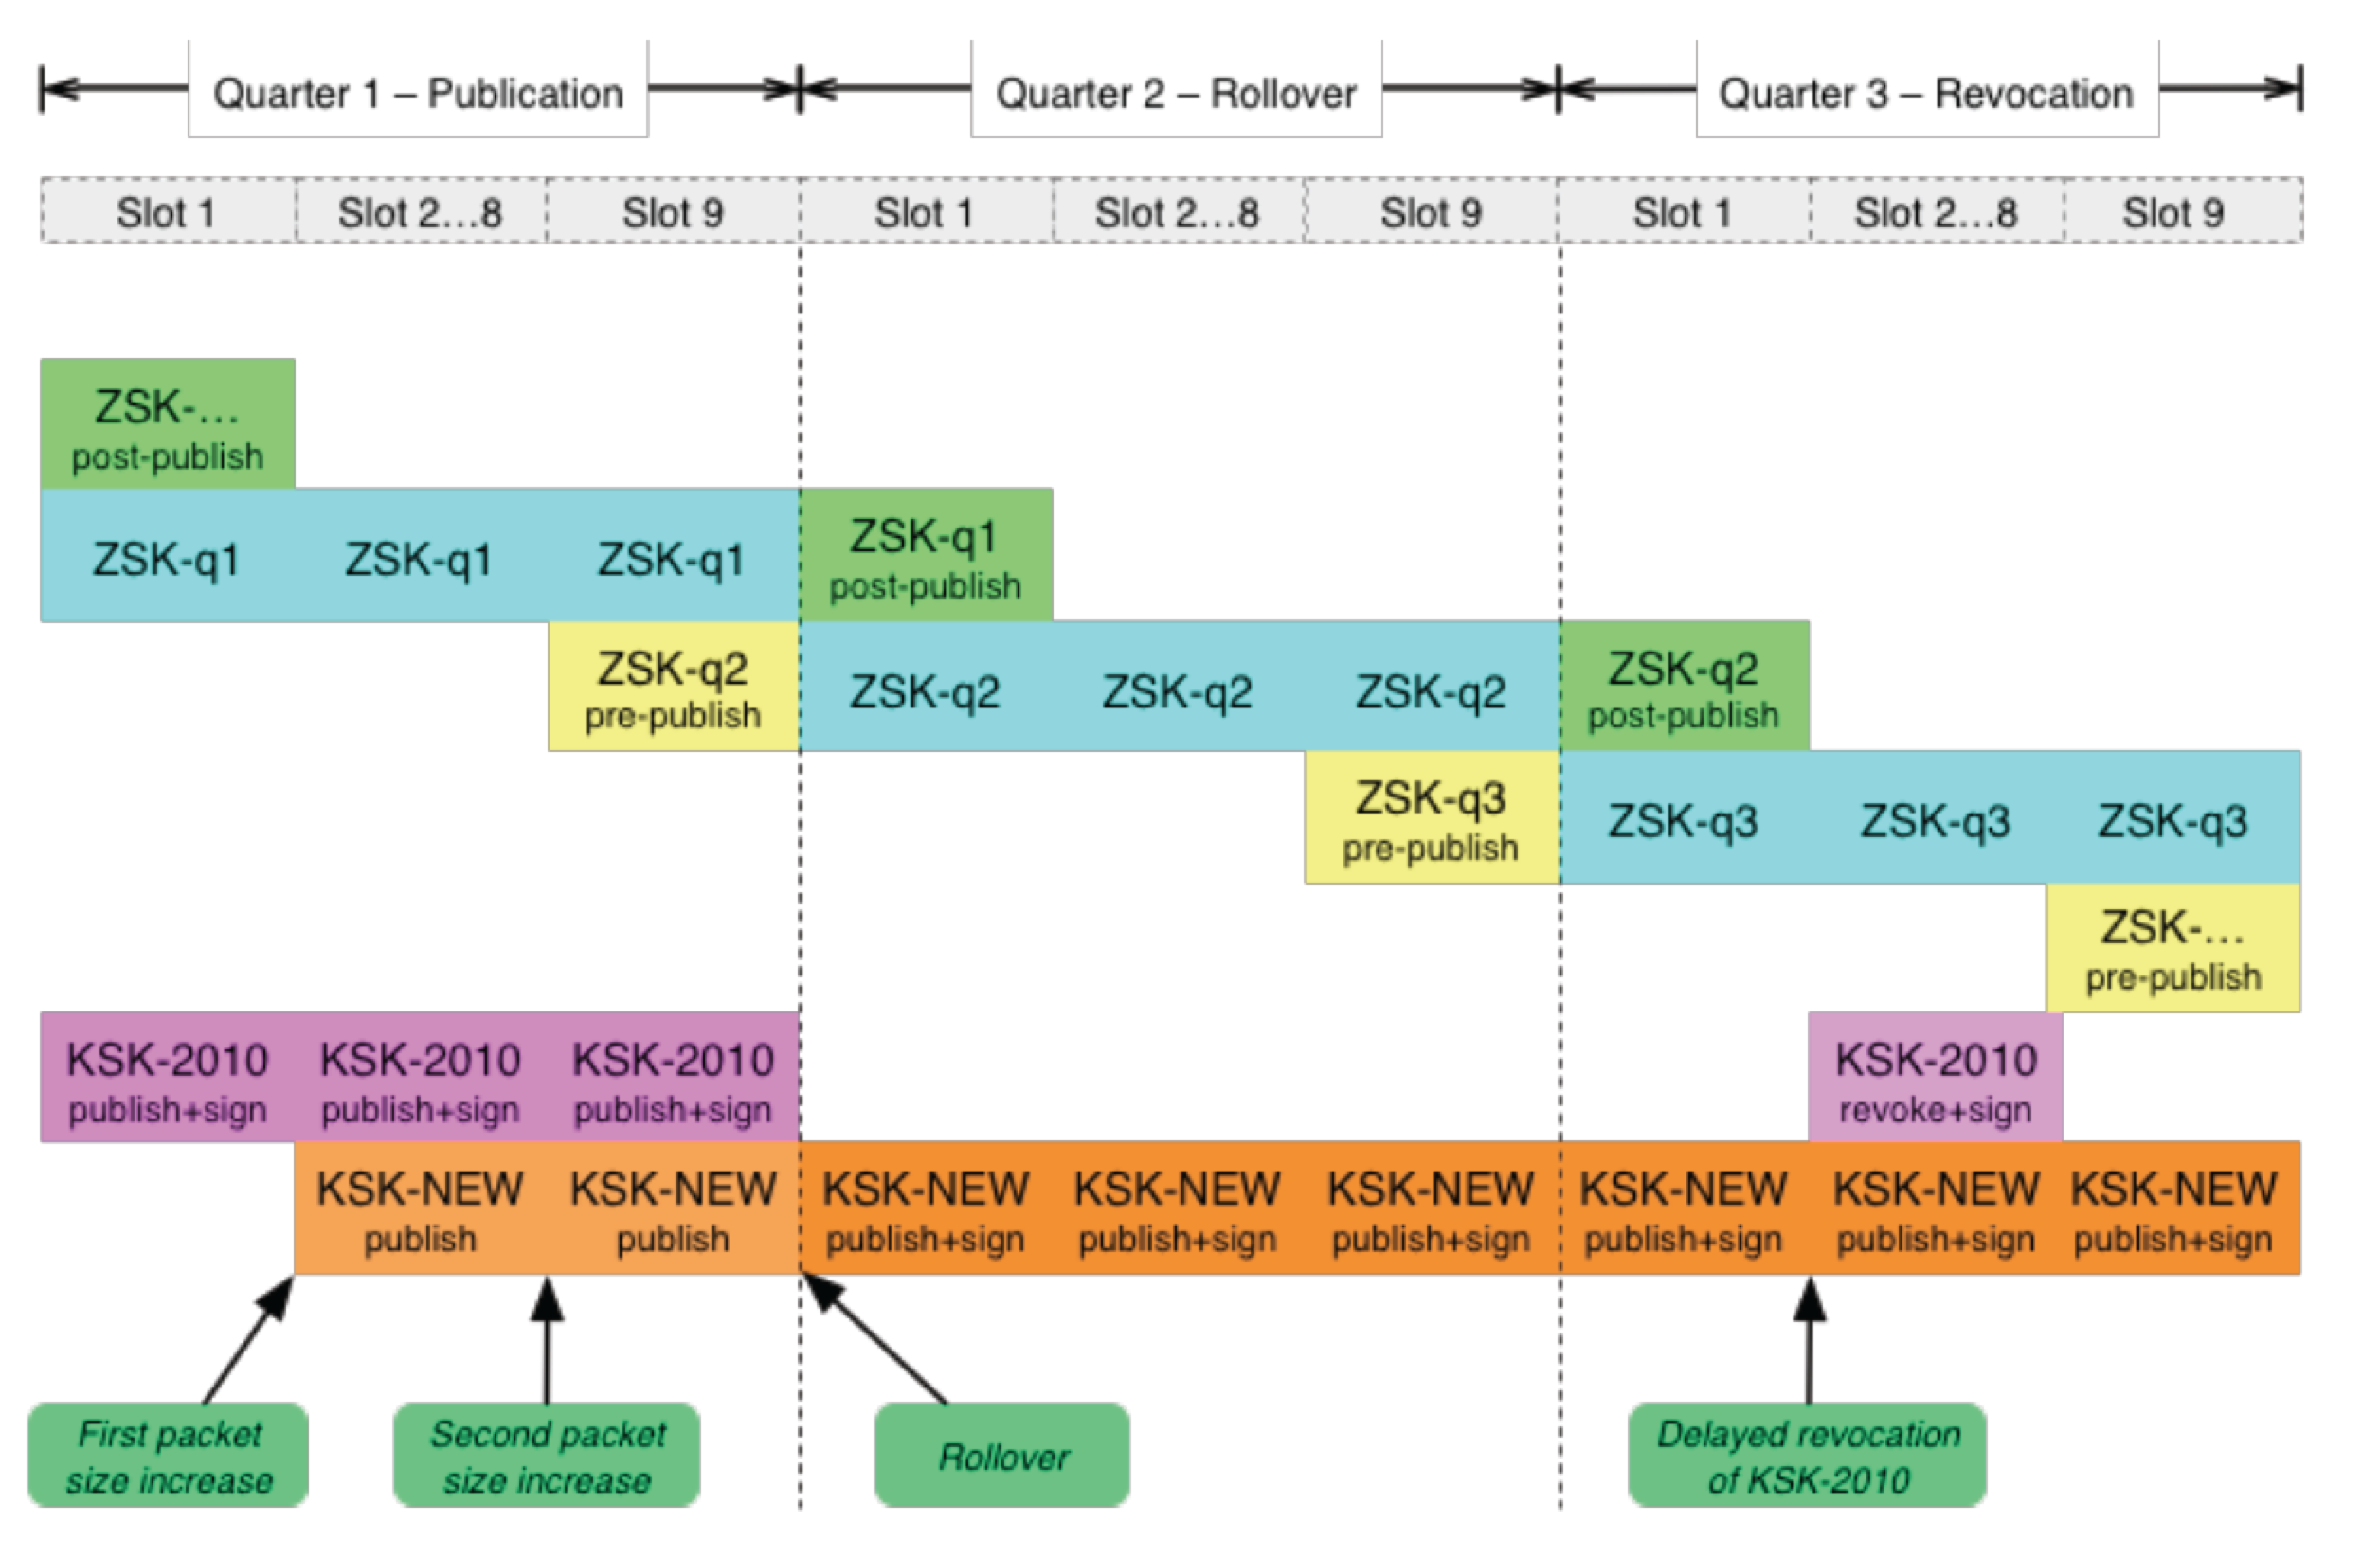
The RFC5011 Approach

Slide 19
1. Introduce New KSK

Slide 20
2. Cutover to New KSK

Slide 21
3. Destroy Old KSK

Slide 22
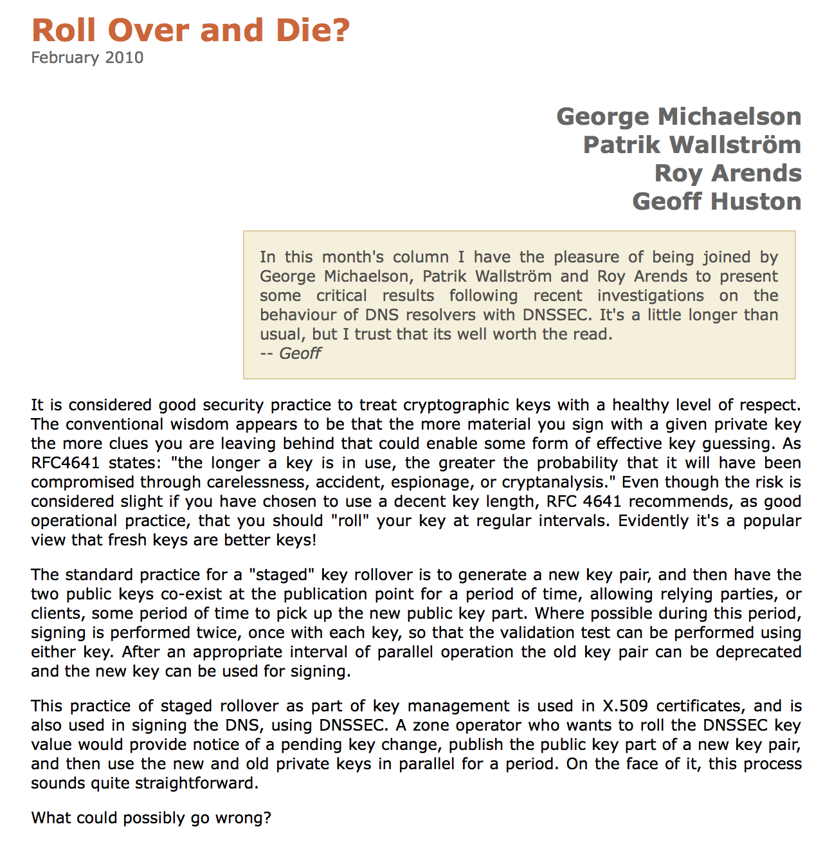
Easy, Right?

Slide 23
But that was then…
And this is now:
Resolvers are now not so aggressive in searching for alternate validation paths when validation fails
(as long as resolvers keep their code up to date, which everyone does – right?)
And now we all support RFC5011 key roll processes
And everyone can cope with large DNS responses
So all this will go without a hitch
Nobody will even notice the KSK roll at the root
Truly ruly!

Slide 24
But that was then…
And this is now:
Resolvers are now not so aggressive in searching for alternate validation paths when validation fails
(as long as resolvers keep their code up to date, which everyone does – right?)
And now we all support RFC5011 key roll processes
And everyone can cope with large DNS responses
So all this will go without a hitch
Nobody will even notice the KSK roll at the root
Truly Ruly!
Not!

Slide 25
What we all should be concerned about…
That resolvers who validate DNS responses will fail to pick up the new DNS root key automatically
i.e. they do not have code that follows RFC5011 procedures for the introduction of a new KSK
The resolvers will be unable to receive the larger DNS responses that will occur during the dual signature phase of the rollover

Slide 26
Technical Concerns
Some DNSSEC validating resolvers do not support RFC5011
How many resolvers may be affected in this way?
How many users may be affected?
What will the resolvers do when validation fails?
Will they perform lookup ‘thrashing’
What will users do when resolvers return SERVFAIL?
How many users will redirect their query to a non-validating resolver

Slide 27
Technical Concerns
Some DNSSEC validating resolvers do not support RFC5011
How many resolvers may be affected in this way?
How many users may be affected?
What will the resolvers do when validation fails?
Will they perform lookup ‘thrashing’
What will users do when resolvers return SERVFAIL?
How many users will redirect their query to a non-validating resolver
Really hard to test this in the wild with heading down the path of fake root zones
And because of the RFC5011 30 day holddown then its not a simple “point your resolver here” kind of test

Slide 28
What can be tested …
That resolvers who validate DNS responses will fail to pick up the new DNS root key automatically
i.e. they do not have code that follows RFC5011 procedures for the introduction of a new KSK
Will resolvers be able to receive the larger DNS responses that will occur during the dual signature phase of the rollover

Slide 29
DNS Response Sizes

Slide 30
So we’ve been testing large responses in the DNS
We are interested in sending DNSSEC-aware DNS resolvers a response that is much the same size as that being contemplated in a KSK key roll
And seeing whether they got the response

Slide 31
Some Interesting Sizes
8 octets UDP pseudo header size
20 octets IPv4 packet header
40 octets maximum size of IPv4 options in an IPv4 IP packet header
40 octets IPv6 packet header
512 octets the maximum DNS payload size that must be supported by DNS
560 octets the maximum IPv4 packet size that must be supported by IPv4 DNS UDP systems
576 octets the largest IP packet size (including headers) that must be supported by IPv4 systems
913 octets the size of the current root priming response with DNSSEC signature
1,232 octets the largest DNS payload size of an unfragmentable IPv6 DNS UDP packet
1,280 octets the smallest unfragmented IPv6 packet that must be supported by all IPv6 systems
1,425 octets the largest size of a ./IN/DNSKEY response with a 2048 bit ZSK
1,452 octets the largest DNS payload size of an unfragmented Ethernet IPv6 DNS UDP packet
1,472 octets the largest DNS payload size of an unfragmented Ethernet IPv4 DNS UDP packet
1,500 octets the largest IP packet supported on IEEE 802.3 Ethernet networks

Slide 32
EDNS(0) UDP Buffer sizes

Slide 33
EDNS(0) UDP Buffer sizes

Slide 34
EDNS(0) UDP Buffer sizes
Around the 1425 octet response size we will see
UDP response truncation rates of around 5.5%

Slide 35
The Test
We are interested in resolvers who are DNSSEC aware (queries that contain the EDNS0 option with DNSSEC OK flag set on)
We would like to test larger responses:
1,440 octets of DNS payload
We would like to test a couple of crypto protocols
RSA
ECDSA

Slide 36
EDNS(0) DNSSEC OK Set
76,456,053 queries
63,352,607 queries with EDNS(0) and DNSSEC OK set
= 83% of queries
777,371 resolvers
649,304 resolvers with EDNS(0) and DNSSEC OK set
= 84% of resolvers

Slide 37
Large Responses
How well are 1,440 octet DNS responses handled when compared to much smaller responses?

Slide 38
1,440 octet RSA-signed Responses
9,113,215 tests
7,769,221 retrieved the 1x1 blot (85%)
2,644,351 queried for the DS record
849,340 queried for the DS record (but no blot fetch)
494,581 timed out (but no blot fetch)
72 appeared to fail the DNS

Slide 39
1,440 octet RSA-signed Responses
9,113,215 tests
7,769,221 retrieved the 1x1 blot
2,644,351 queried for the DS record
849,340 queried for the DS record (but no blot)
494,581 timed out (but no blot)
72 appeared to fail the DNS
Some 5% of experiments did not run through to completion.
For an online ad, this is not an unexpected outcome

Slide 40
1,440 octet RSA-signed Responses
9,113,215 tests
7,769,221 retrieved the 1x1 blot
2,644,351 queried for the DS record
849,340 queried for the DS record (but no blot)
494,581 timed out (but no blot)
72 appeared to fail the DNS
This is measuring USERS not RESOLVERS. Users
often use local configurations of 2 or more resolvers, and problems in one resolver appear to be fixed by the other resolver(s).

Slide 41
Small vs Large
What happens when the response size grows above 1,472 octets?
1,440 Octets Payload
Experiments: 6,542,993
Web Fetch: 5,880,921
DS Fetch: 181,610
Timeout: 480,415
DNS Fail: 47
1,770 Octets Payload
Experiments: 6,566,645
Web Fetch: 5,992,617
DS Fetch: 167,119
Timeout: 401,831
DNS Fail: 5,078

Slide 42
ECDSA vs RSA
The spec says that when a resolver encounters a zone signed only with algorithms that are not supported by the resolver then it will treat the zone as unsigned and not proceed with validation
Most resolvers determine the zone’s signing algorithms from the DS record
What happens when we compare a 1,440 octet response signed by RSA and a 1,440 octet response signed by ECDSA?

Slide 43
1,440 octet ECDSA-signed Responses
9,137,436 tests
7,766,572 retrieved the 1x1 blot
2,644,564 queried for the DS record
860,163 queried for the DS record (but no blot)
505,045 timed out (but no blot!)
5,656 appeared to fail the DNS

Slide 44
1,440 octet ECDSA-signed Responses
9,137,436 tests
7,766,572 retrieved the 1x1 blot
2,644,564 queried for the DS record
860,163 queried for the DS record (but no blot)
505,045 timed out (but no blot!)
5,656 appeared to fail the DNS
This is larger than RSA failure rates, but is still a small proportion of users affected. Some resolvers appear to have problems when presented with an unknown crypto protocol.

Slide 45
IPv4 vs IPv6
Do resolvers prefer IPv4 over IPv6?
Total Queries: 47,826,735
Queries over V6: 394,816
Number of Resolvers: 109,725
Number of Resolvers
using IPv6 for queries: 2,849

Slide 46
IPv4 vs IPv6
Do resolvers prefer IPv4 over IPv6?
Total Queries: 47,826,735
Queries over V6: 394,816
Number of Resolvers: 109,725
Number of Resolvers
using IPv6 for queries: 2,849
In a Dual Stack environment 1% of queries and 3% of resolvers use IPv6.
What if the server was IPv6 only?

Slide 47
Some Observations
There is a LOT of DNSSEC validation out there
87% of all queries have DNSSEC-OK set
30% of all DNSSEC-OK queries attempt to validate the response
25% of end users are using DNS resolvers that will validate what they are told
12% of end users don’t believe bad validation news and turn to other non-validating resolvers when validation fails.

Slide 48
Some Observations
There is very little V6 being used out there
1% of queries use IPv6 as the transport protocol when given a dual stack name server
It seems that when given a choice:
Browsers prefer IPv6
Resolvers prefer IPv4

Slide 49
Some Observations
ECDSA is viable – sort of
1 in 5 clients who use resolvers that validate RSA-signed responses are unable to validate the same response when signed using ECDSA
But they fail to “unsigned” rather than “invalid” so it’s a (sort of) safe fail

Slide 50
What’s “Too Big?”
Out of 82,954 resolvers seen in a glueless delegation measurement experiment, 4,251 resolvers appeared to be incapable of receiving a 1,444 octet DNS response
21% of these failing resolvers used IPv6
6% of queries shifted to TCP for the larger response
So large DNS response packets might be a problem area

Slide 51
Can it work?
If we stick to RSA and keep response sizes at or below 1,440 octets then there appears to be no obvious user impact in terms of packet size
Some resolvers may get stuck, but users appear to use multiple resolvers

Slide 52
But
The signed .org DNSKEY response is 1,625 octets, and there are no obvious signals of service failures for .org names
The potential issues surrounding large responses and the DNS may be a little more subtle than these experimental results suggest

Slide 53
Where are we?
A key roll of the Root Zone KSK will cause some resolvers to fail:
Resolvers who do not pick up the new key in the manner described by RFC5011
Resolvers who cannot receive a DNS response of ~1,300 octets
Many users who use these failing resolvers will just switch over to use a non-validating resolver
A small pool of users will be affected with no DNS

Slide 54
Now?
Public comment:
draft report for ICANN Public Comment
https://www.icann.org/public-comments/root-ksk-2015-08-06-en
Comments close 15th September 2015
Please read & comment

Slide 55
Questions?

