Slide 1
Today’s Mobile Internet
Geoff Huston,
APNIC Labs

Slide 2
The most profound technologies are those that disappear. They weave themselves into the fabric of everyday life until they are indistinguishable from it...
- Mark Weiser 1991

Slide 3
So how should we look at mobile devices and the Internet?
Are these merely a temporary consumer fad, destined to be replaced by the next cool technology item?
Or is this an instance of a profound technology change that will bed down to be a part of our everyday life for many years to come?

Slide 4
To try and answer this, lets try and put this question into some broader context of the evolution the computer and communications enterprise

Slide 5
The Computing Evolutionary Path
1946 – Eniac – a numeric calculator

Slide 6
The Computing Evolutionary Path
1964 IBM 360 – commercial computing
1964: IBM 360

Slide 7
The Computing Evolutionary Path
1984 – Mac - visual personal computing

Slide 8
The Computing Evolutionary Path
2007 – Apple’s iPhone

Slide 9
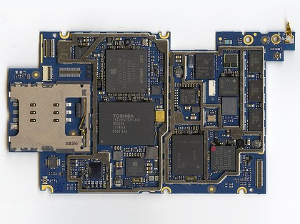
Today’s mobile device is a digital device that has more computing capability than a old mainframe device, with a size of a human hand
And they are transforming the Internet!
It is an Internet-connected device with a general purpose browser and a full set of media capabilities

Slide 10
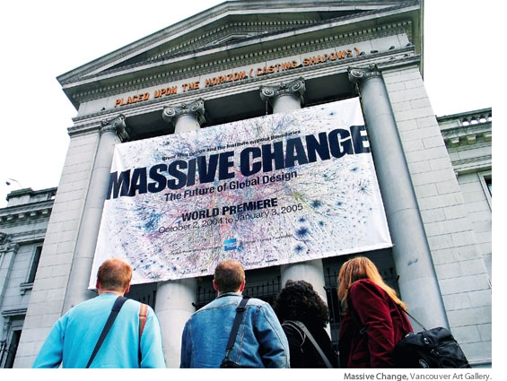

Slide 11
With desktop devices the Internet was a destination
lighting
privacy
reliable power
large view screens
dedicated worktop
wired bandwidth

Slide 12
The Internet is now anywhere and everywhere
radio connectivity
Thumb
operated
hand sized
battery power
Its trivial, commonplace and incidental

Slide 13
Counting Users...
There are 3 billion Internet users today
http://www.itu.int/ITU-D/ict/statistics/

Slide 14
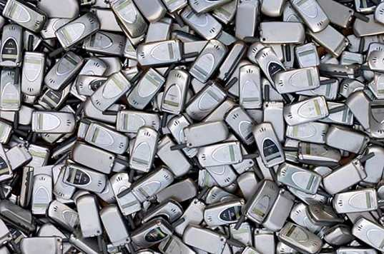
Counting Users...
And 7 billion mobile phone users!
There are 2 billion Internet users today
http://www.itu.int/ITU-D/ict/statistics/

Slide 15
Counting Users...
And 7 billion mobile phones!
There are 2 billion Internet users today
And 2.3 billion mobile Internet users!
Source: Generator Research

Slide 16
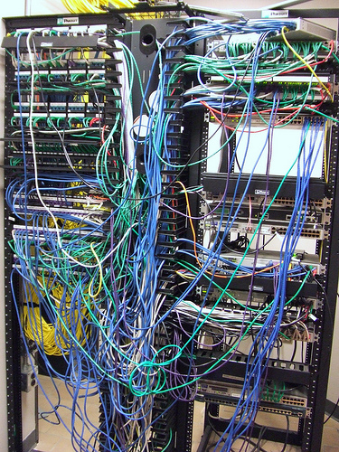
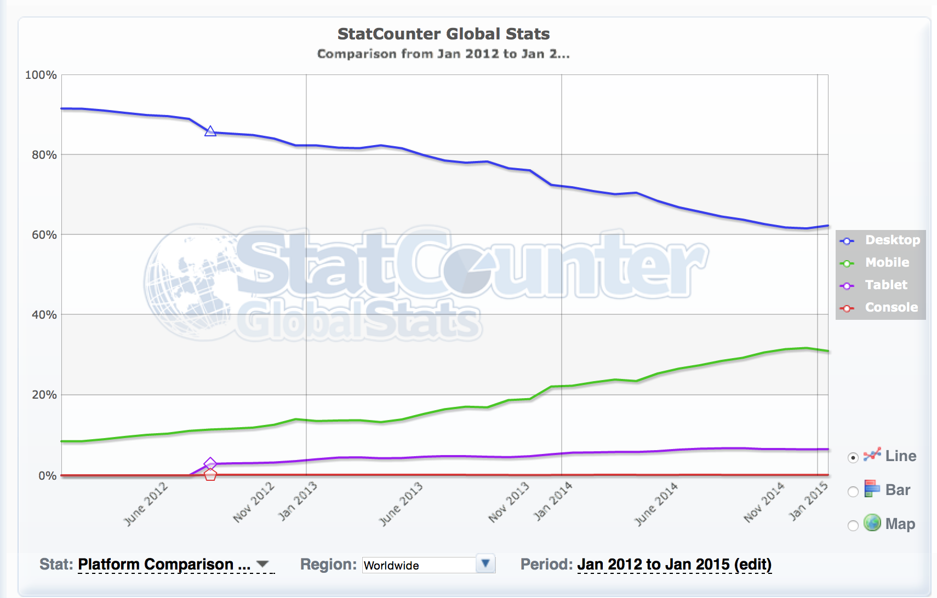
Counting Platforms
Mobiles are now
40% of all visible devices
8.5%
4.3%
http://statcounter.com/

Slide 17
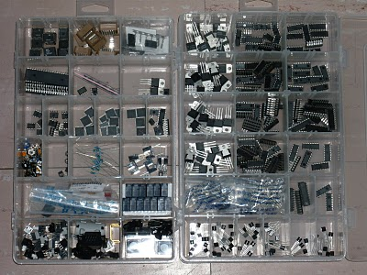
Mobile Production Numbers
2014: 1.5 billion units shipped
Factors:
Production volumes are bringing down component unit cost
Android is bringing down software unit cost
No need for new content - leverage off the the existing web universe of content
Shift away from the desktop and the laptop by the production industry seeking new markets for their production capability

Slide 18
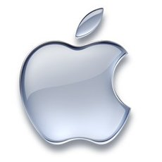
Who’s playing
Android
84% of all smartphone shipments in 2014
Multi-vendor adoption
Android also extending into tablets and large screens
Apple iPhone / iPad
12% of all smartphone shipments in 2014
Revenues for Apple: $182B in 2014
Windows
3% market share
Mostly Lumia models with Nokia

Slide 19
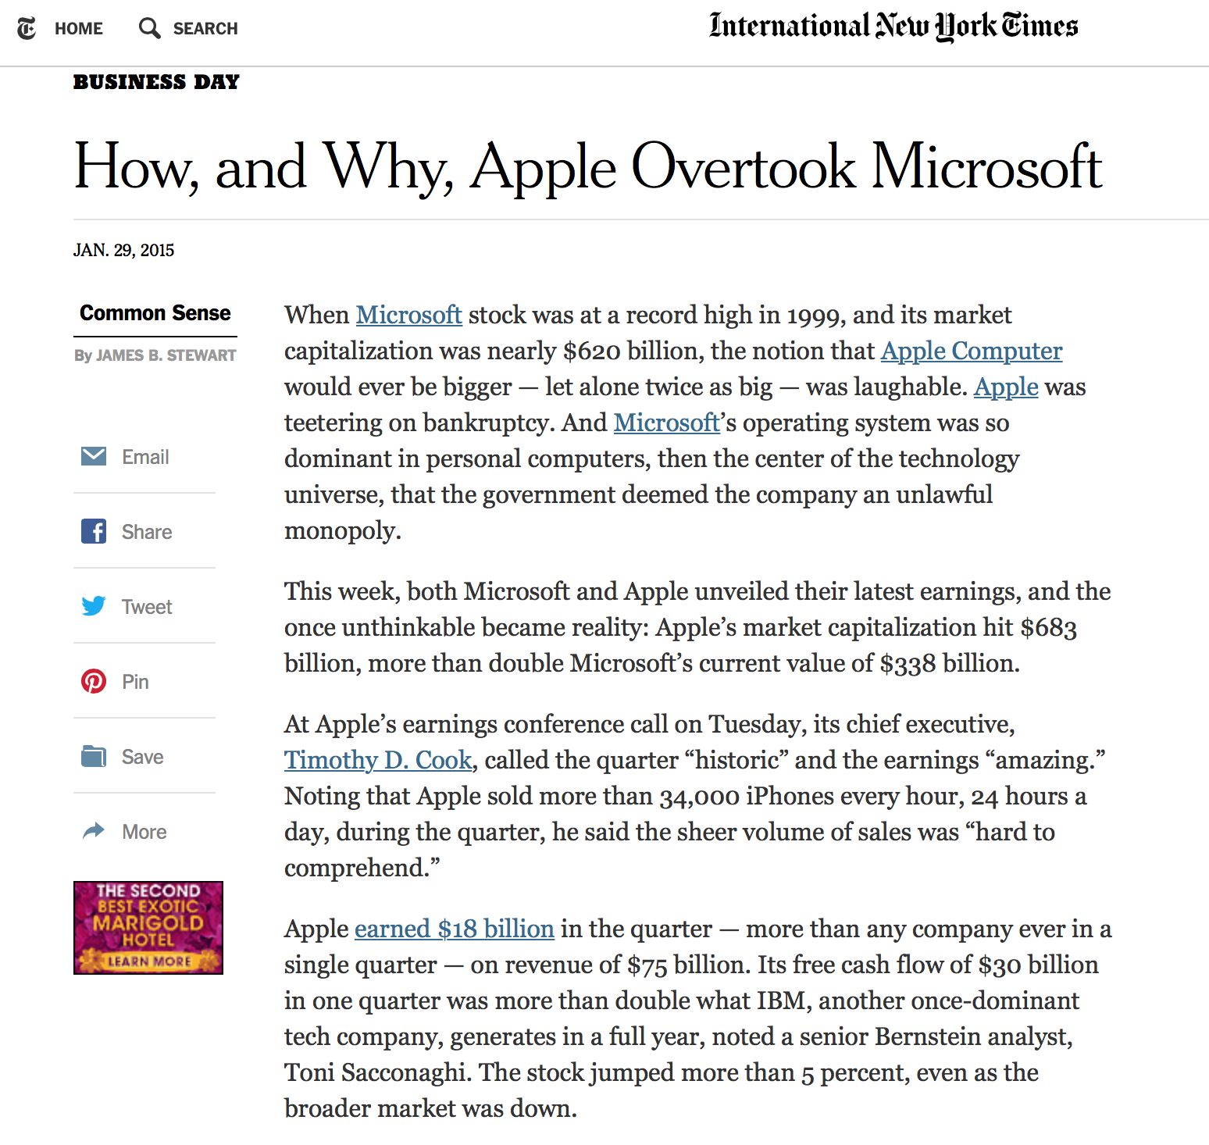
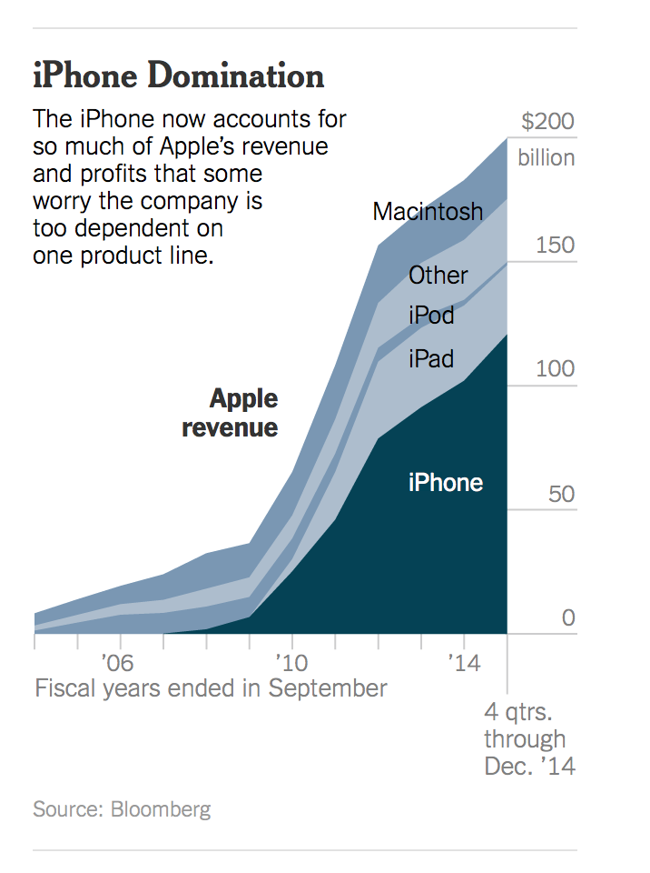
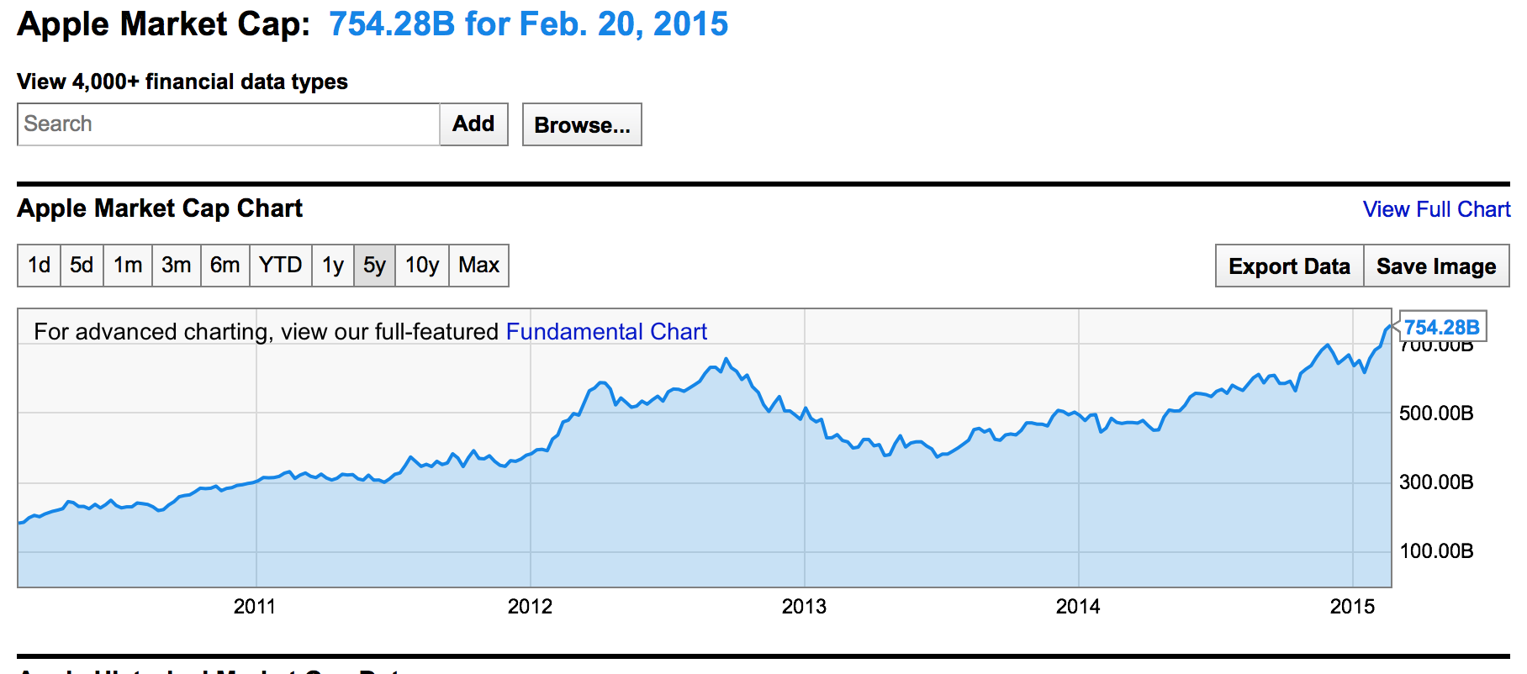
It’s all about the Money
Source: Generator Research

Slide 20
Technology for Mobility

Slide 21
3G: HSPA
High Speed Packet Access – an evolution of W-CDMA
Peak data rates 20Mbps downlink, 5.8Mbps Uplink
Shared channels, shorter Transmission Time Intervals, adaptive use of 16QAM and 64QAM access to increase spectrum efficiency
Mbps – acceptable performance – but nothing special

Slide 22
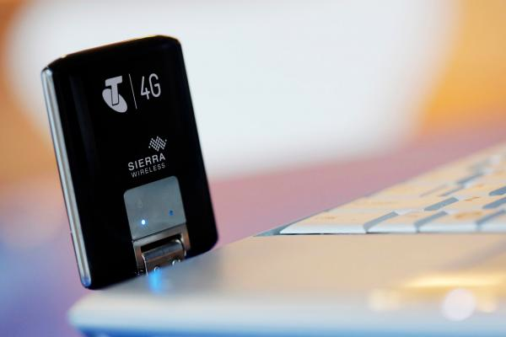
4G: LTE
Theoretical maximum peak speed* 326Mbps
Practical achievable speeds of 4 – 12 Mbps
All IP internal architecture
Now it gets interesting!
* Probably assuming the absence of many of the laws of physics as we understand them ☺

Slide 23
5G:5Gps
5Gbps downloads! *
Yes, that’s 2020!
* In the lab at 15Ghz
And at that frequency it means that the signal is going to be absorbed by almost anything solid!

Slide 24
By The Numbers
Lets look at the allocation statistics to examine how mobiles have impacted overall network growth

Slide 25
IPv4 Allocations

Slide 26
IPv4 Allocations
Unmet Demand

Slide 27
IPv6 Allocated Addresses
Volume of Allocated IPv6 Addresses (using units of /32s) per year

Slide 28
IPv6 Allocated Addresses
Volume of Allocated IPv6 Addresses (using units of /32s) per year
These allocation volumes are small compared to the unmet demand pressures in IPv4 – currently network operators are unable to use Ipv6 as a substitute for IPv4 and instead have to resort to Ipv4 address sharing to meet network address demands

Slide 29
Where are we headed?

Slide 30
Where are we headed?
Up until 2013 mobile Internet had been constructed exclusively using IPv4 infrastructure
Today’s mobile internet continues to grow by extensive use of NATs in the operator’s network
This cannot continue indefinitely

Slide 31
The Mobile Transition
The mobile industry is very heterogeneous
Various spectrum allocations and regulatory constraints
Various service objectives
Various operator business objectives (incumbent vs challenger)
Different objectives from handset suppliers vs network operators
The approach to IPv6 transition is highly fragmented across the operators
The result is the deployment of various permutations of transitional IPv4 and IPv6 support in the mobile environment:
Native mode dual stack over LTE: e.g. Verizon
IPv4 layered over native IPv6, 464 XLAT: e.g. T-Mobile
IPv6 tunelled over IPv4

Slide 32
The Mobile Transition
The mobile industry is very heterogeneous
Various spectrum allocations and regulatory constraints
Various service objectives
Various operator business objectives (incumbent vs challenger)
Different objectives from handset suppliers vs network operators
The approach to IPv4 exhaustion and transition is highly fragmented
The result is the deployment of various permutations of transitional IPv4 and IPv6 support in the mobile environment:
Native mode dual stack over LTE: e.g. Verizon
IPv4 layered over native IPv6, 464 XLAT: e.g. T-Mobile
IPv6 tunelled over IPv4
This diversity implies that many operators have unique requirements for network and device capabilities
Which implies the imposition of cost and complexity for the service operators through customization of technologies
Which all adds to the cost of service to consumers
Nobody wins from this fragmented transition scenario!

Slide 33
It’s not just Transitional Complexities
It’s also Spectrum issues:
The traditional mobile providers operate with exclusive access to spectrum within defined locales (with associated license costs)
Alternate access competitors can operate in unlicensed spectrum with WiFi network services
Handsets are also entering the space with platform services that support connection agility across diverse access networks
Mobile incumbents are being forced to chase this alternate access market or risk losing market share

Slide 34
Where now for Mobiles?
Mobile Operators are being pushed into undistinguished utility roles
No more voice premiums
Erosive pressure on data service margins
Consumers want more for less
Higher download speeds
Larger data caps
Lower premiums
Exclusive Use spectrum is too expensive
Are they pricing themselves out of the consumer market?
WiFi access and application handover approaches are placing pressure on the traditional mobile operator’s margins
The underlying problem here is that the mobile network operator has lost control of the access device
And there is no way back!
The device vendor and its applications are charting a course that is in direct conflict with the mobile network operator’s desires, and managing to monetize this far more efficiently than the mobile network operator

Slide 35
Thank You!
Questions?

