Slide 1
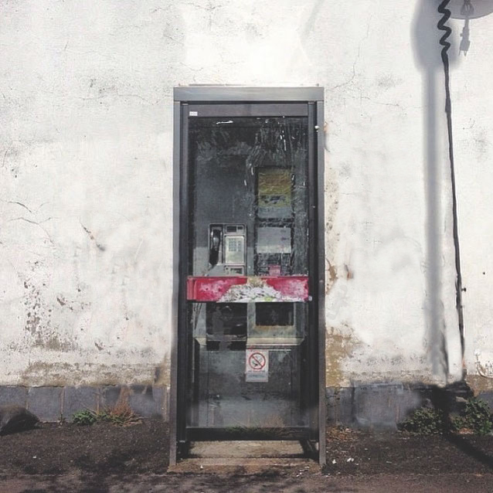
Who’s Watching?
Geoff Huston, APNIC
Street Art: Banksy

Slide 2
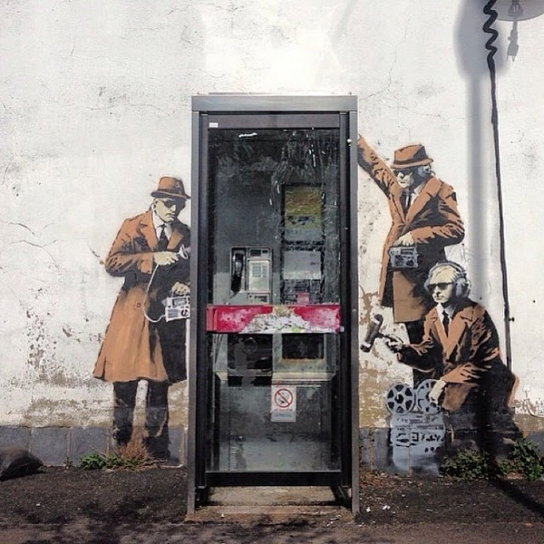
7
Who’s Watching?
Geoff Huston, APNIC
Street Art: Banksy

Slide 3
The Theory
At APNIC we measurement aspects of technology deployment by using Google Ads to deliver a test script to a very large profile of users
We measure penetration of DNSSEC and IPv6, and many other aspects of the end user’s view of the Internet through these scripts
We have some 500,000 tests executed per day
And each of them use uniquely generated URLs
And the URLs direct the end user back to our servers
So, in theory we should see each unique URL retrieved exactly once

Slide 4
The Theory
At APNIC we measurement aspects of technology deployment by using Google Ads to deliver a test script to a very large profile of users
We measure penetration of DNSSEC and IPv6, and many other aspects of the end user’s view of the Internet through these scripts
We have some 500,000 tests executed per day
And each of them use uniquely generated URLs
And the URLs direct the end user back to our servers
So, in theory we should see each unique URL retrieved exactly once
Right?

Slide 5
Here’s what we see at times in the web logs…
[22/Jan/2014:00:10:21 +0000]
120.194.53.xxx
"GET /1x1.png?t10000.u3697062917.s1390349413.i333.v1794.rd.td

Slide 6
Here’s what we see at times in the web logs…
[22/Jan/2014:00:10:21 +0000]
120.194.53.xxx
"GET /1x1.png?t10000.u3697062917.s1390349413.i333.v1794.rd.td
10:21 120.194.53.xxx – Origin AS = 24445
CMNET-V4HENAN-AS-AP Henan Mobile Communications Co.,Ltd

Slide 7
Here’s what we see at times in the web logs…
[22/Jan/2014:00:10:21 +0000]
120.194.53.xxx
"GET /1x1.png?t10000.u3697062917.s1390349413.i333.v1794.rd.td
[22/Jan/2014:00:11:29 +0000]
221.176.4.xxx
"GET /1x1.png?t10000.u3697062917.s1390349413.i333.v1794.rd.td

Slide 8
Here’s what we see at times in the web logs…
[22/Jan/2014:00:10:21 +0000]
120.194.53.xxx
"GET /1x1.png?t10000.u3697062917.s1390349413.i333.v1794.rd.td
[22/Jan/2014:00:11:29 +0000]
221.176.4.xxx
"GET /1x1.png?t10000.u3697062917.s1390349413.i333.v1794.rd.td
10:21 120.194.53.xxx – Origin AS = 24445
CMNET-V4HENAN-AS-AP Henan Mobile Communications Co.,Ltd
68 seconds later -- SAME URL, different IP!
11:29 221.176.4.xxx – Origin AS = 9808
CMNET-GD Guangdong Mobile Communication Co.Ltd.

Slide 9
Searching for Stalkers
We’ve combed over our collected data since the start of 2014 to see what evidence we can gather about URL stalking…

Slide 10
Some Numbers
In the first 149 days of 2014 we saw:
61,576,774 unique end-user IP addresses presented to our servers from these test scripts
110,684 of these end-user IP addresses presented HTTP GET strings to us that were subsequently presented to us from a different client IP address!
That’s some 1 in 500* users that seem to have attracted some kind of digital stalker!
* Or maybe a bit more, due to NATs hiding multiple end users behind a single public IP address

Slide 12
Privacy? Really?
It’s hard to believe that today’s Internet respects personal privacy when it seems that around 1 in 500 users have attracted some kind of digital stalker who is tracking the URLs they visit.

Slide 13
Stalking Rates by Country
CC Samples Stalked Rate/100,000 Country
LA 7,905 245 3,099 Lao People's Democratic Republic
MO 12,382 315 2,544 Macao Special Administrative Region of China
CN 3,409,338 49,552 1,453 China
HK 161,586 2,110 1,306 Hong Kong Special Administrative Region of China
MP 2,642 34 1,287 Northern Mariana Islands
VU 1,866 21 1,125 Vanuatu
GQ 488 5 1,025 Equatorial Guinea
GL 306 3 980 Greenland
ST 215 2 930 Sao Tome and Principe
JP 644,620 4,797 744 Japan
TW 507,789 3,714 731 Taiwan
AL 157,154 823 524 Albania
US 3,596,202 17,096 475 United States of America
MY 623,434 2,232 358 Malaysia
SG 1,334,252 4,562 342 Singapore
MK 156,424 480 307 The former Yugoslav Republic of Macedonia
CA 537,928 1,441 268 Canada
KH 56,676 137 242 Cambodia
ME 70,407 168 239 Montenegro
TG 1,268 3 237 Togo
SR 16,719 38 227 Suriname
GB 3,181,253 6,696 210 United Kingdom of Great Britain and Northern Ireland
PM 495 1 202 Saint Pierre and Miquelon
IR 21,519 39 181 Iran (Islamic Republic of)
MM 13,482 24 178 Myanmar
FJ 6,472 10 155 Fiji
IQ 215,083 322 150 Iraq
LR 710 1 141 Liberia
BJ 1,492 2 134 Benin
MN 29,906 39 130 Mongolia
The top 30 countries in terms
of observed URL stalking rates

Slide 14
Counting Stalkers
213,657,379 unique URLs were presented back to us in this experiment, and we saw some 378,775 URLS that were presented to us more than once, from different source IP addresses
The subsequent presentations came from 1,579 distinct source networks (/24s)

Slide 15
Stalking Delay

Slide 16
Stalking Delay
The advertisement script uses a 10 second wait time before executing results – it seems that some stalking is based on local script execution in the user’s own browser.

Slide 17
Stalking Delay (2)
For a non-scripted URL we see most re-fetches occurring within the first couple of seconds, with some form of local cache object refresh occurring at 30 and 60 minutes

Slide 18
Is it me … or you?
The first result leads to the view that there is some amount of local scriptware on users’ browsers that feeds visited URL streams to a third party
The second result indicates that there is some amount of intercepting middleware that feeds proxy caches, with automatic refresh cycles

Slide 19
Top Stalkers
Rank IP Net Count AVG Delay AS Description
1 119.147.146.0 184,286 74.6 4134 CHINANET-BACKBONE No.31,Jin-rong Street,CN
2 165.12.252.0 65,591 6.9 9509 DEWRSB-AU-AP Dept of Employment, Workplace Relations, AU
3 181.66.157.0 23,851 34,128.6 6147 Telefonica del Peru S.A.A., PE
4 66.249.93.0 23,397 19,353.5 15169 GOOGLE - Google Inc., US
5 66.249.85.0 10,685 14,399.7 15169 GOOGLE - Google Inc., US
6 66.249.81.0 9,367 32,502.5 15169 GOOGLE - Google Inc., US
7 150.101.123.0 8,178 423.6 4739 INTERNODE-AS Internode Pty Ltd, AU
8 221.176.4.0 7,790 295.5 9808 CMNET-GD Guangdong Mobile Communication Co.Ltd., CN
9 66.249.80.0 7,333 18,814.5 15169 GOOGLE - Google Inc., US
10 66.249.88.0 7,241 24,535.5 15169 GOOGLE - Google Inc., US
11 59.167.157.0 4,982 292.9 4739 INTERNODE-AS Internode Pty Ltd, AU
12 69.41.14.0 2,745 1,152.6 47018 CE-BGPAC - Covenant Eyes, Inc. US
13 64.233.172.0 2,548 19,095.9 15169 GOOGLE - Google Inc., US
14 64.125.188.0 2,070 1,181.7 6461 ABOVENET - Abovenet Communications Inc, US
15 93.186.23.0 1,876 20.7 18705 RIMBLACKBERRY - Research In Motion Limited, CA
16 93.186.16.0 1,873 3.3 18705 RIMBLACKBERRY - Research In Motion Limited, CA
17 115.164.209.0 1,519 1,544.0 4818 DIGIIX-AP DiGi Telecommunications Sdn. Bhd., MY
18 93.186.31.0 1,490 8.9 18705 RIMBLACKBERRY - Research In Motion Limited, CA
19 66.249.82.0 1,451 21,705.5 15169 GOOGLE - Google Inc., US
20 208.184.77.0 1,058 1,001.4 6461 ABOVENET - Abovenet Communications Inc, US
21 64.124.98.0 1,055 1,377.7 6461 ABOVENET - Abovenet Communications Inc, US
22 8.35.201.0 726 3.6 15169 GOOGLE - Google Inc., US
23 206.53.152.0 493 7.2 18705 RIMBLACKBERRY - Research In Motion Limited, CA
24 183.60.153.0 484 349.2 4134 CHINANET-BACKBONE No.31 Jin-rong Street, CN
25 199.30.24.0 419 13,339.7 8075 MICROSOFT-CORP-MSN-AS-BLOCK - Microsoft Corporation, US

Slide 20
Top Stalkers
Rank IP Net Count AVG Delay AS Description
1 119.147.146.0 184,286 74.6 4134 CHINANET-BACKBONE No.31,Jin-rong Street,CN
2 165.12.252.0 65,591 6.9 9509 DEWRSB-AU-AP Dept of Employment, Workplace Relations, AU
3 181.66.157.0 23,851 34,128.6 6147 Telefonica del Peru S.A.A., PE
4 66.249.93.0 23,397 19,353.5 15169 GOOGLE - Google Inc., US
5 66.249.85.0 10,685 14,399.7 15169 GOOGLE - Google Inc., US
6 66.249.81.0 9,367 32,502.5 15169 GOOGLE - Google Inc., US
7 150.101.123.0 8,178 423.6 4739 INTERNODE-AS Internode Pty Ltd, AU
8 221.176.4.0 7,790 295.5 9808 CMNET-GD Guangdong Mobile Communication Co.Ltd., CN
9 66.249.80.0 7,333 18,814.5 15169 GOOGLE - Google Inc., US
10 66.249.88.0 7,241 24,535.5 15169 GOOGLE - Google Inc., US
11 59.167.157.0 4,982 292.9 4739 INTERNODE-AS Internode Pty Ltd, AU
12 69.41.14.0 2,745 1,152.6 47018 CE-BGPAC - Covenant Eyes, Inc. US
13 64.233.172.0 2,548 19,095.9 15169 GOOGLE - Google Inc., US
14 64.125.188.0 2,070 1,181.7 6461 ABOVENET - Abovenet Communications Inc, US
15 93.186.23.0 1,876 20.7 18705 RIMBLACKBERRY - Research In Motion Limited, CA
16 93.186.16.0 1,873 3.3 18705 RIMBLACKBERRY - Research In Motion Limited, CA
17 115.164.209.0 1,519 1,544.0 4818 DIGIIX-AP DiGi Telecommunications Sdn. Bhd., MY
18 93.186.31.0 1,490 8.9 18705 RIMBLACKBERRY - Research In Motion Limited, CA
19 66.249.82.0 1,451 21,705.5 15169 GOOGLE - Google Inc., US
20 208.184.77.0 1,058 1,001.4 6461 ABOVENET - Abovenet Communications Inc, US
21 64.124.98.0 1,055 1,377.7 6461 ABOVENET - Abovenet Communications Inc, US
22 8.35.201.0 726 3.6 15169 GOOGLE - Google Inc., US
23 206.53.152.0 493 7.2 18705 RIMBLACKBERRY - Research In Motion Limited, CA
24 183.60.153.0 484 349.2 4134 CHINANET-BACKBONE No.31 Jin-rong Street, CN
25 199.30.24.0 419 13,339.7 8075 MICROSOFT-CORP-MSN-AS-BLOCK - Microsoft Corporation, US
Yes, I’ve cleared the last octet to (ever so slightly) obscure the stalker’s IP address

Slide 21
Web Proxies?
Could this be a variant of a web proxy or active middleware content service that is harvesting URLs off the wire?
A strong indicator of a local proxy device is that it is located in the same AS as the end client.
Let’s filter that list of URL stalkers and look at those stalkers that use a different Origin AS from the original request
Here’s what we see…

Slide 22
Different Origin AS Stalkers
Rank IP Net # Avg Delay AS Description
1 119.147.146.0 132,456 75.1 4134 CHINANET-BACKBONE No.31 Jin-rong Street,CN
2 221.176.4.0 4,954 280.6 9808 CMNET-GD Guangdong Mobile,CN
3 69.41.14.0 2,745 1,152.6 47018 CE-BGPAC - Covenant Eyes Inc.,US
4 64.125.188.0 2,070 1,181.7 6461 ABOVENET - Abovenet Communications Inc,US
5 208.184.77.0 1,058 1,001.4 6461 ABOVENET - Abovenet Communications Inc,US
6 64.124.98.0 1,055 1,377.7 6461 ABOVENET - Abovenet Communications Inc,US
7 183.60.153.0 365 393.4 4134 CHINANET-BACKBONE No.31 Jin-rong Street,CN
8 223.27.200.0 315 3.5 45796 BBCONNECT-TH-AS-AP BB Connect Co. Ltd.,TH
9 101.226.33.0 239 2,591.2 4812 CHINANET-SH-AP China Telecom (Group),CN
10 180.153.206.0 222 2,292.9 4812 CHINANET-SH-AP China Telecom (Group),CN
11 180.153.214.0 161 2,436.1 4812 CHINANET-SH-AP China Telecom (Group),CN
12 101.226.66.0 143 3,068.0 4812 CHINANET-SH-AP China Telecom (Group),CN
13 112.64.235.0 142 3,304.6 17621 CNCGROUP-SH China Unicom Shanghai network,CN
14 180.153.201.0 105 3,079.3 4812 CHINANET-SH-AP China Telecom (Group),CN
15 180.153.163.0 94 3,739.5 4812 CHINANET-SH-AP China Telecom (Group),CN
16 101.226.89.0 77 2,392.5 4812 CHINANET-SH-AP China Telecom (Group),CN
17 111.206.125.0 71 47.4 4808 CHINA169-BJ CNCGROUP IP network China169,CN
18 60.199.178.0 63 103.9 9924 TFN-TW Taiwan Fixed Network Telco,TW
19 101.226.65.0 59 3,820.2 4812 CHINANET-SH-AP China Telecom (Group),CN
20 125.88.25.0 53 374.0 4134 CHINANET-BACKBONE No.31 Jin-rong Street,CN
21 112.65.193.0 47 2,004.0 17621 CNCGROUP-SH China Unicom Shanghai network,CN
22 101.226.51.0 42 2,829.4 4812 CHINANET-SH-AP China Telecom (Group),CN
23 8.35.201.0 33 35.6 15169 GOOGLE - Google Inc.,US
24 180.153.205.0 33 2,788.1 4812 CHINANET-SH-AP China Telecom (Group),CN
25 180.153.114.0 31 2,021.8 4812 CHINANET-SH-AP China Telecom (Group),CN

Slide 23
Maybe it’s ISP and/or National Infrastructure
We’ve all heard about the Great Firewall of China
And other countries may be doing similar things
Possibly this URL stalking is the result of some form of ISP or national content cache program
Let’s filter this list further by using geo-location information to find those cases where the original end client’s IP address and the stalker’s IP address locate to different countries

Slide 24
Different Country Stalkers
Rank IP Net # AVG Delay AS Description
1 119.147.146.0 102,199 66.8 4134 CHINANET-BACKBONE No.31 Jin-rong Street,CN
2 69.41.14.0 831 1,202.0 47018 CE-BGPAC - Covenant Eyes Inc.,US
3 64.124.98.0 749 1,400.4 6461 ABOVENET - Abovenet Communications Inc,US
4 208.184.77.0 444 911.0 6461 ABOVENET - Abovenet Communications Inc,US
5 223.27.200.0 315 3.5 45796 BBCONNECT-TH-AS-AP BB Connect Co. Ltd.,TH
6 183.60.153.0 301 469.3 4134 CHINANET-BACKBONE No.31 Jin-rong Street,CN
7 64.125.188.0 109 2,967.6 6461 ABOVENET - Abovenet Communications Inc,US
8 60.199.178.0 63 103.9 9924 TFN-TW Taiwan Fixed Network Telco,TW
9 8.35.201.0 33 35.6 15169 GOOGLE - Google Inc.,US
10 65.49.68.0 13 1.8 6939 HURRICANE - Hurricane Electric Inc.,US
11 71.58.164.0 8 0.5 7922 COMCAST-7922 - Comcast Cable Communications Inc.,US
12 218.186.15.0 7 4.3 10091 SCV-AS-AP StarHub Cable Vision Ltd,SG
13 8.37.224.0 6 0.2 54994 WANGSU-US - Chinanetcenter (USA),US
14 125.88.123.0 6 43.7 4134 CHINANET-BACKBONE No.31 Jin-rong Street,CN
15 175.156.206.0 5 4.6 4773 MOBILEONELTD-AS-AP MobileOne Ltd. Singapore,SG
16 94.242.251.0 5 16.6 5577 ROOT root SA,LU
17 65.49.2.0 5 1.8 6939 HURRICANE - Hurricane Electric Inc.,US
18 37.130.227.0 4 6.2 13213 UK2NET-AS UK2 - Ltd,GB
19 185.2.138.0 4 8.0 13213 UK2NET-AS UK2 - Ltd,GB
20 77.247.181.0 4 8.8 43350 NFORCE NFOrce Entertainment BV,NL
21 109.201.138.0 4 32.5 43350 NFORCE NFOrce Entertainment BV,NL
22 77.109.138.0 4 10.0 13030 INIT7 Init Seven AG,CH
23 107.219.51.0 4 0.0 7018 ATT-INTERNET4 - AT&T Services Inc.,US
24 68.96.8.0 4 0.0 22773 ASN-CXA-ALL - Cox Communications Inc.,US
25 77.109.141.0 4 6.5 13030 INIT7 Init Seven AG,CH

Slide 25
Different Country Stalkers
Rank IP Net # AVG Delay AS Description
1 119.147.146.0 102,199 66.8 4134 CHINANET-BACKBONE No.31 Jin-rong Street,CN
2 69.41.14.0 831 1,202.0 47018 CE-BGPAC - Covenant Eyes Inc.,US
3 64.124.98.0 749 1,400.4 6461 ABOVENET - Abovenet Communications Inc,US
4 208.184.77.0 444 911.0 6461 ABOVENET - Abovenet Communications Inc,US
5 223.27.200.0 315 3.5 45796 BBCONNECT-TH-AS-AP BB Connect Co. Ltd.,TH
6 183.60.153.0 301 469.3 4134 CHINANET-BACKBONE No.31 Jin-rong Street,CN
7 64.125.188.0 109 2,967.6 6461 ABOVENET - Abovenet Communications Inc,US
8 60.199.178.0 63 103.9 9924 TFN-TW Taiwan Fixed Network Telco,TW
9 8.35.201.0 33 35.6 15169 GOOGLE - Google Inc.,US
10 65.49.68.0 13 1.8 6939 HURRICANE - Hurricane Electric Inc.,US
11 71.58.164.0 8 0.5 7922 COMCAST-7922 - Comcast Cable Communications Inc.,US
12 218.186.15.0 7 4.3 10091 SCV-AS-AP StarHub Cable Vision Ltd,SG
13 8.37.224.0 6 0.2 54994 WANGSU-US - Chinanetcenter (USA),US
14 125.88.123.0 6 43.7 4134 CHINANET-BACKBONE No.31 Jin-rong Street,CN
15 175.156.206.0 5 4.6 4773 MOBILEONELTD-AS-AP MobileOne Ltd. Singapore,SG
16 94.242.251.0 5 16.6 5577 ROOT root SA,LU
17 65.49.2.0 5 1.8 6939 HURRICANE - Hurricane Electric Inc.,US
18 37.130.227.0 4 6.2 13213 UK2NET-AS UK2 - Ltd,GB
19 185.2.138.0 4 8.0 13213 UK2NET-AS UK2 - Ltd,GB
20 77.247.181.0 4 8.8 43350 NFORCE NFOrce Entertainment BV,NL
21 109.201.138.0 4 32.5 43350 NFORCE NFOrce Entertainment BV,NL
22 77.109.138.0 4 10.0 13030 INIT7 Init Seven AG,CH
23 107.219.51.0 4 0.0 7018 ATT-INTERNET4 - AT&T Services Inc.,US
24 68.96.8.0 4 0.0 22773 ASN-CXA-ALL - Cox Communications Inc.,US
25 77.109.141.0 4 6.5 13030 INIT7 Init Seven AG,CH

Slide 26
What are we seeing here?
State-based Espionage?
Compromised Middleware?
Commercial espionage?
Commercial data collection?
Viral spyware?

Slide 27
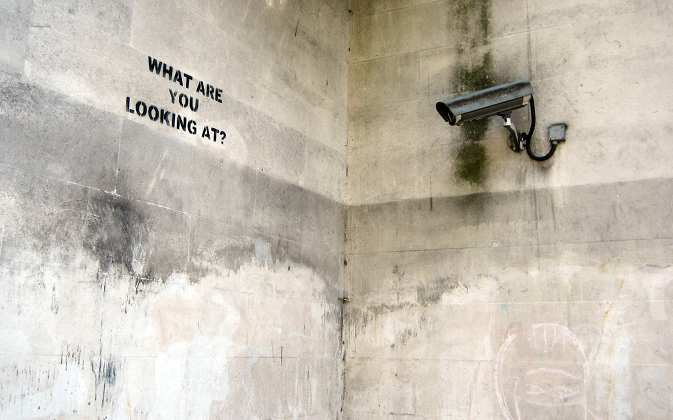
Street Art: Banksy

Slide 28
Where are the Stalked?
CC Stalk Country
Count
AD 1 Andorra
AE 105 United Arab Emirates
AF 2 Afghanistan
AG 8 Antigua and Barbuda
AL 620 Albania
AM 32 Armenia
AO 3 Angola
AR 141 Argentina
AT 39 Austria
AU 1094 Australia
AW 11 Aruba
AZ 17 Azerbaijan
BA 85 Bosnia and Herzegovina
BB 9 Barbados
BD 18 Bangladesh
BE 53 Belgium
BG 379 Bulgaria
BH 10 Bahrain
BN 6 Brunei Darussalam
BO 8 Bolivia
BR 262 Brazil
BS 3 Bahamas
BT 2 Bhutan
BY 28 Belarus
BZ 3 Belize
CA 995 Canada
CD 2 The Congo
CH 48 Switzerland
CI 4 Cote d'Ivoire
HR 49 Croatia
HU 220 Hungary
ID 493 Indonesia
IE 15 Ireland
IL 99 Israel
IN 396 India
IQ 265 Iraq
IR 47 Iran
IT 253 Italy
JM 14 Jamaica
JO 3 Jordan
JP 5782 Japan
KE 11 Kenya
KG 13 Kyrgyzstan
KH 108 Cambodia
KR 128 Republic of Korea
KW 2 Kuwait
KZ 414 Kazakhstan
LA 11 Lao People's Democratic Republic
LB 4 Lebanon
LK 16 Sri Lanka
LR 3 Liberia
LT 90 Lithuania
LU 3 Luxembourg
LV 31 Latvia
LY 7 Libya
MA 409 Morocco
MD 22 Republic of Moldova
ME 128 Montenegro
MK 408 Yugoslav Republic of Macedonia
CL 45 Chile
CM 5 Cameroon
CN 44496 China
CO 195 Colombia
CR 8 Costa Rica
CV 1 Cape Verde
CY 42 Cyprus
CZ 71 Czech Republic
DE 198 Germany
DK 22 Denmark
DO 19 Dominican Republic
DZ 62 Algeria
EC 38 Ecuador
EE 16 Estonia
EG 199 Egypt
ES 120 Spain
FI 54 Finland
FJ 6 Fiji
FR 330 France
GB 6816 United Kingdom
GE 31 Georgia
GH 12 Ghana
GL 4 Greenland
GQ 2 Equatorial Guinea
GR 288 Greece
GT 3 Guatemala
GU 6 Guam
GY 4 Guyana
HK 2827 Hong Kong SAR of China
HN 8 Honduras

Slide 29
Where are the Stalked?
ML 2 Mali
MM 26 Myanmar
MN 24 Mongolia
MO 306 Macao SAR of China
MP 28 Northern Mariana Islands
MR 2 Mauritania
MT 20 Malta
MU 17 Mauritius
MX 485 Mexico
MY 2828 Malaysia
NA 3 Namibia
NG 20 Nigeria
NL 114 Netherlands
NO 17 Norway
NP 18 Nepal
NZ 293 New Zealand
OM 12 Oman
PA 30 Panama
PE 202 Peru
PH 679 Philippines
PK 135 Pakistan
PL 1776 Poland
PR 12 Puerto Rico
PS 51 Occupied Palestinian Territory
PT 33 Portugal
PY 1 Paraguay
QA 49 Qatar
RO 916 Romania
RS 311 Serbia
RU 343 Russian Federation
RW 2 Rwanda
SA 141 Saudi Arabia
SD 1 Sudan
SE 62 Sweden
SG 7027 Singapore
SI 37 Slovenia
SK 35 Slovakia
SN 11 Senegal
SR 27 Suriname
ST 3 Sao Tome and Principe
SV 3 El Salvador
TG 2 Togo
TH 557 Thailand
TJ 3 Tajikistan
TN 29 Tunisia
TR 350 Turkey
TT 11 Trinidad and Tobago
TW 3922 Taiwan
TZ 4 United Republic of Tanzania
UA 185 Ukraine
UG 5 Uganda
US 3007 United States of America
UY 7 Uruguay
VE 54 Venezuela
VN 2429 Vietnam
YE 3 Yemen
ZA 6 South Africa
ZM 1 Zambia
ZW 1 Zimbabwe

Slide 30
Where are the Stalked?
This is an impressive list of countries
Which says a lot about the ubiquity of Google Ads (and YouTube watchers)!
But it also says a lot about the reach of the particular stalking activity we are seeing here
Is this list skewed towards any particular country?

Slide 31
Where are the stalked?
CN 44496 China
SG 7027 Singapore
GB 6816 United Kingdom of Great Britain and Northern Ireland
JP 5782 Japan
TW 3922 Taiwan
US 3007 United States of America
MY 2828 Malaysia
HK 2827 Hong Kong Special Administrative Region of China
VN 2429 Vietnam
PL 1776 Poland
AU 1094 Australia
CA 995 Canada
RO 916 Romania
PH 679 Philippines
AL 620 Albania
TH 557 Thailand
ID 493 Indonesia
MX 485 Mexico
KZ 414 Kazakhstan
MA 409 Morocco
MK 408 The former Yugoslav Republic of Macedonia
IN 396 India
BG 379 Bulgaria
TR 350 Turkey
RU 343 Russian Federation
This is the top 25 countries where we have observed end systems that appear to have attracted this particular stalker

Slide 32
Where are the stalked?
CC Stalk Total Rate/100000 Country
MO 414 13,080 3,165 Macao Special Administrative Region of China
CN 54,770 3,275,057 1,672 China
MP 41 2,474 1,657 Northern Mariana Islands
HK 3,454 209,588 1,647 Hong Kong Special Administrative Region of China
ST 3 205 1,463 Sao Tome and Principe
GL 4 318 1,257 Greenland
TW 4,855 546,492 888 Taiwan
JP 7,377 839,634 878 Japan
GQ 4 506 790 Equatorial Guinea
MY 3,356 68,9486 486 Malaysia
AL 942 211,644 445 Albania
PM 2 470 425 Saint Pierre and Miquelon
LR 3 743 403 Liberia
MK 562 146,663 383 The former Yugoslav Republic of Macedonia
SG 8,229 2184,466 376 Singapore
IR 64 22,508 284 Iran (Islamic Republic of)
KH 144 53,815 267 Cambodia
ME 175 66,077 264 Montenegro
SR 38 15,793 240 Suriname
AW 11 4,906 224 Aruba
FJ 16 7,157 223 Fiji
MM 29 14,212 204 Myanmar
LA 16 8,040 199 Lao People's Democratic Republic
CA 1,157 593,756 194 Canada
AG 10 5,264 189 Antigua and Barbuda
This is the top 25 countries with the highest relative rate of stalking
from this particular stalker

Slide 33
Stalking Delay Distribution
Is this stalking instant, or delayed?
The average interval between the initial URL fetch and the second fetch from this net is 74 seconds. What’s the distribution in delay times?

Slide 34
Distribution of Stalking Delay
Most of these stalking fetches happen with 3 seconds of the initial fetch
(But a small set extend this delay to hours)

Slide 35
User Agent strings
What User Agent string is used by the stalker?
What User Agent strings are used by the stalked?

Slide 36
The Stalker’s User Agent String
Mozilla/4.0 (compatible; MSIE 6.0; Windows NT 5.1; SV1; .NET CLR 2.0.50727; MAXTHON 2.0)

Slide 37
Top 25 User Agent Strings of the stalked systems
6,068 Mozilla/5.0 (Windows NT 5.1) AppleWebKit/537.36 (KHTML, like Gecko) Chrome/28.0.1500.95 Safari/537.36 SE 2.X MetaSr 1.0
5,458 Mozilla/5.0 (Windows NT 6.1; WOW64) AppleWebKit/537.36 (KHTML, like Gecko) Chrome/28.0.1500.95 Safari/537.36 SE 2.X MetaSr 1.0
5,389 Mozilla/5.0 (Windows NT 6.1; WOW64) AppleWebKit/537.36 (KHTML, like Gecko) Chrome/33.0.1750.154 Safari/537.36
5,029 Mozilla/5.0 (Windows NT 6.1; WOW64) AppleWebKit/537.36 (KHTML, like Gecko) Chrome/32.0.1700.107 Safari/537.36
4,669 Mozilla/5.0 (Windows NT 6.1) AppleWebKit/537.36 (KHTML, like Gecko) Chrome/28.0.1500.95 Safari/537.36 SE 2.X MetaSr 1.0
4,641 Mozilla/5.0 (Windows NT 6.1; WOW64) AppleWebKit/537.36 (KHTML, like Gecko) Chrome/31.0.1650.63 Safari/537.36
3,382 Mozilla/5.0 (Windows NT 6.1) AppleWebKit/537.36 (KHTML, like Gecko) Chrome/31.0.1650.63 Safari/537.36
3,265 Mozilla/5.0 (Windows NT 6.1; WOW64; rv:26.0) Gecko/20100101 Firefox/26.0
3,084 Mozilla/5.0 (Windows NT 6.1) AppleWebKit/537.36 (KHTML, like Gecko) Chrome/32.0.1700.107 Safari/537.36
2,915 Mozilla/5.0 (Windows NT 6.1; WOW64) AppleWebKit/537.36 (KHTML, like Gecko) Chrome/32.0.1700.76 Safari/537.36
2,813 Mozilla/5.0 (Windows NT 6.1) AppleWebKit/537.36 (KHTML, like Gecko) Chrome/33.0.1750.154 Safari/537.36
2,813 Mozilla/5.0 (Windows NT 6.1; WOW64; rv:27.0) Gecko/20100101 Firefox/27.0
2,765 Mozilla/5.0 (Windows NT 6.1; WOW64) AppleWebKit/537.1 (KHTML, like Gecko) Chrome/21.0.1180.89 Safari/537.1
2,653 Mozilla/5.0 (Windows NT 6.1; WOW64) AppleWebKit/537.36 (KHTML, like Gecko) Chrome/33.0.1750.117 Safari/537.36
2,651 Mozilla/5.0 (Windows NT 6.1; WOW64) AppleWebKit/537.36 (KHTML, like Gecko) Chrome/34.0.1847.131 Safari/537.36
2,416 Mozilla/5.0 (Windows NT 6.1; WOW64) AppleWebKit/537.36 (KHTML, like Gecko) Chrome/34.0.1847.116 Safari/537.36
2,238 Mozilla/5.0 (Windows NT 6.1; rv:26.0) Gecko/20100101 Firefox/26.0
2,222 Mozilla/5.0 (Windows NT 5.1; rv:26.0) Gecko/20100101 Firefox/26.0
2,142 Mozilla/5.0 (Windows NT 5.1) AppleWebKit/537.36 (KHTML, like Gecko) Chrome/32.0.1700.107 Safari/537.36
2,043 Mozilla/5.0 (Windows NT 6.1; WOW64; rv:28.0) Gecko/20100101 Firefox/28.0
2,028 Mozilla/5.0 (Windows NT 5.1) AppleWebKit/537.36 (KHTML, like Gecko) Chrome/31.0.1650.63 Safari/537.36
1,965 Mozilla/5.0 (Windows NT 6.1) AppleWebKit/537.36 (KHTML, like Gecko) Chrome/32.0.1700.76 Safari/537.36
1,876 Mozilla/5.0 (Windows NT 6.1; rv:27.0) Gecko/20100101 Firefox/27.0
1,846 Mozilla/5.0 (Windows NT 6.1) AppleWebKit/537.36 (KHTML, like Gecko) Chrome/34.0.1847.131 Safari/537.36
1,813 Mozilla/5.0 (Windows NT 6.1; WOW64) AppleWebKit/537.36 (KHTML, like Gecko) Chrome/32.0.1700.102 Safari/537.36

Slide 38
Top 25 User Agent Strings of the stalked systems
6,068 Mozilla/5.0 (Windows NT 5.1) AppleWebKit/537.36 (KHTML, like Gecko) Chrome/28.0.1500.95 Safari/537.36 SE 2.X MetaSr 1.0
5,458 Mozilla/5.0 (Windows NT 6.1; WOW64) AppleWebKit/537.36 (KHTML, like Gecko) Chrome/28.0.1500.95 Safari/537.36 SE 2.X MetaSr 1.0
5,389 Mozilla/5.0 (Windows NT 6.1; WOW64) AppleWebKit/537.36 (KHTML, like Gecko) Chrome/33.0.1750.154 Safari/537.36
5,029 Mozilla/5.0 (Windows NT 6.1; WOW64) AppleWebKit/537.36 (KHTML, like Gecko) Chrome/32.0.1700.107 Safari/537.36
4,669 Mozilla/5.0 (Windows NT 6.1) AppleWebKit/537.36 (KHTML, like Gecko) Chrome/28.0.1500.95 Safari/537.36 SE 2.X MetaSr 1.0
4,641 Mozilla/5.0 (Windows NT 6.1; WOW64) AppleWebKit/537.36 (KHTML, like Gecko) Chrome/31.0.1650.63 Safari/537.36
3,382 Mozilla/5.0 (Windows NT 6.1) AppleWebKit/537.36 (KHTML, like Gecko) Chrome/31.0.1650.63 Safari/537.36
3,265 Mozilla/5.0 (Windows NT 6.1; WOW64; rv:26.0) Gecko/20100101 Firefox/26.0
3,084 Mozilla/5.0 (Windows NT 6.1) AppleWebKit/537.36 (KHTML, like Gecko) Chrome/32.0.1700.107 Safari/537.36
2,915 Mozilla/5.0 (Windows NT 6.1; WOW64) AppleWebKit/537.36 (KHTML, like Gecko) Chrome/32.0.1700.76 Safari/537.36
2,813 Mozilla/5.0 (Windows NT 6.1) AppleWebKit/537.36 (KHTML, like Gecko) Chrome/33.0.1750.154 Safari/537.36
2,813 Mozilla/5.0 (Windows NT 6.1; WOW64; rv:27.0) Gecko/20100101 Firefox/27.0
2,765 Mozilla/5.0 (Windows NT 6.1; WOW64) AppleWebKit/537.1 (KHTML, like Gecko) Chrome/21.0.1180.89 Safari/537.1
2,653 Mozilla/5.0 (Windows NT 6.1; WOW64) AppleWebKit/537.36 (KHTML, like Gecko) Chrome/33.0.1750.117 Safari/537.36
2,651 Mozilla/5.0 (Windows NT 6.1; WOW64) AppleWebKit/537.36 (KHTML, like Gecko) Chrome/34.0.1847.131 Safari/537.36
2,416 Mozilla/5.0 (Windows NT 6.1; WOW64) AppleWebKit/537.36 (KHTML, like Gecko) Chrome/34.0.1847.116 Safari/537.36
2,238 Mozilla/5.0 (Windows NT 6.1; rv:26.0) Gecko/20100101 Firefox/26.0
2,222 Mozilla/5.0 (Windows NT 5.1; rv:26.0) Gecko/20100101 Firefox/26.0
2,142 Mozilla/5.0 (Windows NT 5.1) AppleWebKit/537.36 (KHTML, like Gecko) Chrome/32.0.1700.107 Safari/537.36
2,043 Mozilla/5.0 (Windows NT 6.1; WOW64; rv:28.0) Gecko/20100101 Firefox/28.0
2,028 Mozilla/5.0 (Windows NT 5.1) AppleWebKit/537.36 (KHTML, like Gecko) Chrome/31.0.1650.63 Safari/537.36
1,965 Mozilla/5.0 (Windows NT 6.1) AppleWebKit/537.36 (KHTML, like Gecko) Chrome/32.0.1700.76 Safari/537.36
1,876 Mozilla/5.0 (Windows NT 6.1; rv:27.0) Gecko/20100101 Firefox/27.0
1,846 Mozilla/5.0 (Windows NT 6.1) AppleWebKit/537.36 (KHTML, like Gecko) Chrome/34.0.1847.131 Safari/537.36
1,813 Mozilla/5.0 (Windows NT 6.1; WOW64) AppleWebKit/537.36 (KHTML, like Gecko) Chrome/32.0.1700.102 Safari/537.36
Many of the stalked end systems appear to be using Windows OS platforms!

Slide 39
Top 25 User Agent Strings of the stalked systems
6,068 Mozilla/5.0 (Windows NT 5.1) AppleWebKit/537.36 (KHTML, like Gecko) Chrome/28.0.1500.95 Safari/537.36 SE 2.X MetaSr 1.0
5,458 Mozilla/5.0 (Windows NT 6.1; WOW64) AppleWebKit/537.36 (KHTML, like Gecko) Chrome/28.0.1500.95 Safari/537.36 SE 2.X MetaSr 1.0
5,389 Mozilla/5.0 (Windows NT 6.1; WOW64) AppleWebKit/537.36 (KHTML, like Gecko) Chrome/33.0.1750.154 Safari/537.36
5,029 Mozilla/5.0 (Windows NT 6.1; WOW64) AppleWebKit/537.36 (KHTML, like Gecko) Chrome/32.0.1700.107 Safari/537.36
4,669 Mozilla/5.0 (Windows NT 6.1) AppleWebKit/537.36 (KHTML, like Gecko) Chrome/28.0.1500.95 Safari/537.36 SE 2.X MetaSr 1.0
4,641 Mozilla/5.0 (Windows NT 6.1; WOW64) AppleWebKit/537.36 (KHTML, like Gecko) Chrome/31.0.1650.63 Safari/537.36
3,382 Mozilla/5.0 (Windows NT 6.1) AppleWebKit/537.36 (KHTML, like Gecko) Chrome/31.0.1650.63 Safari/537.36
3,265 Mozilla/5.0 (Windows NT 6.1; WOW64; rv:26.0) Gecko/20100101 Firefox/26.0
3,084 Mozilla/5.0 (Windows NT 6.1) AppleWebKit/537.36 (KHTML, like Gecko) Chrome/32.0.1700.107 Safari/537.36
2,915 Mozilla/5.0 (Windows NT 6.1; WOW64) AppleWebKit/537.36 (KHTML, like Gecko) Chrome/32.0.1700.76 Safari/537.36
2,813 Mozilla/5.0 (Windows NT 6.1) AppleWebKit/537.36 (KHTML, like Gecko) Chrome/33.0.1750.154 Safari/537.36
2,813 Mozilla/5.0 (Windows NT 6.1; WOW64; rv:27.0) Gecko/20100101 Firefox/27.0
2,765 Mozilla/5.0 (Windows NT 6.1; WOW64) AppleWebKit/537.1 (KHTML, like Gecko) Chrome/21.0.1180.89 Safari/537.1
2,653 Mozilla/5.0 (Windows NT 6.1; WOW64) AppleWebKit/537.36 (KHTML, like Gecko) Chrome/33.0.1750.117 Safari/537.36
2,651 Mozilla/5.0 (Windows NT 6.1; WOW64) AppleWebKit/537.36 (KHTML, like Gecko) Chrome/34.0.1847.131 Safari/537.36
2,416 Mozilla/5.0 (Windows NT 6.1; WOW64) AppleWebKit/537.36 (KHTML, like Gecko) Chrome/34.0.1847.116 Safari/537.36
2,238 Mozilla/5.0 (Windows NT 6.1; rv:26.0) Gecko/20100101 Firefox/26.0
2,222 Mozilla/5.0 (Windows NT 5.1; rv:26.0) Gecko/20100101 Firefox/26.0
2,142 Mozilla/5.0 (Windows NT 5.1) AppleWebKit/537.36 (KHTML, like Gecko) Chrome/32.0.1700.107 Safari/537.36
2,043 Mozilla/5.0 (Windows NT 6.1; WOW64; rv:28.0) Gecko/20100101 Firefox/28.0
2,028 Mozilla/5.0 (Windows NT 5.1) AppleWebKit/537.36 (KHTML, like Gecko) Chrome/31.0.1650.63 Safari/537.36
1,965 Mozilla/5.0 (Windows NT 6.1) AppleWebKit/537.36 (KHTML, like Gecko) Chrome/32.0.1700.76 Safari/537.36
1,876 Mozilla/5.0 (Windows NT 6.1; rv:27.0) Gecko/20100101 Firefox/27.0
1,846 Mozilla/5.0 (Windows NT 6.1) AppleWebKit/537.36 (KHTML, like Gecko) Chrome/34.0.1847.131 Safari/537.36
1,813 Mozilla/5.0 (Windows NT 6.1; WOW64) AppleWebKit/537.36 (KHTML, like Gecko) Chrome/32.0.1700.102 Safari/537.36
Many of the stalked end systems appear to be Chrome!

Slide 40
Chrome/Windows Virus?
Well, no – not in this case!
There is some further detail in the User Agent string that may help?

Slide 41
Top 25 User Agent Strings of the stalked systems
6,068 Mozilla/5.0 (Windows NT 5.1) AppleWebKit/537.36 (KHTML, like Gecko) Chrome/28.0.1500.95 Safari/537.36 SE 2.X MetaSr 1.0
5,458 Mozilla/5.0 (Windows NT 6.1; WOW64) AppleWebKit/537.36 (KHTML, like Gecko) Chrome/28.0.1500.95 Safari/537.36 SE 2.X MetaSr 1.0
5,389 Mozilla/5.0 (Windows NT 6.1; WOW64) AppleWebKit/537.36 (KHTML, like Gecko) Chrome/33.0.1750.154 Safari/537.36
5,029 Mozilla/5.0 (Windows NT 6.1; WOW64) AppleWebKit/537.36 (KHTML, like Gecko) Chrome/32.0.1700.107 Safari/537.36
4,669 Mozilla/5.0 (Windows NT 6.1) AppleWebKit/537.36 (KHTML, like Gecko) Chrome/28.0.1500.95 Safari/537.36 SE 2.X MetaSr 1.0

Slide 42
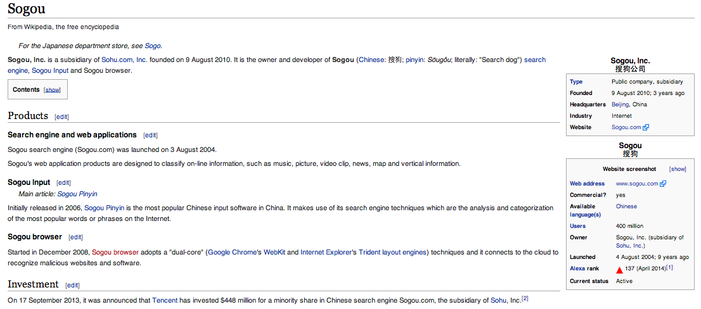
Top 25 User Agent Strings of the stalked systems
6,068 Mozilla/5.0 (Windows NT 5.1) AppleWebKit/537.36 (KHTML, like Gecko) Chrome/28.0.1500.95 Safari/537.36 SE 2.X MetaSr 1.0
5,458 Mozilla/5.0 (Windows NT 6.1; WOW64) AppleWebKit/537.36 (KHTML, like Gecko) Chrome/28.0.1500.95 Safari/537.36 SE 2.X MetaSr 1.0
5,389 Mozilla/5.0 (Windows NT 6.1; WOW64) AppleWebKit/537.36 (KHTML, like Gecko) Chrome/33.0.1750.154 Safari/537.36
5,029 Mozilla/5.0 (Windows NT 6.1; WOW64) AppleWebKit/537.36 (KHTML, like Gecko) Chrome/32.0.1700.107 Safari/537.36
4,669 Mozilla/5.0 (Windows NT 6.1) AppleWebKit/537.36 (KHTML, like Gecko) Chrome/28.0.1500.95 Safari/537.36 SE 2.X MetaSr 1.0
Sogou Explorer 2.X

Slide 43
Top 25 User Agent Strings of the stalked systems
6,068 Mozilla/5.0 (Windows NT 5.1) AppleWebKit/537.36 (KHTML, like Gecko) Chrome/28.0.1500.95 Safari/537.36 SE 2.X MetaSr 1.0
5,458 Mozilla/5.0 (Windows NT 6.1; WOW64) AppleWebKit/537.36 (KHTML, like Gecko) Chrome/28.0.1500.95 Safari/537.36 SE 2.X MetaSr 1.0
5,389 Mozilla/5.0 (Windows NT 6.1; WOW64) AppleWebKit/537.36 (KHTML, like Gecko) Chrome/33.0.1750.154 Safari/537.36
5,029 Mozilla/5.0 (Windows NT 6.1; WOW64) AppleWebKit/537.36 (KHTML, like Gecko) Chrome/32.0.1700.107 Safari/537.36
4,669 Mozilla/5.0 (Windows NT 6.1) AppleWebKit/537.36 (KHTML, like Gecko) Chrome/28.0.1500.95 Safari/537.36 SE 2.X MetaSr 1.0
Sogou Explorer 2.X
“It connects to the cloud to recognize malicious websites and software”

Slide 44
What are we seeing for stalking from 119.147.146.0/24?
State-based Espionage?
Compromised Middleware?
Commercial espionage?
Commercial data collection?
Viral spyware?
Cloud-Mania?

Slide 45
We see an average of around 1 in 500 of all visible end users are attracting an Internet stalker. It’s likely that most of these observed stalkers are either performing some content caching function, or performing URL checking for content rating and monitoring Who else gets to see this data of user behaviour? Under what conditions? Is this form of digital stalking something that we are comfortable with? Are we even aware that it is happening at all?

Slide 46
This data set is just a tiny glimpse into the overall pattern of web activity

Slide 47
What’s happening in the larger world of various forms of tracking users’ behaviour on the Internet?
Street Art: Banksy

Slide 48
Thanks to:
Warren Kumari, of Google, who spent some time looking through user agent strings to identify a pointer to the Sogou browser in the collected data.

Slide 49
Thanks!
Street Art: Banksy

