Slide 1
BGP in 2013
(and a bit of 2014)
Geoff Huston
APNIC
RIPE 68

Slide 2
“Conventional “wisdom” about routing:
“The rapid and sustained growth of the Internet over the past
several decades has resulted in large state requirements for
IP routers. In recent years, these requirements are continuing
to worsen, due to increased deaggregation (advertising more specific
routes) arising from load balancing and security concerns..”
Quoted from a 2012 research paper on routing

Slide 3
“Conventional “wisdom” about routing:
“The rapid and sustained growth of the Internet over the past
several decades has resulted in large state requirements for
IP routers. In recent years, these requirements are continuing
to worsen, due to increased deaggregation (advertising more specific
routes) arising from load balancing and security concerns..”
quote from a 2012 research paper on routing
Is this really true, or do we accept it as true without actually looking at the real behaviours of the Internet’s routing system???

Slide 4
In this presentation we’ll explore the space of inter-domain routing and look at
  the growth of the eBGP routing table over time and some projections for future growth
  the extent to which more specifics are dominating routing table growth ... or not

Slide 5
What we saw

Slide 6
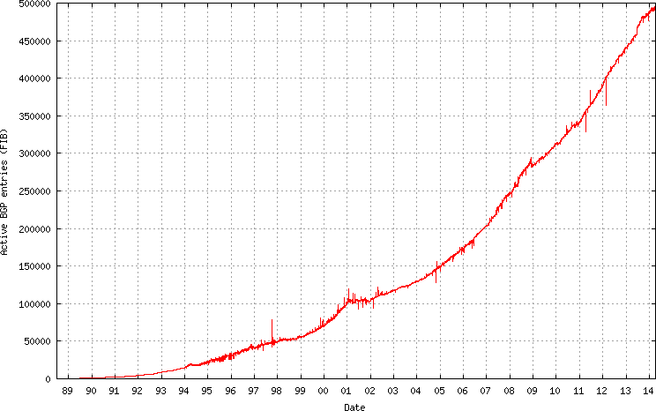
The Big Picture of the v4 Routing Table

Slide 7
The Big Picture of the v4 Routing Table
2011: Address Exhaustion
2009: The GFC hits the Internet
2005: Broadband to the Masses
2001: The Great Internet Boom and Bust
1994: Introduction of CIDR

Slide 8
Lets look at the recent past in a little more detail...

Slide 9
IPv4 BGP Prefix Count 2011 - 2014
550,000
450,000
350,000
Jan
2011
Jan
2012
Jan
2013
Jan
2014
Jan
2015

Slide 10
IPv4 BGP Prefix Count 2013 - 2014
25th June
added HE to the upstream transit set
side effect of adding 10K more specifics:
AS7029 +3,606
AS33363 +1,651
AS4323 +1,351
AS9116 + 348
500,000
460,000
AS5617 - Orange Polska Spolka Akcyjna announced a collection of ~ 1,000 /24s on the 9th April 2014
430,000
Jan
2013
Apr
2013
Jul
2013
Oct
2013
Jan
2014
Apr
2014

Slide 11
IPv4 Routed Address Span: 2011 - 2013
160/8s
150/8s
140/8s
Jan
2011
Jan
2012
Jan
2013
Jan
2014

Slide 12
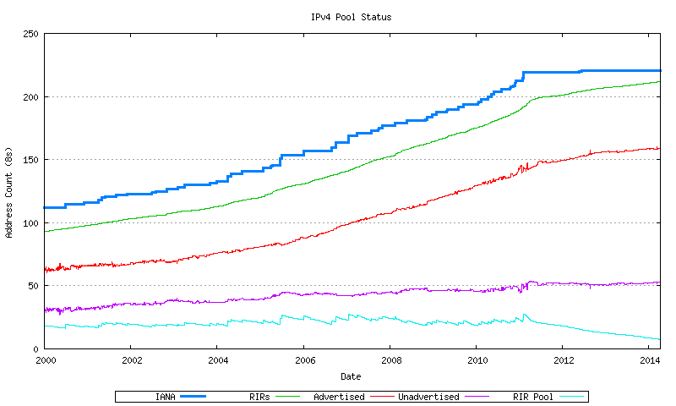
IPv4 Address Pool

Slide 13
The Unadvertised IPv4 Address Pool
Appears to be relatively static in size since early 2011 at some 50 /8s, or 20% of the IPv4 global unicast space.
So far whatever address transfers and trading may have taken place has not had a significant impact on the levels of unadvertised IPv4 address space. This may be due to:
  the last /8 policies of APNIC and the RIPE NCC, or
  the remaining address pools in ARIN and LACNIC, or
  a reluctance on the part of these address holders to trade their addresses at this point in time

Slide 14
IPv4 Routed AS Count
48,000
44,000
40,000
36,000
Jan
2011
Jan
2012
Jan
2013
Jan
2014
Jan
2015
2010
2011

Slide 15
IPv4 2013 BGP Vital Statistics
Jan-13 Jan-14
Prefix Count 440,000 488,000 +11%
Roots 216,000 237,000 +10%
More Specifics 224,000 251,000 +12%
Address Span 156/8s 159/8s + 2%
AS Count 43,000 46,000 + 7%
Transit 6,100 6,600 + 8%
Stub 36,900 39,400 + 7%

Slide 16
IPv4 in 2013 – Growth is Slowing
Overall Internet growth in terms of BGP is at a rate of some ~8-10% p.a.
Address span growing far more slowly than the table size
The rate of growth of the IPv4 Internet is slowing down
  Address shortages?
  Masking by NAT deployments?
  Saturation of critical market sectors?

Slide 17
IPv6 BGP Prefix Count
30,000
World IPv6 Day
15,000
0
2,000
Jan
2011
Jan
2012
Jan
2013
Jan
2014

Slide 18
IPv6 Routed Address Span
80,000
70,000
World IPv6 Day
60,000
50,000
Jan
2011
Jan
2012
Jan
2013
Jan
2014
Jan
2015

Slide 19
IPv6 Routed AS Count
10,000
8,000
6,000
World IPv6 Day
4,000
2,000
0
Jan
2011
Jan
2012
Jan
2013
Jan
2014
Jan
2015

Slide 20
IPv6 2011 BGP Vital Statistics
Jan-13 Jan-14 p.a. rate
Prefix Count 11,500 16,100 + 40%
Roots 8,451 11,301 + 34%
More Specifics 3,049 4,799 + 57%
Address Span (/32s) 65,127 72,245 + 11%
AS Count 6,560 7,845 + 20%
Transit 1,260 1,515 + 20%
Stub 5,300 6,330 + 19%

Slide 21
IPv6 in 2013
Overall IPv6 Internet growth in terms of BGP is 20% - 40 % p.a.
  2012 growth rate was ~ 90%.
(Looking at the AS count, if these relative growth rates persist then the IPv6 network would span the same network domain as IPv4 in16 years time -- 2030!)

Slide 22
IPv6 in 2013 – Growth is Slowing
Overall Internet growth in terms of BGP is at a rate of some ~20-40% p.a.
AS growth sub-linear
The rate of growth of the IPv6 Internet is also slowing down
  Lack of critical momentum behind IPv6?
  Saturation of critical market sectors by IPv4?
  <some other factor>?

Slide 23
What to expect

Slide 24
BGP Size Projections
Generate a projection of the IPv4 routing table using a quadratic (O(2) polynomial) over the historic data
  For IPv4 this is a time of extreme uncertainty
    Registry IPv4 address run out
    Uncertainty over the impacts of any after-market in IPv4 on the routing table
  which makes this projection even more
  speculative than normal!

Slide 25
IPv4 Table Size
600,000
Linear: Y = -1657794 + (t * 1546.283)
Quadratic: Y = -4163100 + (5271.976 * t) + (-1.384441* 10⁻¹² * t²)
Exponential: Y = 10**(3.466156 + (year * 1.603279e-09))
400,000
200,000
0
2004
2006
2008
2010
2012
2014
2016

Slide 26
V4 - Daily Growth Rates

Slide 27
V4 - Relative Growth Rates

Slide 28
IPv4 BGP Table Size predictions
Linear Model
Exponential Model
Jan 2013 441,172 entries
2014 488,011 entries
2015 540,000 entries 559,000
2016 590,000 entries 630,000
2017 640,000 entries 710,000
2018 690,000 entries 801,000
2019 740,000 entries 902,000
These numbers are dubious due to uncertainties introduced by IPv4 address exhaustion pressures.

Slide 29
IPv6 Table Size
40,000
30,000
20,000
10,000
0
2006
2008
2010
2012
2014
2016

Slide 30
V6 - Daily Growth Rates

Slide 31
V6 - Relative Growth Rates

Slide 32
V6 - Relative Growth Rates

Slide 33
IPv6 BGP Table Size predictions
Exponential Model
LinearModel
Jan 2013 11,600 entries
2014 16,200 entries
2015 25,400 entries 19,000
2016 38,000 entries 23,000
2017 57,000 entries 27,000
2018 85,000 entries 30,000
2019 127,000 entries 35,000

Slide 34
Up and to the Right
Most Internet curves are “up and to the right”
But what makes this curve painful?
  The pain threshold is approximated by Moore’s Law

Slide 35
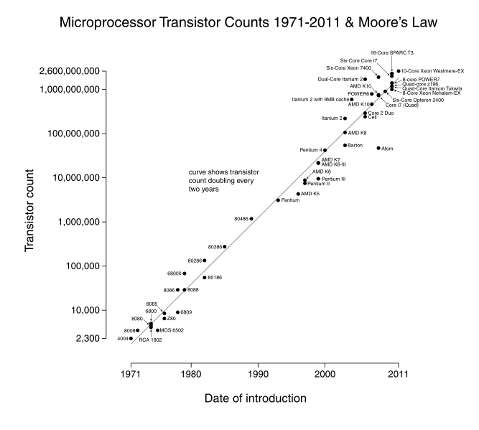

Slide 36
IPv4 BGP Table size and Moore’s Law
Moore’s Law
BGP Table Size Predictions

Slide 37
IPv6 Projections and Moore’s Law
Moore’s Law
BGP Table Size Predictions

Slide 38
eBGP Table Growth
Nothing in these figures suggests that there is cause for urgent alarm -- at present
The overall eBGP growth rates for IPv4 are holding at a modest level, and the IPv6 table, although it is growing rapidly, is still relatively small in size in absolute terms
As long as we are prepared to live within the technical constraints of the current routing paradigm it will continue to be viable for some time yet

Slide 39
Table Size vs Updates

Slide 40
BGP Updates
What about the level of updates in BGP?
Let’s look at the update load from a single eBGP feed in a DFZ context

Slide 41
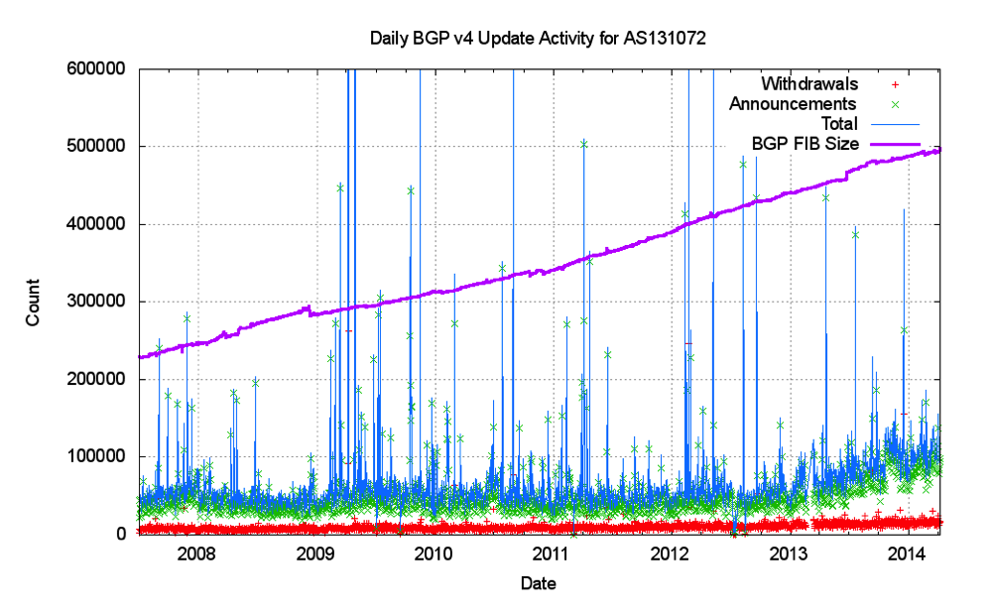
Announcements and Withdrawals

Slide 42
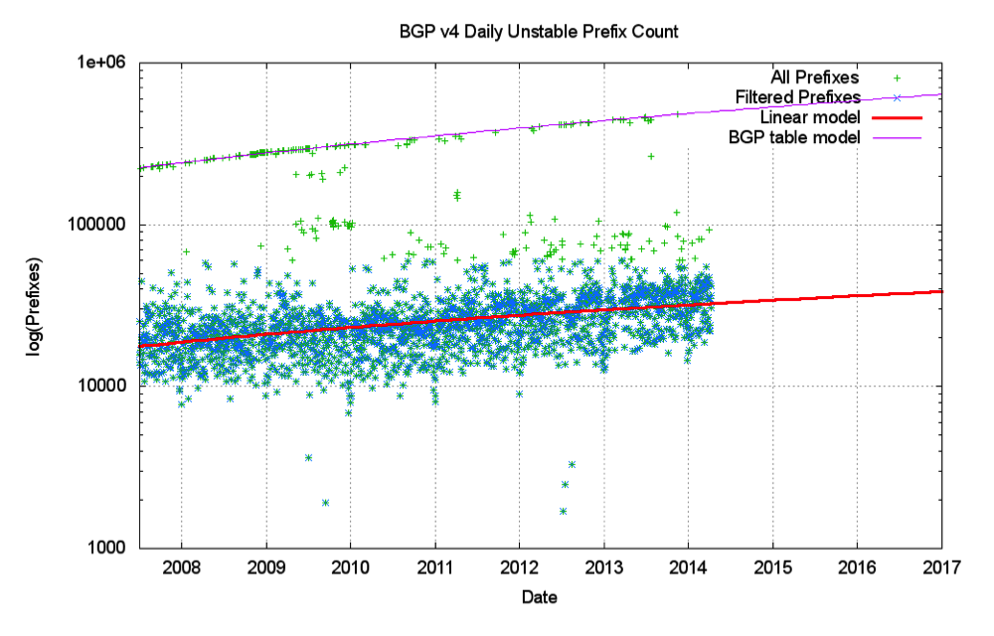
Unstable Prefixes

Slide 43
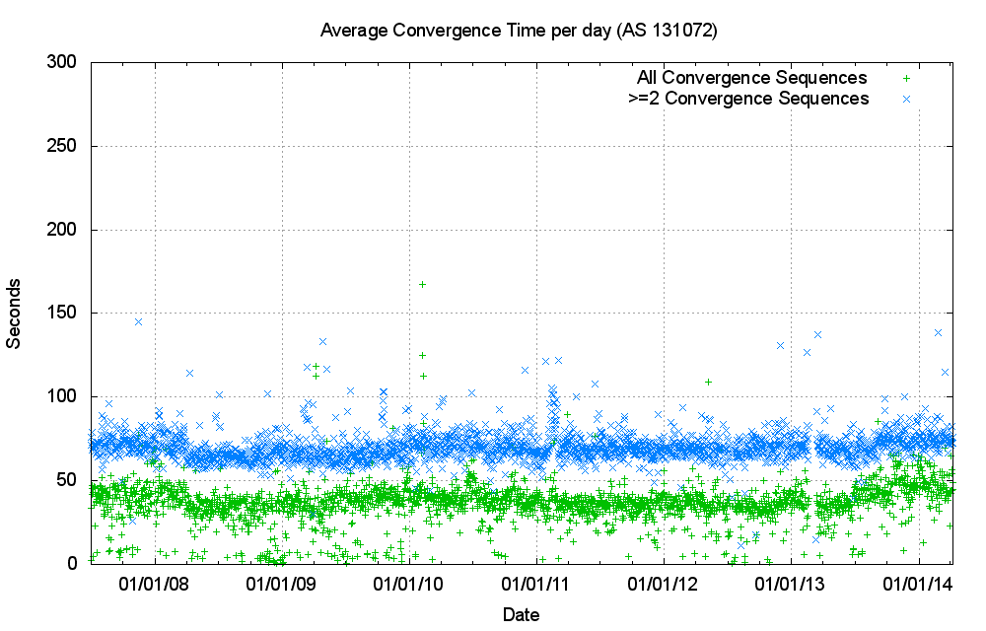
Convergence Performance

Slide 44
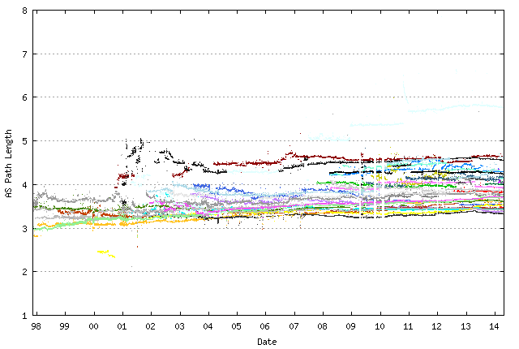
IPv4 Average AS Path Length
Data from Route Views

Slide 45
Updates in IPv4 BGP
Nothing in these figures is cause for any great level of concern …
  The number of unstable prefixes per day is growing at a far lower rate than the number of announced prefixes
  The number of updates per instability event has been constant, due to the damping effect of the MRAI interval, and the relatively constant AS Path length over this interval
What about IPv6?

Slide 46
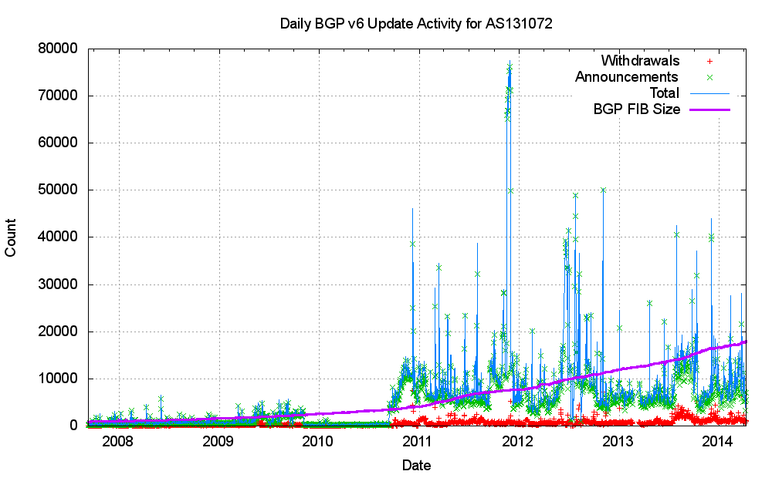
V6 Announcements and Withdrawals

Slide 47
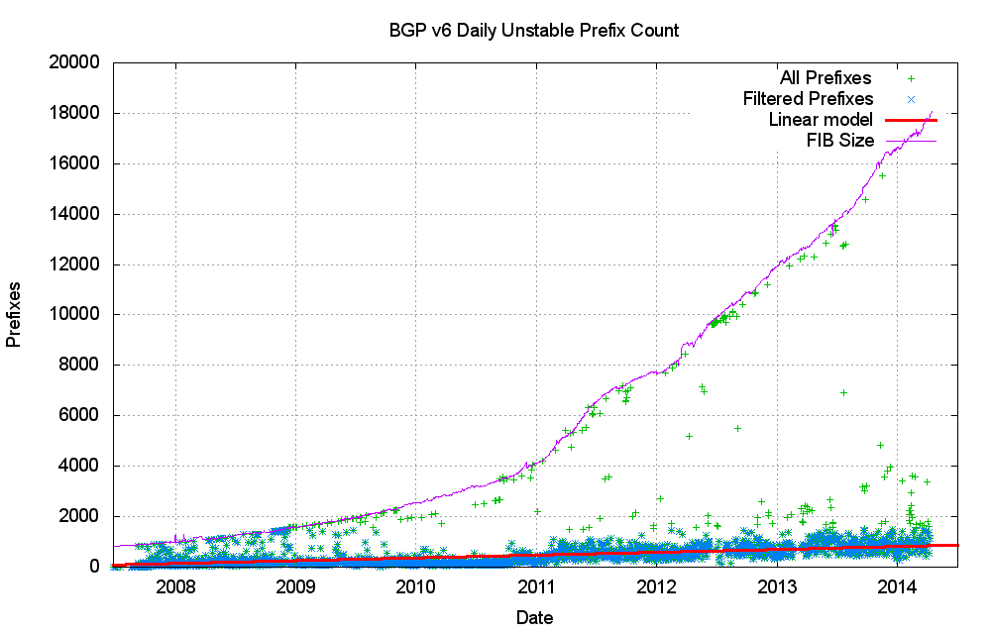
Unstable Prefixes

Slide 48
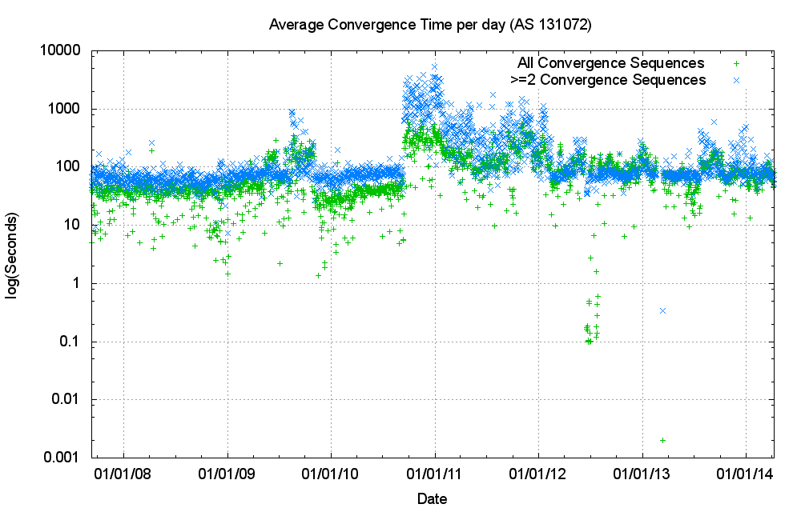
Convergence Performance

Slide 49
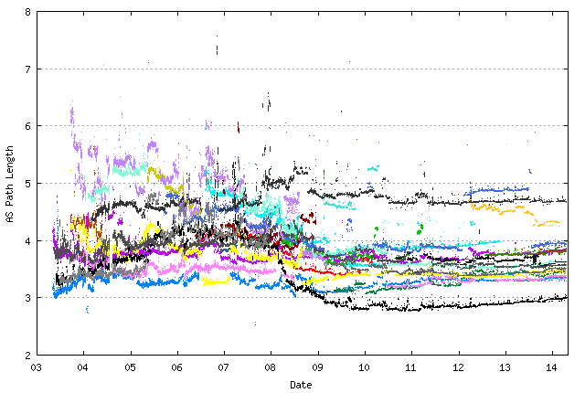
IPv6 Average AS Path Length
Data from Route Views

Slide 50
BGP Convergence
The long term average convergence time for the IPv4 BGP network is some 70 seconds, or 2.3 updates given a 30 second MRAI timer
The long term average convergence time for the IPv6 BGP network is some 80 seconds, or 2.6 updates

Slide 51
BGP Table Growth
However ... continued scalability of the routing system relies on continued conservatism in routing practices.
How good are we at “being conservative” in routing?

Slide 52
CIDR and BGP
To what extent do we still practice “conservative” routing and refrain from announcing more specifics into the routing table?
Are we getting better or worse at aggregation in routing?
What is the distribution of advertising more specifics? Are we seeing a significant increase in the number of more specific /24s in the routing table?

Slide 53
An Example:
Prefix AS Path
193.124.0.0/15 4608 1221 4637 3356 20485 2118 ?
193.124.0.0/24 4608 1221 4637 3356 20485 2118 ?
193.124.1.0/24 4608 1221 4637 3356 20485 2118 ?
193.124.2.0/24 4608 1221 4637 3356 20485 2118 ?
193.124.3.0/24 4608 1221 4637 3356 20485 2118 ?
193.124.4.0/24 4608 1221 4637 3356 20485 2118 ?
193.124.5.0/24 4608 1221 4637 3356 20485 2118 ?
193.124.6.0/24 4608 1221 4637 3356 20485 2118 ?
193.124.7.0/24 4608 1221 4637 3356 20485 2118 ?
193.124.8.0/24 4608 1221 4637 3356 20485 2118 ?
193.124.9.0/24 4608 1221 4637 3356 20485 2118 ?
193.124.10.0/24 4608 1221 4637 3356 20485 2118 ?
193.124.11.0/24 4608 1221 4637 3356 20485 2118 ?
193.124.12.0/24 4608 1221 4637 3356 20485 2118 ?
193.124.13.0/24 4608 1221 4637 3356 20485 2118 ?
193.124.14.0/24 4608 1221 4637 3356 20485 2118 ?
193.124.15.0/24 4608 1221 4637 3356 20485 2118 ?
Origin AS: AS 2118 RELCOM-AS OOO "NPO Relcom"

Slide 54
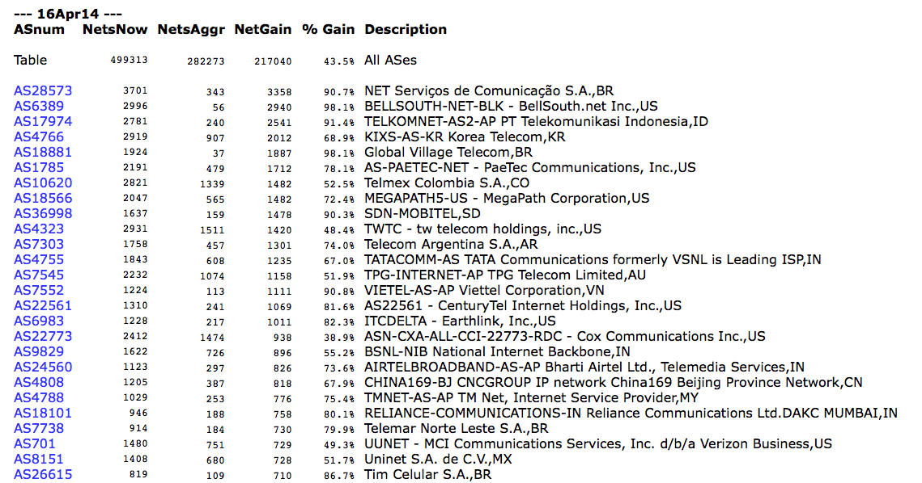
Who is doing this the most?
www.cidr-report.org

Slide 55
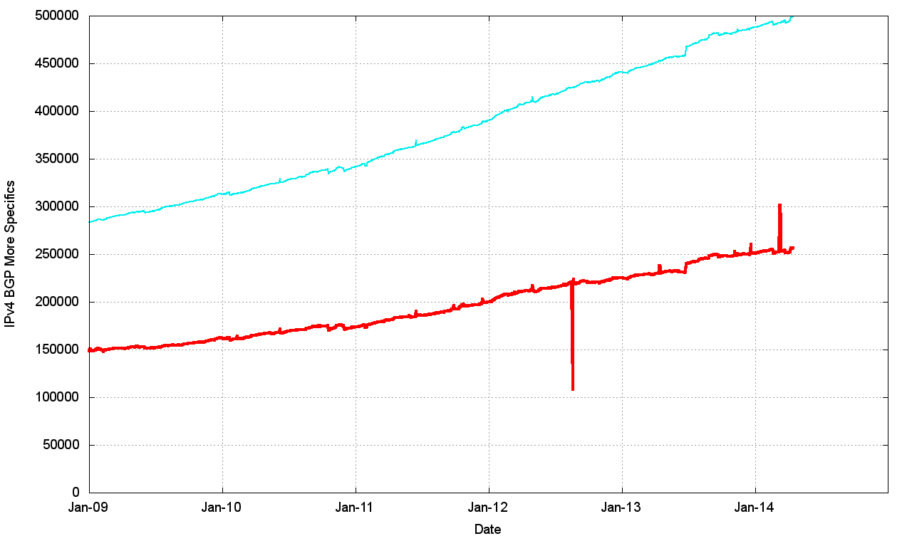
More specifics in the Routing Table
Total Table Size
More Specifics

Slide 56
More specifics in the Routing Table
Since 2002 more specifics account for ~50% of the
Routing Table. This has been a relatively constant
proportion over the past 12 years

Slide 57
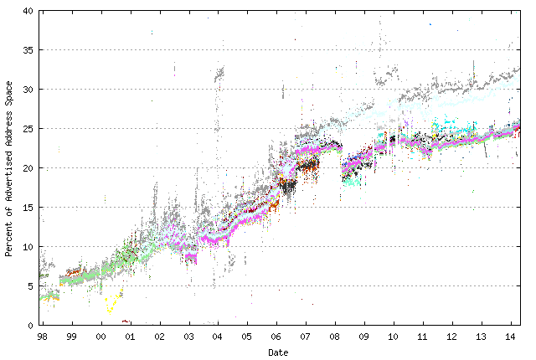
How much address space is announced by more specifics?
% of address space announced by more specifics –
-- as seen by peers of Route Views

Slide 58
Does everyone announce more specifics?
332 Origin AS’s announce 50% of the total set of more specifics!

Slide 59
Is it Everyone?
1% of the ASes (458 ASes) announce 54% of the more specifics (133,688 announcements)
55% of the ASes announce no more specifics
The top 20 ASes announce 40,404 more specifics

Slide 60
More specifics in the V6 Routing Table
Total Table Size
More Specifics

Slide 61
More specifics in the V6 Routing Table

Slide 62
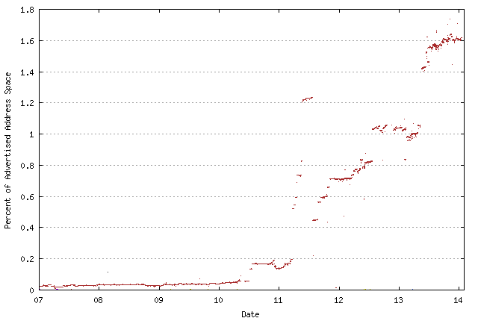
How much V6 address space is announced by more specifics?
% of address space announced by more specifics –
-- as seen by peers of Route Views

Slide 63
Are We Getting Any Better?
Take the daily top 10 ASes of advertisers of more specifics over the past 3 years and track the number of more specifics advertised by these ASes over the entire period

Slide 64
Are We Getting any Better?
These AS’s were seen to be advertising the highest number of more specifics over the past 3 years:
1785 AS-PAETEC-NET - PaeTec Communications, Inc. US
2118 RELCOM-AS OOO "NPO Relcom" RU
3352 TELEFONICA-DATA-ESPANA TELEFONICA DE ESPANA ES
3356 LEVEL3 Level 3 Communications US
4323 TWTC - tw telecom holdings, inc. US
4538 ERX-CERNET-BKB China Education and Research Network Center CN
4755 TATACOMM-AS TATA Communications formerly VSNL is Leading ISP IN
4766 KIXS-AS-KR Korea Telecom KR
6389 BELLSOUTH-NET-BLK - BellSouth.net Inc. US
6503 Axtel, S.A.B. de C.V. MX
7011 FRONTIER-AND-CITIZENS - Frontier Communications of America, Inc. US
7029 WINDSTREAM - Windstream Communications Inc US
7545 TPG-INTERNET-AP TPG Telecom Limited AU
8402 CORBINA-AS OJSC "Vimpelcom" RU
10620 Telmex Colombia S.A. CO
11492 CABLEONE - CABLE ONE, INC. US
15557 LDCOMNET Societe Francaise du Radiotelephone S.A FR
17974 TELKOMNET-AS2-AP PT Telekomunikasi Indonesia ID
18566 MEGAPATH5-US - MegaPath Corporation US
22773 ASN-CXA-ALL-CCI-22773-RDC - Cox Communications Inc. US
28573 NET Servicos de Comunicatio S.A. BR
33363 BHN-TAMPA - BRIGHT HOUSE NETWORKS, LLC US
36998 SDN-MOBITEL SD

Slide 65
Yes ... and No

Slide 66
Are We Getting Any Better?
Some ASes are effectively reducing the number of more specifics that are advertised into the global routing system
Some ASes are increasing the number of more specifics
And some are consistently advertising a significant number of more specifics
There is no net change in the overall distribution and characteristics of more specifics in the routing system.

Slide 67
Why advertise a more specific?
The reasons why we see more specifics in the routing system include:
  Different origination (“hole punching” in an aggregate)
  Traffic engineering of incoming traffic flows across multiple inter-AS paths
  “protection” against route hijacking by advertising more specifics
  Poor routing practices

Slide 68
Types of More Specifics
Senseless Routing Vandalism
Hole Punching
Traffic Engineering

Slide 69
Types of More Specifics
Senseless Routing Vandalism?
Hole Punching?
Traffic Engineering?

Slide 70
Daily Update Rates
Do more specifics experience a higher update rate than aggregate advertisements?
Lets examine the past 3 years of updates and examine the daily count of prefix updates for root aggregates and more specifics

Slide 71
Daily BGP Updates

Slide 72
Relatively Speaking

Slide 73
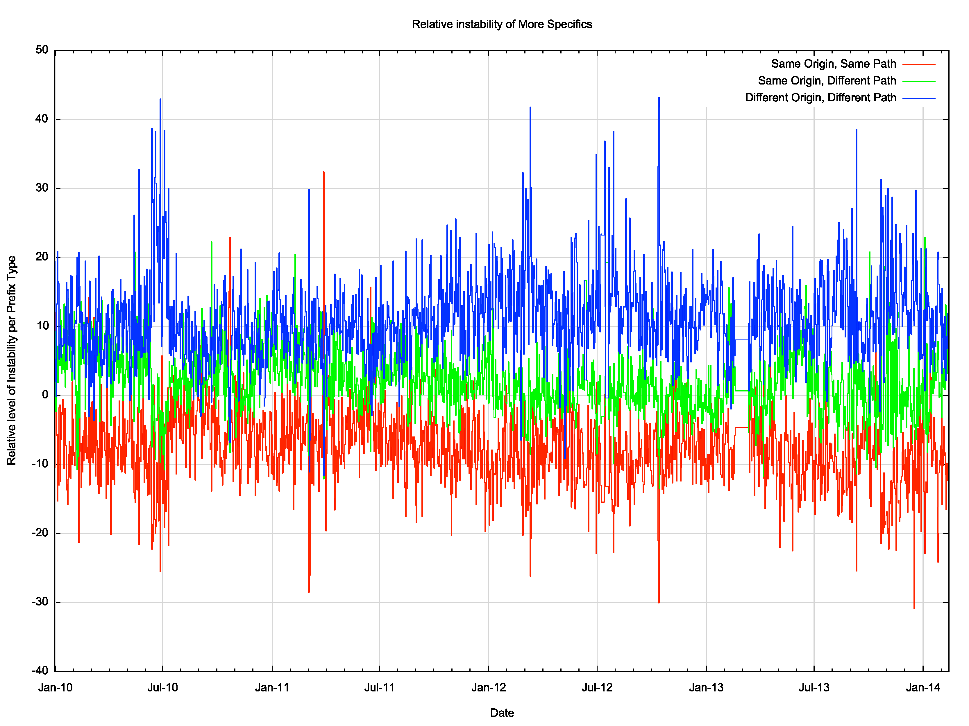
Relative Stability of More Specifics
Hole Punching
Traffic Engineering
Less Stable
More Stable
Senseless Routing Vandalism

Slide 74
Daily Update Rates
Do more specifics generate a higher update rate than aggregate advertisements?
    Yes – in terms of prefix updates, more specifics are some 4 times noisier than the aggregates in terms of update traffic totals
    More Specifics that “hole punch” (different origin AS) tend to be relatively noisier than other forms of more specifics
Is this because they are less stable or noisier?

Slide 75
What are we seeing?
The profile of updates in BGP is dominated by the instability of the more specific announcements, which are 4 x more likely to experience instability compared to aggregate advertisements
With the set of more specifics, “hole punching” (different origin AS, different AS Path) is consistently less stable than the other two types of more specifics.

Slide 76
Problem? Not a Problem?
It’s evident that the global BGP routing environment suffers from a certain amount of neglect and inattention

Slide 77
Problem? Not a Problem?
It’s evident that the global BGP routing environment suffers from a certain amount of neglect and inattention
Could we do better?
  Yes!
  Filtering out more specifics will both reduce table size and also reduce the level of dynamic update in the inter-domain environment

Slide 78
Problem? Not a Problem?
It’s evident that the global BGP routing environment suffers from a certain amount of neglect and inattention
Should we do better?
  It can be difficult to justify the effort and the cost: the current growth rates of the routing table lie within relatively modest parameters of growth and still sit within the broad parameters of constant unit cost of routing technology
  On the other hand, we need to recognize that we could do a lot better in terms of eliminating routing noise, and achieve this with with a relatively modest amount of effort

Slide 79
Thank You
Questions?

