Slide 1
Measuring DNSSEC Use
Geoff Huston
APNIC Labs

Slide 2
We all know…

Slide 3
We all know…
what DNSSEC does.

Slide 4
We all know…
And why its probably a Good Thing to do if you are a zone admin or a DNS resolver operator

Slide 5
We all know…
And why its probably a Good Thing to do if you are a zone admin or a DNS resolver operator.
And why its probably good for end users to use DNSSEC-validating resolvers as well.

Slide 6
We all know…
And we’ve all seen various measurements of how many zones are DNSSEC-signed…

Slide 7
DNSSEC-Signed TLDs at the Root

Slide 8
We all know…
And we’ve all seen various measurements of how many zones are DNSSEC-signed…
But these are generally supply-side measurements
What about the demand size?
If you sign it will they come to validate it?

Slide 9
But what we don’t know is…
What will happen to your authoritative name server when you serve a signed zone?
Will you experience:
Query load meltdown?
TCP session overload?
DDOS amplification from hell?
No change?

Slide 10
Our Questions…
What proportion of the Internet’s users will perform DNSSEC validation if they are presented with a signed domain?
Where are these DNSSEC-validating users?
What is the performance overhead of serving signed names?
What happens when the DNSSEC signature is not valid?

Slide 11
The Experiment
Three URLs:
the good (DNSSEC signed)
the bad (invalid DNSSEC signature)
the control (no DNSSEC at all)
And an online ad system to deliver the test to a large pseudo-random set of clients

Slide 12
Understanding DNS Resolvers is “tricky”
What we would like to think happens in DNS resolution!
x.y.z?
x.y.z?
Authoritative
Nameserver
Client
DNS Resolver
x.y.z? 10.0.0.1
x.y.z? 10.0.0.1

Slide 13
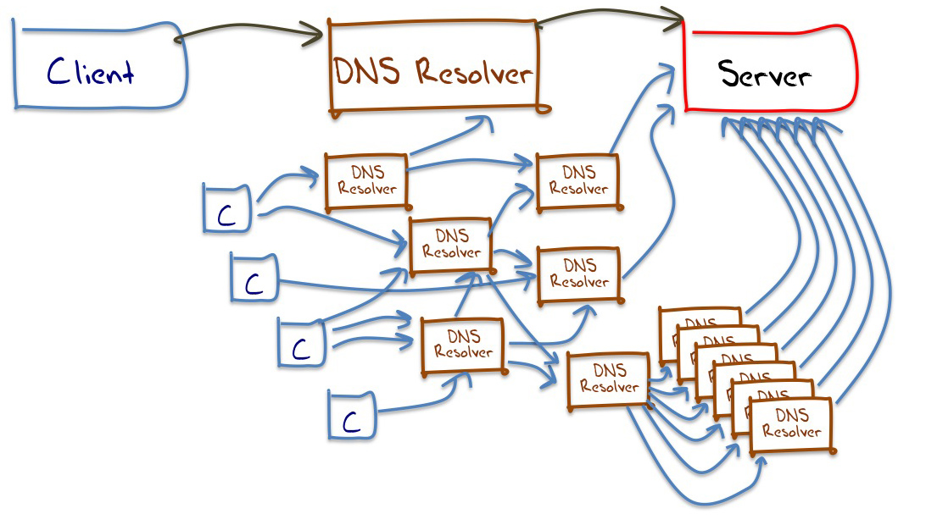
Understanding DNS Resolvers is “tricky”
A small sample of what appears to happen in DNS resolution

Slide 14
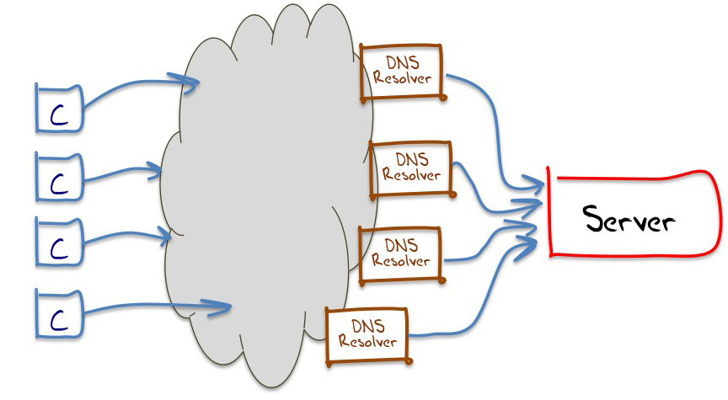
Understanding DNS Resolvers is “tricky”
The best model we can use for DNS resolution

Slide 15
Understanding Resolvers is “tricky”
If we combine www and dns data we can map clients to the
visible resolvers that query our server

Slide 16
This means…
That it’s hard to talk about “all resolvers”
  We don’t know the ratio of the number of resolvers we cannot see compared to the resolvers we can see from the perspective of an authoritative name server
We can only talk about “visible resolvers”

Slide 17
This means…
And there is an added issue here:
  It can be hard to tell the difference between a visible resolver performing DNSSEC validation and an occluded validating resolver performing validation via a visible non-validating forwarder
  (Yes, I know it’s a subtle distinction, but it makes looking at RESOLVERS difficult!)

Slide 18
This means…
It’s easier to talk about end clients rather than resolvers, and whether these end clients use / don’t use a DNS resolution service that performs DNSSEC validation

Slide 19
On to Some Results
December 2013
  Presented: 5,683,295 experiments to clients
  Reported: 4,978,829 experiments that ran to “completion”
  Web results for clients:
  Did Not Fetch invalidly signed object: 7.1%
  Fetched all URLs: 92.9%

Slide 20
That means…
That 7.1% of clients use DNSSEC validating resolvers, because these clients did not fetch the object that had the invalid DNSSEC signature
Right?

Slide 21
That means…
That 7.1% of clients use DNSSEC validating resolvers, because these clients did not fetch the object that had the invalid DNSSEC signature
Right?
Well, not really, due to the experimental technique.
We can learn more if we look at the logs of the DNS queries…

Slide 22
Refining these Results
December 2013
  Presented: 5,683,295 experiments
  Reported: 4,978,929 experiments that ran to “completion”
  Web + DNS query log results for clients:
  Performed DNSSEC signature validation and did not fetch the invalidly signed object: 6.8%
  Fetched DNSSEC RRs, but then retrieved the invalidly signed object anyway: 4.7%
  Did not have a DNSSEC clue at all - only fetched A RRs: 88.5%

Slide 23
That means…
That 6.8% of clients appear to be performing DNSSEC validation and not resolving DNS names when the DNSSEC signature cannot be validated
A further 4.7% of clients are using a mix of validating and non-validating resolvers, and in the case of a validation failure turn to a non-validating resolver!

Slide 24
Where is DNSSEC? – The Top 20
% of clients who appear to use only DNSSEC-validating resolvers
% of clients who use non-validating resolvers
% of clients who use a mix of DNSSEC-validating resolvers and non-validating resolvers
Geo-locate clients to countries, and select countries with more than 1,000 data points

Slide 25
Where is DNSSEC? – The Top 20
Geo-locate clients to countries, and select countries with more than 1,000 data points

Slide 26
Where is DNSSEC? – The bottom 20
Geo-locate clients to countries, and select countries with more than 1,000 data points

Slide 27
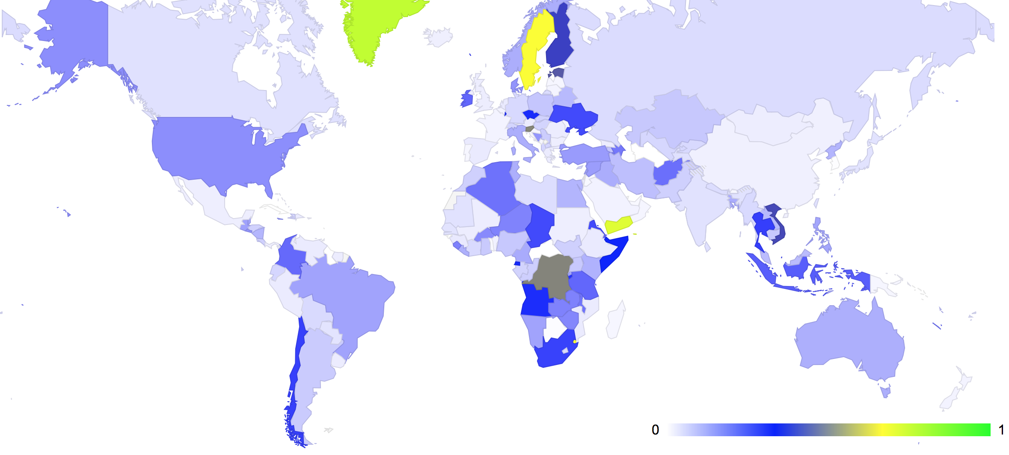
The Mapped view of DNSSEC Use
Fraction of users who use DNSSEC-validating resolvers

Slide 28
Why
is it that 7% of users performing DNSSEC validation is about 3 times the number of users who are capable of using IPv6?
Why has DNSSEC deployment been so successful compared to IPv6?

Slide 29
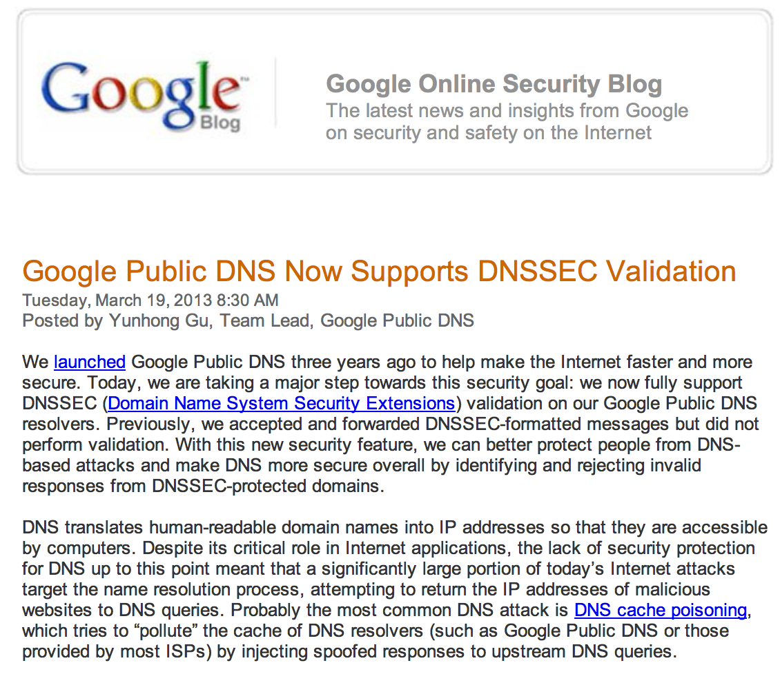
Is Google’s P-DNS a Factor?

Slide 30
Another observation from the data
Clients who used Google’s Public DNS servers: 10.4%
  Exclusively Used Google’s P-DNS: 5.4%
  Used a mix of Google’s P-DNS and other resolvers: 5.0%

Slide 31
Is Google’s P-DNS a Factor?
% of validating clients who exclusively use Google’s P-DNS
% of clients who do not use Google’s P-DNS service
% of clients who use a mix of Google’s P-DNS and other resolvers
Of those clients who perform DNSSEC validation, what resolvers
are they using: All Google P-DNS? Some Google P-DNS? No Google P-DNS?

Slide 32
Is Google’s P-DNS a Factor?
Of those clients who perform DNSSEC validation, what resolvers
are they using: All Google P-DNS? Some Google P-DNS? No Google P-DNS?

Slide 33
Is Google’s P-DNS a Factor?
Of those clients who perform DNSSEC validation, what resolvers
are they using: All Google P-DNS? Some Google P-DNS? No Google P-DNS?

Slide 34
DNSSEC by Networks – the Top 25
% of clients who do not use Google’s P-DNS
% of clients who appear to use DNSSEC-validating resolvers
% of clients who use Google’s P-DNS and other resolvers
% of clients who use non-validating resolvers
% of clients who use a mix of DNSSEC-validating resolvers and non-validating resolvers
% of clients who exclusively use Google’s P-DNS
Map client IP to origin AS, and select origin ASs with more than 500 data points

Slide 35
DNSSEC by Networks – the Top 25
Map client IP to origin AS, and select origin ASs with more than 500 data points

Slide 36
DNS Performance
How can we measure the time taken to resolve each of the three DNSSEC domain name types (signed, unsigned, badly signed)?

Slide 37
2. DNSSEC Performance

Slide 38
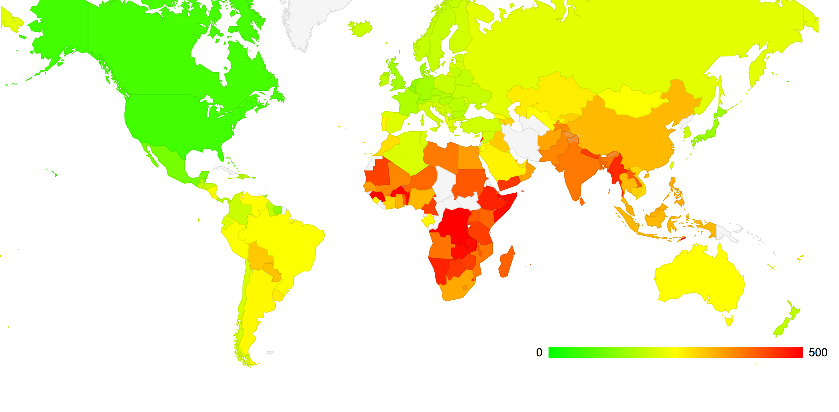
Absolute Measurements don’t make much sense…
Server Location
Average RTT from Client to Server
by country of origin (ms)

Slide 39
Relative Measurements …
Let’s define the FETCH TIME as the time at the authoritative server from the first DNS query for an object to the HTTP GET command for the same object
  This time should reflect the DNS resolution time and a single RTT interval for the TCP handshake
If the “base” fetch time is the time to load an unsigned DNSSEC object, then how much longer does it take to load an object that is DNSSEC-signed?

Slide 40
Result

Slide 41
Result
DNS Validation Time

Slide 42
Invalid DNSSEC Signature

Slide 43
Invalid DNSSEC Signature
1/3 of clients who use a mix of Validating and non-validating resolvers
take more than 10 seconds to resolve a name when the DNSSEC signature is
invalid

Slide 44
DNS Query Time
Now let’s look at the elapsed time at the DNS server between the first query for a name and the last query

Slide 45
DNS Query Time

Slide 46
DNS Query Time
This is unexpected!

Slide 47
What can we say?
DNSSEC takes longer
  Which is not a surprise
  Additional queries for DS and DNSKEY RRs
  At a minimum that’s 2 DNS query/answer intervals
    Because it appears that most resolvers serialise and perform resolution then validation
Badly-Signed DNSSEC takes even longer
  Resolvers try hard to find a good validation path
  And the SERVFAIL response causes clients to try subsequent resolvers in their list

Slide 48
3. At the other end…
Let’s look at performance from the perspective of an Authoritative Name server who serves DNSSEC-signed domain names

Slide 49
DNS Query count per Domain Name

Slide 50
DNS Query count per Domain Name

Slide 51
DNSSEC Performance
At the Authoritative Name Server:
Serving DNSSEC-signed zones = More Queries!
  The Authoritative server will now see additional queries for the DNSKEY and DS RRs for a zone, in addition to the A (and AAAA) queries
  6,095,289 launched experiments
    8,367,427 unsigned name queries
    12,375,232 signed name queries
    20,130,781 badly-signed name queries

Slide 52
What if everybody was doing it?
For the control name there are 1.4 queries per experiment
The total profile of queries for the control DNS name was:
    7.4M A queries
    0.7M AAAA queries
    0.2M Other (NS, MX, ANY, SOA, CNAME, TXT, A6) queries
For the signed name, only 11.4% of clients use DNSSEC-aware resolvers, so the theory (2 additional queries per name) says we will see 1.4M additional queries, or 9.8M queries in total
But we saw 12.4 M queries for the signed DNS Name
  If 11.5% of clients’ resolvers using DNSSEC generate an additional 4.0M queries for a signed domain name, what if every DNS resolver was DNSSEC aware?
  That would be 35M queries in the context of our experiment
A DNSSEC signed zone would see ~4 times the query level of an unsigned zone if every resolver performed DNSSEC validation

Slide 53
Good vs Bad for Everyone
If 12.6% of clients performing some form of DNSSEC validation generate 20.1M queries for a badly-signed name, compared to the no-DNSSEC control level of 8.4M queries, what would be the query load if every resolver performed DNSSEC validation for the same badly signed domain?
  In our case that would be 102M queries
A badly-signed DNSSEC signed zone would seen 12 times the query level of an unsigned zone if every resolver performed DNSSEC validation

Slide 54
Response Sizes
What about the relative traffic loads at the server?
In particular, what are the relative changes in the traffic profile for responses from the Authoritative Server?

Slide 55
DNS Response Sizes
These are not constant sizes – the DNS packet sizes of responses relate to the particular name being resolver, the number of keys being used, and the key size
So these numbers are illustrative of what is going on, but particular cases will vary from these numbers
Control (no DNSSEC)
Query: 124 octets
Response: 176 octets
DNSSEC-Signed
Query: (A Record) 124 octets
Response: 951 Octets
Query: (DNSKEY Record) 80 octets
Response: 342 Octets
Query: (DS Record) 80 octets
Response: 341 Octets
Total: Query: 284 octets
Total Response: 1634 octets

Slide 56
Measurement – Response Traffic Volume
DNSSEC (invalid)
DNSSEC (valid signed)
Control (unsigned)

Slide 57
Interpreting Traffic Data
The validly-signed domain name appears to generate 8x the DNS response traffic volume, as compared to the unsigned domain name
The badly-signed domain name appears to generate 10x – 14x the DNS response traffic volume
What’s contributing to this?
  Setting the DNSSEC OK bit in a query to the signed zone raises the response size from 176 to 951 octets
  Performing DNSSEC signature validation adds a minimum of a further 683 octets in DS and DNSKEY responses

Slide 58
What if you just sign your domain?
Lets start with the hypothetical question: How much more traffic will you be generating at the Authoritative Server if you sign your domain and NO resolvers perform DNSSEC validation?
84% of A and AAAA queries seen at the authoritative nameserver have the EDNS0 + DNSSEC OK flags set
81.5% of queries for the unsigned zone
83.3% of queries for the signed zone
85.9% of queries for the badly-signed zone
(aside: why are these proportions different for each of these zones?)
If you just sign your zone and NO resolvers are performing DNSSEC validation
  84% of queries elicit the larger DNS response then the total outbound traffic load is 4.7x the traffic load of an unsigned zone
But we saw a rise of 8x – why?
  That’s because 12.6 % of clients are also performing DNSSEC validation in various ways

Slide 59
What if everybody was doing it?
If 12.6% of clients performing some form of DNSSEC validation for a signed zone generate around 8x the traffic as compared to an unsigned zone, then what if every DNS resolver performed DNSSEC validation?
An authoritative server for a DNSSEC signed zone would see some 13 times the traffic level of an unsigned zone if every resolver performed DNSSEC validation
A badly-signed DNSSEC zone would see some 31 times the traffic level of an unsigned zone

Slide 60
DNSSEC means more Server Grunt
It’s probably a good idea to plan to serve the worst case: a badly signed zone
In which case you may want to consider provisioning the authoritative name servers with processing capacity to handle 15x the query load, and 30x the generated traffic load that you would need to serve the unsigned zone when signing the zone

Slide 61
A Couple of Caveats:

Slide 62
Reality could be better than this…
“Real” performance of DNSSEC could be a lot better than what we have observed here
We have deliberately negated any form of resolver caching
  Every client receives a “unique” signed URL, and therefore every DNS resolver has to to perform A, DS and DNSKEY fetches for the unique label
  The Ad placement technique constantly searches for “fresh eyeballs”, so caching is not as efficient as it could be
  Conventional DNS caching would dramatically change this picture
    Our 16 day experiment generated 12,748,834 queries
    A 7 day TTL would cut this to a (roughly estimated) 2M queries

Slide 63
And it could be a whole lot worse!
For the invalid DNSSEC case we deliberately limited the impact of invalidity on the server
  DNSSEC invalidity is not handled consistently by resolvers
  Some resolvers will perform an exhaustive check of all possible NS validation paths in the event of DNSSEC validation failure
    See “Roll Over and Die” (http://www.potaroo.net/ispcol/2010-02/rollover.html)
  In this experiment we used a single NS record for the invalidly signed domains
  If we had chosen to use multiple nameservers, or used a deeper-signed label path, or both, on the invalid label, then the query load would’ve been (a lot?) higher
Resolver caching of invalidly signed data is also unclear – so a break in the DNSSEC validation material may also change the caching behaviour of resolvers, and increase load at the server

Slide 64
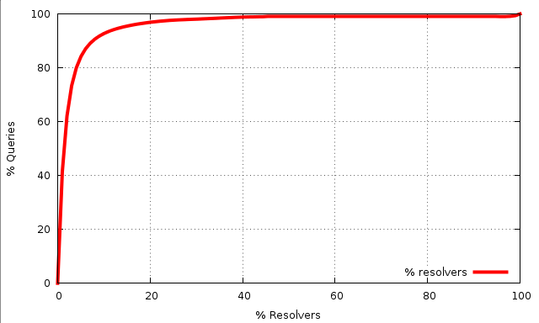
Some things to think about
Resolver / Client Distribution
1% of visible resolvers provide the server with 58% of the seen queries
A few resolvers handle a very significant proportion of the total query volume
But there are an awful lot of small, old, and poorly maintained resolvers running old code out there too!

Slide 65
Some things to think about
Google’s Public DNS is currently handling queries from ~10% of the Internet’s end client population
  That’s around 1 in 12 users
  In this time of heightened awareness about corporate and state surveillance, and issues around online anonymity and privacy, what do we think about this level of use of Google’s Public DNS Service?

Slide 66
Some things to think about
Google’s Public DNS is currently handling queries from 8% of the Internet’s end client population
  That’s around 1 in 12 users
  In this time of heightened awareness about corporate and state surveillance, and issues around online anonymity and privacy, what do we think about this level of use of Google’s Public DNS Service?

Slide 67
Some things to think about
Is the DNS borked?
  Why do 20% of clients use resolvers that make >1 DNS query for a simple unsigned uncached domain name?
    Is the DNS resolver ecosystem THAT broken that 1 in 5 clients use resolvers that generate repeat queries gratuitously?
    And is it reasonable that 1 in 20 clients take more than 1 second to resolve a simple DNS name?

Slide 68
Some things to think about
Why do some 84% of queries have EDNS0 and the DNSSEC OK flag set, yet only 6% of clients perform DNSSEC validation?
How come we see relatively more queries with the DNSSEC OK flag set for queries to domains in signed zones?

Slide 69
Some things to think about
SERVFAIL is not just a “DNSSEC validation is busted” signal
  clients start walking through their resolver set asking the same query
  Which delays the client and loads the server
    The moral argument: Failure should include a visible cost!
    The expedient argument: nothing to see here, move along!
Maybe we need some richer signaling in the DNS for DNSSEC validation failure

Slide 70
Thanks!

