Slide 1
Measuring IPv6
Geoff Huston
APNIC Labs, February 2014

Slide 2
What’s the question?
How “well” are we going with the transition to IPv6?

Slide 3
What’s the question?
How “well” are we going with the transition to IPv6?
That’s a very difficult question to measure!

Slide 4
“Measurable” Questions
How much traffic uses IPv6?
How many connections use IPv6?
How many routes are IPv6 routes?
How many service providers offer IPv6?
How many domain names have AAAA RRs?
How many domain NS’s use AAAA’s?
How many DNS queries are for AAAA RRs?
How many DNS queries are made over IPv6?
How many end devices have IPv6?
How many end devices use IPv6?
…

Slide 5
Back to the Question
None of these specific measurement questions really embrace the larger question
They are all aimed at measuring IPv6 within particular facets of the network infrastructure, but they don’t encompass all of the infrastructure of the network at once

Slide 6
Back to the Question
To make an IPv6 connection everything else (routing, forwarding, DNS, transport) has to work with IPv6
So can we measure how many connected devices on today’s Internet are capable of making IPv6 connections?
The best answer we can offer to this question is to use scripting on a web server to text the capabilities of clients via a scripted set of related web object fetches

Slide 7
But…
We really need to use a massively popular web service to conduct this experiment
But “massively popular web services” worry constantly about service resiliency and privacy of their data regarding users
So they tend to be extremely suspicious of adding script elements to their service that performs third party dual stack tests with their clients (and I can’t blame them!)
So we need to rethink this approach…

Slide 8
How to measure a million end users for their IPv6 capability

Slide 9
How to measure a million end users for their IPv6 capability
Be Google (or any other massively popular web service provider)

Slide 10
How to measure a million end users for their IPv6 capability
Be Google (or any other massively popular web service provider)
or

Slide 11
How to measure a million end users for their IPv6 capability
Be Google (or any other massively popular web service provider)
or
Get your code to run on a million users’ machines via online advertisements, using Flash/actionscript embedded in the ad

Slide 12
Measuring IPv6 via Ads
Use Flash code that is executed on ad impression
Client retrieves set of “tests” that use unique DNS labels from an ad-controller
(http://drongo.rand.apnic.net/measureipv6id.cgi?advertID=9999)
Client is given 5 URLs to load:
Dual Stack object
V4-only object
V6-only object
V6 literal address (no DNS needed)
Result reporting URL (10 second timer)
(All DNS is dual stack)

Slide 13
Why These Tests?
Dual Stack URL
Which protocol will the client PREFER to use?
V4 only URL
Control comparison (Reliability, RTT)
V6 only URL
Is the client CAPABLE of using IPv6?
V6 Literal URL
Does the client have an IPv6 stack at all?
Result URL
Did the client keep the experiment running, or was it terminated early?

Slide 14
Experiment Server config
There are three servers, identically configured (US, Europe, Australia)
Server runs Bind, Apache and tcpdump
Experiment directs the client to the “closest” server (to reduce rtt-related timeouts) based on simple /8 map of client address to region

Slide 15
Collected Data
Per Server, Per Day:
http-access log
(successfully completed fetches)
dns.log
(incoming DNS queries)
Packet capture
All packets

Slide 16
Collected Data
Web Logs:
h.labs.apnic.net 2002:524d:xxxx::524d:xxxx [29/Apr/2013:05:55:05 +0000] "GET /1x1.png?
t10000.u7910203317.s1367214905.i888.v1794.v6lit
h.labs.apnic.net 2002:524d:xxxx::524d:xxxx [29/Apr/2013:05:55:05 +0000] "GET /1x1.png?
t10000.u7910203317.s1367214905.i888.v1794.r6.td
h.labs.apnic.net 82.77.xxx.xxx [29/Apr/2013:05:55:05 +0000] "GET /1x1.png?
t10000.u7910203317.s1367214905.i888.v1794.rd.td
h.labs.apnic.net 82.77.xxx.xxx [29/Apr/2013:05:55:05 +0000] "GET /1x1.png?
t10000.u7910203317.s1367214905.i888.v1794.r4.td
h.labs.apnic.net 82.77.xxx.xxx [29/Apr/2013:05:55:05 +0000] "GET /1x1.png?
t10000.u7910203317.s1367214905.i888.v1794&r=zrdtd-348.zr4td-376.zr6td-316.zv6lit-228

Slide 17
Collected Data
Web Logs:
h.labs.apnic.net 2002:524d:xxxx::524d:xxxx [29/Apr/2013:05:55:05 +0000] "GET /1x1.png?
t10000.u7910203317.s1367214905.i888.v1794.v6lit
h.labs.apnic.net 2002:524d:xxxx::524d:xxxx [29/Apr/2013:05:55:05 +0000] "GET /1x1.png?
t10000.u7910203317.s1367214905.i888.v1794.r6.td
h.labs.apnic.net 82.77.xxx.xxx [29/Apr/2013:05:55:05 +0000] "GET /1x1.png?
t10000.u7910203317.s1367214905.i888.v1794.rd.td
h.labs.apnic.net 82.77.xxx.xxx [29/Apr/2013:05:55:05 +0000] "GET /1x1.png?
t10000.u7910203317.s1367214905.i888.v1794.r4.td
h.labs.apnic.net 82.77.xxx.xxx [29/Apr/2013:05:55:05 +0000] "GET /1x1.png?
t10000.u7910203317.s1367214905.i888.v1794&r=zrdtd-348.zr4td-376.zr6td-316.zv6lit-228
(In this case the client is using 6to4 to access IPv6, and prefers to use IPv4 in a dual stack context)

Slide 18
Data Processing
Web Logs:
V6 Capable/Preferred host counts
Breakdown of Teredo/6to4 vs Unicast
Packet Logs:
Connection Failure counts (incomplete TCP handshake)
Performance measurements (TCP RTT)

Slide 19
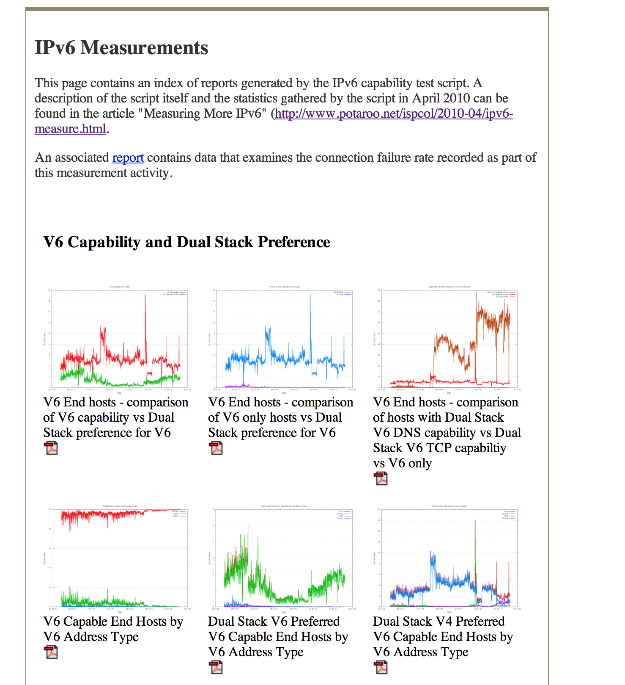
Reports
We perform a basic scan of the daily data and produce a number of reports:
A “summary” report of capabilities
http://www.potaroo.net/ipv6/

Slide 20
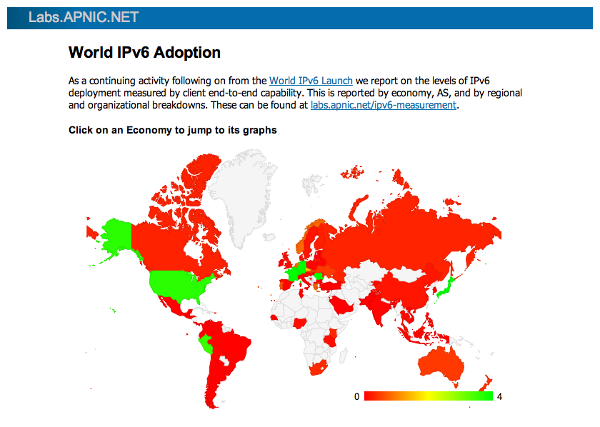
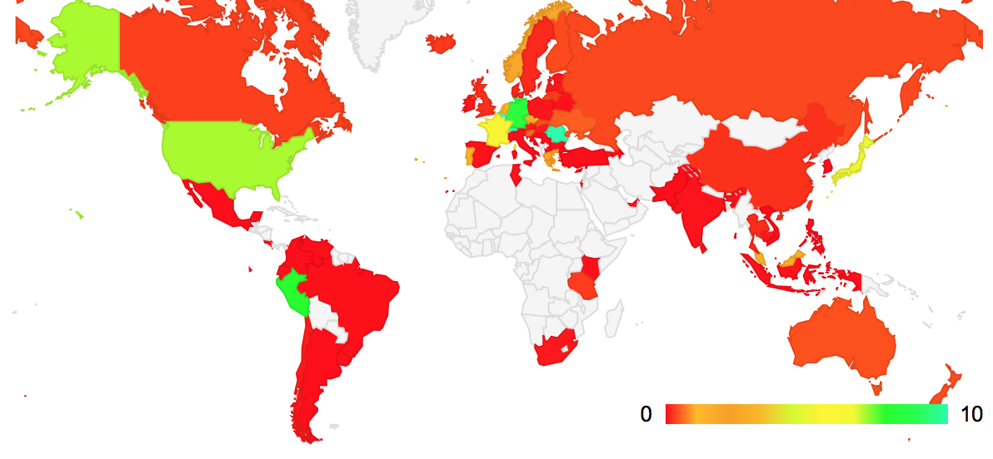
Reports
We perform a basic scan of the daily data and produce a number of reports:
A “summary” report of capabilities
A map of the IPv6 world
http://labs.apnic.net/index.shtml

Slide 21
Reports
We perform a basic scan of the daily data and produce a number of reports:
A “summary” report of capabilities
A map of the IPv6 world
Per-ASN and Per-Country reports
http://labs.apnic.net/ipv6-measurement/

Slide 22
Reports
We perform a basic scan of the daily data and produce a number of reports:
A “summary” report of capabilities
A map of the IPv6 world
Per-ASN and Per-Country reports
Daily Per-Country statistics report
http://labs.apnic.net/dists/v6cc.html

Slide 23
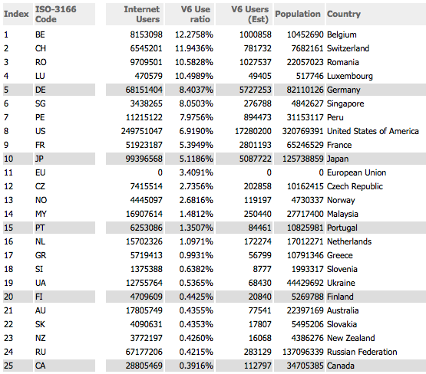
The IPv6 Country League Table
http://labs.apnic.net/dists/v6dcc.html

Slide 24
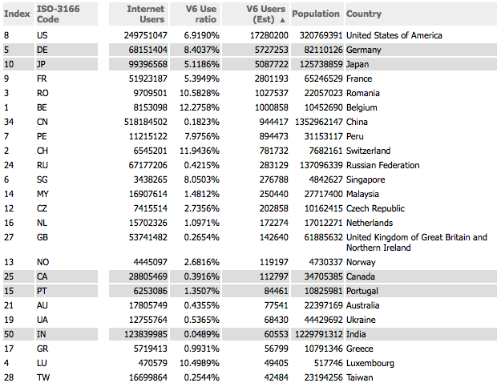
The IPv6 Country League Table
http://labs.apnic.net/dists/v6dcc.html

Slide 25
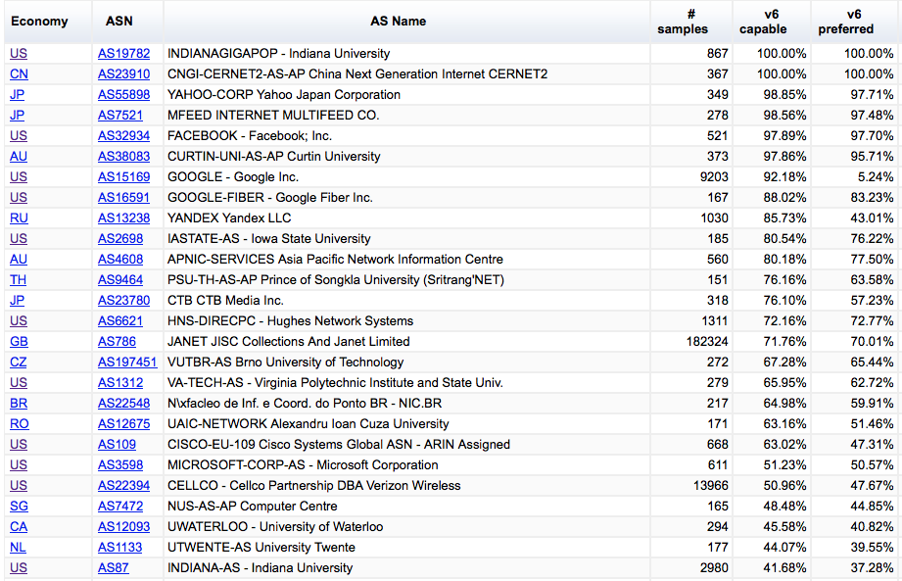
The IPv6 ASN League Table
http://labs.apnic.net/ipv6-measurement/AS/

Slide 26
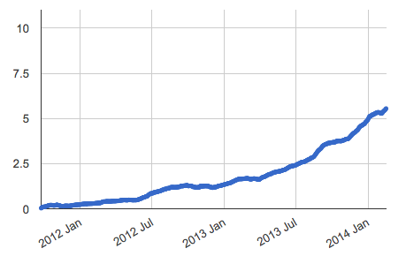
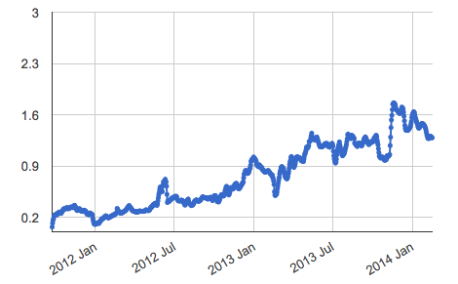
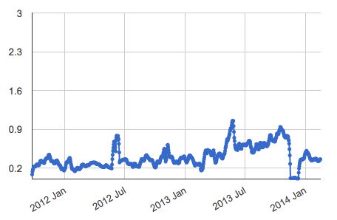
And some Time Series…
North America IPv6
Global IPv6
Asia IPv6

Slide 27
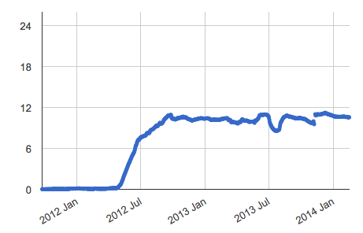
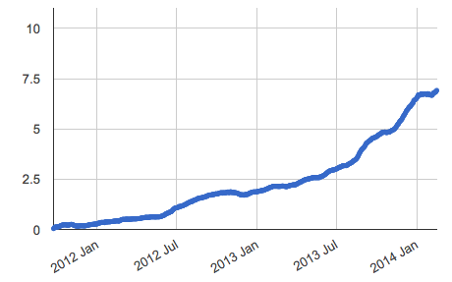
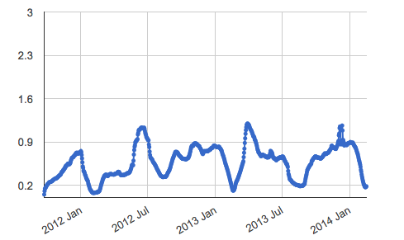
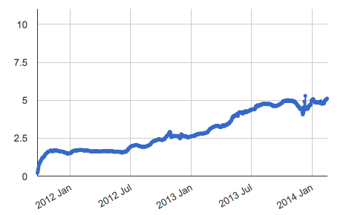
And Some Countries…
Romania
USA
China
Japan

Slide 28
Questions?
APNIC Labs:
Geoff Huston
George Michaelson
research@apnic.net

