Slide 1
Launch+365
Geoff Huston
APNIC
research@apnic.net

Slide 2
Launch+365 (and a bit)
Geoff Huston
APNIC
research@apnic.net

Slide 3

6 June 2012
Was it only a year (and a bit) ago?

Slide 4
One year later…
Did it work? What has changed in the past 12 months?
Who is deploying IPv6?
Where are they?
What have we seen?
What have we measured?

Slide 5
Measuring IPv6 via Ads
Use Flash code embedded in an advertisement
  Code is triggered by the impression of the ad, not by the “clock”
Client retrieves set of “tests” that use unique DNS labels from an ad-controller
  Client is given 5 URLs to load:
    Dual Stack object
    V4-only object
    V6-only object
    V6 literal address (no DNS needed)
    Result reporting URL (10 second timer)
    All DNS is dual stack

Slide 6
Why These Tests?
Dual Stack URL
  Which protocol will the client PREFER to use?
V6 only URL
  Is the client CAPABLE of using IPv6?
V6 Literal URL
  Does the client have an IPv6 stack at all? (the Teredo option)
V4 only URL
  Control comparison (Reliability, RTT)
Result URL
  Did the client keep the experiment running for 10 seconds, or was it terminated early?

Slide 7
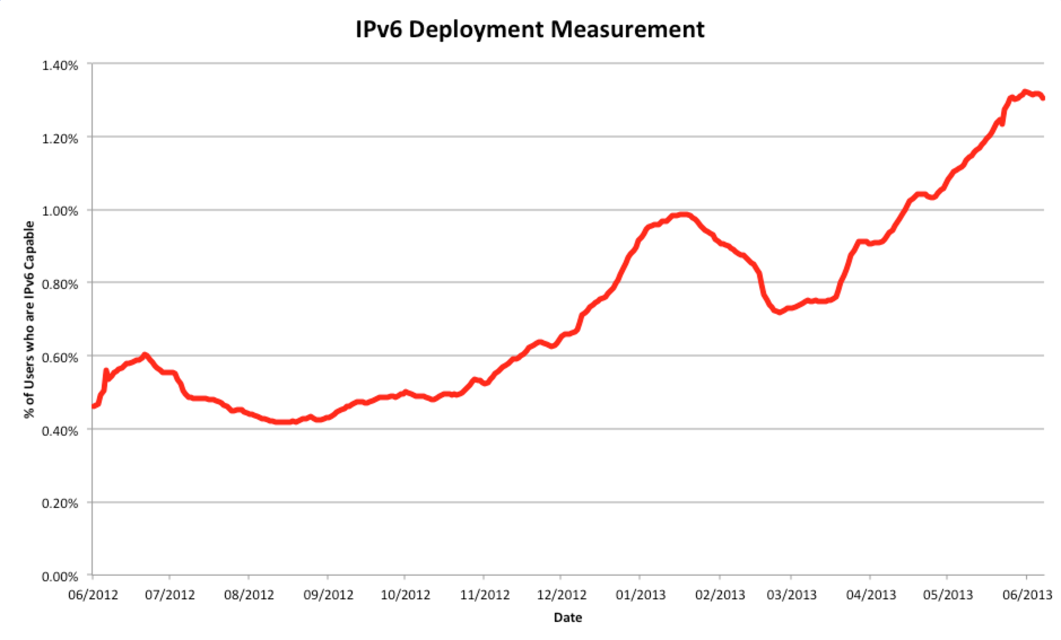
IPv6, Globally

Slide 8
IPv6, Globally
June 2012
0.45%
June 2013
1.29%

Slide 9
IPv6, Globally
What’s this?
And this?
June 2012
0.45%
June 2013
1.29%

Slide 10
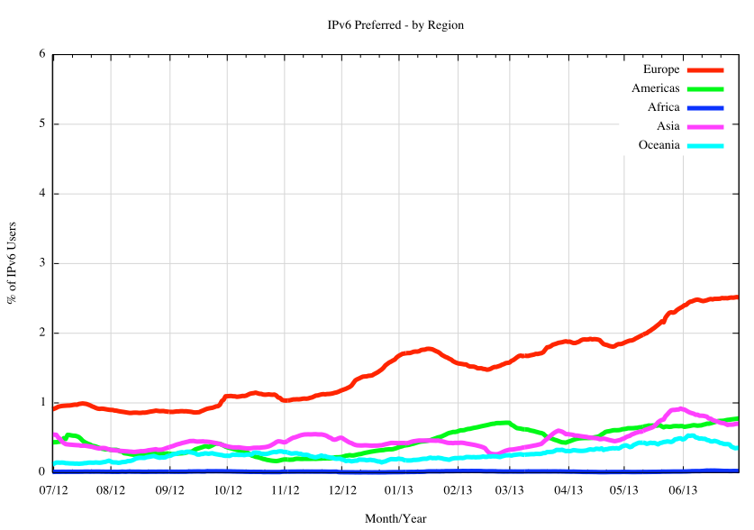
IPv6, Regionally
In relative terms, Europe has been the most active region in 2012/2013

Slide 11
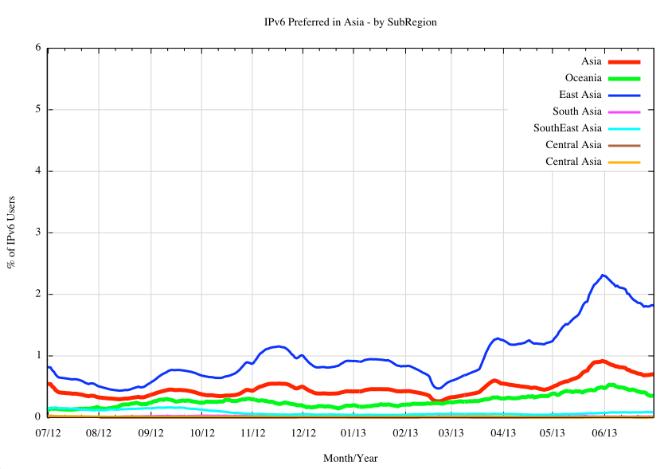
IPv6 in the AP Region
In Asia Pacific the last 12 months of Ipv6 is all about East Asian Economies

Slide 12
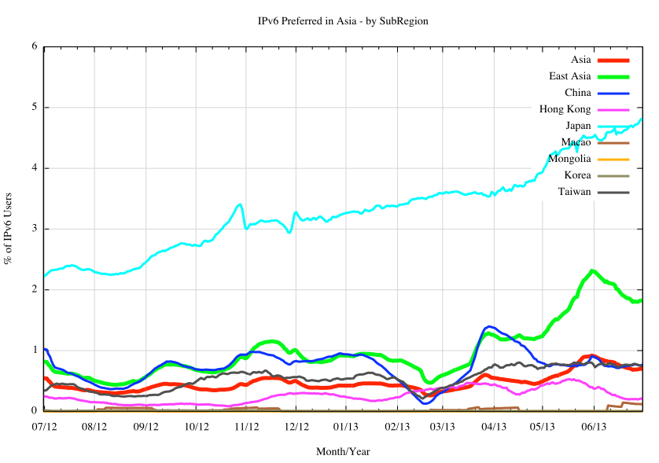
IPv6 in East Asia
Japan
Hong Kong
China
Taiwan

Slide 13
IPv6 in the EU Region

Slide 14
IPv6 in North Europe
Norway
Sweden

Slide 15
IPv6 in South Europe
Slovenia
Portugal
Greece

Slide 16
IPv6 in East Europe
Romania
Czech Rep.
Slovakia

Slide 17
IPv6 in West Europe
Luxembourg
Switzerland
Belgium
France
Germany

Slide 18
Globally Speaking
IPv6 did not happen everywhere and all at once in 2012 / 2013
Some economies have been very active in terms of IPv6 deployment
So lets look at this on a country-by-country basis…

Slide 19
Where is IPv6?
The National Top 20 – Jul 2012 and Jul 2013
2012
Rank Economy % of Internet Users
# of IPv6 Users (est)
1 Romania 7.40% 641,389
2 France 4.03% 2,013,920
3 Luxembourg 2.59% 12,049
4 Japan 1.75% 1,766,799
5 Slovenia 1.07% 15,175
6 United States 1.01% 2,500,684
7 China 1.01% 5,209,030
8 Croatia 0.85% 22,551
9 Switzerland 0.80% 51,575
10 Lithuania 0.66% 13,845
11 Czech Republic 0.55% 39,694
12 Norway 0.51% 23,333
13 Slovakia 0.44% 19,112
14 Russian Fed. 0.39% 238,576
15 Germany 0.32% 217,494
16 Hungary 0.31% 19,896
17 Portugal 0.30% 16,406
18 Netherlands 0.27% 40,870
19 Australia 0.25% 49,425
20 Taiwan 0.24% 38,843
2013
Rank Economy % of Internet Users
# of IPv6 Users (est)
1 Romania 10.84% 1,053,237
2 Switzerland 10.72% 700,777
3 Luxembourg 6.96% 32,535
4 France 5.46% 2,824,465
5 Belgium 4.17% 339,651
6 Japan 4.13% 4,137,476
7 Germany 3.24% 2,212,062
8 United States 2.72% 6,768,264
9 Peru 2.42% 273,370
10 Czech Republic 2.12% 157,203
11 Singapore 1.58% 54,060
12 Norway 1.21% 53,677
13 Slovenia 0.92% 13,230
14 China 0.90% 4,651,953
15 Greece 0.78% 44,572
16 Portugal 0.76% 45,408
17 Taiwan 0.72% 120,180
18 Netherlands 0.70% 109,425
19 Australia 0.69% 121,256
20 Slovakia 0.52% 21,169

Slide 20
Where is IPv6?
The National Top 20 – Then and Now
2012
Rank Economy % of Internet Users
# of IPv6 Users (est)
1 Romania 7.40% 641,389
2 France 4.03% 2,013,920
3 Luxembourg 2.59% 12,049
4 Japan 1.75% 1,766,799
5 Slovenia 1.07% 15,175
6 United States 1.01% 2,500,684
7 China 1.01% 5,209,030
8 Croatia 0.85% 22,551
9 Switzerland 0.80% 51,575
10 Lithuania 0.66% 13,845
11 Czech Republic 0.55% 39,694
12 Norway 0.51% 23,333
13 Slovakia 0.44% 19,112
14 Russian Fed. 0.39% 238,576
15 Germany 0.32% 217,494
16 Hungary 0.31% 19,896
17 Portugal 0.30% 16,406
18 Netherlands 0.27% 40,870
19 Australia 0.25% 49,425
20 Taiwan 0.24% 38,843
2013
Rank Economy % of Internet Users
# of IPv6 Users (est)
1 Romania 10.84% 1,053,237
2 Switzerland 10.72% 700,777
3 Luxembourg 6.96% 32,535
4 France 5.46% 2,824,465
5 Belgium 4.17% 339,651
6 Japan 4.13% 4,137,476
7 Germany 3.24% 2,212,062
8 United States 2.72% 6,768,264
9 Peru 2.42% 273,370
10 Czech Republic 2.12% 157,203
11 Singapore 1.58% 54,060
12 Norway 1.21% 53,677
13 Slovenia 0.92% 13,230
14 China 0.90% 4,651,953
15 Greece 0.78% 44,572
16 Portugal 0.76% 45,408
17 Taiwan 0.72% 120,180
18 Netherlands 0.70% 109,425
19 Australia 0.69% 121,256
20 Slovakia 0.52% 21,169

Slide 21
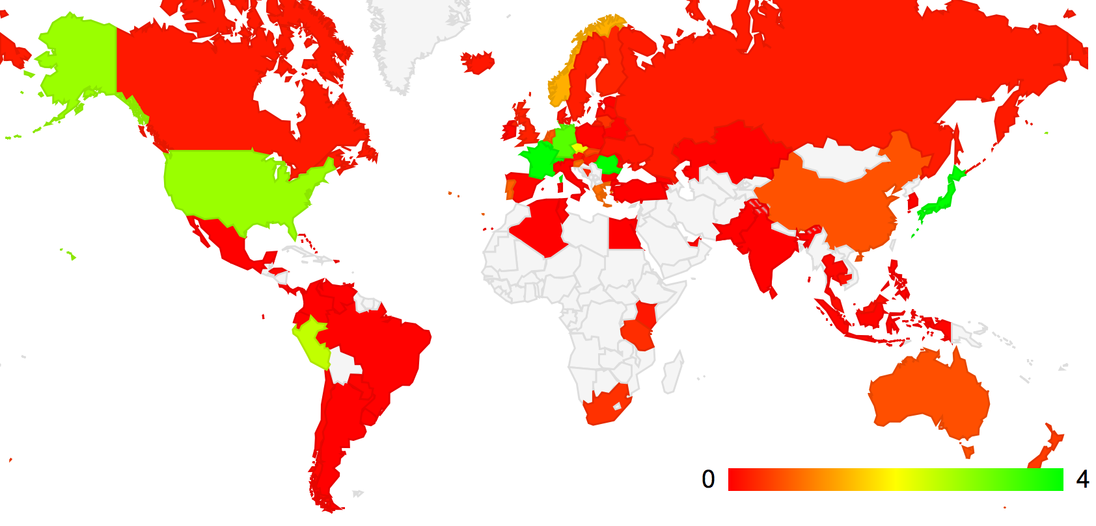
Geographically Speaking…

Slide 22
Nationally, who’s deploying IPv6 over the past year?
2013
Rank Economy Diff (%) Diff IPv6 User Count
1 Switzerland +9.92% + 649,202
2 Luxembourg +4.37% + 20,486
3 Belgium +4.07% + 331,153
4 Romania +3.44% + 411,848
5 Germany +2.92% +1,994,568
6 Peru +2.41% + 272,327
7 Japan +2.38% +2,370,677
8 United States +1.71% +4,267,580
9 Czech Republic +1.57% + 117,509
10 Singapore +1.43% + 48,524
11 France +1.43% + 810,545
12 Greece +0.70% + 40,530
13 Norway +0.70% + 30,344
14 Taiwan +0.48% + 81,337
15 Portugal +0.46% + 29,002
16 Australia +0.44% + 71,831
17 Netherlands +0.43% + 68,555
18 New Zealand +0.35% + 13,174
19 South Africa +0.33% + 34,022
20 Bosnia and Herz. +0.32% + 8,914

Slide 23
And Some Countries…
Germany
United States
Switzerland
Japan

Slide 24
Drilling down to the AS level…
Economy AS Number AS Name 2012 IPv6 (%) 2013 IPv6 (%)
United States of America
AS6939 Hurricane Electric 29% 37%
AS22394 Cellco Partnership DBA Verizon Wireless
6% 20%
AS7018 AT&T Services 6% 15%
AS3561 Savvis 1% 5%
AS7922 Comcast 1% 3%
Japan
AS2516 KDDI 16% 27%
AS18126 Chubu Telecomm 0% 23%
AS17676 Softbank 1% 4%
Germany
AS3320 Deutsche Telekom AG 0% 5%
AS31334 Kabel Deutschland 1% 7%
AS29562 Kabel BW GmbH 0% 10%
France
AS12322 Free SAS 19% 22%
Switzerland
AS67722 Swisscomm 0% 23%
AS559 Switch 11% 18%
Romania
AS8708 RCS & RDS SA 11% 24%
Belgium
AS12392 Brutele SC 0% 33%
AS2611 BELNET 2% 22%
Peru
AS6147 Telefonica del Peru SA 0% 3%
Czech Republic
AS2852 CESNET z.s.p.o. 20% 27%
AS5610 Telefonica Czech 0% 3%
AS51154 Internethome; s.r.o. 0% 2%
Economy AS Number AS Name 2012 IPv6 (%) 2013 IPv6 (%)
United Kingdom
AS786 JANET 51% 68%
AS13213 UK2 Ltd 0% 23%
Taiwan
AS9264 Academic Sinica 0% 21%
AS1659 Taiwan Academic 2% 8%
Australia
AS7575 AARNet 13% 21%
AS4739 Internode 5% 11%
Netherlands
AS3265 XS4ALL Internet 6% 27%
Singapore
AS7472 Starhub Internet 0% 13%
AS4773 MobileOne Ltd. 0% 10%
Greece
AS5408 Greek R&D 17% 19%
South Africa
AS2018 TENET 0% 3%
Canada
AS6453 TATA Comms. 10% 13%
AS22995 Xplornet Comms 0% 9%
Norway
AS224 Uninett 16% 24%
AS39832 Opera Software 1% 100%
AS57963 Lynet Internett 0% 56%
Portugal
AS3243 PT Comunicacoes 0% 1%
Luxembourg
AS6661 Postes et Telecom 4% 14%

Slide 25
Update to Today…

Slide 26
Update to Today…
The pace of deployment continues in some countries
AT&T Internet Services (AS7018)
United States
Comcast (AS7922)

Slide 27
Update to Today…
And there’s Verizion’s Mobile network…

Slide 28
Update to Today…
Germany
France
Deutsche Telekom
Free.Fr

Slide 29
And of course: Greece…

Slide 30
IPv6 Performance
Is IPv6 getting more reliable over the past 12 months?

Slide 31
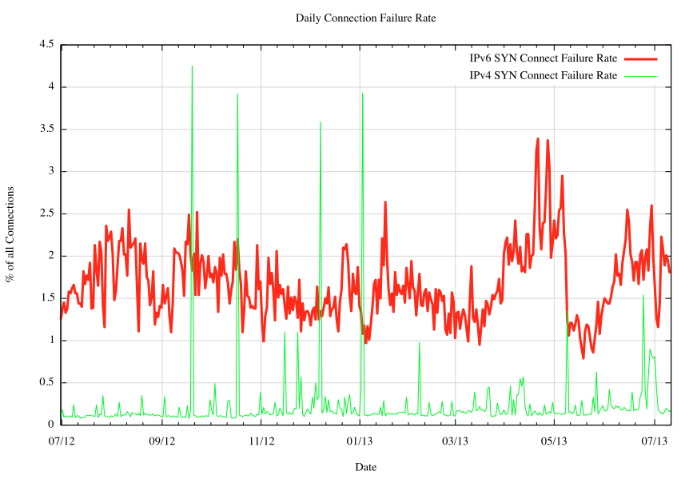
IPv6 Performance
Is IPv6 getting more reliable over the past 12 months?
V6 connection failure rate
V4 connection failure rate

Slide 32
IPv6 Performance
Is IPv6 getting more reliable over the past 12 months?
  Not really

Slide 33
IPv6 Performance
Is IPv6 getting more reliable over the past 12 months?
  Not really
  IPv6 shows a SYN handshake failure rate at appears to be around 10x that of IPv4, at around 2% of all IPv6 connections
  This has not really changed over the past year
  So, no, its not getting any more reliable over the past 12 months

Slide 34
What about Relative Performance?
This experiment allows us to gather IPv6 and IPv4 pairs that appear to refer to the same endpoint
  Because the same client retrieves both IPv4 and IPv6 objects and the web server logs allows us to associate the two addresses back to the same client
And out of the TCP packet dump we get a Round Trip Time sample from the SYN handshake

Slide 35
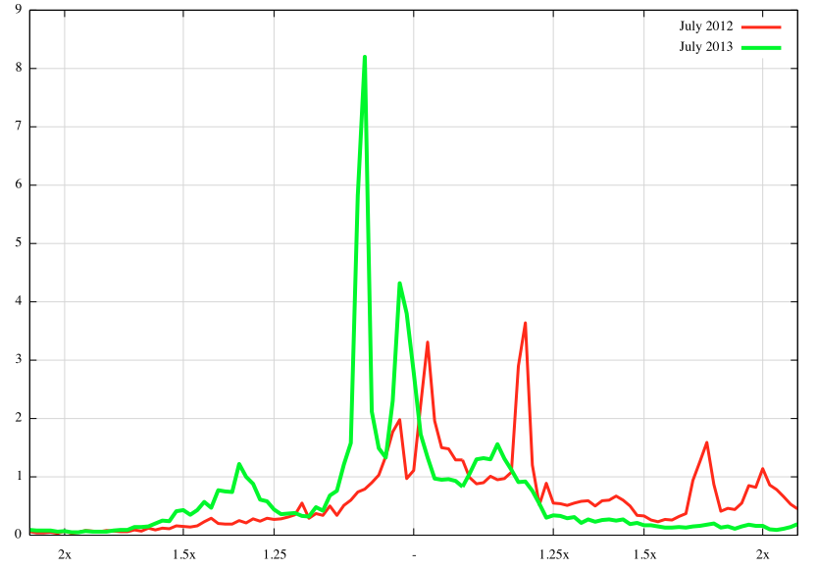
Paired RTT Distribution
IPv6 is faster than IPv4
IPv4 is faster than IPv6
% of RTT measurements
Now:
July 2013
Then:
July 2012
RTT Ratio

Slide 36
Performance
When it works, IPv6 is working far better than a year ago
  It’s often faster in RTT terms than IPv4!
    (Which seems counter-intuitive)
  And its generally no more that 25% slower than IPv4 in terms of relative RTT times between the same two endpoints

Slide 37
What are we seeing?
IPv6 deployment is not happening everywhere.
IPv6 is not happening all at once.
IPv6 is happening in a small number of countries, with still a relatively small set of service providers.

Slide 38
What are we seeing?
What we appear to be seeing are concentrated areas of quite intense IPv6 activity.

Slide 39
Is IPv6 still “A Waiting Game”?
So far what we have heard from many industry actors about IPv6 is:
“I’m waiting for others. I’ll jump when they jump.”
In the past year we have seen a number of major commercial network service operators, primarily in the United States, Japan, Germany, France, Switzerland and Romania, launch programs that integrate IPv6 services into their mass market retail offerings.
Is this effort “enough” to break out of the waiting game?
Whether this effort will provide sufficient impetus to motivate other providers to also commit to a similar program of IPv6 deployment is perhaps still an open issue today, but there is some evidence that there is now a building momentum and possibly an emerging sense of inexorable progress with the deployment of IPv6.

Slide 40
Acknowledgement and Thanks
A number of folk have been generous in their support for APNIC Labs conducting this long term experiment in measuring IPv6 deployment.
We’d like to acknowledge and thank Google, RIPE NCC, ISOC, and ISC for their support of this work.

Slide 41
Thank You
Questions?

