Slide 1
Launch+365
Geoff Huston
research@apnic.net

Slide 2
I was going to talk about “IPv6 Launch”
and look at what has happened to the IPv6 Internet one year after the launch

Slide 3
But…

Slide 4
It’s our 20th Birthday!
So I thought I would add a little nostalgia to the proceedings

Slide 5
It’s our 20th Birthday!
Lets start by looking way back to my early presentations on IPv6, and see how they have changed over the years…

Slide 6
Launch-3650
10 years of IPv6 Presentations
Geoff Huston
research@apnic.net

Slide 7
A question to each of you…

Slide 8
A question to each of you…
How many IPv6 presentations have you sat through?

Slide 9
A question to each of you…
How many IPv6 presentations have you sat through?
20?
100?
1,000?
I don’t know – I was comatose by the end!

Slide 10
A reminder
In case you weren’t paying attention at the time here’s a few blasts from my archives…

Slide 11
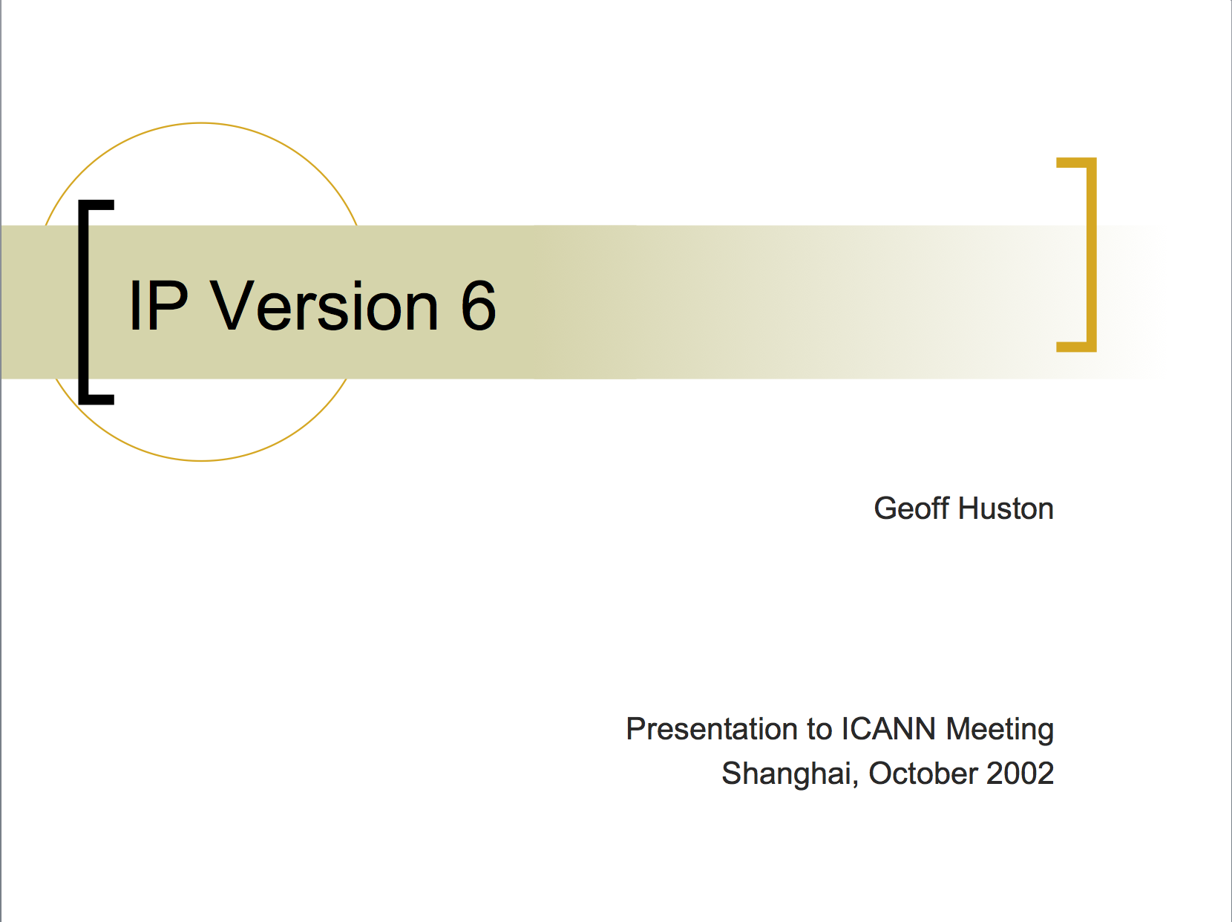
11 years ago, in China

Slide 12
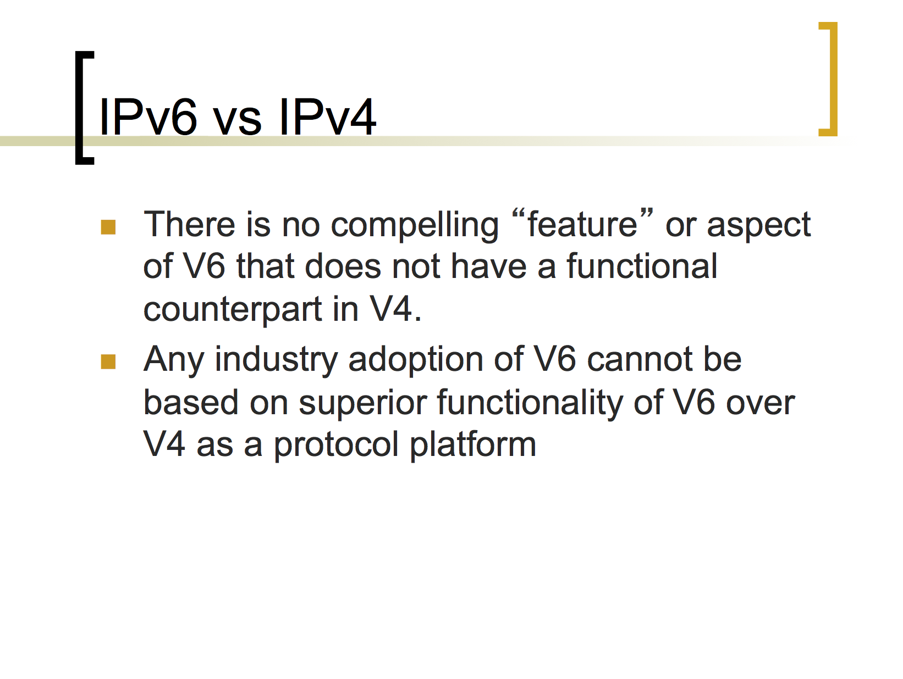
2002: On IPv6 Myths
The “anti-hype” message – IPv6 is not brighter, shiner, or more miraculous. It just has more addresses!

Slide 13
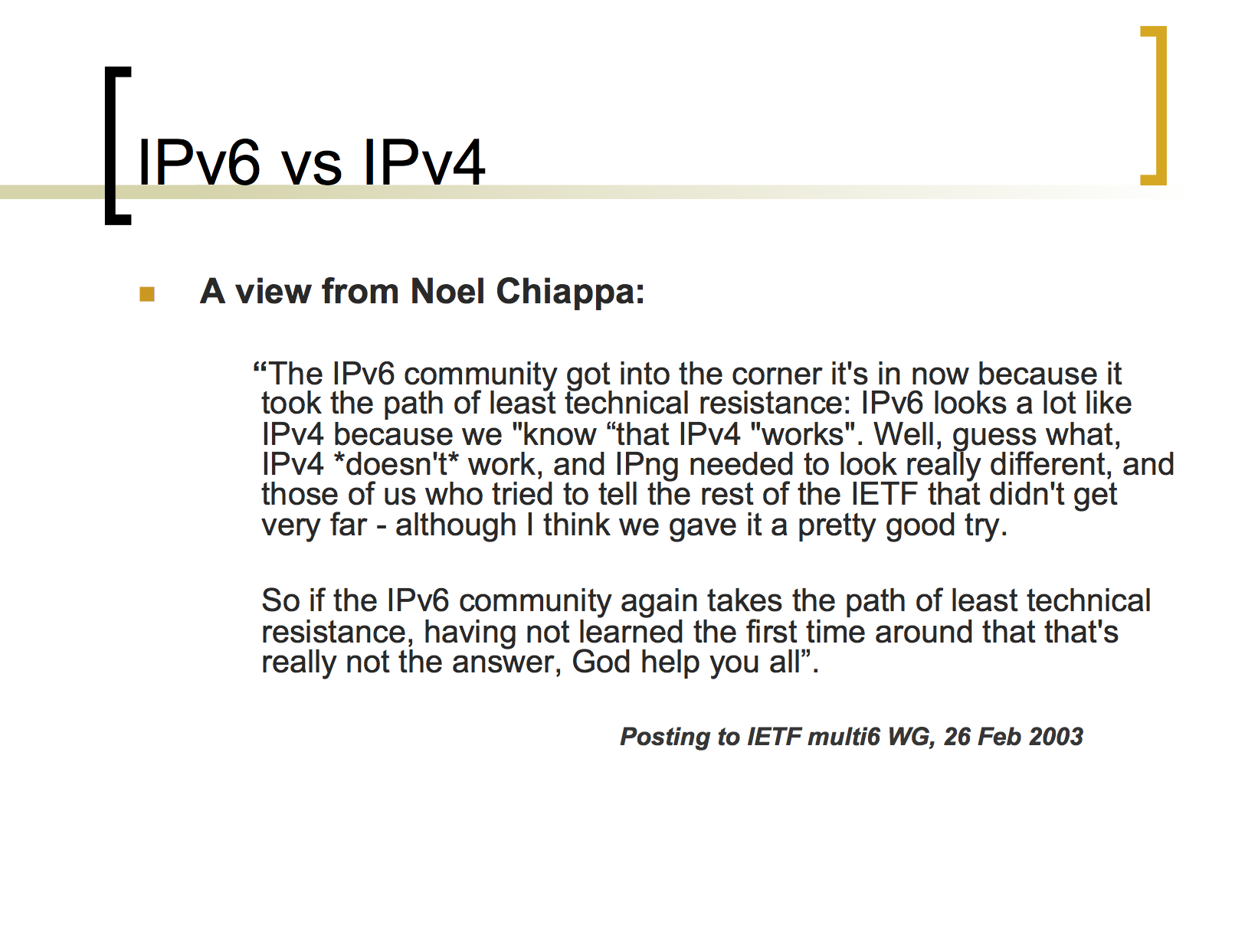
2003: On IPv6 Myths
The “anti-hype” message – IPv6 is not brighter, shiner, or more miraculous. It just has more addresses!

Slide 14
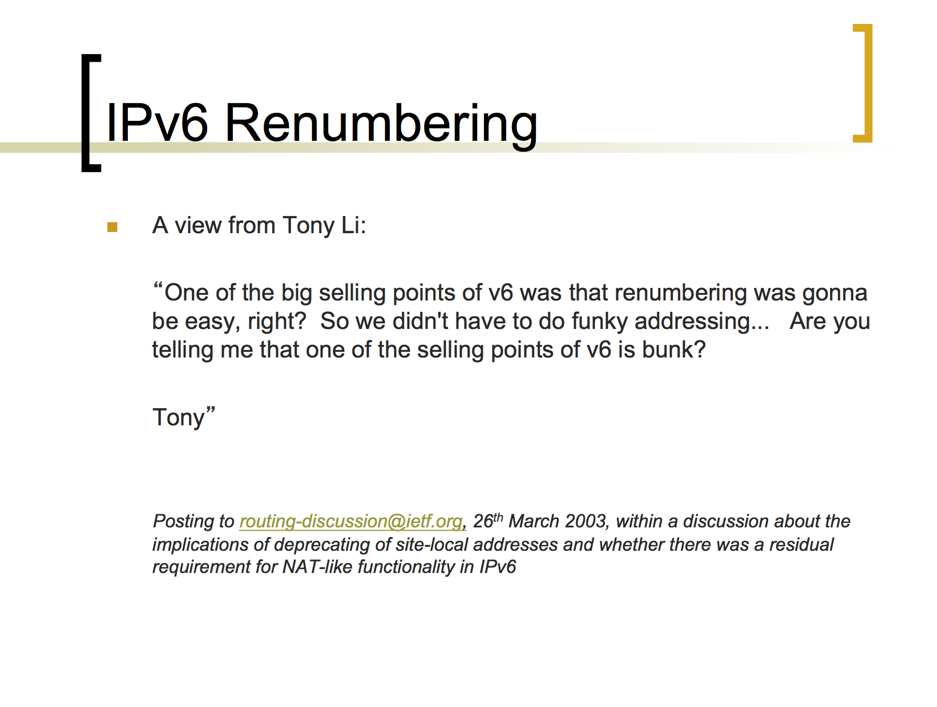
2003: On IPv6 Myths
The “anti-hype” message – IPv6 is not brighter, shiner, or more miraculous. It just has more addresses!

Slide 15
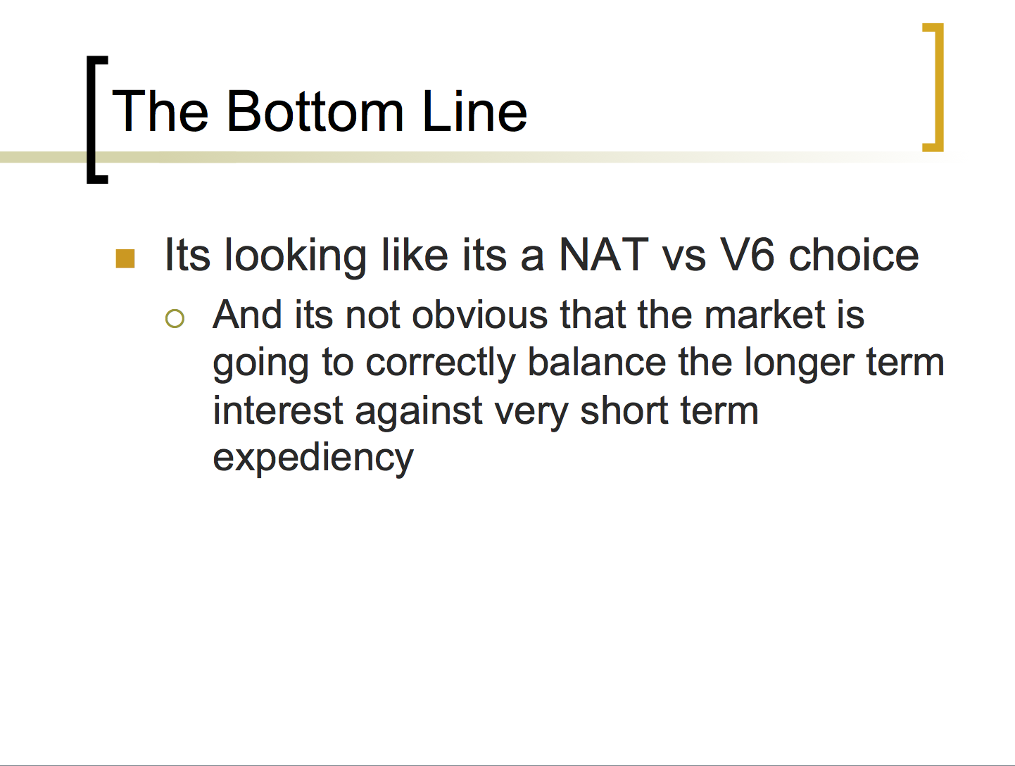
2003: Wavering in the ranks!
I’m having moments of doubt and uncertainty!

Slide 16
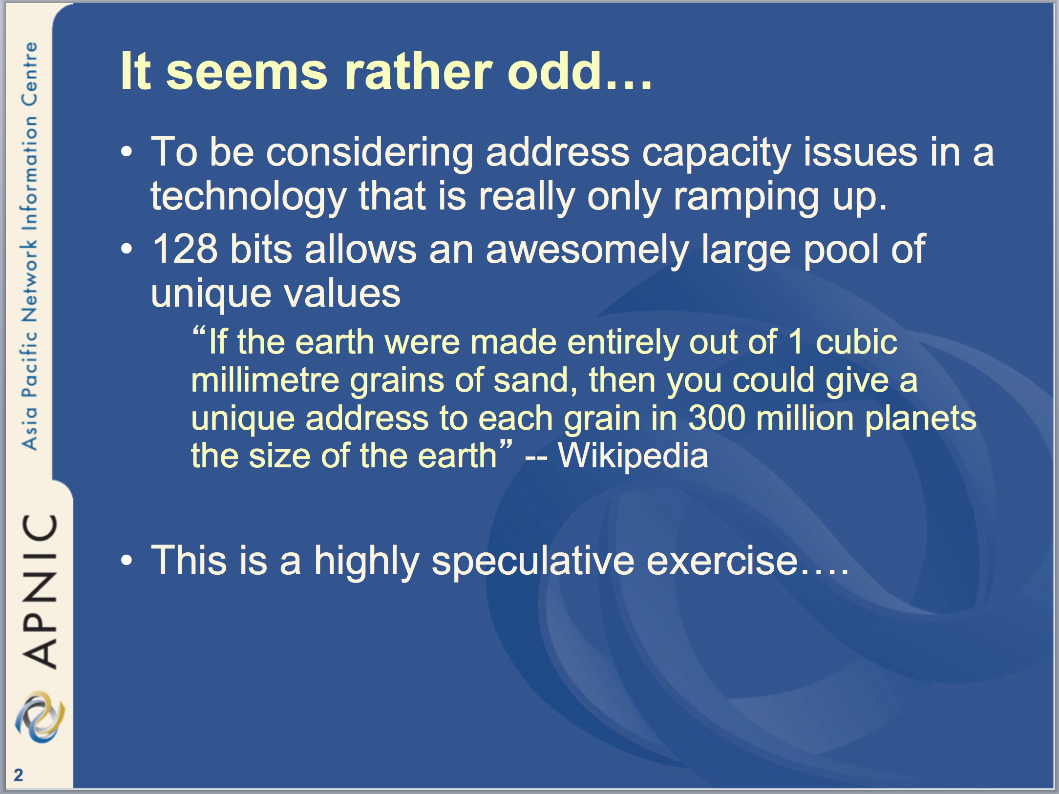
2004: IPv6 Address Policies Revisited
Contemplating changing the HD Ratio and the 48 bit end site prefix.
“But you can’t do that! The installed base of IPv6 is too big to change!”

Slide 17

2005:

Slide 18
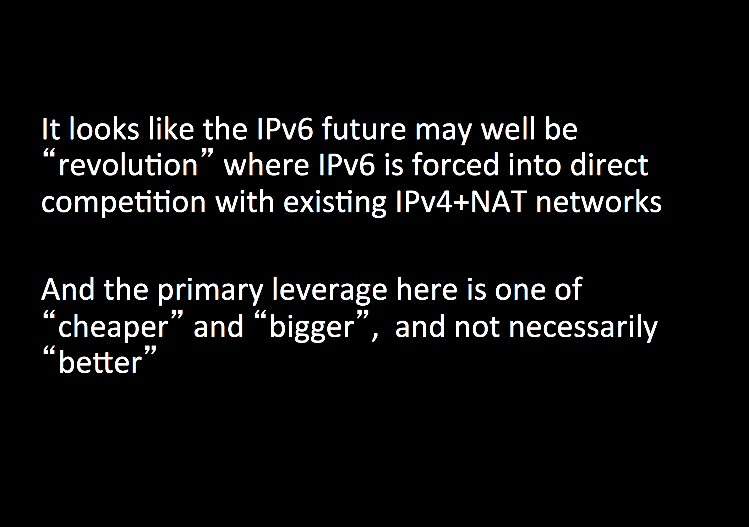
2005: defining terms of engagement
The realization that IPv6 won’t just happen – there are other factors at play here.

Slide 19
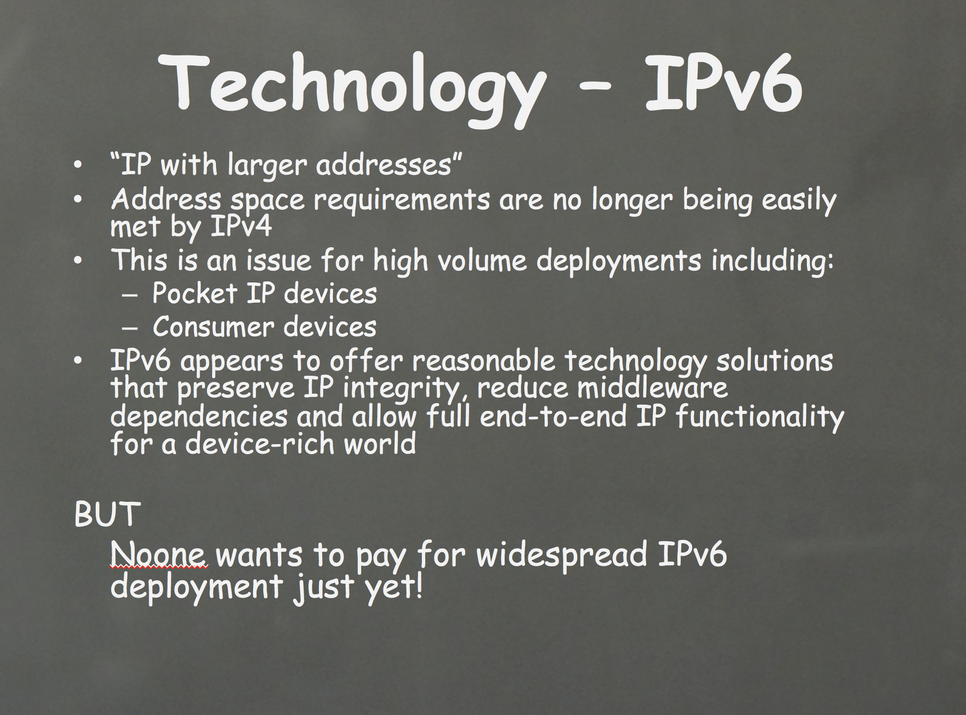
2006:
Searching for drivers for IPv6 adoption

Slide 20
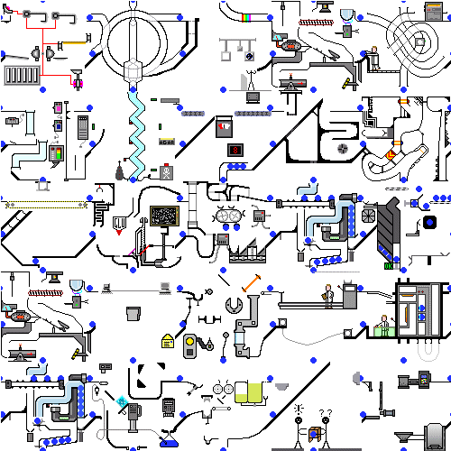

Slide 21
I could watch that for hours!

Slide 22
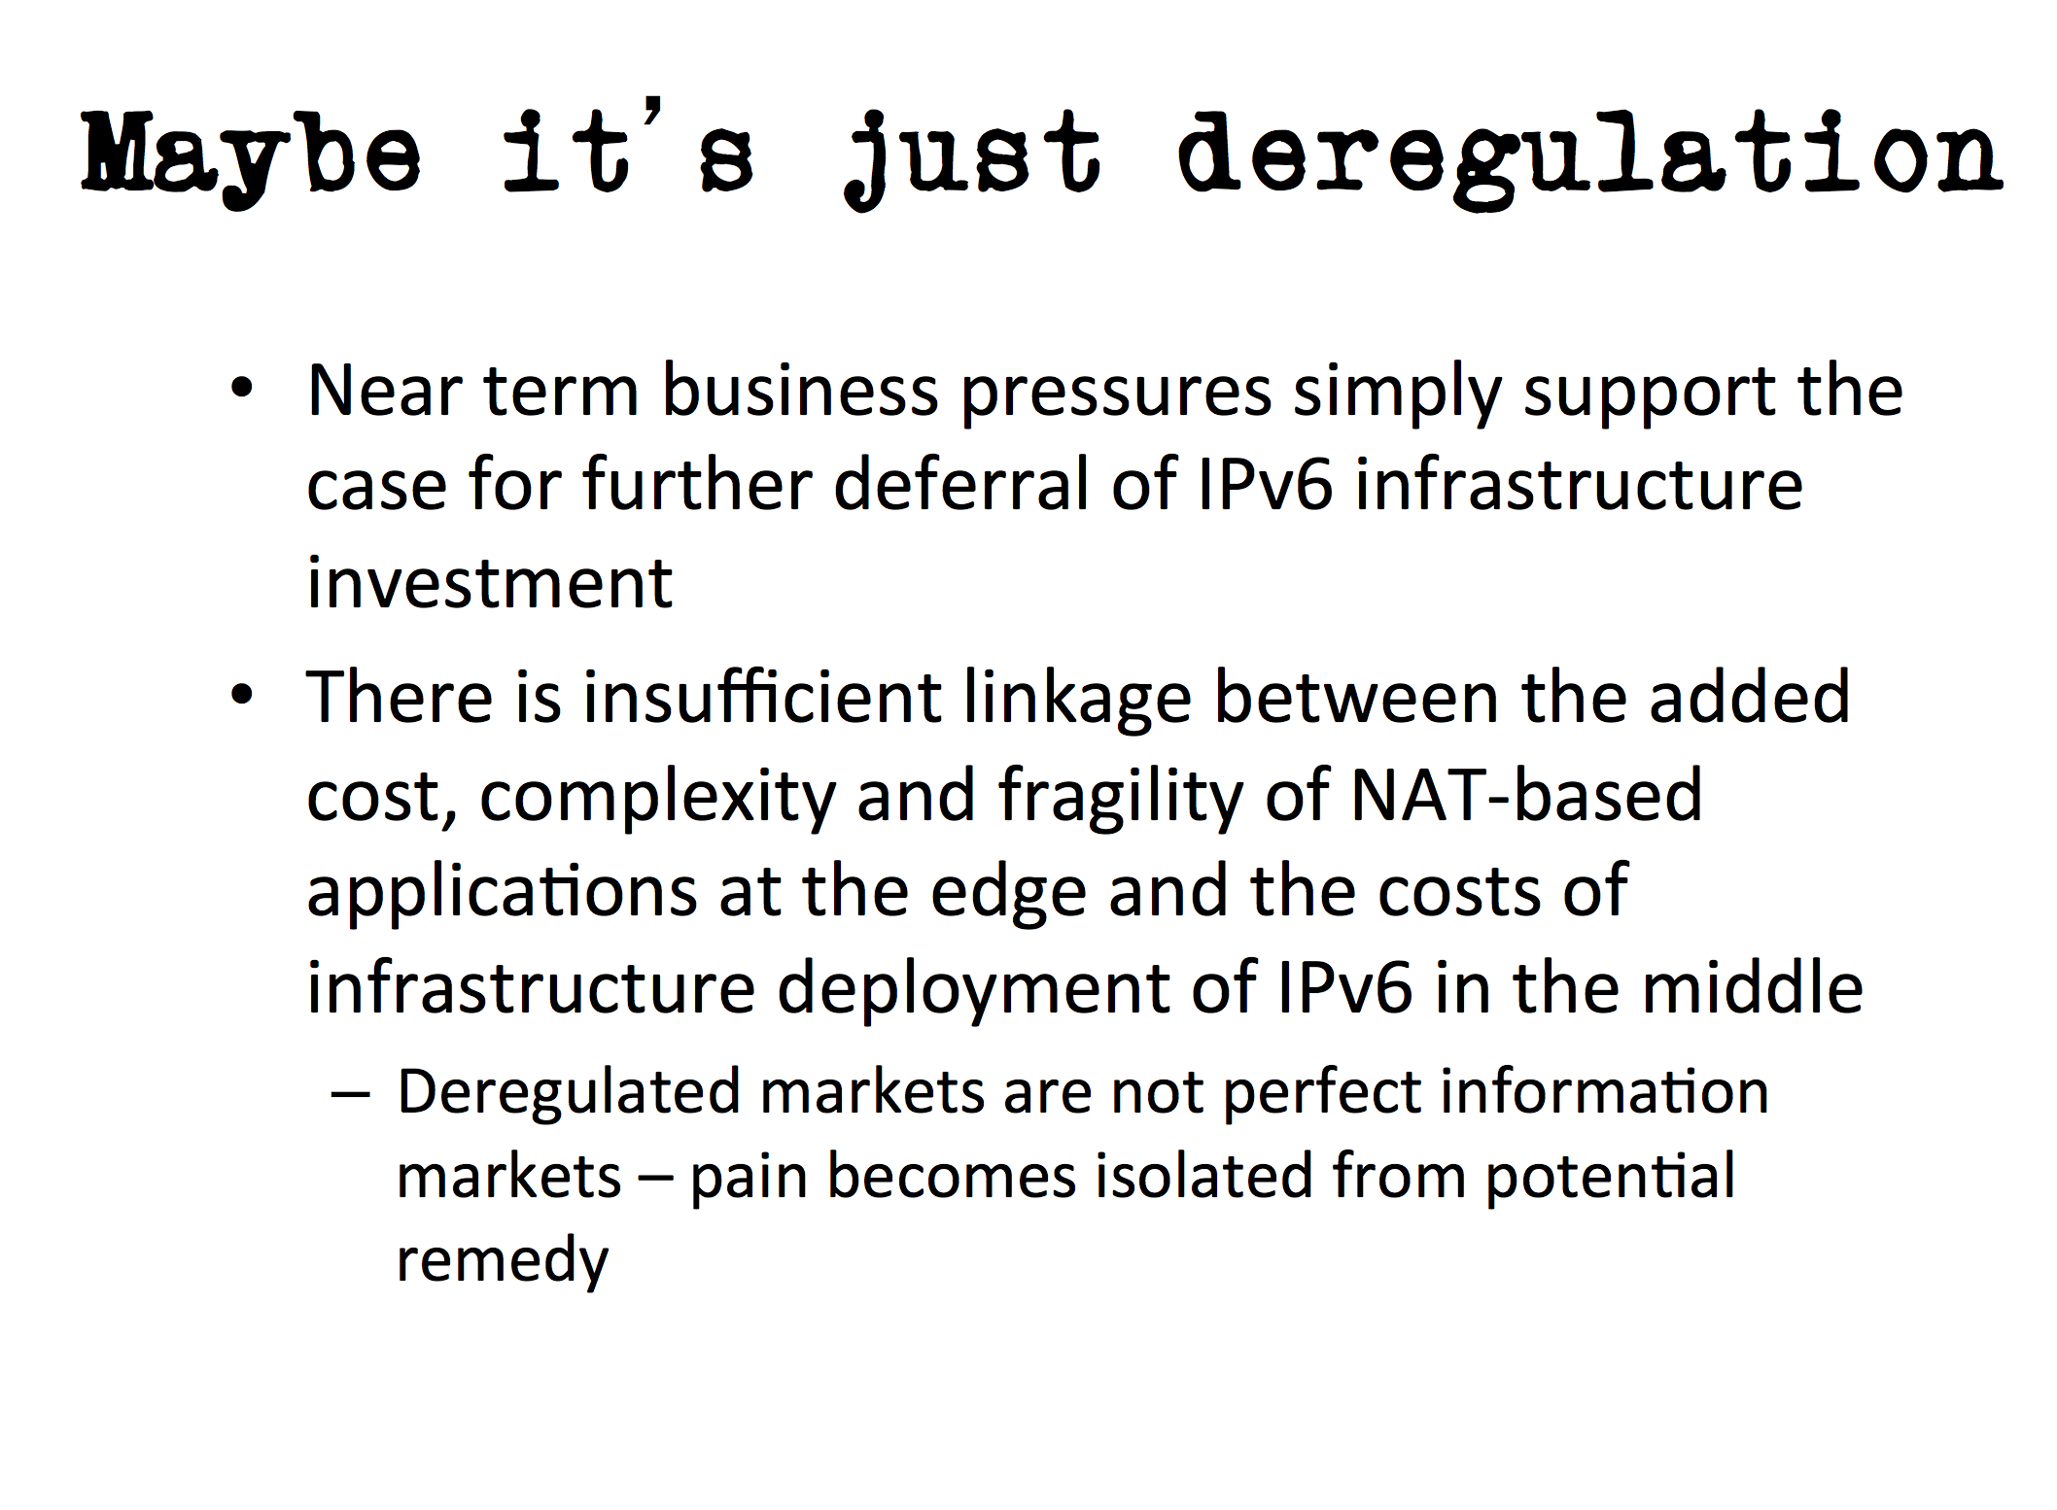
2007:
It’s not just a technology issue – there are business drivers here as well

Slide 23

2008:
New Markets for IPv6?
The Universe of Tiny Things?
  The world of billions of chattering devices unleashing new rivers of gold into the IP industry?
    Or is this just the economy? There is no new money and these billions of chattering devices will generate much the same revenue as we have today
      So we have to cram all these billions of new devices trillions of new packets into the same money that we have today.
        technology leverage will make tomorrow’s networks 1,000 times CHEAPER to deliver an IP packet than today’s network?
Or have we reached some limit to the economic viability of communications that imply that ever smaller valued transactions can’t be sustained over ever larger networks?
Do RFID and Bluetooth provide a different model of communication that is viable in the universe of things, where the identity is global but the communication is strictly limited in scope and
And if you ever are curious enough to enlarge this slide to see if there is text all the way down the page you will have got yourself to this point, where it becomes obvious that I’ve got nothing more to say and I want to fill up the bottom of the slide with tiny text.

Slide 24
2008
This is the time of the “IPv4 exhaustion is coming. What are we going to do?”
presentations.
Lets dive into one of them for a few slides from 2008…

Slide 25
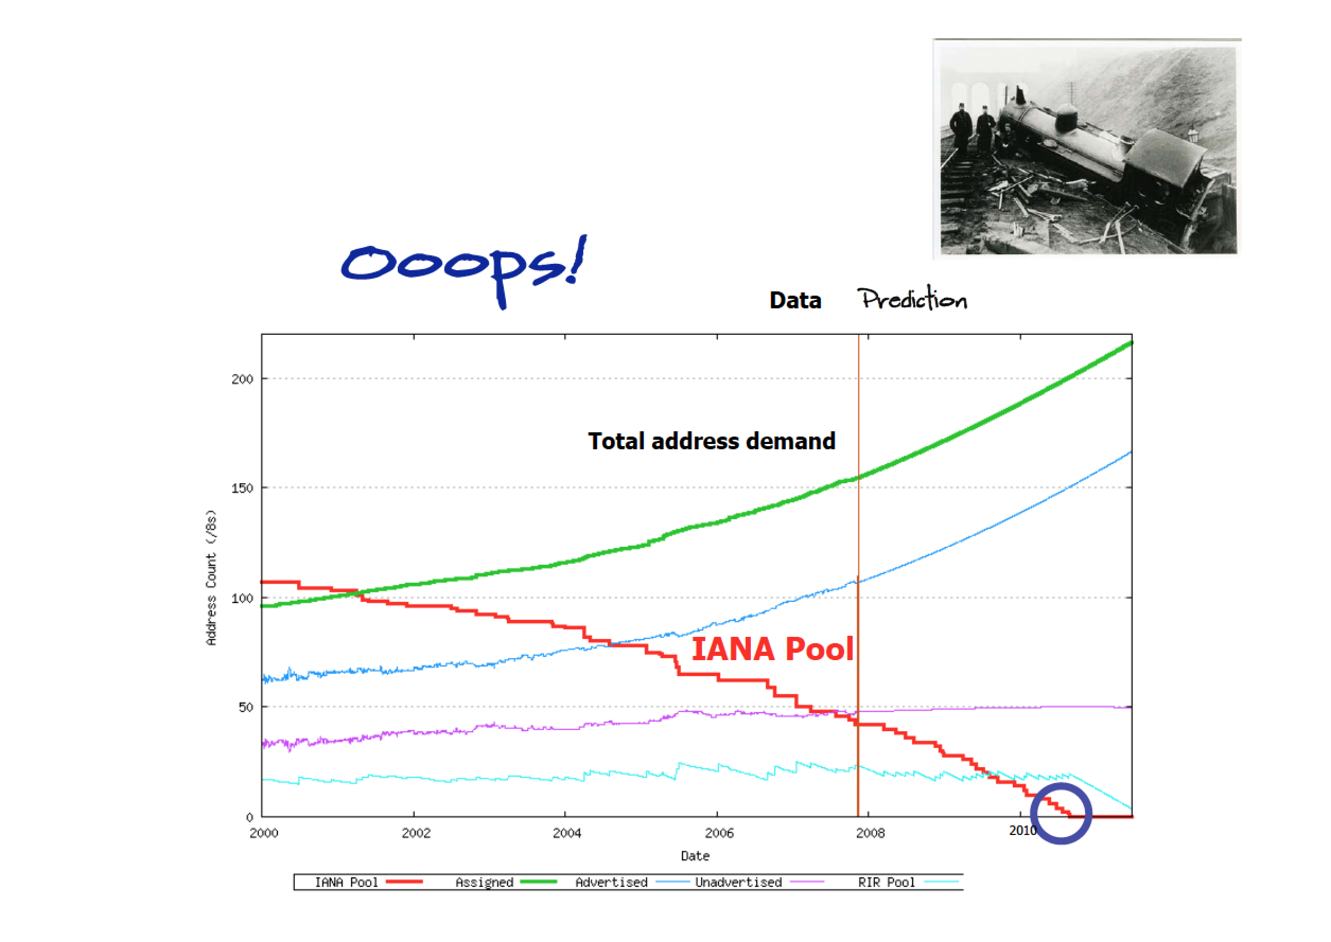

Slide 26


Slide 27


Slide 28
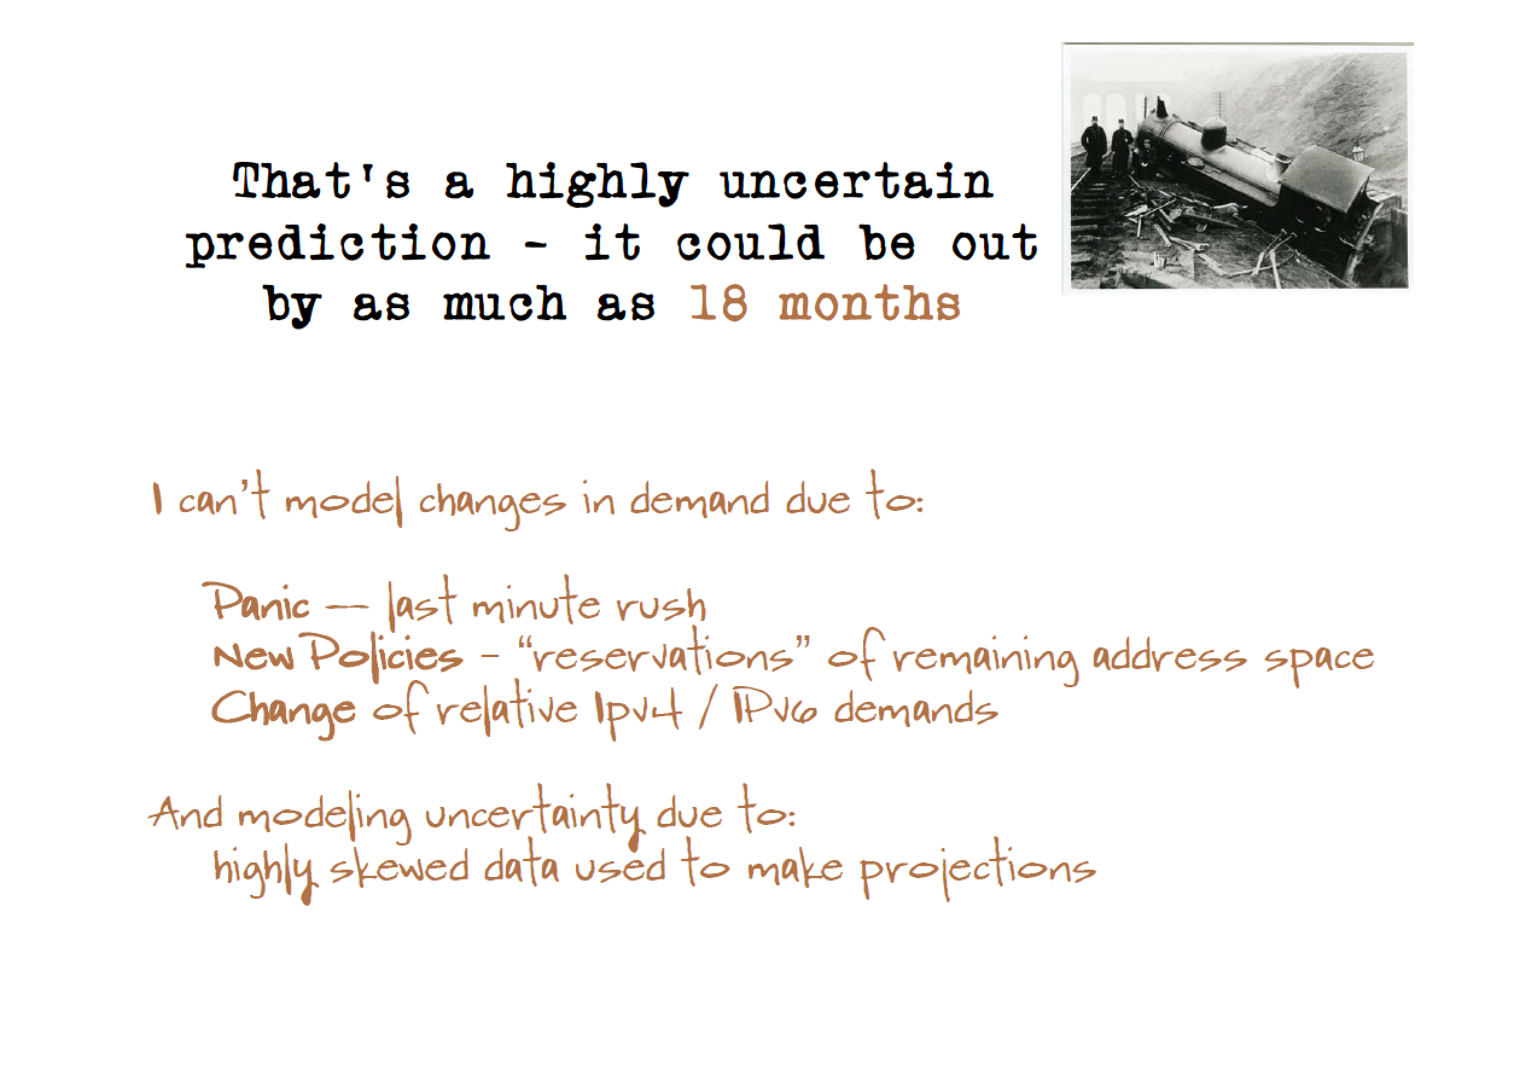

Slide 29
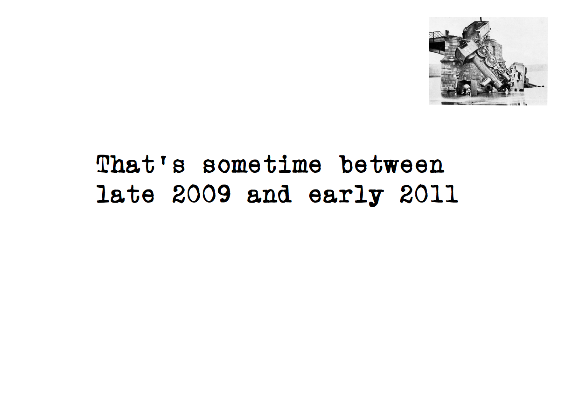

Slide 30


Slide 31


Slide 32


Slide 33
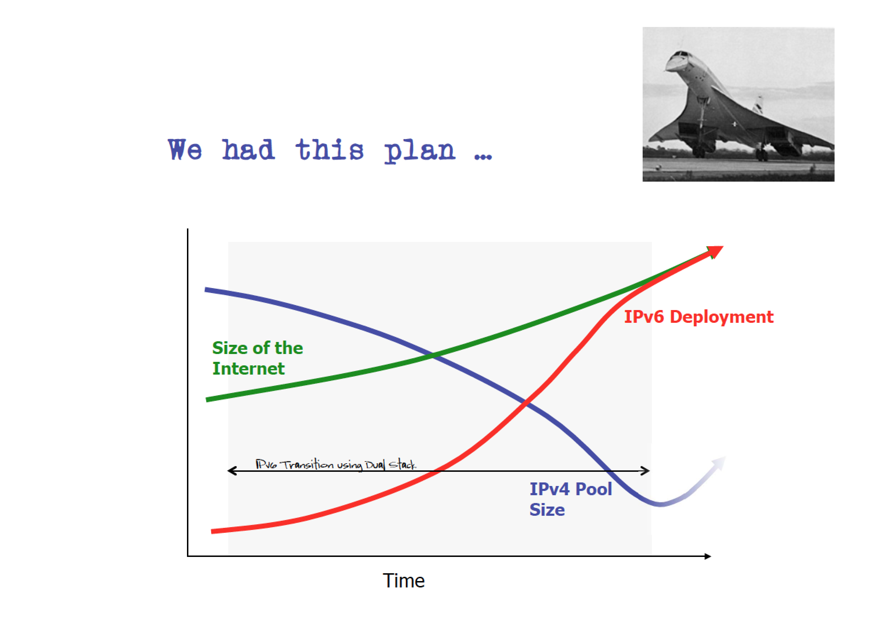

Slide 34
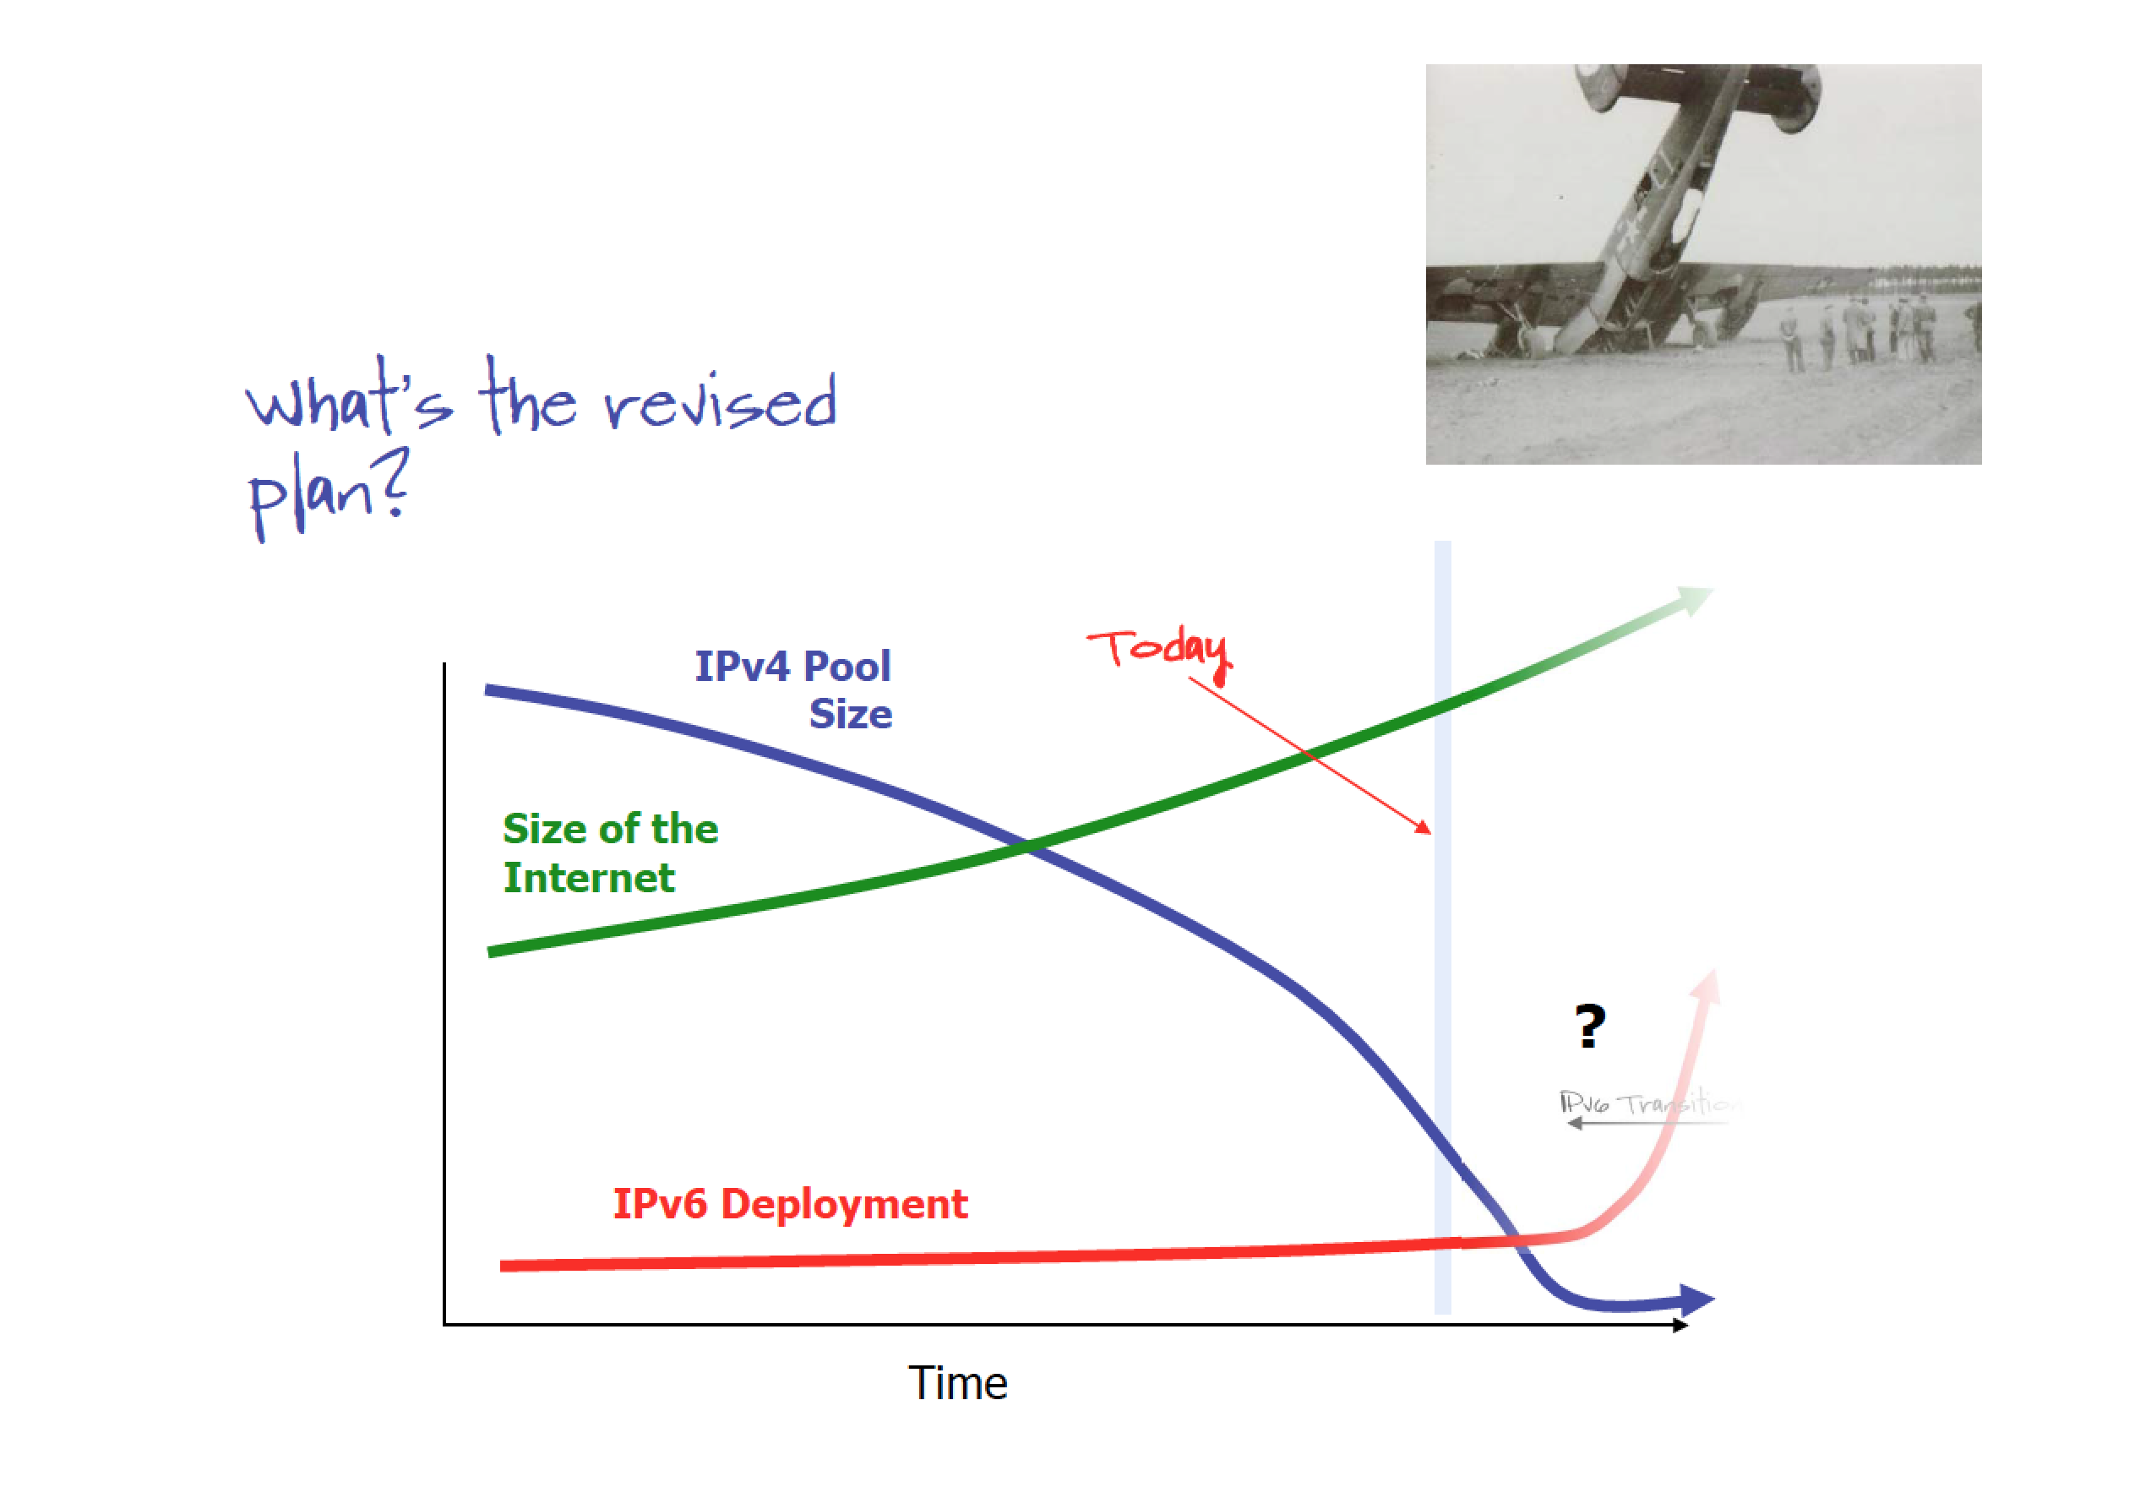

Slide 35
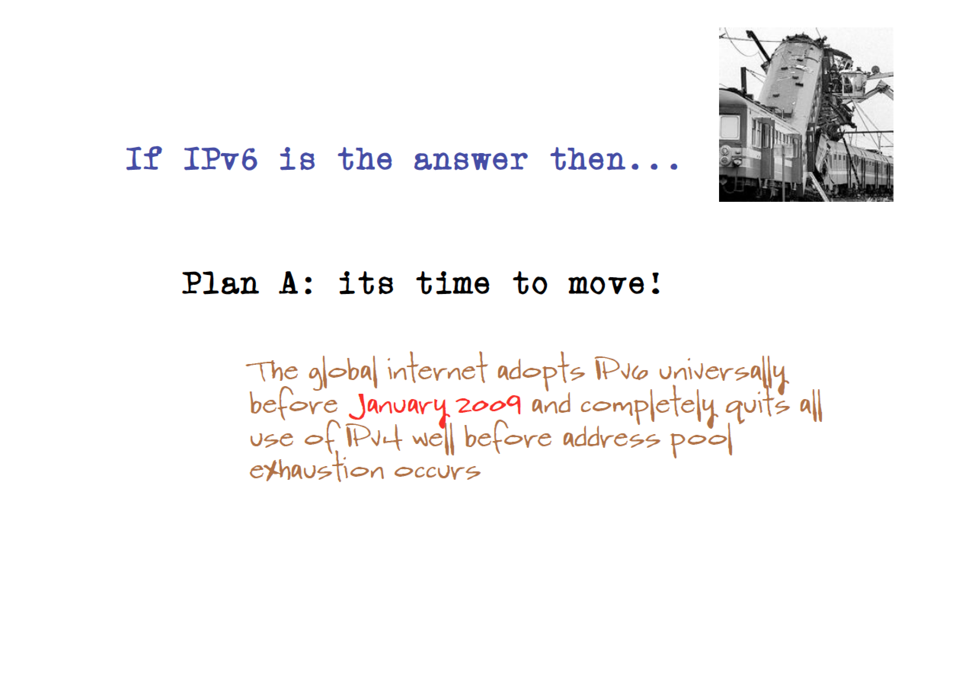

Slide 36


Slide 37


Slide 38


Slide 39


Slide 40
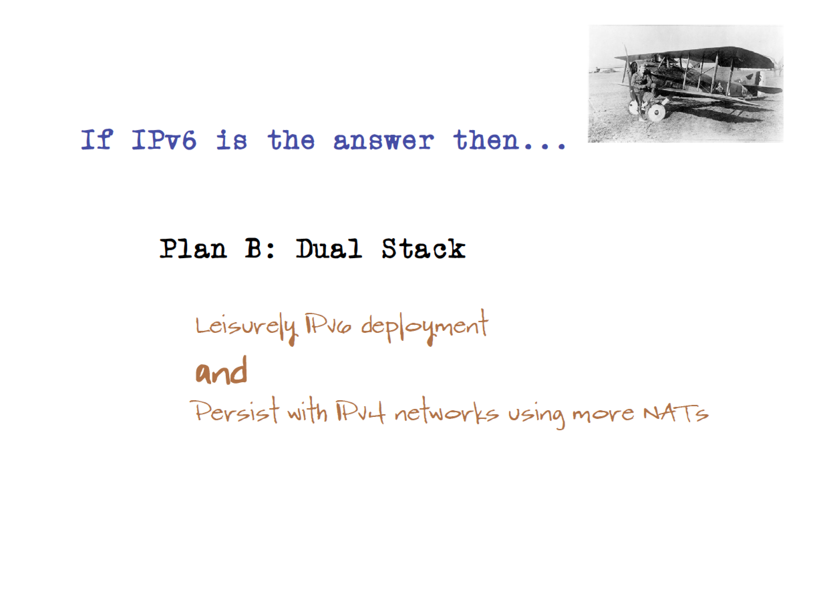

Slide 41
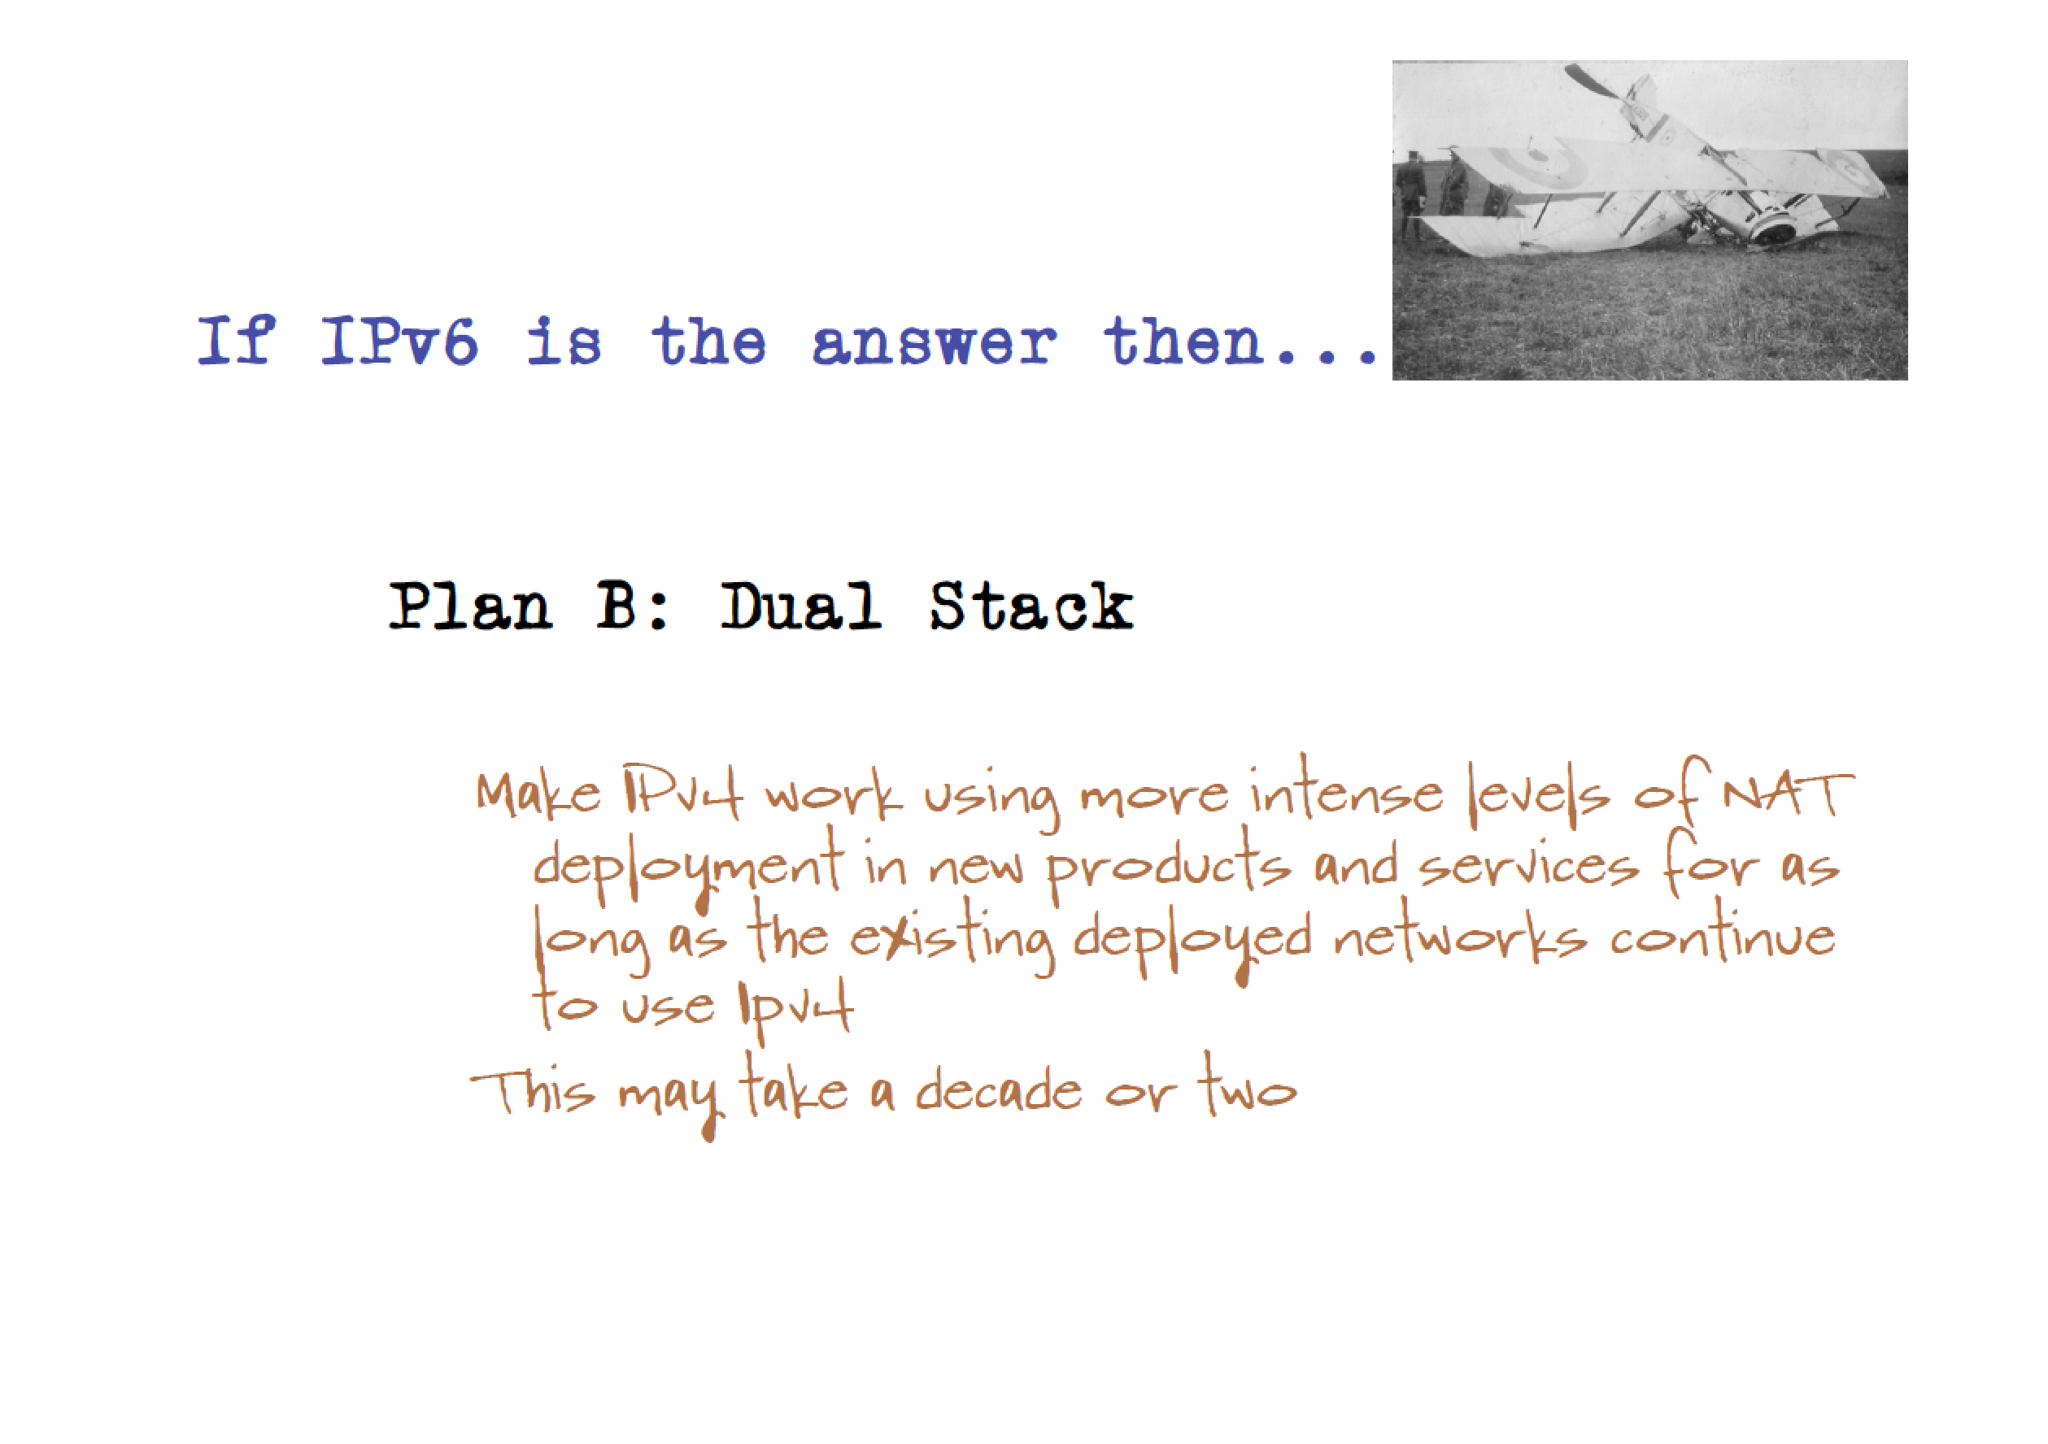

Slide 42


Slide 43


Slide 45
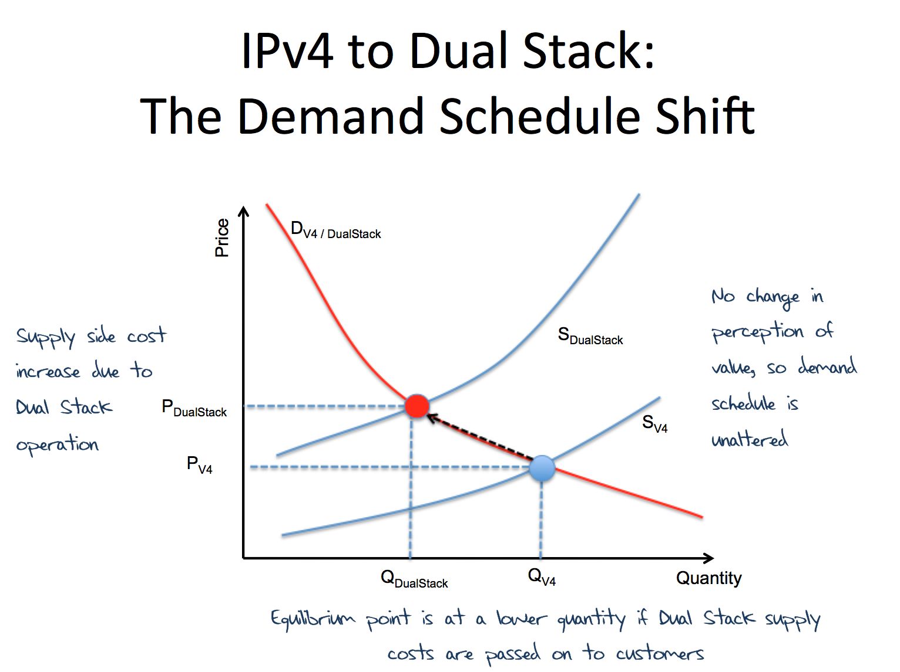
2010 – invoking economics!

Slide 46
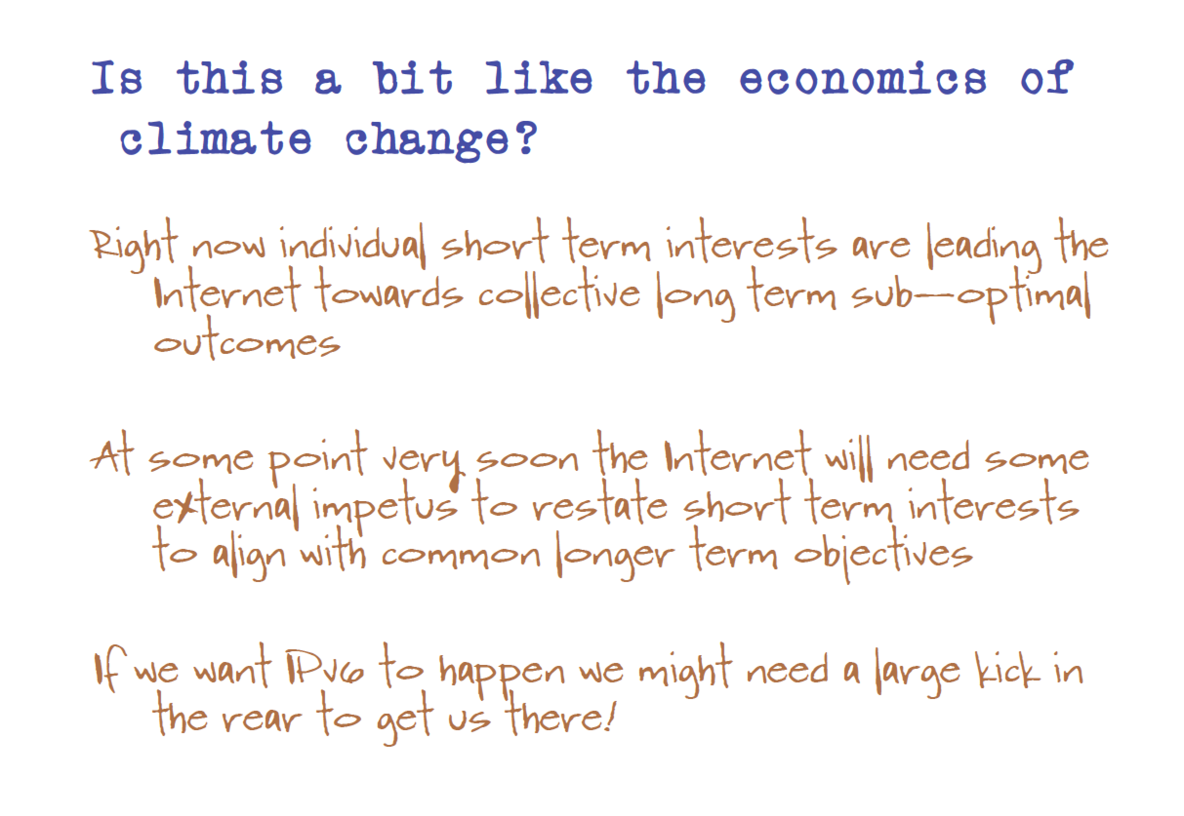
2010 – invoking economics!

Slide 47
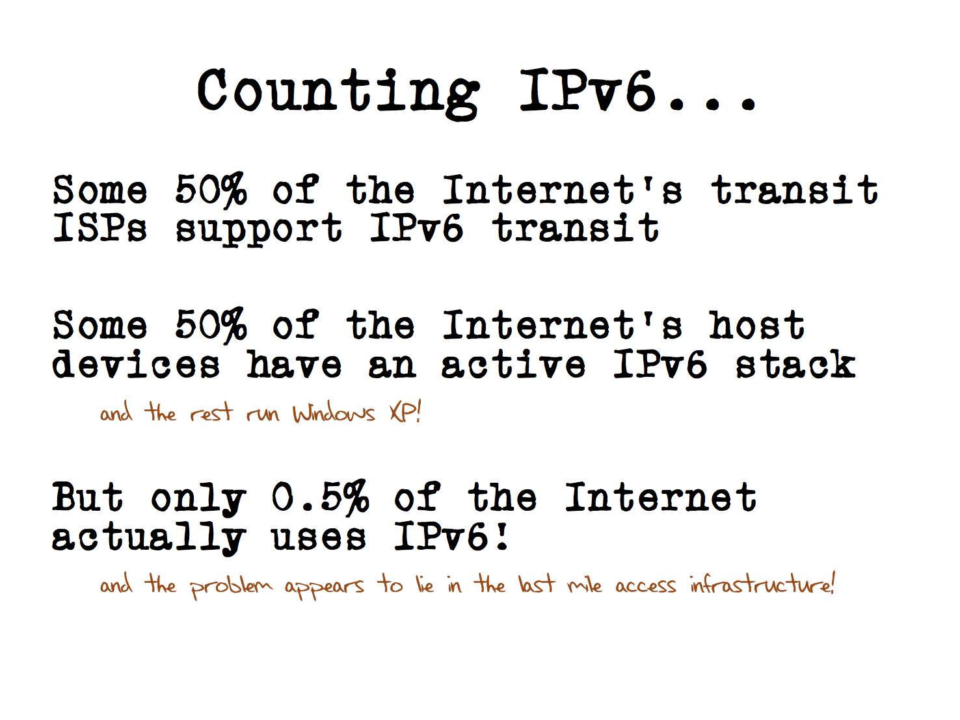
2012: measurement

Slide 48
Which brings us to…

Slide 49

6 June 2012
Was it only a year ago?

Slide 50
World IPv6 Launch
“This time it’s forever”
Urging service providers to turn on IPv6, and leave it on.
Reach out to network, access and content providers to start moving in public on IPv6 services

Slide 51
Some Questions one year later…
Did it work?
What has changed in the past 12 months?
Who is deploying IPv6?
Where are they?

Slide 52
APNIC’s IPv6 Measurements
The Internet is all about end-to-end services
We want to also perform end-to-end measurements
But how can we measure the IPv6 capability of millions of end users?
And do so day by day?

Slide 53

Measuring Millions?
Option A - Be Google!

Slide 54
Measuring Millions
Option B - Use Google!
Use their online ad network as a vehicle for embedded measurement tests

Slide 55
Embedded on the ad are 3 tests
V4 only URL
  Control comparison (Reliability, RTT)
Dual Stack URL
  Which protocol will the client PREFER to use?
V6 only URL
  Is the client CAPABLE of using IPv6?

Slide 56
And this is what we saw
When we asked 300,000 new end users every day about their IPv6 capability we saw this…

Slide 57
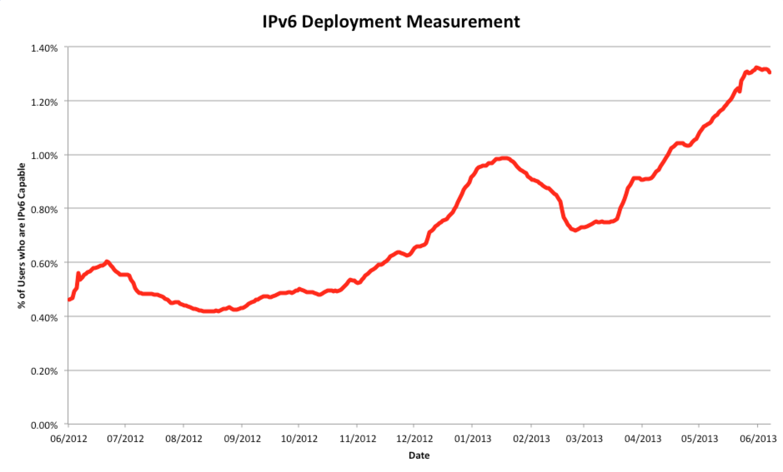
IPv6, Globally
June 2012
0.45%
June 2013
1.29%

Slide 58
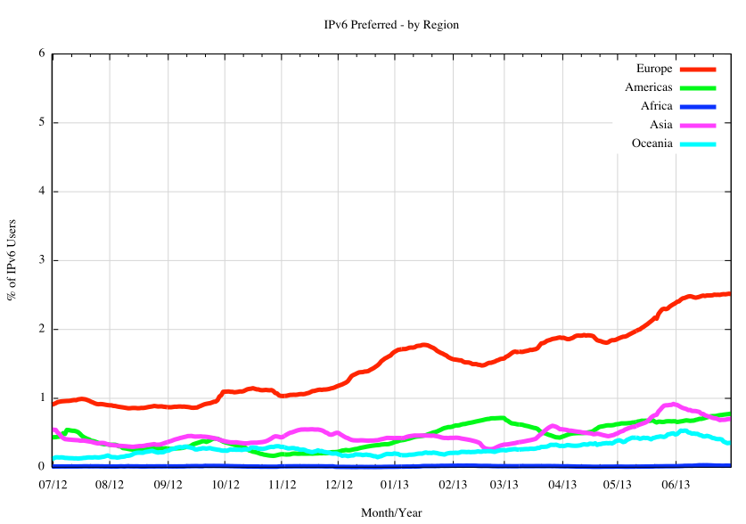
IPv6, Regionally
In relative terms, Europe has been the most active region in 2012/2013

Slide 59
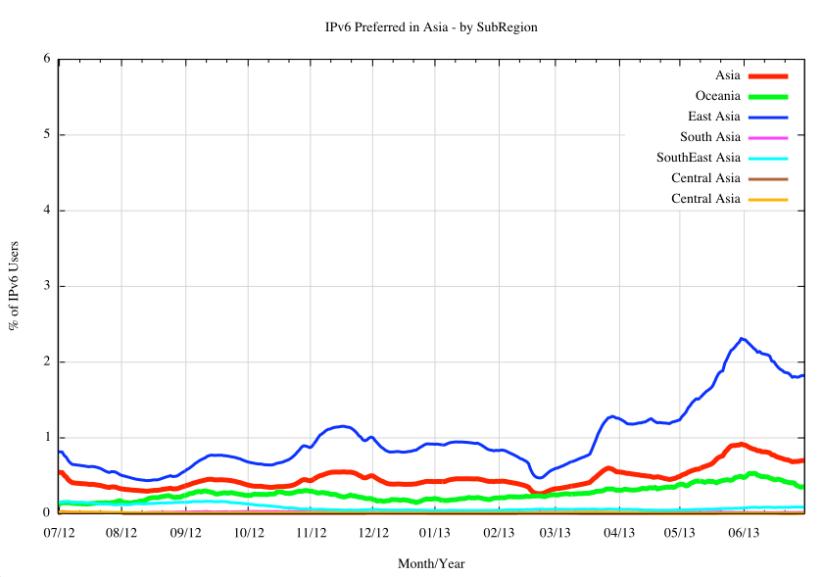
IPv6 in the AP Region
In Asia Pacific the last 12 months of Ipv6 is all about East Asian Economies

Slide 60
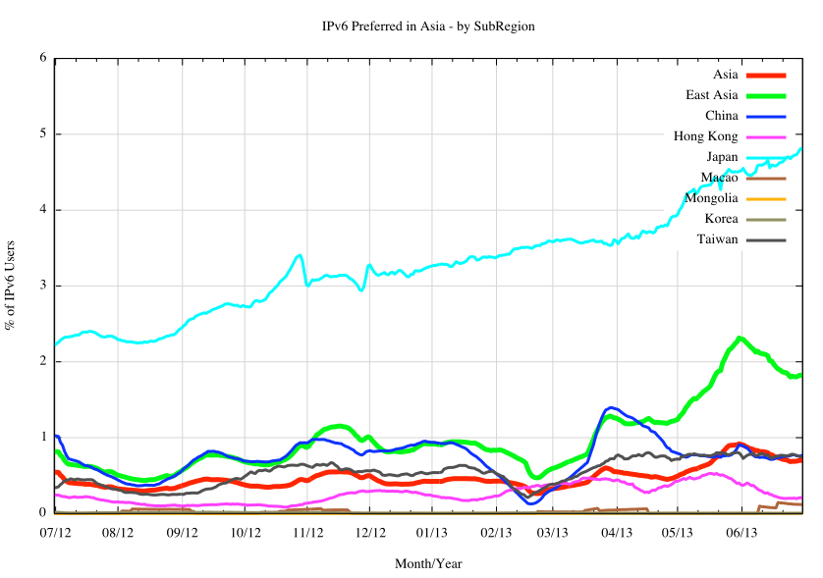
IPv6 in East Asia
Japan
Hong Kong
China
Taiwan

Slide 61
Globally Speaking
IPv6 did not happen everywhere and all at once in 2012 / 2013
Some economies have been very active in terms of IPv6 deployment
So lets look at this on a country-by-country basis…

Slide 62
Where is IPv6?
The National Top 20 – Then and Now
2012
Rank Economy % of Internet Users
# of IPv6 Users (est)
1 Romania 7.40% 641,389
2 France 4.03% 2,013,920
3 Luxembourg 2.59% 12,049
4 Japan 1.75% 1,766,799
5 Slovenia 1.07% 15,175
6 United States 1.01% 2,500,684
7 China 1.01% 5,209,030
8 Croatia 0.85% 22,551
9 Switzerland 0.80% 51,575
10 Lithuania 0.66% 13,845
11 Czech Republic 0.55% 39,694
12 Norway 0.51% 23,333
13 Slovakia 0.44% 19,112
14 Russian Fed. 0.39% 238,576
15 Germany 0.32% 217,494
16 Hungary 0.31% 19,896
17 Portugal 0.30% 16,406
18 Netherlands 0.27% 40,870
19 Australia 0.25% 49,425
20 Taiwan 0.24% 38,843
2013
Rank Economy % of Internet Users
# of IPv6 Users (est)
1 Romania 10.84% 1,053,237
2 Switzerland 10.72% 700,777
3 Luxembourg 6.96% 32,535
4 France 5.46% 2,824,465
5 Belgium 4.17% 339,651
6 Japan 4.13% 4,137,476
7 Germany 3.24% 2,212,062
8 United States 2.72% 6,768,264
9 Peru 2.42% 273,370
10 Czech Republic 2.12% 157,203
11 Singapore 1.58% 54,060
12 Norway 1.21% 53,677
13 Slovenia 0.92% 13,230
14 China 0.90% 4,651,953
15 Greece 0.78% 44,572
16 Portugal 0.76% 45,408
17 Taiwan 0.72% 120,180
18 Netherlands 0.70% 109,425
19 Australia 0.69% 121,256
20 Slovakia 0.52% 21,169

Slide 63
Where is IPv6?
The National Top 20 – Then and Now
2012
Rank Economy % of Internet Users
# of IPv6 Users (est)
1 Romania 7.40% 641,389
2 France 4.03% 2,013,920
3 Luxembourg 2.59% 12,049
4 Japan 1.75% 1,766,799
5 Slovenia 1.07% 15,175
6 United States 1.01% 2,500,684
7 China 1.01% 5,209,030
8 Croatia 0.85% 22,551
9 Switzerland 0.80% 51,575
10 Lithuania 0.66% 13,845
11 Czech Republic 0.55% 39,694
12 Norway 0.51% 23,333
13 Slovakia 0.44% 19,112
14 Russian Fed. 0.39% 238,576
15 Germany 0.32% 217,494
16 Hungary 0.31% 19,896
17 Portugal 0.30% 16,406
18 Netherlands 0.27% 40,870
19 Australia 0.25% 49,425
20 Taiwan 0.24% 38,843
2013
Rank Economy % of Internet Users
# of IPv6 Users (est)
1 Romania 10.84% 1,053,237
2 Switzerland 10.72% 700,777
3 Luxembourg 6.96% 32,535
4 France 5.46% 2,824,465
5 Belgium 4.17% 339,651
6 Japan 4.13% 4,137,476
7 Germany 3.24% 2,212,062
8 United States 2.72% 6,768,264
9 Peru 2.42% 273,370
10 Czech Republic 2.12% 157,203
11 Singapore 1.58% 54,060
12 Norway 1.21% 53,677
13 Slovenia 0.92% 13,230
14 China 0.90% 4,651,953
15 Greece 0.78% 44,572
16 Portugal 0.76% 45,408
17 Taiwan 0.72% 120,180
18 Netherlands 0.70% 109,425
19 Australia 0.69% 121,256
20 Slovakia 0.52% 21,169

Slide 64
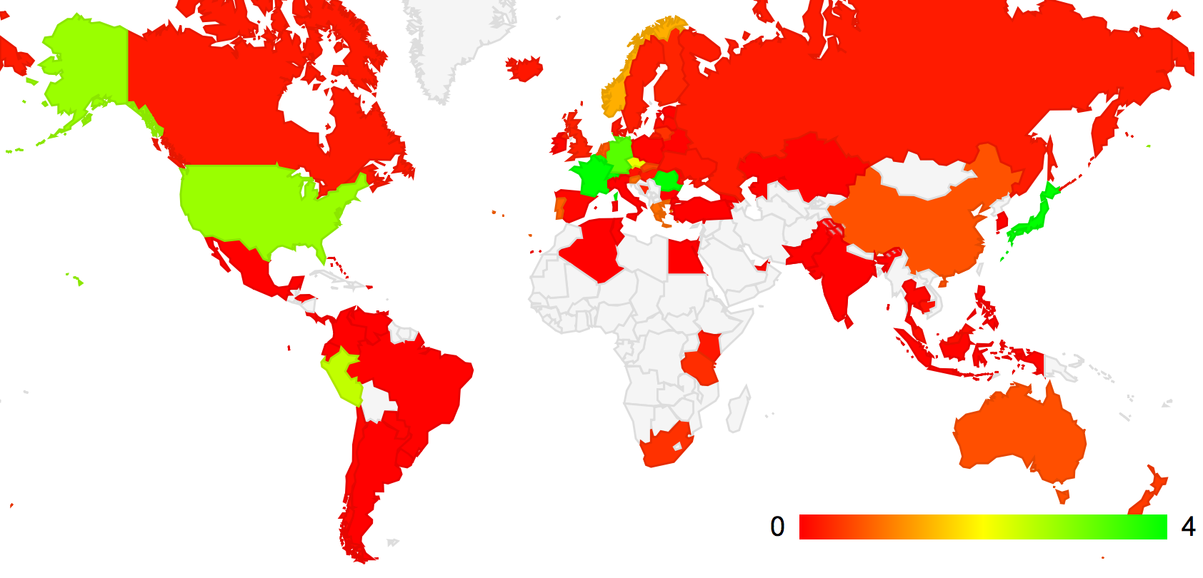
The IPv6 world, Geographically Speaking…

Slide 65
Nationally, who’s deploying IPv6 over the past year?
2013
Rank Economy Diff (%) Diff IPv6 User Count
1 Switzerland +9.92% + 649,202
2 Luxembourg +4.37% + 20,486
3 Belgium +4.07% + 331,153
4 Romania +3.44% + 411,848
5 Germany +2.92% +1,994,568
6 Peru +2.41% + 272,327
7 Japan +2.38% +2,370,677
8 United States +1.71% +4,267,580
9 Czech Republic +1.57% + 117,509
10 Singapore +1.43% + 48,524
11 France +1.43% + 810,545
12 Greece +0.70% + 40,530
13 Norway +0.70% + 30,344
14 Taiwan +0.48% + 81,337
15 Portugal +0.46% + 29,002
16 Australia +0.44% + 71,831
17 Netherlands +0.43% + 68,555
18 New Zealand +0.35% + 13,174
19 South Africa +0.33% + 34,022
20 Bosnia and Herz. +0.32% + 8,914

Slide 66
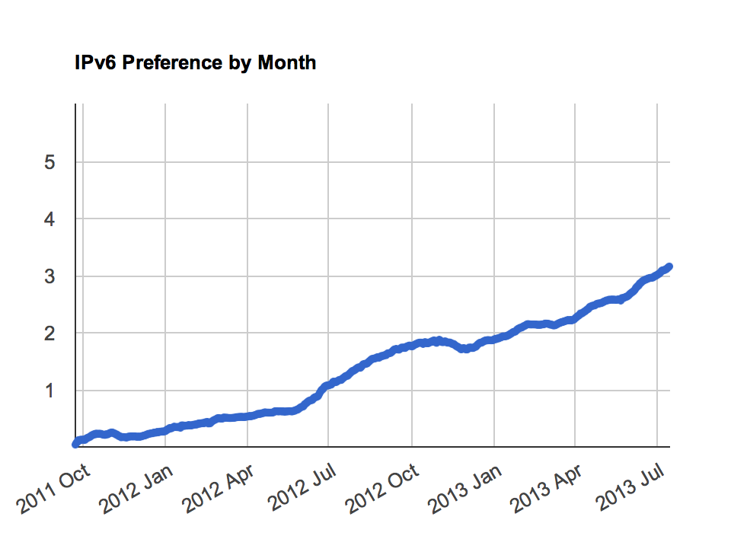
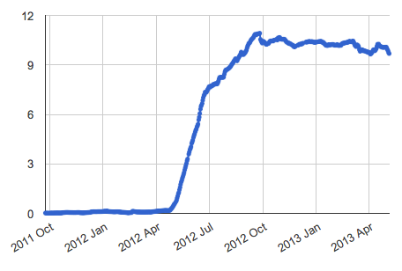
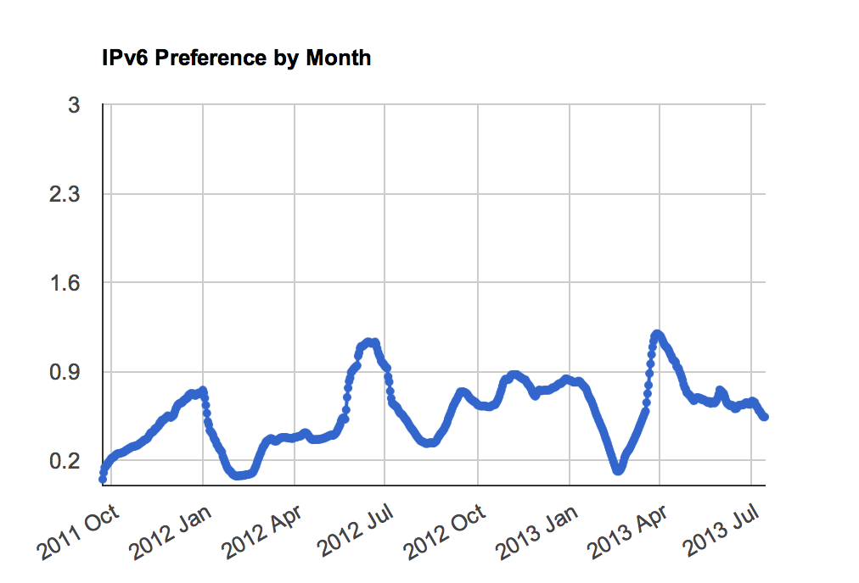
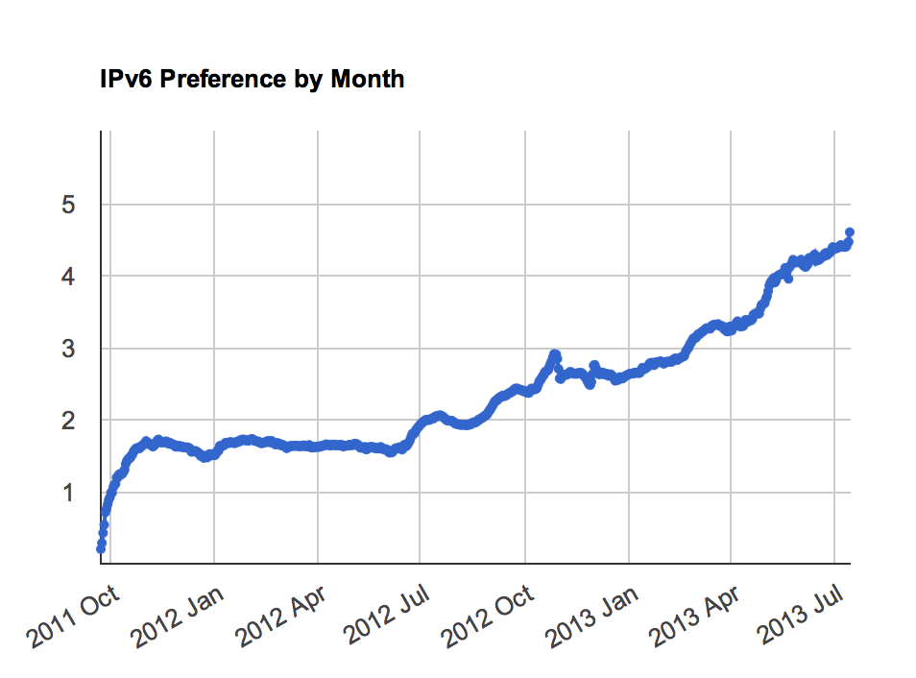
And Some Countries…
Romania
United States
China
Japan

Slide 67
Drilling down to the AS level…
Economy AS Number AS Name 2012 IPv6 (%) 2013 IPv6 (%)
United States of America
AS6939 Hurricane Electric 29% 37%
AS22394 Cellco Partnership DBA Verizon Wireless
6% 20%
AS7018 AT&T Services 6% 15%
AS3561 Savvis 1% 5%
AS7922 Comcast 1% 3%
Japan
AS2516 KDDI 16% 27%
AS18126 Chubu Telecomm 0% 23%
AS17676 Softbank 1% 4%
Germany
AS3320 Deutsche Telekom AG 0% 5%
AS31334 Kabel Deutschland 1% 7%
AS29562 Kabel BW GmbH 0% 10%
France
AS12322 Free SAS 19% 22%
Switzerland
AS67722 Swisscomm 0% 23%
AS559 Switch 11% 18%
Romania
AS8708 RCS & RDS SA 11% 24%
Belgium
AS12392 Brutele SC 0% 33%
AS2611 BELNET 2% 22%
Peru
AS6147 Telefonica del Peru SA 0% 3%
Czech Republic
AS2852 CESNET z.s.p.o. 20% 27%
AS5610 Telefonica Czech 0% 3%
AS51154 Internethome; s.r.o. 0% 2%
Economy AS Number AS Name 2012 IPv6 (%) 2013 IPv6 (%)
United Kingdom
AS786 JANET 51% 68%
AS13213 UK2 Ltd 0% 23%
Taiwan
AS9264 Academic Sinica 0% 21%
AS1659 Taiwan Academic 2% 8%
Australia
AS7575 AARNet 13% 21%
AS4739 Internode 5% 11%
Netherlands
AS3265 XS4ALL Internet 6% 27%
Singapore
AS7472 Starhub Internet 0% 13%
AS4773 MobileOne Ltd. 0% 10%
Greece
AS5408 Greek R&D 17% 19%
South Africa
AS2018 TENET 0% 3%
Canada
AS6453 TATA Comms. 10% 13%
AS22995 Xplornet Comms 0% 9%
Norway
AS224 Uninett 16% 24%
AS39832 Opera Software 1% 100%
AS57963 Lynet Internett 0% 56%
Portugal
AS3243 PT Comunicacoes 0% 1%
Luxembourg
AS6661 Postes et Telecom 4% 14%

Slide 68
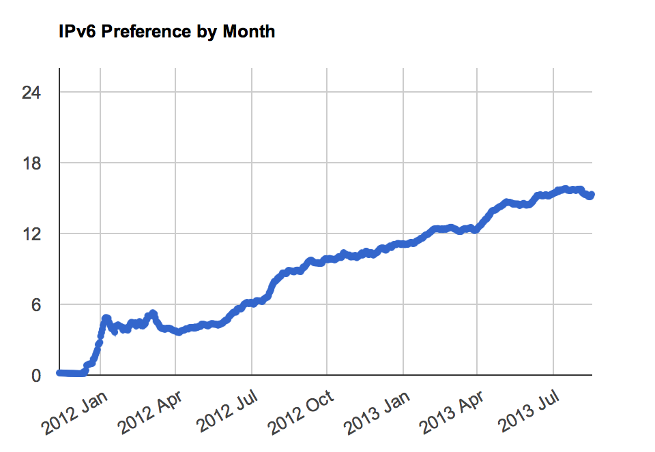
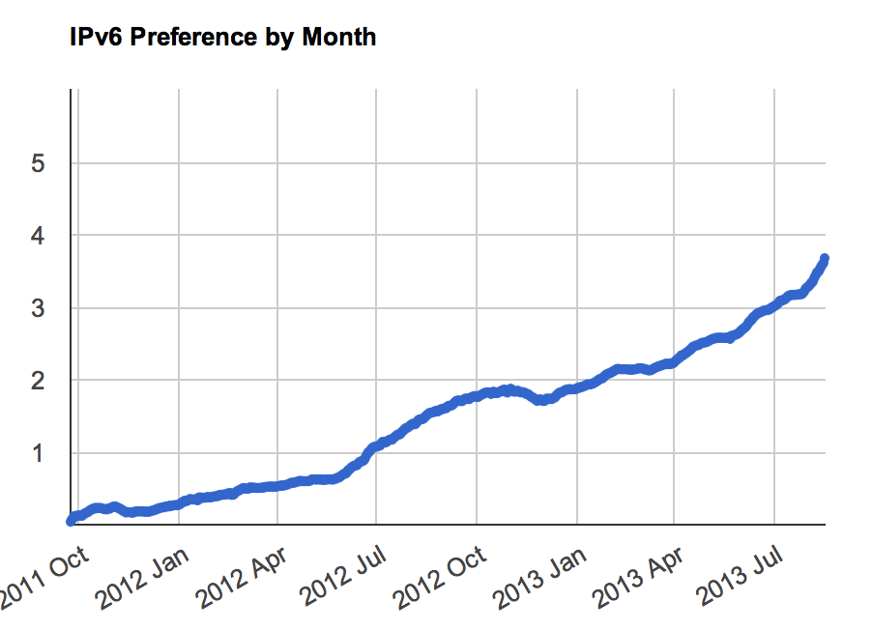
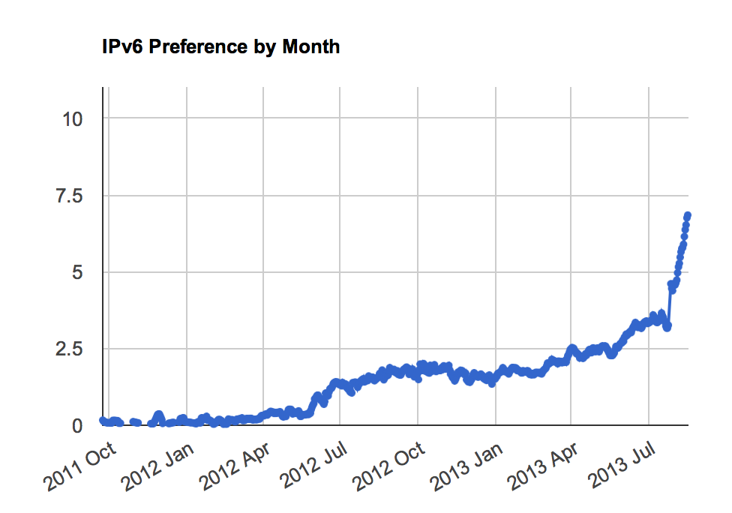
Moving on…
The pace of deployment continues in some countries
AT&T Internet Services (AS7018)
United States
Comcast (AS7922)

Slide 69
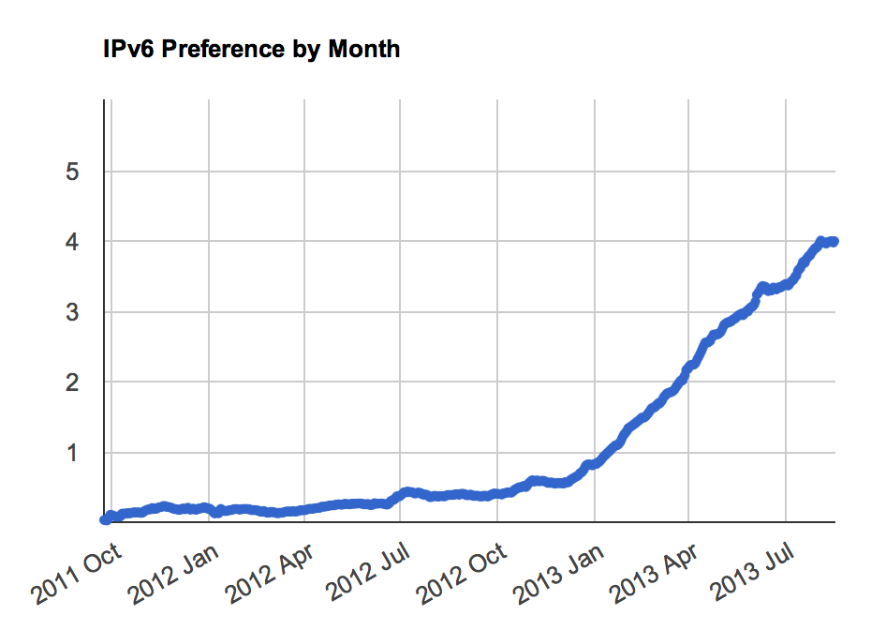
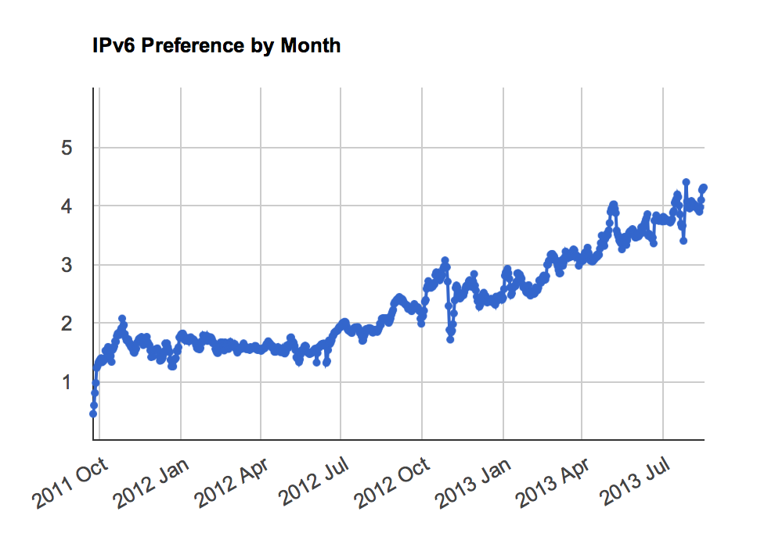
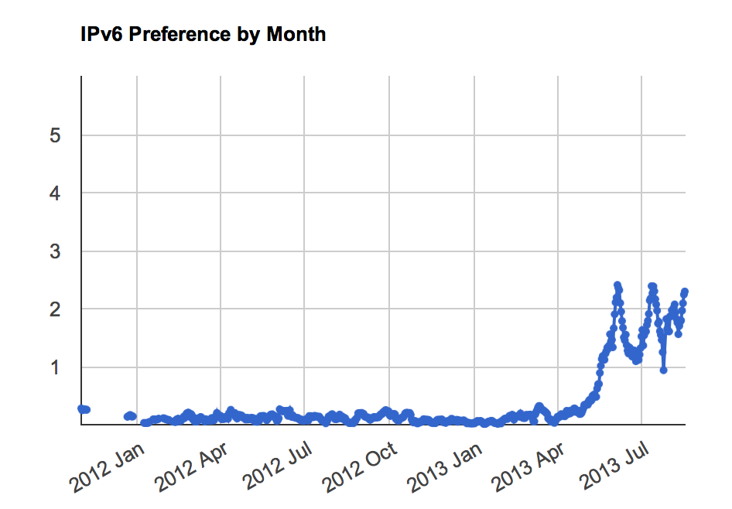
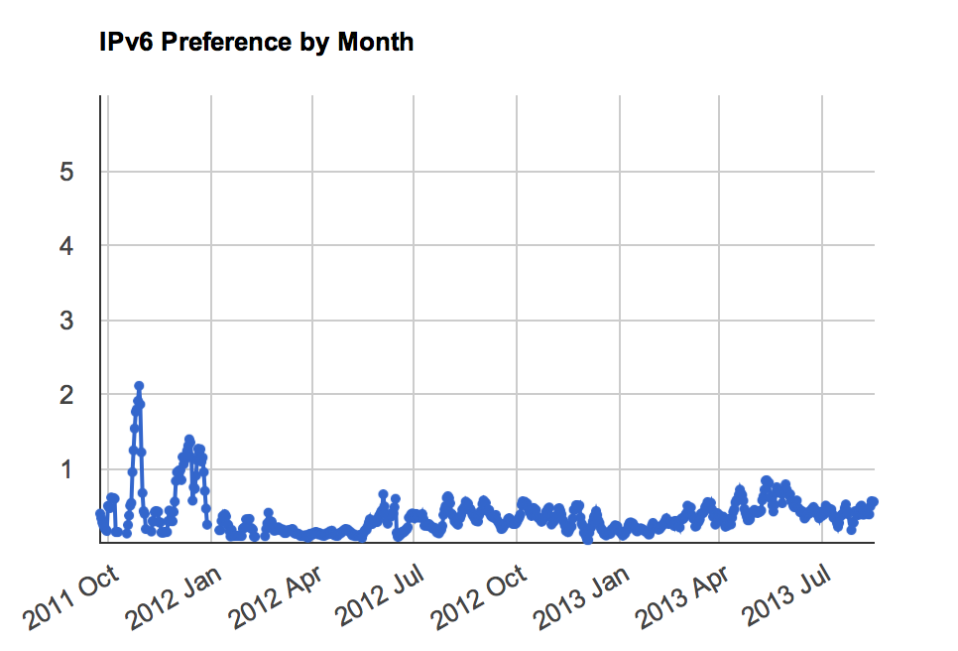
Moving on…
Germany
Japan
Australia
Singapore

Slide 70
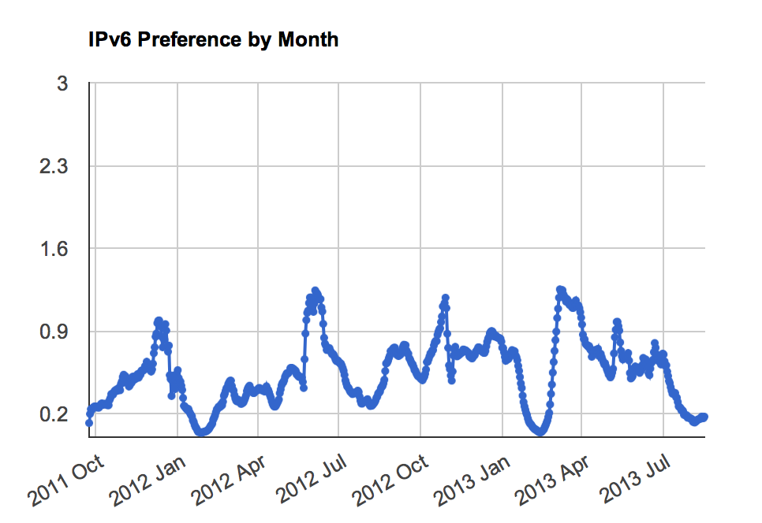
And then there’s China…
This high variance is difficult to explain. This is a view of clients’ IPv6 capabilities when the client is located within China and the server is external to China. The picture may be different if the experiment’s server was located within China as well.

Slide 71
What are we seeing?
IPv6 deployment is not happening everywhere.
IPv6 is not happening all at once.
But it IS happening.

Slide 72
What are we seeing?
What we appear to be seeing are concentrated areas of quite intense IPv6 activity.

Slide 73
Is IPv6 still “A Waiting Game”?
So far what we have heard from many industry actors about IPv6 is:
“I’m waiting for others. I’ll jump when they jump.”

Slide 74
Is IPv6 still “A Waiting Game”?
In the past year we have seen a number of major commercial network service operators, primarily in the United States, Japan, Germany, France, Switzerland, China and Romania, launch programs that integrate IPv6 services into their mass market retail offerings.

Slide 75
Is IPv6 still “A Waiting Game”?
Is this effort “enough” to break out of the waiting game?
I’d like to think so!

Slide 76
A question to each of you…
How many IPv6 presentations have you sat through?
21?
101?
1,001?
I don’t know – I was comatose by the end!

Slide 77

Thank You!

