Slide 1
Measuring IPv6
Geoff Huston
George Michaleson
APNIC Labs, May 2013

Slide 2
What’s the question?
The Big Question:
How “well” are we going with the transition to IPv6?

Slide 3
What’s the question?
The Big Question:
How “well” are we going with the transition to IPv6?
That’s a very difficult question to measure!

Slide 4
“Measurable” Questions
How much traffic uses IPv6?
How many connections use IPv6?
How many routes are IPv6 routes?
How many service providers offer IPv6?
How many domain names have AAAA RRs?
How many domain NS’s use AAAA’s?
How many DNS queries are for AAAA RRs?
How many DNS queries are made over IPv6?
How many end devices have IPv6?
How many end devices use IPv6?
…

Slide 5
Back to the Big Question
None of these specific measurement questions really embrace the larger question
They are all aimed at measuring IPv6 within particular facets of the network infrastructure, but they don’t encompass all of the infrastructure of the network at once

Slide 6
Back to the Big Question
To make an IPv6 connection everything else (routing, forwarding, DNS, transport) has to work with IPv6
So can we measure how many connected devices on today’s Internet are capable of making IPv6 connections?

Slide 7
An Observation…
The conventional view of transition was that end hosts would use a very simple protocol selection algorithm:
If the local host has an IPv6 interface, and the remote host has an IPv6 address, then always try to connect using IPv6.
Otherwise use IPv4.

Slide 8
How to measure IPv6 in the Internet
Set up a service on both IPv6 and IPv4
Measure the proportion of users who connect to the service using IPv6

Slide 9
But…
We tried this on http://www.apnic.net in 2010
We found a very high number of IPv6 users (~5%)
Why?
Small, geek-centric client population of users of this service have biased the measurement!
We really need to use a massively popular web service to conduct this experiment
But “massively popular web services” worry constantly about service resiliency and privacy of their data regarding users
So they tend to be extremely suspicious of adding Javascript elements to their service that performs third party dual stack tests with their clients (and I can’t blame them!)
So we need to rethink this approach…

Slide 10
How to measure a million end users for their IPv6 capability

Slide 11
How to measure a million end users for their IPv6 capability
Be Google (or any other massively popular web service provider)

Slide 12
How to measure a million end users for their IPv6 capability
Be Google (or any other massively popular web service provider)
or

Slide 13
How to measure a million end users for their IPv6 capability
Be Google (or any other massively popular web service provider)
or
Get your code to run on a million users’ machines

Slide 14
Ads are ubiquitous

Slide 15
Ads are ubiquitous

Slide 16
Ads are ubiquitous

Slide 17
Ads are ubiquitous

Slide 18
Ads are implemented in Adobe Flash
Advertising channels use Flash to make ads interactive
This is not just an ‘animated gif’

Slide 19
Flash makes ads interactive
[Apply Now] hover-over is interactive, and responds when selected.

Slide 20
Flash and the network
Flash includes primitives in ‘actionscript’ to fetch ‘network assets’
Typically used to load alternate images, sequences
Not a generalized network stack, subject to constraints:
Port 80
crossdomain.xml on hosting site must match source name (wildcard syntax)
Flash has asynchronous ‘threads’ model for event driven, sprite animation

Slide 21
APNIC’s measurement technique
Craft flash/actionscript which fetches network assets to measure.
Assets are reduced to a notional ‘1x1’ image which is not added to the DOM and is not displayed
Assets can be named (gethostbyname()) or use literals (bypass DNS based constraints)
Encode data in the name of fetched assets
Result is returned by DNS name with wildcard

Slide 22
Advertising placement logic
Fresh Eyeballs == Unique IPs
We have good evidence the advertising channel is able to sustain a constant supply of unique IP addresses
Pay by click, or pay by impression
If you select a preference for impressions, then the channel tries hard to present your ad to as many unique IPs as possible
Time/Location/Context tuned
Can select for time of day, physical location or keyword contexts (for search-related ads)
But if you don’t select, then placement is generalized
Aim to fill budget
If you request $100 of placement a day, then inside 24h algorithm tries hard to even placement but in the end, will ‘soak’ place your ad to achieve enough views, to bill you $100

Slide 23
Advertizing placement logic
Budget: $100 per day, at $1.00 ‘CPM’ max
Clicks per millepressions: aim to pay no more than $1 per click but pay up to $1 for a thousand impressions
Even distribution of ads throughout the day
No constraint on location, time
Outcome: 350,000 placements per day, on a mostly even placement model with end of day ‘soak’ to achieve budget goal

Slide 24
Measuring IPv6 via Ads
Use Flash code that is executed on ad impression
Client retrieves set of “tests” that use unique DNS labels from an ad-controller
(http://drongo.rand.apnic.net/measureipv6id.cgi?advertID=9999)
Client is given 5 URLs to load:
Dual Stack object
V4-only object
V6-only object
V6 literal address (no DNS needed)
Result reporting URL (10 second timer)
All DNS is dual stack

Slide 25
Why These Tests?
Dual Stack URL
Which protocol will the client PREFER to use?
V4 only URL
Control comparison (Reliability, RTT)
V6 only URL
Is the client CAPABLE of using IPv6?
V6 Literal URL
Does the client have an IPv6 stack at all?
Result URL
Did the client keep the experiment running, or was it terminated early?

Slide 26
Experiment Server config
There are three servers, identically configured (US, Europe, Australia)
Server runs Bind, Apache and tcpdump
Experiment directs the client to the “closest” server (to reduce rtt-related timeouts) based on simple /8 map of client address to region

Slide 27
Collected Data
Per Server, Per Day:
http-access log
(successfully completed fetches)
dns.log
(incoming DNS queries)
Packet capture
All packets

Slide 28
Collected Data
Web Logs:
h.labs.apnic.net 2002:524d:xxxx::524d:xxxx [29/Apr/2013:05:55:05 +0000] "GET /1x1.png?
t10000.u7910203317.s1367214905.i888.v1794.v6lit
h.labs.apnic.net 2002:524d:xxxx::524d:xxxx [29/Apr/2013:05:55:05 +0000] "GET /1x1.png?
t10000.u7910203317.s1367214905.i888.v1794.r6.td
h.labs.apnic.net 82.77.xxx.xxx [29/Apr/2013:05:55:05 +0000] "GET /1x1.png?
t10000.u7910203317.s1367214905.i888.v1794.rd.td
h.labs.apnic.net 82.77.xxx.xxx [29/Apr/2013:05:55:05 +0000] "GET /1x1.png?
t10000.u7910203317.s1367214905.i888.v1794.r4.td
h.labs.apnic.net 82.77.xxx.xxx [29/Apr/2013:05:55:05 +0000] "GET /1x1.png?
t10000.u7910203317.s1367214905.i888.v1794&r=zrdtd-348.zr4td-376.zr6td-316.zv6lit-228
(In this case the client is using 6to4 to access IPv6, and prefers to use IPv4 in a dual stack context)

Slide 29
Data Processing
Web Logs:
V6 Capable/Preferred host counts
Breakdown of Teredo/6to4 vs Unicast
Packet Logs:
Connection Failure counts (incomplete TCP handshake)
Performance measurements (TCP RTT)

Slide 30
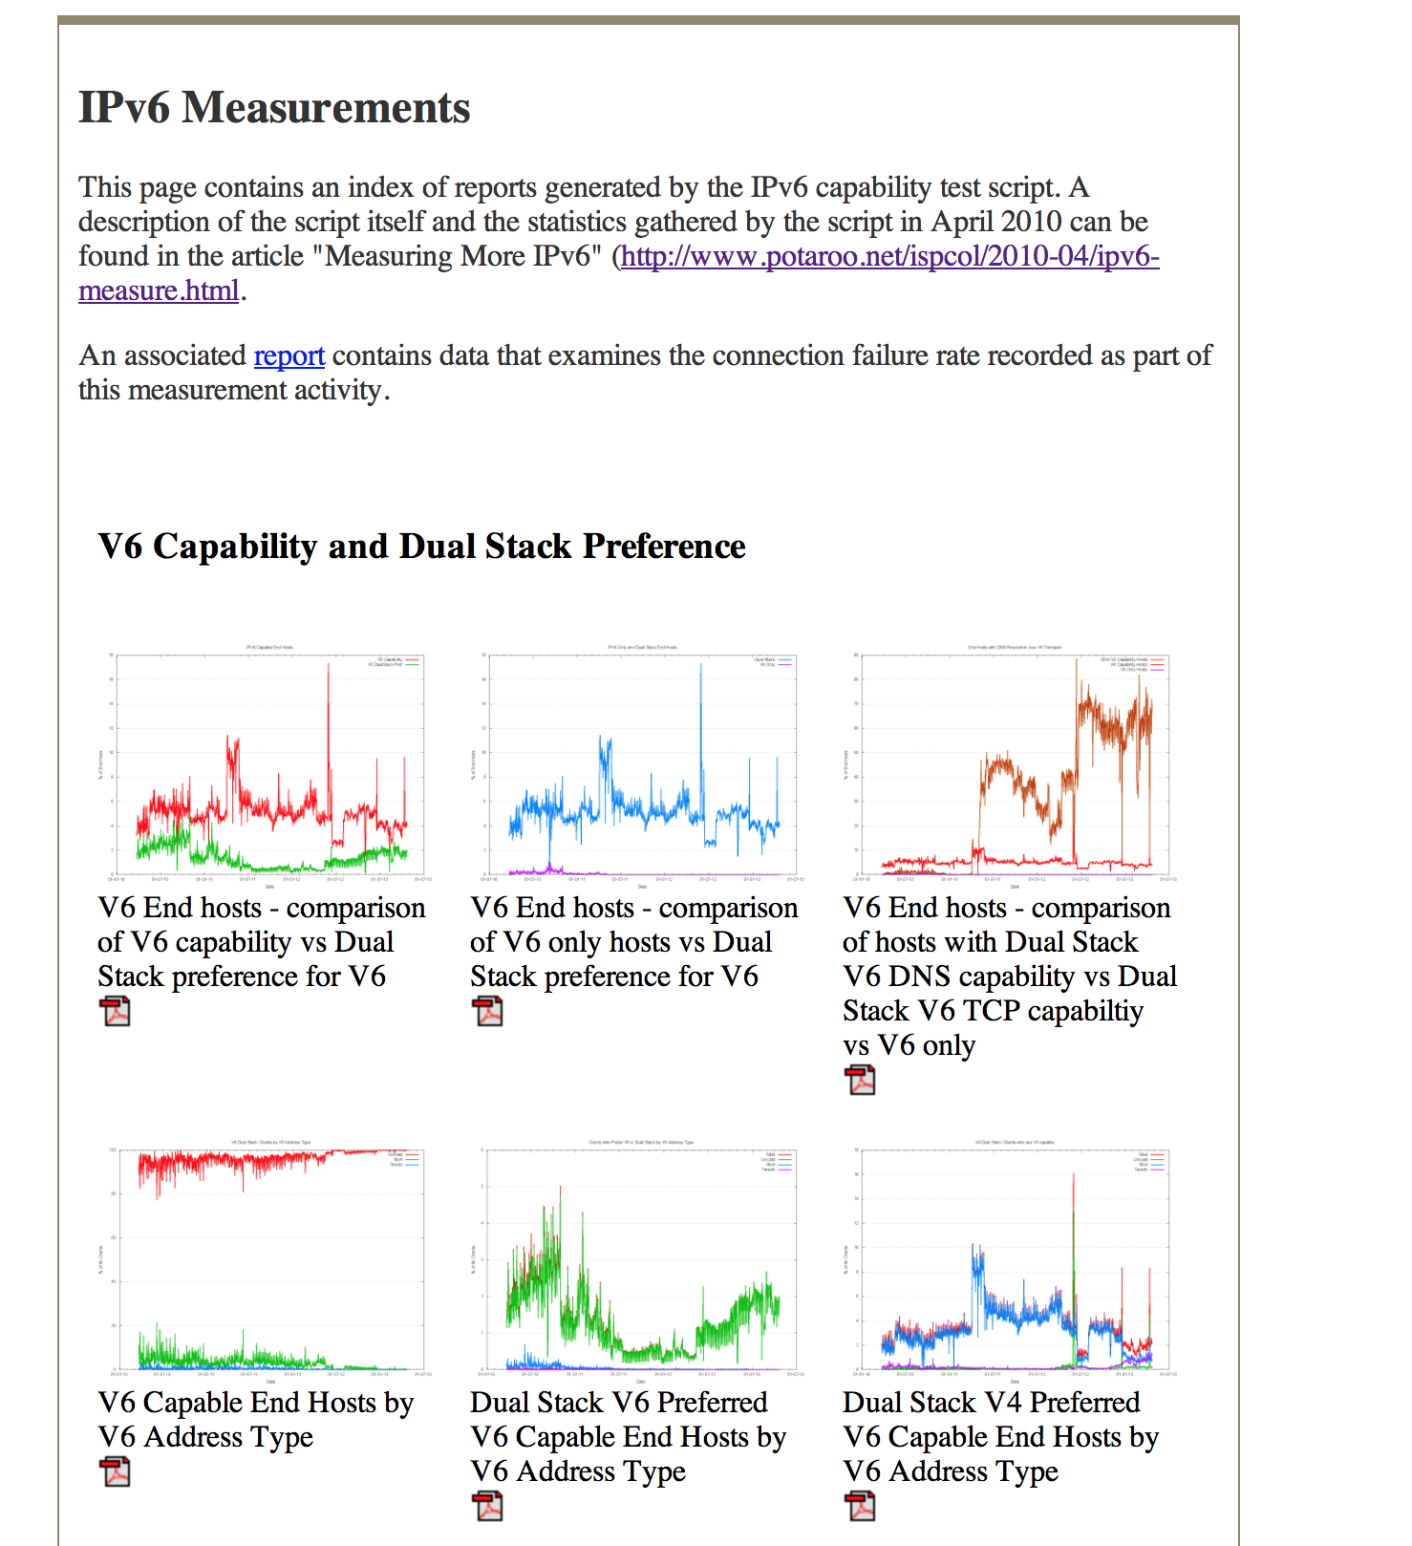
Reports
We perform a basic scan of the daily data and produce a number of reports:
A “summary” report of capabilities
http://www.potaroo.net/ipv6/

Slide 31
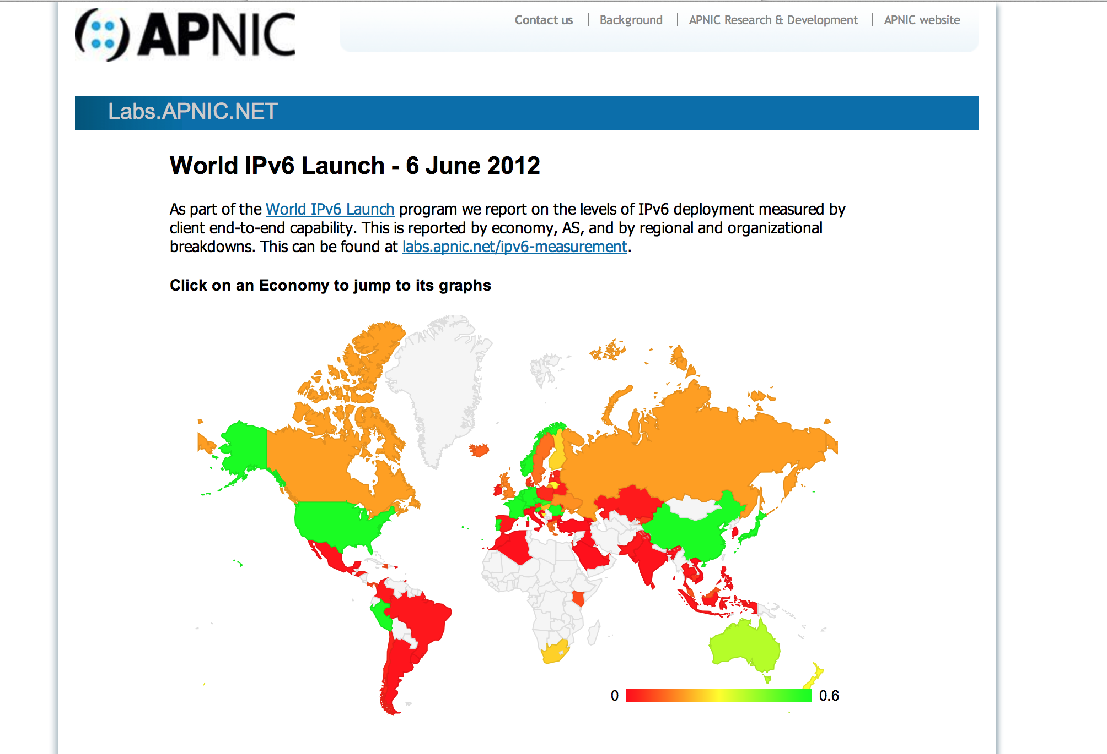
Reports
We perform a basic scan of the daily data and produce a number of reports:
A “summary” report of capabilities
A map of the IPv6 world
http://labs.apnic.net/index.shtml

Slide 32
Reports
We perform a basic scan of the daily data and produce a number of reports:
A “summary” report of capabilities
A map of the IPv6 world
Per-ASN and Per-Country reports
http://labs.apnic.net/ipv6-measurement/

Slide 33
Reports
We perform a basic scan of the daily data and produce a number of reports:
A “summary” report of capabilities
A map of the IPv6 world
Per-ASN and Per-Country reports
Daily Per-Country statistics report
http://labs.apnic.net/dists/v6cc.html

Slide 34
The IPv6 Country League Table

Slide 35
The IPv6 Country League Table

Slide 36
The IPv6 ASN League Table

Slide 37
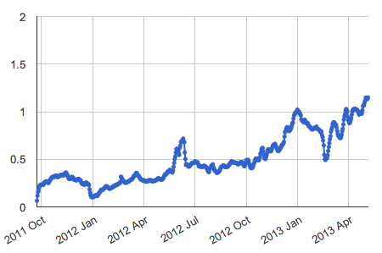
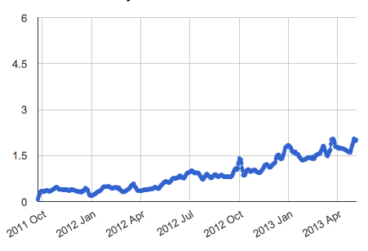
And some Time Series…
Global IPv6
Europe IPv6

Slide 38
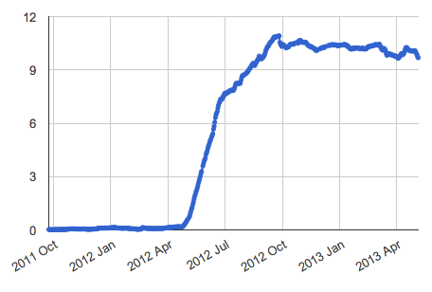
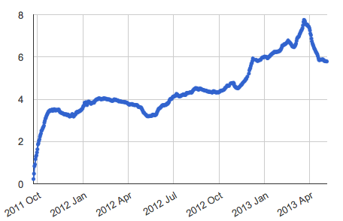
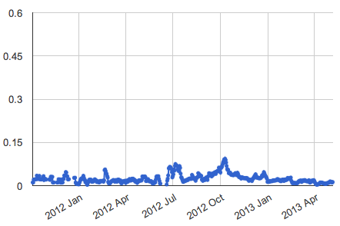
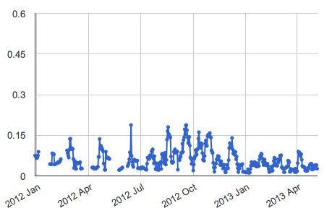
And Some Countries…
Romania
France
Italy
Ireland

Slide 39
What the….?
We noticed this class of entries in the web logs:
222.154.187.xx http://t10000.u1367873034830.s644708422.i647302.v10a.r6.td.labs.apnic.net/1x1.png
84.23.58.xx http://t10000.u1367873368824.s1566062113.i245974.v10i.r6.td.labs.apnic.net/1x1.png
We get some 200 of these web log entries every day
But *.r6.td.labs.apnic.net has NO A record
So why are these clients attempting to fetch a V6-only URL using IPv4 as the transport protocol?
No idea!
No common country of origin, no common AS, no common device, no common host OS

Slide 40
What the²….?
Even stranger…
202.124.201.xx http://[2401:2000:6660::f003]/1x1.png
118.148.0.xx http://[2401:2000:6660::f003]/1x1.png
We get some 16-20 of these web log entries every day
But this is a V6 literal form of URL!
Here’s the origin Ases for this V4 fetch of a V6 literal URL for the 7th May
Origin AS count AS name
3352 1 TELEFONICA-DATA-ESPANA TELEFONICA DE ESPANA
4134 4 CHINANET-BACKBONE No.31,Jin-rong Street
4837 1 CHINA169-BACKBONE CNCGROUP China169 Backbone
35662 1 REDSTATION Redstation Limited
38793 8 NZCOMMS-AS-AP Two Degress Mobile Limited
55443 1 BAKST-AS-AU Level 16, 55 Hunter Street

Slide 41
Questions?
APNIC Labs:
Geoff Huston
George Michaelson
research@apnic.net

