Slide 1
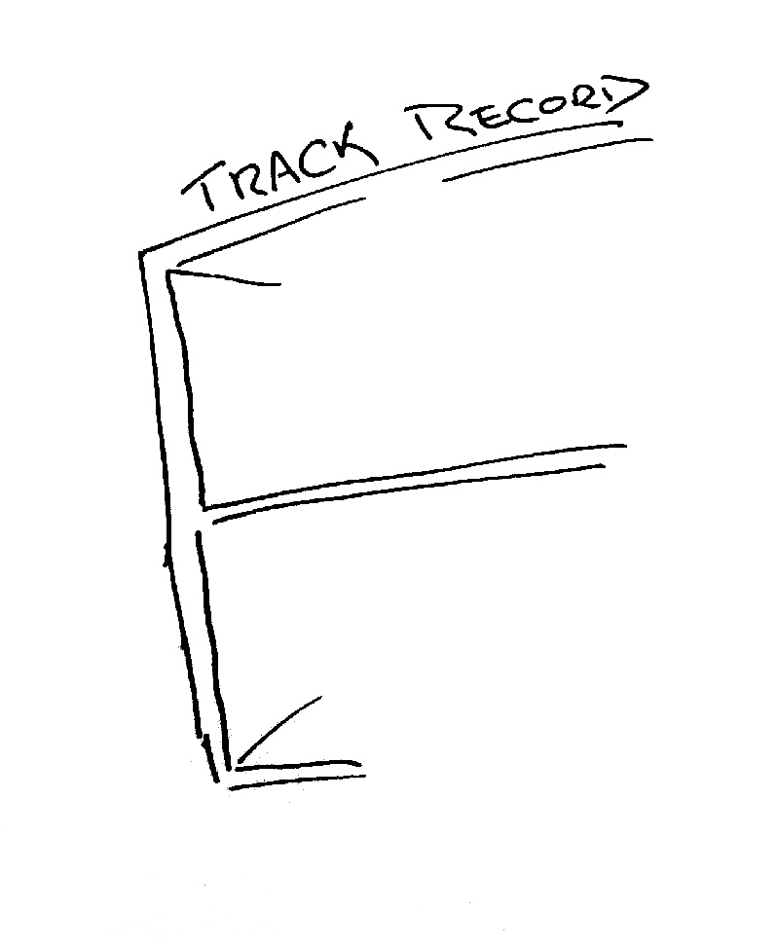
The mainstream telecommunications industry has a rich history

Slide 2
The mainstream telecommunications industry has a rich history
…of making very poor
technology choices

Slide 3
The mainstream telecommunications industry has a rich history
…of making very poor
technology guesses
and regularly being
taken by
surprise!

Slide 4
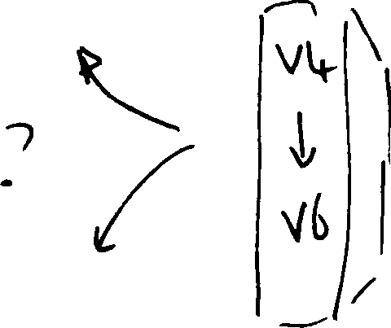
So, how are we going with the IPv4 to IPv6 transition?

Slide 5
Some Measurements
50% of the IPv4 transit networks appear to be dual stack capable
50% of the Internet’s end devices have an installed IPv6 stack that can be tickled into life
0.6% of the Internet’s end devices have native IPv6 delivered to them

Slide 6
IPv6 Uptake is NOT uniform!

Slide 7
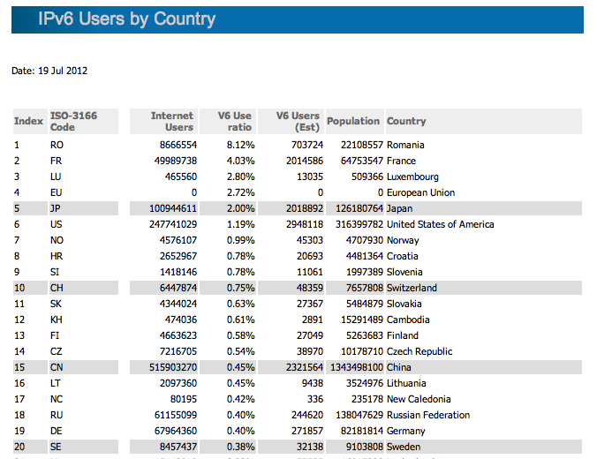
http://labs.apnic.net/dists/v6dcc.html

Slide 8
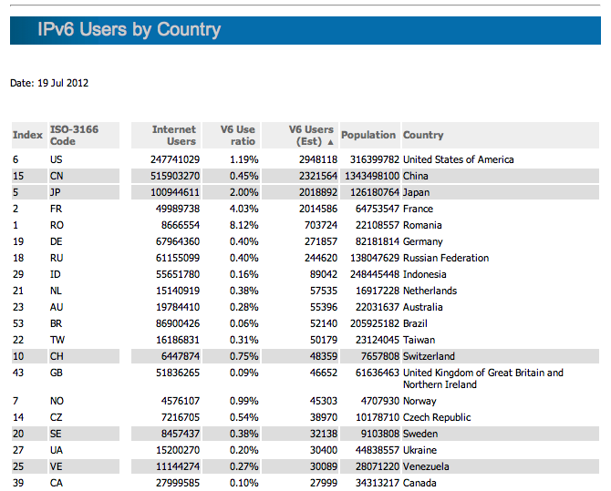
http://labs.apnic.net/dists/v6dcc.html

Slide 9
AsiaPac IPv6 User Ratio

Slide 10
AsiaPac IPv6 User Population

Slide 11
The challenge often lies in managing the transition from one technology to another
IPv6
CGNs
IPv4
ALGs
CDNs
The risk in this transition phase is that the Internet heads off in a completely different direction!

Slide 12
The Hard Public Policy Question
Will market forces drive the industry to complete this transition to IPv6 ...
Or is this transition turning into a case of a market failure?

Slide 13
10 Years from now?
2022

Slide 14
My personal view...by 2022
The Internet will be all IPv6 by 2022!
The market in IPv4 trading is a short term phase
CGNs also have near term limits under intense scaling pressure
There is no extended afterlife in store for CGNs + IPv4 if we make this transition to IPv6
(look at what happened to DECnet, SNA, Appletalk, X.25,...)

Slide 15
My personal view...by 2022
Or there will be no more Internet by then
because all the CGNs, ALGs, CDNs in the world will not hold the Internet for 10 years of intense growth pressure
And because one common protocol platform, one common address space, one common name space is a brittle state, it will fracture and splinter under address pressure

