Slide 1
Internet Futures

Slide 2
Internet Futures
A personal glimpse into a future of the Internet
Geoff Huston
APNIC

Slide 3
A quick look back:
20 years ago

Slide 4
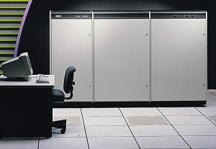
A quick look back:
20 years ago
The flagship of Digital's technology of the time, that turned out to be a commercial flop. Anyhow, it's still a true mainframe, in that: the system takes up a whole room, it consumes electricity as if it was free, and generates heat like hell. All this is due the fact that it's built out of ECL components, which are very fast (CMOS wasn't even close to that at that time), but draws significant power (the whole system takes around 20 kW). It was designed to have water-cooling, but that didn't work, so they modified it to air-cooling, the name however remained: "Aquarius". There were different models, with performances varying from 40 to 157 VUPs (125 MFLOPS). The I/O-memory-CPU interconnect is switched (with a frequency of 1 GHz), which was a totally new concept at that time. There were only a few dozen 9000's ever made.

Slide 5
A quick look back:
20 years ago
The end of the
mainframe dinosaur
The flagship of Digital's technology of the time, that turned out to be a commercial flop. Anyhow, it's still a true mainframe, in that: the system takes up a whole room, it consumes electricity as if it was free, and generates heat like hell. All this is due the fact that it's built out of ECL components, which are very fast (CMOS wasn't even close to that at that time), but draws significant power (the whole system takes around 20 kW). It was designed to have water-cooling, but that didn't work, so they modified it to air-cooling, the name however remained: "Aquarius". There were different models, with performances varying from 40 to 157 VUPs (125 MFLOPS). The I/O-memory-CPU interconnect is switched (with a frequency of 1 GHz), which was a totally new concept at that time. There were only a few dozen 9000's ever made.

Slide 6
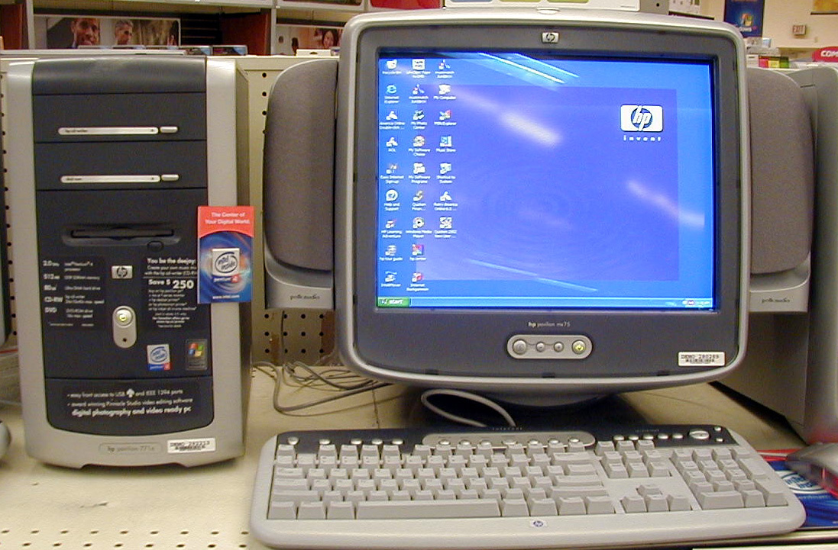
A quick look back:
10 years ago
Computing meets consumer electronics:
the rise and rise of the personal computer
Ugly, aren’t they!

Slide 7
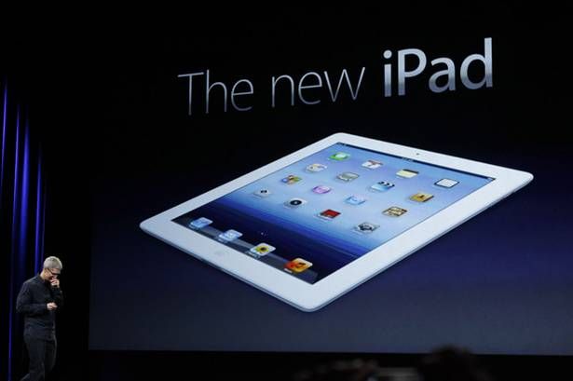
Today!

Slide 8
“We are now living in a post-PC world”
Apple’s Tim Cook, March 2012

Slide 9
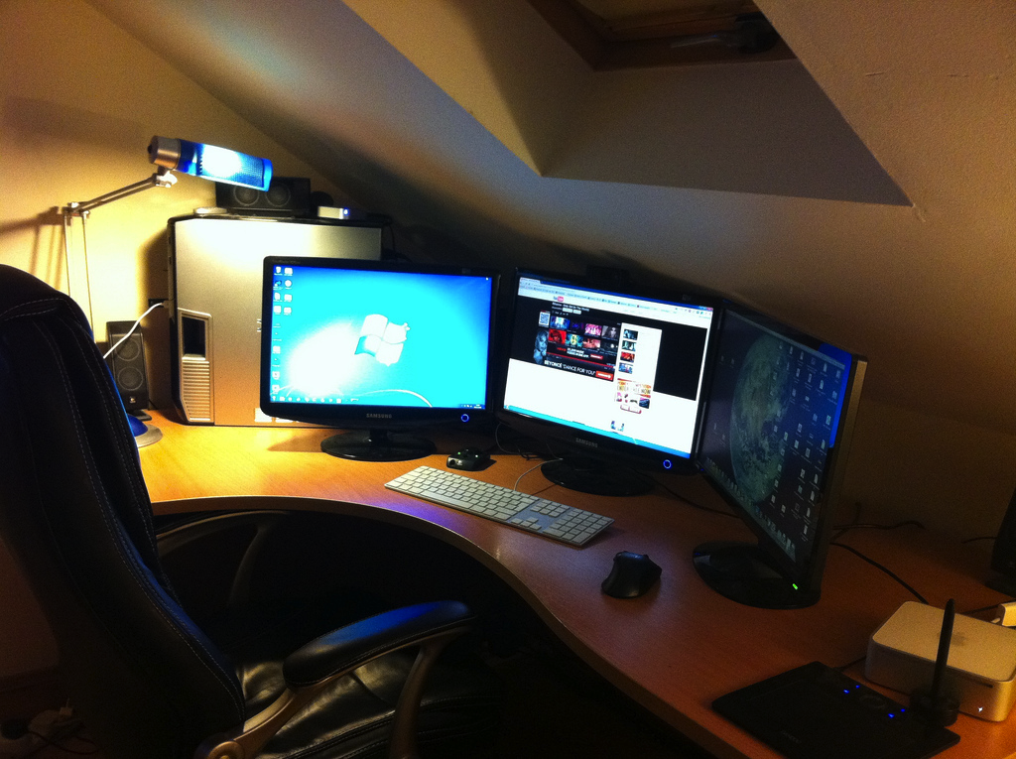
With desktop devices the Internet was a dedicated activity
reliable power
lighting
privacy
large view screens
dedicated worktop
wired bandwidth
dedicated chair

Slide 10
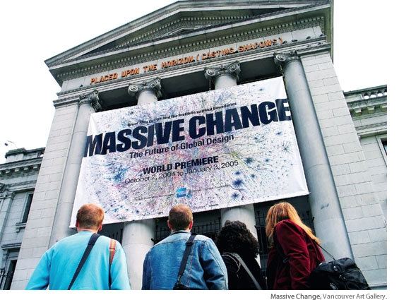

Slide 11

The Internet is now anywhere and everywhere
radio connectivity
Thumb
operated
hand sized
battery power
Its trivial, commonplace and blends into all our activities

Slide 12
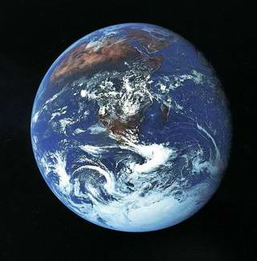
Counting Users...
There are 2.5 billion Internet users today
http://www.itu.int/ITU-D/ict/statistics/

Slide 13
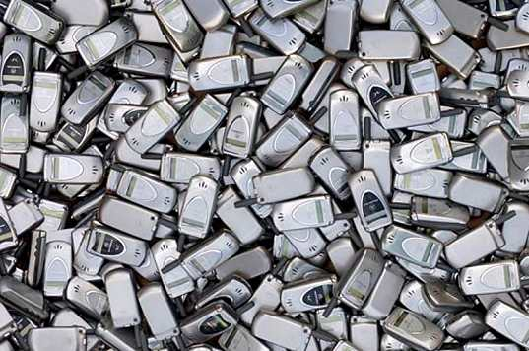
Counting Users...
And 5 billion mobile phone users!
There are 2 billion Internet users today
http://www.itu.int/ITU-D/ict/statistics/

Slide 14
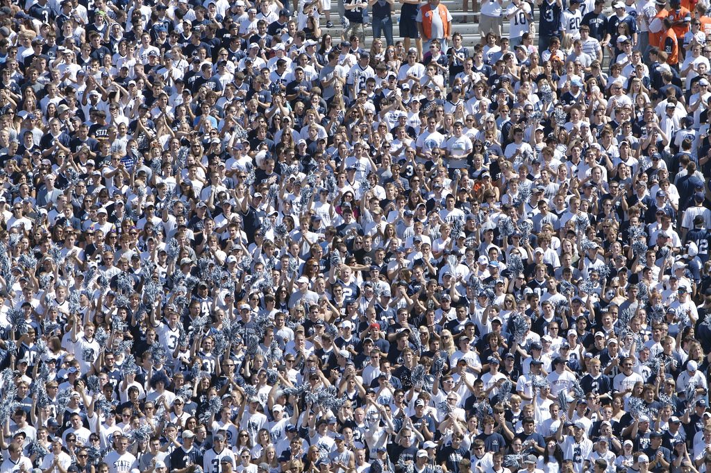
Counting Users...
And 5 billion mobile phones!
There are 2 billion Internet users today
And 750 million mobile Internet users!
Source: Generator Research

Slide 15
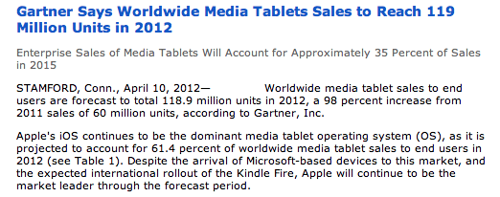
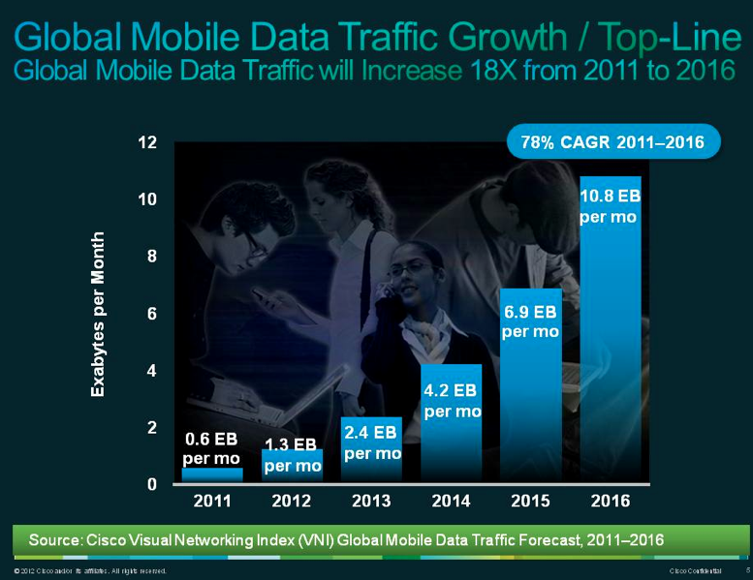
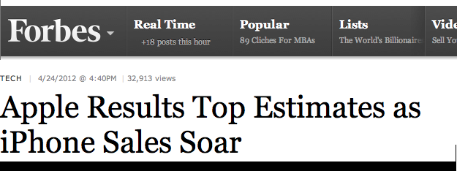
Tomorrow’s Users and Usage

Slide 16
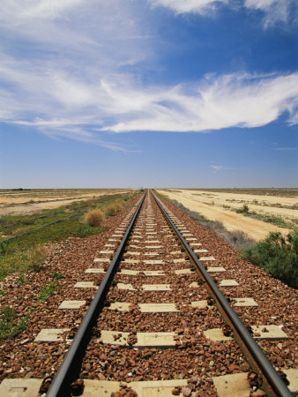
Where to from here?

Slide 17
5 Years Out
2017

Slide 18
It’s a mobile world!
  2011: 270 million mobile units shipped
  Factors:
    Production volumes are bringing down component unit cost
    Android is bringing down software unit cost
    No need for new content - leverage off the the existing web universe of content
    Shift away from the desktop and the laptop by the production industry seeking new markets for their production capability

Slide 19
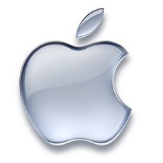
Apple’s Numbers
iPhones:
Q3 2010 : Apple shipped 8.4M iPhones
Q3 2011 : Apple shipped 20.3M iPhones
  Added 42 carriers and 15 countries in the quarter!
iPads:
Q3 2010 : Apple shipped 3.3M iPads
Q3 2011 : Apple shipped 9.2M iPads
  “every iPad we could make has been sold”
Q3 2011 profit: $US 7.3B

Slide 20
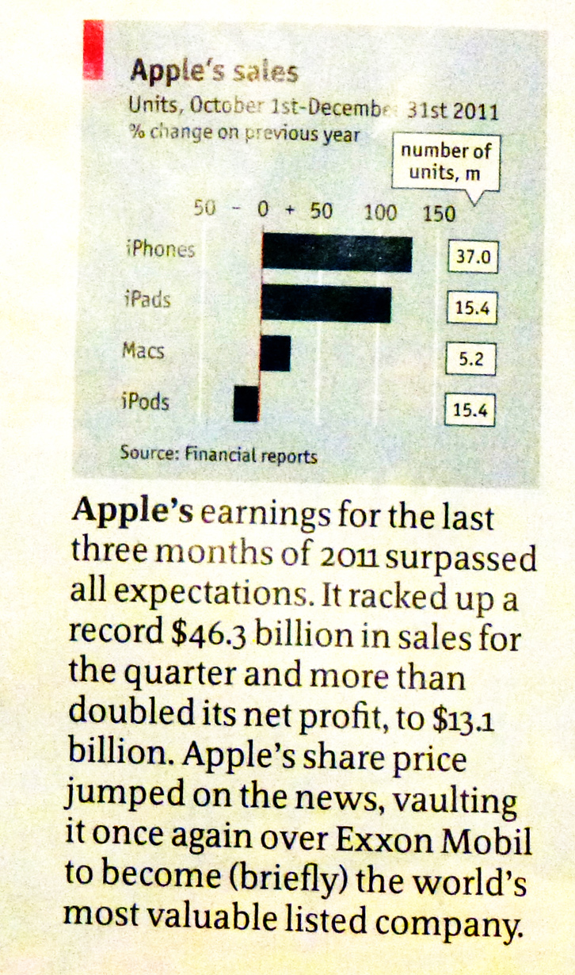
Apple’s Numbers
iPhones:
Q3 2010 : Apple shipped 8.4M iPhones
Q3 2011 : Apple shipped 20.3M iPhones
  Added 42 carriers and 15 countries in the quarter!
iPads:
Q3 2010 : Apple shipped 3.3M iPads
Q3 2011 : Apple shipped 9.2M iPads
  “every iPad we could make has been sold”
Q3 2011 profit: $US 7.3B
And Q4 2011 was even bigger!

Slide 21
Apple’s Numbers
iPhones:
Q3 2010 : Apple shipped 8.4M iPhones
Q3 2011 : Apple shipped 20.3M iPhones
  Added 42 carriers and 15 countries in the quarter!
iPads:
Q3 2010 : Apple shipped 3.3M iPads
Q3 2011 : Apple shipped 9.2M iPads
  “every iPad we could make has been sold”
Q3 2011 profit: $US 7.3B
37M iPhones
15M iPads
And Q4 2011 was even bigger!
$13.1B profit!

Slide 22
Coping with Demand
Global IPv4 supply shortfall is predicted to reach 800m addresses by 2014

Slide 23
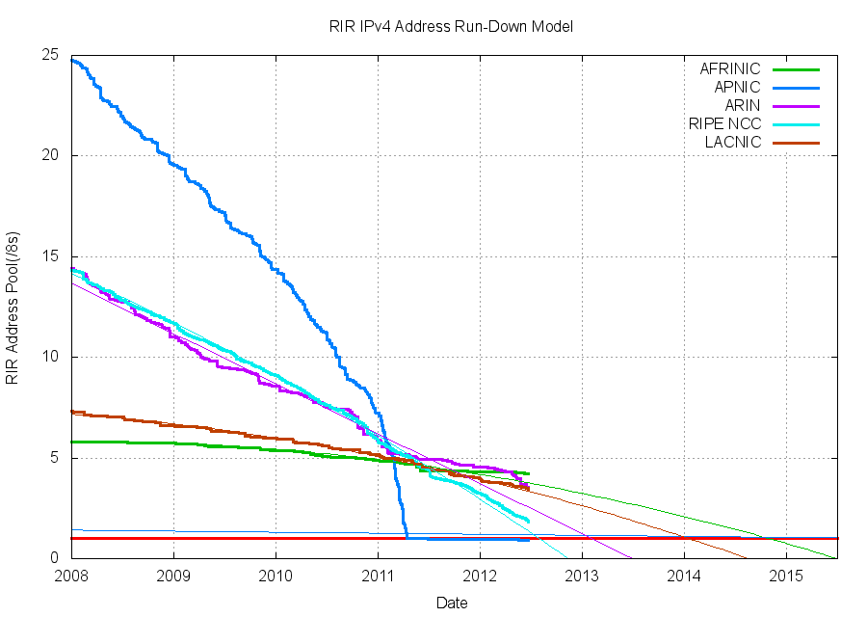
Coping with IPv4 Address Exhaustion

Slide 24
Coping with IPv4 Address Exhaustion
Hopefully, we’ve figured out this
transition to IPv6 by 2017!!
2017

Slide 25
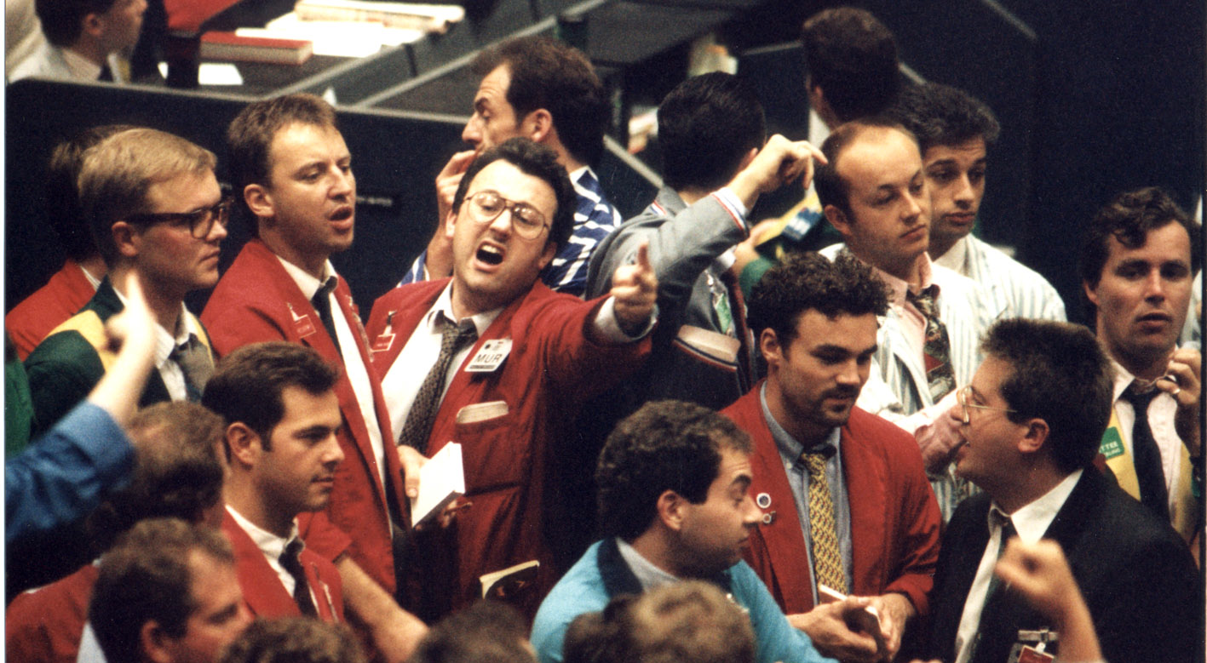
But we’re now High Risk!
The emergence of a market in IPv4 addresses is now a certainty.
But the outcomes of this market are by no means assured...

Slide 26
But we’re now High Risk!
If the price goes too high then this will generate acute instability and potentially fragment the network
If the price is highly volatile this will deter new investors in networked services and entrench the incumbent services and incumbent providers
The emergence of a market in IPv4 addresses is now a certainty.
But the outcomes of this market are by no means assured...

Slide 27

In the next five years...
we have a choice

Slide 28
In the next five years...
Everything gets squashed into HTTP, IPv4 and CGNs
IPv6

Slide 29
And its not yet clear which path the Internet will take!

Slide 30
And its not yet clear which path the Internet will take!
market forces

Slide 31
Can we look further out?

Slide 32
10 Years Out?
2022

Slide 33
My personal view...by 2022
The Internet will be all IPv6 by 2022!
  The market in IPv4 trading is a short term phase
  CGNs also have near term limits under intense scaling pressure
  There is no extended afterlife in store for CGNs + IPv4 if we make this transition to IPv6
    (look at what happened to DECnet, SNA, Appletalk, X.25,...)

Slide 34
My personal view...by 2022
Or there will be no more Internet by then
  becuase all the CGNs, ALGs, CDNs in the world will not hold the Internet for 10 years of intense growth pressure
  And because one common protocol platform, one common address space, one common name space is a brittle state, it will fracture and splinter under address pressure

Slide 35
My personal view...by 2022
Radio spectrum will become even more of a scarce and highly valuable asset
  well it is already, but the competition for spectrum in highly populous areas will continue
  Fewer wide area services - more cellular / femtocell services backed by fibre backhaul to improve spectrum efficiency

Slide 36
My personal view...by 2022
Cloud / Data Centre services may well be at their peak by 2022
  Innovative competitive pressure at this time may well come from highly distributed systems that do not rely on intense concentrations of computation and information storage

Slide 37
20 Years Out?
2032

Slide 38
My personal view...by 2032
This is extremely tough!
  very little from the world of 1992 is still with us today
  very little of today’s environment will be persistent for the next two decades
  Why?

Slide 39
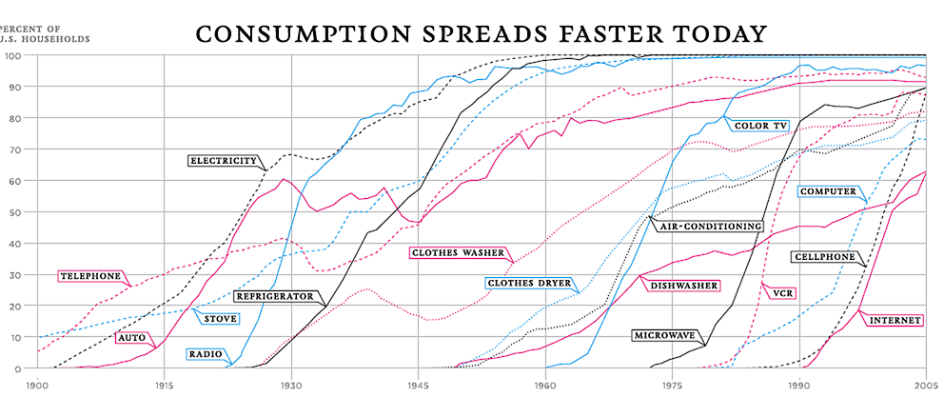
As the pace of technology adoption gets faster we cycle through successive generations of technologies at ever faster rates
http://visualecon.wpengine.netdna-cdn.com/wp-content/uploads/2008/02/history-of-products.gif

Slide 40
What’s shaping our future?
You and I!

Slide 41
What’s shaping our future?
You and I!
We need to think about a post-PC world where computation, storage and communications are abundant commodities. It’s innovative mass-produced consumer devices and services that will shape much of the Internet’s future. And the innovative force here is one of constant technology refinement and evolution!

Slide 42

The most profound technologies are those that disappear. They weave themselves into the fabric of everyday life until they are indistinguishable from it...
- Mark Weiser 1991

